Slide 1

Институт морской геологии и геофизики Дальневосточного отделения Российской Академии наук (ИМГиГ ДВО РАН)
Institute of Marine Geology and Geophisics, Far East Branch, Russian Academy of Scienes
Вариации вертикальной составляющей электротеллурического поля и сейсмическая активность южной части Cахалина в 2024-2025 годах
Variations of the vertical component of the electrotelluric field and seismic activity in the southern part of Sakhalin in 2024-2025
Стовбун Николай Сергеевич,
Богомолов Л.М., Закупин С.А., Дудченко И.П., Гуляков С.А, Костылев Д.В.
Stovbun Nikolay Sergeevich,
Bogomolov L.M., Zakupin S.A., Dudchenko I.P, Gulyakov S.A., Kostylev D.V.

Slide 2
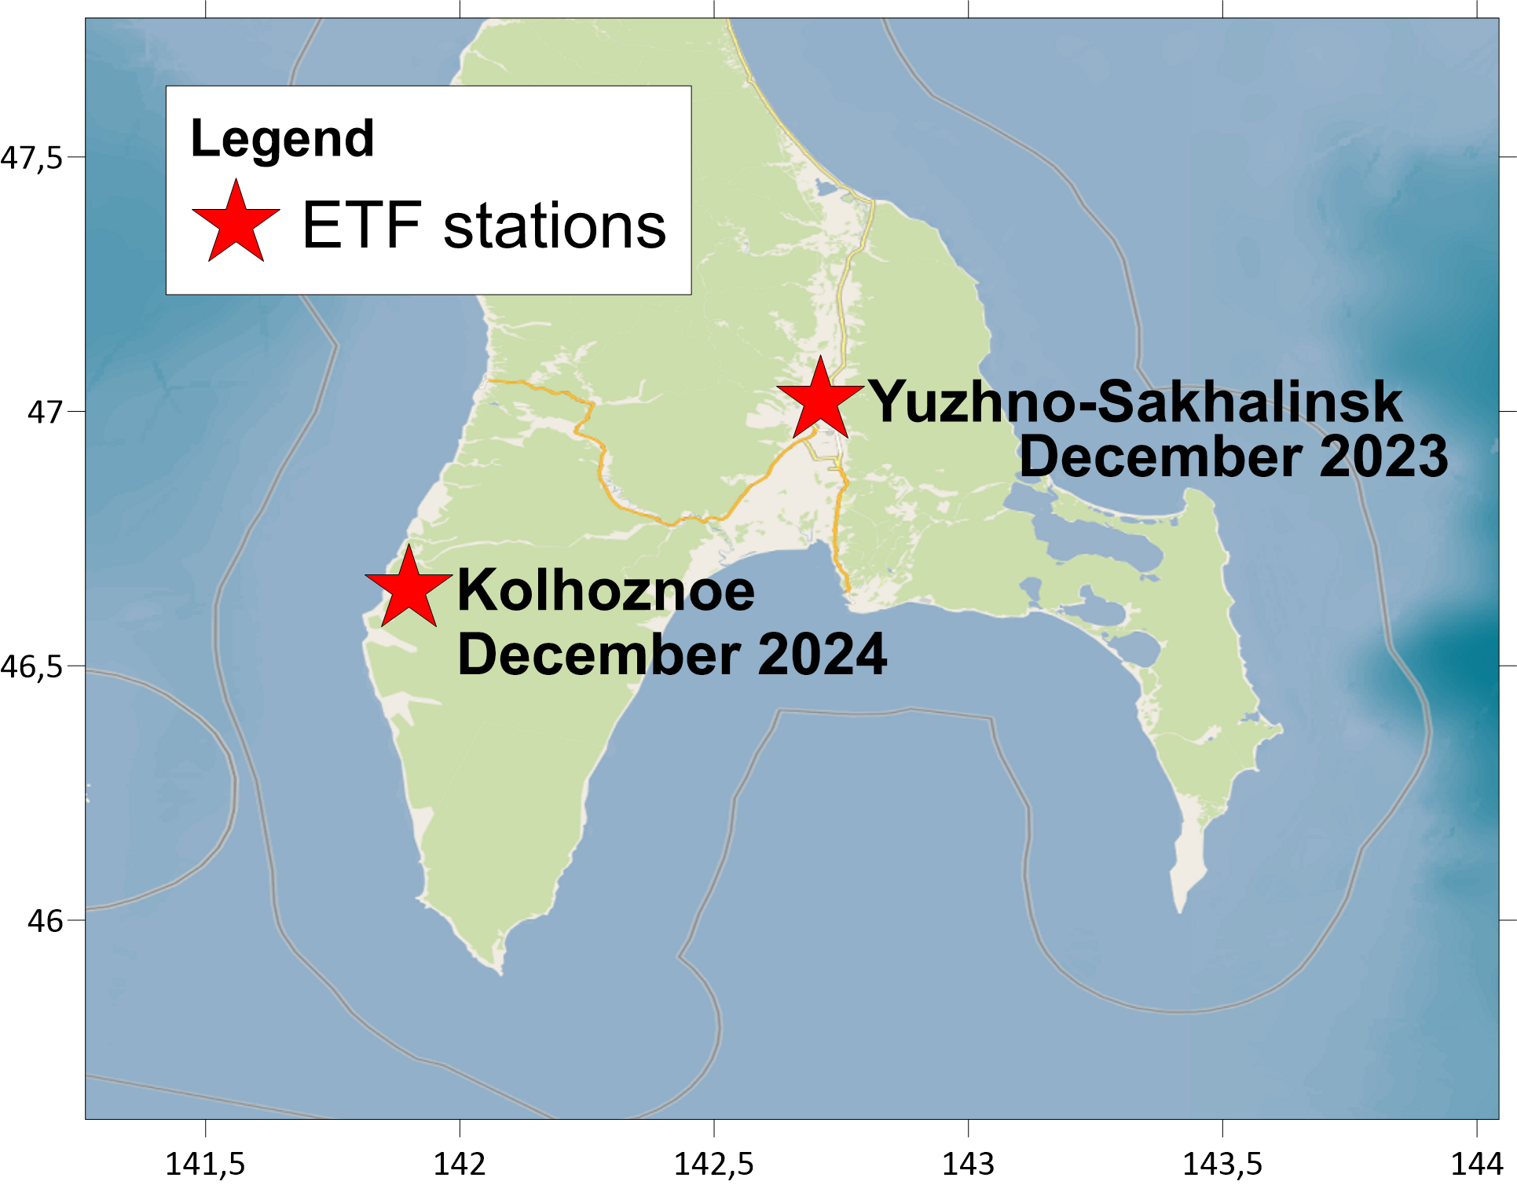
Location of measuring stations for monitoring the vertical electrotelluric field (ETF)

Slide 3

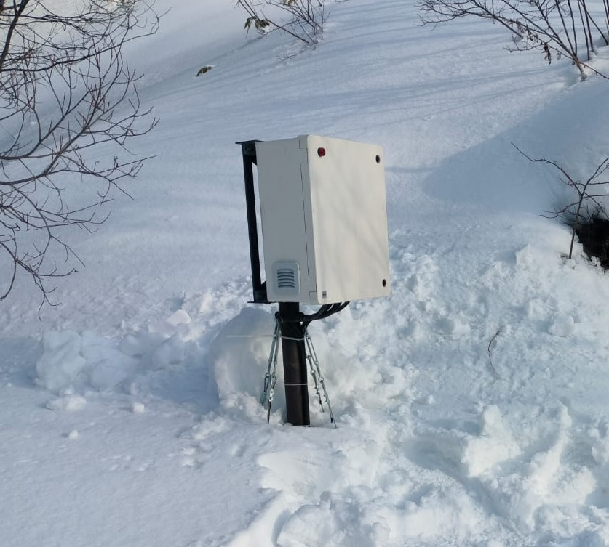
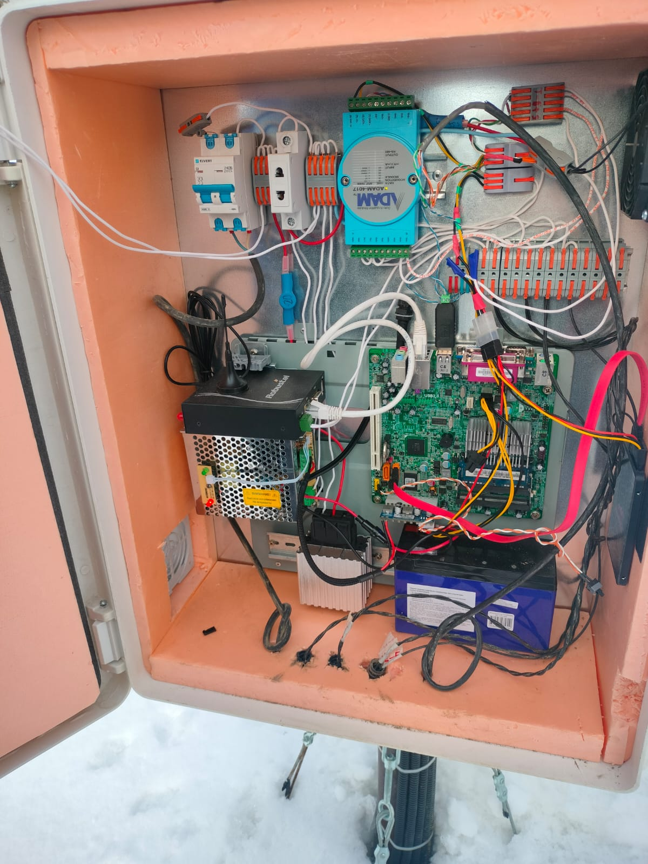
Analog-to-digital converter ADAM-4017
0-10 Hz frequency band

Slide 4
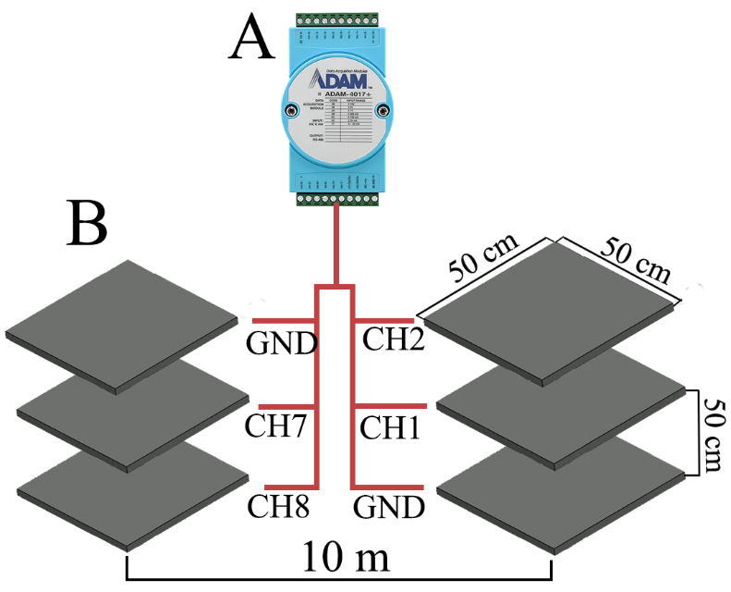
Equipment of the ETF station

Slide 5
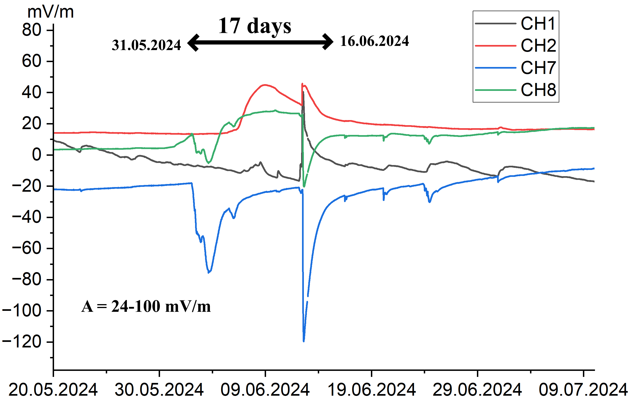
Example of disturbances on channels CH1, CH2, CH7, CH8 at the Yuzhno-Sakhalinsk station

Slide 6
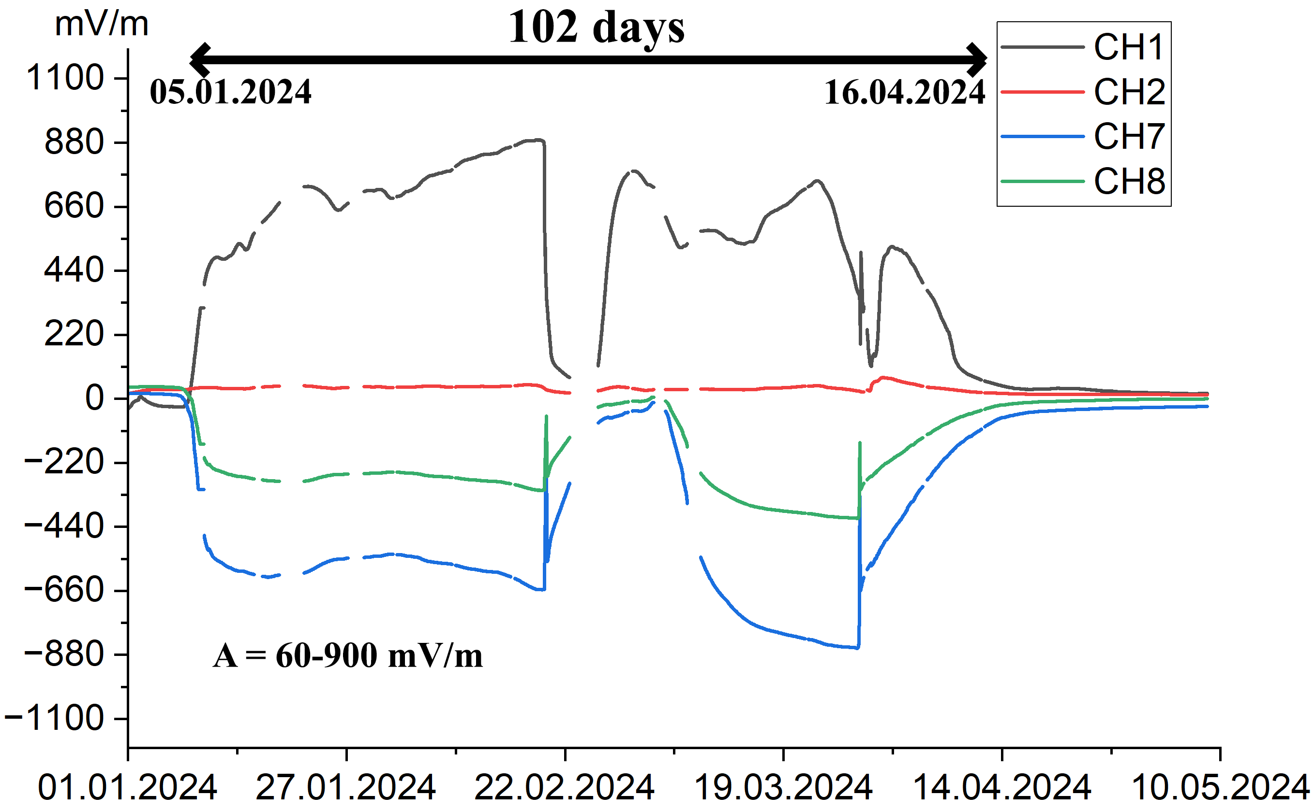
Example of a long disturbances on channels CH1, CH2, CH7, CH8 at the Yuzhno-Sakhalinsk station

Slide 7
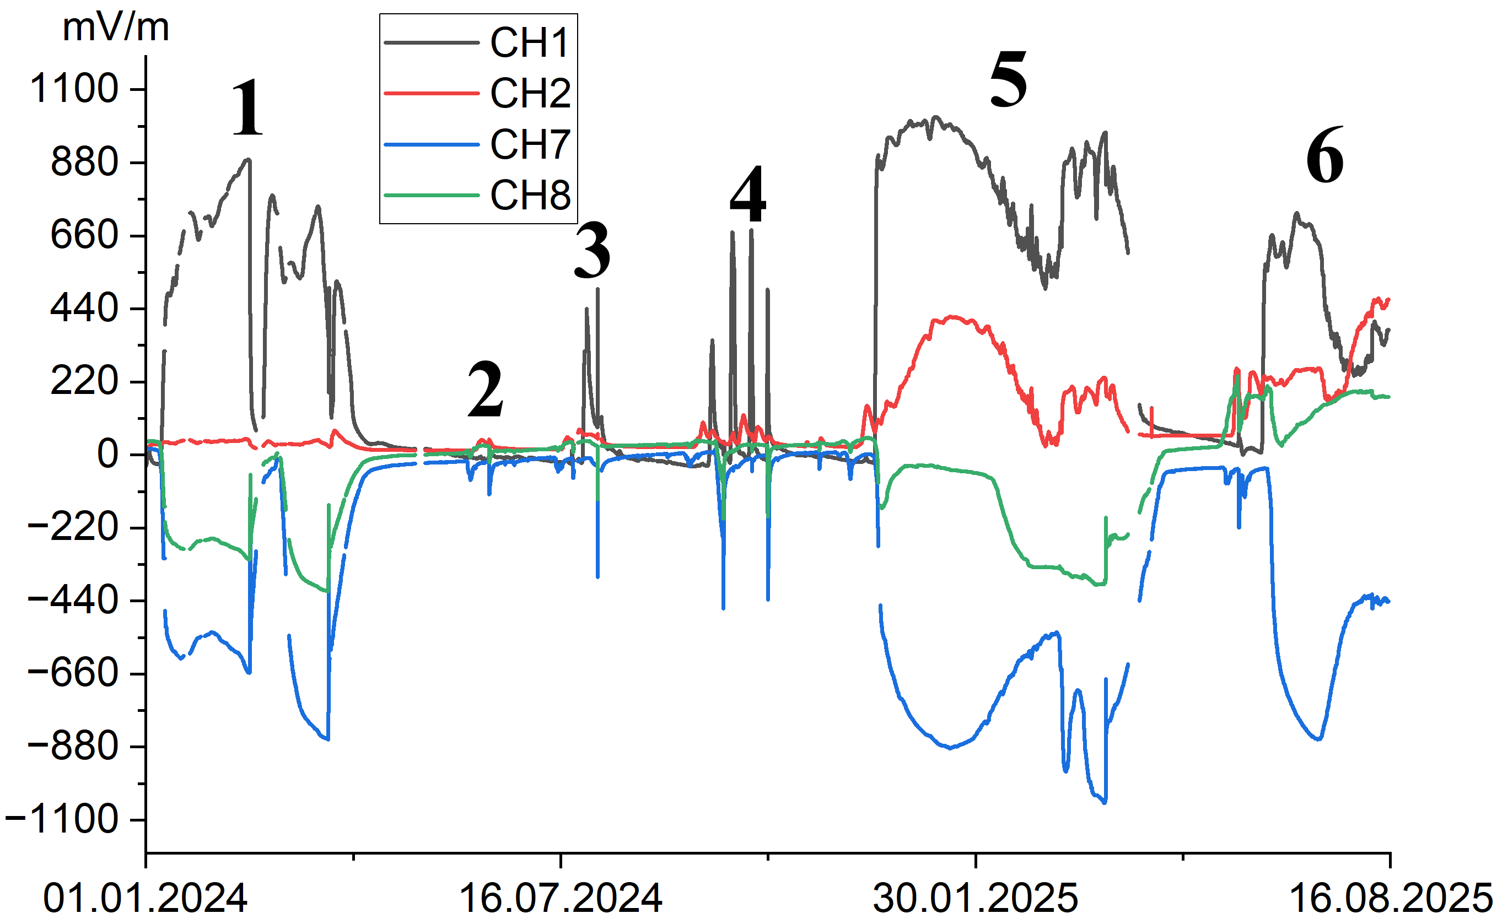
Variations in ETF from 01.01.2024 to 16.08.2025 - Yuzhno-Sakhalinsk station

Slide 8
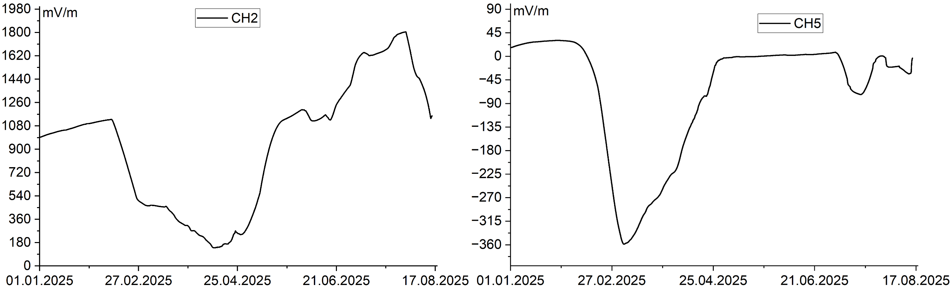
Variations in ETF from 01.01.2025 to 16.08.2025 on channels CH2, CH5 - Kolkhoznoe Station

Slide 9
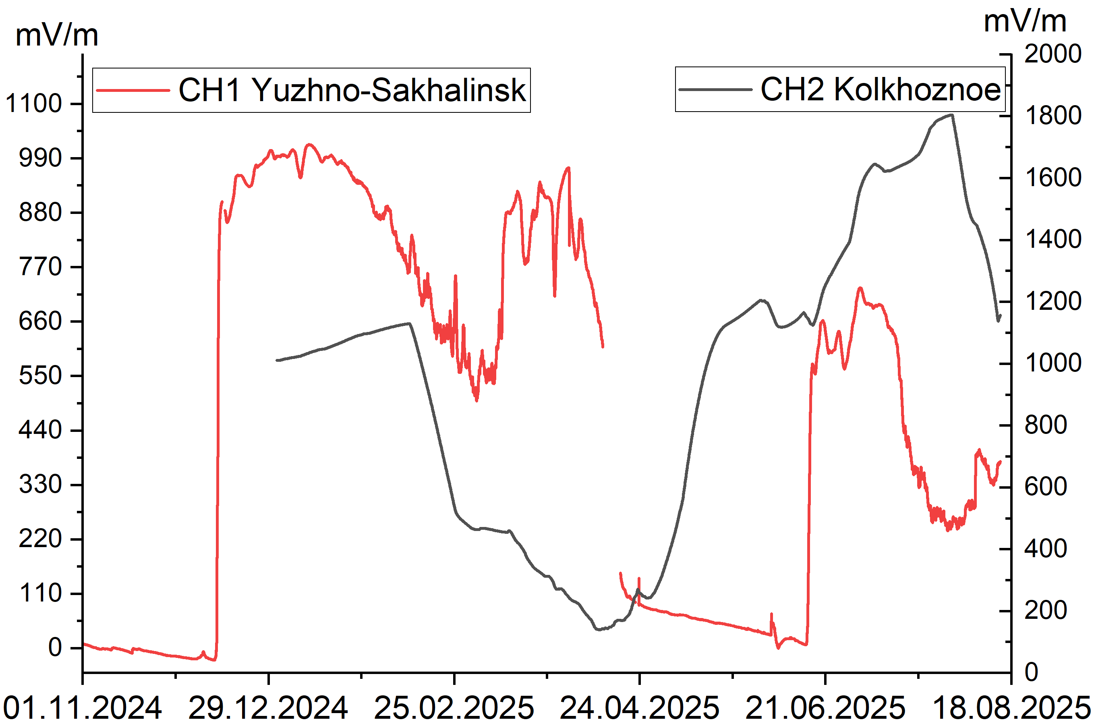
Graph of ETP data for the Yuzhno-Sakhalinsk and Kolkhoznoe stations from 01.11.2024 to 18.08.2025

Slide 10
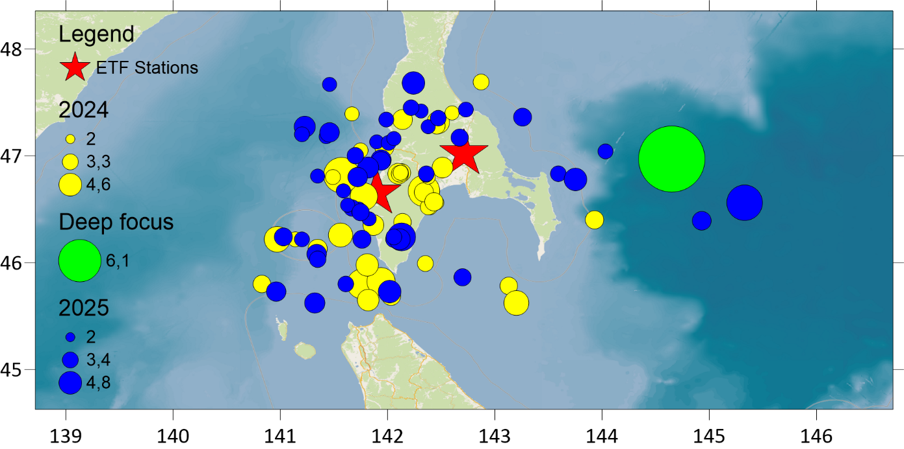

Slide 11
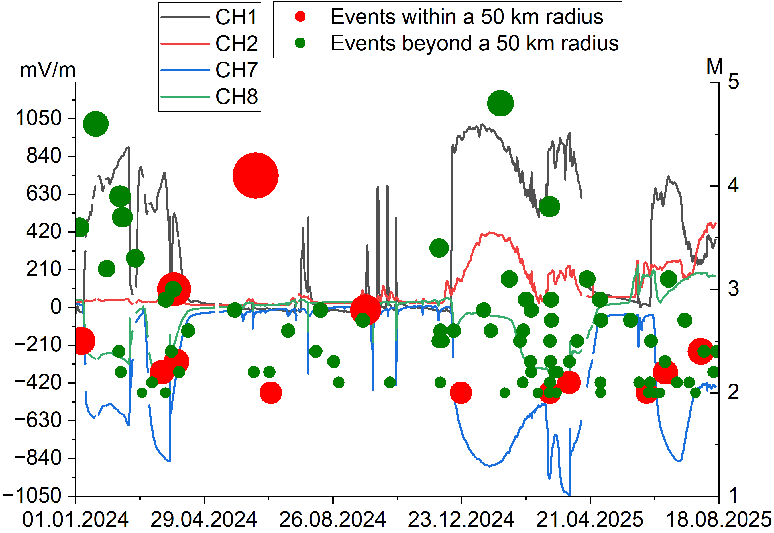

Slide 12
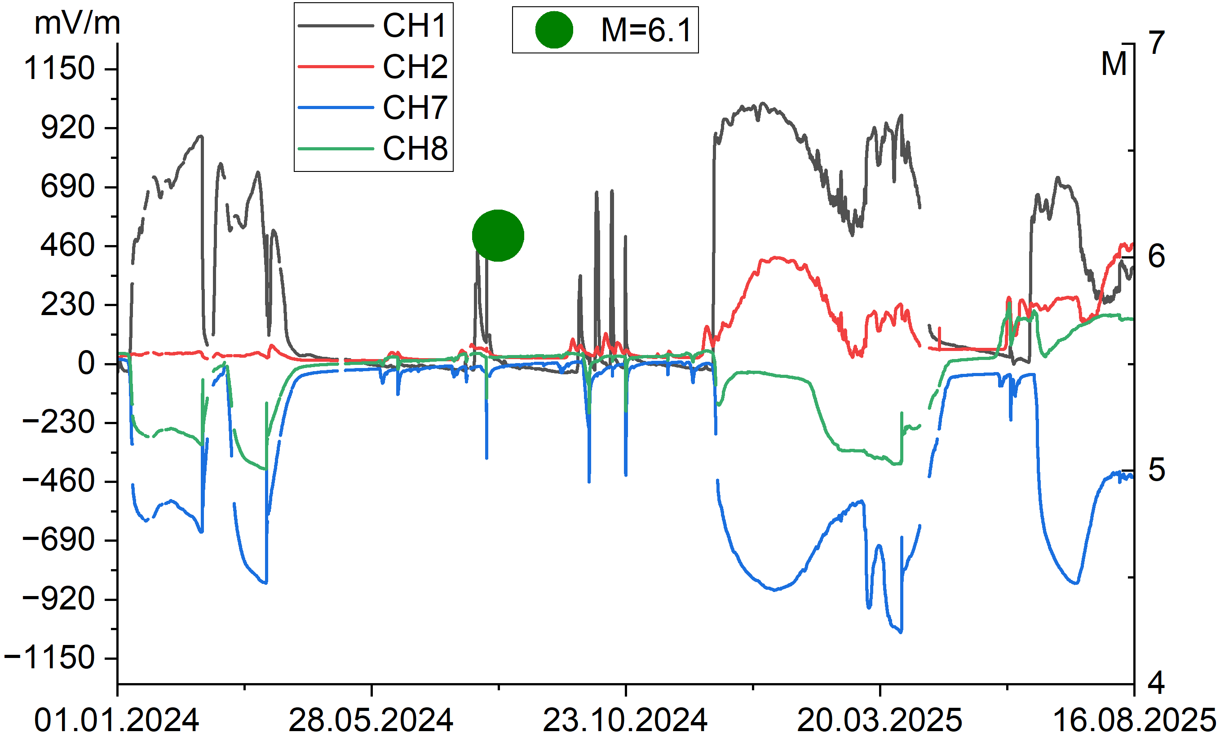

Slide 13
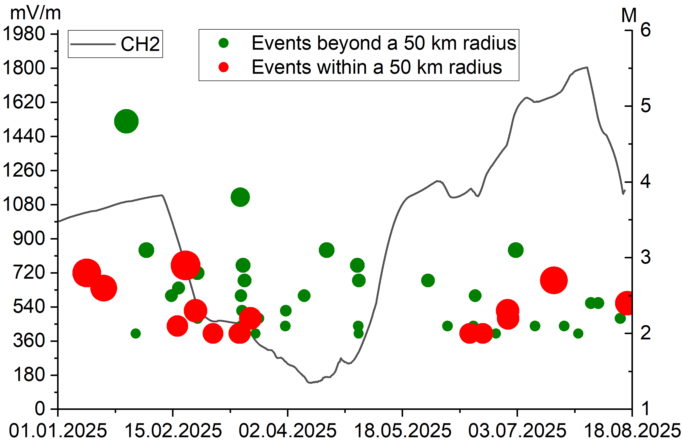

Slide 14
№ | Begin | End | Duration, days | Amplitude, mV/m | within R≤50 | All events
A1 | 05.01.2024 | 16.04.2024 | 102 | 57-912 | 3 | 18
A2 | 31.05.2024 | 16.06.2024 | 17 | 24-98 | 1 | 2
A3 | 16.07.2024 | 07.08.2024 | 22 | 59-476 | 0 | 0
A4 | 16.09.2024 | 28.10.2024 | 43 | 95-640 | 1 | 3
A5 | 06.12.2024 | 18.04.2025 | 134 | 300-1042 | 3 | 30
A6 | 02.06.2025 | 16.08.2025 | 76 | 260-851 | 4 | 19
Sum for A1-A6 |  |  | 394 (64%) | - | 12 (86%) | 72 (78%)
Normal | - | - | 198 (36%) | - | 2 | 20

Slide 15
Conclusion
To assess the statistical significance of the obtained results, Fisher's exact test and the
binomial test were used. According to both tests, the occurrence of 72 out of 92
earthquakes during disturbances periods is statistically significant: p-value = 0.03
for Fisher's test and p-value = 0.01 for the binomial test at a significance level of 0.05.
The occurrence of 12 out of 14 events during perturbation periods is not statistically
significant: p-value = 0.16 for Fisher's test and p-value = 0.10 for the binomial test at a
significance level of 0.05.
Preliminary results of the analysis of variations in vertical ETF and the earthquakes
in southern Sakhalin indicate that vertical ETP reflects both the general activation
of seismicity in southern Sakhalin and the preparation of individual
seismic events in the near zone to the monitoring stations.

