Slide 1

Why aren’t all Forbush effects associated with geomagnetic storms?
Shlyk N., Belov A.,
Abunina M., Belov S.

Slide 2
Cosmic ray (CR) intensity decrease during geomagnetic storms (GMS)
[Forbush 1937; 1938]
Nonlinear relationship,
magnetospheric effects
[Dorman 1963, Debrunner et al. 1979, Dvornikov & Sdobnov 2002, Kudela & Storini 2005]
Forbush-effect (FE) – changes in CR density and anisotropy under the influence of large-scale interplanetary disturbances
[Belov 2001]
Aim:
study of various FE characteristics and corresponding geomagnetic activity indices recorded during these events from 1957 to 2024.
Databases used:
FE – Forbush Effects and Interplanetary Disturbances (FEID), https://tools.izmiran.ru/feid/
SW and IMF – OMNI, https://omniweb.gsfc.nasa.gov/
Geomagnetic activity – ftp://ftp.gfz-potsdam.de/pub/home/obs/kp-ap/wdc
GMS – a magnetospheric phenomenon,
FE – a heliospheric one!

Slide 3
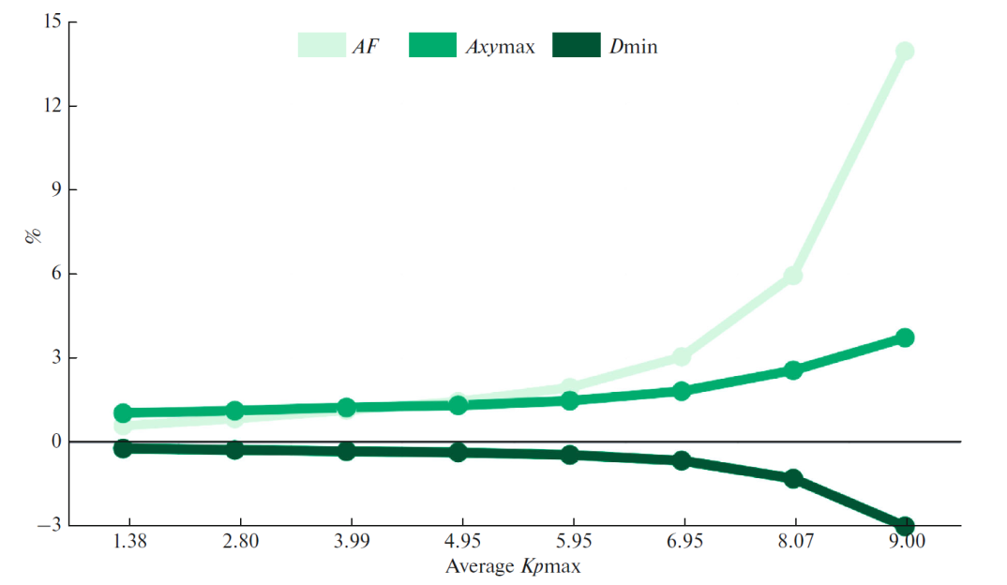
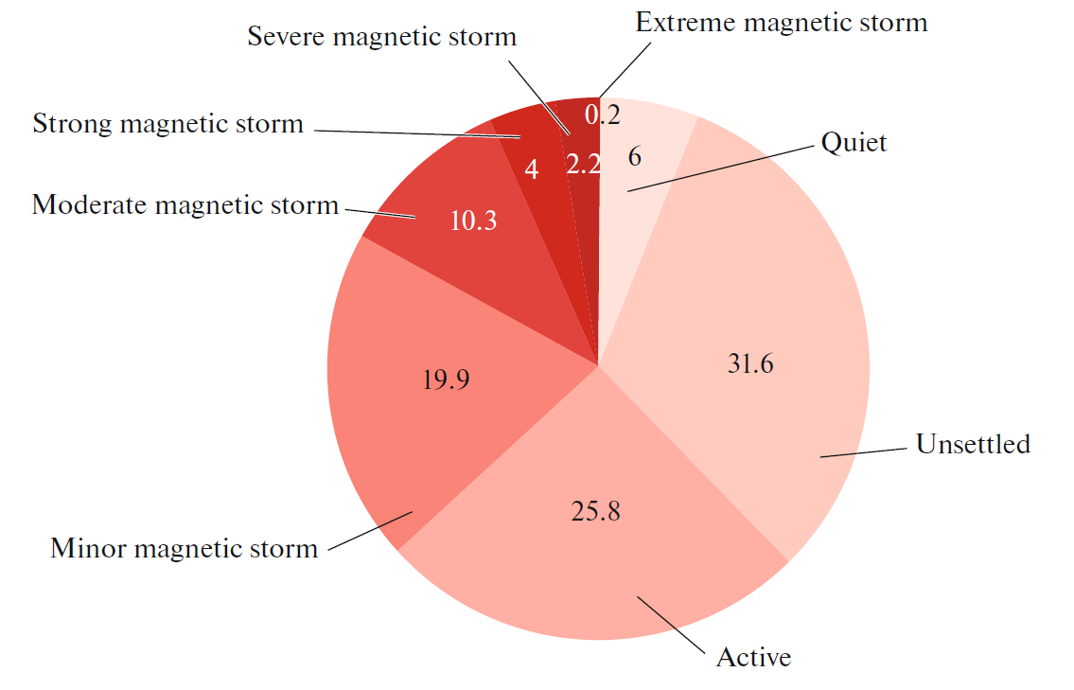
Relationship between average values ​​of cosmic ray and geomagnetic activity parameters [Belov et al., 2024]
AF – FE magnitude
Axymax – maximum value of the equatorial component of CR anisotropy
Dmin – maximum hourly decrease in CR density
Крmax – maximum value of Kp-index
Aрmax – maximum value of Ap-index
Dstmin – minimum value of Dst-index

Slide 4
Geomagnetic activity (Крmax) | Number of events | Average value
 |  | Крmax | AF, % | Axymax, % | Dmin, %
Quiet 0…2– | 512 (6 %) | 1.38 ± 0.01 | 0.61 ± 0.02 | 1.05 ± 0.02 | –0.23 ± 0.01
Unsettled 2…3+ | 2691 (31.6 %) | 2.80 ± 0.01 | 0.85 ± 0.01 | 1.13 ± 0.01 | –0.27 ± 0.01
Active 4–…4+ | 2201 (25.8 %) | 3.99 ± 0.01 | 1.15 ± 0.02 | 1.23 ± 0.01 | –0.32 ± 0.01
Minor GMS 5–…5+ | 1694 (19.9 %) | 4.95 ± 0.01 | 1.45 ± 0.03 | 1.31 ± 0.01 | –0.36 ± 0.01
Moderate GMS 6–…6+ | 876 (10.3%) | 5.95 ± 0.01 | 1.96 ± 0.05 | 1.48 ± 0.02 | –0.45 ± 0.01
Strong GMS 7–…7+ | 347 (4%) | 6.95 ± 0.01 | 3.04 ± 0.12 | 1.81 ± 0.05 | –0.65 ± 0.03
Very strong GMS 8–…9– | 186 (2.2%) | 8.07 ± 0.03 | 5.93 ± 0.28 | 2.54 ± 0.09 | –1.29 ± 0.07
Extreme GMS 9 | 17 (0.2%) | 9 | 13.89 ± 1.87 | 3.72 ± 0.59 | –2.99 ± 0.49

Slide 5
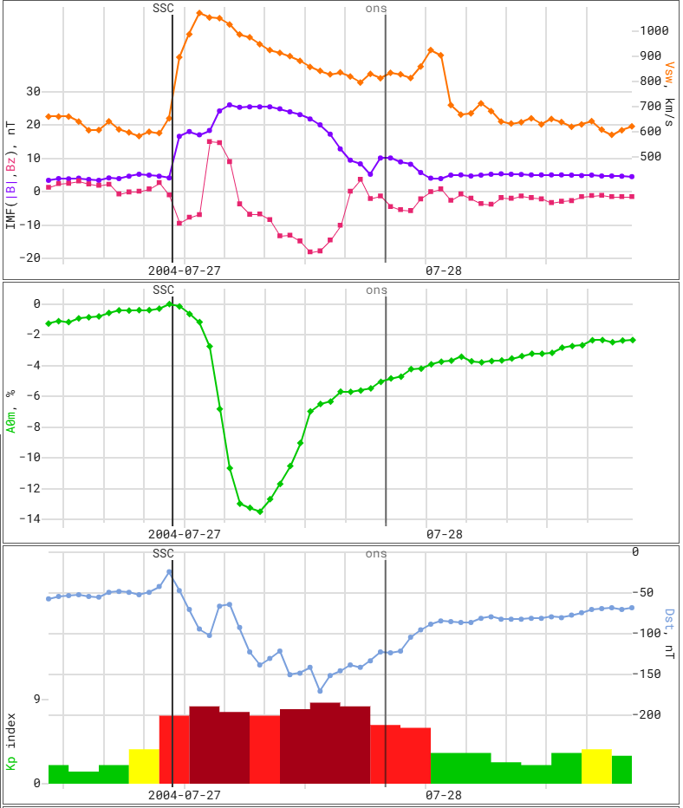
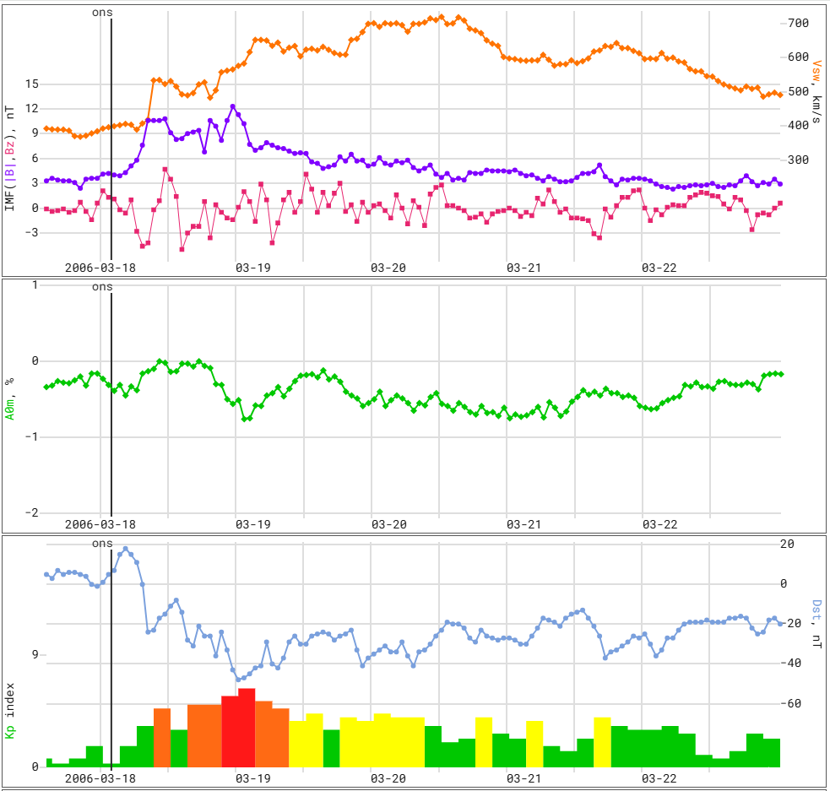
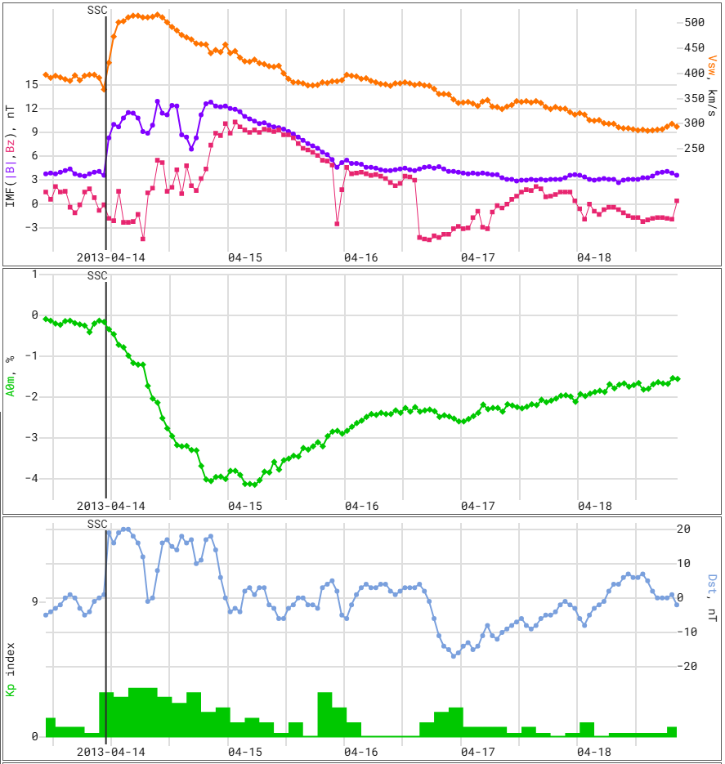
Examples

Slide 6
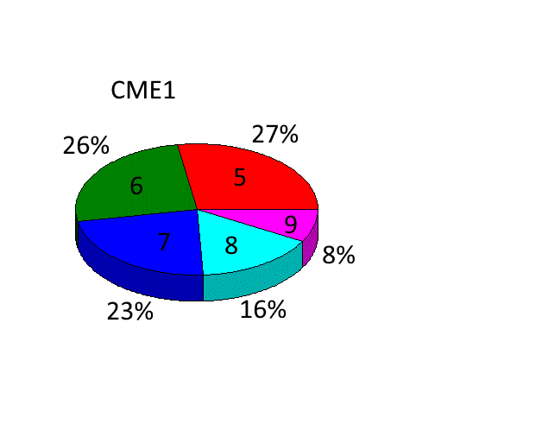
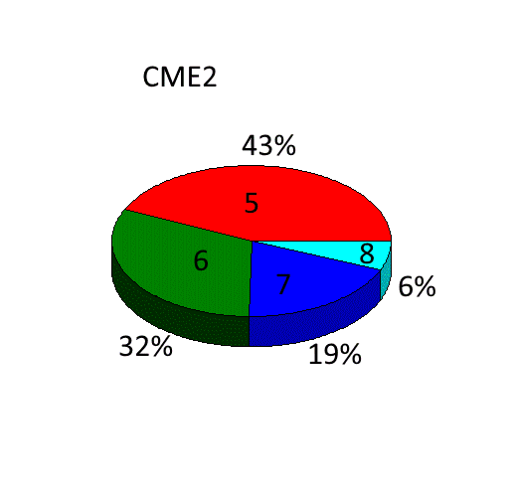
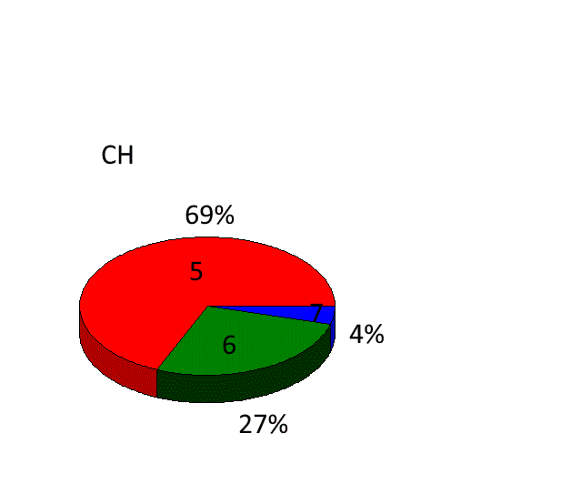
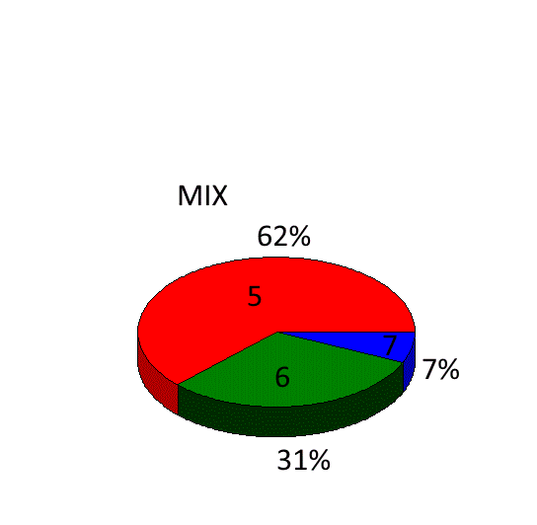
Differences between solar sources
CME1 = coronal mass ejection (CME) from active region (AR)
CME2 = CME beyond AR
CH = high-speed stream from a coronal hole (CH)
MIX = several sources
 | CME1 | CME2 | CH | MIX
Number of events | 209 | 145 | 160 | 430
Dstmin, nT | –67 | –53 | –33.5 | –39
Apmax | 67 | 39 | 32 | 32
AF, % | –2.3 | –1.2 | –1.0 | –1.0
Axymax, % | 1.64 | 1.36 | 0.95 | 1.19
Vmax, km/s | 544 | 443 | 595.5 | 554.5
Bmax, nT | 16.6 | 13 | 11.4 | 12.1
Bzmin, nT | –9.2 | –8.6 | –6.6 | 5.05
Kpmax
[Melkumyan et al., 2024]
Рис. 1 к ст. Мелкумян и др. «Форбуш-понижения и геомагнитные возмущения: 1 …»

Slide 7
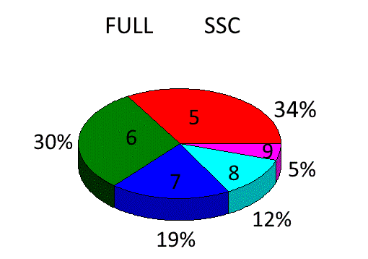
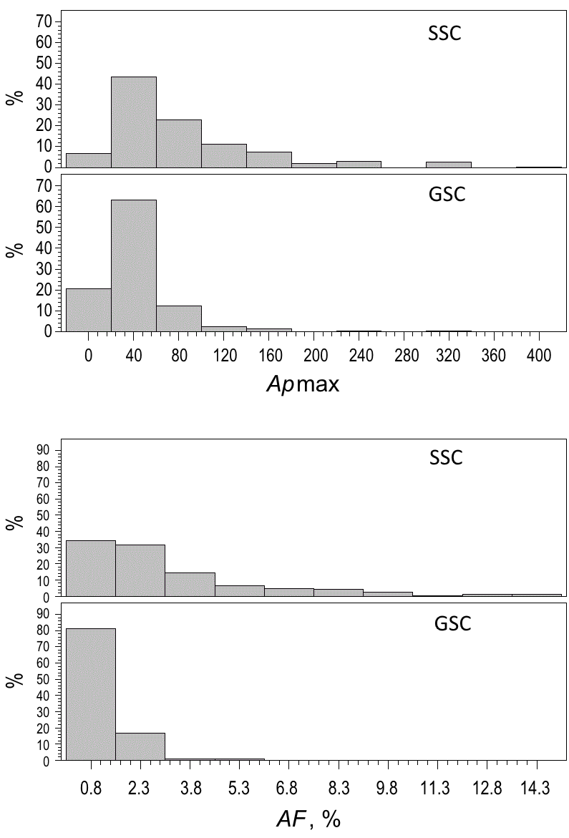
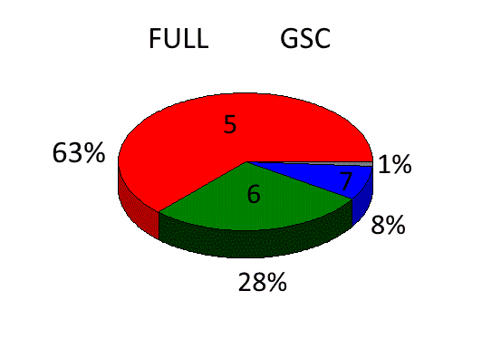
Events with a sudden (SSC) and gradual (GSC) onsets
Kpmax
Kpmax
[Melkumyan et al., 2024]

Slide 8
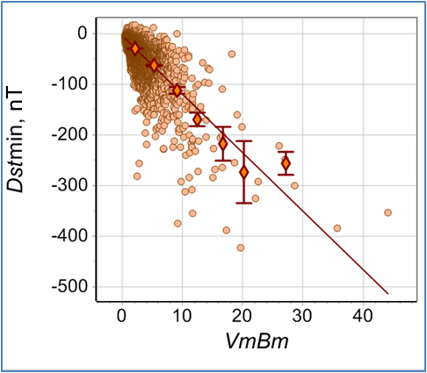
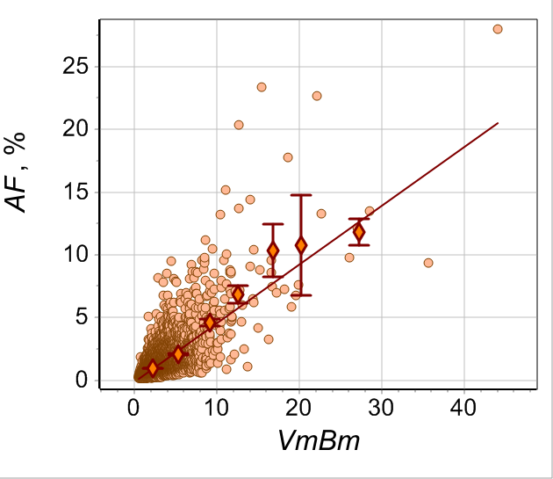
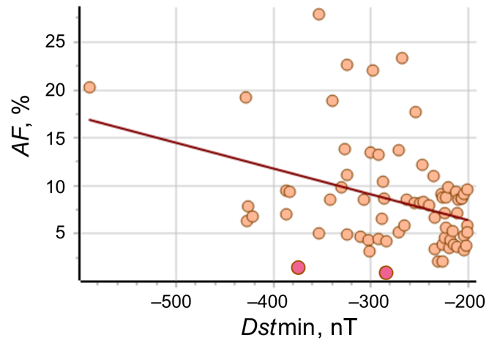
A record GMS ≠ a record FE?
Correspondence between
FEs and GMSs
by registration frequency:
GMS type | FE magnitude
Minor and moderate | > 2%
Strong | > 3%
Very strong and extreme | > 5%
[Belov et al., 2024]

Slide 9
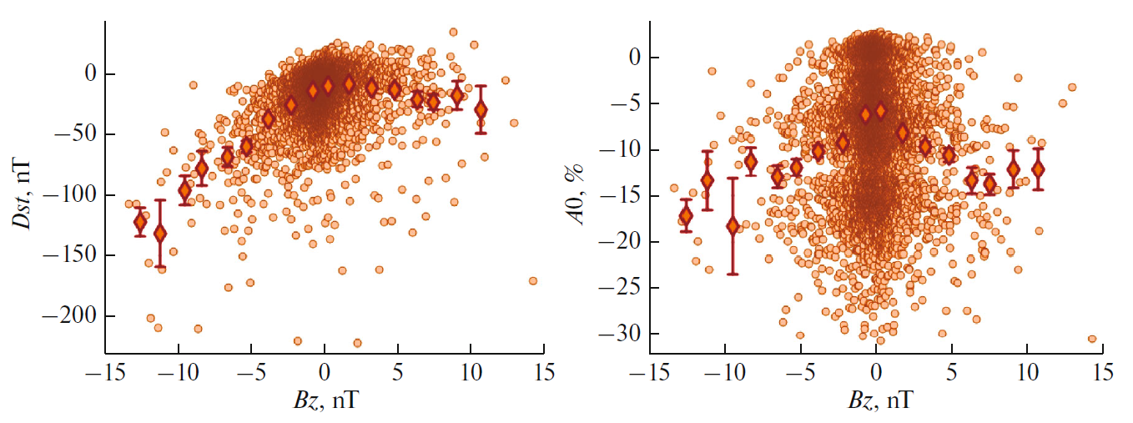
Relation with IMF Bz-component
[Belov et al., 2024]

Slide 10
The parameters of "storms" in the solar wind, Earth's magnetosphere, and cosmic rays correlate well with each other, with the relationship being closer for events with a sudden onset and those caused by CMEs from ARs.
Each GMS corresponds to at least a small decrease in CR density (by 1-2%), whereas an FE without GMS is a fairly common phenomenon.
The disruption of the relationship between the parameters of FEs and GMSs is explained by the magnitude and sign of the IMF Bz-component.
The established relationship between FEs and GMSs can be used to model FEs magnitudes from the 1830s to the 1950s, when data on GMSs but not on CR fluxes are already available.

Slide 11
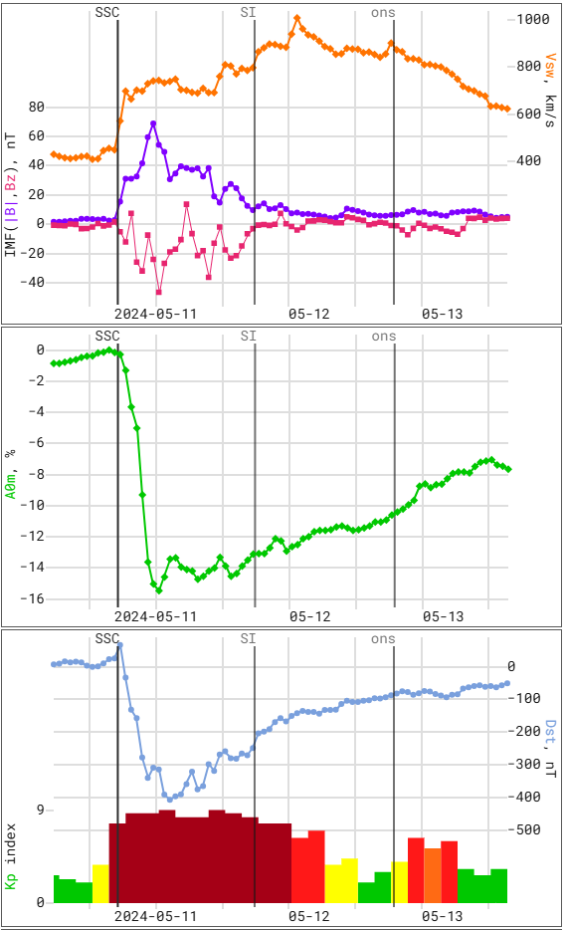
Thanks for your attention!
Belov A.V., Belova E.A., Shlyk N.S., Abunina M.A., Abunin A.A., Belov S.M. Forbush Effects and Geomagnetic Storms // Geomagnetism and Aeronomy. – 2024. – V. 64. – N. 3. – P. 289-301. https://doi.org/10.1134/S0016793224600097
Melkumyan A.A., Belov A.V., Shlyk N.S., Abunina M.A., Abunin A.A., Oleneva V.A., Yanke V.G. Forbush Decreases and Associated Geomagnetic Storms: Statistical Comparison in Solar Cycles 23 and 24 // Solar Physics. – 2024. – V. 299. – Article ID 40. https://doi.org/10.1007/s11207-024-02281-3

