Slide 1
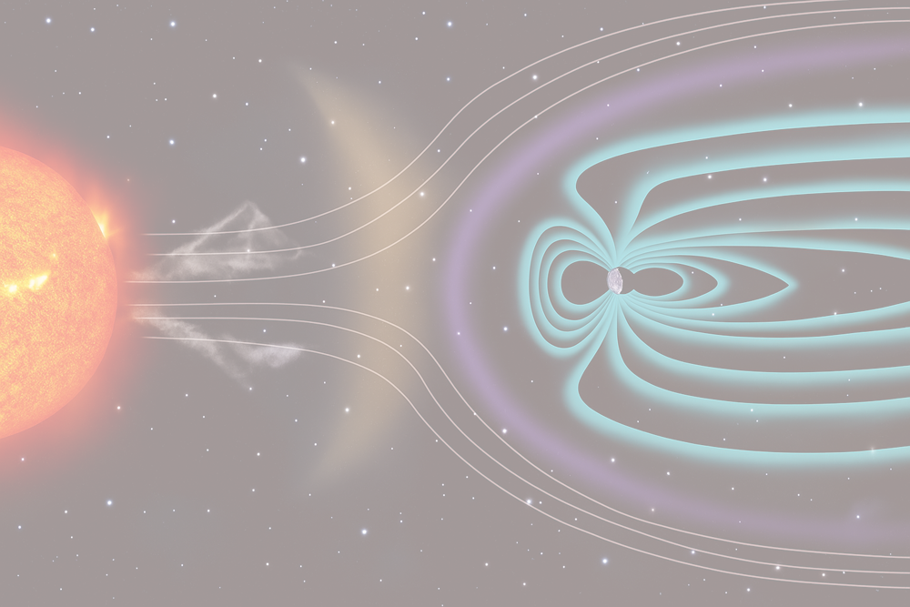
The Earth's atmosphere cosmic rays ionization estimation for the high latitude region during solar proton events
Maurchev E.A., Didenko K.A.
SOLAR-TERRESTRIAL RELATIONS AND PHYSICS OF EARTHQUAKES PRECURSORS XIV INTERNATIONAL CONFERENCE
Paratunka, 2025

Slide 2
Abstract
The Arctic is located in a region with low values of vertical geomagnetic cutoff rigidity (≤ 0.65 GV)
Galactic cosmic rays (GCR) are continuously present at the magnetosphere boundary and can reach the Earth’s atmosphere, causing ionization and cascade processes
Solar cosmic rays (SCR) have lower energies (from MeV up to ~5 GeV), but their flux can exceed GCR by several orders of magnitude
Both GCR and SCR increase atmospheric ionization (10–100 km), affecting radiation dose levels and chemical processes
This study presents examples of the altitude ionization profiles at different cutoff rigidities for several cases of the primary SCR proton spectra

Slide 3
Overview. GEANT4
GEANT4 SDK
DATA_SETS (SHORT LIST)
Neutron data files (with thermal CS) [G4NDL4.6]
Low energy electromagnetic processes [G4EMLOW8.0]
Photon evaporation [G4PhotonEvaporation5.7]
Radioactive decay [G4RadioactiveDecay5.6]
Evaluated cross-sections [G4SAIDDATA2.0]
Evaluated particle cross-sections on natural composition of elements [G4PARTICLEXS4.0]
Nuclear shell effects in INCL/ABLA hadronic model [G4ABLA3.1]
Proton and neutron density profiles in INCL [G4INCL1.0]
Shell ionization cross-sections [G4PII1.3]
Nuclides properties [G4ENSDFSTATE2.3]
[https://geant4.web.cern.ch/download/data_files_citations]
INTERACTION MODELS (MAIN LIST)
The quark-gluon string Parton model (for hadrons E > 10 GeV) [Amelin et al., 2001]
The Bertini cascades (for hadrons E < 10 GeV) [Heikkinen et al., 2003]
The low-energy neutron interactions model (E < 20 MeV) [Garny et al., 2009]
OWN_MODULES
Primary particle generators
Geometry
Angle distribution detector
Energy-binned scorer
Ionization yield function scorer
Particle flux scorer
* INCL – Liège intra-nuclear cascade model
* ABLA - de-excitation models
[Pekka Kaitaniemi et al, 2011]
[https://geant4.web.cern.ch/]

Slide 4
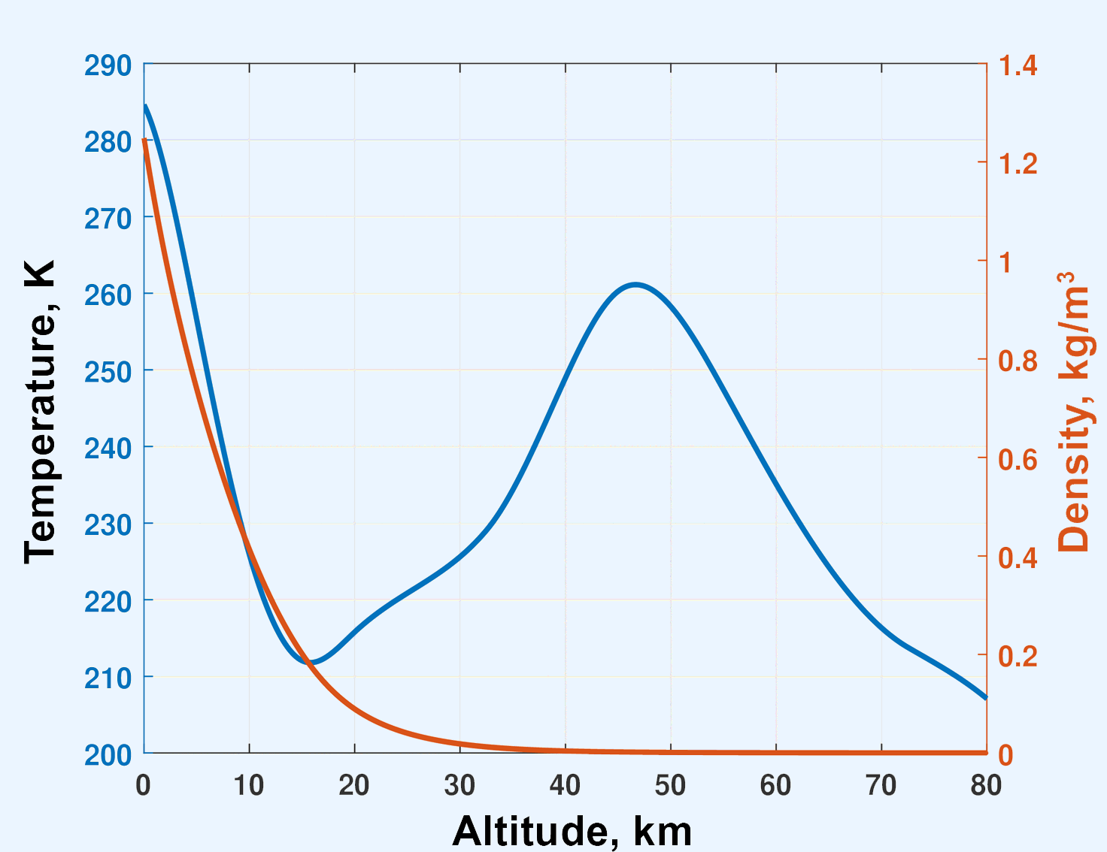
Overview. NRLMSISE-00
Temperature and density profiles of the Earth’s atmosphere vs. altitude (NRLMSISE-00 model output data)

Slide 5
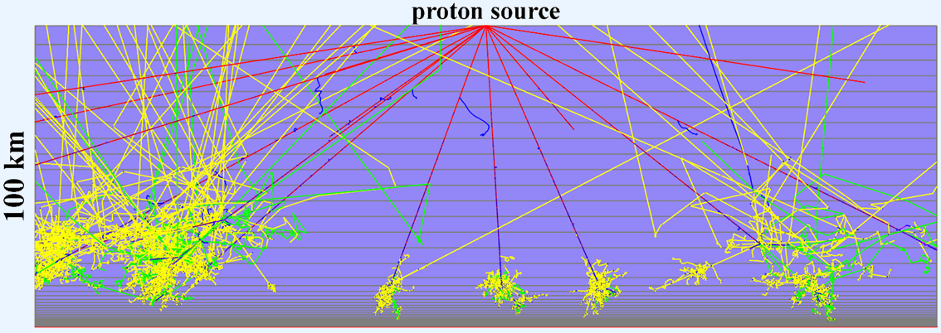
Overview
Example of the modeling of primary and secondary cosmic rays propagation through the Earth’s atmosphere using the RUSCOSMICS model (only one atmospheric geometry projection is shown). The figure illustrates the atmosphere geometry in a "flat" approximation, the primary proton source defined as a point with an isotropic angular distribution, as well as the tracking of secondary particles. The atmosphere is divided into layers and parameterized using the NRLMSISE-00 model. Red lines represent positively charged particles, blue lines – negatively charged particles, green – neutrons and yellow – photons

Slide 6
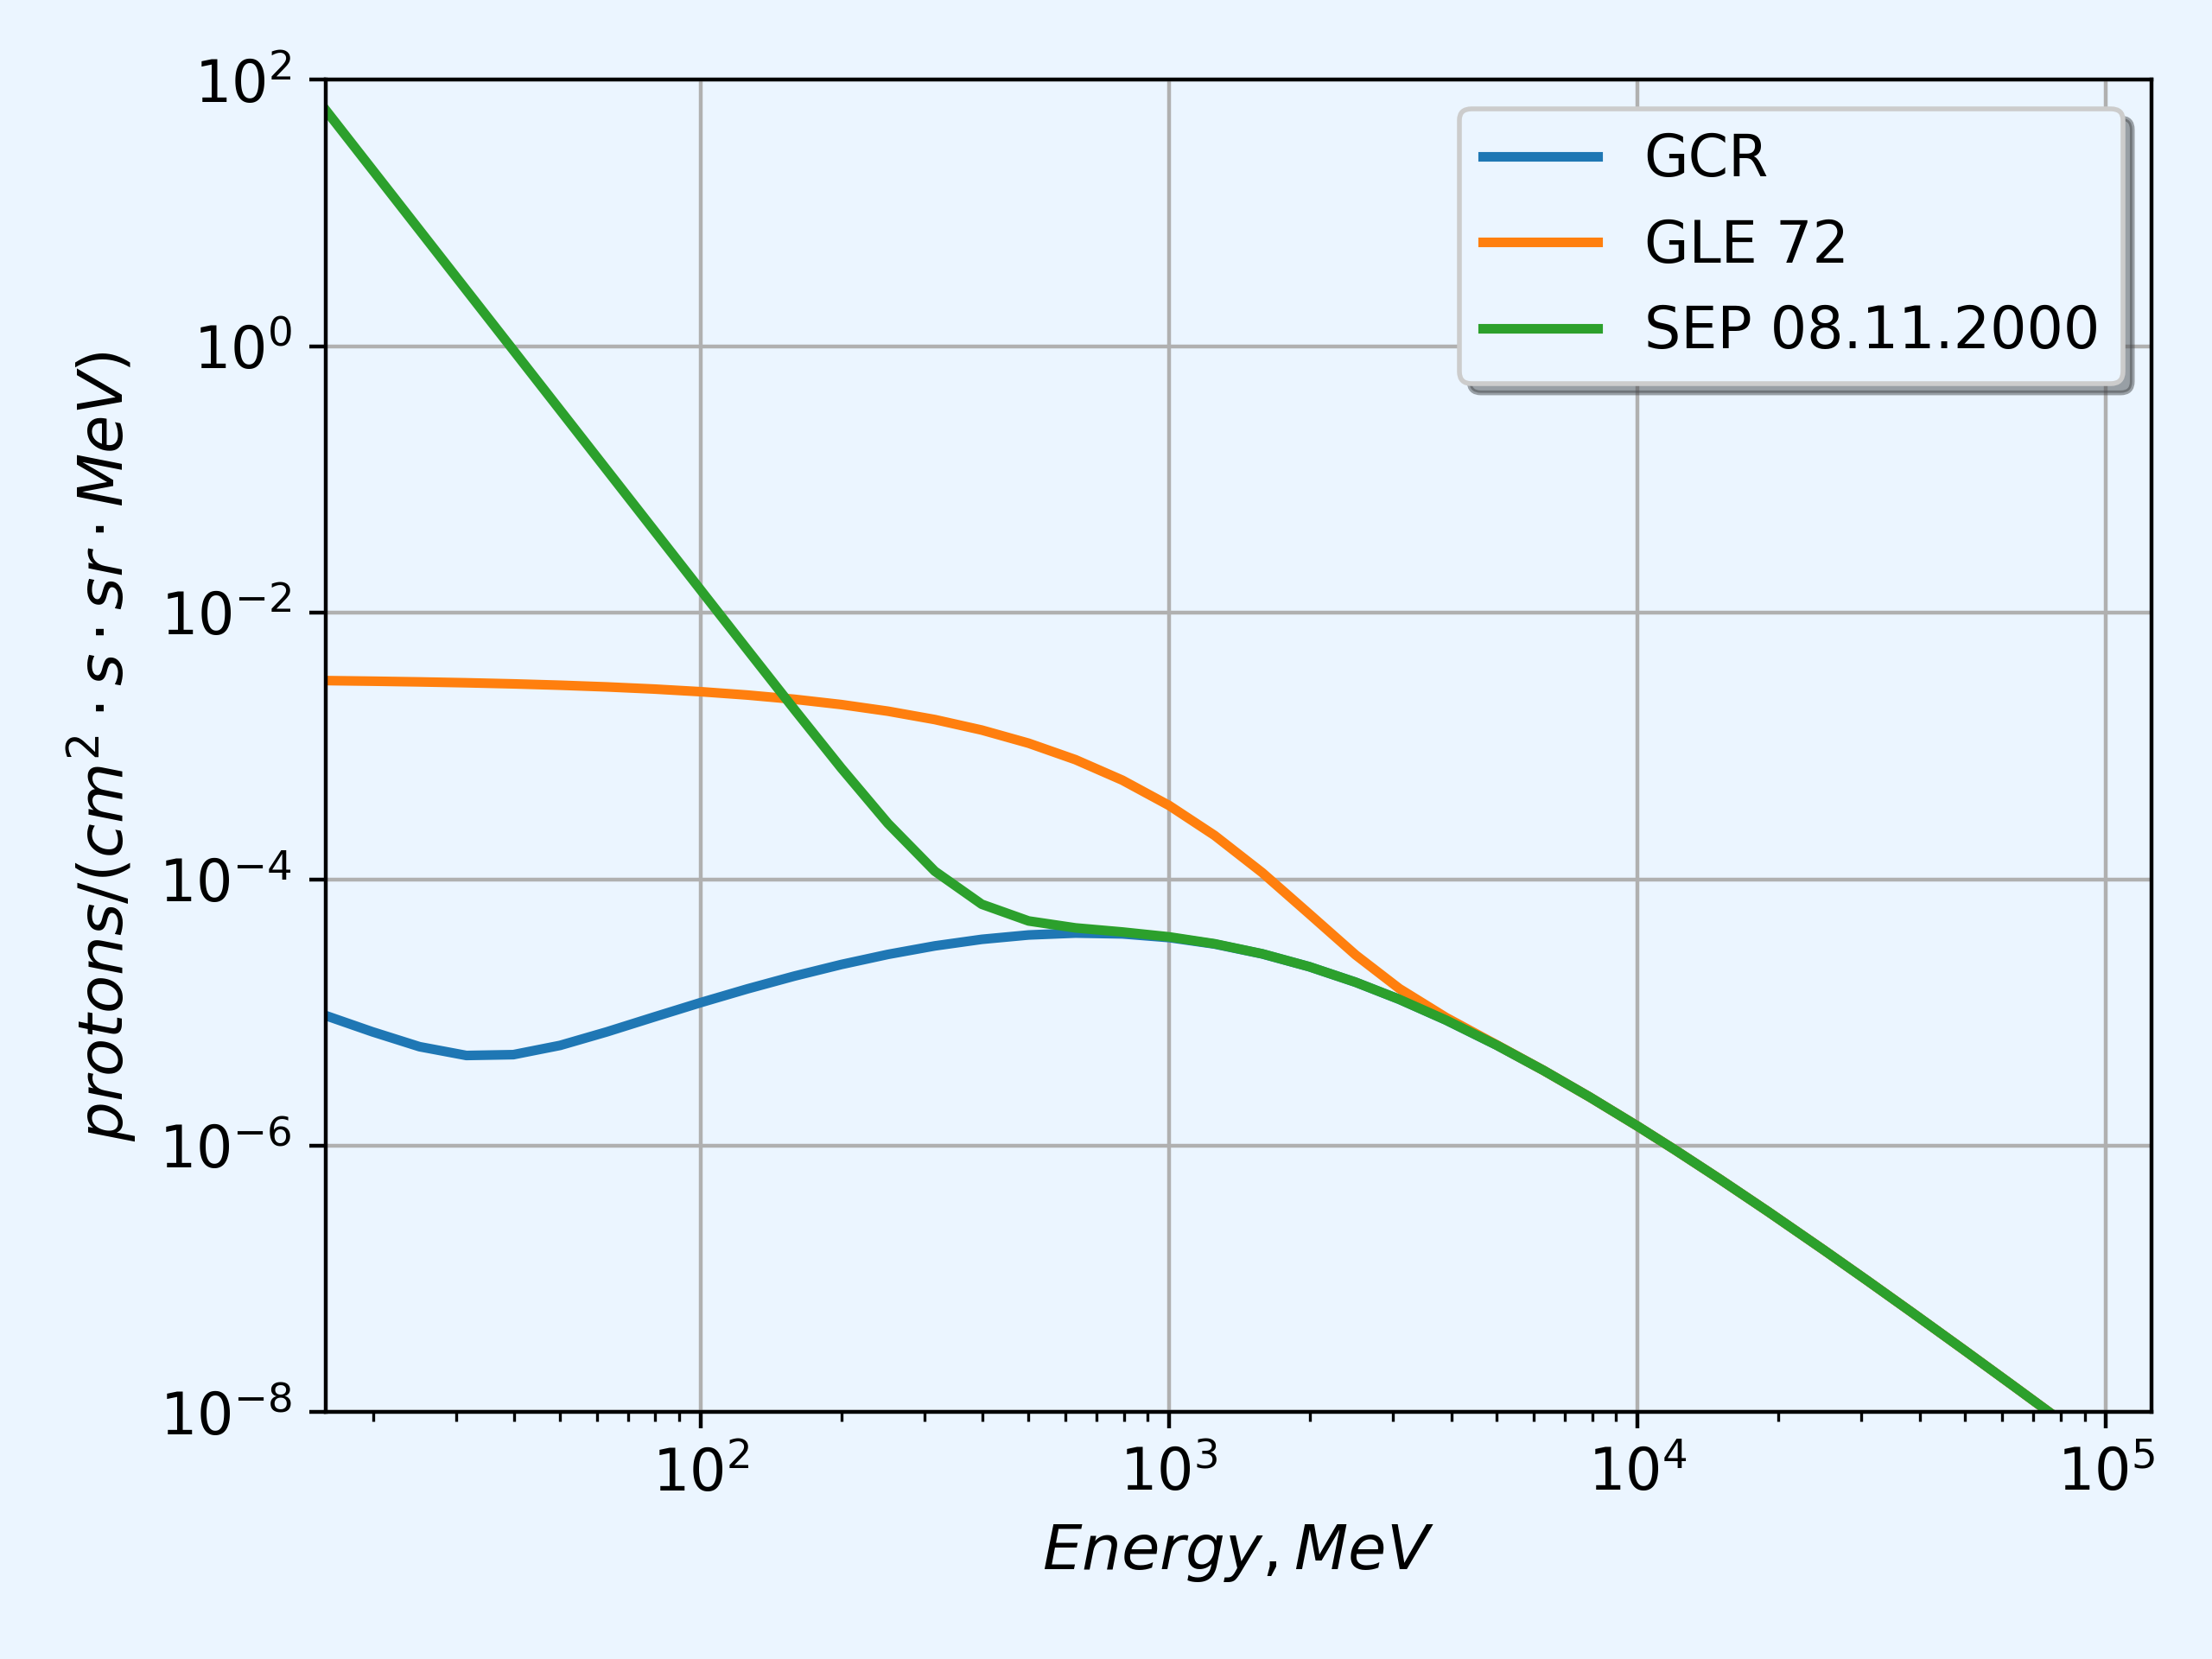
General input data. Primary spectra
The derived differential proton energy spectra for SEP and GLE events used in modeling of the CR transport trough the Earth atmosphere

Slide 7
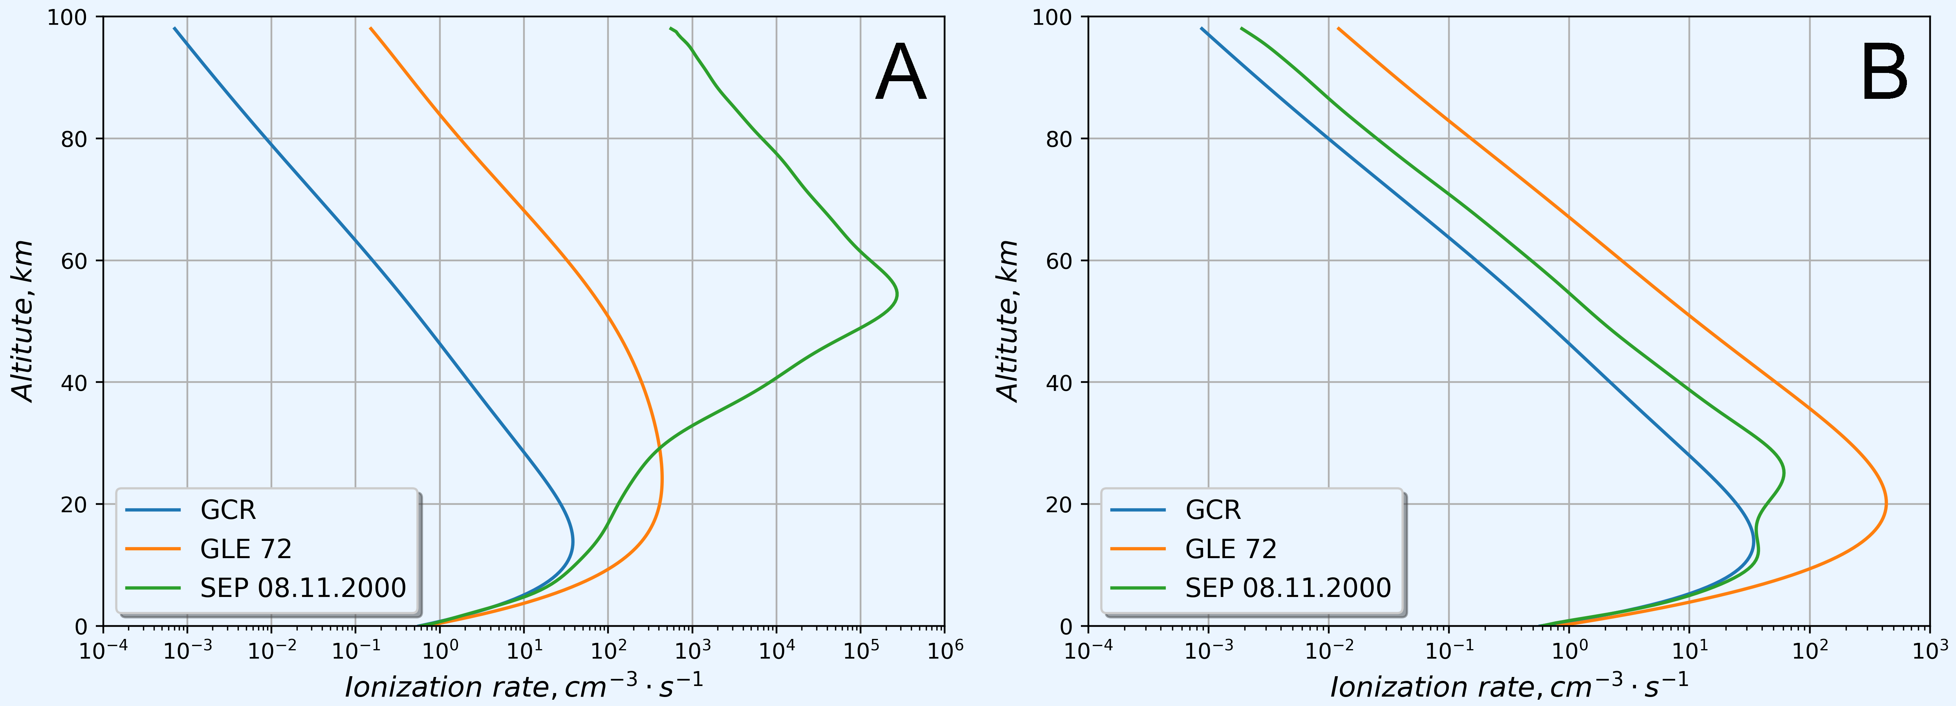
Results
The dependence of the calculated ionization count rate vs altitude for geomagnetic cutoff rigidity R=0.17 GV (A) and R=0.64 GV (B)

Slide 8
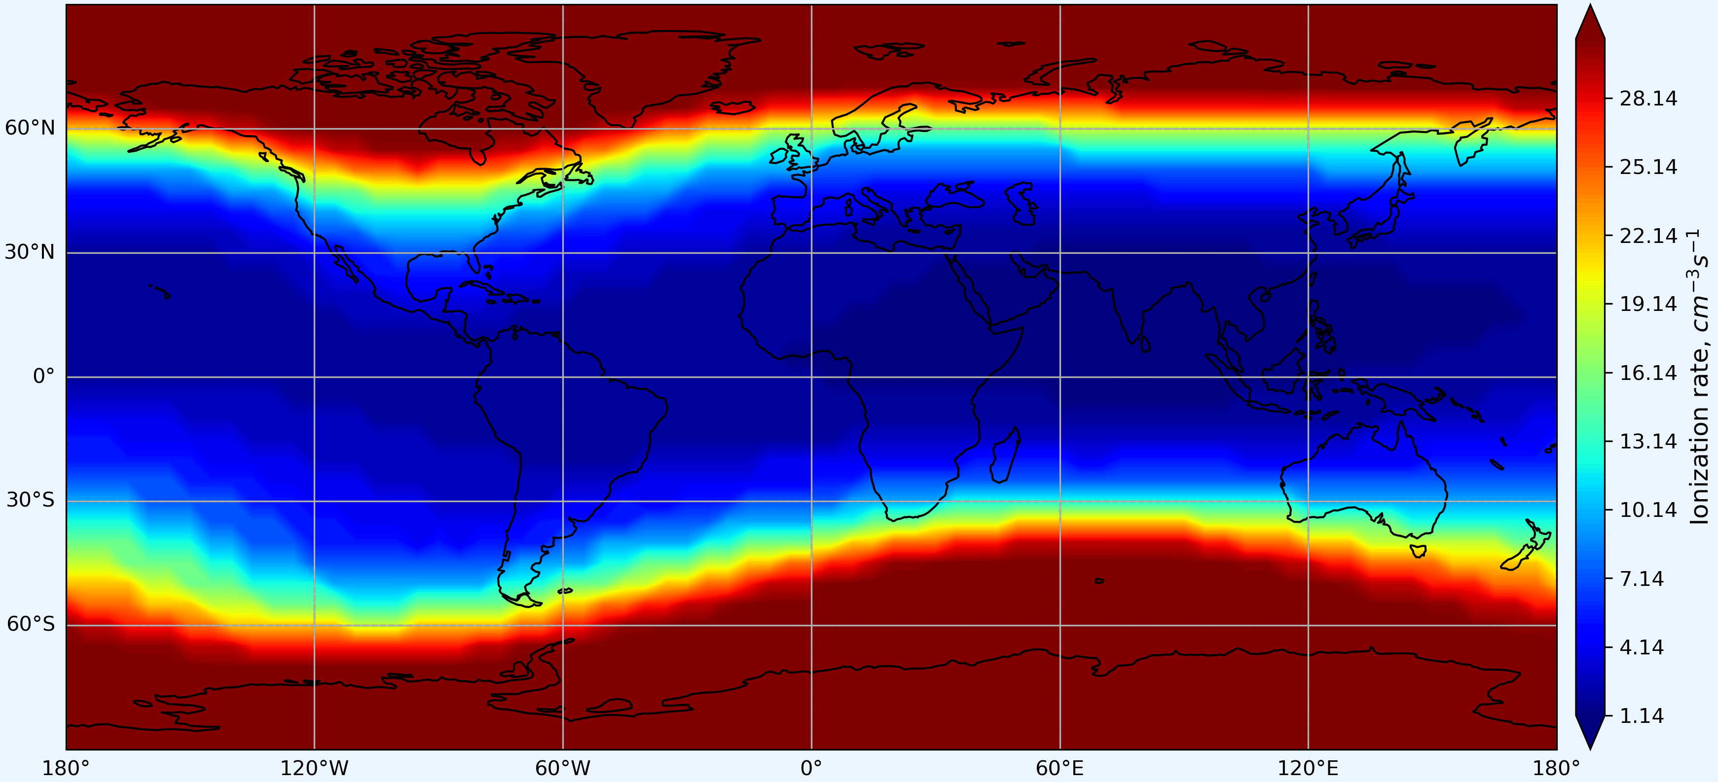
Results. Ionization count rate (h = 10 km, GCR)

Slide 9
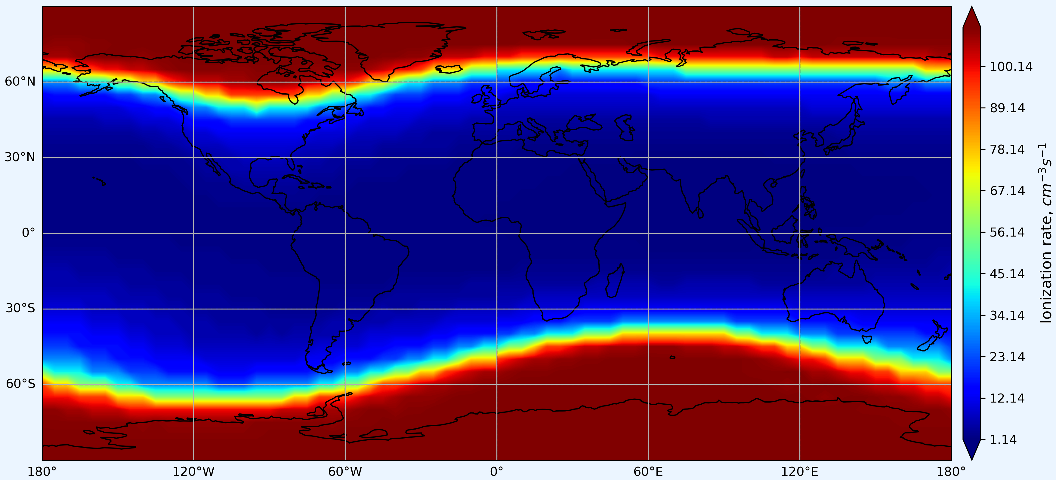
Results. Ionization count rate (h = 10 km, GLE72)

Slide 10

Thanks for your attention!
Vilyuchinsky, Team lunch-time show 01.10.2025
The research was supported by the Russian Science Foundation (grant No 25-17-20038), https://rscf.ru/project/25-17-20038/

