Slide 1


Numerical modeling
of QBO and ENSO phase impact
on the atmospheric waves’ processes
Didenko K.A. , Koval A.V., Ermakova T.S., Fadeev A.S.
didenko.xeniya@yandex.ru
XIV International Conference «Solar-Terrestrial Relations and Physics of Earthquake Precursors»
September 29 - October 3, 2025, Kamchatka, Russia

Slide 2
QBO phases: easterly QBO and westerly QBO.
ENSO phases: El Niño and La Niña.
Planetary waves (PW) propagate from their sources, transfer energy and momentum, form specific types of atmospheric circulation, and transfer a signal from the quasi-biennial oscillation (QBO) and the El Niño Southern Oscillation (ENSO).
Zonal wavenumber (m) is one of the main wave parameter (an integer number of waves fitting along the latitude circle).
The propagation of individual PW can modulate the speed of the background wind and the components of the residual meridional circulation up to 5%, especially in the areas of their maxima (Koval et al, 2023 (doi:10.5194/acp-23-4105-2023)).
Overview

Slide 3
to investigate the influence of different QBO and ENSO phases on wave processes and their structural characteristics;
to analyze the Middle and Upper Atmosphere Model’s (MUAM) simulation results;
to estimate the amplitudes and Eliassen-Palm (EP) fluxes of stationary planetary waves (SPWs) and westward travelling PWs with a zonal wave number m = 1, having periods of 5- and 10-days and with a zonal wave number m = 2 having periods of 4- and 7-days.
Purpose and task

Slide 4
The Middle and Upper Atmosphere Model (MUAM)
is based on the standard system of primitive equations in a spherical coordinates.
Radiation unit takes into account the atmosphere warming in the ultraviolet and visible regions of the spectrum, as well as cooling in the infrared radiation bands.
Ion drag, molecular viscosity, thermal conductivity, turbulent diffusion and three-dimensional distribution of ozone are taken on.
The main parameters calculated by the model are zonal, meridional, and vertical wind components, geopotential, and temperature.
The horizontal grid is 36x64 grid-steps in latitude and longitude, respectively. Vertical grid – log-isobaric vertical coordinate, 56 nodes from the surface to 300-400 km. The time step is 2 hours.
Weather changes and clouds in the troposphere are not modeled.

Slide 5
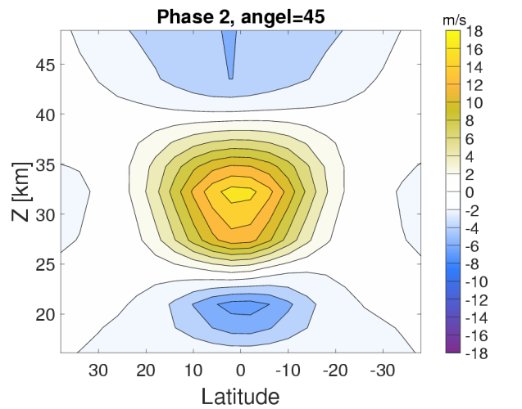
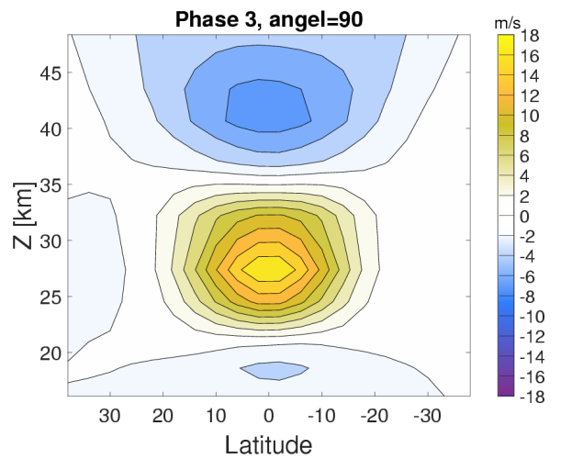
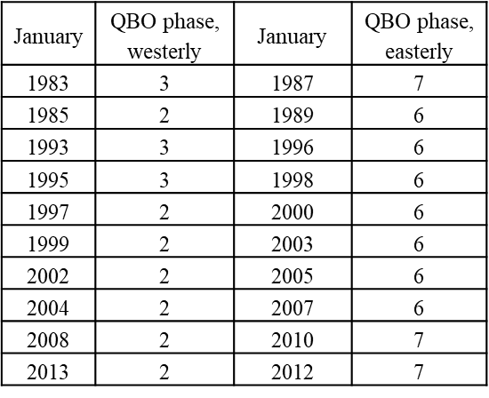
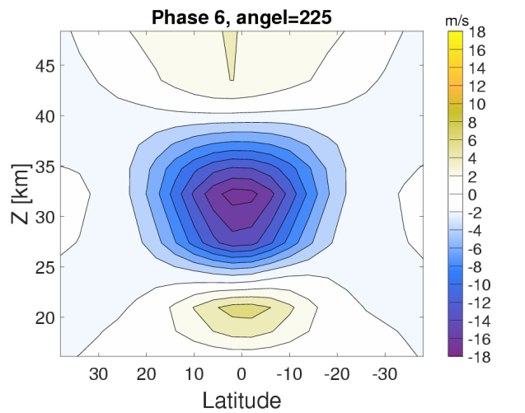
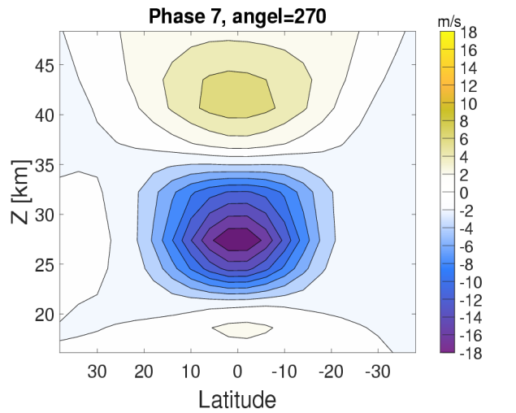
QBO and ENSO in MUAM
Fig. 1. Zonally averaged zonal wind structures – 2 and 3 QBO phases (westerly QBO).
Table 1. Years with westerly and easterly phase of the QBO.
 | Years (January)
El Niño | 1983, 1992, 1998, 2003, 2010
La Niña | 1989, 1999, 2000, 2008, 2011
Fig. 2. Zonally averaged zonal wind structures – 6 and 7 QBO phases (easterly QBO).
Table 2. Years with El Niño and La Niña conditions.

Slide 6
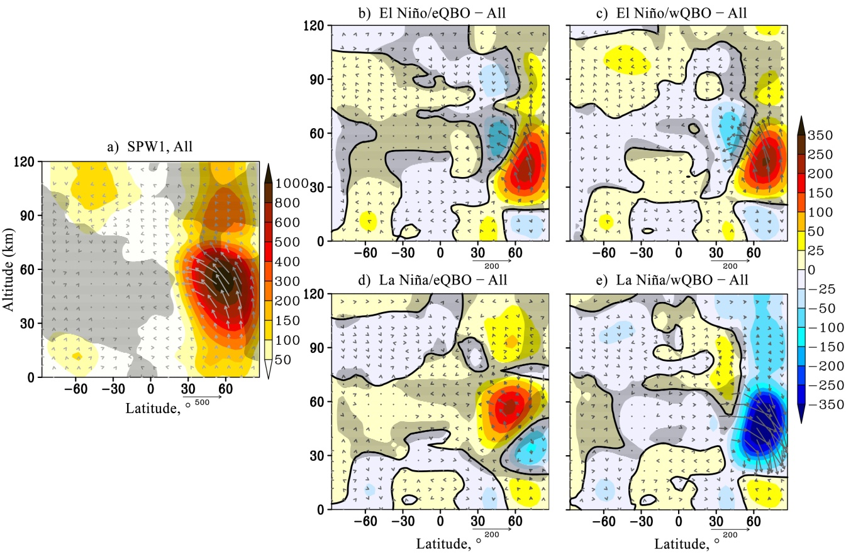
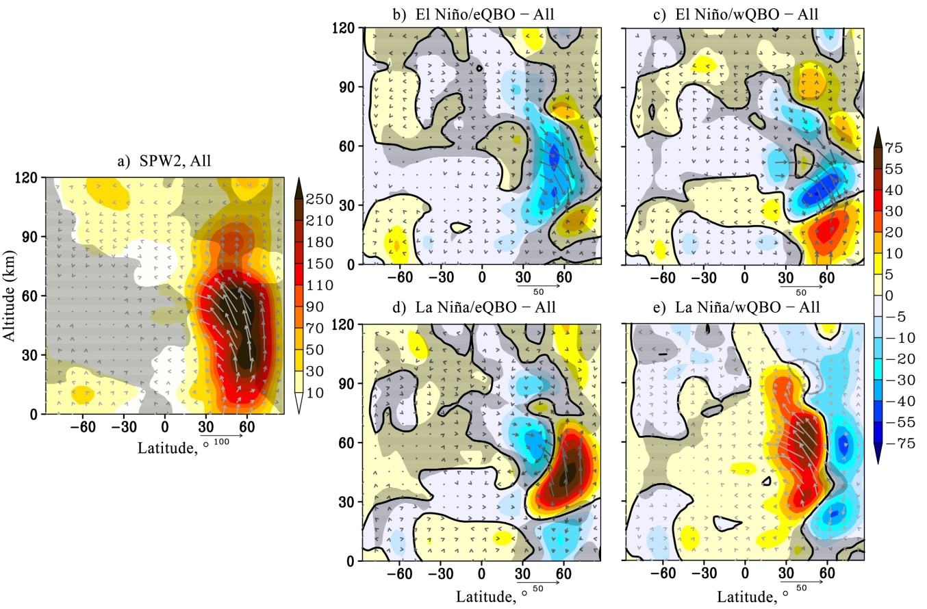
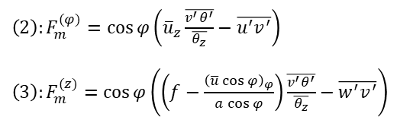

Stationary planetary waves
Fig. 3. a): amplitude of the geopotential height variations caused by SPW1 (gp.m., shaded), EP flux (m²/s², arrows). Hatched areas show negative refractive index beyond the waveguide. Data is averaged over January–February and all MUAM simulations; b-e): respective amplitude and EP flux increments due to change of ENSO/QBO phase, hatched areas show insignificant data at 95%. Vertical EP flux component is multiplied by 200.
Fig. 4. The same as Fig. 3 but for the SPW2.
(1): $n^{2}\left(φ,z\right)=\frac{\overline{q_{φ}}}{u−c}−{\left(\frac{m}{a\cos{φ}}\right)}^{2}−{\left(\frac{f}{2NH}\right)}^{2}$
– refractivity index squared
${\left(2\right):F}_{m}^{(φ)}=\cos{φ}\left({\overline{u}}_{z}\frac{\overline{v^{′}θ^{′}}}{\overline{θ_{z}}}−\overline{u^{′}v^{′}}\right)$
${\left(3\right):F}_{m}^{(z)}=\cos{φ}\left(\left(f−\frac{{\left(\overline{u}\cos{φ}\right)}_{φ}}{a\cos{φ}}\right)\frac{\overline{v^{′}θ^{′}}}{\overline{θ_{z}}}−\overline{w^{′}v^{′}}\right)$
– components of the EP flux

Slide 7
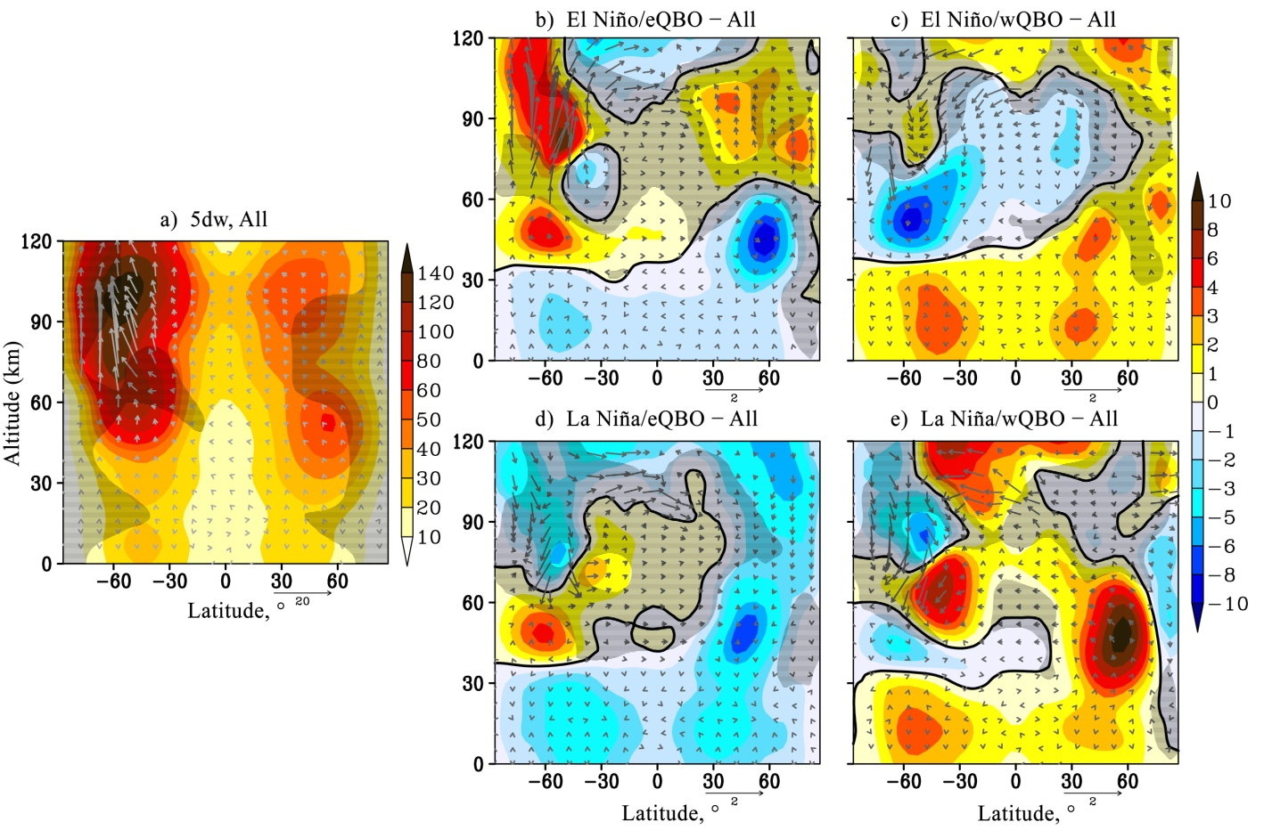
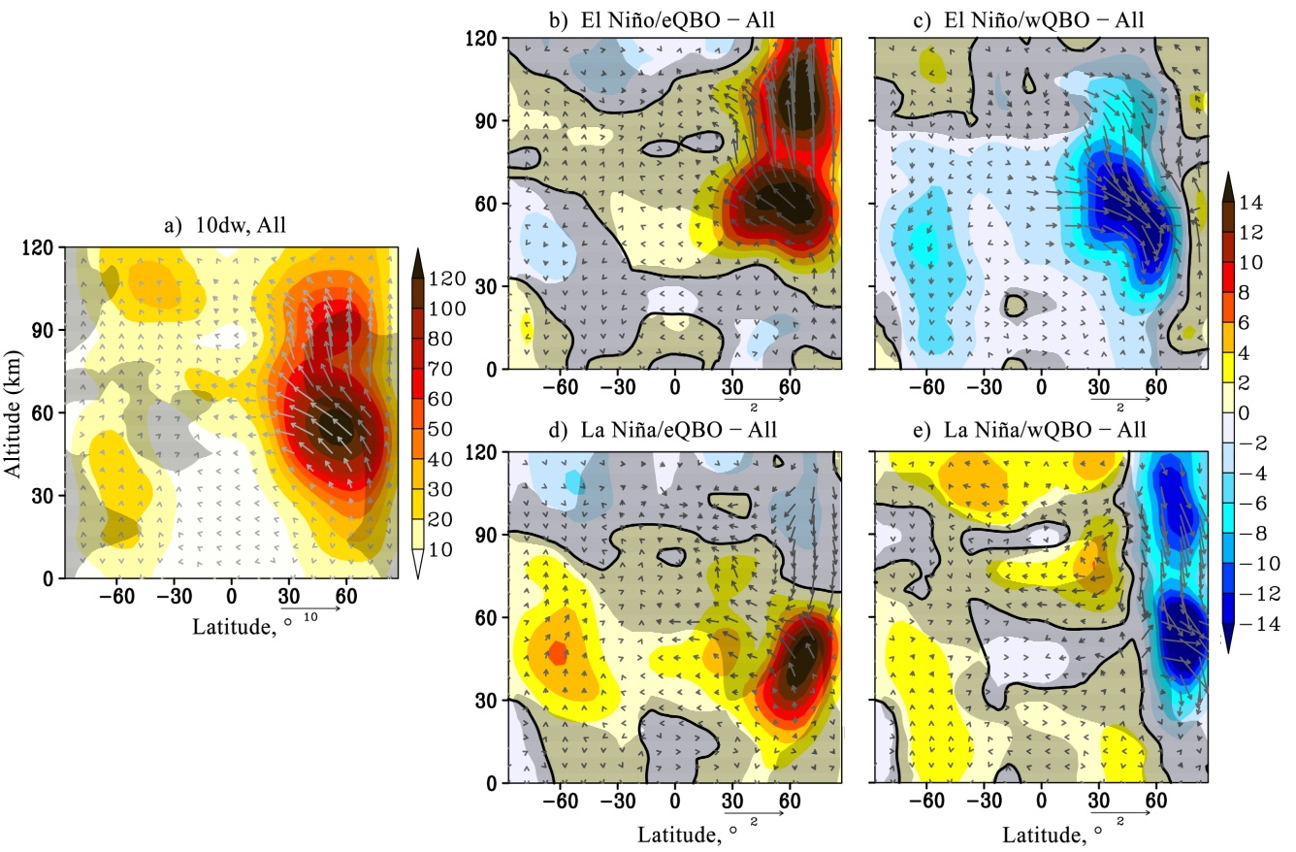
Westward travelling planetary waves (m = 1)
Fig. 5. The same as Fig. 3 but for the westward travelling atmospheric PW with period = 5 days, m = 1.
Fig. 6. The same as Fig. 3 but for the westward travelling atmospheric PW with period = 10 days, m = 1.

Slide 8
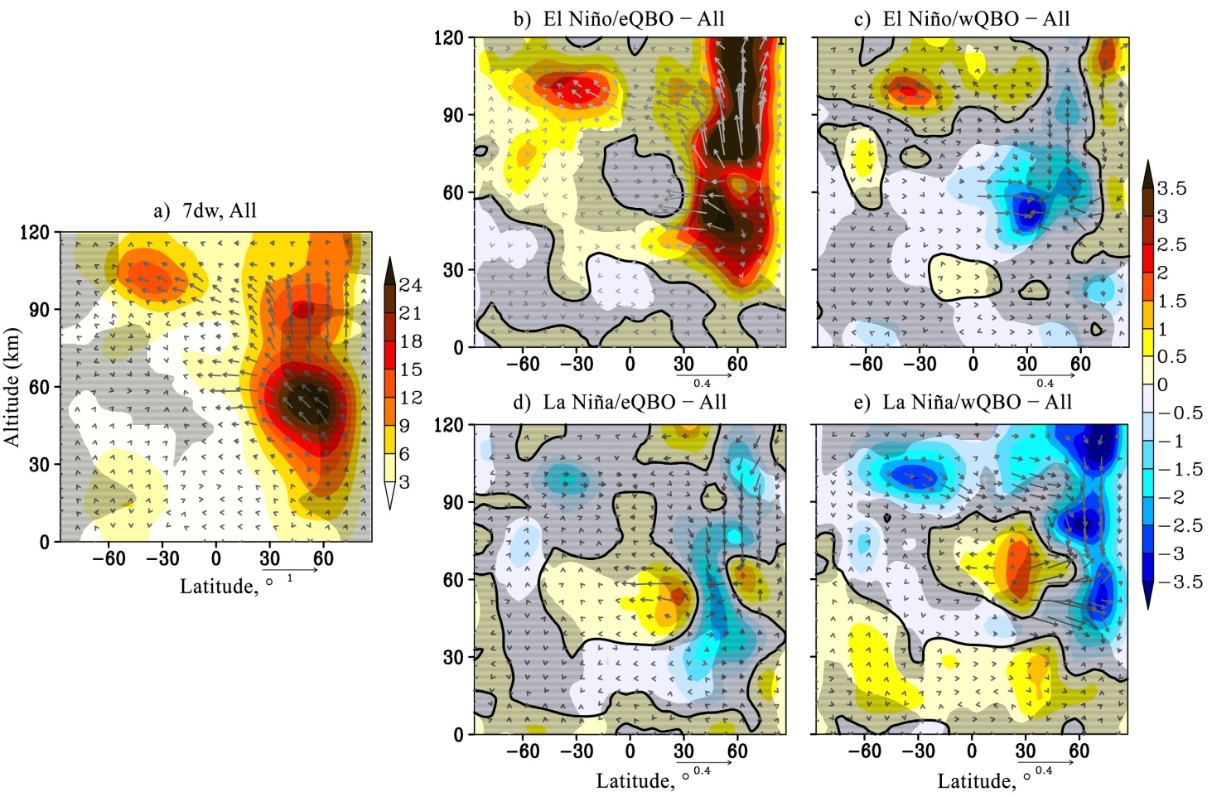
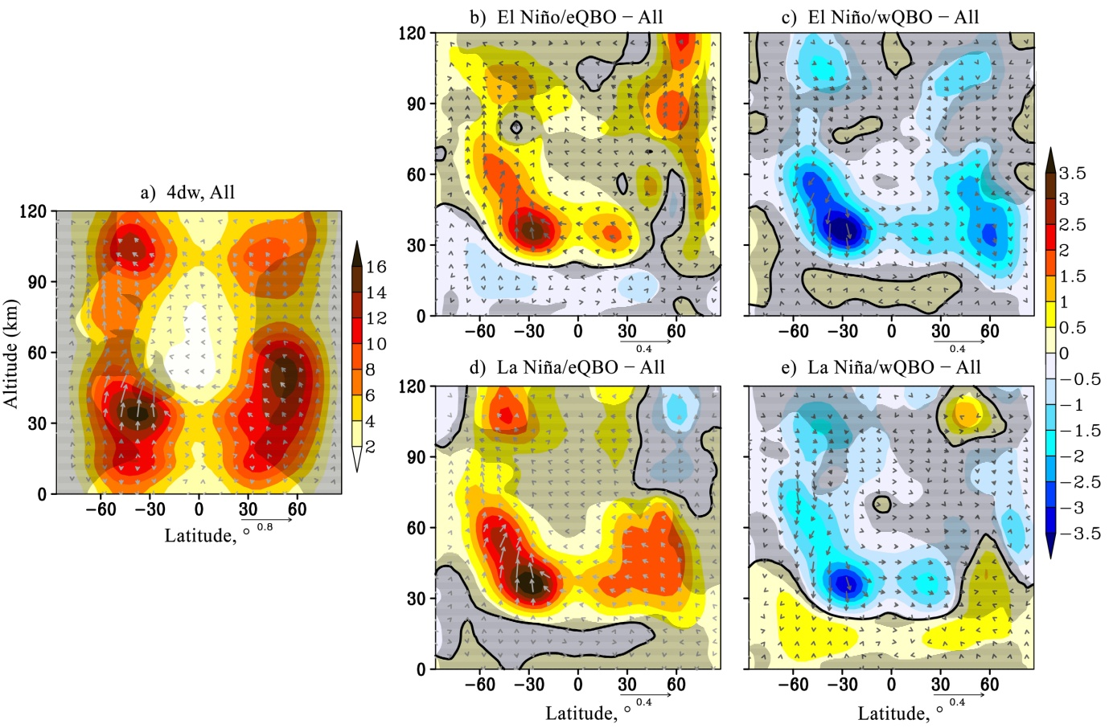
Westward travelling planetary waves (m = 2)
Fig. 5. The same as Fig. 3 but for the westward travelling atmospheric PW with period = 7 days, m = 2.
Fig. 6. The same as Fig. 3 but for the westward travelling atmospheric PW with period = 4 days, m = 2.

Slide 9
Conclusion
Model simulation allows to examine the variability of atmospheric waves of a global scale under the various combinations of long-period tropical oscillation phases.
The results of the numerical experiments revealed a significant difference in the considered PW’s structures under various combinations of QBO and ENSO.
The results confirmed the existing views that natural tropical oscillations, originating in low latitudes, significantly affect the structure of planetary waves and their wave activity fluxes, not only in the regions of their climatic maxima but also throughout the middle atmosphere and thermosphere of both hemispheres.
The research was supported by Russian Science Foundation grant # 25-47-00122

Slide 10
Thank you for your attention!
didenko.xeniya@yandex.ru

