Slide 1


PAYLOAD FOR STUDY OF ATMOSPHERIC GAMMA-RAY FLASHES ADD TRANSIENT PHENOMENA ONBOARD SMALL SATELLITE "SCORPION"
Vitalii Bogomolov, Alexander Belov, Andrey Bogomolov, Egor Voskresenskov, Anatoly Iyudin, Pavel Klimov, Ivan Kucherenko,
Alexey Murashov, Vladislav Osedlo, Sergey Svertilov
M.V. Lomonosov Moscow state university
History of upper atmosphere research on MSU small satellites
Characteristics and payload of small satellite “Scorpion”
Gamma-ray spectrometer TGS for study of TGF, GRB, SF
Complex of optical and UV fast instruments SONET
Preflight tests and expected data
Paratunka, 30.09.2025

Slide 2
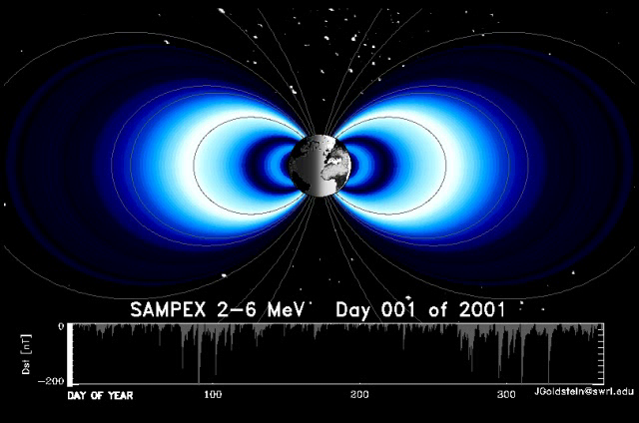
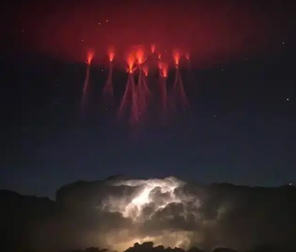
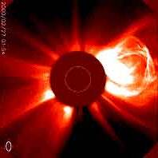
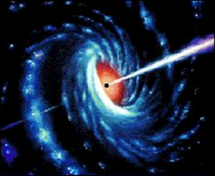
Space program of M.V. Lomonosov Moscow State University
A lot of space phenomena are studied by MSU scientists and students:
Cosmic rays
Solar activity
Gamma ray bursts
Transients in
high atmosphere
Space weather

Slide 3
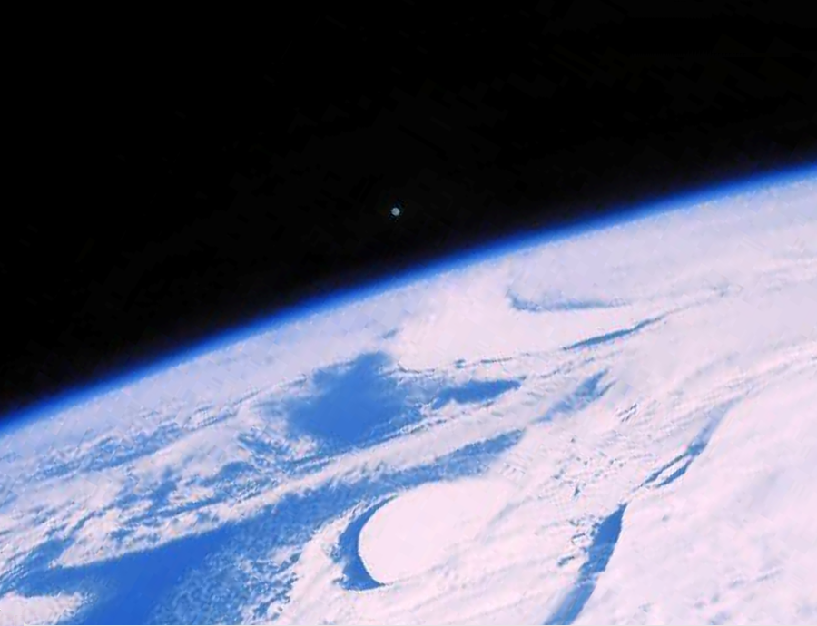
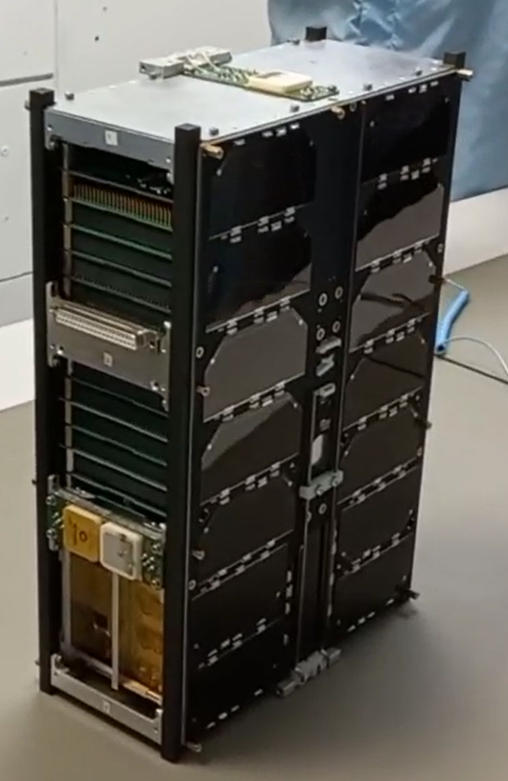
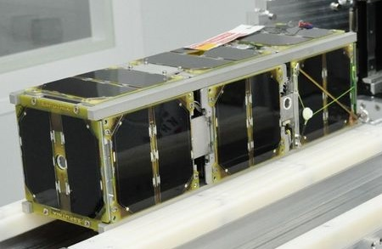
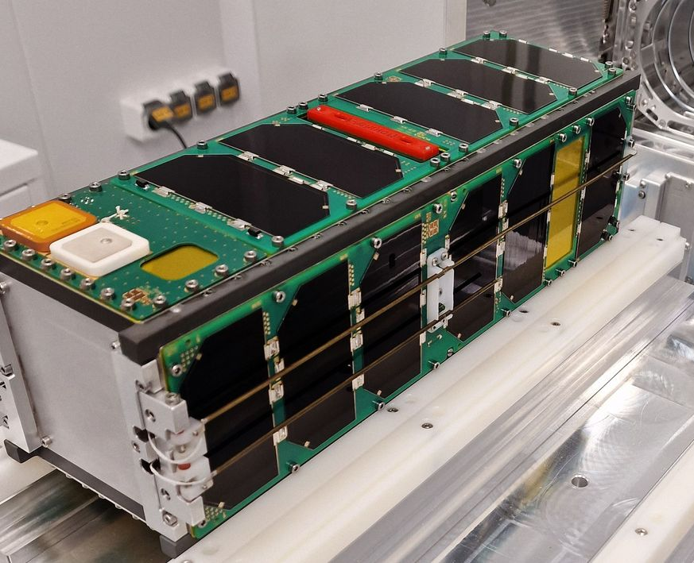
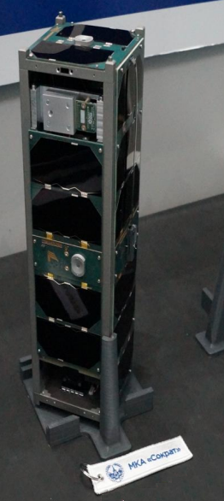
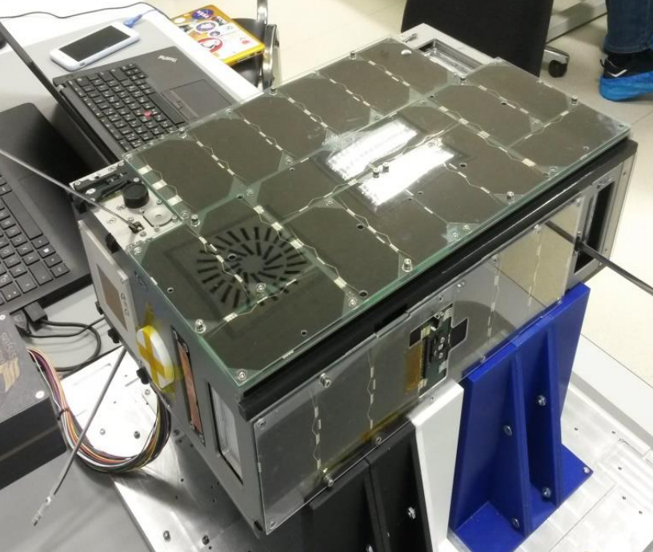
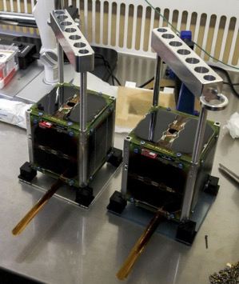
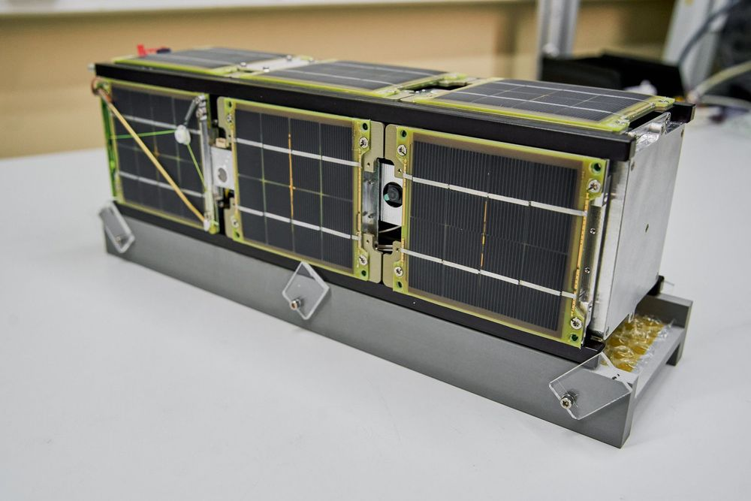
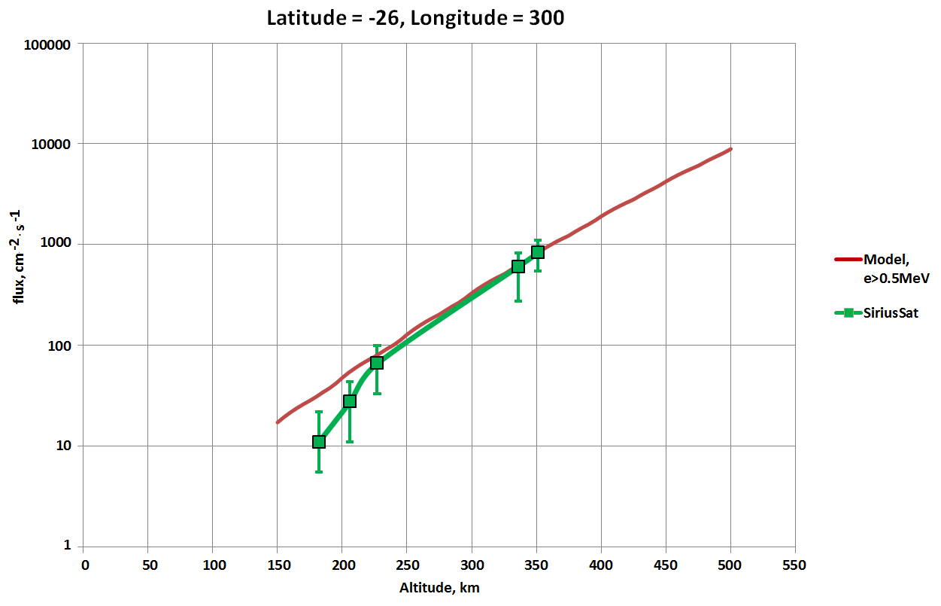
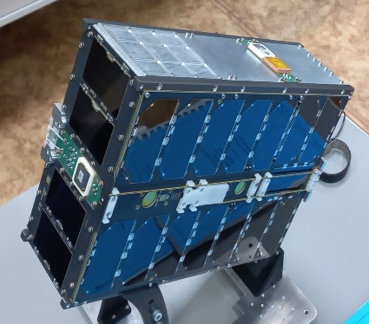
MSU cubesat program Sozvezdie-270
Монитор-2
Monitor-1
Monitor-3
DEKART
Avion
SiriusSat-1,2
SOKRAT
Monitor-4
One of the important results of the MSU cubesate program is the measurement of the radiation level in SAA region at low altitude
Altair

Slide 4
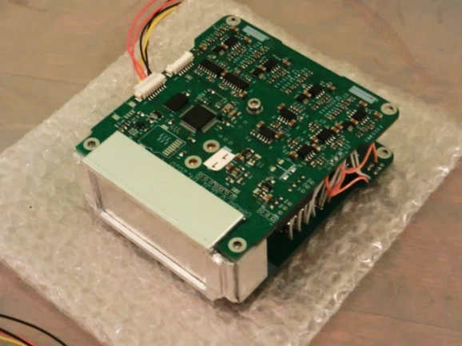
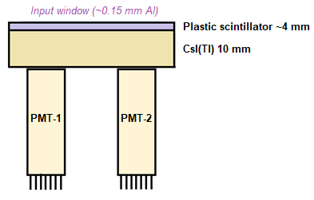
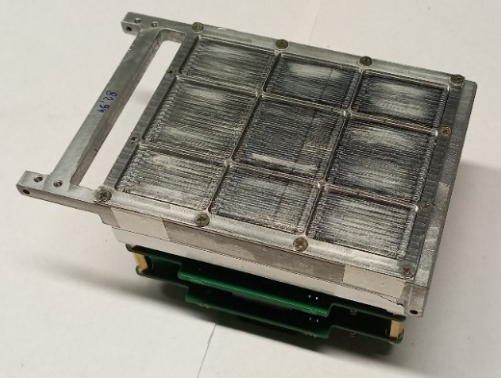
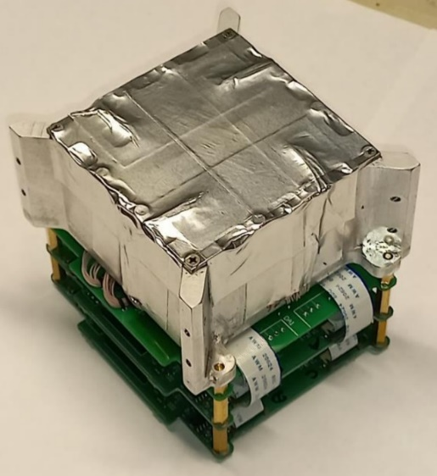
DeCoR instrument family
The DeCoR spectrometer of space radiation was primarily designed to study fast variations of near-Earth electron fluxes as well as bright gamma-ray bursts
Energy range: 0.05-2 MeV
Effective area – 18 cm²
3-axe magnetometer is placed inside the instrument
Size: 99х91х29 mm
Mass: < 480 g
Power consumption: 1.2 W
The cubesats launched in 2023 and 2024 are equipped with large area device DeCoR-2 (two sections with area 32 cm2 each) and DeCoR-3 device based on single large volume crystal (6cm x 6cm x 4 cm CsI(Tl) )
DeCoR-2 and DeCoR-3 devices use SiPM photodetectors

Slide 5
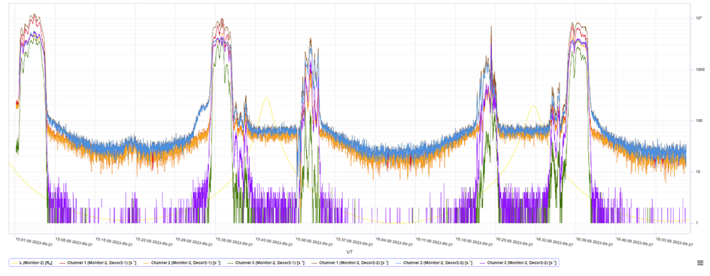
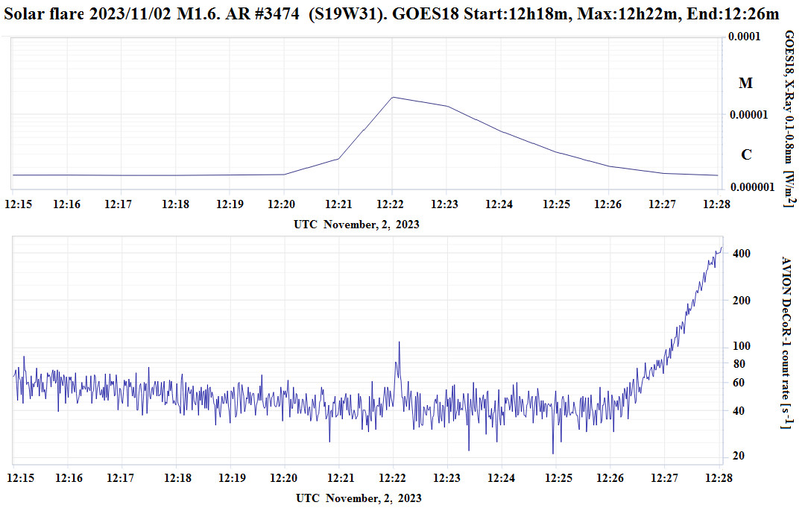
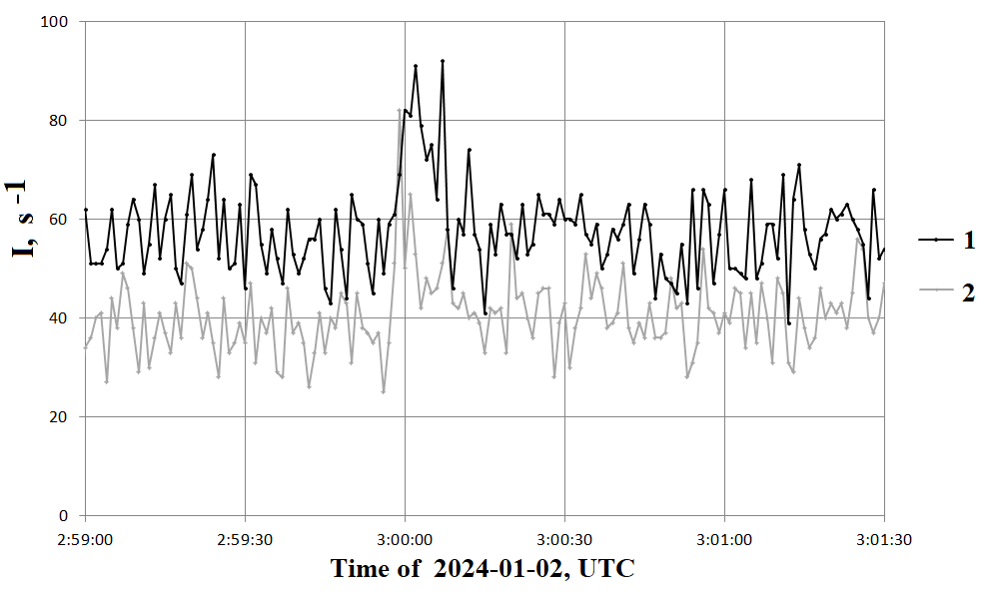
Examples of DeCoR data
Behavior of near-Earth electrons.
Gamma-rays from Solar Flare (M1.6)
GRB-detection

Slide 6
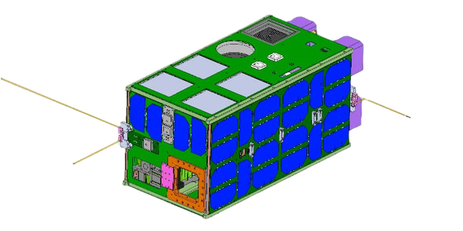
Satellite «Scorpion»
The satellite is scheduled to be launched in December of 2025.
Parameters:
Design cubesate 16U
Platform mass 16 kg
Payload mass 8 kg
Volume for the payload 12U
Mean power for the payload 10 W
Communication Control ~146 MHz, Telemetry~435 MHz,
Scientific data ~2400 MHz
Scientific data transfer rate 500 kbod -2000 kbod

Slide 7
Scientific instruments onboard «Scorpion»
Gamma-ray spectrometer for the study of solar, astrophysical and atmospheric gamma-ray bursts
Spectrometer-photometer for the study of atmospheric UV and optical flashes
The device for registration of charged particles and neutrons
Biocontainer for the study of the behavior of microorganisms under the influence of cosmic factors

Slide 8
Parameters of TGS instrument
Parameter | Value
Type of radiation | Gamma, electrons
Energy range | 50 keV – 10 MeV (can be changed by commands)
Sensitive area | 4 units of 64 cm² each
Mass of one unit | 1000 g
Power consumption | 2.2 W for each unit
Interface | CAN
Day amount of data | 10 Mb from each unit

Slide 9
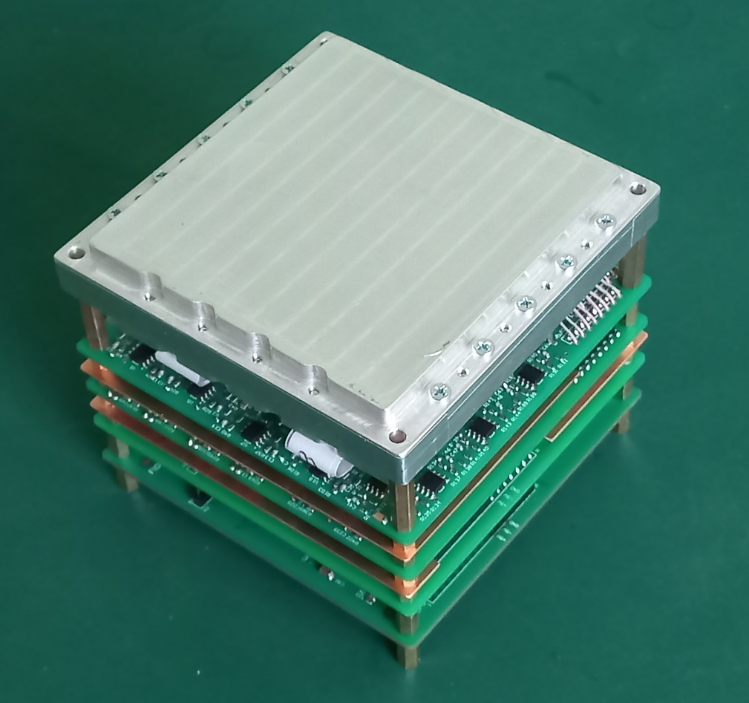
Gamma-ray spectrometer TGS (1 of 4 units)
64 scintillator elements of 2 kinds (GAGG:Ce and plastic) and silicon PMTs (SiPM) are placed in array 8х8
Preamps (32 * 2) that convert a weak current pulse into a voltage pulse
Amplifiers that summarize signals by rows and columns
Two 8-channel ADCs that simultaneously convert analog signals into digital pulses with an amplitude of 1-5 V and a duration of 5 microseconds
An MCU that reads digitized values over a parallel interface and generates output data
Scintillation crystals GAGG:Ce are used as detecting elements having a high density of 6.6 g/cm3, a relatively short illumination time of ~90 ns and an energy resolution of 5%-6% for an energy of 662 keV

Slide 10
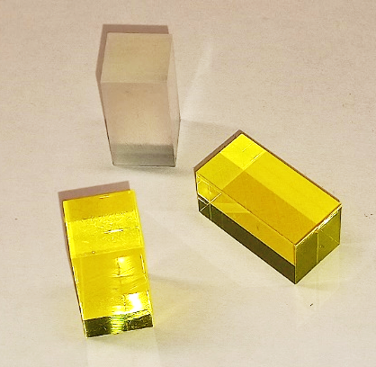
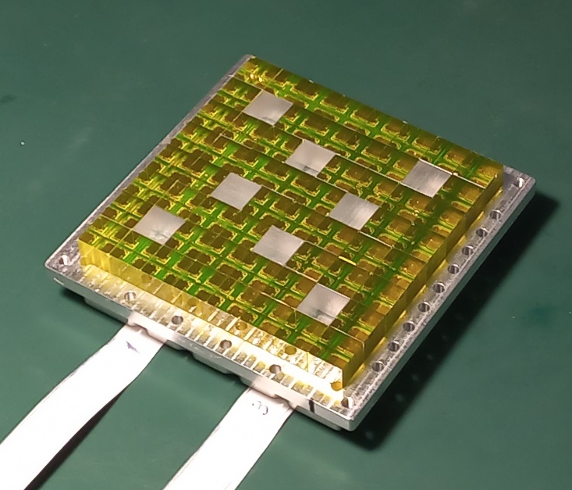
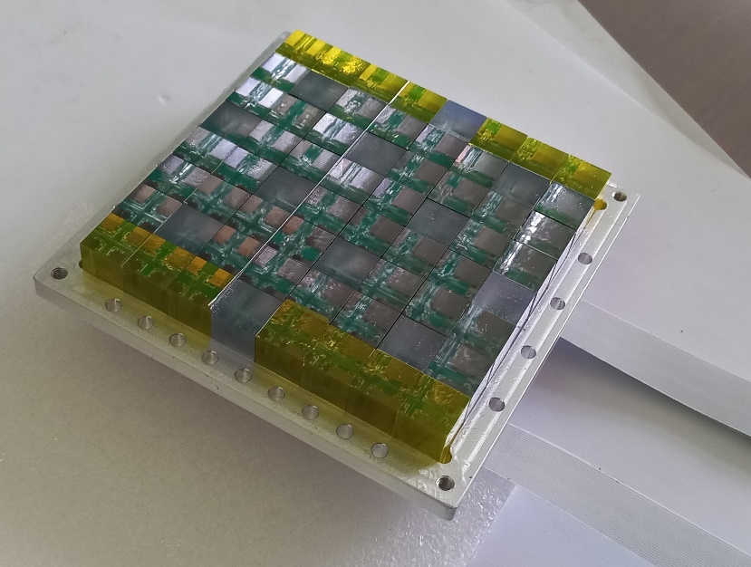
The composition of the TGS
gamma spectrometer
Position sensitive unit based on GAGG:Ce
Position sensitive unit based on YSO
Two “regular” units based on large CsI(Tl) bricks.
Detecting elements made from GAGG:Ce (yellow) and plastic scintillator
Ce:GAGG Detector of TGS position sensitive module №1
YSO/Ce:GAGG Detector of TGS position sensitive module №2

Slide 11
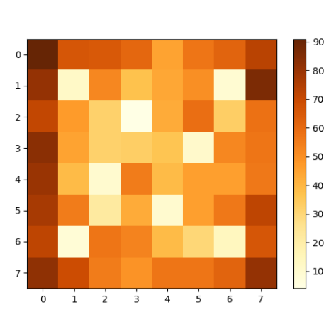
Data of TGS gamma-ray spectrometer
The day amount of data for one TGS device module is 5-10 MB: (there are 4 independent modules in the device)
Two main types of data will be generated:
- Monitoring (counting rate in 8 channels)
- Array (an event-by-event record containing for each act of interaction the exact time (accuracy of 1 microsecond) and a set of amplitudes and coordinates of the brightest pixels)
The expected speed of data generation
of the type ”Monitoring" is 1.3 Mbytes per day
The expected speed of data generation of
the type “Array”:
- At the equator: 1 kbyte per second
- In polar caps: 2-3 kbytes per second
The data will be stored in the device’s memory.
The flash memory capacity of each
module is at least 128 MB
Modeling of the brightness distribution over the surface of the PSD for E=1 MeV and an angle of incidence of 60^{о}

Slide 12
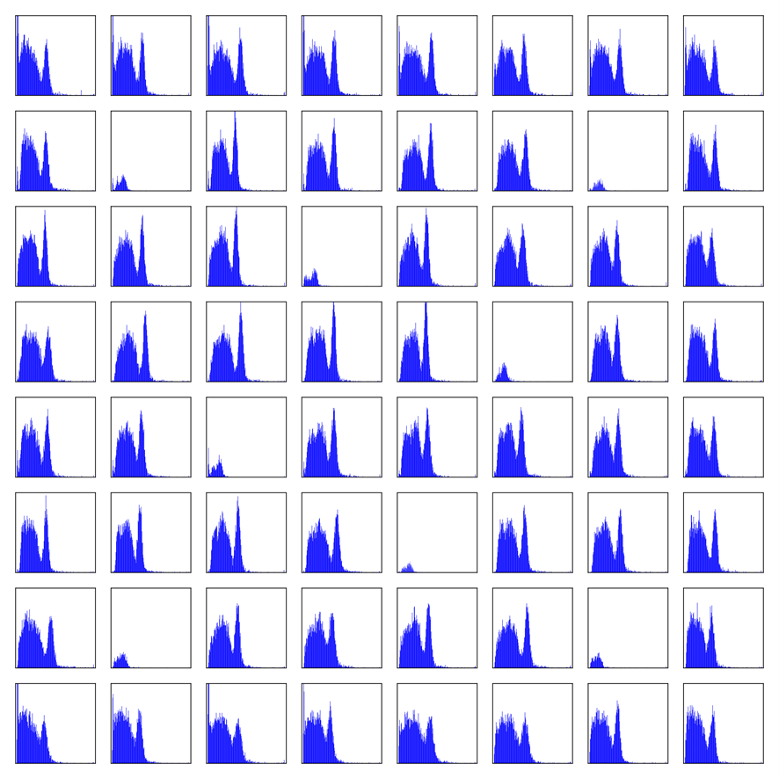
Preflight tests of TGS
Individual spectra of Cs-137 measured by elements of TGS position sensitive module (Ce:GAGG crystals)

Slide 13
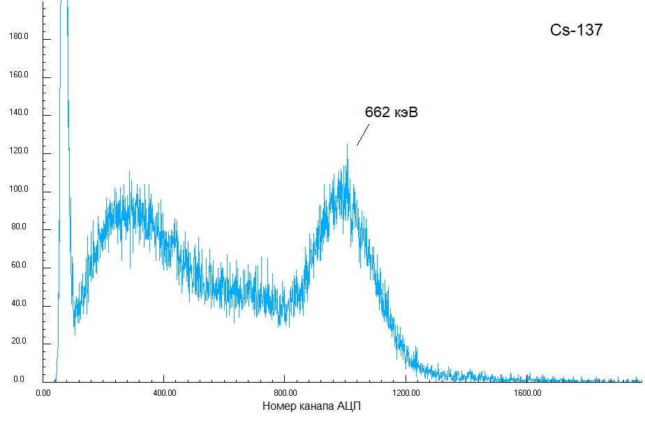
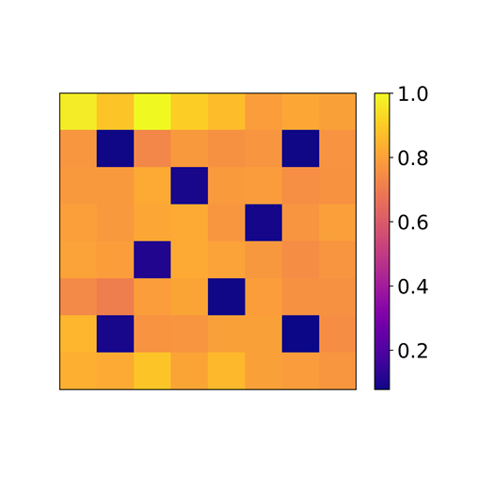
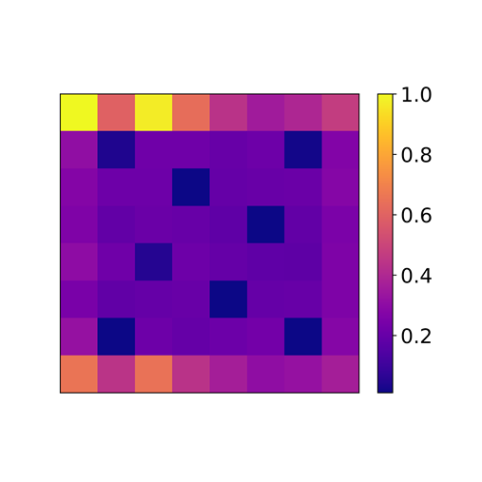
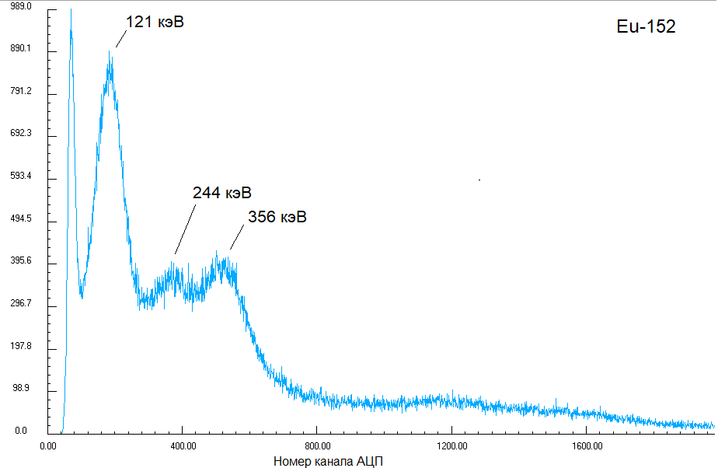
Energy spectra measured with whole TGS module (sum of pixel responses)
Relative amount of events in each detector element
Cs-137
Background
Part of complex events for Cs-137 (threshold energy release 150 keV):
Single ~ 80%
Double ~ 20% Tripple ~ 0.68%

Slide 14
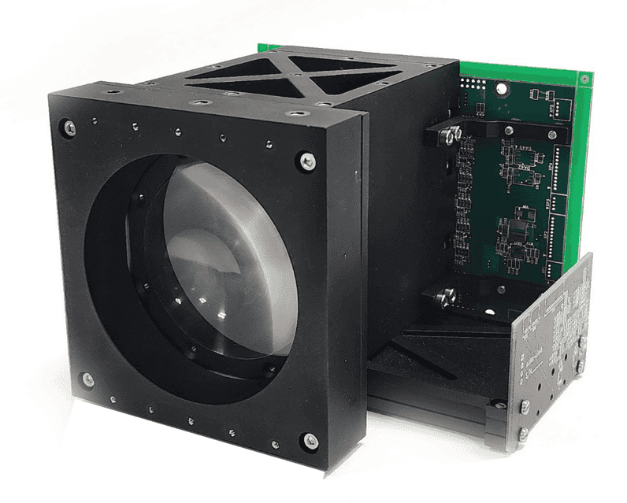
Instrument SONET (System for Optical Observations of Energetic Transients)
SONET scientific equipment is designed to study the space-time dynamics and spectral composition of radiation from transient atmospheric phenomena and lightning discharges from a nanosatellite
The composition of scientific equipment::
The telescope (AURA-T) is a highly sensitive imaging photometer
The spectrometer designed to identify the type and height of the flash
A limbo camera is a pinhole camera aimed at the limb with an angular resolution of 30 mrad.

Slide 15
Characteristics of SONET device
The optical system of the telescope is a Fresnel lens made of PMMA
D = 7,62 cm
F = 8,382 cm
S_{geom} = 45,6 cm²
Time resolution 1 us
Photosensor: matrix of 8х8 SiPM MicroFJ-30035 (3×3 mm)
Angular resolution: 2°
Field of view: 16×16°
Spectrometer: 4 channels
337 ± 10 nm, line N2 – marker of high-atmospheric transients observed from the orbit
390 ± 10 nm, line N2
777 ± 10 nm, line O2 – the characteristic lightning line
760 ± 10 nm, absorption line O2 – marker of high-atmospheric transients observed from the orbit.

Slide 16
Data of SONET device
Data of limb camera in monitoring mode with resolution ~1 s, 6 channels, 4 bytes for each point. Day amount 700 kb
Monitoring data of the telescope and the spectrometer: number of channels 64+4, time resolution 500 ms. Day amount 6 Mb.
High resolution data collected after the trigger: Each event contain - 68 light curves with size of 256 points with 1 us time resolution. One event takes 34 kb. Taking into account the day quota ~20 Mb it can be transferred to ground station about 600 events per day from whole instrument (~13 Мб).

Slide 17
Conclusion
In the end of 2025, it is planned to launch the Scorpion satellite in cubesat 16U format with complex payload from SINP MSU.
TGS instrument is a large area gamma-ray spectrometer with position-sensitive detectors, providing data in both monitoring and event-by-event formats. The program of the space experiment with TGS gamma-spectrometer includes the study of TGF, GRB and solar flares. Preflight tests of TGS confirm its characteristics.
SONET complex of fast optical and UV imaging photometer, spectrometer and limb camera is desigted to study TLE phenomena
The use of all instruments onboard the Scorpion satellite provide the complex research of atmospheric transient phenomena.
This work was supported by MSU Program of Development, Project №24-S01-05., the state assignment of Lomonosov Moscow State University. and RSF grant №23-42-10005

Slide 18
Thank You!

