Slide 1
Solar-Terrestrial Relations and Physics of Earthquake Precursors
XIII International Conference
Disturbances in E and F layers of the ionosphere preceding earthquakes in the Kamchatka region
V.V. Bogdanov, A.V. Pavlov
Institute of cosmophysical research and radio wave propagation FEB RAS, Paratunka, Russia
2023

Slide 2
Introduction
The study of the possibility of predicting earthquakes is an urgent and important scientific task. One of the approaches to its solution is the search for earthquake precursors in such geophysical shells of the Earth as the atmosphere and ionosphere. Such precursors can be useful for short-term (hours-days) forecasts of powerful earthquakes.
It is known that in the sporadic Es layer before earthquakes, in addition to an increase in the limiting reflection frequency, a number of specific effects are noted: sharp jumps in the screening frequency, an increase in the semi transparency range, and the appearance of diffuse reflections [Liperovskaya E.V. et al., 1994; 1 Ondoh T., 2003]. But none of these effects is observed consistently for all earthquakes of a certain class. The analysis carried out in [Korsunova L.P., et al., 2005; Korsunova L.P., Khegai V.V., 2006] showed that several days before an earthquake, sporadic formations appear at much higher altitudes, exceeding the corresponding median values by 10 km or more. In addition, high-lying sporadic layers are usually accompanied by 2-3 hour “bursts” in the deviations of the frequency parameters of the Es and F2 layers during the same daily observation interval. Thus, these features in the changes in the parameters of the ionospheric layers can be attributed to the supposed precursors of upcoming earthquakes.
A more reliable way to identify a possible ionospheric precursor of an earthquake is to analyze the anomalous values of a set of ionospheric parameters. The purpose of this work is to identify ionospheric disturbances in the E and F regions, compare them to the Kamchatka earthquakes for 2012-2022 with magnitudes M≥5.0, and evaluate the predictive efficiency of these ionospheric disturbances.

Slide 3
Anomalous temporal variations of the following ionospheric parameters will be considered as possible earthquake precursors:
h'Es is the smallest virtual height of the sporadic layer Es for an ordinary wave;
foEs is the limiting frequency of the ordinary wave of the sporadic Es-layer of the ionosphere;
fbEs is the screening frequency of the ordinary wave of the sporadic Es-layer of the ionosphere;
foF2 is the critical frequency of the ordinary wave of the F2-layer of the ionosphere;
h'F is the minimum virtual height of the ordinary wave reflection trail for the F region of the ionosphere.
Hourly values of ionospheric parameters were obtained in the course of radiophysical observations performed by means of vertical radio sounding of the ionosphere. Automatic ionospheric station (AIS) for vertical radio sounding "Parus-A" is located in the village Paratunka (φ=52.97°N, λ=158.24°E).
Accounting for the level of geomagnetic activity was carried out according to the values of K-indices measured at the complex geophysical observatory (GPhO) "Paratunka“.

Slide 4
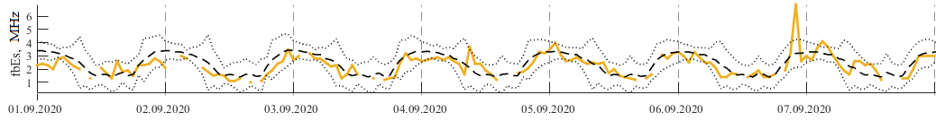
To determine seismoionospheric effects in diurnal variations of ionospheric parameters, it is necessary to obtain background distributions. Also, when analyzing variations in the ionosphere, an important role is played by the presence or absence in the considered period of time of significant geomagnetic disturbances that can affect the ionosphere.
For each moment of the day of each ionospheric parameter Y(t_{i}) on the previous interval of duration T_{med}=30 days, the median Y_{med}(t_{i}) was calculated. At the same time, magnetically quiet days were chosen as the background, and the median was calculated only for days in which the values of the geomagnetic index were K≤2 in all three hourly intervals. To determine the measure of deviation from a quiet background distribution, the parameters of interquartile changes were used:
К± =Y_{med}(t_{i}) ± 1.5IQR
where Y_{med}(t_{i}) is the median calculated for selected magnetically quiet days,
IQR is the difference between the upper and lower quartiles.
The value of Y(t_{i}) under the influence of various random factors should fluctuate within the specified boundaries of K± with a probability of 95%, or, on the other hand, the probability that the values go beyond the boundaries of the K± band is due to purely random factors is only 5%. Values Y(t_{i}) outside the “noise” bands were referred to as anomalous values if the duration of such a disturbance in time was at least one and a half hours (taking into account the averaging over three points).
Figure 1. Time series of values of ionospheric parameter fbEs, their median values (dashed lines) and boundaries of the background range of values (dotted lines) for the time interval 01.09.2020-08.09.2020.

Slide 5
Reliability and validity of the earthquakes precursor
N₊ ‒ the number of earthquakes for which the precursor was identified;
N ‒ total number of earthquakes that occurred.
‒ the number of precursor anomalies;
‒ the total number of identified anomalies.
Evaluation of the efficiency of the precursor using the method of A.A. Gusev
N₊ ‒ the number of earthquakes for which the precursor was identified;
N ‒ total number of earthquakes that occurred;
T_{alarm} ‒ total waiting time (alarms);
T ‒ total observation time.
Evaluation of the efficiency of the precursor using the method of G.M. Molchan
‒ alarm measure.
‒ the share of the misses of the target.

Slide 6
Table 1. Predictive efficiency of anomalous values of ionospheric parameters for earthquakes with magnitude M≥5.0, h≤100 km, R=1000 km, T=2012‒2022.
Ionospheric parameter | h'Es | foEs | fbEs | foF2 | h'F
T_{exp} (day) | 2.12±2.42 | 2.55±2.67 | 2.19±2.48 | 3.23±3.2 | 3.18±3.2
N₊ | 436 | 390 | 439 | 371 | 390
N | 668 | 668 | 668 | 668 | 668
n(A_{E}) | 309 | 258 | 302 | 218 | 224
n(A) | 1424 | 1081 | 1488 | 737 | 795
R | 0.65 | 0.58 | 0.65 | 0.56 | 0.58
V | 0.21 | 0.24 | 0.2 | 0.3 | 0.28
J_{G} | 1.16 | 1.16 | 1.17 | 1.2 | 1.29
τ | 0.56 | 0.5 | 0.56 | 0.46 | 0.45
ν | 0.35 | 0.42 | 0.34 | 0.45 | 0.41
J_{M} | 0.09 | 0.08 | 0.09 | 0.09 | 0.13
The values of the predictive efficiency J_{G} for the studied ionospheric parameters are greater than 1 and are in the range from 1.16 to 1.29. This indicates a connection between these prognostic parameters and earthquakes with M≥5.0. It follows from this that the forecast made on the basis of these ionospheric parameters is not accidental. The forecast reliability R (the relative number of predicted earthquakes) according to these parameters is in the range from 0.56 to 0.65. At the same time, these prognostic anomalies do not have a sufficiently high veracity V (the relative number of anomalies after which an earthquake occurred), which takes values from 0.2 to 0.3.

Slide 7
The method for identifying a possible ionospheric precursor of earthquakes with M≥5.0 based on a set of prognostic parameters was built according to the following procedure:
On the time interval T, anomalous values h'Es with a duration of ∆t≥1.5 hours are identified, which go beyond the background values of K±.
Deviations with a duration ∆t≥1.5 hours of additional ionospheric parameters foEs, fbEs, foF2 and h'F from the boundaries of their background K± ranges are determined within the daily time interval ∆T (±12 hours relative to the moment of occurrence of anomalous h'Es values).
The group of ionospheric parameters was considered as a possible short-term ionospheric precursor of earthquakes with magnitude M≥5.0 if low geomagnetic activity was observed in the daily time interval ∆Т (all three-hour values of the geomagnetic index were K≤2) and at least three of the four additional parameters were anomalous deviations of their values from the boundaries of the background range K± were found.

Slide 8
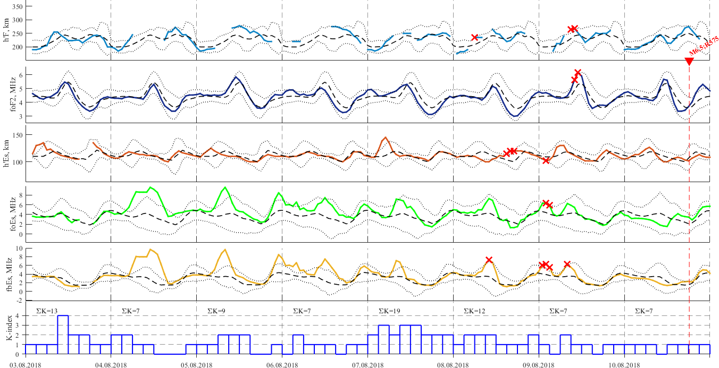
Figure 1. Time series of values of ionospheric parameters foEs, fbEs, h'Es, foF2, h'F, their median values (dashed lines) and boundaries of the background range of values (dotted lines) for the time interval 01.08.2018-11.08.2018. Identified anomalies are marked with a red 'x' marker. The earthquake with magnitude M=6.5 that occurred on 10.08.2018 18:12:03 (UT) with epicenter coordinates φ=48.15° N, λ=155.27° E, magnitude M=6.5, hypocenter depth h=60 km, and epicentral distance r=575 km to the location of the station for vertical radio sounding of the ionosphere is marked on the time axis with a red triangle.

Slide 9
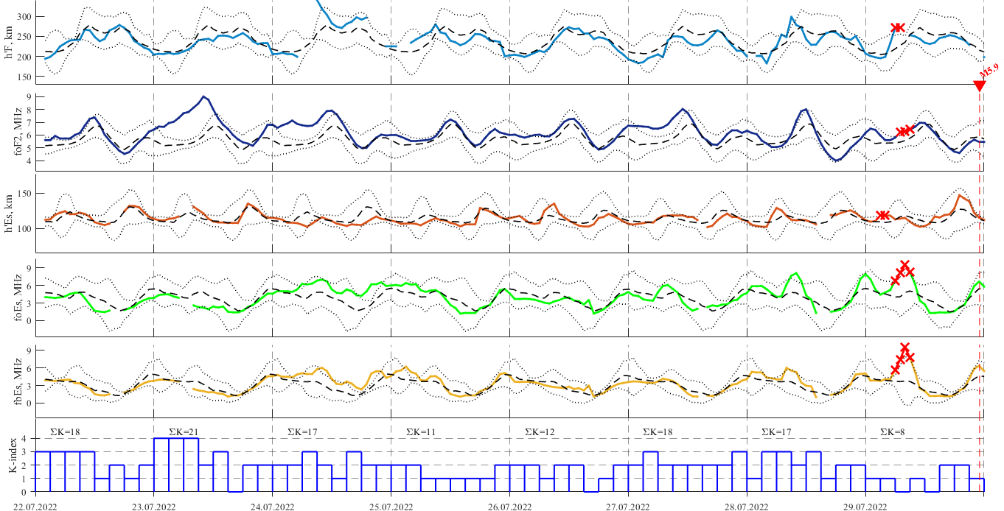
Figure 2. Time series of values of ionospheric parameters foEs, fbEs, h'Es, foF2, h'F, their median values (dashed lines) and boundaries of the background range of values (dotted lines) for the time interval 22.07.20202-29.07.2022. Identified anomalies are marked with a red 'x' marker. The earthquake with magnitude M=5.9 that occurred on 29.07.2022 23:05:43 (UT) with epicenter coordinates φ=51.2°N, λ=161.03° E, magnitude M=5.9, hypocenter depth h=68.9 km and epicentral distance r=273 km to the location of the ionospheric station is marked on the time axis with a red triangle.

Slide 10
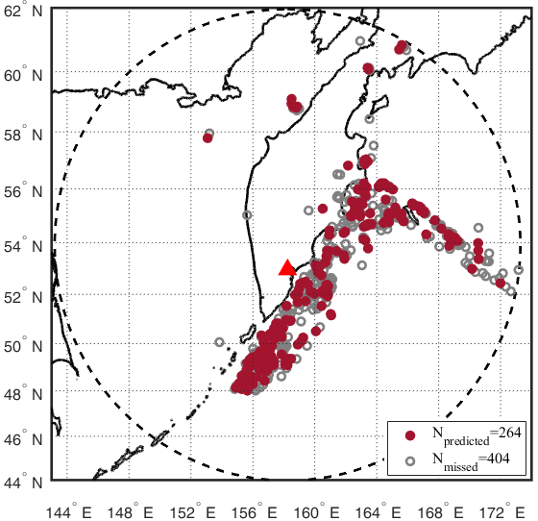
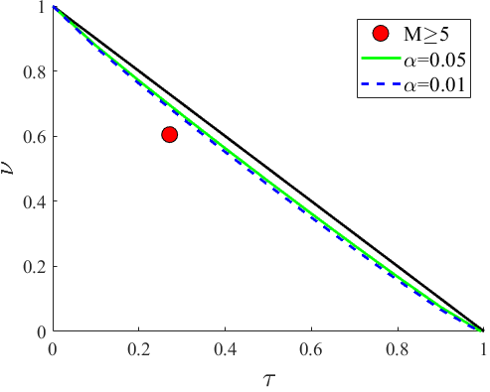
Table 2. Predictive efficiency of the complex of ionospheric precursors of earthquakes with magnitude M≥5.0, h≤100 km, R=1000 km, T=2012‒2022.
T_{exp},( day) | N₊ | N | n(A_{E}) | n(A) | R | V | J_{G} | τ | ν | J_{M}
3.85±3.54 | 264 | 668 | 136 | 265 | 0.4 | 0.51 | 1.46 | 0.27 | 0.6 | 0.124
Figure 4. Diagram of errors for the method of identifying a possible precursor of earthquakes with magnitude M≥5.0 based on a complex of ionospheric predictive parameters. Confidence intervals are constructed for significance levels α=0.01 and α=0.05.
Figure 5. Location of earthquake epicenters
with magnitude M≥5.0

Slide 11
Conclusion
Anomalies in the ionospheric parameters h'Es, foEs, fbEs, foF2 and h'F, which can be considered as possible earthquake precursors, have been identified. The predictive efficiency of each parameter was evaluated separately for earthquakes with magnitude M≥5.0 that occurred in the Kamchatka region for the period 2012-2022 at epicentral distances up to 1000 km from the ionospheric observation point. It was found that the predictive efficiency J_{G}>1 (i.e. differs from random guessing), but the veracity V of each prognostic parameter is not very high and takes values from 0.2 to 0.3.
A retrospective analysis of the reliability and veracity of the methodology for predicting earthquakes with M≥5.0 based on a complex of ionospheric parameters showed that 40% of earthquakes were preceded by a complex of ionospheric disturbances, while seismic events of the considered energy range occurred within 3.85±3.54 days after 51% of the detected anomalies. An analysis of the predictive efficiency of complex of ionospheric parameters showed that the prediction of earthquakes with a magnitude of M≥5.0 differs from random guessing. The use of a complex of ionospheric prognostic parameters makes it possible to increase the efficiency of the J_{G} forecast and reduce the number of false alarms.
Further work related to the identification of ionospheric precursors and improving the reliability, veracity and efficiency of short-term earthquake prediction with M≥5.0 in the Kamchatka region on the basis of the proposed approach can be carried out both by introducing additional criteria for the for the prognostic parameters, and by involving other ionospheric parameters, which could be considered as the precursors of earthquakes.

Slide 12
Thank you!

