Slide 1

МONITORING OF RADIATION FIELDS IN NEAR-EARTH SPACE WITH THE USE OF KODIZ INSTRUMENT ON-BOARD CUBESAT MONITOR-1
Paratunka 2023

Slide 2
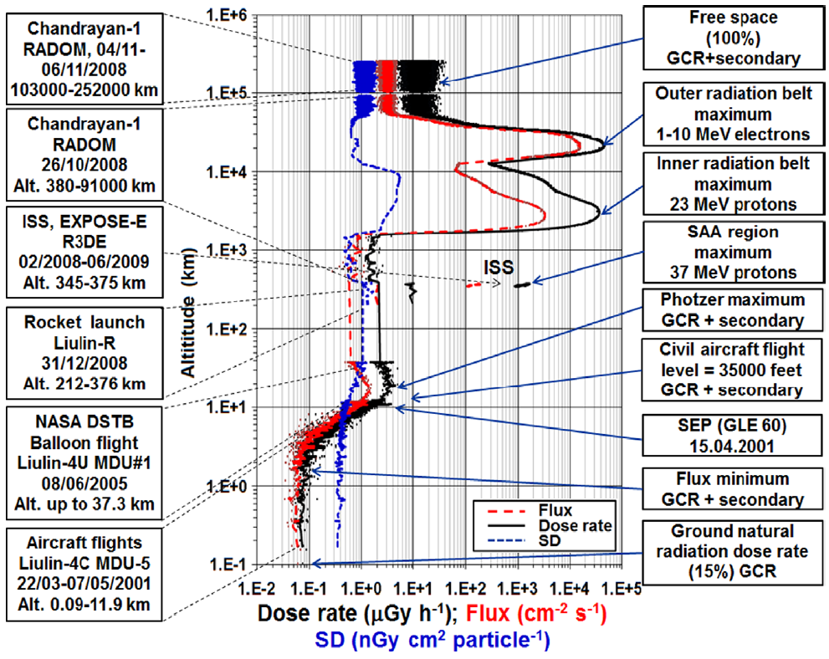
The relevance of research
The presence of potential radiation effects from fluxes of high-energy SCR protons for the equipment and crews of airliners flying along circumpolar routes
Dose rate at an altitude of 10.67 km:
Quiet period: 1.62 µGy/h
During SPS: 3.66 µGy/h
T.P. Dachev / Journal of Atmospheric and
Solar-Terrestrial Physics 102 (2013) 148–156

Slide 3

Object of study

Slide 4
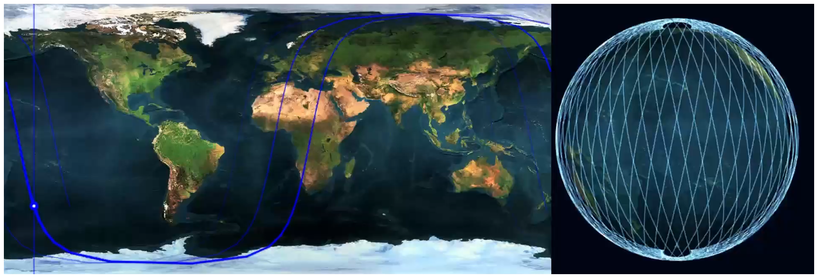
Nanosatellite MONITOR-1
Launched on August 9, 2022 on the Soyuz-2.1b
Altitude 500 km, inclination 97.4°, orbital period 94.4 minutes
CubeSat 3U mass 2.84 kg (platform 2.09 kg, device 0.75 kg)

Slide 5
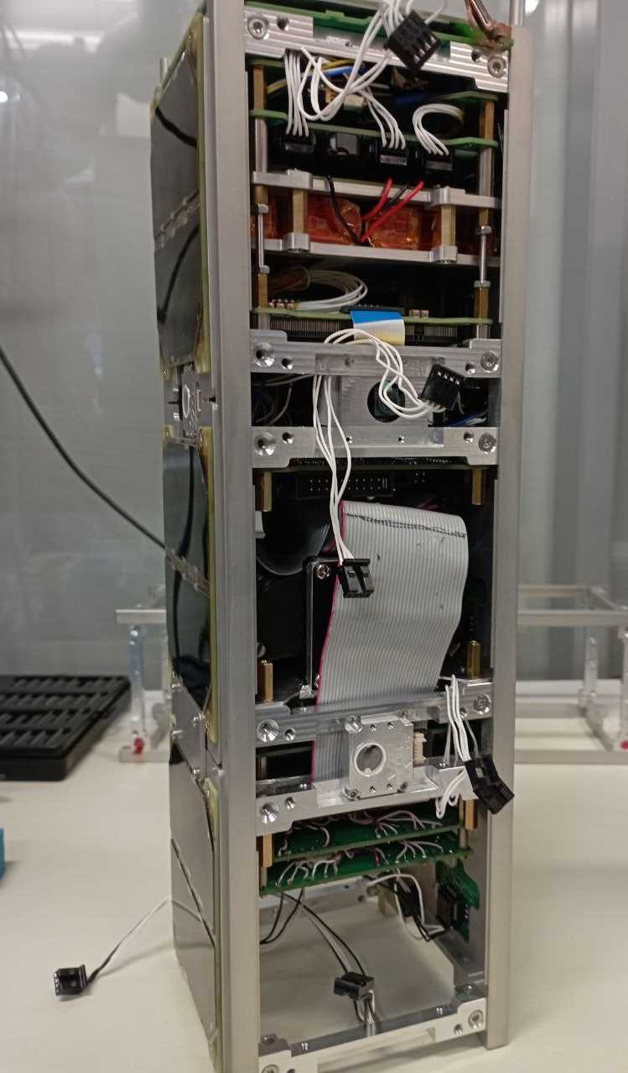
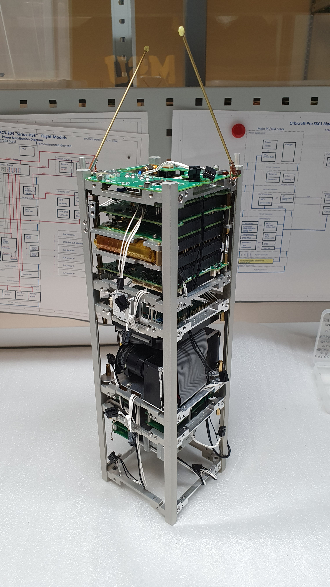
Structure of the MONITOR-1 spacecraft
Antennas for receiving and transmitting information
Spacecraft service control unit
Digital processing unit
Detector unit No. 1 (PMT and SiPM)
Detector unit No. 2 (P/P detectors)

Slide 6
Tasks of the KODIZ device
Target task of the device:
Providing information sufficient to detect large increases in SCR proton fluxes, which can significantly increase the dose rate on board aircraft compared to the background created by GCR.
Fluxes of protons and nuclei with Z>1 with energy greater than 320 MeV/nucleon
Fluxes of protons and nuclei with Z>1 with energy greater than 30 – 50 MeV/nucleon
Additional task:
Development of technical means for recording cosmic radiation, suitable for use on small spacecraft, under real space flight conditions.
Using a SiPM detector to record a Cherenkov flash
Registration of the absorbed dose rate of charged particles
Registration of neutron fluxes using lithium glasses

Slide 7
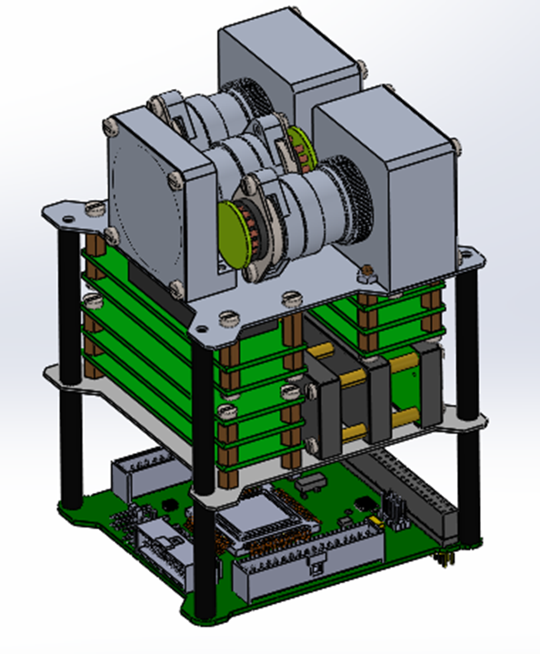
Scheme of arrangement of units
of the KODIZ device
The top board is for PMT detectors
the middle board is for semiconductor detectors
the bottom board is for digital processing

Slide 8
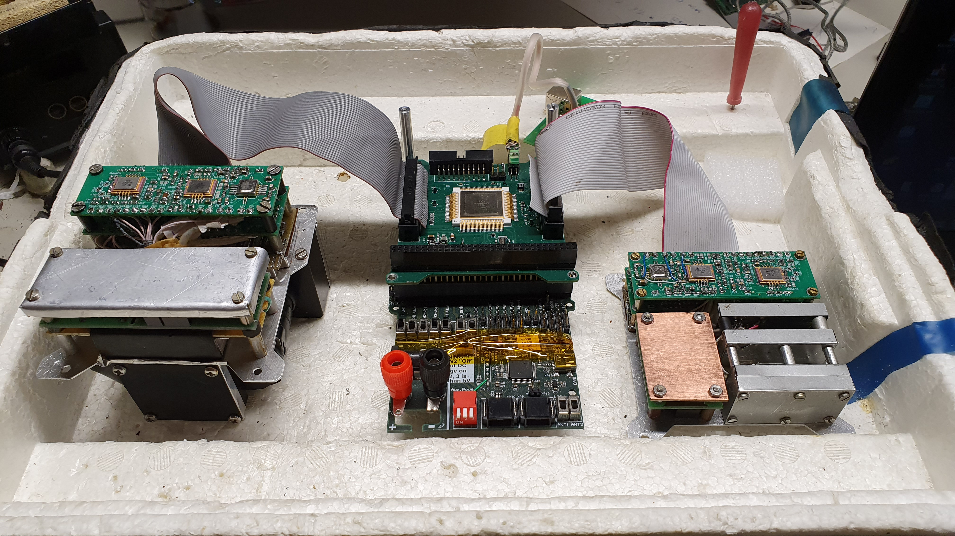
Structure of the KODIZ device (photo)
Detector node No. 1
Cherenkov detector (PMT and SiPM)
Two neutron detectors
Detector signal amplifiers and pulse shapers
Power supply
Detector node No. 2
Two semiconductor detectors
Scintillation CsI detector with SiPM
Detector signal amplifiers and pulse shapers
Power supply
Digital processing unit
Microcontroller Milandr 1986BE93U
Set of comparators

Slide 9
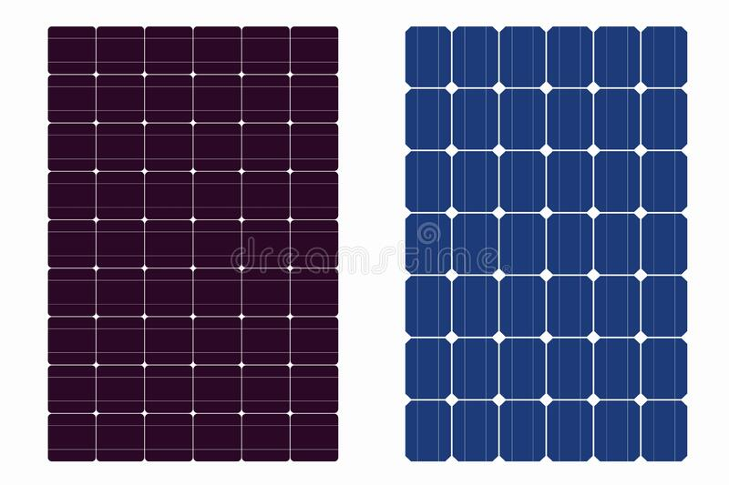
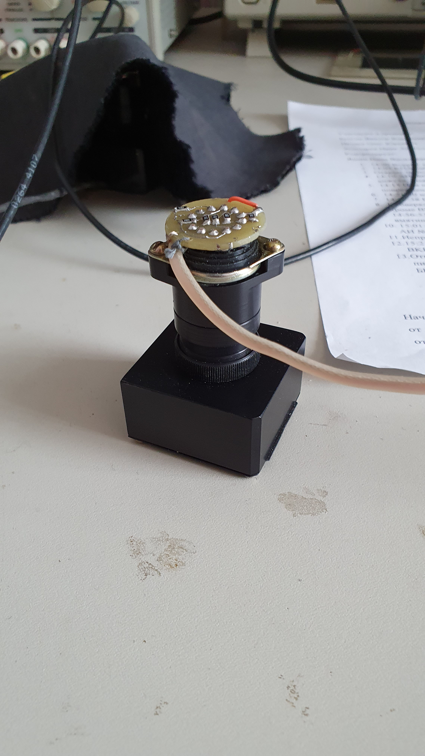
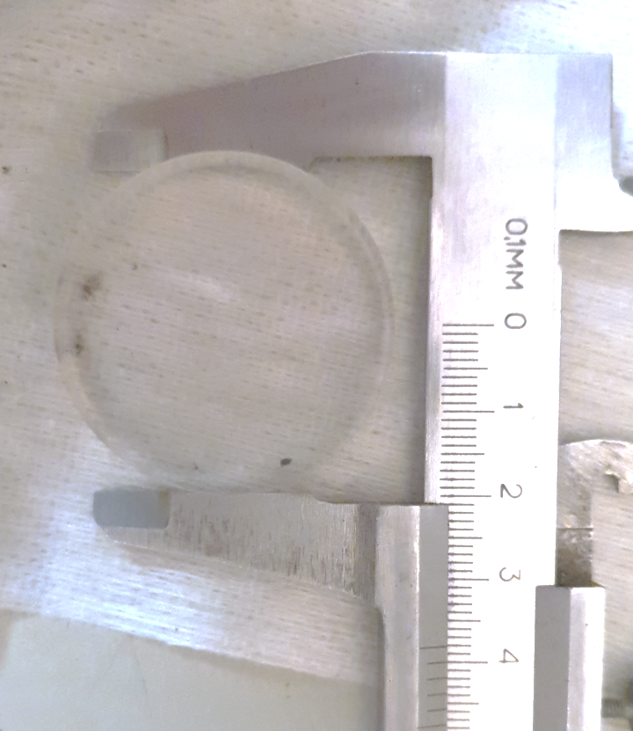

Cherenkov detector
Чувствительный объем:
Оргстекло n~1.5, энергетический порог $E_{p}=320 МэВ, E_{e}=175 кэВ$, диаметр 38 мм толщина 20 мм
Светосбор излучения:
ФЭУ Hamamatsu R5611A
SiPM
Солн.
панель
Чувствит.
объем
p⁺
ФЭУ
Hamamatsu
SiPM

Slide 10
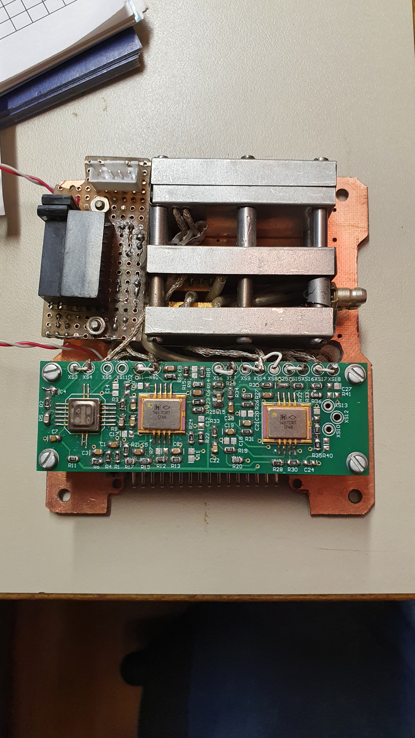
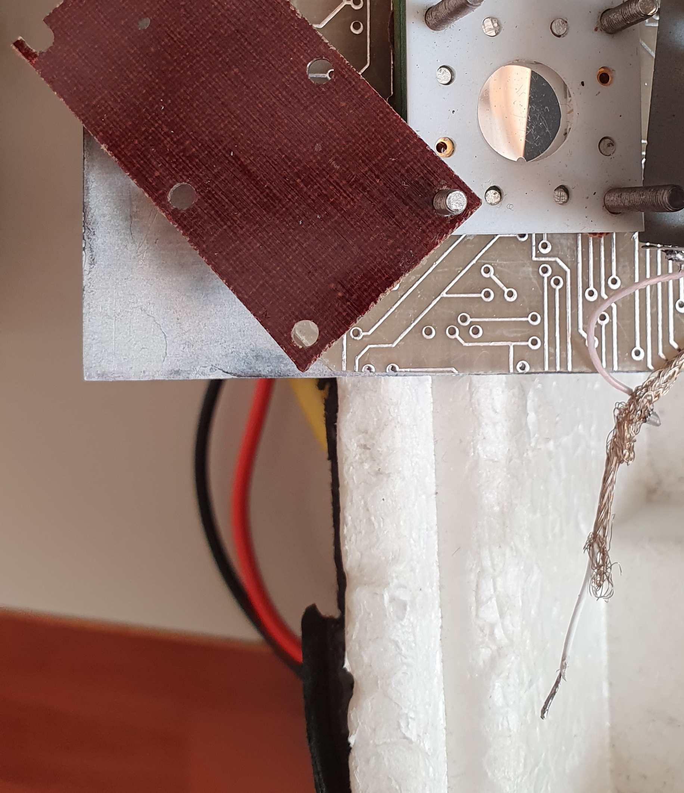

Semiconductor detector
Чувствительный объем:
Два кремниевых полупроводниковых детектора с ионной имплантацией, толщина 0,3 мм площадь 1 см²
Разрешение:
Энергетическое $\sim 0,03\frac{МэВ}{канал}$, поглощенная доза $\sim 70\frac{нГр}{импульс}$
Чувствит.
объем
Чувствит.
объем
p⁺

Slide 11
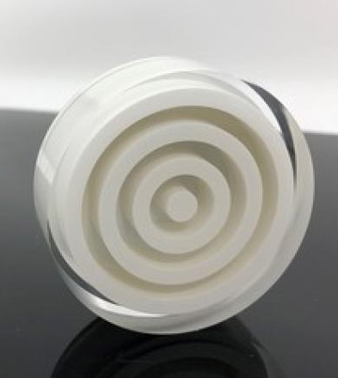
Neutron detectors
Чувствительный объем:
Сцинтиллятор тепловых нейтронов BC-702 – матрица из литиевого компаунда, обогащенного до 95% ₆Li, растворенного в чистом фосфорном порошке на основе ZnS(Ag); диаметр 38 мм, толщина 6,35 мм
Сцинтиллятор быстрых нейтронов BC-720 – люминофор ZnS(Ag), заключенный в водородсодержащий пластик; диаметр 38 мм толщина 15,9 мм
Светосбор излучения:
ФЭУ Hamamatsu R5611A
Солн.
панель
Чувствит.
объем
n⁰
ФЭУ
Hamamatsu

Slide 12
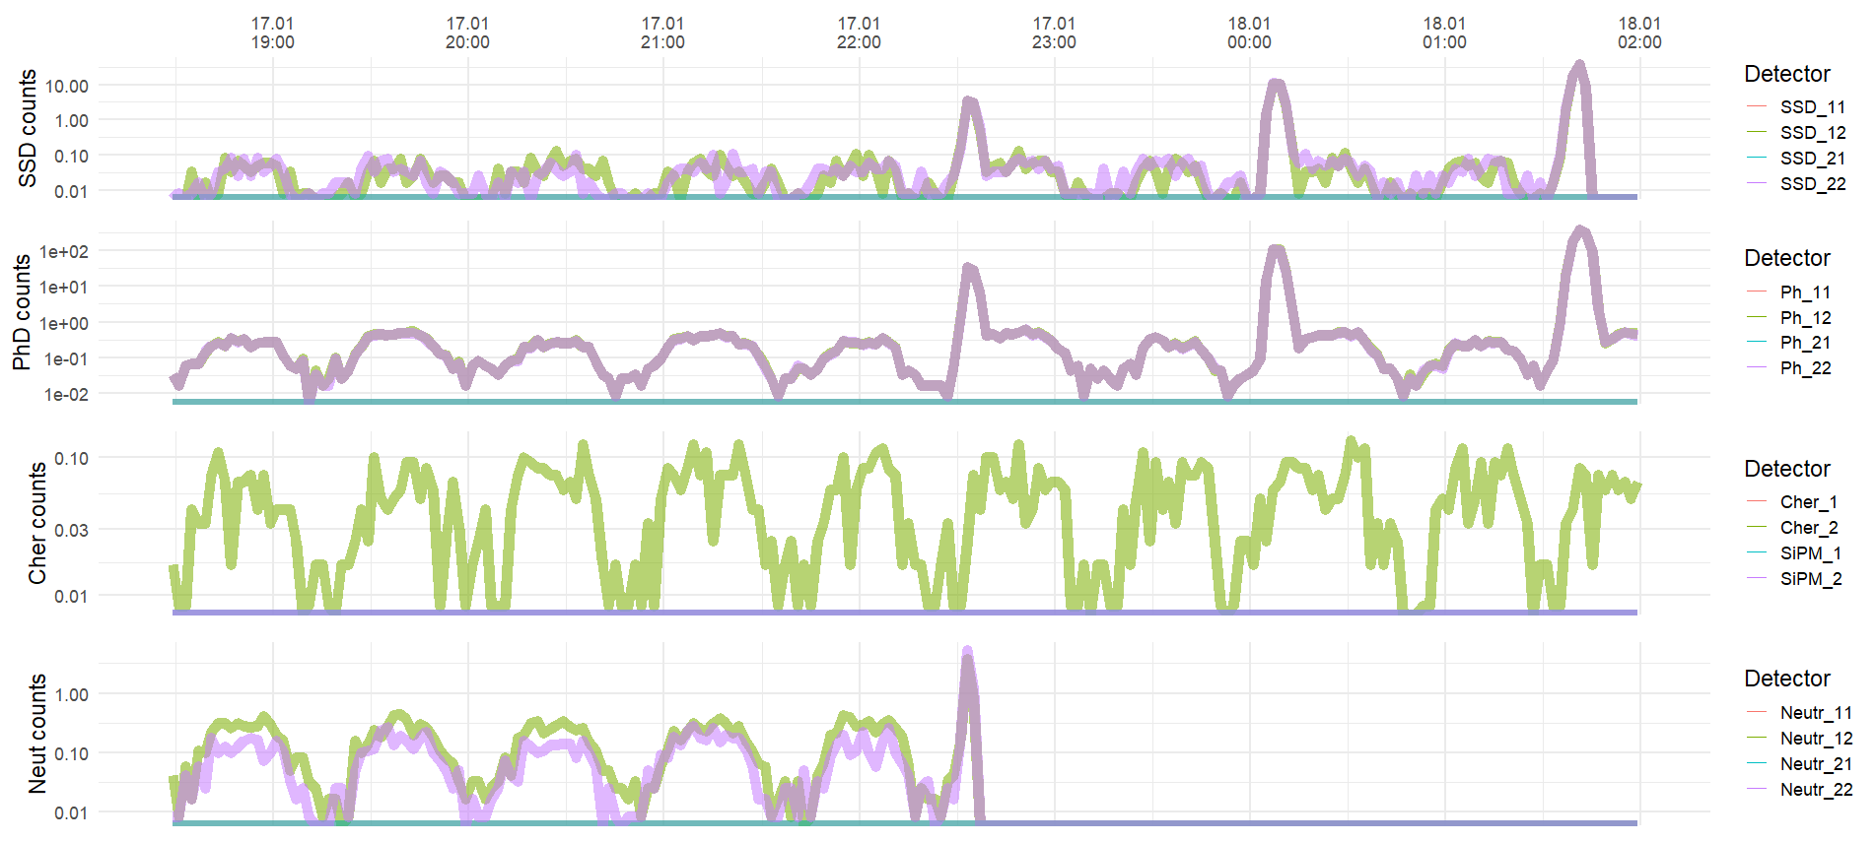
Evaluation of the performance of the KODIZ device in flight conditions
Example of a change in the count rate of detectors over time
the top panel presents data from semiconductor detectors
the second panel shows data from photoconverters of a scintillation detector
the third panel shows data from a Cherenkov detector obtained using a PMT
the bottom panel shows data from neutron detectors.

Slide 13
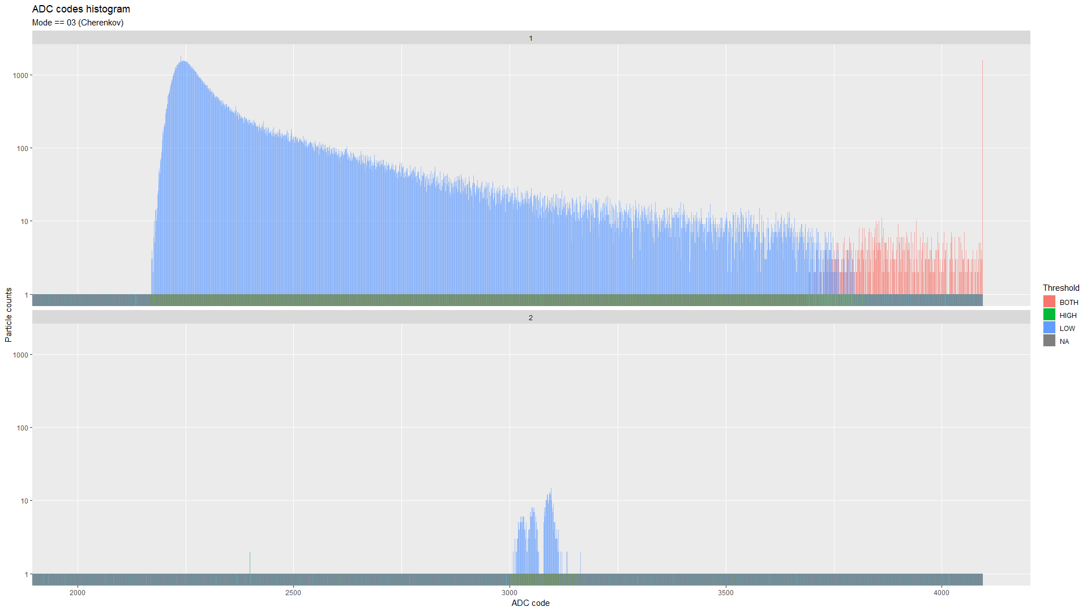
Evaluation of the performance of the KODIZ device in flight conditions
Amplitude spectrum of signals from the Cherenkov detector:
the top panel is the spectrum of signals from the PMT
the bottom panel is the spectrum of signals from the SiPM.

Slide 14
Conclusions
Developed, manufactured and integrated into the microsatellite of the Cubesat type, the KODIZ device, designed to develop methods for monitoring the radiation situation in low Earth orbit. After the launch on August 9, 2022, the device successfully operates as part of the Monitor-1 microsatellite.

Slide 15
This work was done with the support of MSU Program of Development, Project No 23-SCH01-02
THANK YOU

