Slide 1


Advanced Instruments for Geo and Helio Environment Monitoring on the Cubesat Format Spacecraft
V.V. Bogomolov^{1,2}, S.I. Svertilov^{1,2}, V.I. Оsedlo¹, V.V. Bengin¹,
I.А. Zolotarev¹, A.F. Iyudin¹, O.Yu. Nechaev¹, I.V. Yashin¹,
G.I. Antonyuk¹, I.А. Kucherenko^{1,2}, Mikhail Korzhik³
(1) - М.V. Lomonosov Moscow State University, D.V. Skobel’tsyn Institute
of Nuclear Physics
(2) - M.V. Lomonosov Moscow State University, Physical Department
(3) - Institute for Nuclear Problems of Belarusian State University
Paratunka, 25-28.09.2023

Slide 2
Space program of M.V.Lomonosov Moscow State University
A lot of space phenomena are studied by MSU scientists and students:
Cosmic rays
Solar activity
Gamma ray bursts
Light transients in high atmosphere
Space weather

Slide 3
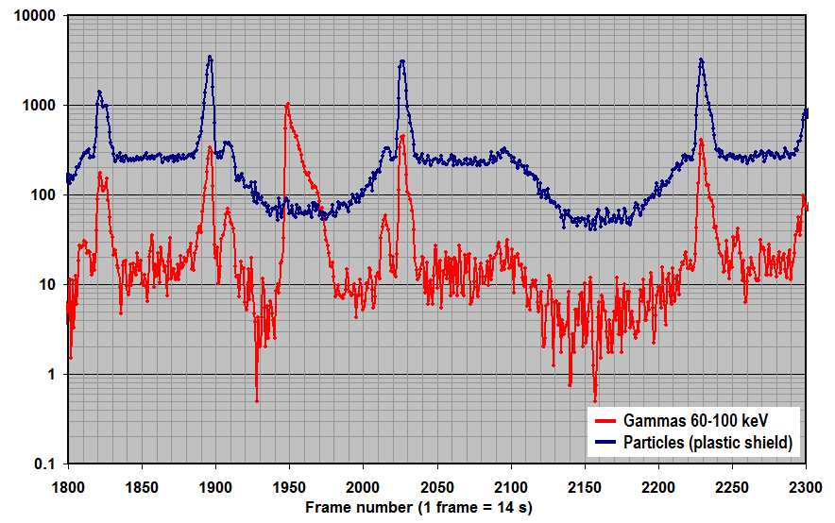
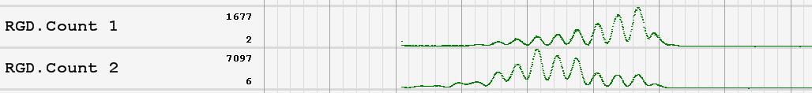
What factors one must take into account while studying transient and variable sources in low-orbit experiment
One must distinguish between the increases of detector readings appearing when the satellite passes through some regions of trapped radiation and the real temporal phenomena
Example of time sequences of the readings in x-ray and particle channels (SPRN / CORONAS-F)
Gamma-ray bursts and electron precipitations must be also separated
Radiation
belt
Solar
flare
Example of modulation of the detector readings by the satellite rotation (RGD/Chibis data)

Slide 4
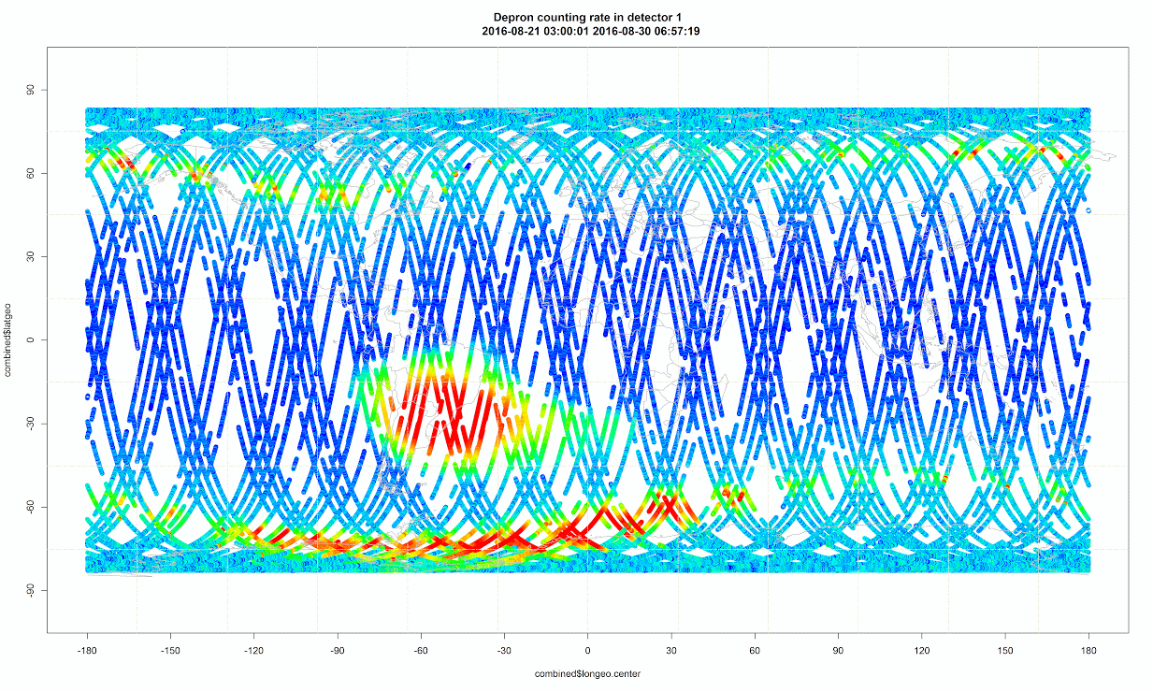
What map will obtain the device measuring the radiation fluxes on low orbit
Geographical distribution of charged particle fluxes
measured on low orbit.
(from DEPRON / Lomonosov data)
Inner radiation belt
Outer radiation belt

Slide 5
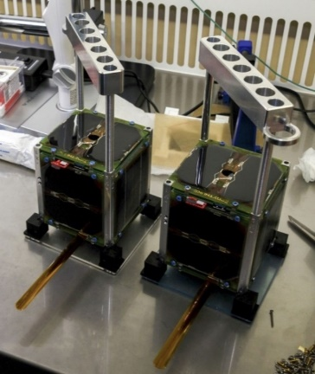
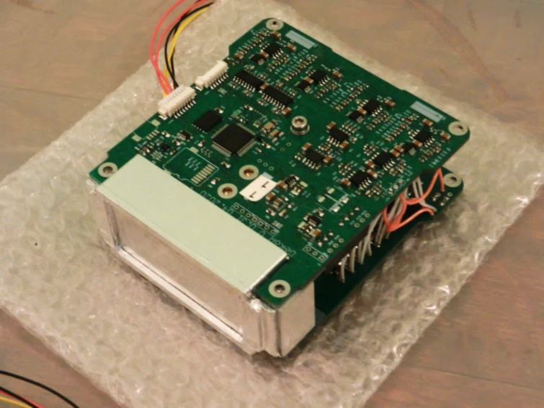
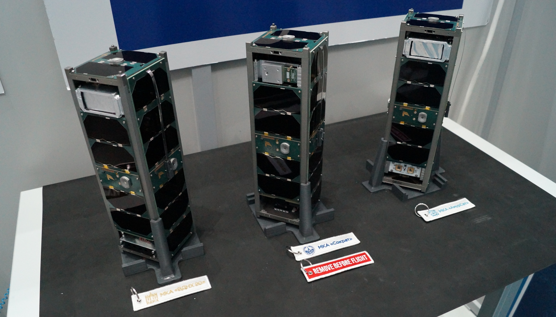
CubeSat program of MSU
In 2018, the SiriusSat-1 and SiriusSat-2 satellites in the 1U+ CubeSat format with multilayer scintillation detector onboard were launched from the International Space Station.
Similar detectors with increased area were installed on a number of scientific and educational small spacecraft launched into low polar orbit in 2019 (VDNH-80, AmurSat, both CubeSats 3U) and in 2020 (Norby, Descartes, both CubeSats 6U)

Slide 6
Principles of the gamma-ray and electron detector design
Scintillation detector with enough sensitive area: not less than 50 см². Optimal value >100 см²
Combination of plastic scintillator and crystal one for separate registration of gamma-quanta and electrons on the Earth orbit
Storage of the collected data in the internal memory of the device. The stored data can be transferred after the correspondent request command.
Combination of monitoring and event-by-event data

Slide 7

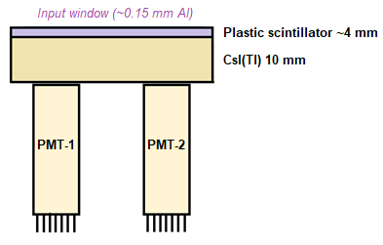
DeCoR instrument
The DeCoR spectrometer of space radiation is primarily designed to study fast variations of near-Earth electron fluxes such as micro-bursts observed in the experiment on the FIREBIRD-II satellite
Detector: combination of ~4 mm of plastic
scintillator and ~10 mm of CsI(Tl)
Energy range: 0.05-2 MeV
Effective area – 18 cm²
3-axe magnetometer is placed inside the instrument
Size: 99х91х29 mm
Mass: < 480 g
Power consumption: 1.2 W
Pulse shape analysis is used to determine the scintillator where the interaction took place
Data are stored in the device memory in monitoring mode (count rates in several channels, continuously) and in event-by-event mode (exact energy and time data for every interaction for a number of events, starts by command)

Slide 8
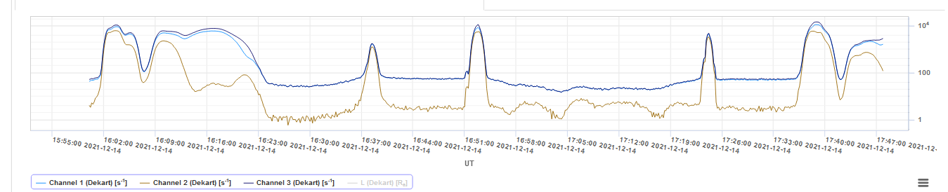
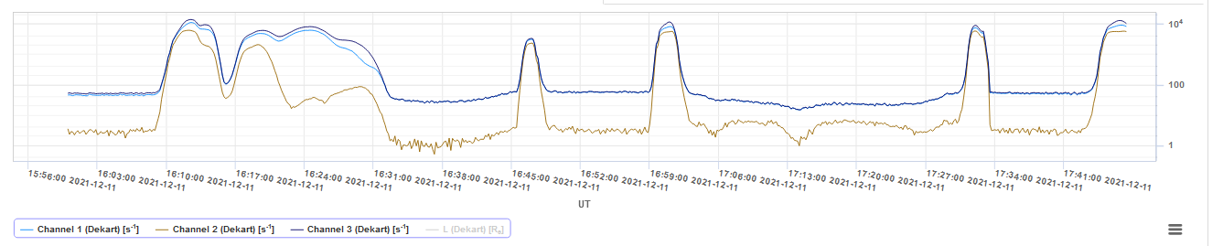
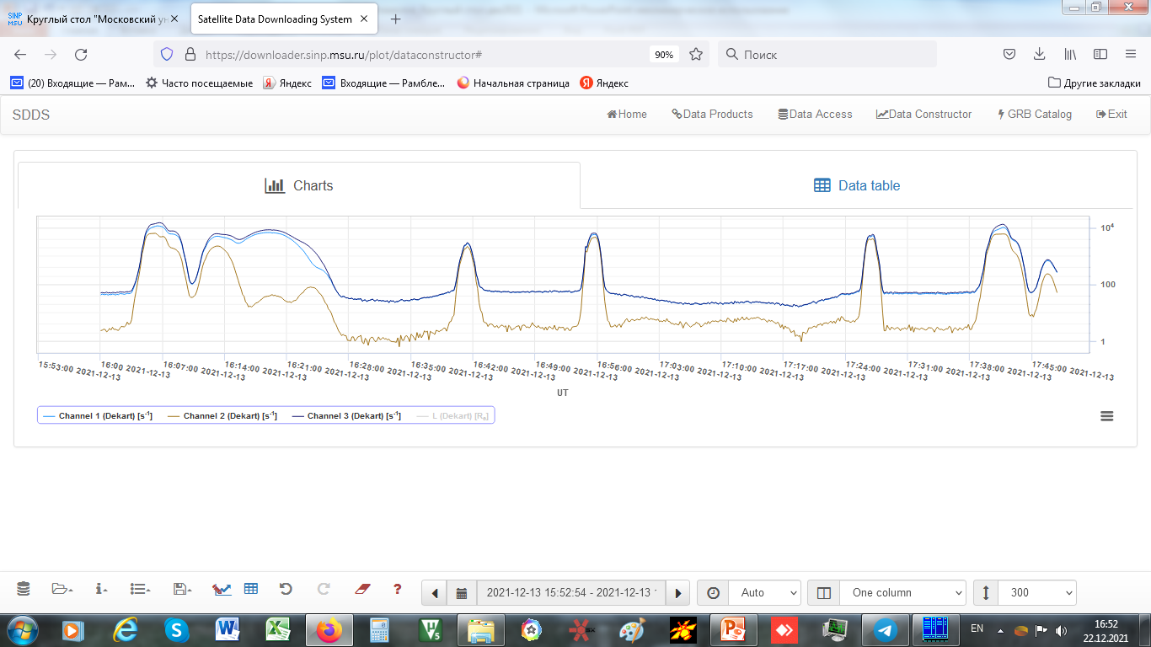
Space experiments with DeCoR devices
Flight history of DeCoR: 2019 - … AmurSat, VDNH-80
2020 - … Norby, Descartes
Example of data from DeCoR / Descartes: three similar orbits with 1 day interval

Slide 9
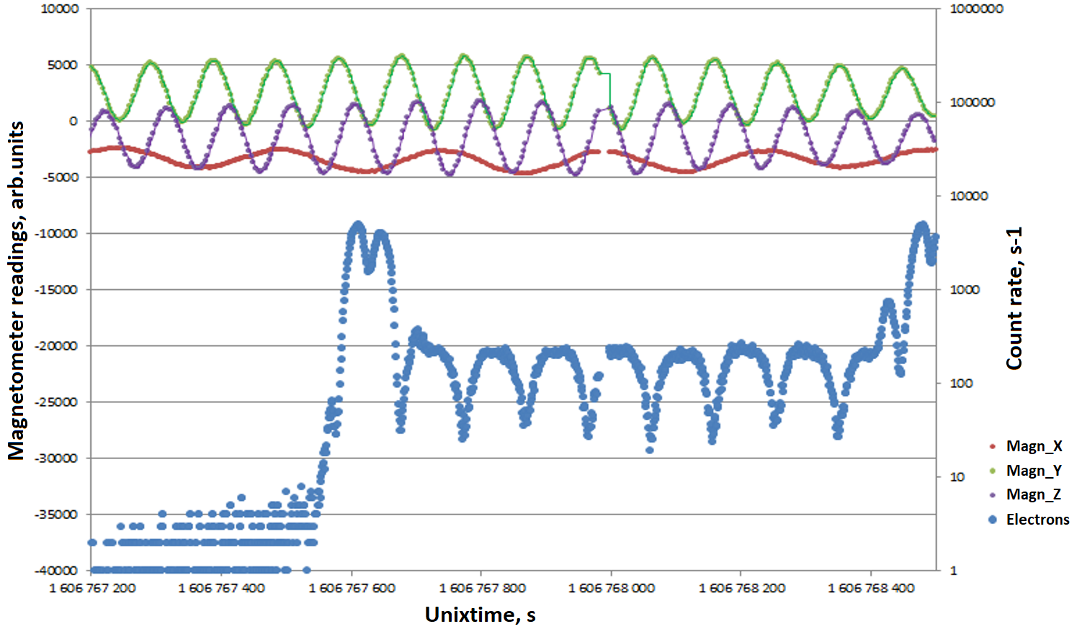
Previous space experiments with DeCoR devices
Correlation of count rate of electrons with magnetometer readings in the outer radiation belt (monitoring data of DeCoR / Norby are presented)

Slide 10
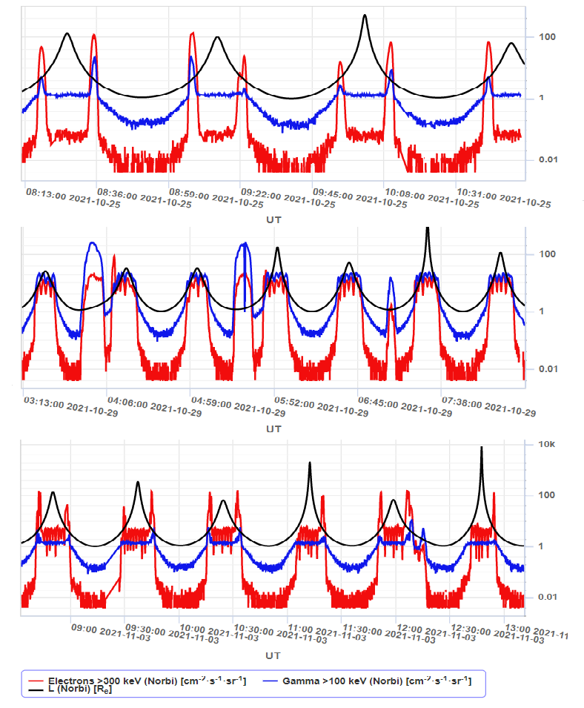
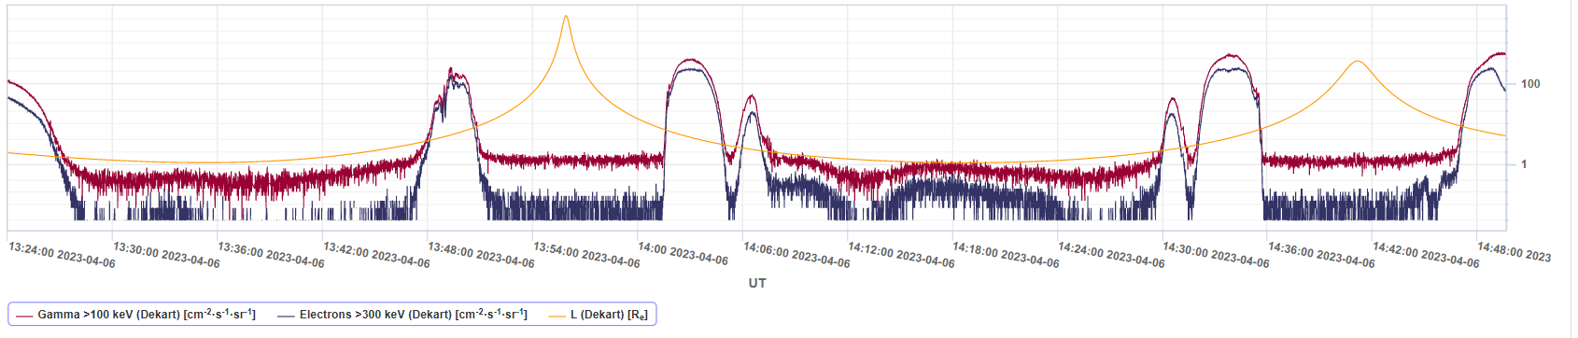
Observation of solar cosmic rays filling the polar cap
Observation of magnetospheric electrons at L~2.5

Slide 11
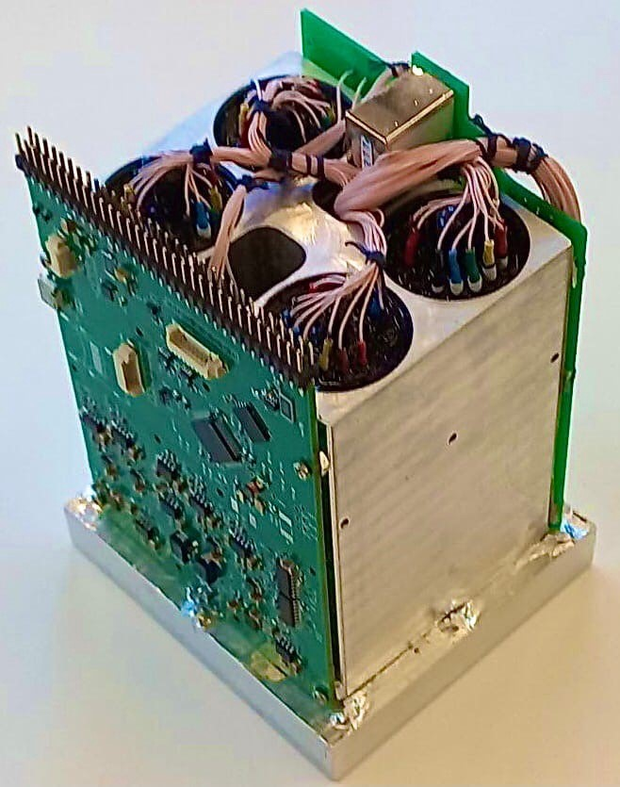
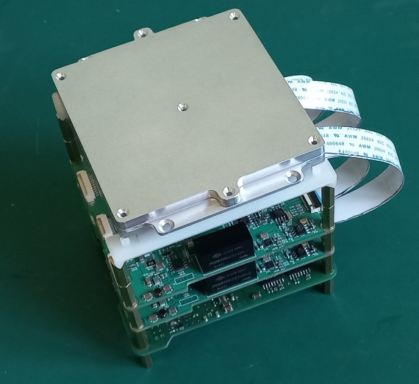
Missions with DeCoR instruments of 2022-2023: sensitive area is increased up to 64 см²
Skoltech-B1 и Skoltech-B2 were launched in Aug, 2022
Avion, Monitor 2, 3, 4, UTMN-2, Sirius-SINP-3U were launched in June, 2023
The DeCoR-2 instruments on these satellites have an increased sensitive area, which makes it possible to expand the range of scientific tasks, in particular, to study gamma-ray bursts of various nature.
The devices inherited from their predecessors:
A combined detector made of a plastic scintillator and a crystal, which allows to register electrons and gamma quanta separately
Both monitoring and event-by-event data, stored in the device memory.
DeCoR-2 devices use SiPM photodetectors, the energy threshold is reduced to 20 keV

Slide 12
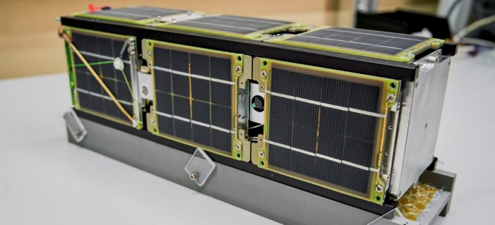
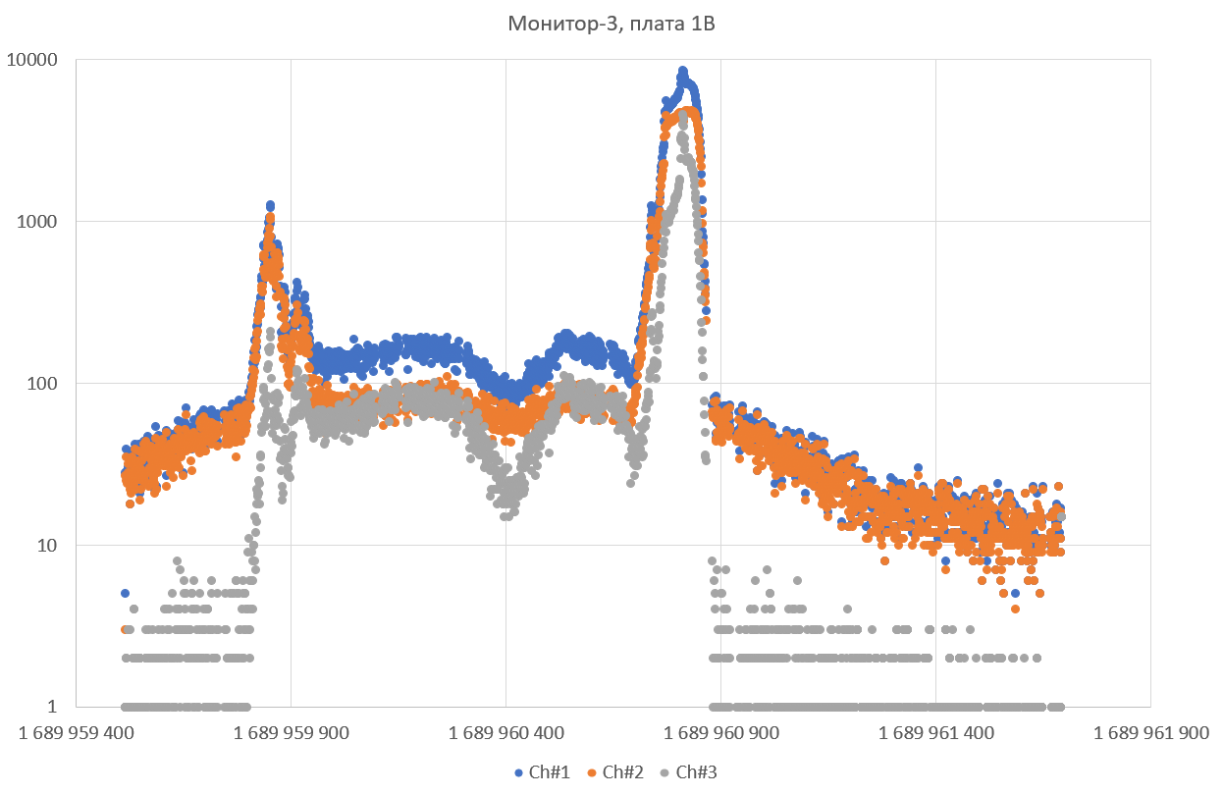
First data from «Monitor-3»
Three similar satellites “Monitor-3”, “Monitor-4” and UTMN-2 were launched on June,27 of 2023 to the circular solar synchronous orbit ~550 km high.

Slide 13
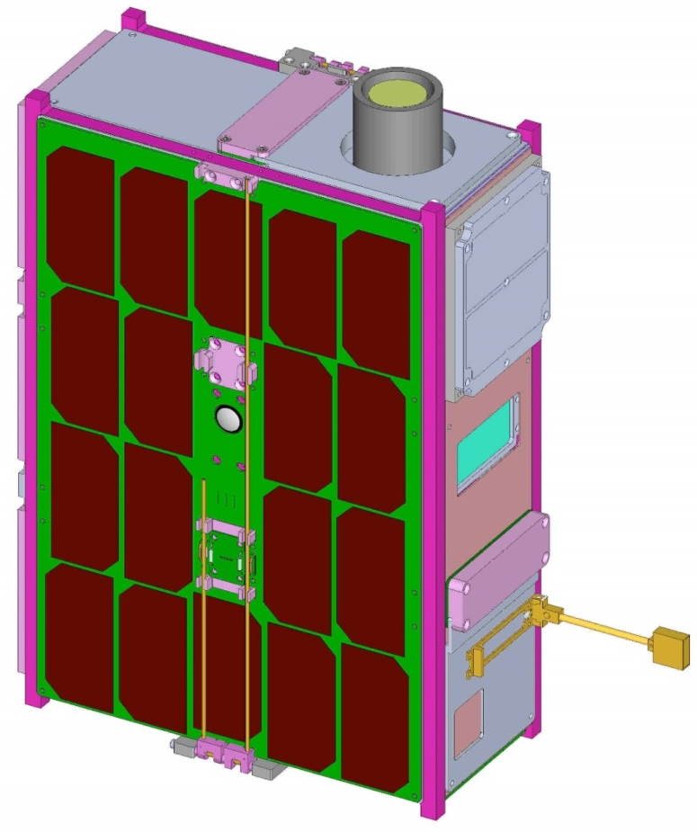
Avion satellite
The Avion satellite, made in the cubesat-6U standard, was launched on June, 27 of 2023. This satellite is equipped with a complex of three scientific instruments DeCoR, designed to study the temporal and spectral characteristics of electrons and gamma radiation in energy range from 20 keV to 5 MeV.
CubeSat 6U
Mean power >10 W
Data transfer:
Command and telemetry - VHF, ~1 Mb/day.
Scientific data – S-band, >10 Mb/day
Data storage in the device memory:
Monitoring – 15 days
Event-by-event – several orbits or burst trigger mode

Slide 14
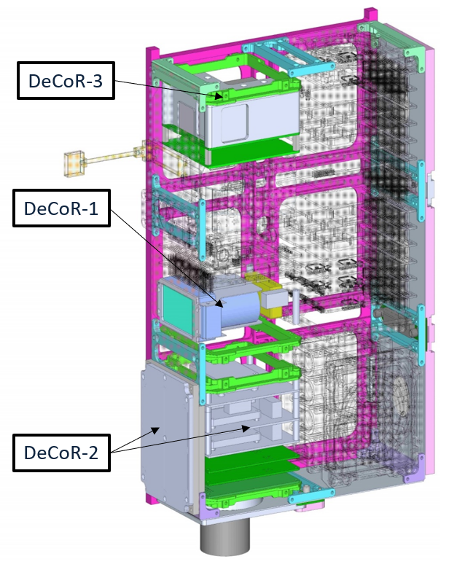
Payload of “Avion” satellite
1. Main scientific payload DeCoR (Detectors of Cosmic Radiation) Consists of three independent detectors of gamma-quanta and electrons:
-- DeCoR-1
-- DeCoR-2 (S=64 cm², SiPM are used)
-- DeCoR-3 (spectrometric unit)
(Designed by SINP MSU)
Educational payload
(designed by schoolchildren educational centrum “Quantorium” from Kaluga)
3. Technological payload
(designed by NILAKT DOSAAF from Kaluga being the designers of the satellite platform)

Slide 15
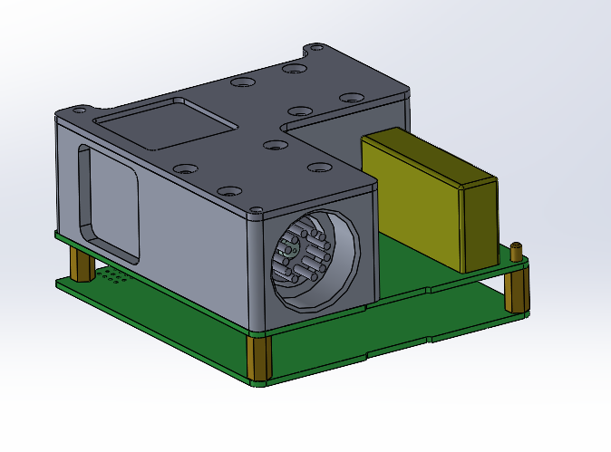
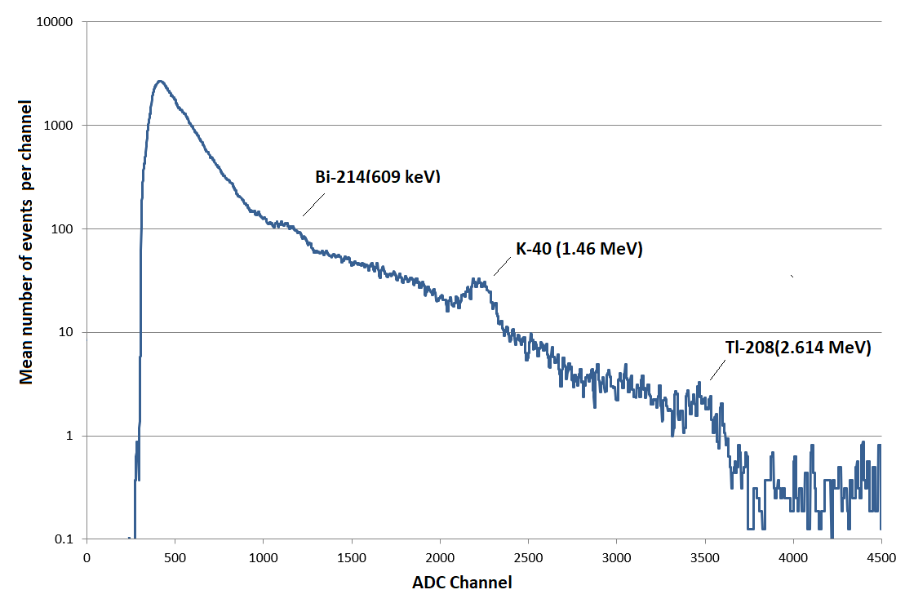
DeCoR-3 device onboard «Avion»
Main goal: Measurement of the fluxes and gamma-ray spectra of solar flares and gamma-ray bursts in energy range from tens of keV to several MeV.
Detector: CsI(Tl) 30х30х30 mm, watched by two PMTs
Energy range: 0.02-5 MeV
Power consumption: 1.2 W
Mass: <700 g
Background spectrum measured by DeCoR-3 during calibrations

Slide 16
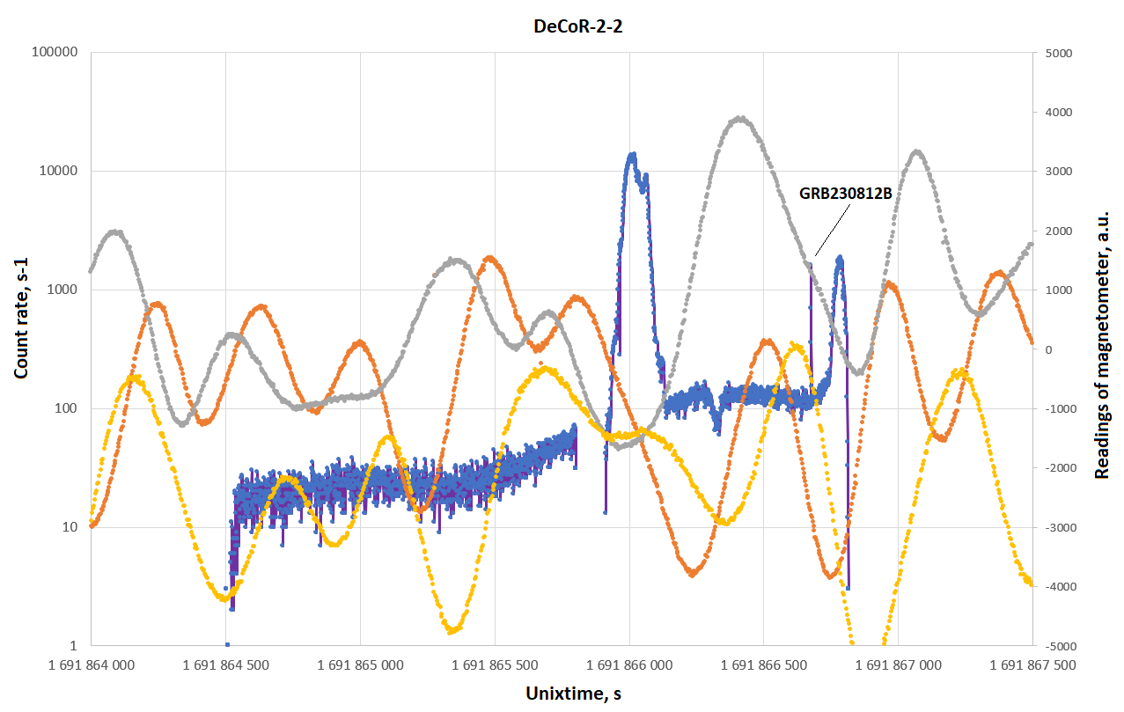
DeCoR-2/Avion count rate data together with internal 3-axe magnetometer readings

Slide 17
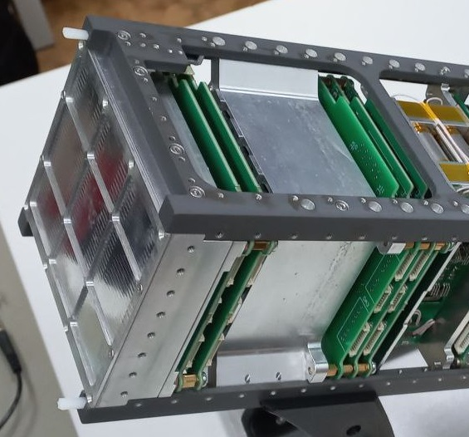
Monitor-2 satellite (“Orion”)
Monitor-2 satellite in cubesat-3U format was launched on June, 27 of 2023. It is equipped with a set of two DeCoR instruments: A large area detector placed on the top of the satellite and a spectrometric unit based on a big CsI(Tl) crystal with size 40 х 60 х 60 mm.

Slide 18
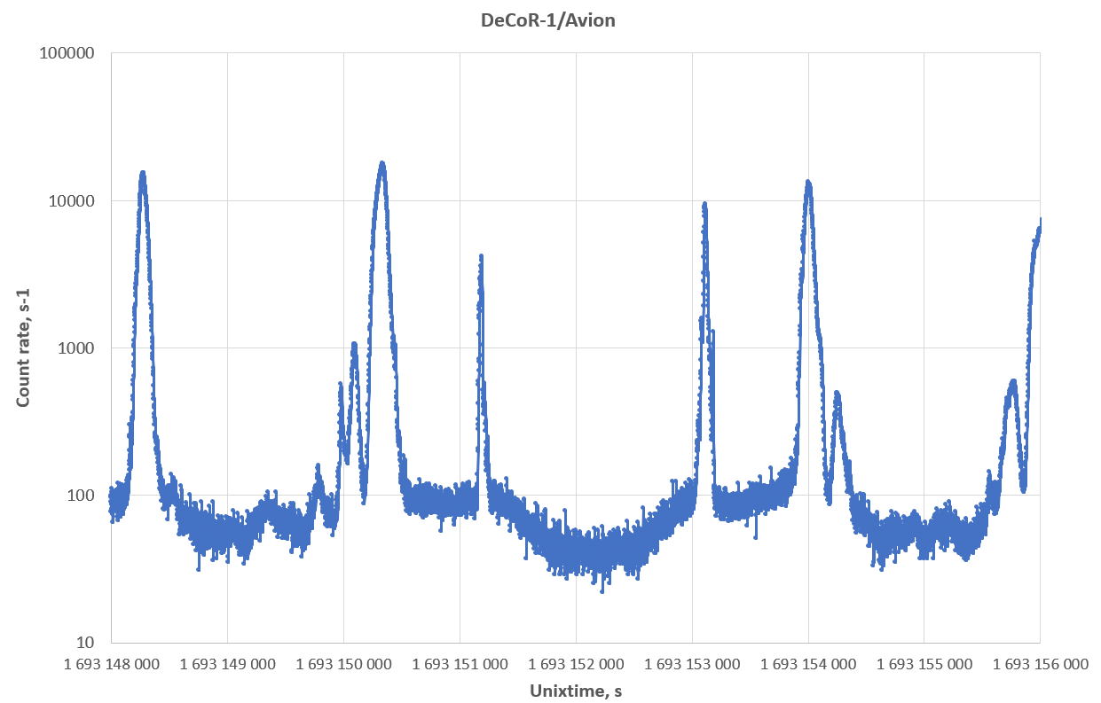
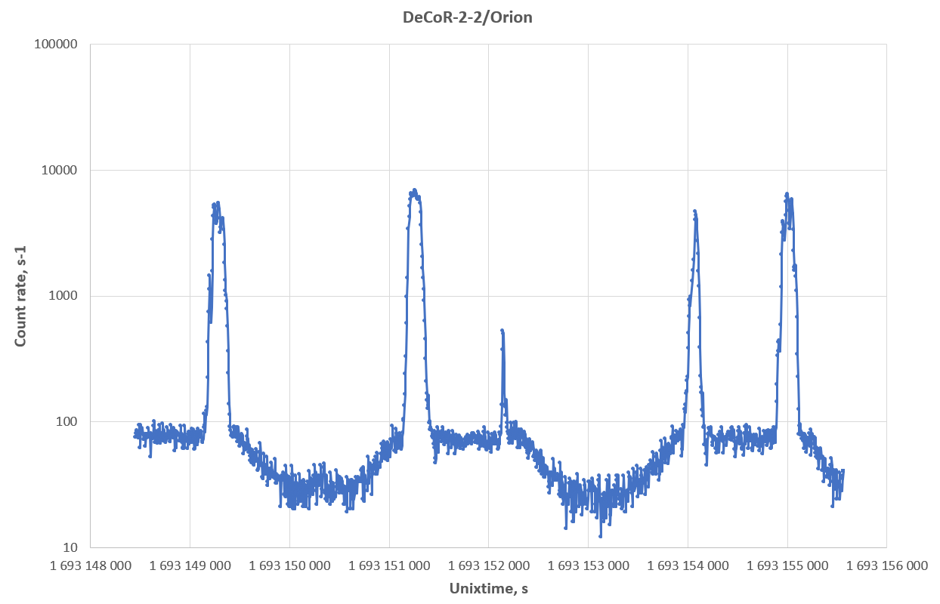
Consequent pass of the regions of trapped radiation by Avion and Monitor-2 satellites (time interval is 18 min)

Slide 19
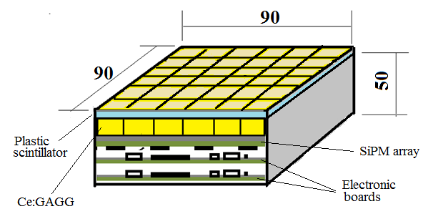
Future cubesats of MSU for Geo and Helio Environment Monitoring
The new payload is now designed in MSU to be launched in 2024 onboard 16U cubesat.
combination of large area pixelated detector and large volume spectrometric detector will be realized
modern scintillators will be used to improve spectral and time characteristics
SiPM arrays will be used for light collection in both detectors

Slide 20
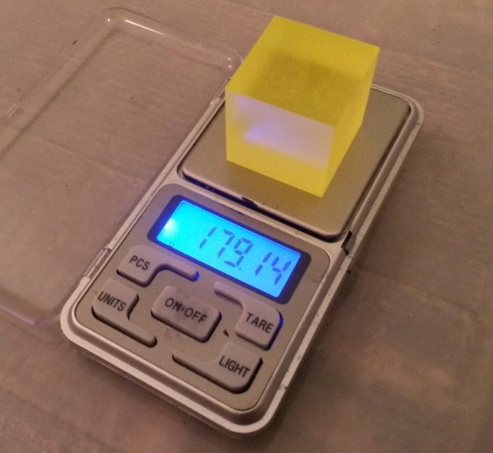
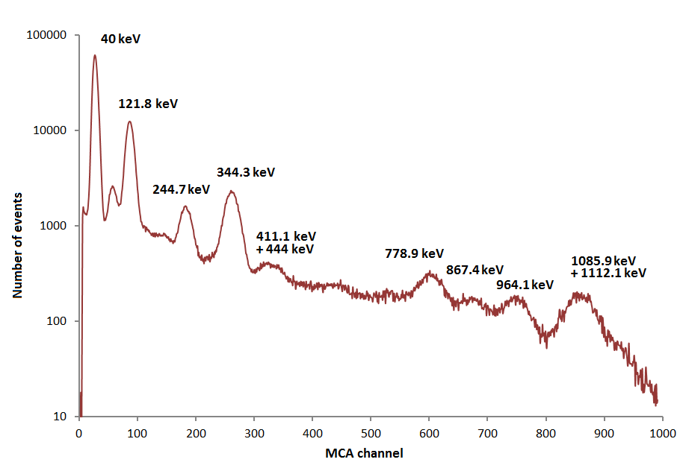
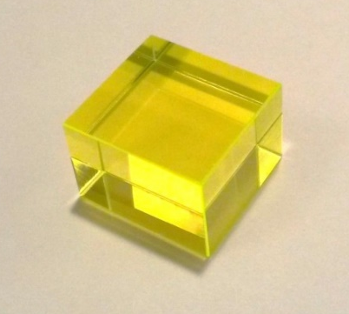
Ce:GAGG scintillator for high efficiency detectors
High efficiency and stop factor
Good energy resolution
Fast response
No internal background
Radiation hardness
Not hygroscopic
Parameters of Ce:GAGG
Density 6.6 g/cm3
Flashing time ~90 ns
Energy resolution <6% at 662 keV
Crystal of Ce:GAGG 3х3х3 cm

Slide 21
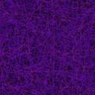
Conclusion
Currently, the number of cubesats with DeCoR payload are operating in solar-synchronous orbit.
The data obtained in the space experiment will be used for the space research as well as for the practice of the university students specialized in the branch of space physics.
New payload with position sensitive detector based on GAGG:Ce scintillator is now designed

Slide 22
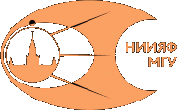
Thank You!!
This work was supported
by RSF grant №23-42-10005
and BFFR grant F23-RSF-074

