Slide 1
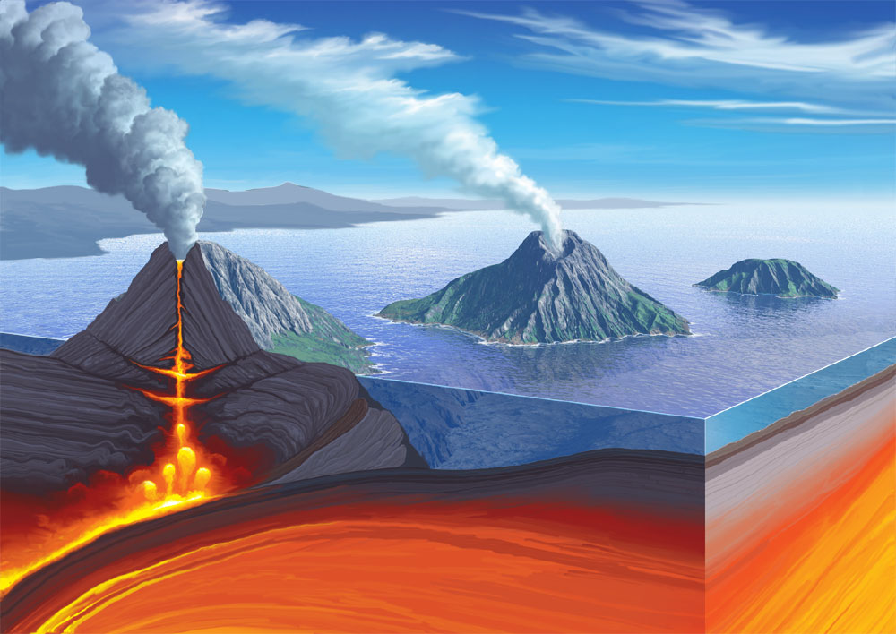
Небо и Земля
разделены, но они делают одно дело
Конфуций
A seismic phenomenon considered from the standpoint of nonequilibrium thermodynamics as a process of destruction of an unstable nonlinear structure on the example of the Kronotsky earthquake on December 05, 1997.
Bogdanov V. V., Pavlov A.V.
Institute of Сosmophysical Research and Radio Wave Propagation FEB RAS, Russia

Slide 2
1. Introduction
The study of the processes that determine the evolution of open physical systems has led scientists to understand the fact that their development is due to unstable dissipative nonlinear systems. Moreover, the instability of open systems is understood as such that, at characteristic observation times, as a result of the influence of minor external perturbations, it comes to a deviation in its state by an amount comparable to the characteristic values ​​of the quantities that determine this state. In turn, an open non-equilibrium system that is in a stationary state far from thermodynamic equilibrium, which is provided by a balance between energy dissipation within the system itself and the influx of energy coming from outside, is called a dissipative system or a dissipative structure. In addition, in an open system, due to the coordinated interaction of many of its elements through intensive (flow) exchange of matter and energy with the environment in non-equilibrium conditions, an ordering process (spatial, temporal or spatio-temporal), called self-organization, can occur. In other words, in such systems, the coordinated behavior of subsystems is observed, as a result of which the degree of its ordering increases, i.e. entropy decreases. The conducted research in the field of "dissipative structures" led to the conclusion that the process of "self-organization" occurs much faster in the presence of external and internal disturbances (noise) in the system. Thus, noise phenomena lead to an acceleration of the self-organization process.

Slide 3
Thus, from the most general considerations, we can consider the preparatory stage of an earthquake as the development of instability that forms in local areas of the lithosphere against the background of external disturbances that arise in the chain ”Sun - heliosphere - magnetosphere - ionosphere - neutral atmosphere - lithosphere”.A regular process, determined by compression or extension of the lithospheric plate, or other physical and chemical phenomena in a seismically active region on a global scale, is affected by a certain set of external disturbances in a consistent system of geospheres, determined by the system of solar-terrestrial relations. These perturbations excite the development of various instabilities, ultimately leading to local (in the volume of the focus) destruction of the structure, which is in a special limiting (critical) state. This state is characterized by a certain, but rather complex balance between fluctuations in the system and its average characteristics, which determine the macroscopic state. It should be noted that the greatest difficulties in processing the parameters of the Catalog arise when determining the depth of an event. Each real value of the depth h_{real} is within the corresponding error interval ± Δh_{mist} relative to the depth h_{met} calculated by a certain method. That is, the real depth h_{real} can take any value from the set of values covered by the interval h_{met}±Δh_{mist} (h_{real} ∈ h_{met}±Δh_{mist} ). Therefore, in this fuzzy situation, we will be interested not in some undefined value of the depth hreal, which falls somewhere in the corresponding error interval, but in the depth value hmet itself, calculated according to a certain method, for which the error interval ±Δhmist is calculated.

Slide 4
The proposed work uses the Catalog of earthquakes recorded by the Kamchatka regional network of seismic stations of the Kamchatka branch of the Geophysical Service of the Russian Academy of Sciences (KB GS RAS).
2. Probabilistic methods for describing the seismic regime
In the most general case, in order to consistently fulfill an earthquake forecast and answer the questions “where and when” a structure will form in a special state, and “what energy will be released” when it is destroyed, you need to know the trajectory of the unstable system. This trajectory describes the evolution of the active structure of the source zone in the phase space with a dimension equal to the number of variables describing its behavior. For such a description of earthquakes, it is necessary to create a model that includes the whole complex of phenomena of various nature, and it is also necessary to know the parameters of the macroscopic state of the structure and the boundary conditions. But there is no such model. However, assuming that the structure of the source zone is an unstable nonlinear system, which is under the influence of external perturbations, then, according to the general principles of nonlinear dynamics, it can go into a special limiting state. In this case (purely theoretically) we must calculate various averaged characteristics on the actual trajectories of unstable systems, the dynamics of which has the nature of chaos.

Slide 5
The averaging functional is chosen as a certain probability. Consequently,initially nonlinear systems with chaos dynamics are described by probabilistic methods. Therefore, the transition of the system to one or another special state and its destruction itself is of a probabilistic nature. However, it is the destruction of unstable structures in the lithosphere in a seismically active region that is perceived as an earthquake, and this fact, therefore, also has a probabilistic character. Thus, by studying the result of the destruction of the nonlinear structure of the source zone as a random event, we ultimately study the seismic regime by probabilistic methods and, ultimately, by indirect methods, study the dynamics of the structure of seismically active zones of the lithosphere. The methods of monitoring of a stress-strain geoenvironment related to the study of changes in the seismic regime can be extended. Indeed, if for its study we use the method of calculating the probabilities of earthquakes for various random events proposed by Bogdanov and his collaborators. This method is based on the axiomatic approach proposed by A.N. Kolmogorov in 1933. This allows us to consider each earthquake as a single outcome ωi in the space of elementary events Ω, the power of which is determined by the number of events n of earthquake catalog. In turn, each elementary event ωi in Ω is characterized by a system of random variables: energy class Ki, latitude φi, longitude λi, depth hi, time ti. The time of a specific event in this model, as a random variable and having no mathematical expectation, is excluded from this system.

Slide 6
In the future, we will consider a certain time interval ΔT, in which random events fall according to the earthquake catalog. The seismicity of the entire region or its selected part is considered as a complete group of events and is described in the form of distributions of conditional and unconditional probabilities P having a frequency representation. Random events are defined as combinations of a system of random variables φ, λ, h,K in the set F . This allows us to represent the catalog of seismic events over the observation period as a probability space of three objects {Ω, F, P}. For continuous values of the probability of hitting random events for some interval, the time interval ΔT within the given intervals in latitude Δφi, longitude Δλj , depth Δhm and class ΔKn are calculated by the formula:
P(Δφi,Δλj ,Δhm,ΔKn) = F(φi, λj , hm,Kn) − F(φi−1, λj−1, hm−1, Kn−1) =
= P(Δφi) ・ P(Δλj |Δφi) ・ P(Δhm|Δφi,Δλj) ・ P(ΔKn|Δφi,Δλj ,Δhm),
where i, j, m and n are the indices of the corresponding intervals of random variables.
Let us consider the practical application of this approach to describe the seismic regime
using examples of the study of the distribution of the depth of weak events KS ≥ 8.5 on
the eve of Kronotsky earthquake (05.12.1997). To this end, on the basis of the described
approach with the subsequent use of wavelet decomposition methods, we study the
dynamics of changes in the probability distributions over the depth of ”background”
earthquakes that occur several years before strong Kamchatka events with M ˃7.0.

Slide 7
This allows us to identify the depth range at which anomalous changing the
Parameters of this wavelet decomposition. At the same time, according to the findings
of nonlinear dynamics, it is known that as the degree of instability of an arbitrary
system increases and it approaches the critical state, both the intensity of parameter
fluctuations and the time and length of correlations increase. Therefore, the initial
local (“microscopic”) internal processes develop and acquire the character of
coordinated ones, forming already on a global (“macroscopic”) scale and capturing
large seismically active areas. An increase in the length and amplitude of correlations
in a nonequilibrium seismically active system indicates the connection of processes
in some local selected area with its other parts. But logically, this should lead, over a
certain time interval τ , to the formation of conditions conducive to an increase in the
frequency of earthquakes in various parts of this region with less energy than in the
main impending shock. Therefore, during the preparation of a strong (catastrophic)
earthquake, large volumes of the lithosphere of a seismically active region are
involved in the preparation area with a simultaneous increase in the frequency of
occurrence of weak (background) events.

Slide 8
Based on the foregoing, it can be assumed that the preparation of an earthquake
corresponds to the formation of an unstable nonlinear system, which is under the influence of external disturbance factors and develops according to the scenario of nonlinear dynamics. The interaction of the lithosphere with the environment (the chain ”Sun–heliosphere–magnetosphere–ionosphere–neutral atmosphere”) with its non-equilibrium conditions, can be the starting point in the emergence of a new dynamic system, called the dissipative structure. In this case, the scales of the connection between different parts of the nonlinear structure change. In this regard, we make a hypothesis:
During the preparation of the main major event with M ∼ 7.0 in a certain volume
of a seismically active region, which is in an unstable state far from equilibrium, a
consistent, correlated increase in seismic activity occurs at the ”background” level,
which covers areas far from the epicenter of the future event. At the same time,
strong foreshocks with subsequent development of aftershock activity are possible in
these areas at the depths of an upcoming earthquake. The scales that determine the
temporal τ and spatial L correlation during the formation of these earthquakes are
several years for τ and hundreds of kilometers for L and depend on the magnitude M
of the upcoming main shock.

Slide 9
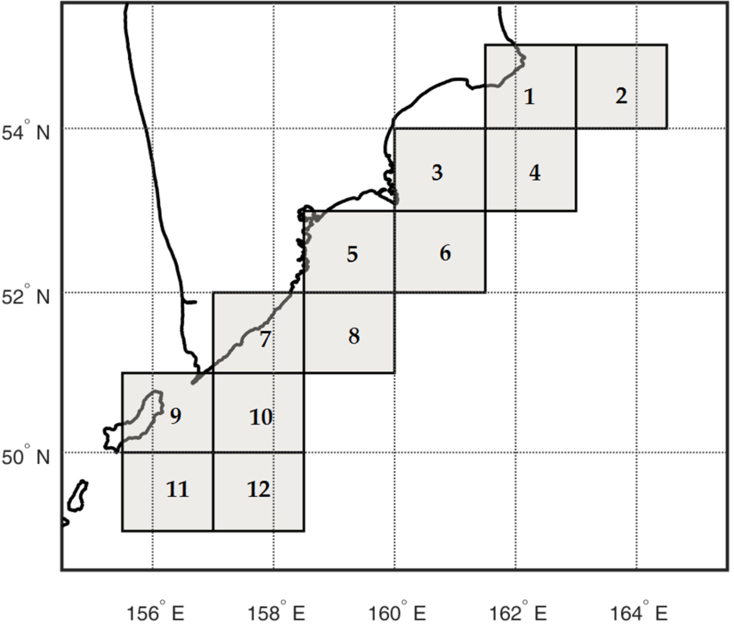
3 ANALYSIS OF THE KRONOTSKY EARTHQUAKE
To test this hypothesis, the Kronotsky earthquake was considered: 05.12.1997 11:26:51 (UT), φ = 54.64◦N, λ = 162.55◦E, depth h = 10 km, depth determination
error 2 km, energy class in terms of the amplitude of the S wave, determined by the nomogram of S.A. Fedotov KS = 15.5, local magnitude of the Kamchatka region (according to Ch. Richter) ML = 7.0, magnitude by code-waves Mc = 7.7.
Figure 1 shows the area along the eastern coast of the Kamchatka Peninsula, which is divided into 12 sectors, defined by intervals of latitude Δφ = 1◦ andlongitude Δλ = 1.5◦. For these areas, based on the catalog of seismic eventsprovided by the KB GS RAS, on the basis of equation (1) the probability distributions P(Δh) (histograms) characterizing the occurrence of seismic events with an energy class M ≥ 3.5 in the given depth intervals with a step Δh = 1 km will be further calculated up to H = 100 km. At the next processing step, the obtained seismic event probability distribution series P(Δh) over depth were presented in the form of a continuous wavelet decomposition. The decomposition was carried out up to the 32nd scale level.
Fig. 1. Location of 12 regions along the eastern coast of Kamchatka with dimensions in latitude and longitude Si = Δφ × Δλ = 1◦ × 1.5◦.

Slide 10
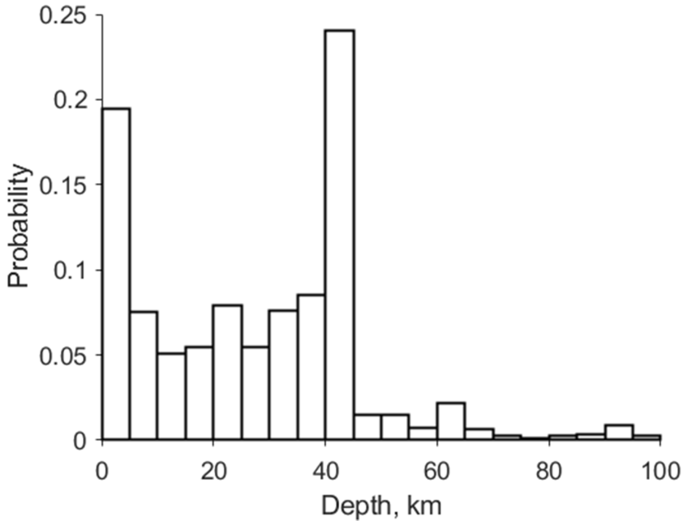
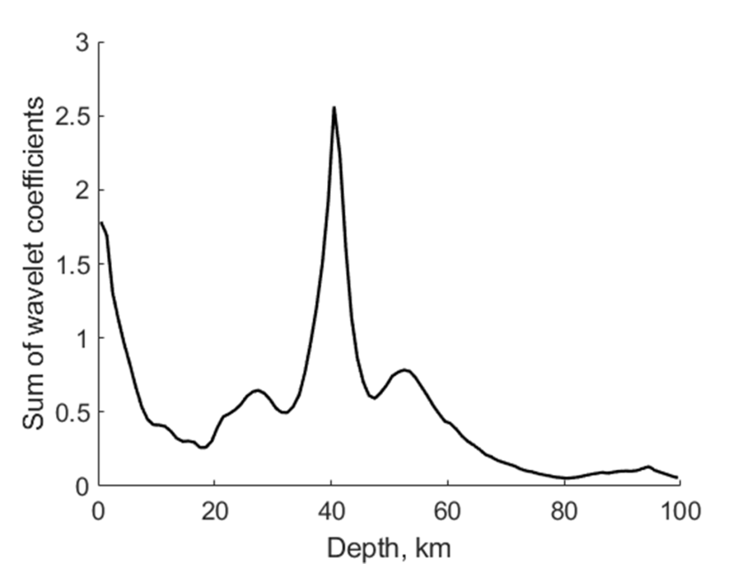
Fig. 2. Probability distribution earthquakes by depth for 1996 (a) and Sum of wavelet
coefficients for probability distribution earthquakes by depth for 1996 (b).
As an example, Fig. 2a shows the original probability distribution series calculated for 1996 for the entire area indicated in Fig. 1. the calculation of the sum of wavelet coefficients over all scale levels, which characterizes the distribution of the "energy" of the studied seismic process over depth in a given sector (the y-axis in Fig. 2b), was performed. For the Kronotsky earthquake, four time periods were considered from January 01 to December 31 for 1994, 1995, 1996 and from January 01 to December 04, 1997. until the event itself. The earthquake itself occurred on December 05, 1997. in sector number 1.

Slide 11
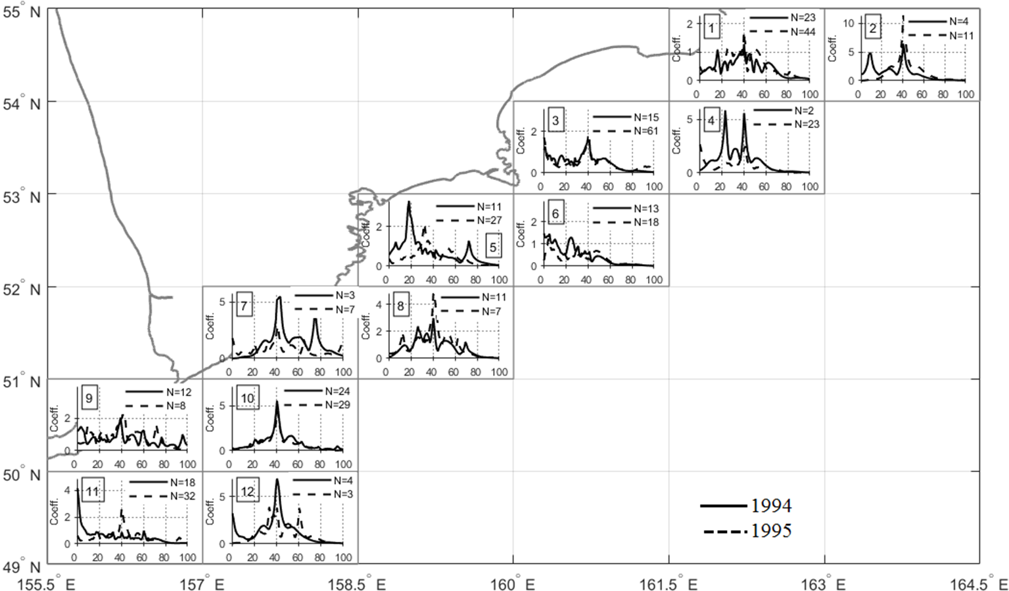
Fig. 3. The summed wavelet coefficients from scale level 1 to 32 for probability distributions P(Δh) of earthquakes with energy class KS ≥ 8.5 over depth intervals Δh=1km for 1994 and 1995.

Slide 12
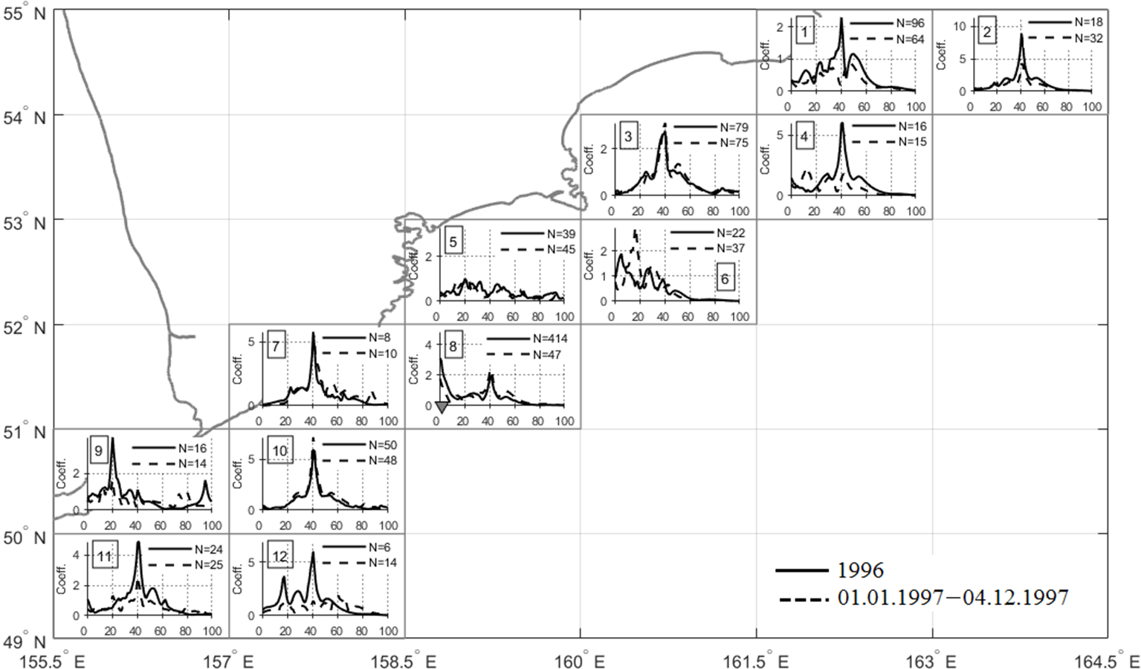
Fig. 4. The summed wavelet coefficients from scale level 1 to 32 for the probability
distributions P(Δh) of earthquakes with energy class KS ≥ 8.5 over depth intervals
Δh=1 km for 1996 and for the period from 01.01.1997 to 04.12.1997. The triangle in
sector №8 marks two earthquakes on June 21, 1996 and July 18, 1996 (see text)

Slide 13
Figure 3 shows the results of wavelet decompositions for 1994 and 1995 for all the studied sectors. In sector №1 in 1994, 23 events occurred (N is marked in the legend for the corresponding year and in the corresponding sector) with their concentration at depths of 18 km and 40 km, while the sum of the wavelet coefficients for these depths was, respectively Coeff18 = 1 and Coeff40 =1.5. In 1995, the number of events in this sector increased to 44, and their intensity shifted to depths in the region of 30, 40, and 50 km and Coeff30 = 1.1, Coeff40 = 1.6, Coeff50 = 1.1. In 1996, the number of events increased to 96 with a clear maximum at 40 km Coeff40 = 2.2 and additional maxima at 12 km Coeff12 = 0.5, 23 km Coeff23 = 0.9 and 50 km Coeff50 = 1.1. In 1997, the number of events decreased to 64 with two intensity maxima at depths of 36 km Coeff36 = 0.6 and 48 km Coeff48 = 0.8 (see Figure 4). Moreover, at a depth of 40 km, there was a clear decrease in seismic activity Coeff40 = 0.2. Corresponding changes for the period 1994–1995 (Figure 3) also occurred in each of the studied sectors from 2 to 12, and an increase in the number of events is characteristic of all sectors. The exceptions are sectors №8, №9, and №12, for which the number of events decreased from 11, 12, and 4 in 1994 to 7, 8 and 3 in 1995. At the same time, a shift to shallow depths with increasing earthquake intensity occurred in 1995 in sectors №4 (at zero depths with Coeff0 = 2.4) and №7 (at zero depths with Coeff0 = 1.8). In sector №6, the intensity of events at shallow depths up to 20 km in 1994 slightly decreased compared to 1995.

Slide 14
In sector №11, the intensity of events in 1994 was located at shallow depths from 0 to 10 km with a maximum at zero depth (Coeff0 = 4). In 1995, the intensity of earthquakes dropped sharply with the formation of a maximum at a depth of 40 km with Coeff40 = 2.2. It should be noted that for the period 1994–1995 at a depth of 40 km, distinct maxima of events of different intensity formed at a depth of 40 km in sectors 2, 3, 4, 7, 8, 10, and 12. In 1996 (see Figure 4), an increase in the intensity of earthquakes at shallow depths up to 20 km clearly manifested itself in sectors №6 (Coeff5 = 1.9) and №8 (Coeff0 = 3). During this period, two earthquakes occurred in sector №8, followed by aftershock activity with a total number of events N = 414:
– 21.06.1996.; φ = 51.27, λ = 159.63; h = 2 km, KS = 13.9; M = 6.2;
– 18.07.1996; φ = 51.22, λ = 159.82; h = 8 km, KS = 13.5; M = 6.0.
From 01 January 1996 to 20 June 1996 (before the earthquake of 21 June 1996), 5
seismic events with KS ≥ 8.5 occurred in sector №8. From 21 June 1996 to 17 July
1996 (before the earthquake of 18 July 1996), there were 348 earthquakes with
KS ≥ 8.5 (aftershock activity). After the earthquake of 18 July 1996 the aftershock
activity in this sector sharply decreased, and only 61 seismic events with KS ≥ 8.5
occurred until 31 December 1996. Seismic activity at a depth of 40 km decreased in
1997 in sectors №1, 2, 4, 9, 11, 12.

Slide 15
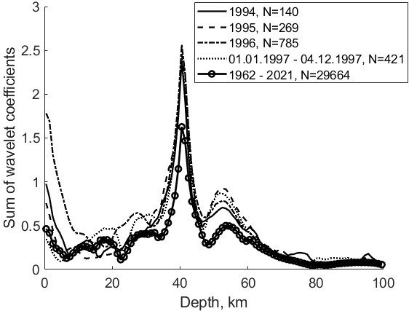
Fig. 5. The summed wavelet coefficients from scale level 1 to 32 for the probability
distributions P(Δh) of earthquakes with energy class KS ≥ 8.5 over depth intervals
Δh = 1 km for the SΣ region for the entire period of 1994, 1995, 1996 and from
01.01.1997 to 04.12.1997. For comparison, the intensity distribution of seismic events
for the period of instrumental observations from 01.01.1962 to 31.12.2021 is presented,
against which events develop for the considered period of time 1994–1997.

Slide 16
It follows from Figures 3–5 that for 1994, starting from zero depths, the intensity of seismic events (numerical values of Coeff) decreases with increasing depth and merges with the averaged intensity of 1962–2021 obtained over the entire instrumental period of observation. The intensity for 1994 exceeds the average starting from 30 km. The intensity over 1995 at shallow depths (from 0 to 10 km) becomes less than the intensity over 1994. The intensity of seismic events at shallow depths (from 0 to 15 km) in 1996 exceeds the intensity for 1994 and 1995 , due to the aftershock activity after occurence the earthquakes of 21 June 1996 and 18 July 1996, remaining similar to the average intensity for the period of instrumental observations from 1962 to 2021. The intensity at shallow depths decreases in 1997 and practically merges with the intensity from 1994–1996 at depths greater than 35 km.

Slide 17
4 Conclusions
Taking into account the hypothesis expressed earlier, let us summarize the results of the
study. In sector №8 in 1996, two earthquakes with magnitudes M ≥ 6.0 took place at
depths ranging from 0 to 10 km. The first event (21.06.1996) was accompanied by
increased aftershock activity (348 earthquakes with KS ≥ 8.5 occurred from
21.06.1996 to the second shock on 18.07.1996). After the second shock, the activity
decreased sharply, and until 31 December 1996, only 61 seismic events occurred.
Considering the dynamics of general seismicity over the years (see Figures 3, 4), we see
that in areas far from the main shock, at the depths of the upcoming earthquake, strong
events with aftershock activity arose, after which a seismic lull followed, lasting until
the onset of the main event on 05.12.1997 with ML = 7.0 (h = 10 km). The distance
from the main shock, which took place in sector №1, to the seismic events preceding it
in sector №8 with subsequent intensification of aftershock activity, was more than 400
km. In turn, from 1994 to the main shock on 05.12.1997, seismic activity increased at
shallow depths (from 0 to 20 km) in sectors that are mosaically scattered along the
eastern coast of Kamchatka, as well as in different time intervals (not simultaneously). To support this hypothesis, we can note:
– in the sectors, mosaically scattered along the east coast, there was a background
increase in seismic activity at the depths of an impending strong earthquake several years before its onset;
– the occurrence of foreshock events far and at the depths of an impending
major earthquake.

Slide 18
It is absolutely clear that the consideration of one event as a confirmation of
the stated hypothesis is not enough and requires further research on the example of other large earthquakes. In addition, due to the impossibility of accurately determining the depth of the earthquake hypocenter, replacing it with hmet, when the error Δhmist can be commensurate with the depth itself, seems to be somewhat arbitrary. However, the ideology of this approach to the analysis of the depth distributions of earthquake epicenters on the eve of major events based on the application of the general conclusions of nonequilibrium thermodynamics, in our opinion, is promising.

Slide 19
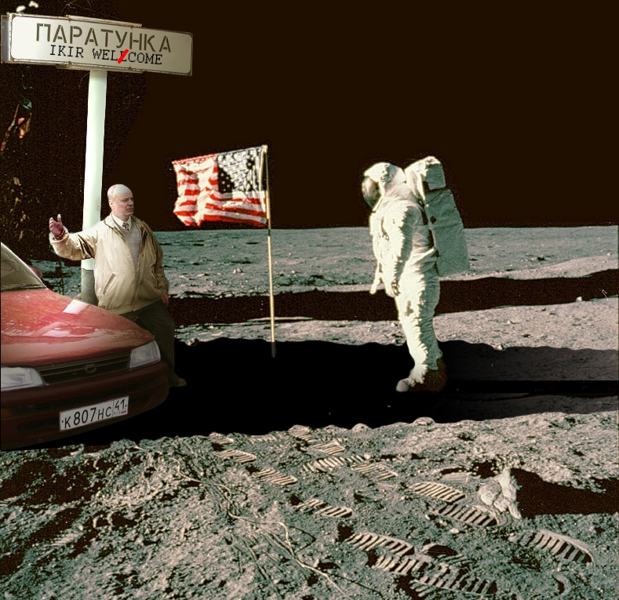
Thank you
for attention!

