Slide 1
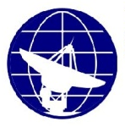

GEOMAGNETIC MEASUREMENTS AT THE PLESHCHENITSY GEOPHYSICAL OBSERVATORY (MINSK, REPUBLIC OF BELARUS)
SOLAR-TERRESTRIAL RELATIONS AND PHYSICS OF EARTHQUAKE PRECURSORS
13th International Conference
September 25-29, 2023, Paratunka, Russia
Genady A. Aronov, Arkady G. Aronov, Ihar A. Saladukhin*,
Aliaksei A. Kadymau, Valiantsina M. Laziuk
Center of Geophysical Monitoring of the National Academy of Sciences of Belarus
1/3 Kuprevich str.
Minsk, 220141
Republic of Belarus
*Corresponding author. E-mail: saladukhin@cgm.by

Slide 2
Outline
Historical investigations of the Earth’s magnetic field in Belarus
Description of the Pleshchenitsy Geophysical Observatory
Observations of the geomagnetic field elements at the Pleshchenitsy Geophysical Observatory
Analysis of the geomagnetic field disturbance based on the data of the Pleshchenitsy Geophysical Observatory
Conclusions

Slide 3
Historical investigations of the Earth’s
magnetic field in Belarus
The characteristics of the magnetic field of the Earth was measured in Minsk for the first time in 1875 by I.N. Smirnov, an Associate Professor of the Kazan University (Russia), who was among the pioneers of the magnetic survey in Belarus.
Later, the determinations of the values of the geomagnetic elements in Minsk were repeated by the staff of the Main Geophysical Observatory (St. Petersburg, Russia) in 1904, 1924 and 1927.
Subsequent measurements were carried out at the base observation station of the secular variations in Minsk, which was created by the Institute of Terrestrial Magnetism (now IZMIRAN). The Earth’s magnetic field measurements were made there in 1938, 1945, 1947, 1948, 1949, 1954, 1959, 1960.
Note. All the data of observations made at the Minsk station were reduced to the values obtained at the Pleshchenitsy Geophysical Observatory.

Slide 4
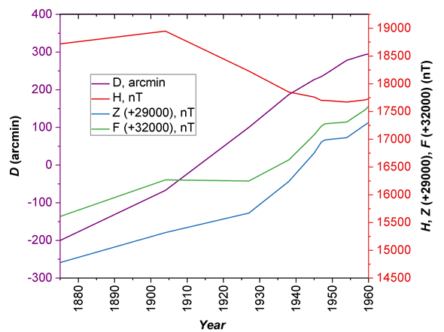
Historical investigations of the Earth’s
magnetic field in Belarus
Changes in the annual mean values of the magnetic declination D, horizontal H and vertical Z components, as well as of the full geomagnetic field vector F during the period of 1875–1960
The Earth’s magnetic field parameters changed considerably in the region of Minsk since 1875 till 1960.
During this period the magnetic declination D changed from the western one equal to 3°20′ in 1875 to the eastern one in about 1913 and reached 4°55′ till 1960. Hence, the overall change of the magnetic declination made up more than 8°.
The vertical component Z and an absolute value of the full vector of Earth's magnetic field strength F increased for the above-mentioned period by 2520 and 1980 nT, respectively.

Slide 5
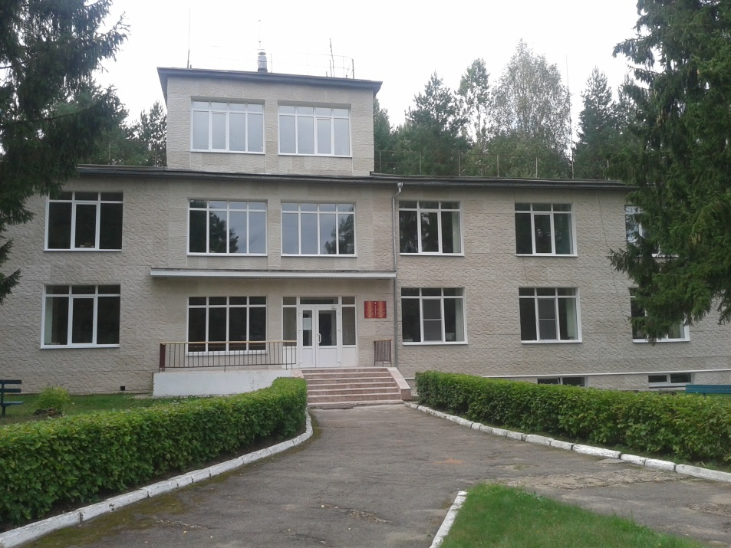
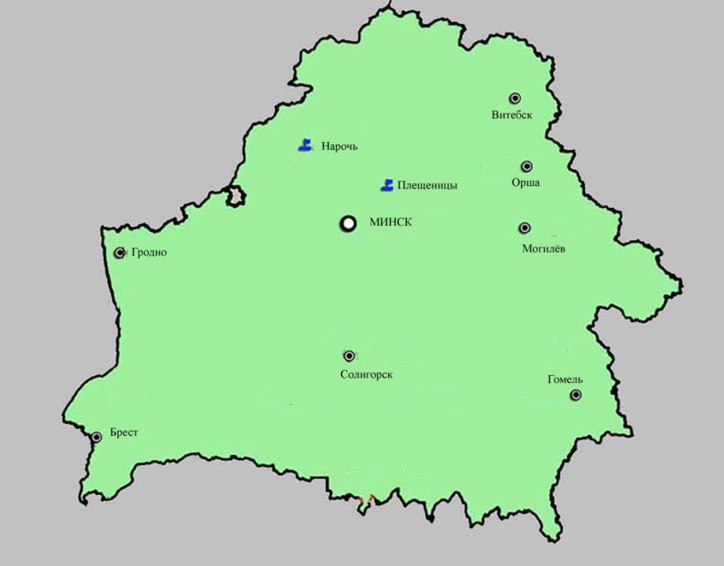
Pleshchenitsy Geophysical Observatory
The complex Pleshchenitsy Geophysical Observatory for investigation of the geomagnetic field and seismic activity was created in 1958 within the framework of the participation of the Academy of Sciences of the Belarusian SSR in investigations for the International Geophysical Year program.
54.4186° N 27.7958° E
Continuous observations of the geomagnetic field elements have been carried out since 1960.
Pleshche-
65 km
nitsy
Minsk
At present, the Pleshchenitsy Geophysical Observatory is a part of the Center of Geophysical Monitoring of the National Academy of Sciences of Belarus.

Slide 6
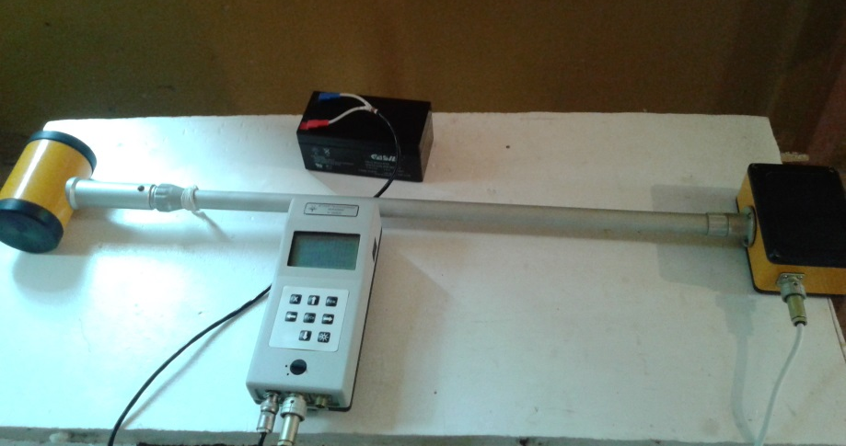
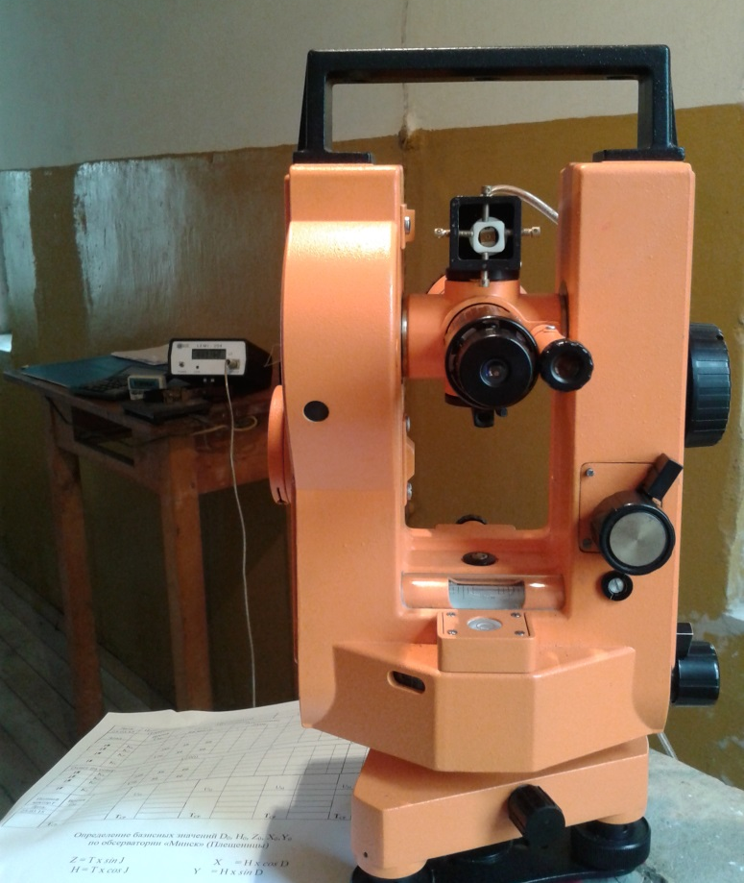

Pleshchenitsy Geophysical Observatory
Measuring instruments and equipment
Currently used
scalar Overhauser magnetometer MINIMAG (SPE “Geologorazvedka”, Russia)
fluxgate fDI magnetometer LEMI-204 based on a nonmagnetic theodolite 3T2KP-NM (Lvov Center of the Institute for Space Research, Ukraine)
three-component fluxgate magnetometer LEMI-022 (Lvov Center of the Institute for Space Research, Ukraine)

Slide 7
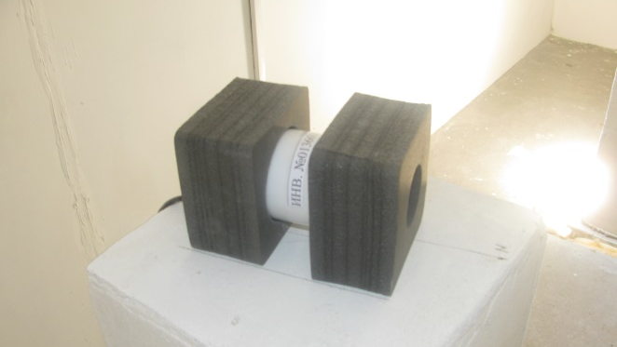

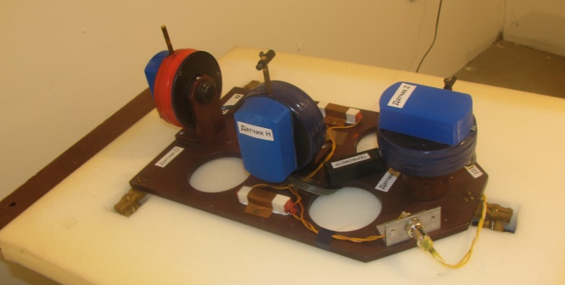
Pleshchenitsy Geophysical Observatory
Measuring instruments and equipment
Putting into operation
scalar Overhauser magnetometer POS-1 (Ural Federal University, Russia)
fDI-magnetometer MinGeo based on a nonmagnetic theodolite Theo-020B (MinGeo Ltd, Hungary)
three-component digital magneto-variation station "Quartz-7" (IZMIRAN, Russia)

Slide 8
Pleshchenitsy Geophysical Observatory
Measured components and corresponding instruments
Variations of the northern, X, eastern, Y, and vertical, Z, components of the Earth's magnetic field using 3-components fluxgate magnetometer LEMI-022 (resolution is 0.033 nT, data frequency is 1 Hz).
Geomagnetic field declination, D, and inclination, I, using a fluxgate fDI magnetometer LEMI-204 based on a nonmagnetic theodolite 3T2KP-NM (magnetometer resolution is 0.1 nT, value of the microscope scale graduation is 1″, mean squared error of angle measurement is 2″; the null-method is being applied).
Absolute value of the full geomagnetic field vector, F, using a scalar Overhauser magnetometer MINIMAG (resolution is 0.01 nT, mean squared error of magnetic induction measurement is 0.03 nT).

Slide 9
Pleshchenitsy Geophysical Observatory
Software
For processing data obtained with a magnetometer LEMI-022 “Moxa Viewer” program has been developed at the Center of Geophysical Monitoring which permits the following procedures to be performed:
visualization of obtained data on display;
formation of a daily table of the geomagnetic field variations with minute data;
formation of a monthly table of the geomagnetic field variations with hourly data;
determination of daily three-hour K-index values;
determination of characteristics of the magnetic storms;
input of new corrections to base-line values;
export of the data processing results into the database.

Slide 10
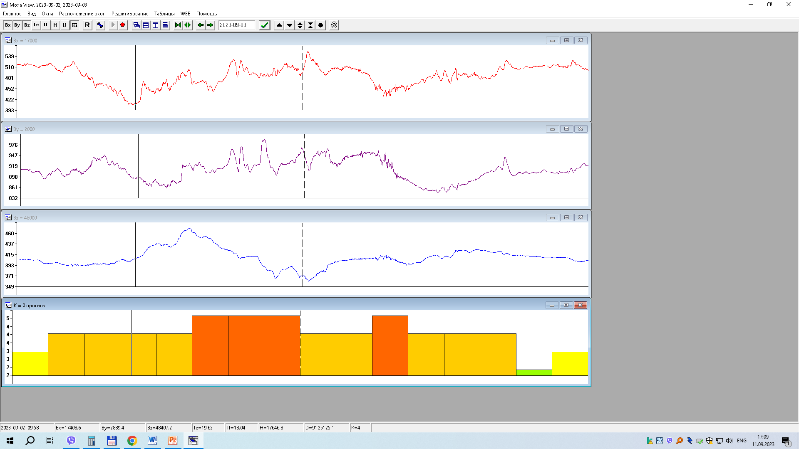
Pleshchenitsy Geophysical Observatory
Software
Presentation of the LEMI-022 magnetometer data, as well as the results of their processing using the Moxa Viewer program

Slide 11
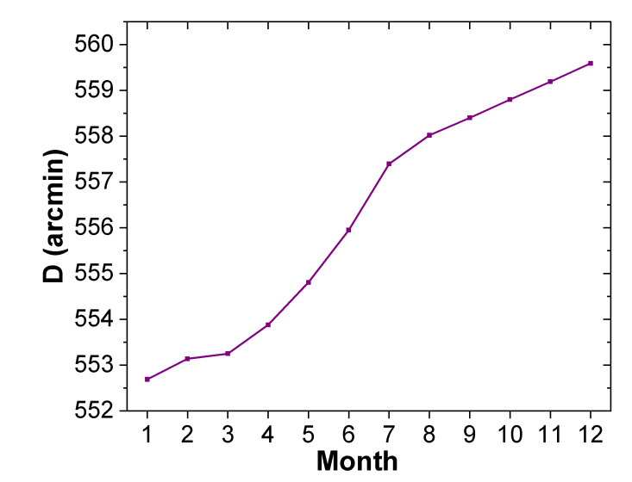
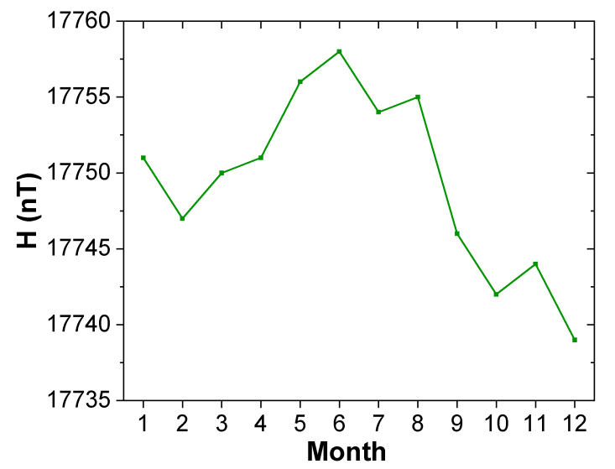
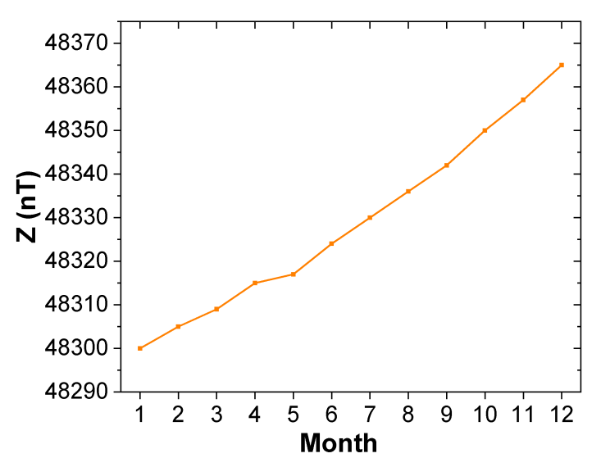
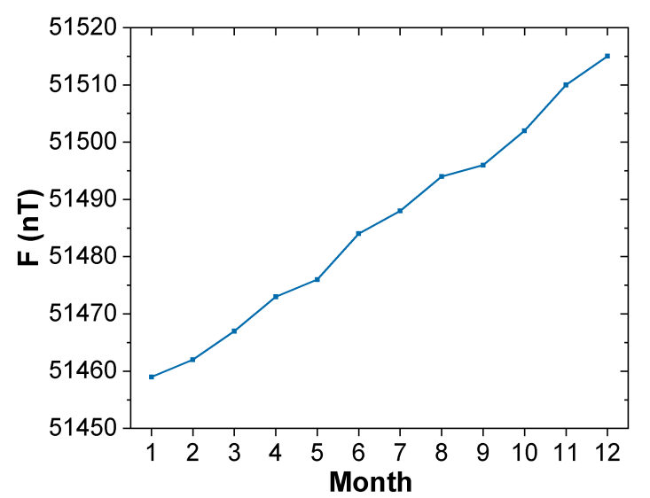
Observations of the geomagnetic field elements at the Pleshchenitsy Geophysical Observatory
An increase of monthly mean values of the D, Z, F components was observed during the whole year of 2022
declination: + 6′54″
D
(arcmin)
H (nT)
horizontal: – 12 nT
vertical: + 65 nT
vector magnitude: + 56 nT
Z (nT)
F (nT)

Slide 12
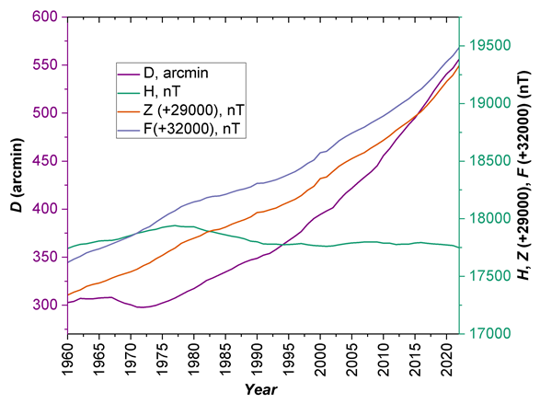
Observations of the geomagnetic field elements at the Pleshchenitsy Geophysical Observatory
Secular variations of the annual mean values of the declination D, horizontal H, vertical Z components, the full geomagnetic field vector F between the years of 2022 and 1960:
– 253.56 arcmin (4°13′34″) for the geomagnetic field declination D; the average annual variation is 4.09 arcmin (4′5″), though since 2009 the secular variation averaged 8′34″ per year;
– 7.4 nT for the horizontal component H of the geomagnetic field; the average annual variation is 0.1 nT;
– 1991.2 nT for the vertical component Z of the geomagnetic field; the average annual variation is 32.1 nT;
– 1864.5 nT for the full geomagnetic field vector F; the average annual variation is 30.1 nT.

Slide 13
Geomagnetic field disturbance analysis based on the data of Pleshchenitsy Observatory
Monthly reviews of the magnetic field state composed at the Pleshchenitsy Geophysical Observatory describe the magnetic field disturbance using the magnetic storm characteristics and three-hourly values of the K-indices (9-scores scale)
Magnetic storms
Table 1. Scale of magnetic storms adopted at the Pleshchenitsy Geophysical Observatory
Storm type |  | D (arcmin) | Н (nT) | Z (nT)
minor storm | (G1) | 19-26 | 80-125 | 40-90
moderate storm | (G2) | 27-38 | 126-200 | 91-140
major storm | (G3) | 39-55 | 201-270 | 141-250
severe storm | (G4) | >55 | >270 | >250
К-indices
Table 2. Scale of K-indices adopted at the Pleshchenitsy Geophysical Observatory
K-index value | 0 | 1 | 2 | 3 | 4 | 5 | 6 | 7 | 8 | 9
Upper limit (nT) | 5 | 10 | 20 | 40 | 70 | 120 | 200 | 330 | 550 | >550

Slide 14
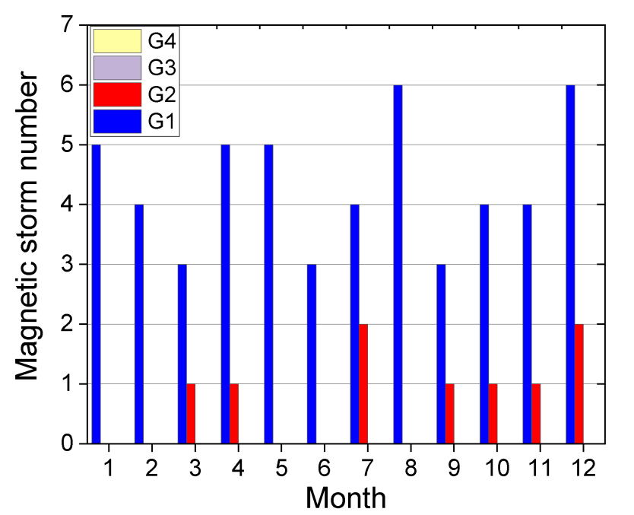
Geomagnetic field disturbance analysis based on the data of Pleshchenitsy Observatory
Magnetic storms
61 magnetic storms were recorded and processed in 2022, which exceed by 32 the number of storms recorded in 2021 (29) and is 1.86 times the average value (32.8) of long-term observations over 52 years (1970–2021).
Change in the number of magnetic storms in 2022: the greatest number of magnetic storms (8) was observed in December, and the least number – in June (3).
24 storms were recorded during the first half of 2023, which is indicative of a high degree of the geomagnetic field disturbance in the current year.

Slide 15
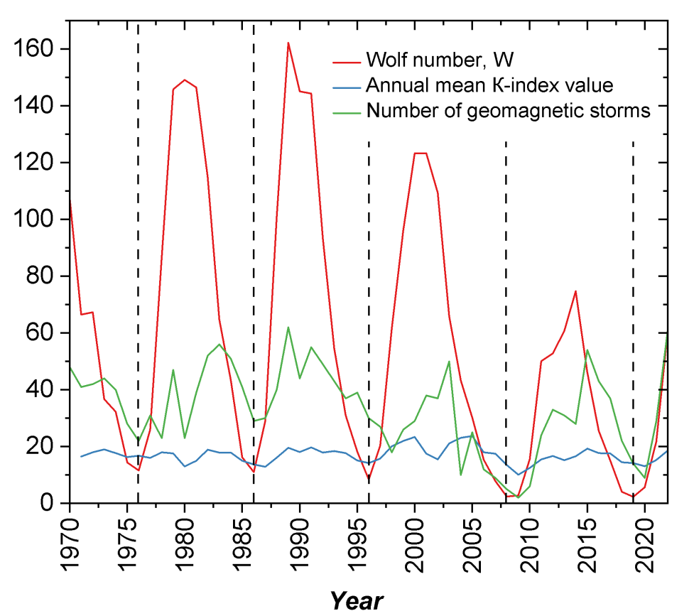
Geomagnetic field disturbance analysis based on the data of Pleshchenitsy Observatory
Dynamics of the geomagnetic field disturbance
The impact of the solar plasma stream (solar wind) on the Earth’s magnetosphere, the internal magnetospheric changes and the magnetosphere and ionosphere interaction influence the geomagnetic field disturbance which manifests itself as irregular magnetic field variations (Adushkin V.V. et al., GEOS, 2021; Kilifarska et al., Elsevier, 2020; Bezrodnykh I.P. et al., VNIIEM Proceedings, 2019).
In this context, the analysis of the dynamics of the geomagnetic field disturbance is presented in comparison with the solar activity within four adjacent 11-year cycles:
21st (1976–1986),
22nd (1986–1996),
23rd (1996–2008),
24th (2008–2019).

Slide 16
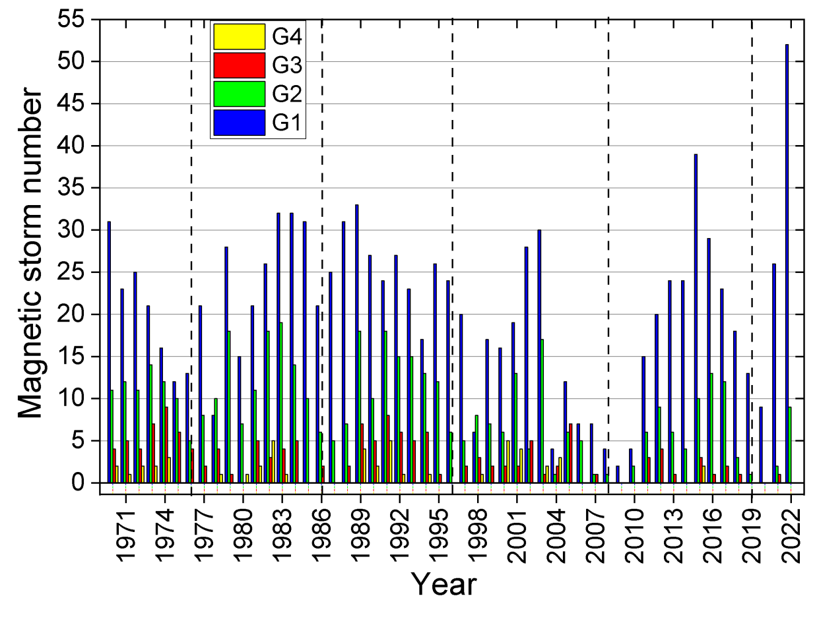
Geomagnetic field disturbance analysis based on the data of Pleshchenitsy Observatory
Long-term variations of the magnetic storm number during 1970–2022
The maximum number of magnetic storms (> 60) was observed in 1989 and 2022, and the minimum one - in 2008-2010.
In 2021-2022 there was a great increase in the number of magnetic storms, while from 2016 to 2020 there was a decrease in their number.

Slide 17
Geomagnetic field disturbance analysis based on the data of Pleshchenitsy Observatory
Long-term variations of the magnetic storm number during 1970–2022
Long-term variations of the magnetic storm number suggest that phases of storm number reduction are followed by phases of increasing number of storms.
The period between the minimum values is 11-12 years that coincides with the current period of solar activity.
At the same time, the maxima of the magnetic storm number do not coincide with the maxima of Wolf numbers, but are shifted toward the phase of decreasing solar activity which corresponds to other authors results (Obridko V.N. et al., Geomagn. Aeron+, 2013; Reyes P.I. et al., Space Weather, 2021; Owens M.J. et al., Solar Physics, 2021).
An increase of the geomagnetic field disturbance was observed in 2021–2022 simultaneously with an increase of the solar activity.

Slide 18
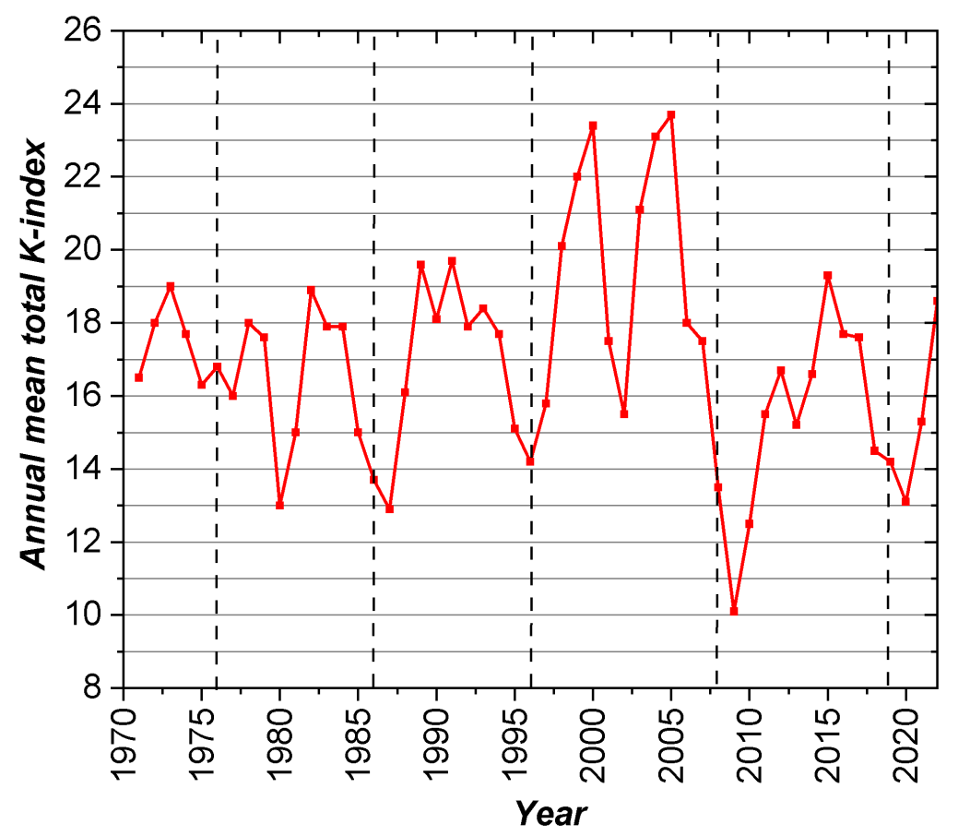
Geomagnetic field disturbance analysis based on the data of Pleshchenitsy Observatory
Long-term variations of the annual mean values of the total K-indexes during 1971–2022
The maximum values of the annual mean total K-indexes (>23) were recorded in 2000 and 2005, the minimum ones (<13) were observed within 2009–2010.
In 2021–2022 a growth of the annual mean values of the total K-index was outlined which testifies to the onset of the next activation period within the 25th solar cycle.

Slide 19
Geomagnetic field disturbance analysis based on the data of Pleshchenitsy Observatory
Long-term variations of the annual mean values of the total K-indices during 1971–2022
Long-term variations of the annual mean values of the total K-indices show quite a complicated pattern. There are the fluctuations with the period smaller than the 11-year solar activity period.
In the years when the Wolf numbers W have the minimum values (1976, 1986, 1996, 2008, 2019), the annual mean values of K-indices also tends to the minimum values.
There is one or two years lag of the growth and decrease stages with respect to 11-year solar cycles as it was also revealed in the case of the magnetic storms quantity.
After the early growth stage a decrease (sufficiently great in some solar cycles) of the annual mean values of the K-index is observed.

Slide 20
Conclusions
In Republic of Belarus, the determination of the secular variations of the Earth’s magnetic field elements D, H, Z, F is continuously carried out by the geomagnetic station at the Pleshchenitsy Geophysical Observatory (65 km out of Minsk) since 1960.
An increase in the geomagnetic field elements D, Z, F observed is likely connected with the continuing displacement of the Earth’s magnetic poles.
A periodic character of the change of the geomagnetic field disturbance which corresponds to the solar activity cycles with a shift towards the solar activity decrease phase is revealed.
The Earth’s magnetic field in 2022 is rather disturbed, and geomagnetic activity level higher than the previous year one.

Slide 21
Thank you for your attention!

