Slide 1

Space Weather Prediction
in SINP MSU Space Weather
Analysis Center
Myagkova I.N., Dolenko S.A., Kalegaev V.V.
SKOBELTSYN INSTITUTE OF NUCLEAR PHYSICS LOMONOSOV MOSCOW STATE UNIVERSITY
irina@srd.sinp.msu.ru

Slide 2
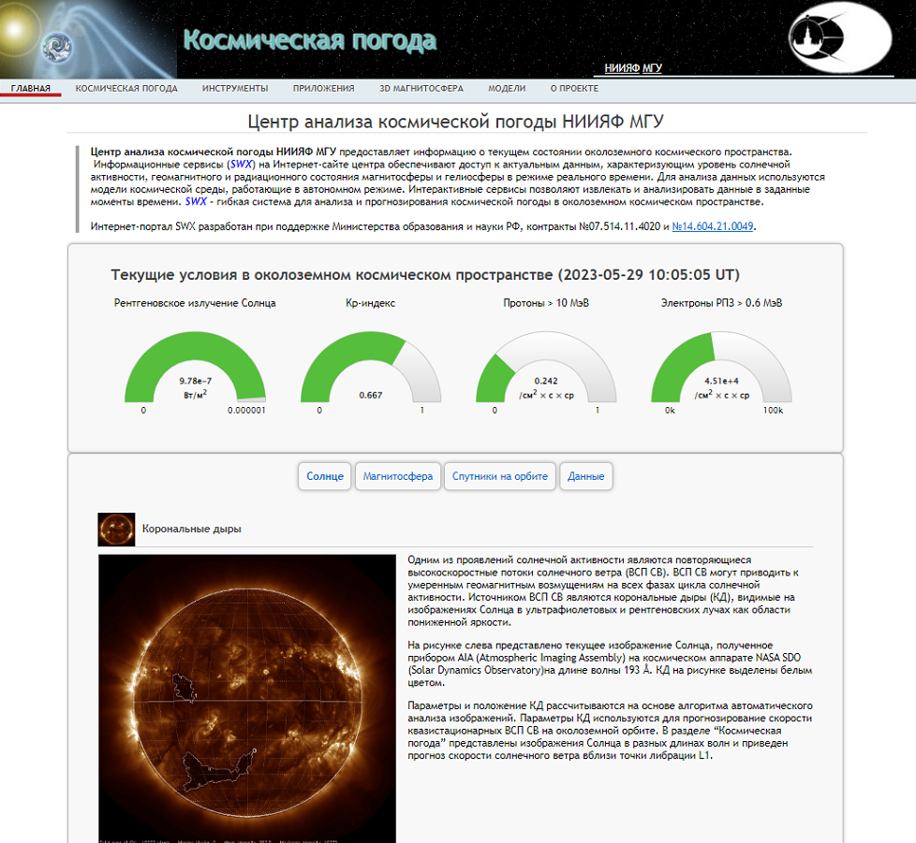
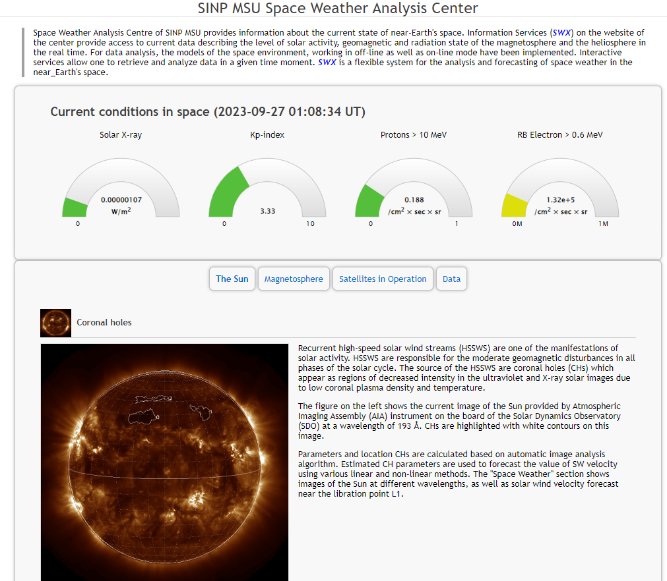
swx.sinp.msu.ru

Slide 3
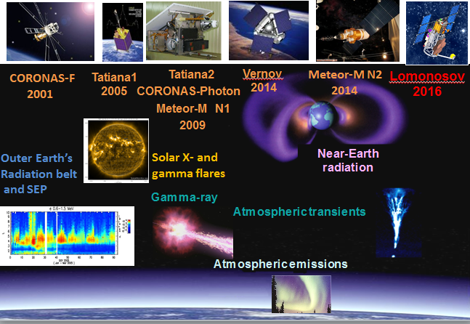

Slide 4
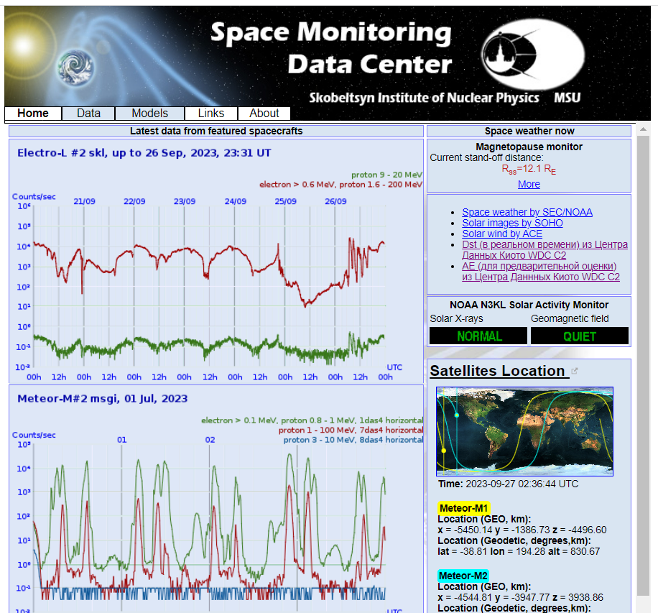

Slide 5
Forecast:
Hourly Dst index values
Three-hour Kp index values
Hourly average values of the relativistic electron (RE) flux of the Earth's outer radiation belt (E > 2 MeV) in geostationary orbit
Daily fluences of RE of the Earth's outer radiation belt (E > 2 MeV) in geostationary orbit
Notes:
5

Slide 6
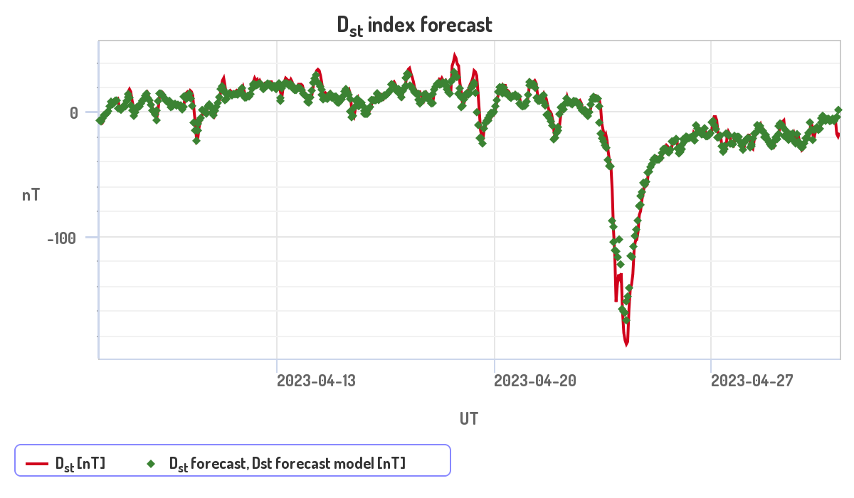
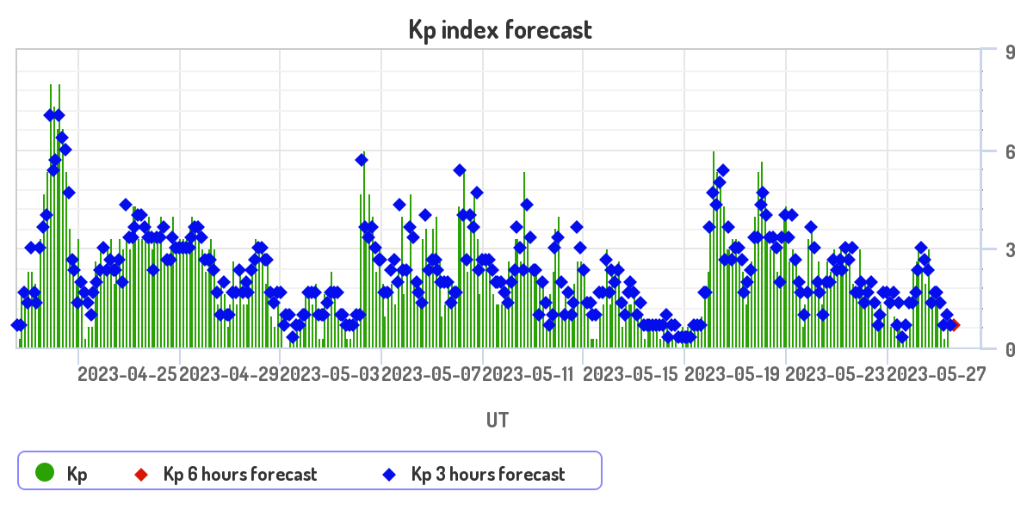
Forecast Dst and Кр
http://swx.sinp.msu.ru/models/dst.php?gcm=1
https://swx.sinp.msu.ru/models/kp.php?gcm=1

Slide 7
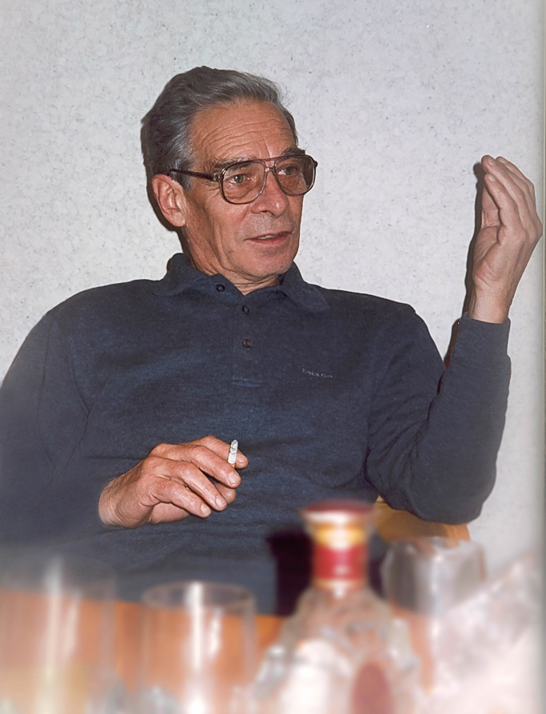
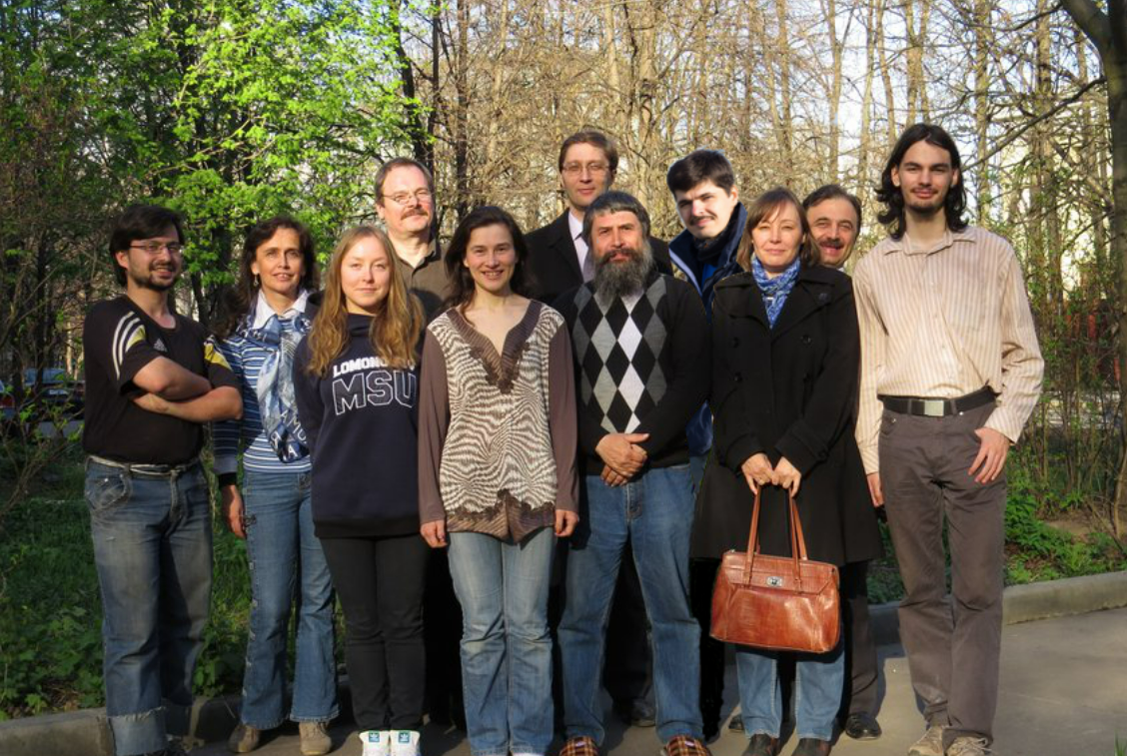
Founder of adaptive methods at SINP MSU –
Igor Georgievich Persiansev
1937 – 2015
Team swx.sinp.msu.ru (примерно 2016-2018)

Slide 8
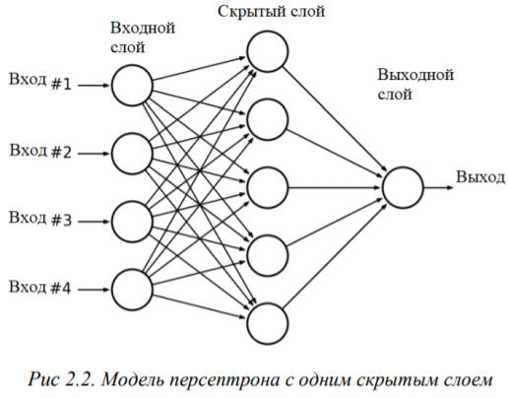
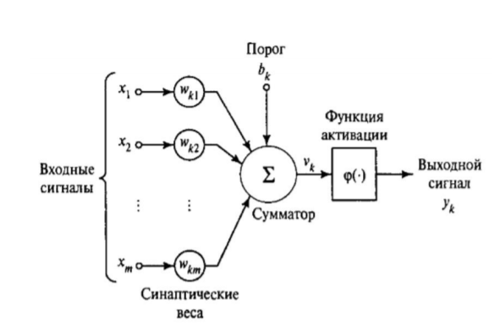
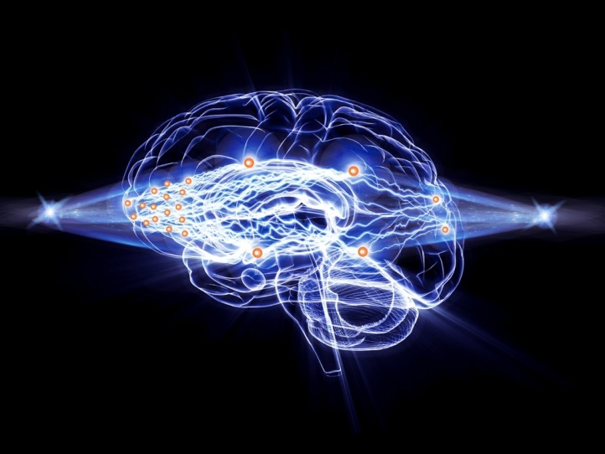


Circuits of an artificial neuron and a multilayer perceptron
Artificial Neuron

Slide 9
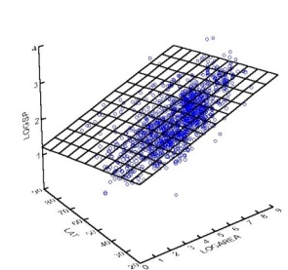
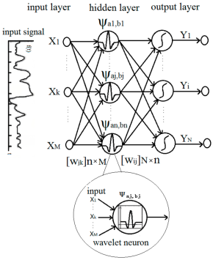
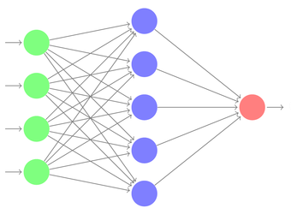
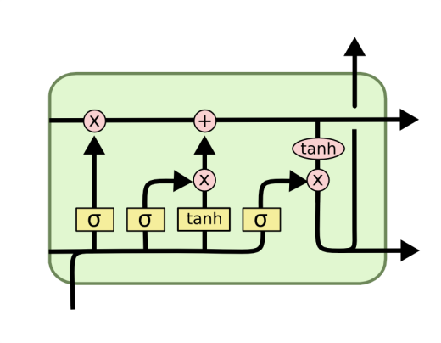

Adaptive forecasting methods used
Linear regression
Linear regression in linear and nonlinear basis
Method of projections onto latent structures
Artificial neural networks without feedback
Multilayer perceptrons
Wavelet neural networks
Recurrent neural networks
Long Short-Term Memory (LSTM) networks
Method of group accounting of arguments (MGUA)
Adaptive Neuro-Fuzzy Systems (ANFIS)
Decision trees and algorithms based on them
Random forest algorithme
Xtreme Gradient Boosting
Committees (ensembles) of predictors
Notes:
9

Slide 10
Dynamic systems and time series
Dynamic system (DS) is a complex system that changes over time, described by a set of parameters (features)
The state of the DS depends on its background
The state of the DS may depend on external influences
The behavior of the DS is described by a multivariate time series (MTS), each feature corresponds to a component of the time series
Notes:
10

Slide 11
Methods for processing multivariate time series data
Recurrent mode - examples must follow in the same order as in the original time series
Time series immersion
The issue of additional inclusion of components of each time series, as a rule, requires a separate study. So, we build an approximation of the display of points in the original space according to the value of the desired forecast: (A_{t}, A_{t-1},…, A_{t-tA}, B_{t}, B_{t-1},…, B_{t-tB}, С_{t}, С_{t-1},…, С_{t-tС}, Y_{t}, Y_{t-1},…, Y_{t-tY}) → Y_{t+1}
Notes:
11

Slide 12
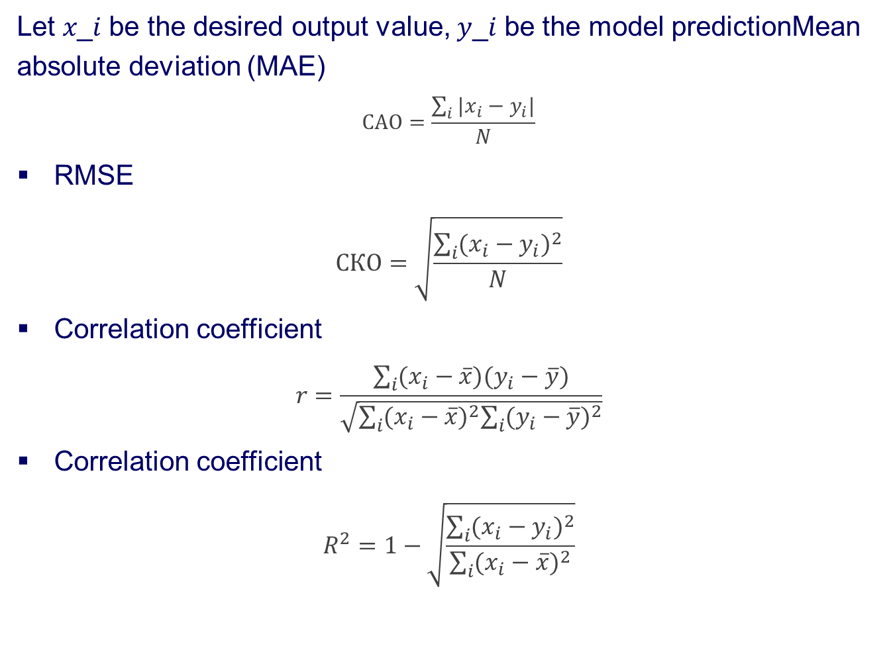
Criteria for assessing the quality of forecast
Let 𝑥_𝑖 be the desired output value, 𝑦_𝑖 be the model predictionMean absolute deviation (MAE)
$$САО=\frac{\sum_{i}{|x_{i}−y_{i}|}}{N}$$
RMSE
$$СКО=\sqrt{\frac{\sum_{i}{{(x_{i}−y_{i})}^{2}}}{N}}$$
Correlation coefficient
$$r=\frac{\sum_{i}{(x_{i}−\overline{x})(y_{i}−\overline{y})}}{\sqrt{\sum_{i}{{(x_{i}−\overline{x})}^{2}\sum_{i}{{(y_{i}−\overline{y})}^{2}}}}}$$
Correlation coefficient
$$R^{2}=1−\sqrt{\frac{\sum_{i}{{(x_{i}−y_{i})}^{2}}}{\sum_{i}{{(x_{i}−\overline{x})}^{2}}}}$$
Notes:
12

Slide 13
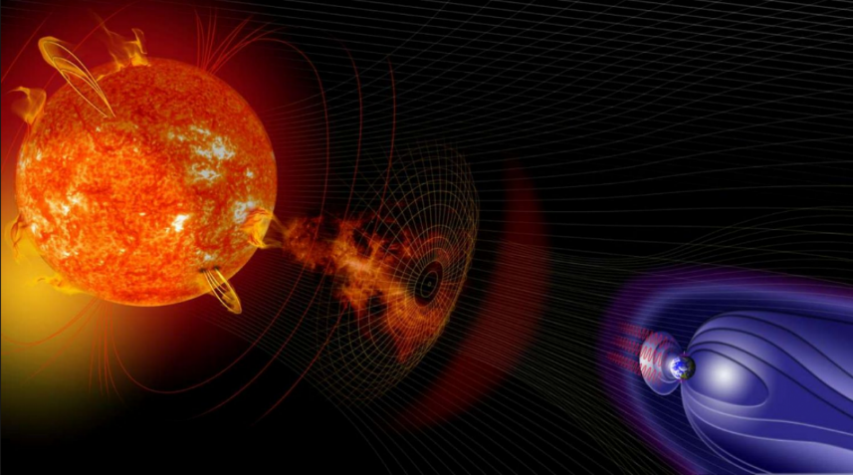
The Earth's magnetosphere as a dynamic system
The state of the Earth's magnetosphere
and the external influence on it
can be described by the following
physical quantities:
Geomagnetic indices: Dst, Kp, Ap, AE
Solar wind (SW) parameters: speed V, density nP, temperature T
Parameters of the interplanetary magnetic field (IMF): Bx, By, Bz, |B|
Fluxes of relativistic electrons of the Earth's outer radiation belt in geostationary orbit
Phases of the Earth's rotation around its axis and around the Sun
Prediction of SW velocity from the area of coronal holes in solar images
Information about the presence of a coronal mass ejection (CME)
Sunspot number data
Physically based combinations of the listed parameters
ULF indices calculated based on the listed parameters
Special physically based functions that effectively describe the transfer of energy from SW to the magnetosphere (coupling functions)
Notes:
13

Slide 14
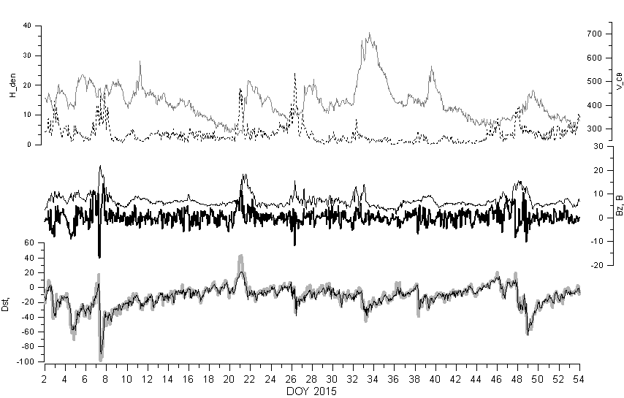
Forecast of hourly Dst index values
BP of hourly values of the Dst index and its forecast for 3 hours ahead (below).Main input parameters for the forecast (top).
Notes:
14

Slide 15
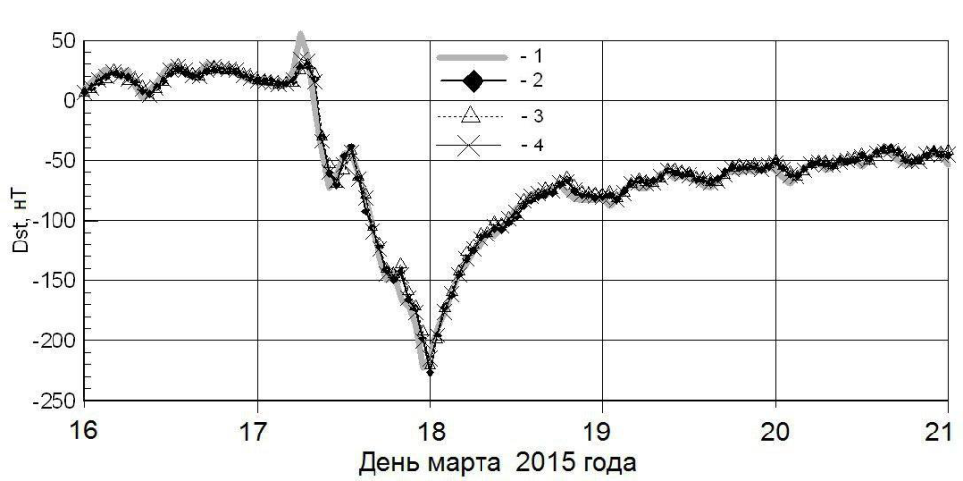
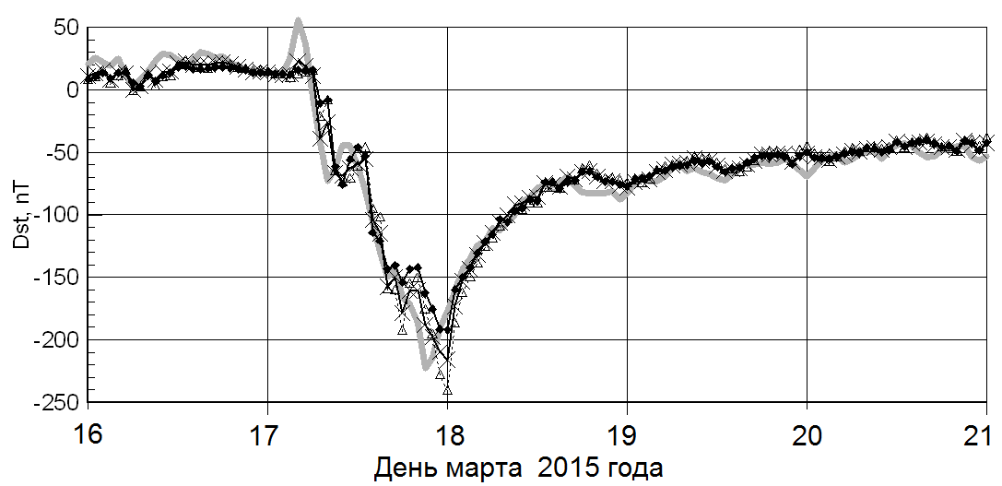
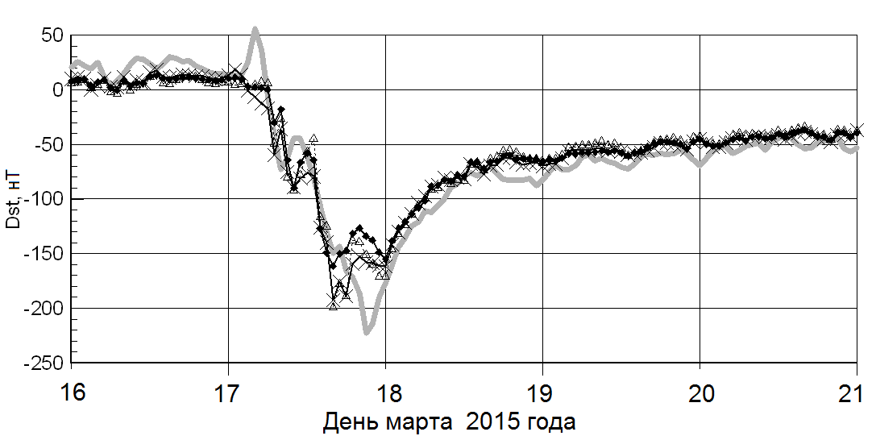
Прогноз часовых значений индекса Dst
1 – измеренные значения Dst индекса
2 – прогноз при помощи среднего по 12 сетям
3 – прогноз при помощи
гетерогенного комитета из 12 сетей
4 – прогноз при помощи среднего из 3 рекуррентных сетей с одинаковыми параметрами (LSTM с 96 блоками).
На 1 час
На 3 часа
На 6 часов
Notes:
15

Slide 16
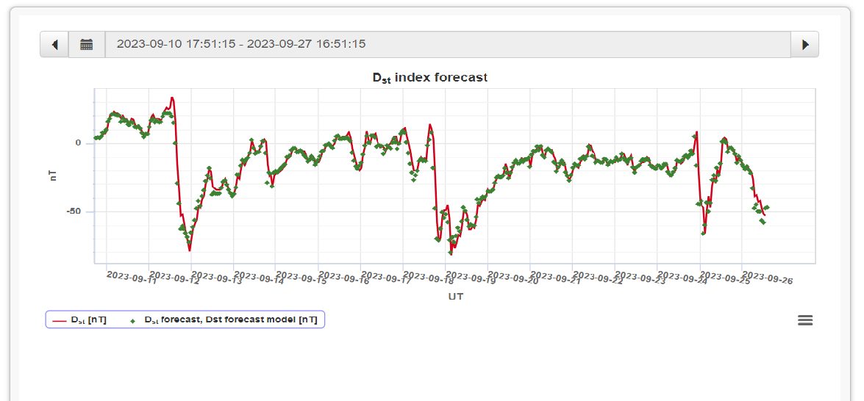
Прогноз значений индекса Dst
http://swx.sinp.msu.ru/models/dst.php?gcm=1
Notes:
16

Slide 17
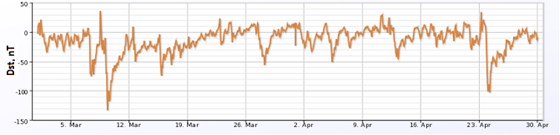
Automatic marking of geomagnetic disturbances
The algorithm is based solely on the dynamics of the hourly Dst index.Unambiguously reproducible and allows you to identify the beginning, end and phases of geomagnetic disturbances (SSC, main phase, relaxation phase).From October 22, 1997 to December 31, 2017, 1116 GW were allocated, of which 375 with SSC
An example of how the algorithm works from March 1 to April 30, 2012.
Notes:
17

Slide 18
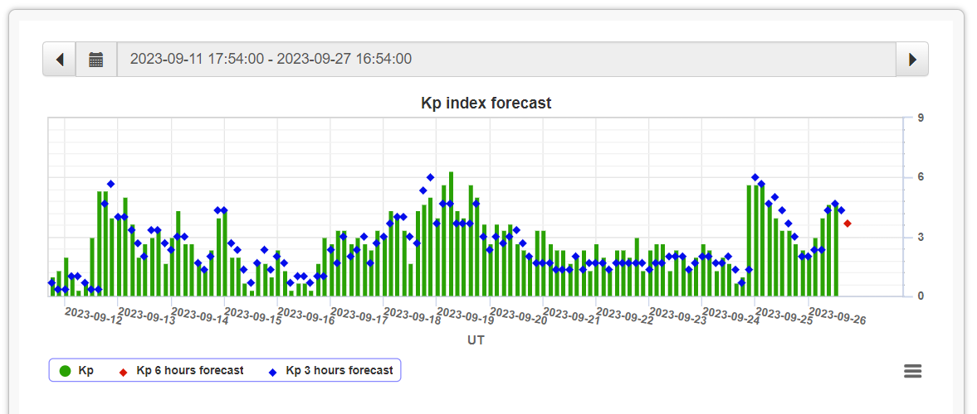
Forecast of Kp-index
http://swx.sinp.msu.ru/models/kp.php?gcm=1
Notes:
18

Slide 19
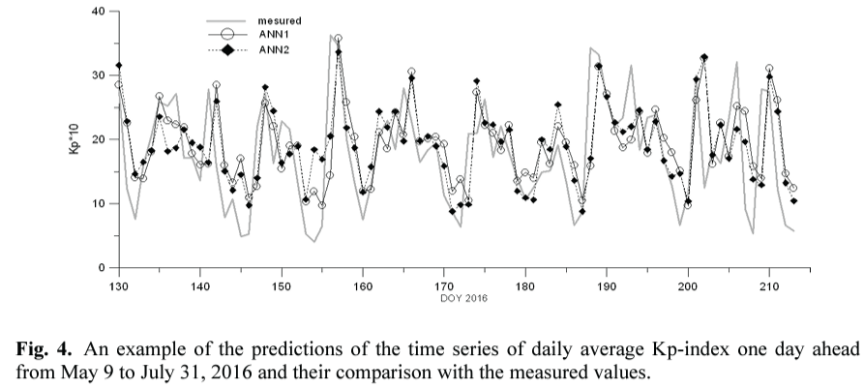
Forecast of average daily values of the Kp-index
I. Myagkova, V. Shiroky, and S. Dolenko. Prediction of geomagnetic indexes with the help of artificial neural networks. E3S Web of Conferences, 20:art. 02011, 2017.
Notes:
19

Slide 20
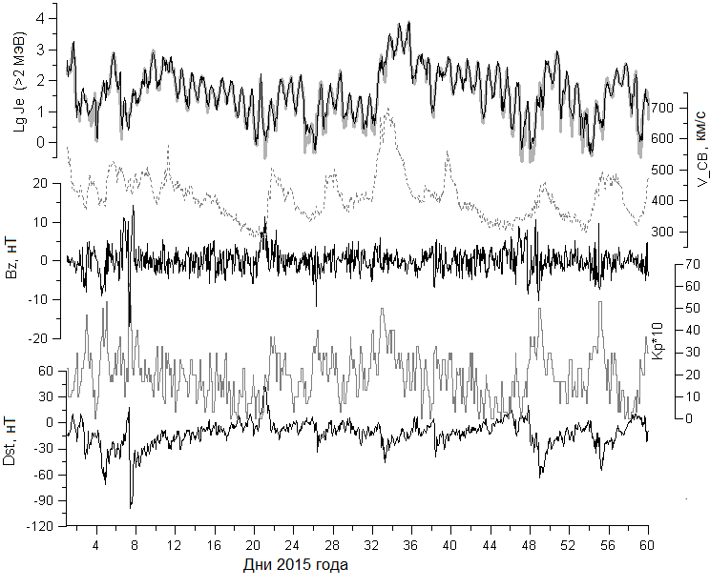
Forecast of average hourly RE fluxes of the outer ERB
TS of hourly values of the RE fluxes and its forecast for 3 hours ahead (above).Main input parameters for the forecast (bottom).
Notes:
20

Slide 21
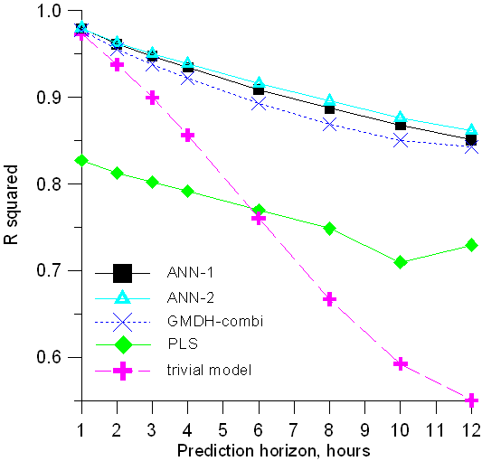
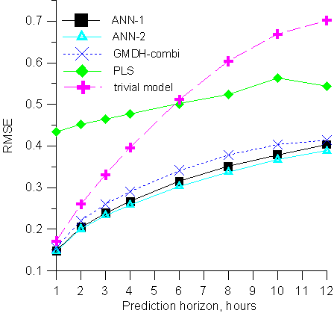
Forecast of average hourly RE RE fluxes of the outer ERB
1 – ANN, 2 – GMDH, 3 – PLS, 4 – trivial model
The best result was shown by the ANN (perceptron)
Notes:
21

Slide 22
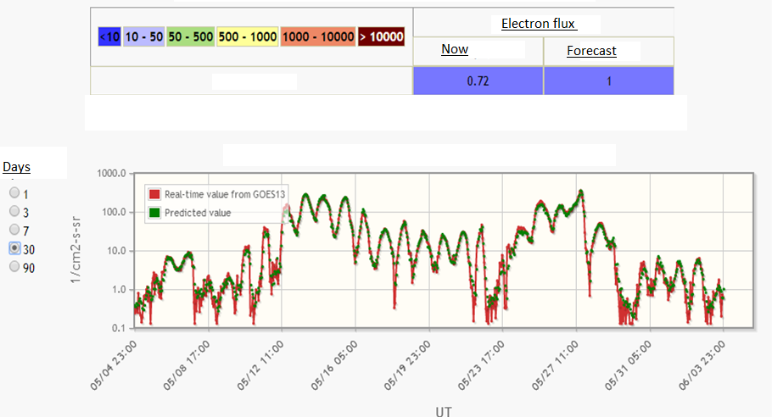
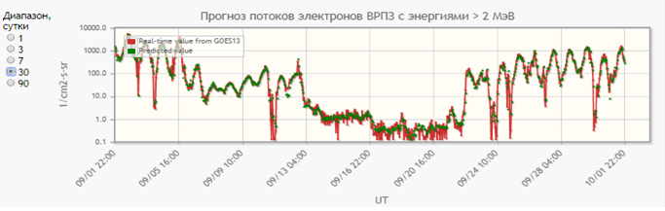
Model for short-term prediction of electron flow (> 2 MeV) in real time in geostationary orbit based on artificial neural networksGOES-13 satellite.

Slide 23
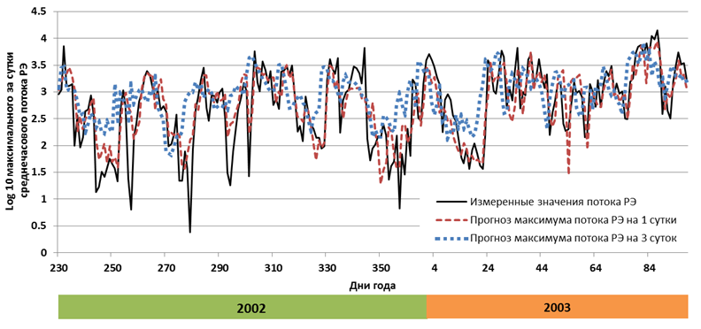
Forecast of maximum daily average hourly RE fluxes of the outer ERB
An example of comparison of the results of forecasting the time series of the decimal logarithm of ERPZ RE fluxes (> 2 MeV) (in (cm2 s sr)-1) by the decision tree committee method for a day (red line) and three days ahead (blue line) with observational results (black line) from August 25, 2002 to April 8, 2003.
Notes:
23

Slide 24
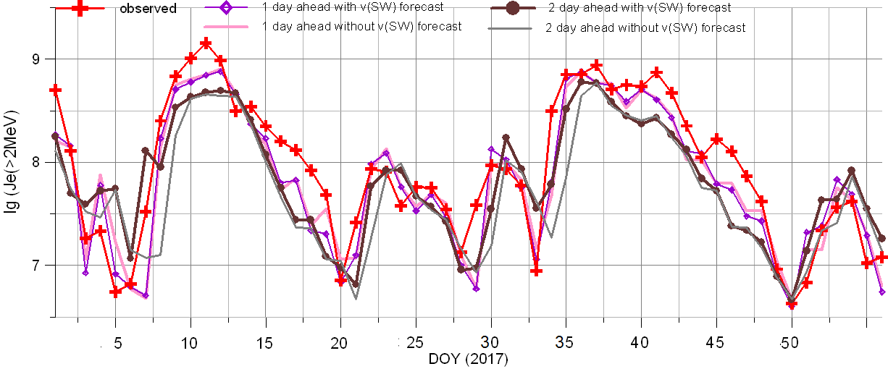
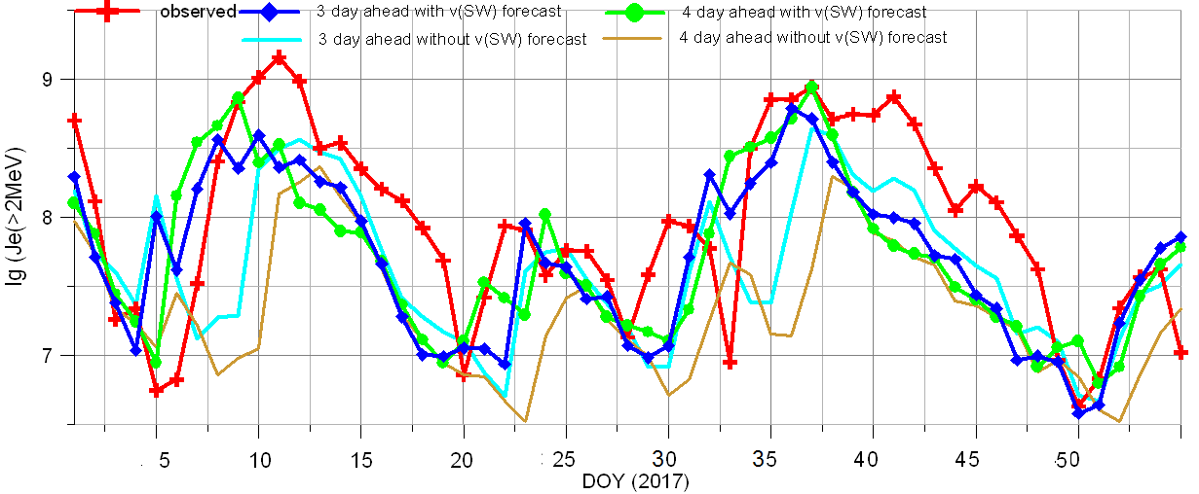
Forecast of daily RE fluence of outer ERB
Comparison of the quality of forecasts of daily fluences of the ERPZ RE, made without taking into account and taking into account the forecast of SW velocity based on the areas of coronal holes in solar images
Notes:
24

Slide 25
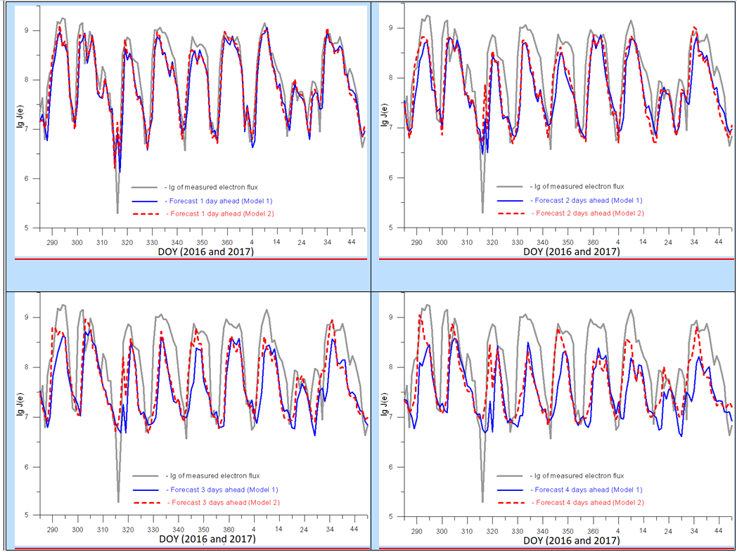
Forecast of daily RE fluence of outer ERB
Notes:
25

Slide 26
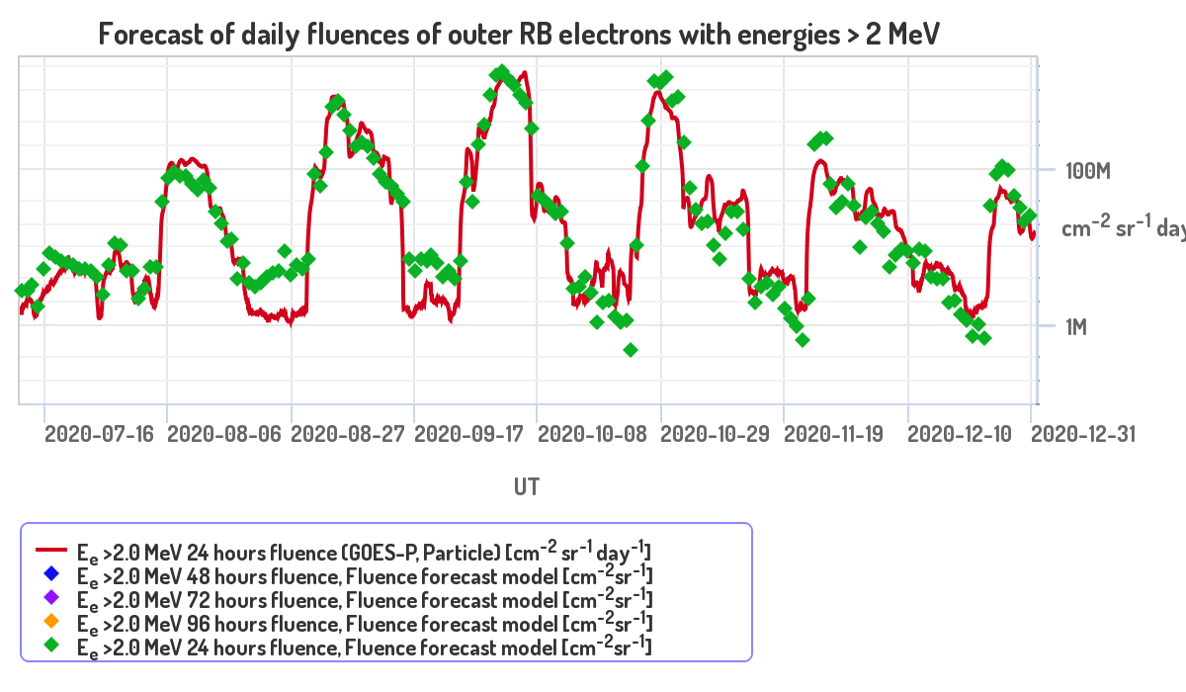
Forecast of daily RE fluence of outer ERB
http://swx.sinp.msu.ru/models/rb_electrons/index.php?gcm=1
Notes:
26

Slide 27
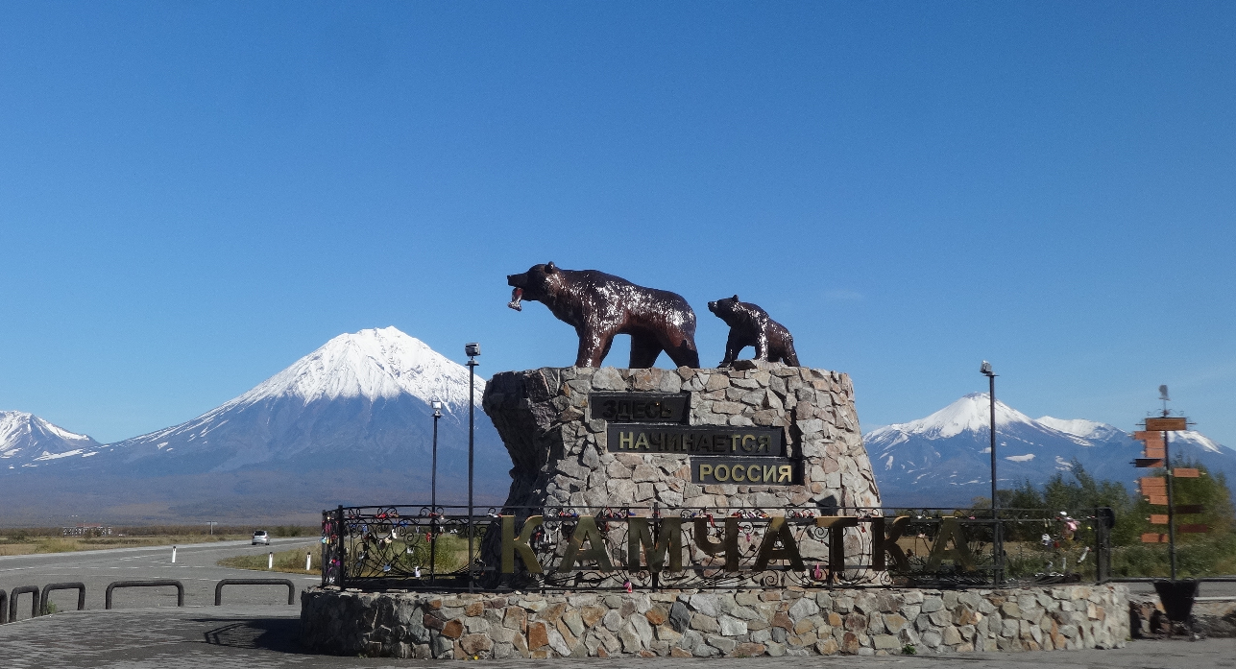
Thank you for your attention!
Авторы благодарят Российский научный фонд (грант № 23-21-00237, https://rscf.ru/project/23-21-00237/ ) за финансовую поддержку исследований

Slide 28
Mathematical Model of a Neuron
x₀=1
w₀
x₁
w₁
w₂
x₂
...
w_{n}
x_{n}
Provides a weighted sum of the inputs fed through a non-linear activation function -
Предоставляет взвешенную сумму входных данных, подаваемых через нелинейную функцию активации.

Slide 29
Multi-Layer Perceptron
F( X )
It can approximate any continuous function of several variables - Он может аппроксимировать любую непрерывную функцию нескольких переменных.
Notes:
Несколько выходов

Slide 30
Use of an Artificial Neural Network
Data preparation
Network type selection Training Applying
Answer
Tuning of
network
parameters
(weights)
Trained network
Training of an approximation model by examples instead of using a physically based model
Database
Data
Notes:
Отличие от традиционного программирования
Вместо алгоритма - примеры
1) Подготовка данных
2) Выбор архитектуры
3) Тренировка
4) Применение

Slide 31
Input parameters and data sources
Геомагнитные индексы:
World Data Center, Kyoto, Japan
Параметры солнечного ветра (СВ) и межпланетного магнитного поля (ММП) в точке Лагранжа L1 между Землёй и Солнцем:
Данные космического аппарата ACE, приборы SWEPAM и MAG
Потоки РЭ ВРПЗ на геостационарной орбите:
Данные проекта GOES
Изображения Солнца для расчёта площадей корональных дыр:
Данные проекта SDO, прибор AIA
Значения индексов ультранизких частот (УНЧ) (ULF)
Институт Физики Земли (ИФЗ РАН)
Число солнечных пятен
Royal Observatory of Belgium, Brussels
Notes:
31

Slide 32
Отбор и преобразование входных признаков
Погружение временного ряда приводит к резкому увеличению числа входных признаков (число физических признаков × глубину погружения)
Это усложняет работу алгоритмов и увеличивает возможность т.н. переучивания (падения качества работы на независимых данных)
Требуется увеличение количества примеров или понижение входной размерности данных
Количество примеров ограничено доступными массивами данных
Понижение входной размерности может быть достигнуто путем отбора существенных признаков или преобразования признаков
Адаптивные методы отбора признаков (плюс – интерпретируемость!):
Определение глубины погружения признака по автокорреляции
Отбор существенных признаков по кросс-корреляции
Нелинейные адаптивные методы отбора (в осн. нейросетевые)
Часто методы отбора требуют задания порога отбора
Notes:
32

