Slide 1
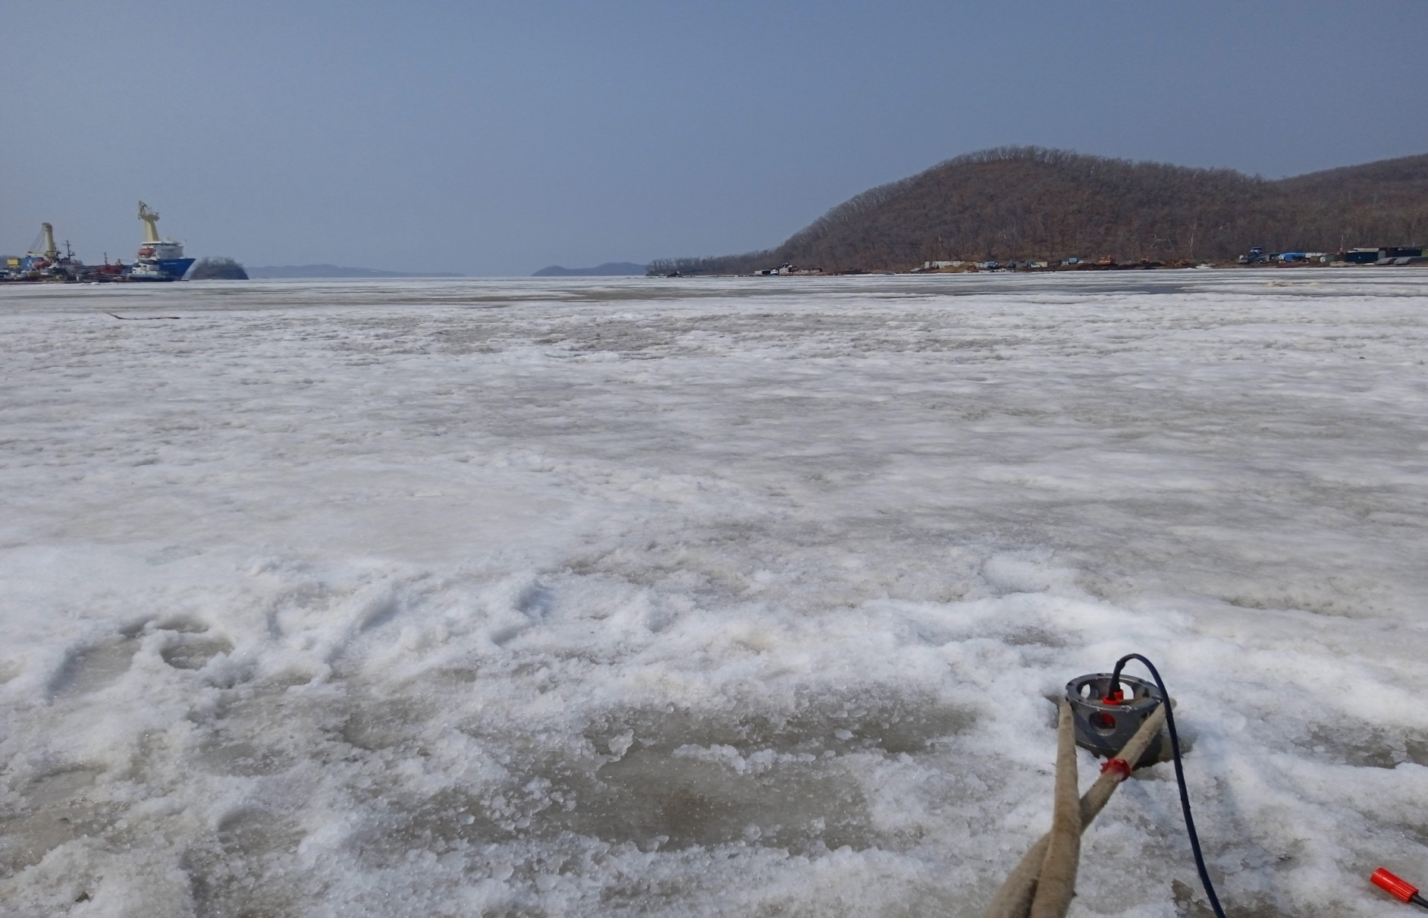
METHODS OF IMPROVING THE ENERGY EFFICIENCY OF COMMUNICATION SYSTEMS TAKING INTO ACCOUNT DYNAMIC CHARACTERISTICS IN AN ICE ENVIRONMENT
Korochentsev V.I., Xue Wei, Statsenko L.G., Bengard A.V.

Slide 2
Goal
Increasing antenna efficiency by converting reactive energy from the antenna's near field into active energy.

Slide 3
Materials and methods
Methods have been proposed for increasing the energy efficiency of communication systems using synthesized antennas located on moving platforms at extremely low temperatures. Energy efficiency is estimated by the antenna directivity coefficient, which is determined by the boundary conditions and the excitation function of the antenna array. To increase the operating efficiency of each emitter included in the antenna array, the elastic parameters of the carrier (platform) are taken into account in the mathematical model. With the optimal choice of the distance between the elements of the antenna array, the conversion of the reactive part of the energy into the active one is achieved. The active part of the converted energy is radiated into the far field, which increases the directivity of the antenna.

Slide 4
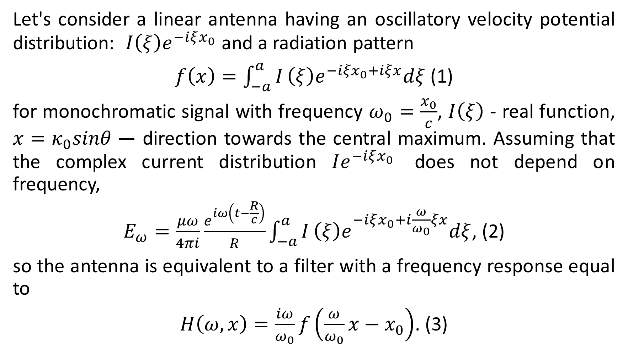
Let's consider a linear antenna having an oscillatory velocity potential distribution: $I\left(ξ\right)e^{−iξx_{0}}$ and a radiation pattern
$f\left(x\right)=\int_{−a}^{a}{I}\left(ξ\right)e^{−{iξx}_{0}+iξx}dξ$ (1)
for monochromatic signal with frequency $ω_{0}=\frac{x_{0}}{c}$, $I\left(ξ\right)$ - real function, $x=κ_{0}sinθ$— direction towards the central maximum. Assuming that the complex current distribution $Ie^{−iξx_{0}}$ does not depend on frequency,
$E_{ω}=\frac{μω}{4πi}\frac{e^{iω\left(t−\frac{R}{c}\right)}}{R}\int_{−a}^{a}{I}\left(ξ\right)e^{−iξx_{0}+i\frac{ω}{ω_{0}}ξx}dξ$, (2)
so the antenna is equivalent to a filter with a frequency response equal to
$H\left(ω,x\right)=\frac{iω}{ω_{0}}f\left(\frac{ω}{ω_{0}}x−x_{0}\right)$. (3)

Slide 5
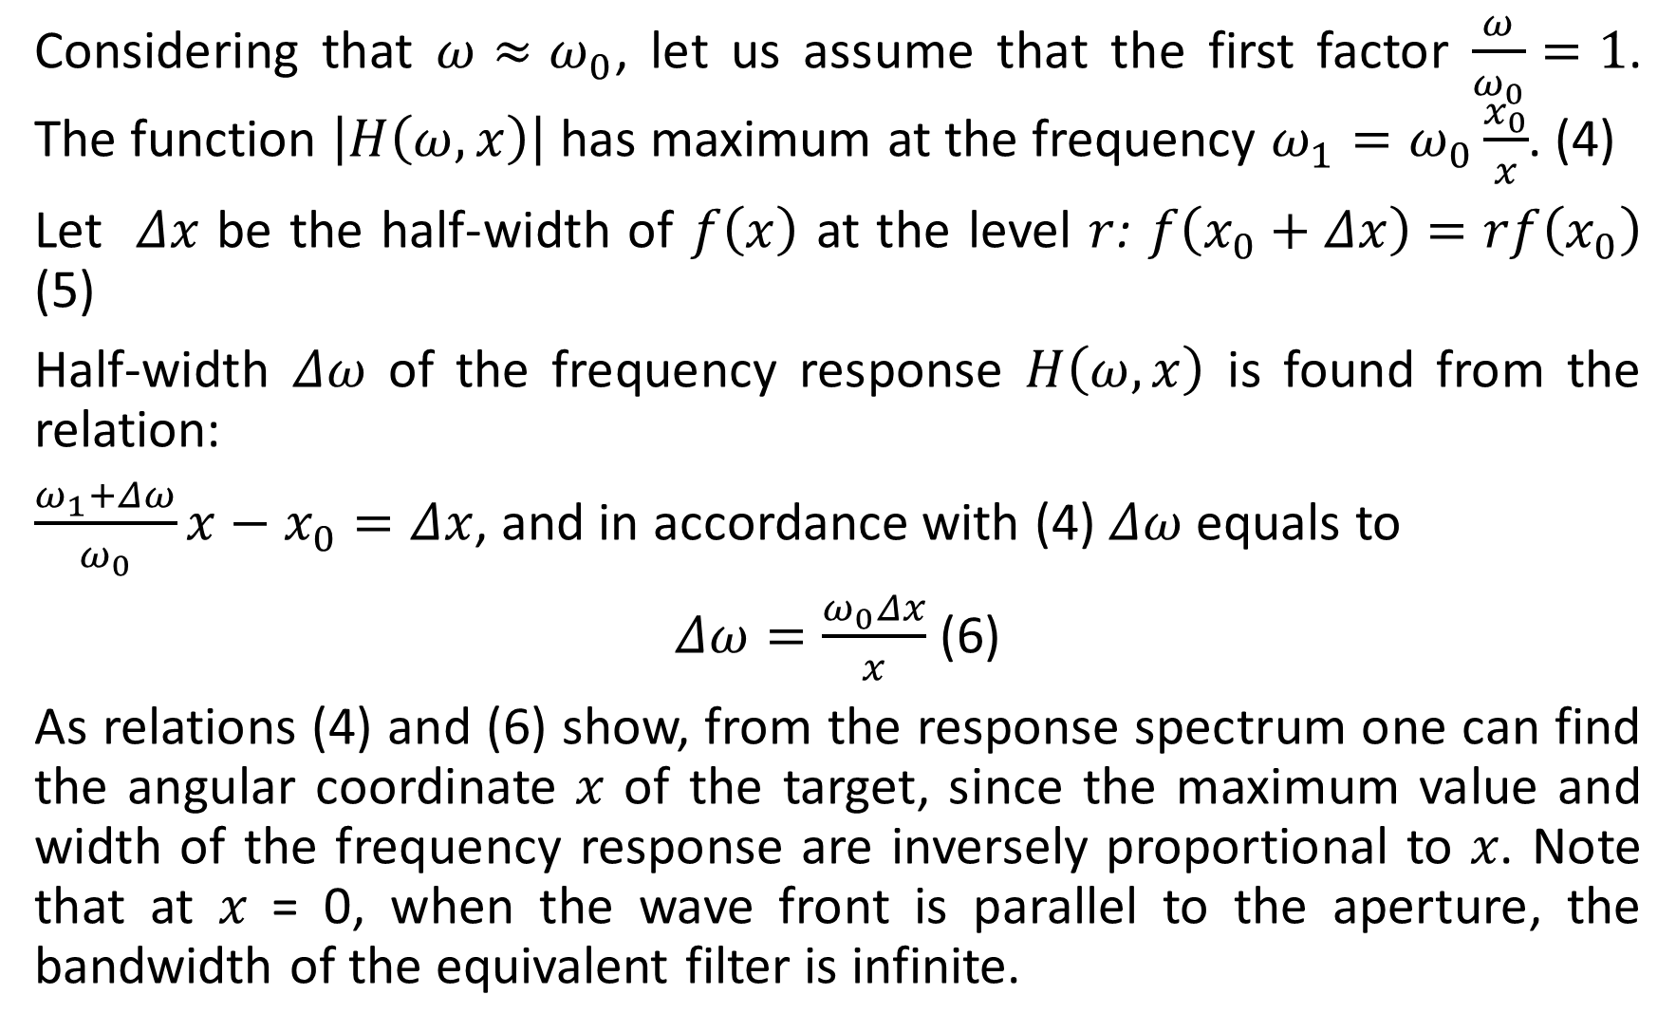
Considering that $ω≈ω_{0}$, let us assume that the first factor $\frac{ω}{ω_{0}}=1$. The function $\left|H\left(ω,x\right)\right|$ has maximum at the frequency $ω_{1}=ω_{0}\frac{x_{0}}{x}$. (4)
Let $Δx$ be the half-width of $f\left(x\right)$ at the level $r$: $f\left(x_{0}+Δx\right)=rf\left(x_{0}\right)$ (5)
Half-width $Δω$ of the frequency response $H\left(ω,x\right)$ is found from the relation:
$\frac{ω_{1}+Δω}{ω_{0}}x−x_{0}=Δx$, and in accordance with (4) $Δω$ equals to
$Δω=\frac{ω_{0}Δx}{x}$ (6)
As relations (4) and (6) show, from the response spectrum one can find the angular coordinate 𝑥 of the target, since the maximum value and width of the frequency response are inversely proportional to 𝑥. Note that at 𝑥 = 0, when the wave front is parallel to the aperture, the bandwidth of the equivalent filter is infinite.

Slide 6
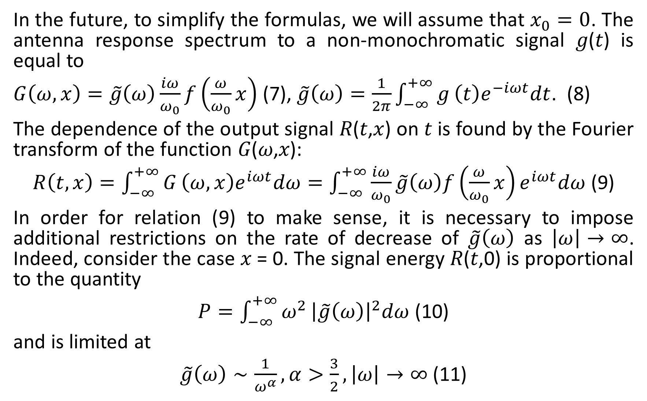
In the future, to simplify the formulas, we will assume that $x_{0}=0$. The antenna response spectrum to a non-monochromatic signal 𝑔(𝑡) is equal to
$G\left(ω,x\right)=\tilde{g}\left(ω\right)\frac{iω}{ω_{0}}f\left(\frac{ω}{ω_{0}}x\right)$ (7), $\tilde{g}\left(ω\right)=\frac{1}{2π}{\int_{−∞}^{+∞}{g}\left(t\right)e}^{−iωt}dt$. (8)
The dependence of the output signal 𝑅(𝑡,𝑥) on 𝑡 is found by the Fourier transform of the function 𝐺(𝜔,𝑥):
$R\left(t,x\right)=\int_{−∞}^{+∞}{G}\left(ω,x\right)e^{iωt}dω=\int_{−∞}^{+∞}{\frac{iω}{ω_{0}}}\tilde{g}\left(ω\right)f\left(\frac{ω}{ω_{0}}x\right)e^{iωt}dω$ (9)
In order for relation (9) to make sense, it is necessary to impose additional restrictions on the rate of decrease of $\tilde{g}\left(ω\right)$ as $\left|ω\right|→∞$. Indeed, consider the case 𝑥 = 0. The signal energy 𝑅(𝑡,0) is proportional to the quantity
$P=\int_{−∞}^{+∞}{ω^{2}}{\left|\tilde{g}\left(ω\right)\right|}^{2}dω$ (10)
and is limited at
$\tilde{g}\left(ω\right)∼\frac{1}{ω^{α}},α>\frac{3}{2},\left|ω\right|→∞$ (11)

Slide 7
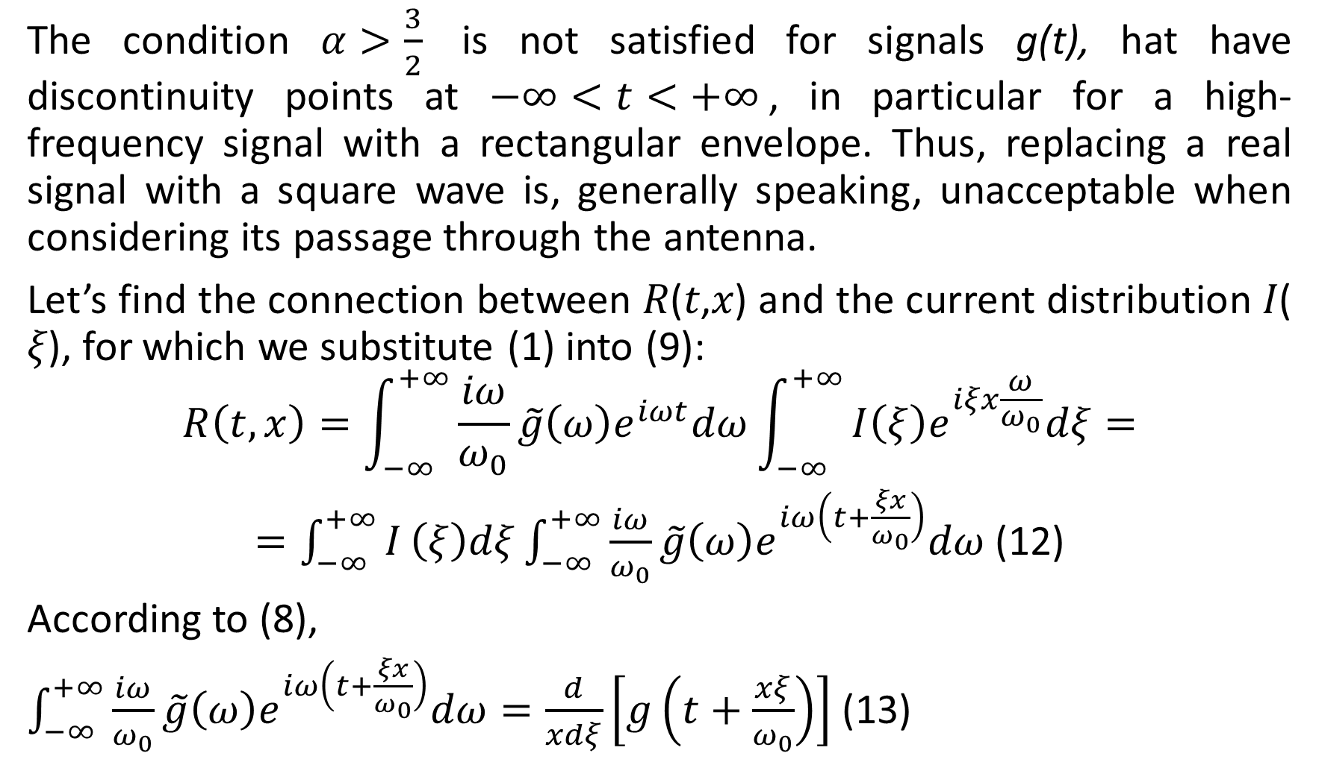
The condition $α>\frac{3}{2}$ is not satisfied for signals g(t), hat have discontinuity points at $−∞<t<+∞$, in particular for a high-frequency signal with a rectangular envelope. Thus, replacing a real signal with a square wave is, generally speaking, unacceptable when considering its passage through the antenna.
Let’s find the connection between 𝑅(𝑡,𝑥) and the current distribution 𝐼(𝜉), for which we substitute (1) into (9):
$$R\left(t,x\right)=\int_{−∞}^{+∞}{\frac{iω}{ω_{0}}}\tilde{g}\left(ω\right)e^{iωt}dω\int_{−∞}^{+∞}{I\left(ξ\right)e^{iξx\frac{ω}{ω_{0}}}dξ}=$$
$=\int_{−∞}^{+∞}{I}\left(ξ\right)dξ\int_{−∞}^{+∞}{\frac{iω}{ω_{0}}}\tilde{g}\left(ω\right)e^{iω\left(t+\frac{ξx}{ω_{0}}\right)}dω$ (12)
According to (8),
$\int_{−∞}^{+∞}{\frac{iω}{ω_{0}}}\tilde{g}\left(ω\right)e^{iω\left(t+\frac{ξx}{ω_{0}}\right)}dω=\frac{d}{xdξ}\left[g\left(t+\frac{xξ}{ω_{0}}\right)\right]$ (13)

Slide 8
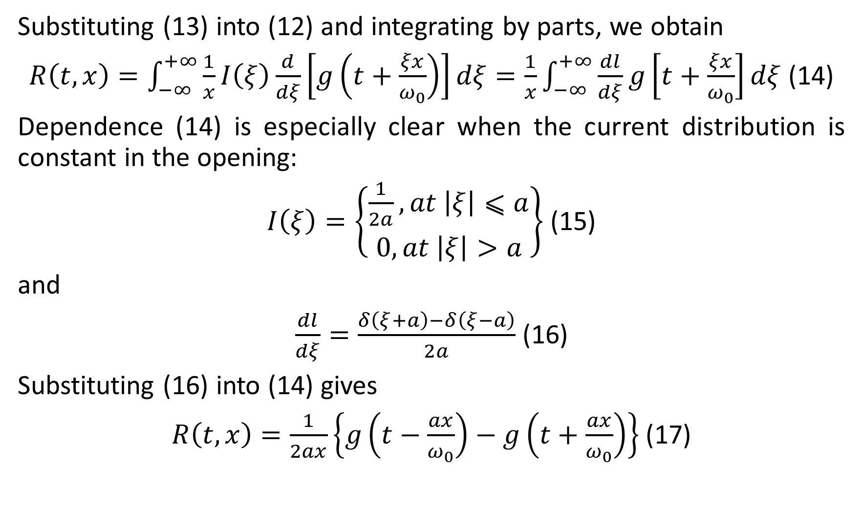
Substituting (13) into (12) and integrating by parts, we obtain
$R\left(t,x\right)=\int_{−∞}^{+∞}{\frac{1}{x}}I\left(ξ\right)\frac{d}{dξ}\left[g\left(t+\frac{ξx}{ω_{0}}\right)\right]dξ=\frac{1}{x}\int_{−∞}^{+∞}{\frac{dl}{dξ}}g\left[t+\frac{ξx}{ω_{0}}\right]dξ$ (14)
Dependence (14) is especially clear when the current distribution is constant in the opening:
$I\left(ξ\right)=\left\{\begin{aligned}\frac{1}{2a},at \left|ξ\right|⩽a \\ 0,at \left|ξ\right|>a\end{aligned}\right\}$ (15)
and
$\frac{dl}{dξ}=\frac{δ\left(ξ+a\right)−δ\left(ξ−a\right)}{2a}$ (16)
Substituting (16) into (14) gives
$R\left(t,x\right)=\frac{1}{2ax}\left\{g\left(t−\frac{ax}{ω_{0}}\right)−g\left(t+\frac{ax}{ω_{0}}\right)\right\}$ (17)

Slide 9
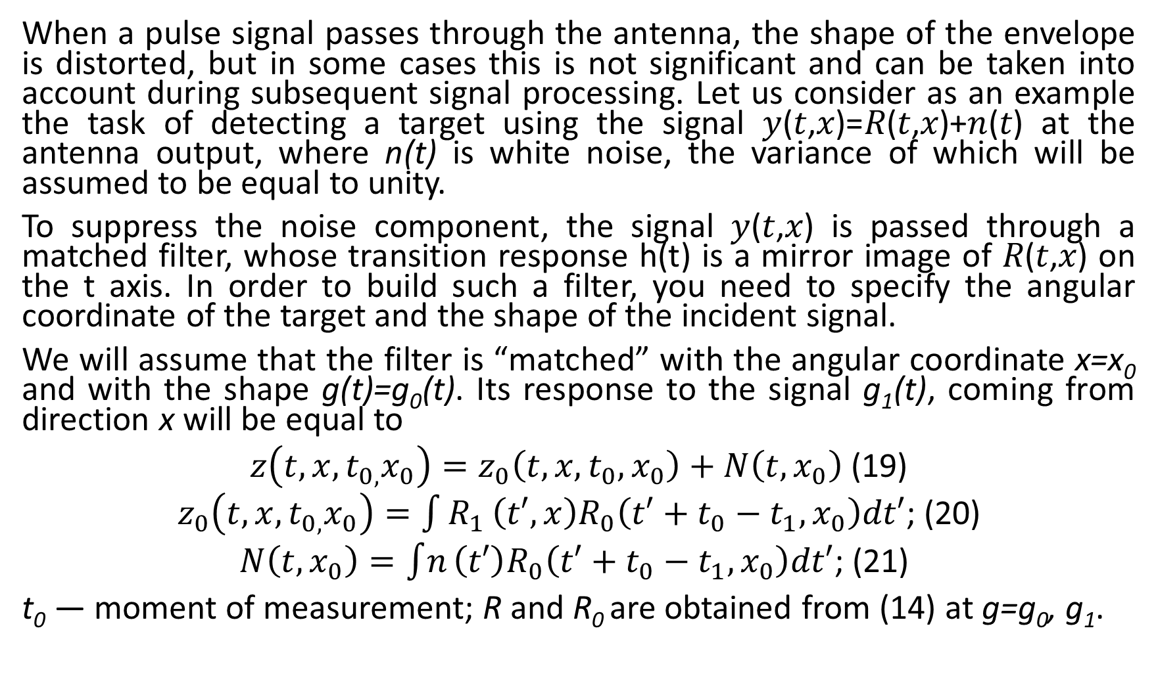
When a pulse signal passes through the antenna, the shape of the envelope is distorted, but in some cases this is not significant and can be taken into account during subsequent signal processing. Let us consider as an example the task of detecting a target using the signal 𝑦(𝑡,𝑥)=𝑅(𝑡,𝑥)+𝑛(𝑡) at the antenna output, where n(t) is white noise, the variance of which will be assumed to be equal to unity.
To suppress the noise component, the signal 𝑦(𝑡,𝑥) is passed through a matched filter, whose transition response h(t) is a mirror image of 𝑅(𝑡,𝑥) on the t axis. In order to build such a filter, you need to specify the angular coordinate of the target and the shape of the incident signal.
We will assume that the filter is “matched” with the angular coordinate x=x₀ and with the shape g(t)=g₀(t). Its response to the signal g₁(t), coming from direction x will be equal to
$z\left(t,x,t_{0,}x_{0}\right)=z_{0}\left(t,x,t_{0},x_{0}\right)+N\left(t,x_{0}\right)$ (19)
$z_{0}\left(t,x,t_{0,}x_{0}\right)=\int{R_{1}}\left(t′,x\right)R_{0}\left(t′+t_{0}−t_{1},x_{0}\right)dt′$; (20)
$N\left(t,x_{0}\right)=\int{n}\left(t′\right)R_{0}\left(t′+t_{0}−t_{1},x_{0}\right)dt′$; (21)
t₀ — moment of measurement; R and R₀ are obtained from (14) at g=g₀, g₁.

Slide 10
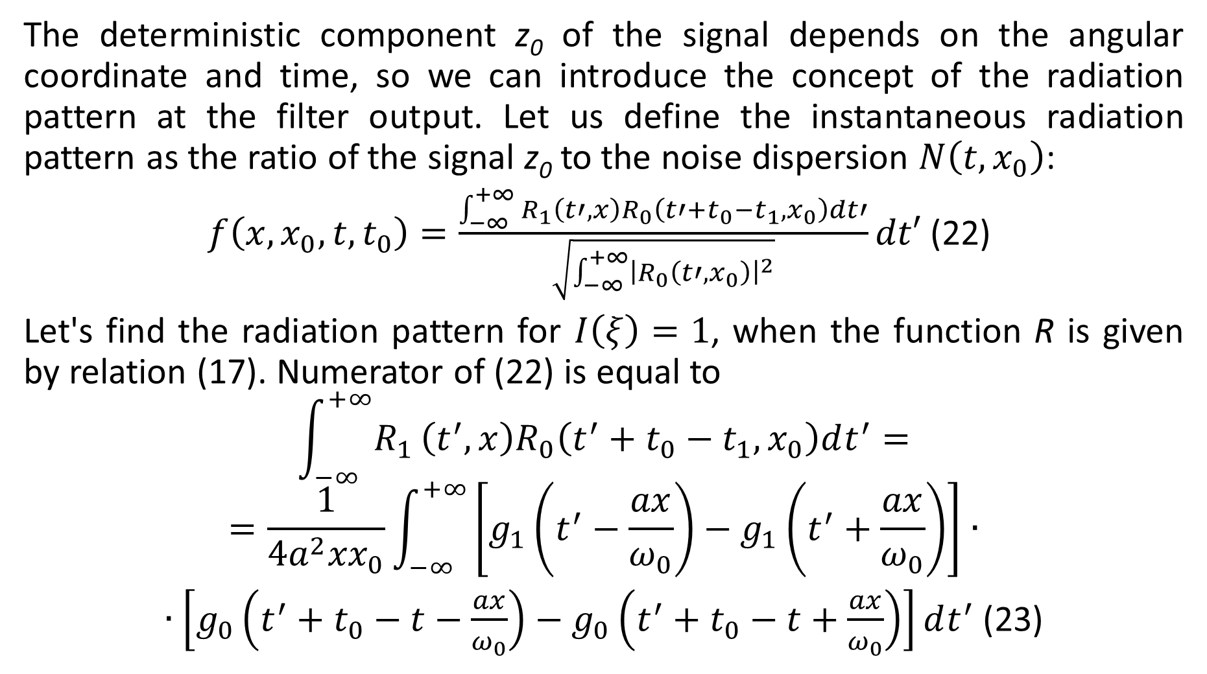
The deterministic component z₀ of the signal depends on the angular coordinate and time, so we can introduce the concept of the radiation pattern at the filter output. Let us define the instantaneous radiation pattern as the ratio of the signal z₀ to the noise dispersion $N\left(t,x_{0}\right)$:
$f\left(x,x_{0},t,t_{0}\right)=\frac{\int_{−∞}^{+∞}{R_{1}}\left(t′,x\right)R_{0}\left(t′+t_{0}−t_{1},x_{0}\right)dt′}{\sqrt{\int_{−∞}^{+∞}{{\left|R_{0}\left(t′,x_{0}\right)\right|}^{2}}}}dt′$ (22)
Let's find the radiation pattern for $I\left(ξ\right)=1$, when the function R is given by relation (17). Numerator of (22) is equal to
$$\int_{−∞}^{+∞}{R_{1}}\left(t^{′},x\right)R_{0}\left(t^{′}+t_{0}−t_{1},x_{0}\right)dt^{′}=$$
$$=\frac{1}{4a^{2}{xx}_{0}}\int_{−∞}^{+∞}{\left[g_{1}\left(t^{′}−\frac{ax}{ω_{0}}\right)−g_{1}\left(t^{′}+\frac{ax}{ω_{0}}\right)\right]}∙$$
$∙\left[g_{0}\left(t^{′}+t_{0}−t−\frac{ax}{ω_{0}}\right)−g_{0}\left(t^{′}+t_{0}−t+\frac{ax}{ω_{0}}\right)\right]dt^{′}$ (23)

Slide 11
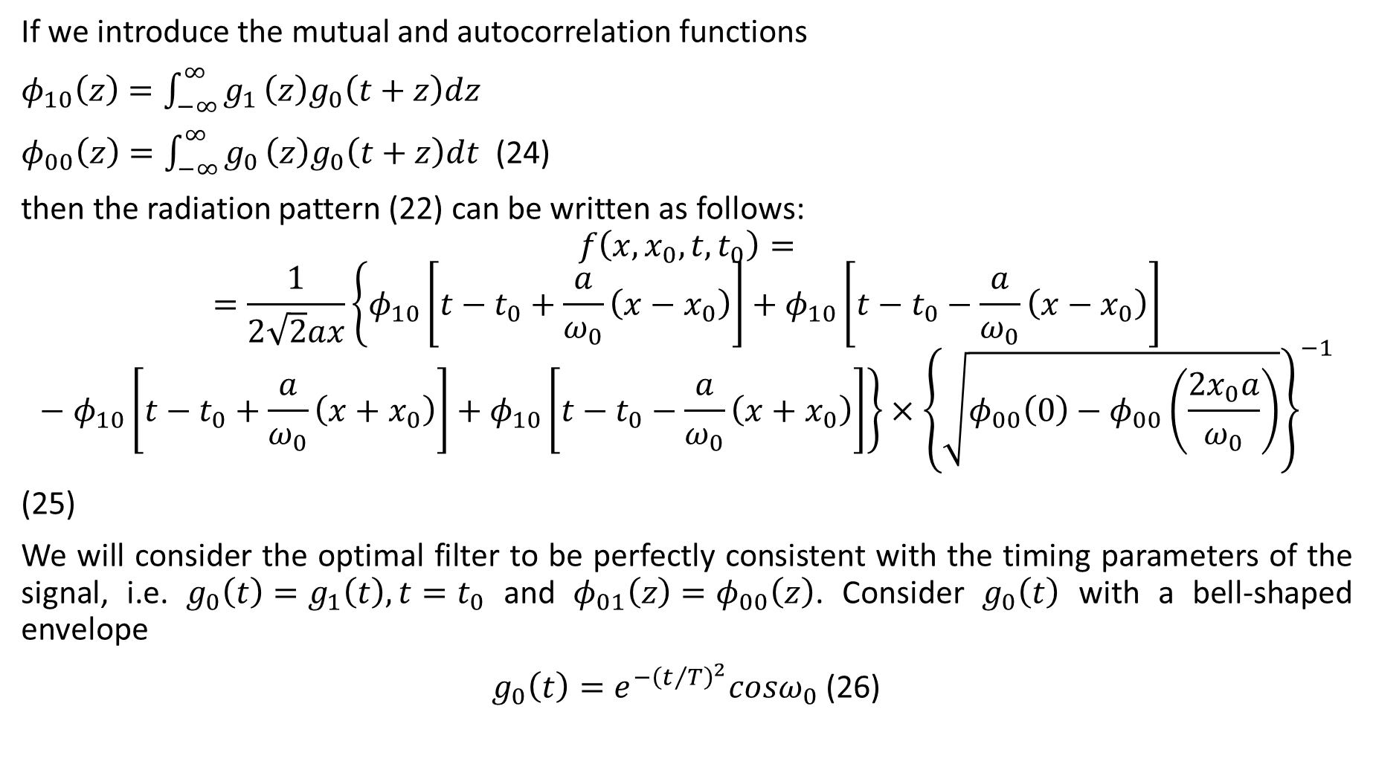
If we introduce the mutual and autocorrelation functions
$φ_{10}\left(z\right)=\int_{−∞}^{∞}{g_{1}}\left(z\right)g_{0}\left(t+z\right)dz$
$φ_{00}\left(z\right)=\int_{−∞}^{∞}{g_{0}}\left(z\right)g_{0}\left(t+z\right)dt$ (24)
then the radiation pattern (22) can be written as follows:
$$f\left(x,x_{0},t,t_{0}\right)==\frac{1}{2\sqrt{2}ax}\left\{φ_{10}\left[t−t_{0}+\frac{a}{ω_{0}}\left(x−x_{0}\right)\right]+φ_{10}\left[t−t_{0}−\frac{a}{ω_{0}}\left(x−x_{0}\right)\right]−φ_{10}\left[t−t_{0}+\frac{a}{ω_{0}}\left(x+x_{0}\right)\right]+φ_{10}\left[t−t_{0}−\frac{a}{ω_{0}}\left(x+x_{0}\right)\right]\right\}×{\left\{\sqrt{φ_{00}\left(0\right)−φ_{00}\left(\frac{2x_{0}a}{ω_{0}}\right)}\right\}}^{−1}$$
(25)
We will consider the optimal filter to be perfectly consistent with the timing parameters of the signal, i.e. $g_{0}\left(t\right)=g_{1}\left(t\right), t=t_{0}$ and $φ_{01}\left(z\right)=φ_{00}\left(z\right)$. Consider $g_{0}\left(t\right)$ with a bell-shaped envelope
$g_{0}\left(t\right)=e^{−{\left(t/T\right)}^{2}}cosω_{0}$(26)

Slide 12
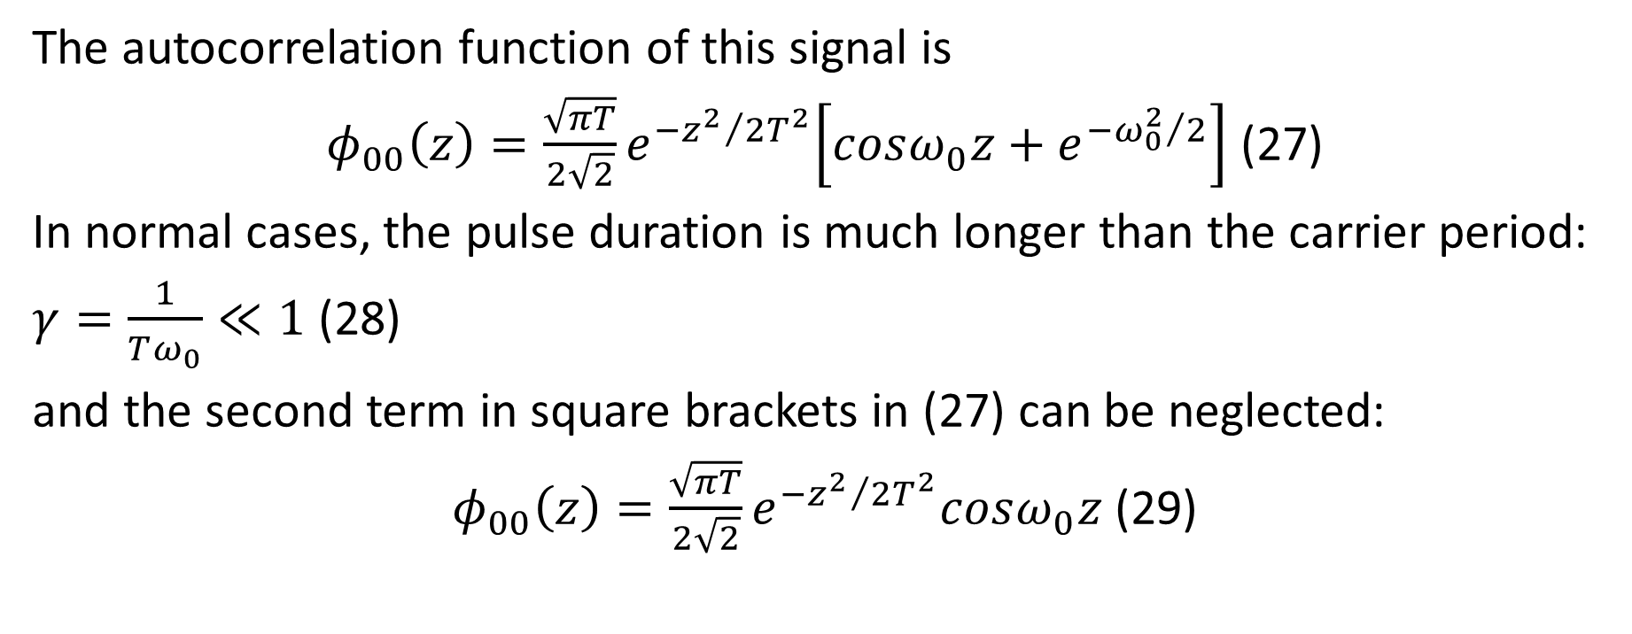
The autocorrelation function of this signal is
$φ_{00}\left(z\right)=\frac{\sqrt{πT}}{2\sqrt{2}}e^{{−z^{2}}/2T^{2}}\left[cosω_{0}z+e^{{−ω_{0}^{2}}/2}\right]$ (27)
In normal cases, the pulse duration is much longer than the carrier period:
$γ=\frac{1}{Tω_{0}}≪1$ (28)
and the second term in square brackets in (27) can be neglected:
$φ_{00}\left(z\right)=\frac{\sqrt{πT}}{2\sqrt{2}}e^{{−z^{2}}/2T^{2}}cosω_{0}z$ (29)

Slide 13
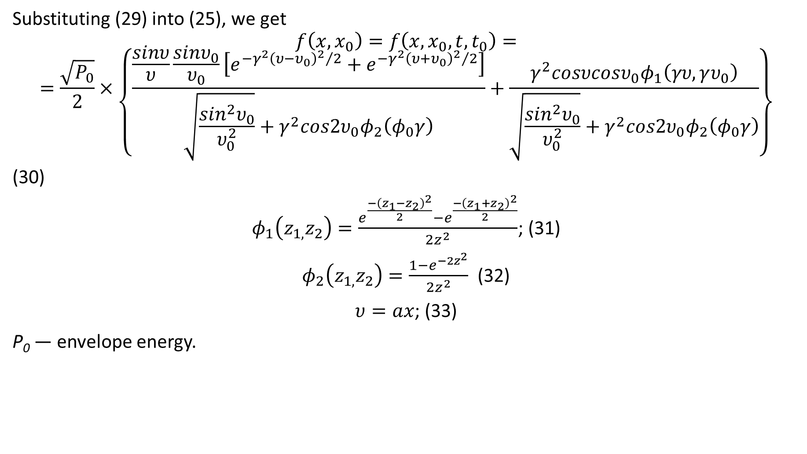
Substituting (29) into (25), we get
$$f\left(x,x_{0}\right)=f\left(x,x_{0},t,t_{0}\right)==\frac{\sqrt{P_{0}}}{2}×\left\{\frac{\frac{sinυ}{υ}\frac{sinυ_{0}}{υ_{0}}\left[e^{−γ^{2}{{\left(υ−υ_{0}\right)}^{2}}/2}+e^{−γ^{2}{{\left(υ+υ_{0}\right)}^{2}}/2}\right]}{\sqrt{\frac{\sin^{2}υ_{0}}{υ_{0}^{2}}}+γ^{2}cos2υ_{0}φ_{2}\left(φ_{0}γ\right)}+\frac{γ^{2}cosυcosυ_{0}φ_{1}\left(γυ,γυ_{0}\right)}{\sqrt{\frac{\sin^{2}υ_{0}}{υ_{0}^{2}}}+γ^{2}cos2υ_{0}φ_{2}\left(φ_{0}γ\right)}\right\}$$
(30)
$φ_{1}\left(z_{1,}z_{2}\right)=\frac{e^{\frac{−{\left(z_{1}−z_{2}\right)}^{2}}{2}}−e^{\frac{−{\left(z_{1}+z_{2}\right)}^{2}}{2}}}{2z^{2}}$; (31)
$φ_{2}\left(z_{1,}z_{2}\right)=\frac{1−e^{−2z^{2}}}{2z^{2}}$ (32)
$υ=ax$; (33)
P₀ — envelope energy.

Slide 14
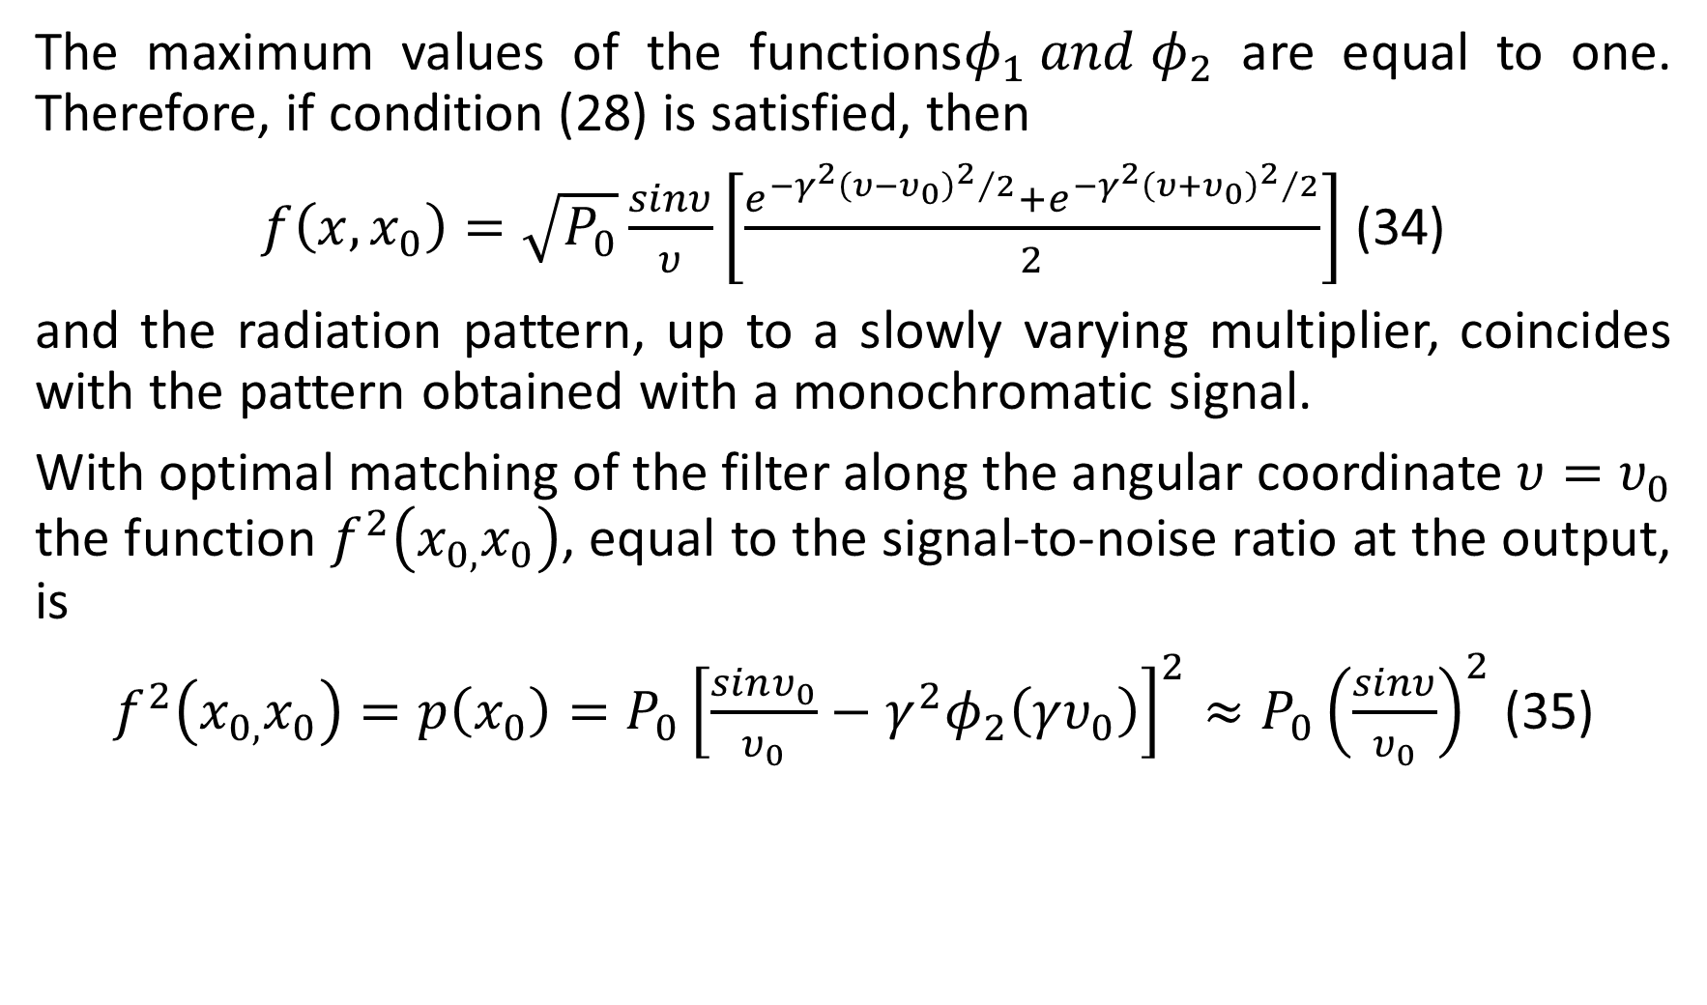
The maximum values of the functions$φ_{1} and φ_{2}$ are equal to one. Therefore, if condition (28) is satisfied, then
$f\left(x,x_{0}\right)=\sqrt{P_{0}}\frac{sinυ}{υ}\left[\frac{e^{−γ^{2}{{\left(υ−υ_{0}\right)}^{2}}/2}+e^{−γ^{2}{{\left(υ+υ_{0}\right)}^{2}}/2}}{2}\right]$ (34)
and the radiation pattern, up to a slowly varying multiplier, coincides with the pattern obtained with a monochromatic signal.
With optimal matching of the filter along the angular coordinate $υ=υ_{0}$ the function $f^{2}\left(x_{0,}x_{0}\right)$, equal to the signal-to-noise ratio at the output, is
$f^{2}\left(x_{0,}x_{0}\right)=p\left(x_{0}\right)=P_{0}{\left[\frac{sinυ_{0}}{υ_{0}}−γ^{2}φ_{2}\left(γυ_{0}\right)\right]}^{2}≈P_{0}{\left(\frac{sinυ}{υ_{0}}\right)}^{2}$ (35)

Slide 15
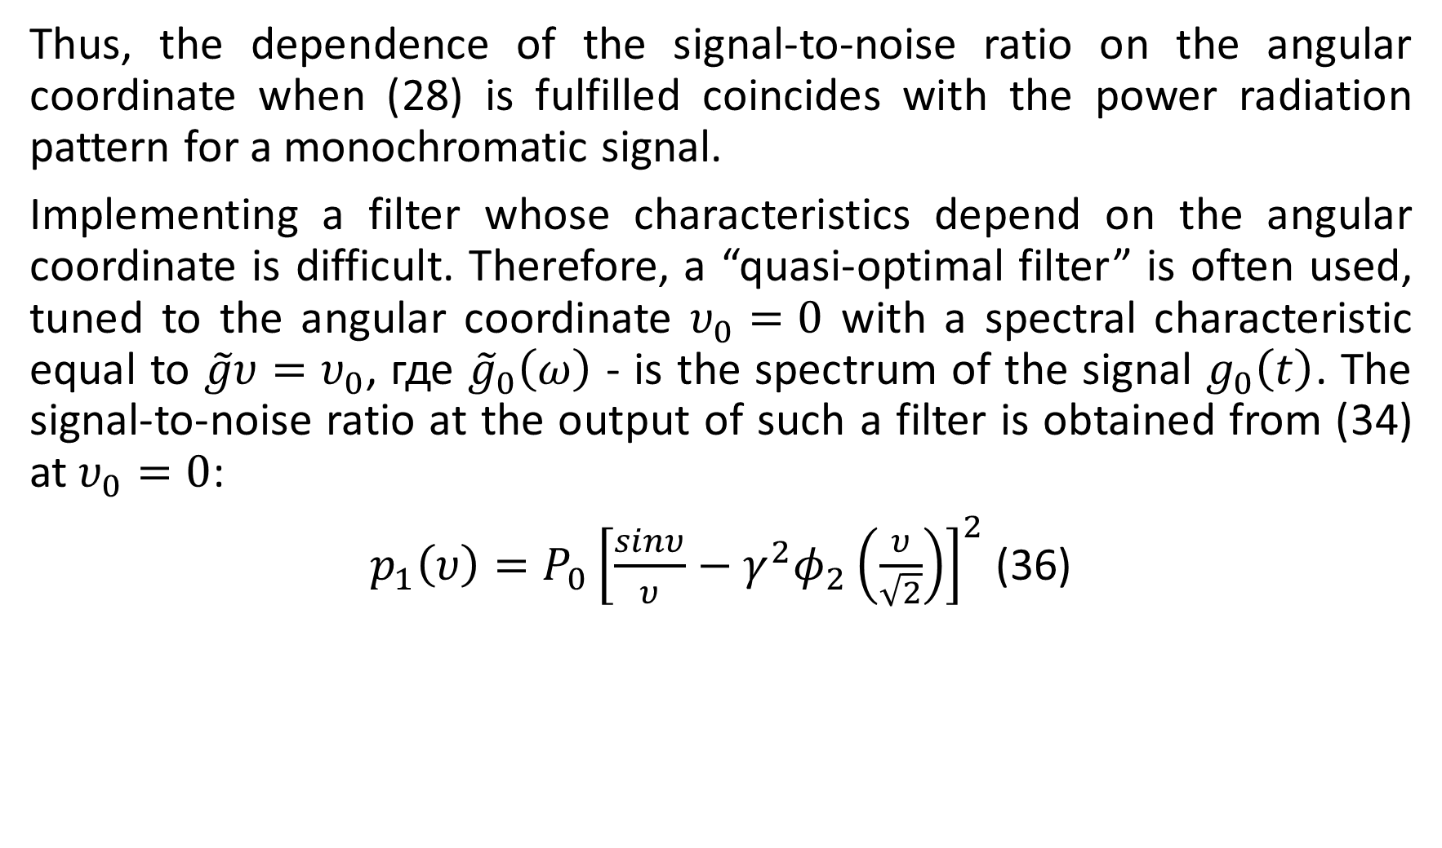
Thus, the dependence of the signal-to-noise ratio on the angular coordinate when (28) is fulfilled coincides with the power radiation pattern for a monochromatic signal.
Implementing a filter whose characteristics depend on the angular coordinate is difficult. Therefore, a “quasi-optimal filter” is often used, tuned to the angular coordinate $υ_{0}=0$ with a spectral characteristic equal to $\tilde{g}υ=υ_{0}$, где ${\tilde{g}}_{0}\left(ω\right)$ - is the spectrum of the signal $g_{0}\left(t\right)$. The signal-to-noise ratio at the output of such a filter is obtained from (34) at $υ_{0}=0$:
$p_{1}\left(υ\right)=P_{0}{\left[\frac{sinυ}{υ}−γ^{2}φ_{2}\left(\frac{υ}{\sqrt{2}}\right)\right]}^{2}$ (36)

Slide 16
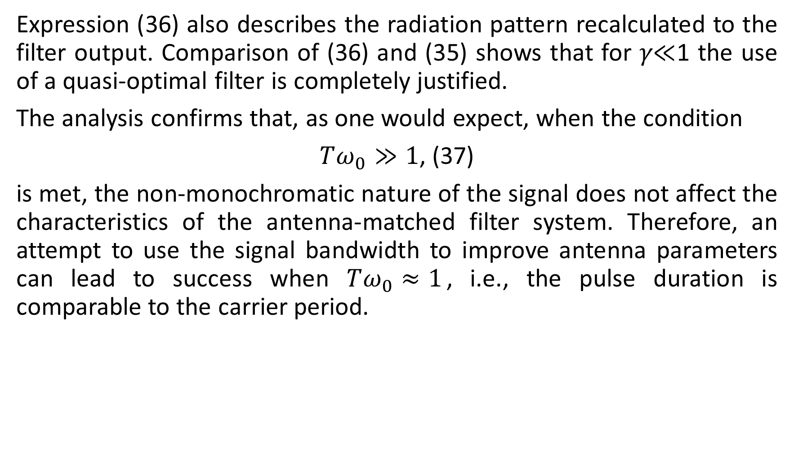
Expression (36) also describes the radiation pattern recalculated to the filter output. Comparison of (36) and (35) shows that for 𝛾≪1 the use of a quasi-optimal filter is completely justified.
The analysis confirms that, as one would expect, when the condition
$Tω_{0}≫1$, (37)
is met, the non-monochromatic nature of the signal does not affect the characteristics of the antenna-matched filter system. Therefore, an attempt to use the signal bandwidth to improve antenna parameters can lead to success when $Tω_{0}≈1$, i.e., the pulse duration is comparable to the carrier period.

Slide 17
Results
Analytical expressions are obtained for calculating the fields of antennas located on mechanically elastic carriers. Numerical experiments were carried out with the developed mathematical model.
Optimal excitation of the antenna array, taking into account the elastic characteristics of ice, makes it possible to increase the active energy, which increases the range of the system and can be successfully used for the development of communication systems and the study of geophysical fields in the Arctic zone.

Slide 18
Данная работа выполнена в рамках государственного задания Минобрнауки России в сфере научной деятельности по проекту № FZNS-2023-0008.

Slide 19
Thank you for attention!

