Slide 1
Magnetosheath Filamentary Structures Driven by Foreshock Energetic Ions
Chunlin CAI
National Space Science Center, CAS, China
XIII International Conference Solar-Terrestrial Relations and Physics of Earthquake Precursors, Paratunka, September 25-29, 2023

Slide 2

Outline
Introduction
Case studies
Statistical analysis
Conclusions

Slide 3
Introduction
Foreshock region Foreshock transients
Foreshock bubble
Hot flow anomaly
Foreshock cavity/Traveling Foreshock
Foreshock transients can be effective accelerators of foreshock particles.
Energetic particles convected by the solar wind entering into the magnetosheath are believed to cause prominent local disturbances.

Slide 4
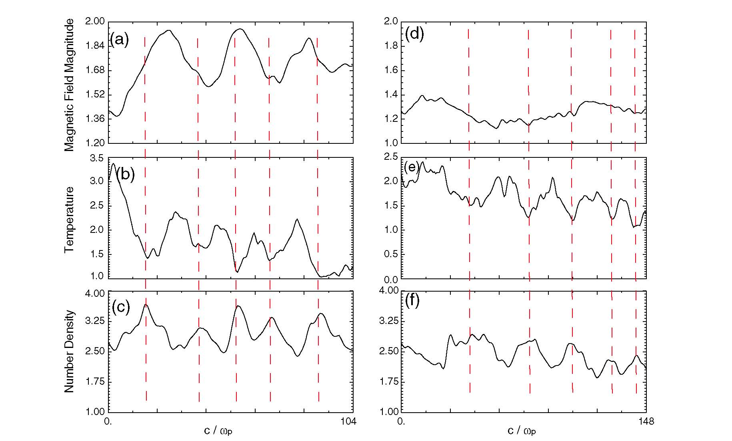
Magnetosheath filamentary structures
[Omidi et al., 2014]

Slide 5
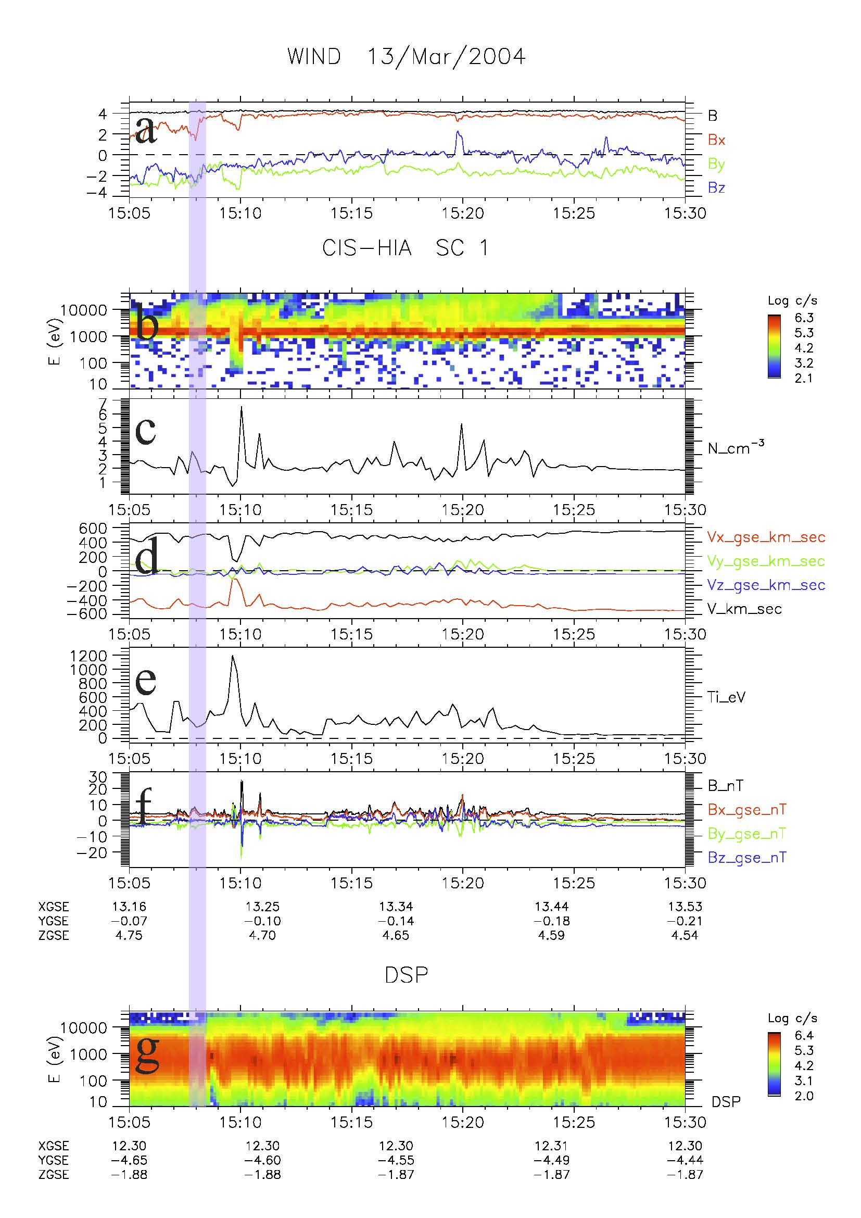
Case studies
1 Foreshock bubble
Cluster and Double
Star observations

Slide 6
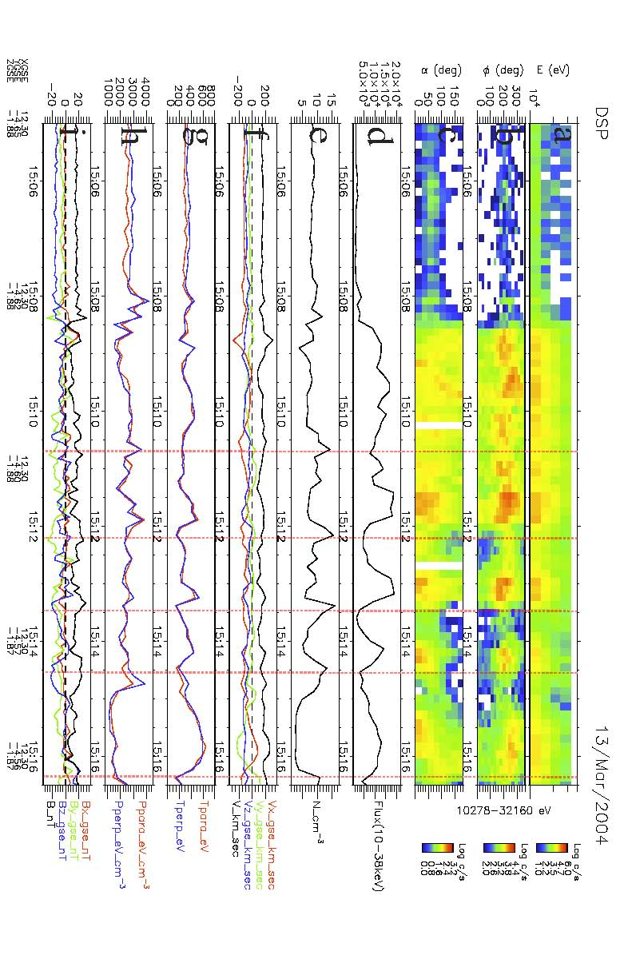
Filamentary structures
Ion fluxes have quasi-periodic modifications.
Earthward azimuthal angular distributions and parallel/anti-parallel pitch angular distributions
a series of ion density and pressure oscillations anticorrelated to temperature oscillations

Slide 7
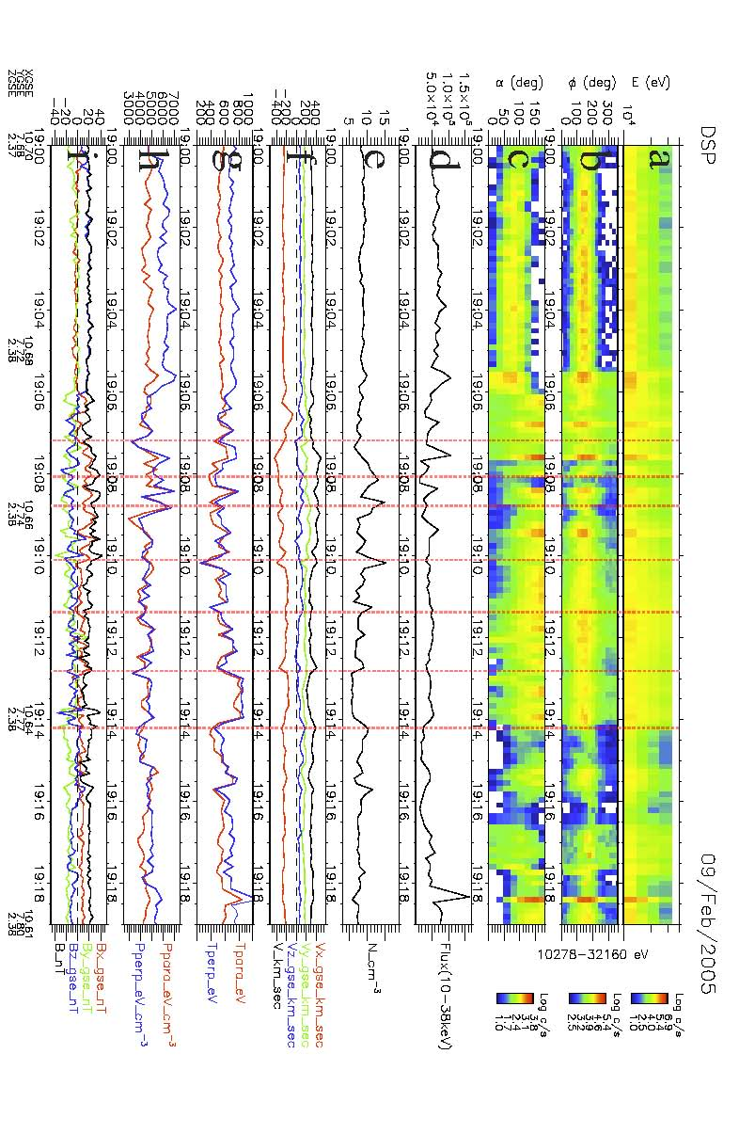
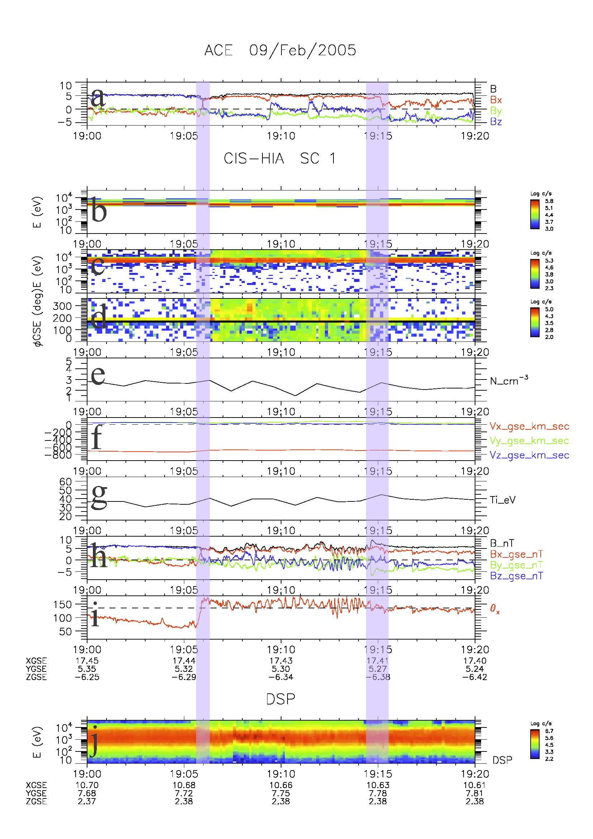
2 Traveling Foreshock

Slide 8
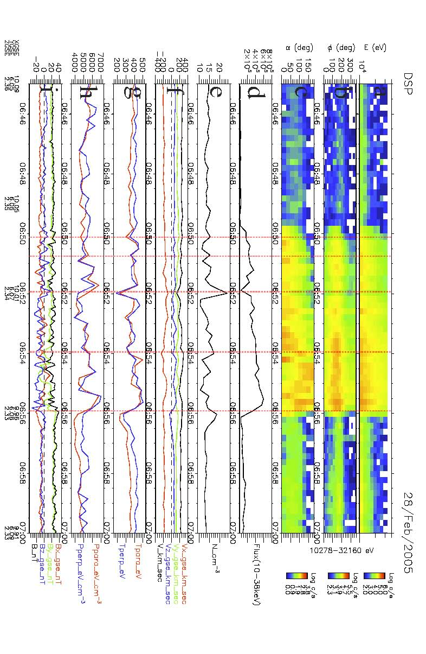
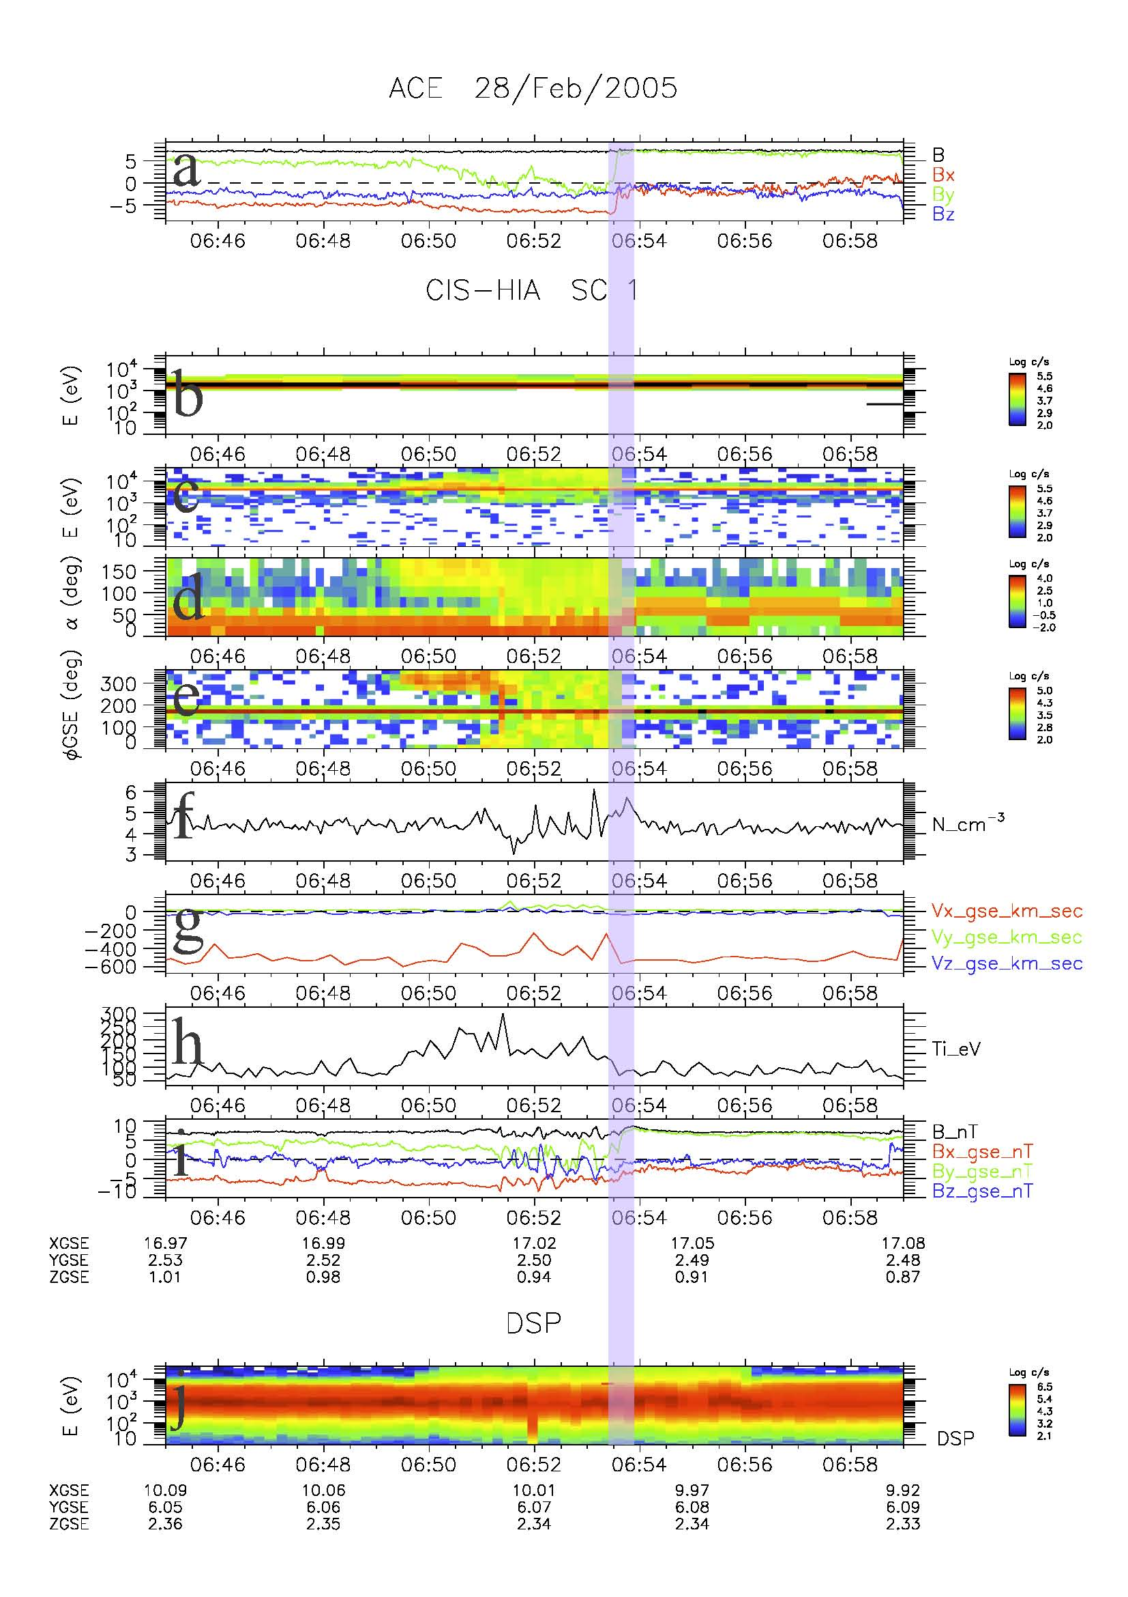
3 Hot flow anomaly

Slide 9
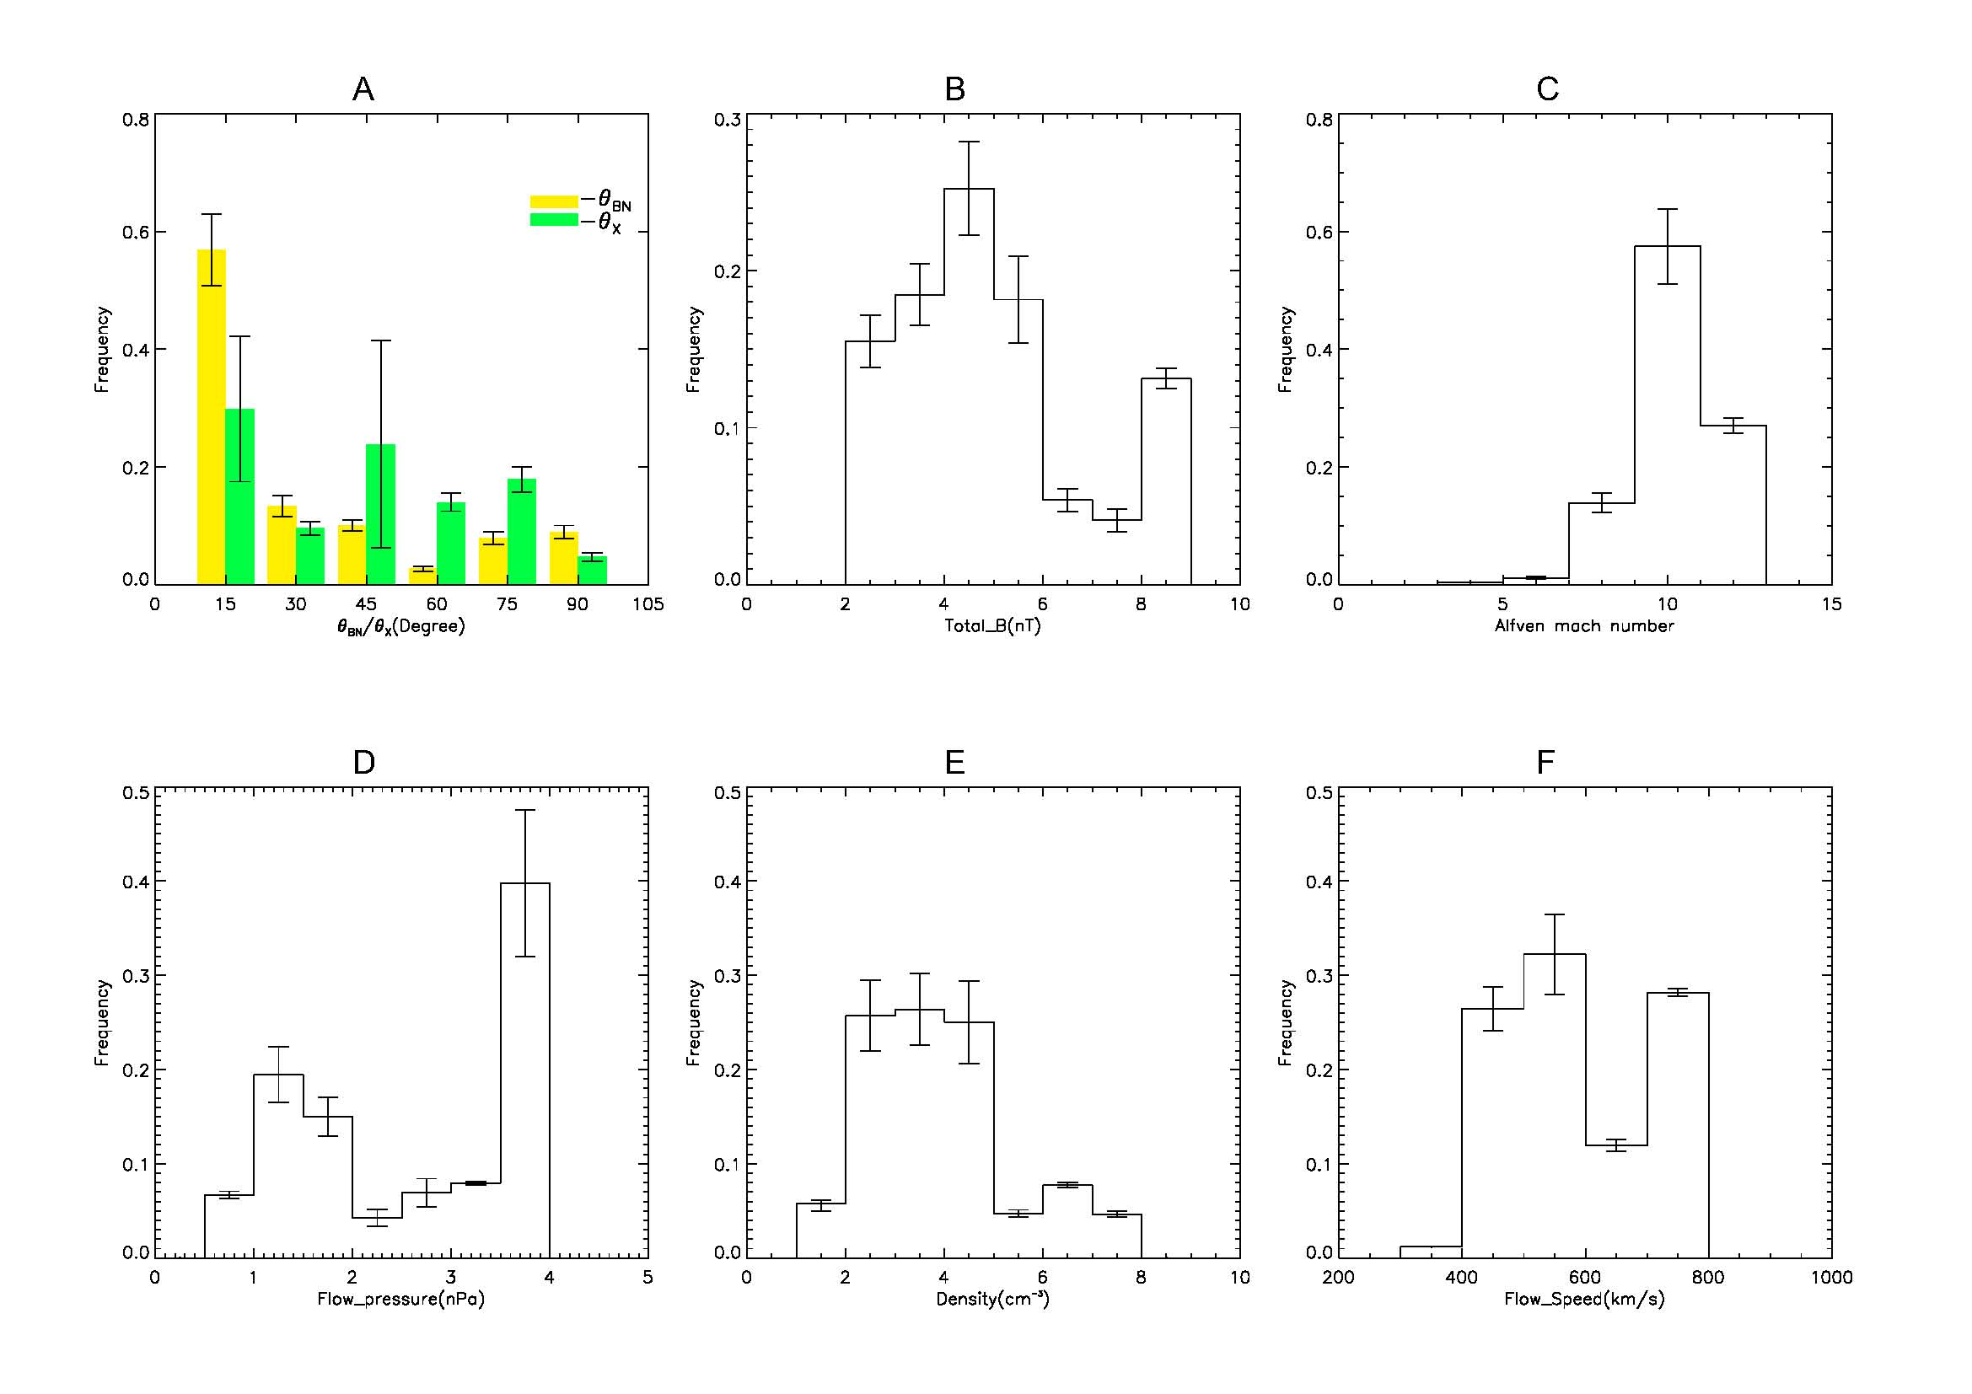
Statistical Properties
Upstream Conditions

Slide 10
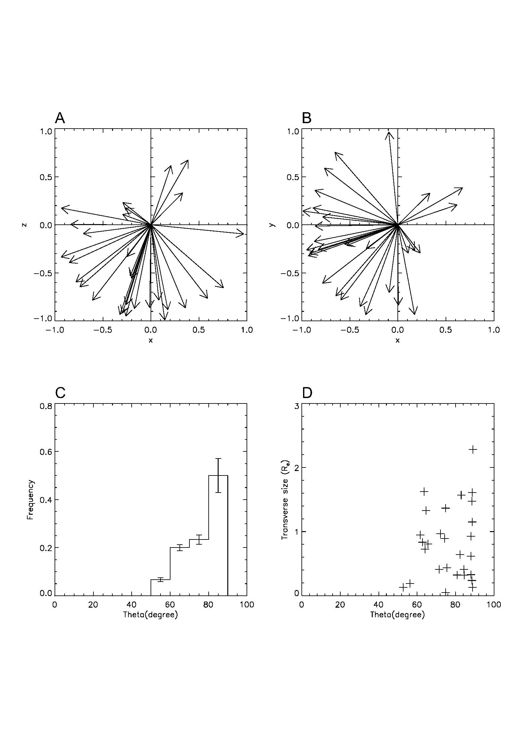
Orientations and Scale sizes

Slide 11
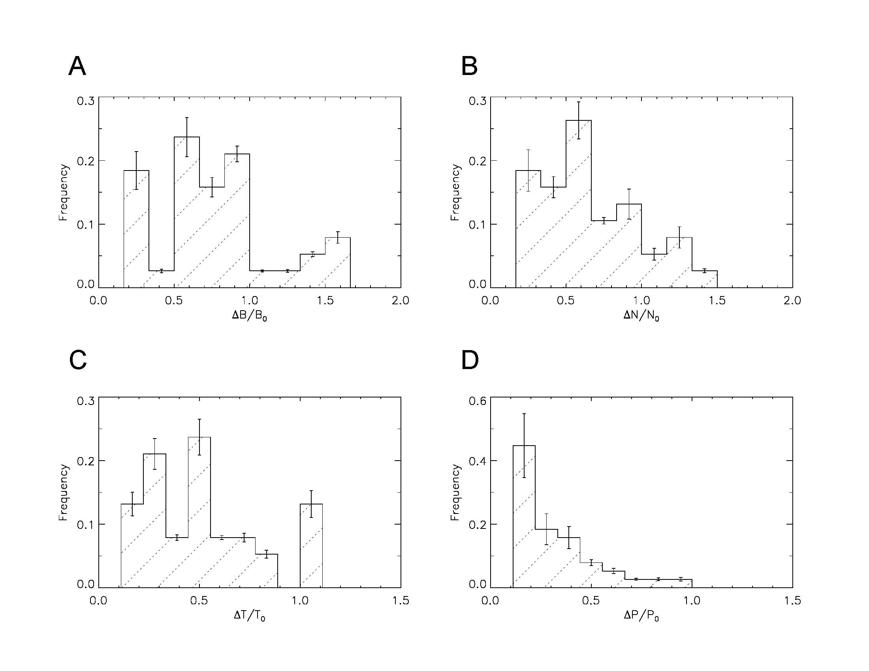
Perturbation Amplitudes

Slide 12
Conclusions
The formation of MFS can link to various foreshock phenomena since they are directly caused by the foreshock energetic ion injections, whose productions are an intrinsic nature of foreshock activities.
MFS primarily form in the quasi-parallel magnetosheath and under favorable formation conditions similar to those of foreshock transients.
MFS are field-aligned plasma structures with small transverse sizes and are associated with large-amplitude ion density and temperature perturbations.

Slide 13
Thank you

