Slide 1




Ozone dynamics during geomagnetic and meteorological disturbances in October 2015 and 2018
1. O3 lab, St Petersburg University, St. Petersburg, Russia.
2. WD IZMIRAN, Kaliningrad, Russia.
Aleksandr Timchenko^{1,2},
Olga Borchevkina^{1,2},
Yuliya Kurdaeva^{1,2},
Fedor Bessarab^{1,2}
2023
The work was supported by the MegaGrant of the Ministry of Education and Science of Russia, agreement No. 075-15-2021-583

Slide 2
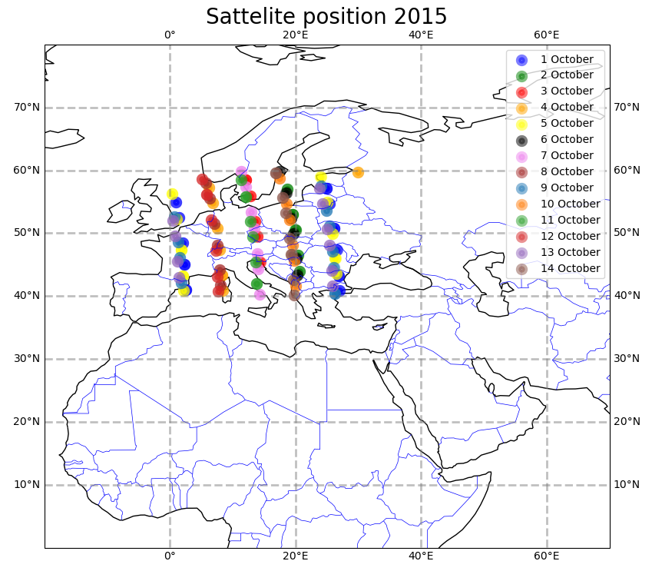
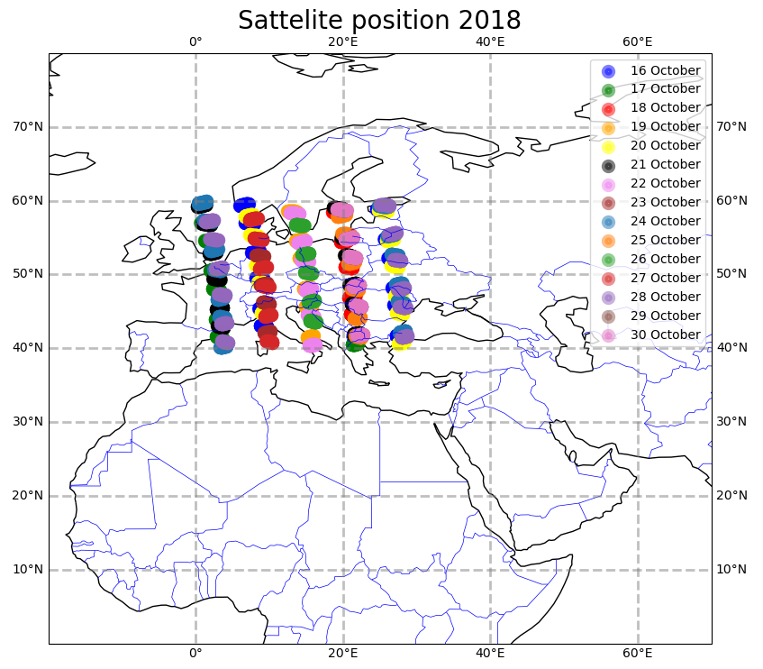
Motivation and introduction
There are not a lot of studies of ozone dynamics during geomagnetic disturbances and even less during meteorological disturbances. Most of these studies were published when satellite measurements were not as advanced as they are today. Also, most researchers have looked at the Arctic region.
In this paper, we consider satellite data of mesospheric ozone in the European region during the geomagnetic storm in October 2015 and the meteorological storm in the Baltic Sea in October 2018.
The ozone concentration and temperature data set derived from the SABER instrument onboard the NASA TIMED satellite analyzed from 80 to 110 km in altitude and between 40° N and 60° N latitude, 0° E and 30° E longitude.
The position in which the measurements of the parameters considered in this work were made.
The work was supported by the MegaGrant of the Ministry of Education and Science of Russia, agreement No. 075-15-2021-583

Slide 3
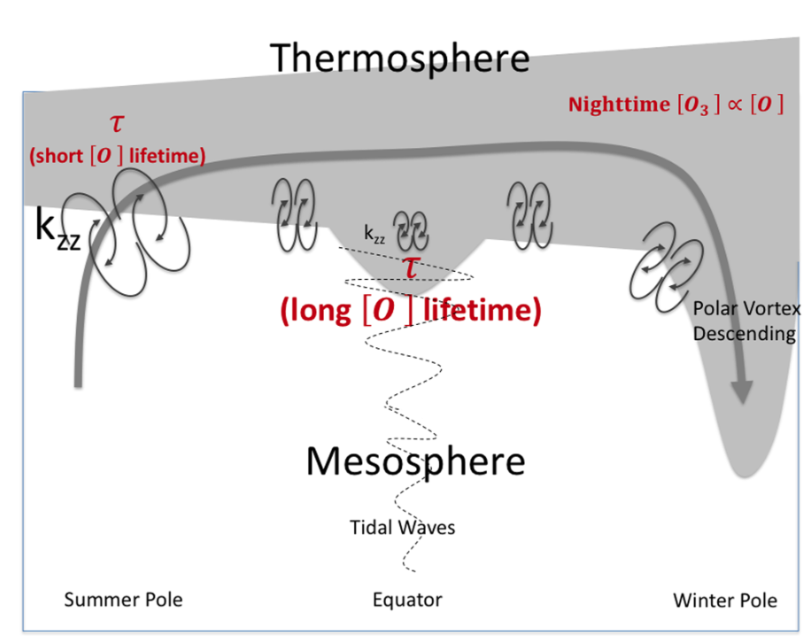
Introduction
In upper Earth's atmosphere by Solar UV (λ < 240 nm) the O2 is dissociate:
O2 + hν → O + O, (1)
which leads to the formation of increased concentrations of O with a maximum at altitudes of about 90–100 km. In triple collisions involving an O and an O2, ozone O3 is formed:
О + O2 + М → O3 + М, (2)
where М is nitric or oxygen molecule at Earth's atmosphere.
The O3 distribution in the middle atmosphere is driven by vertical transport and eddy diffusion, as summarized by a simple diagram. Vertical transport inside the polar vortex brings anomalously large nighttime O3 values from the lower thermosphere down to the upper mesosphere in highlatitudes. Near the tropics, smaller the eddy diffusion coefficient and the increased lifetime of O3 lead to small local increases in O3 during equinox.
Lee, J. N., & Wu, D. L. https://doi.org/10.1029/2019EA001063

Slide 4
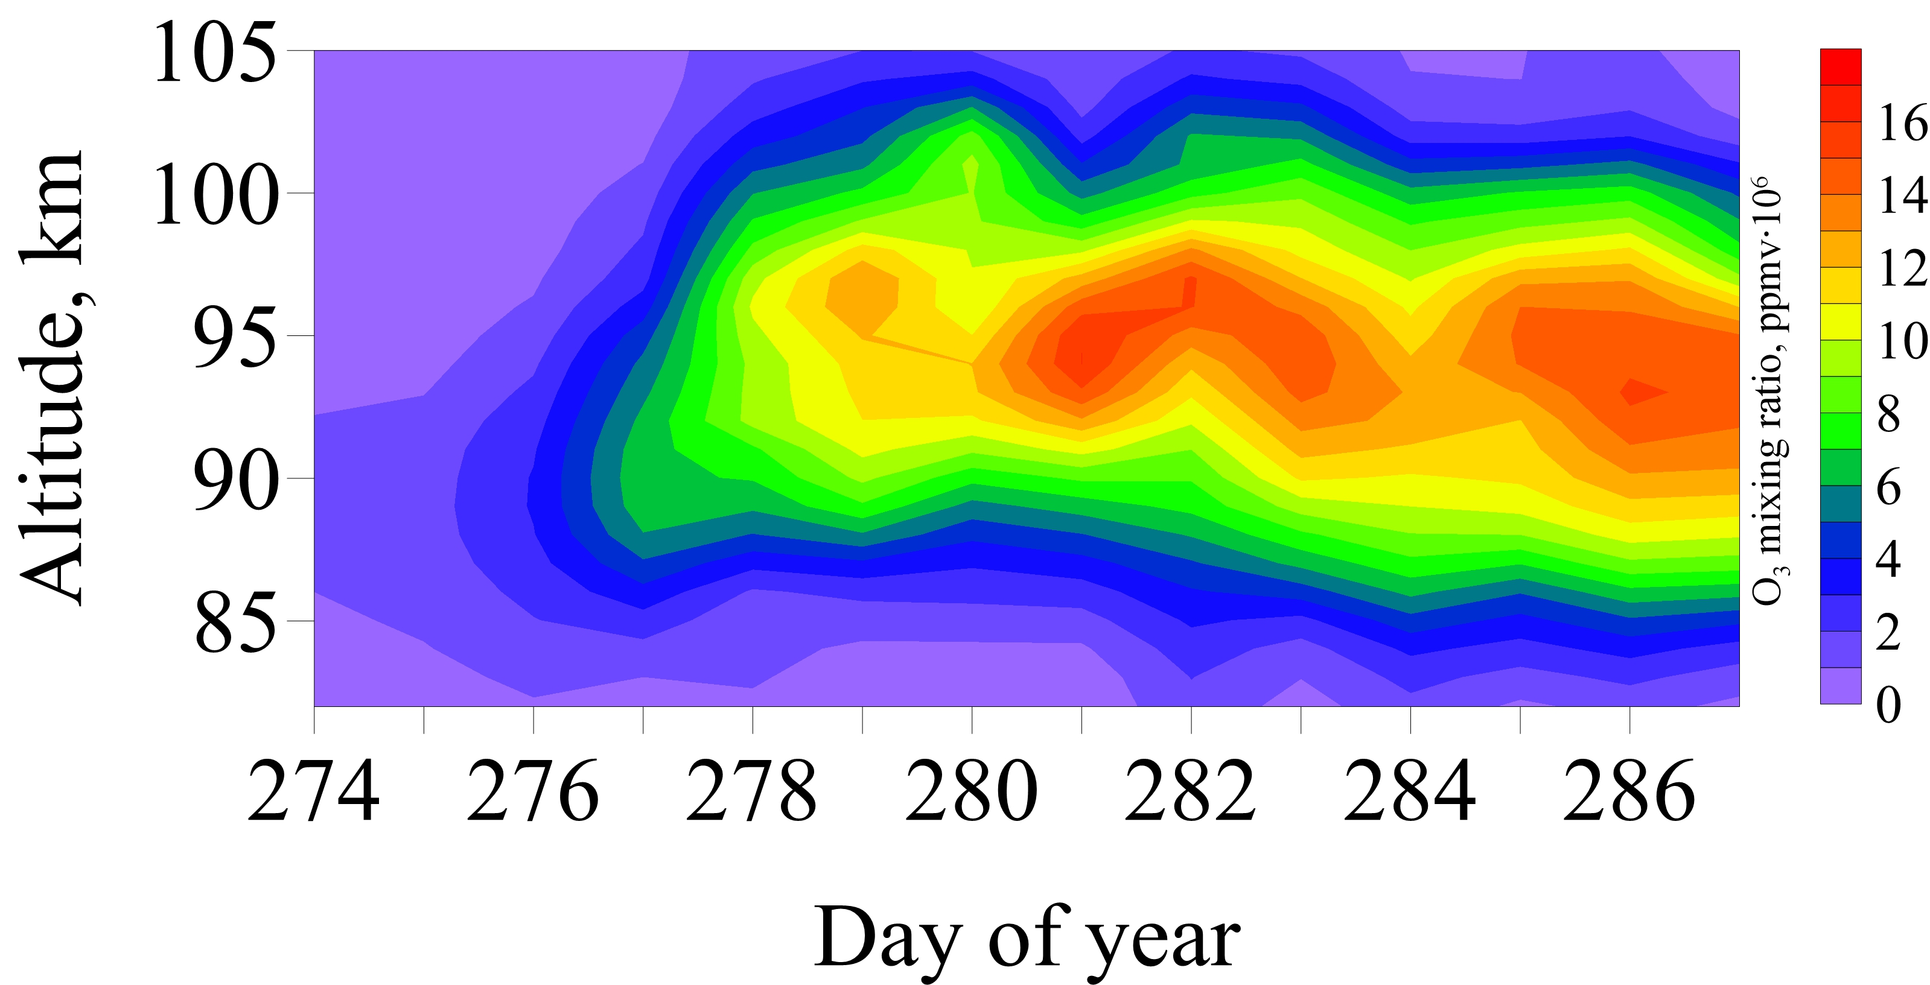
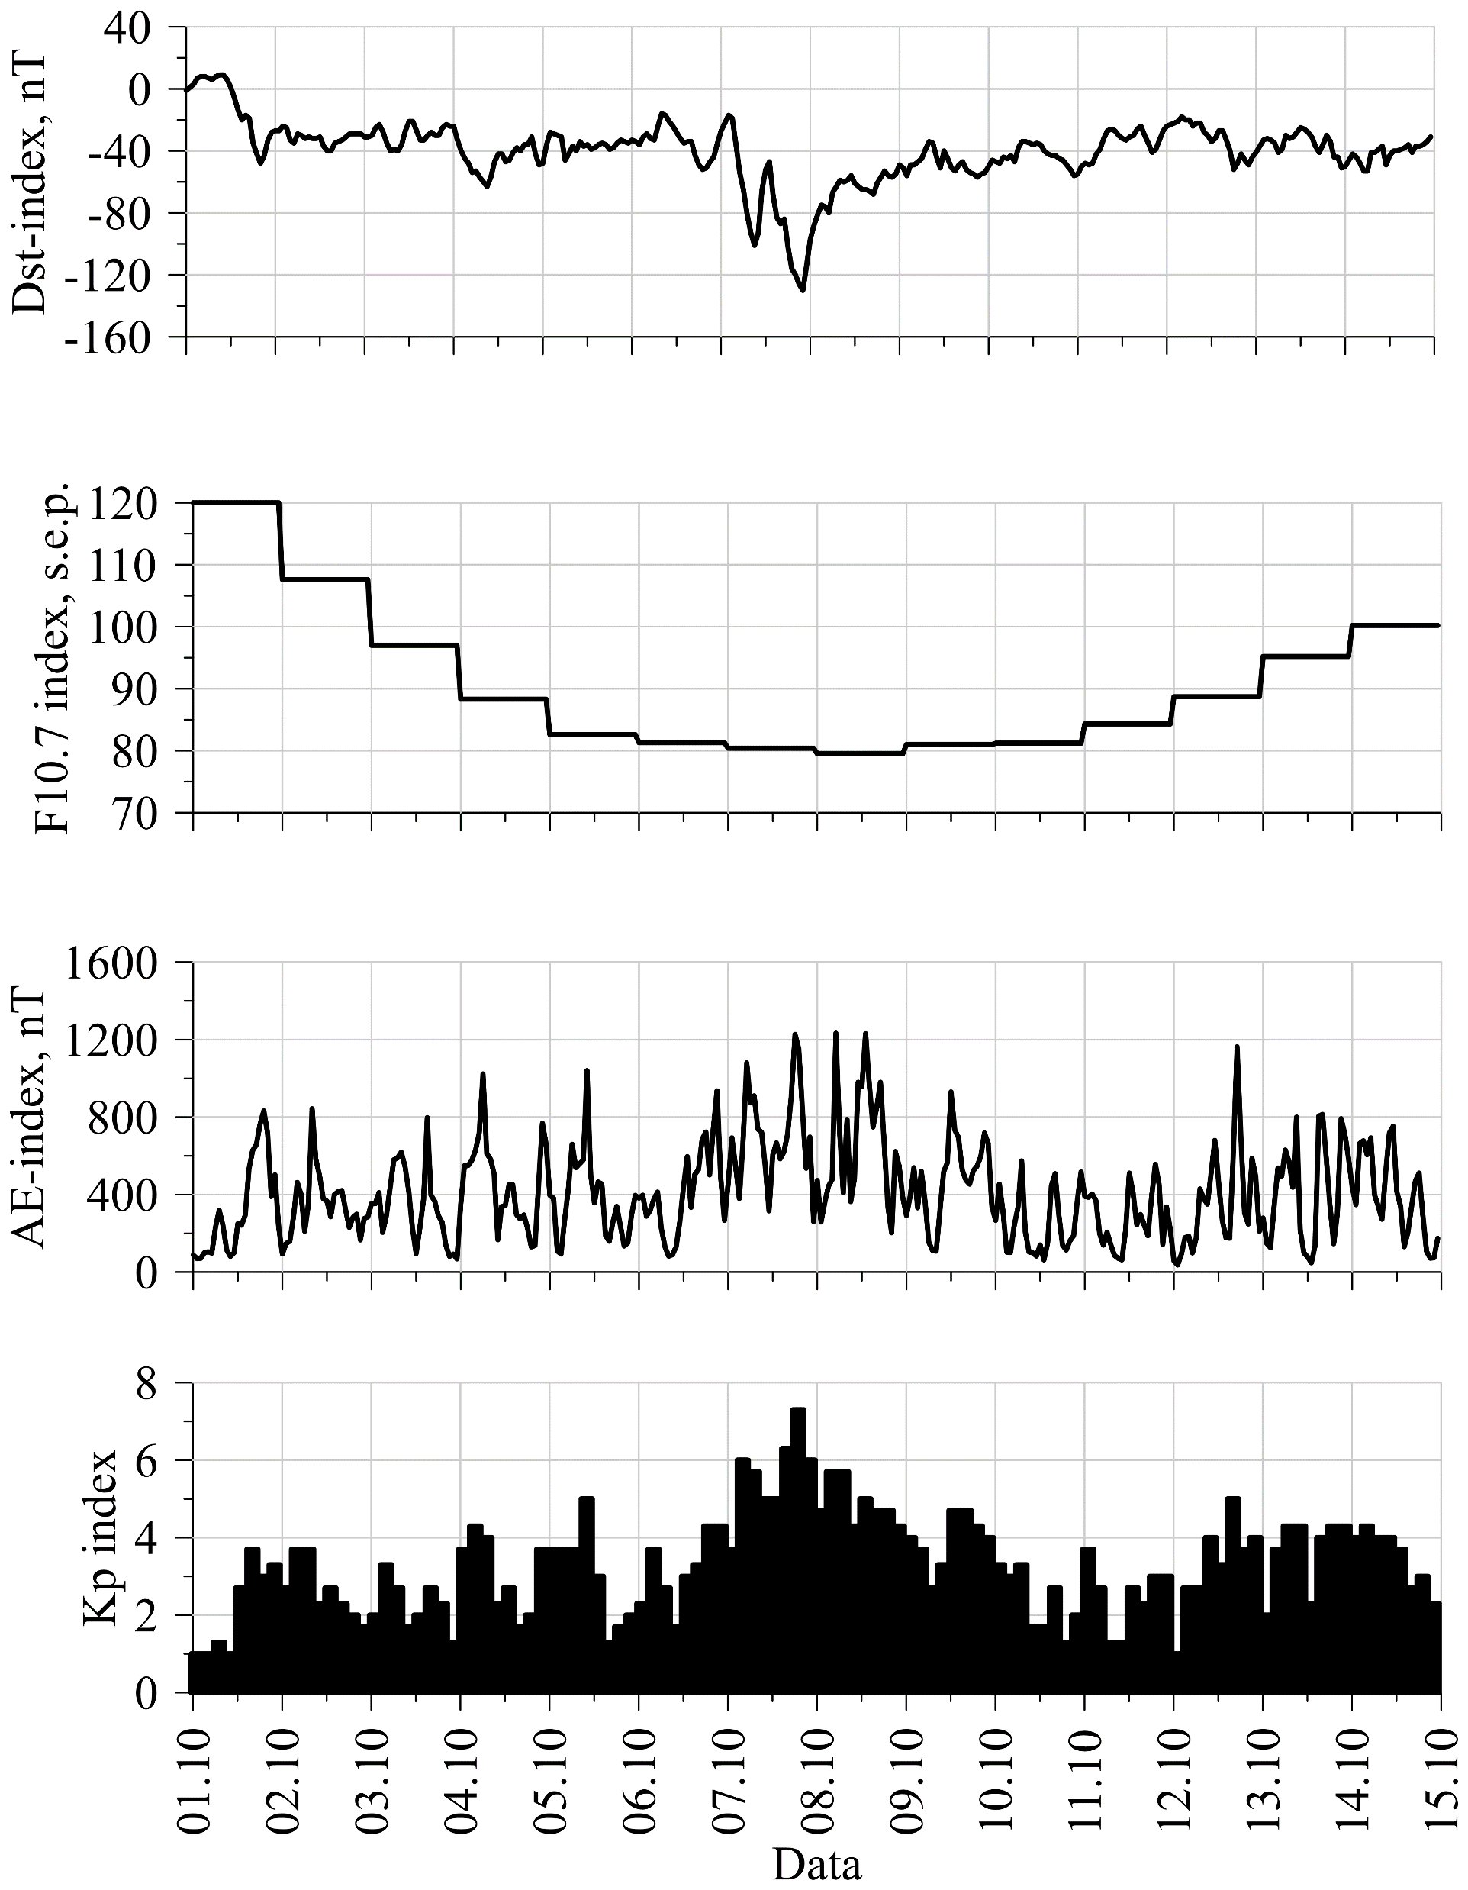
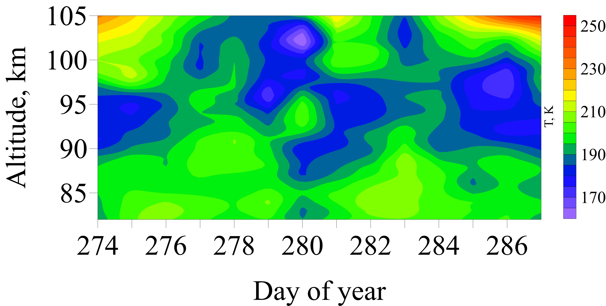
Geomagnetic storm at October 2015

Slide 5
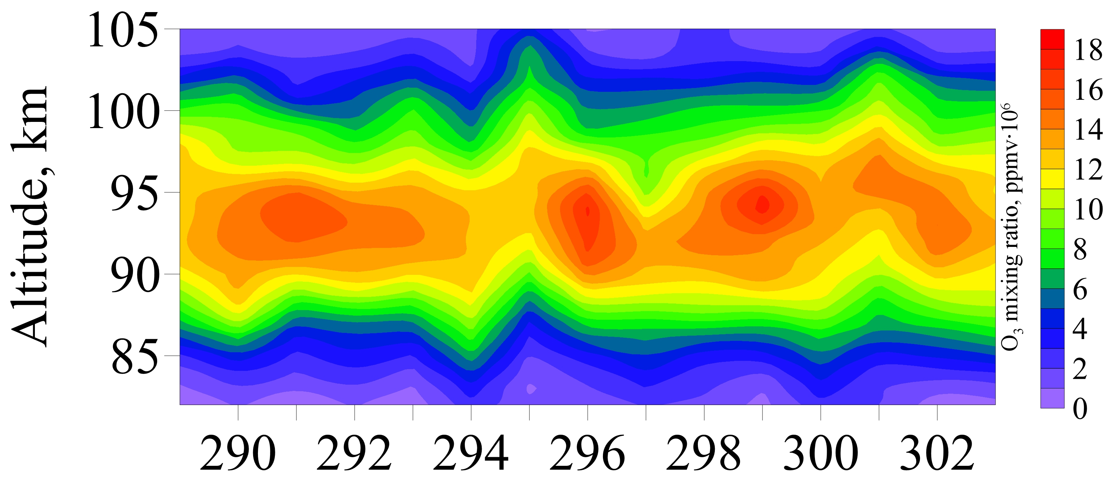
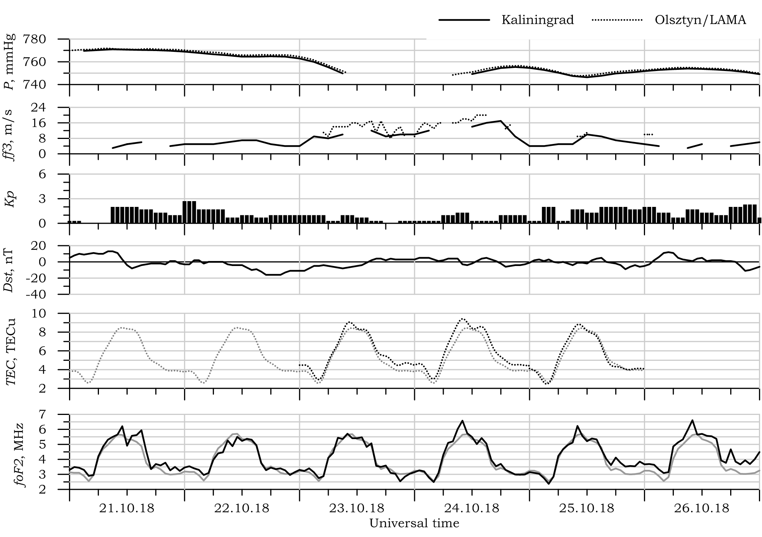
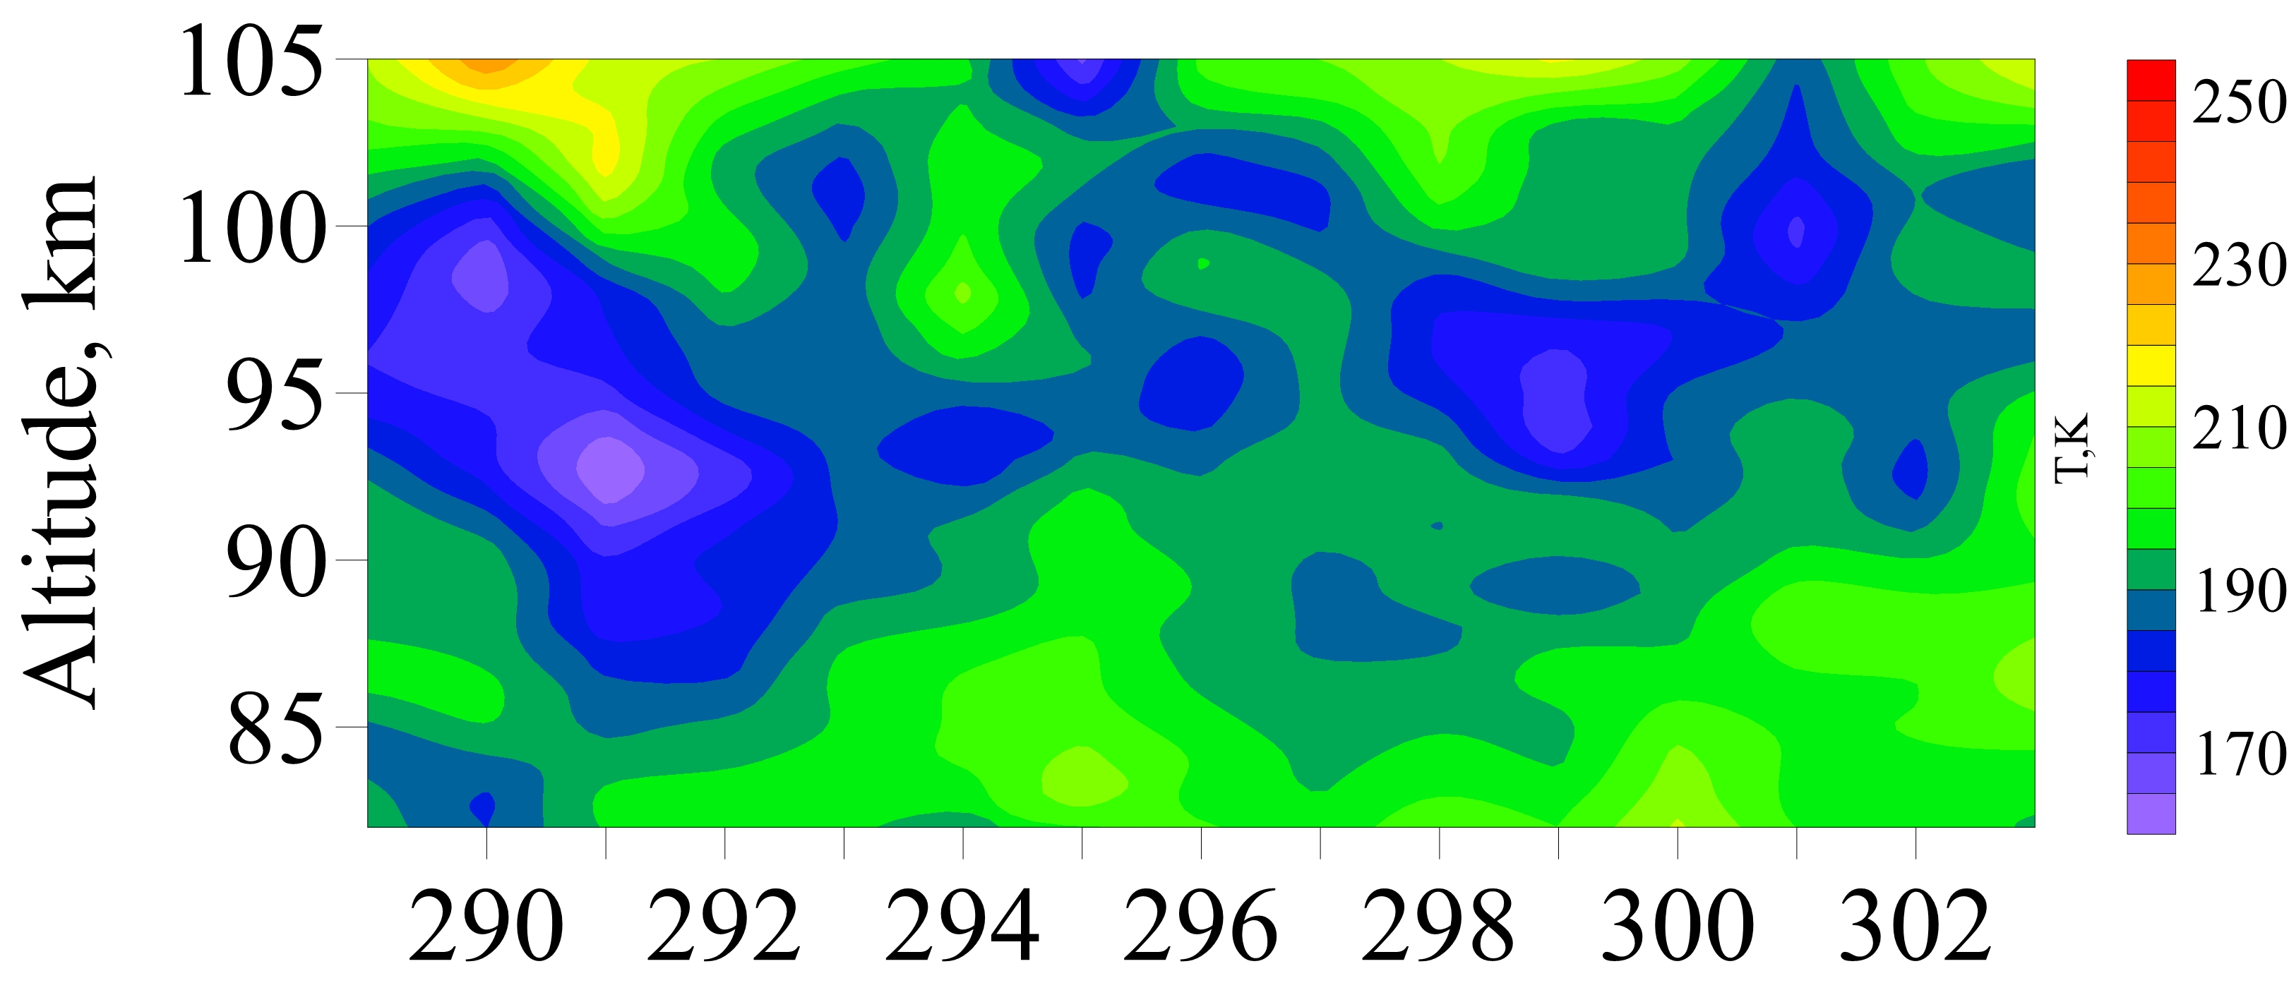

Meteorological storm at October 2018

Slide 6
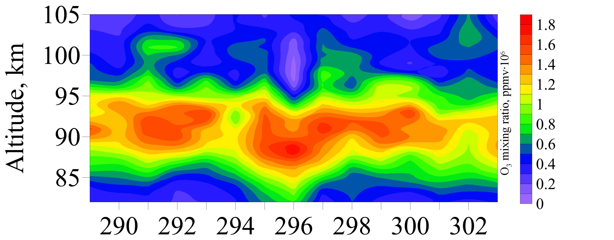
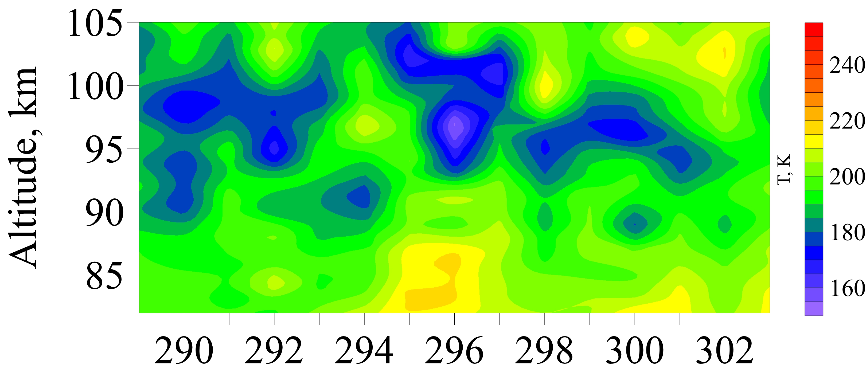
Meteorological storm at October 2018

Slide 7
Conclusion
In this work, was considered the height-time ozone variations in the lower thermosphere during a geomagnetic storm in October 2015 and a meteorological storm in the Baltic Sea in October 2018. The mid-latitude region in Europe (40–60° N, 0-30° E) was considered. Ozone concentration were taken from experimental data of the SABER instrument on the TIMED satellite.
During the geomagnetic storm on October 7–8, 2015, there is an increase in the mesospheric ozone concentration. Such increase begins a day before the beginning of the geomagnetic storm. The temperature decreases at the same altitudes and at the same time corresponding to the local ozone concentration maximums.
According to the daytime data, at the altitudes of about 85 km, there is a significant heating of the neutral atmosphere during a meteorological storm. At the same time, a region of decreased temperature is formed at the altitudes of 95–100 km. At nighttime, a simultaneous increase in temperature and decrease in ozone concentration are observed at an altitude of 85 km. At the same time there is an increase of ozone concentration at an altitude of 100–105 km.
Propagating from the meteorological storm region, the IGW in the lower thermosphere becomes unstable and tails off, forming local areas of increased turbulence that affect the temperature and redistribution of chemical constituents at mesospheric and lower thermospheric altitudes.
The work was supported by the MegaGrant of the Ministry of Education and Science of Russia, agreement No. 075-15-2021-583

Slide 8
Thank you for your attention!
2023

Slide 9
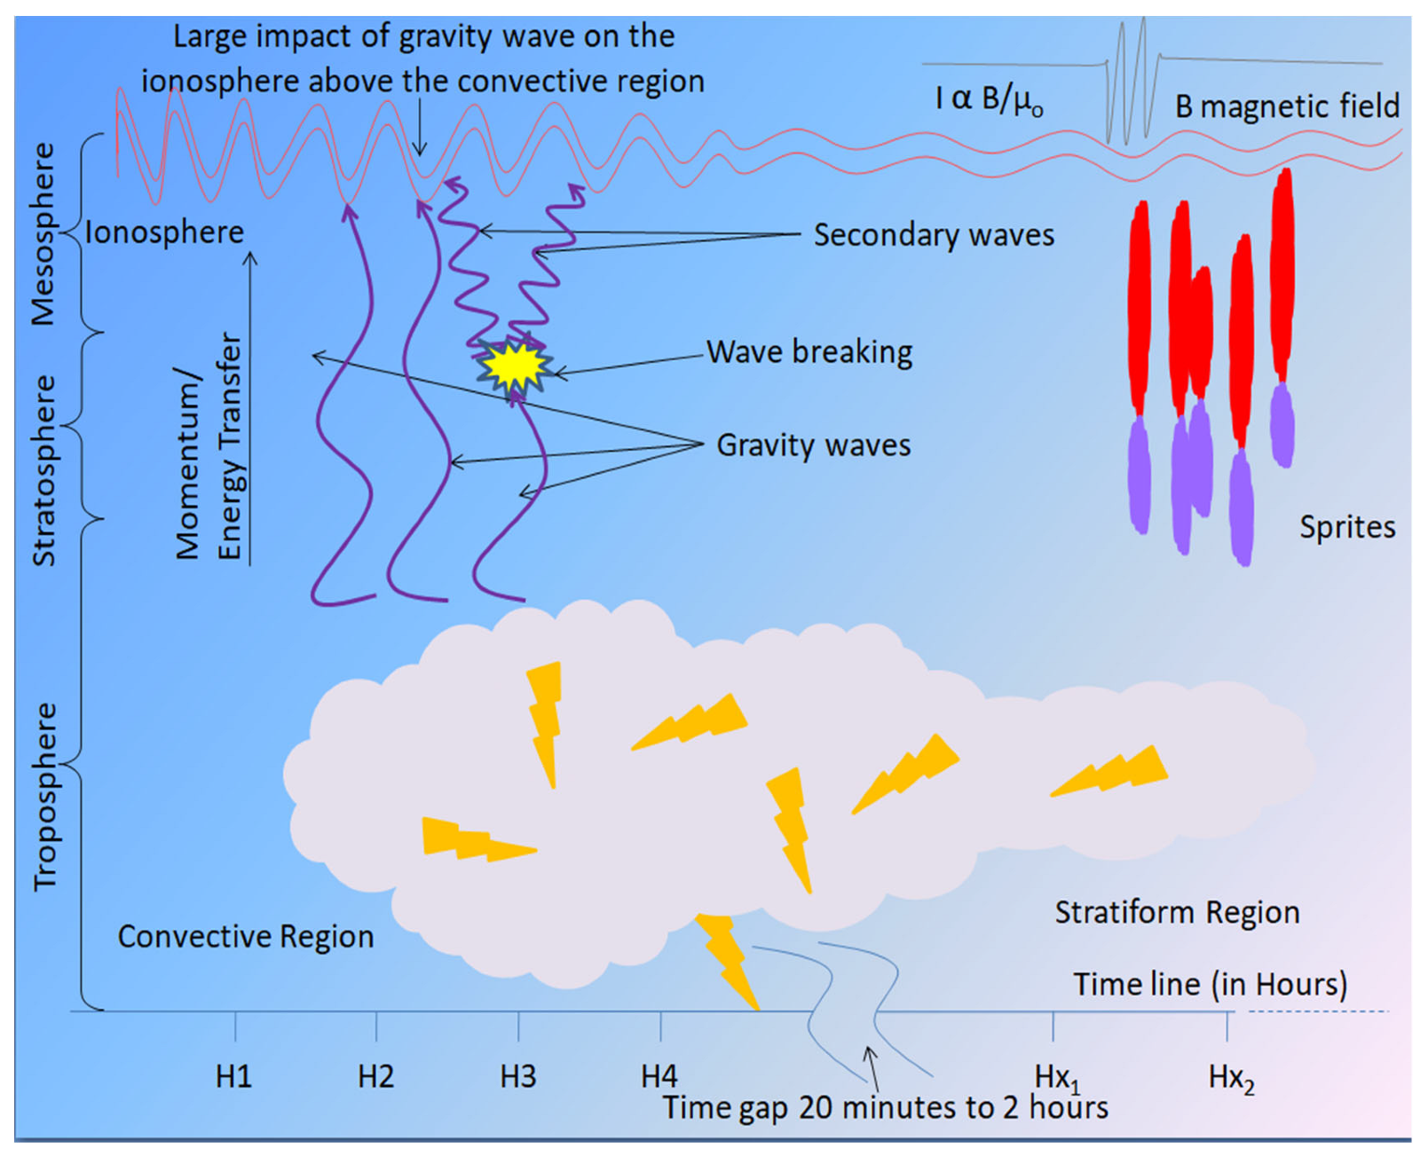
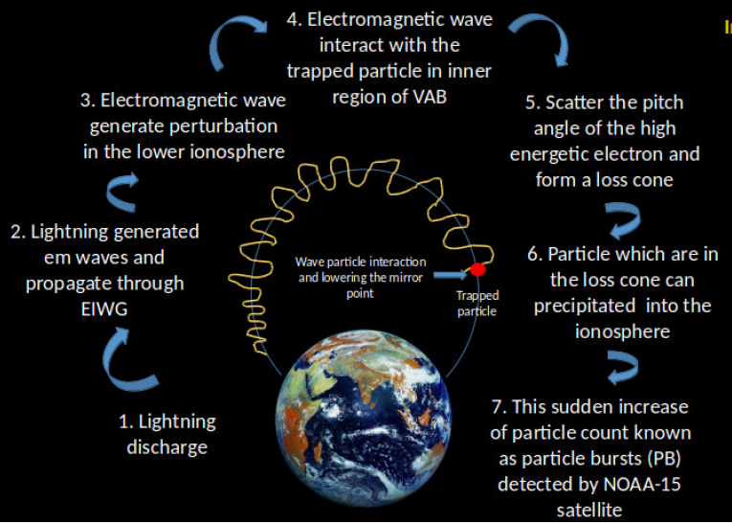
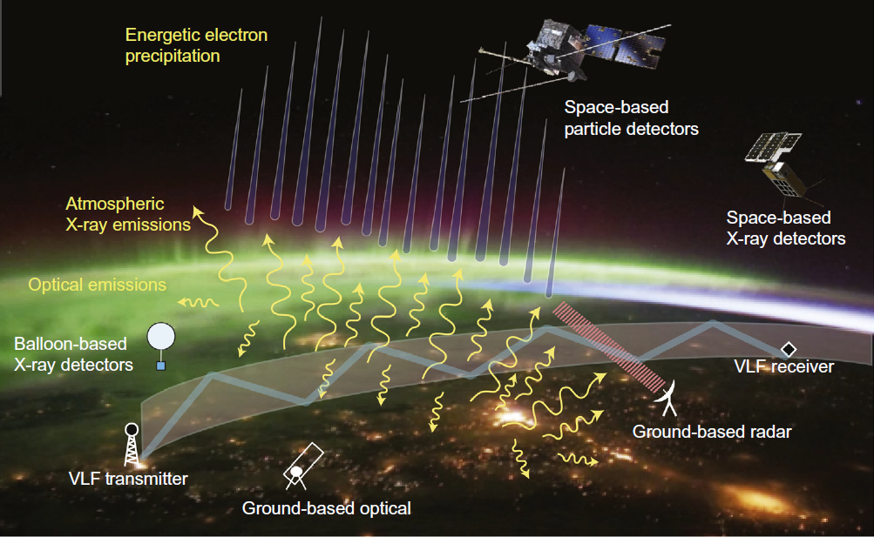
Introduction
In upper Earth's atmosphere by Solar UV (λ < 240 нм) the O2 is dissociate:
O2 + hν → O + O, (1)
which leads to the formation of increased concentrations of O with a maximum at altitudes of about 90–100 km. In triple collisions involving an O and an O2, ozone O3 is formed:
О + O2 + М → O3 + М, (2)
where М is nitric or oxygen molecule at Earth's atmosphere.
Chowdhury S. et al., https://doi.org/10.1016/j.asr.2021.08.008.
Babalola Ogunsua et al., https://doi.org/10.3390/rs15102572
Marshall, R. A., & Cully, C. M., doi:10.1016/b978-0-12-813371-2.00007-x

