Slide 1
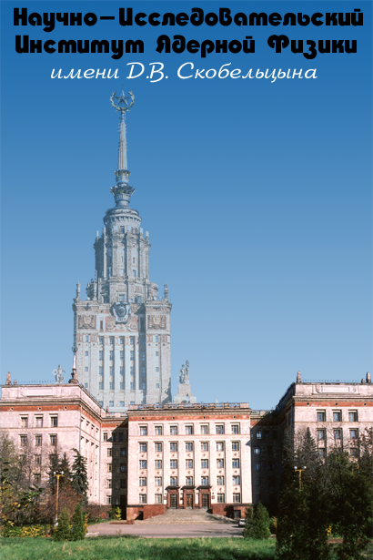

Space project “Modulation”, a new approach to studying the fluxes of galactic cosmic rays in the field of solar modulation energies
D.M Podorozhny, V.V. Kalegaev, D.E. Karmanov, A.A. Kurganov, A.D. Panov, M.V. Podzolko, A.N. Turundaevsky

Slide 2
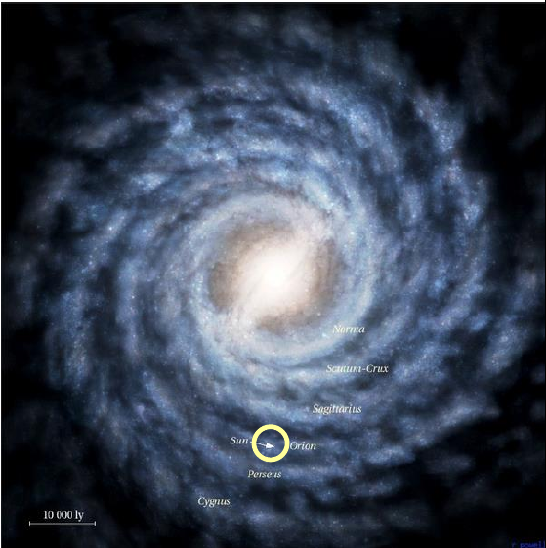
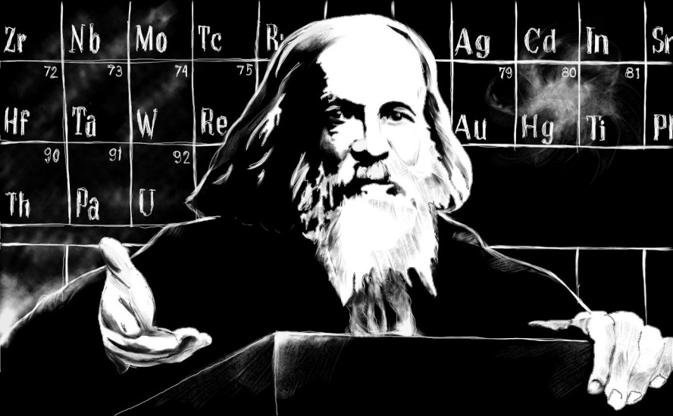
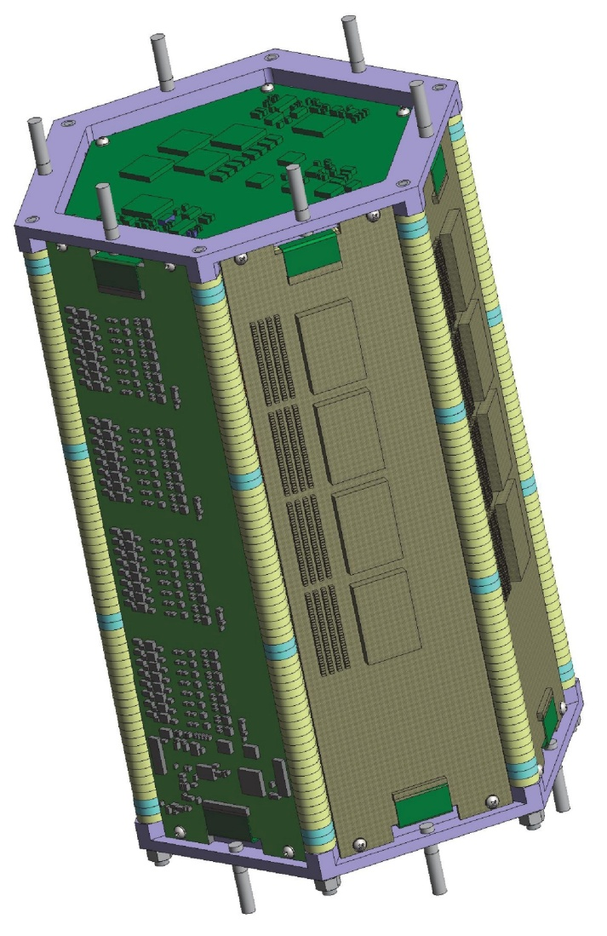
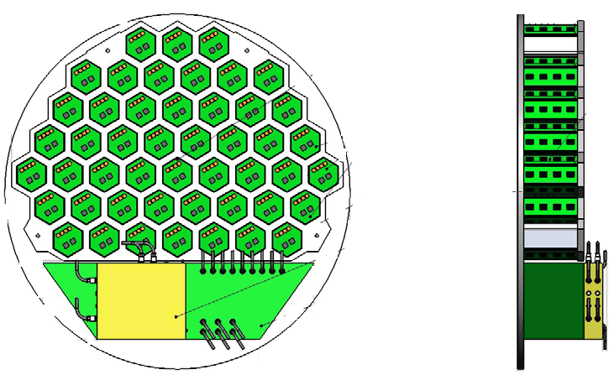
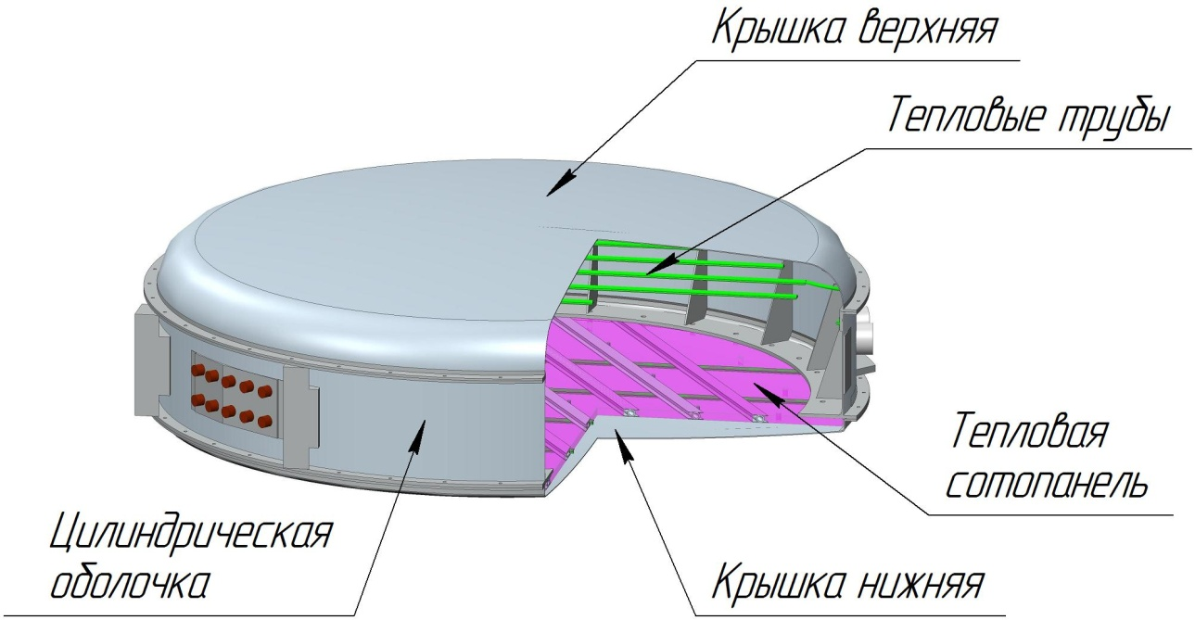
Astrophysical experiment NUCLEON 2
The main objectives of the NUCLEON 2 experiment:
- determination of the charge composition of cosmic rays up to the boundaries of the known list of stable ones (94 ?);
study of the isotopic composition of superheavy CR nuclei behind the iron peak, up to Z~60
Energy region 0.3-1.0 GeV/nucleon
This experiment plans to study the cosmic origin of all elements of the periodic table. Taking into account the anniversary of D.I. Mendeleev (February 8, 2024 will be the 190th anniversary of his birth)), it is proposed to name the scientific equipment and experiment after the great scientist D.I. Mendeleev.
NUCLEON 2 consists of 48 identical modular silicon calorimeters. Each is an autonomous recording device.

Slide 3
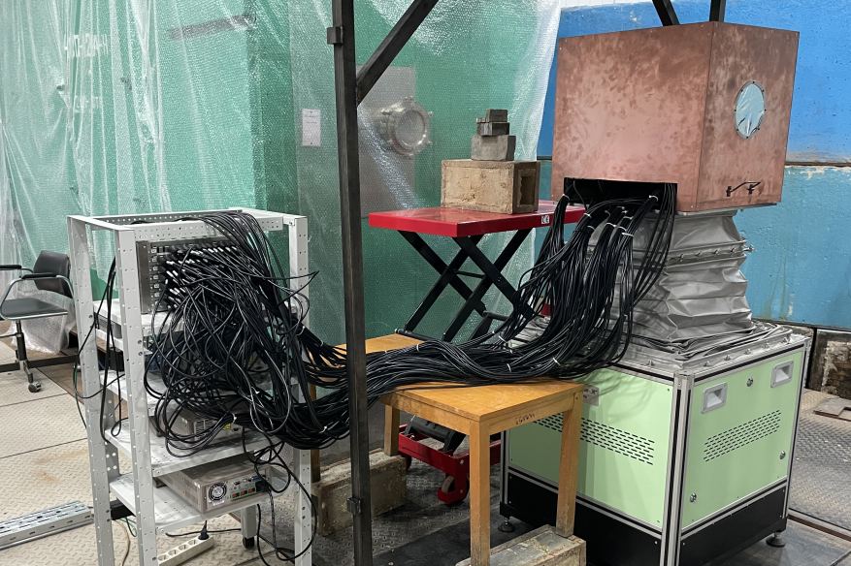
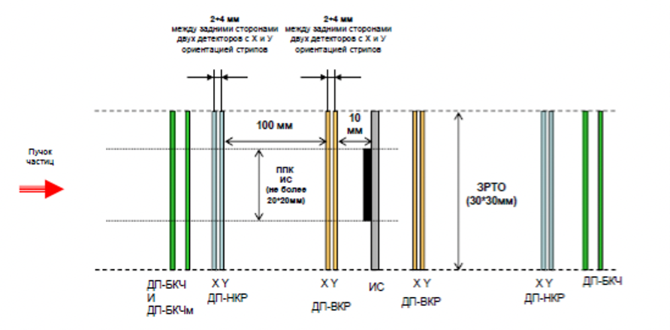
Detector part of the station (DPS) for monitoring the effects of heavy charged particles on electronics for space applications. As part of the mega project NICA

Slide 4
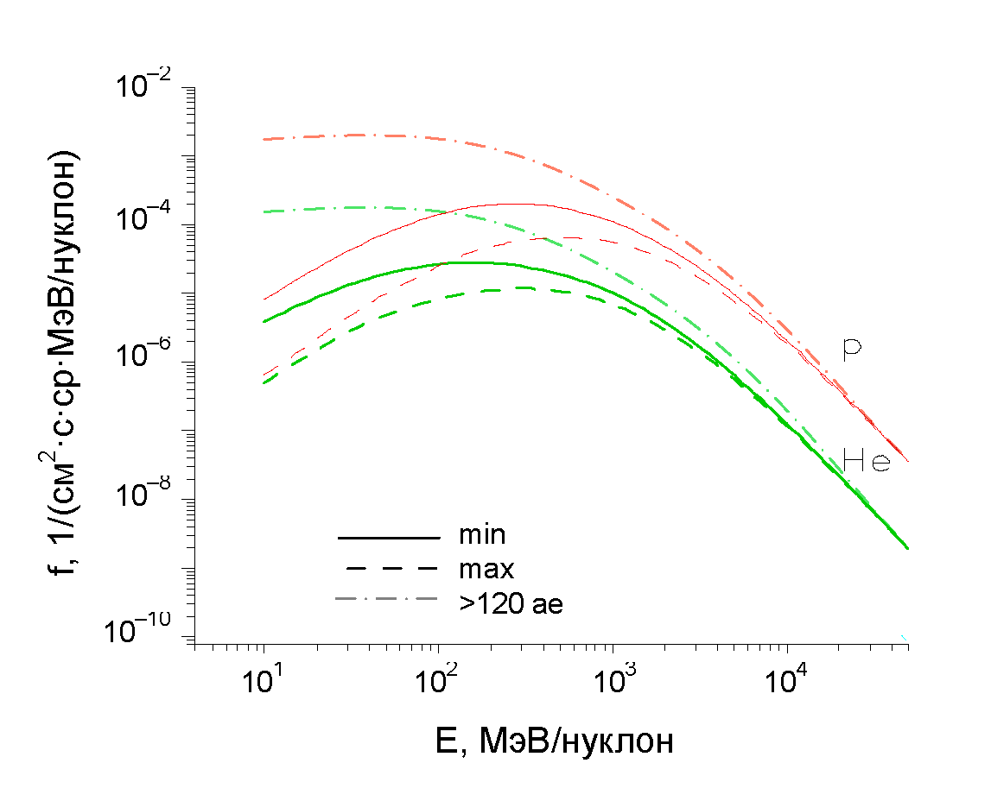
Proposal.
Experiment to measure the fluxes of galactic and solar cosmic rays in the energy range 30 to 1000 MeV/nucleon, taking into account solar modulation
Russian space station
Energy spectra of protons and He nuclei outside the heliosphere and in the region of the Earth’s orbit at minimum and maximum
GCR consist of more than 90% protons, " 6% He nuclei, and " 1% nuclei of heavier elements.

Slide 5
The future Russian station will have a polar orbit. In polar regions, the GCR and SCR particle fluxes are fully penetrating.
Methodology for registration of nuclei from protons to iron for the project
The main difficulty in the construction of the instrument is in the wide range of energies and charges in the investigated CR.
Various techniques are known to be applicable to the registration of nuclei. These techniques are based on different physical effects depending on the properties of the particle: trajectory curvature by magnetic field, Cherenkov and transient radiation, direct velocity measurement by time-of-flight technique, ionization losses in matter. In many cases, a combination of several methods is required to simultaneously determine the charge, mass, and energy of a nucleus.
These approaches are realized in PAMELA, AMS and a number of other experiments. The installations are complex systems, with large mass and dimensions.

Slide 6
For the NUCLON 2 and DPS projects, the method of determining the product MZ^2 (Z - charge, M - mass number) for very heavy nuclei was used. The method is based on the simultaneous measurement of the total nucleus energy E released in the detectors and the energy loss dE/dx during the passage of a thin detector of thickness dx. The product E*(dE/dx) ~ MZ^2[ln E + const], determines Z and M, and the energy E is measured directly as the sum of the energy in the individual detectors.
For very heavy nuclei Z>30, a small amount of matter (~6 cm Si in NUCLON 2) is sufficient for complete absorption.
However, for light high-energy nuclei, this technique would require a very deep detector (for example, a proton with E~1000 MeV requires >1 m Si). This is not realizable.

Slide 7
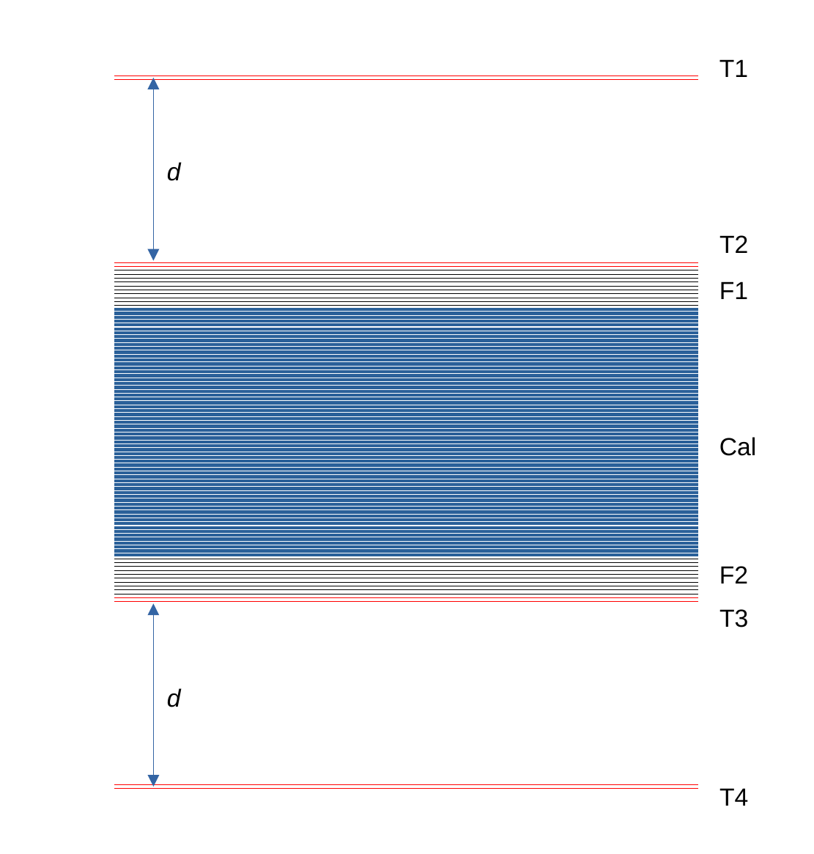
For the "Modulation" project it is planned to use the methods and developments obtained in the NUCLON-2 and DPS projects, with transfer of research to the field of SCR and abundant (source-generated) GCR nuclei in the energy region of 30-1000 MeV/nucleon and charges Z = 1-26.
The FLUKA software package was used to simulate various aspects of the "Modulation" spectrometer. The NUCLON 2 elements with some modification were used for the spectrometer.
T1 and T2 - two double-layer silicon strip trackers in the upper part of the device, T3 and T4 - two similar trackers in the lower part of the device (red lines). F1 and F2 - two thin-layer silicon calorimeters (300 µm layer thickness). Cal - basic silicon calorimeter with 1 mm thick planes. The total thickness of the calorimeter F1+Cal+F2 is 60 mm.

Slide 8
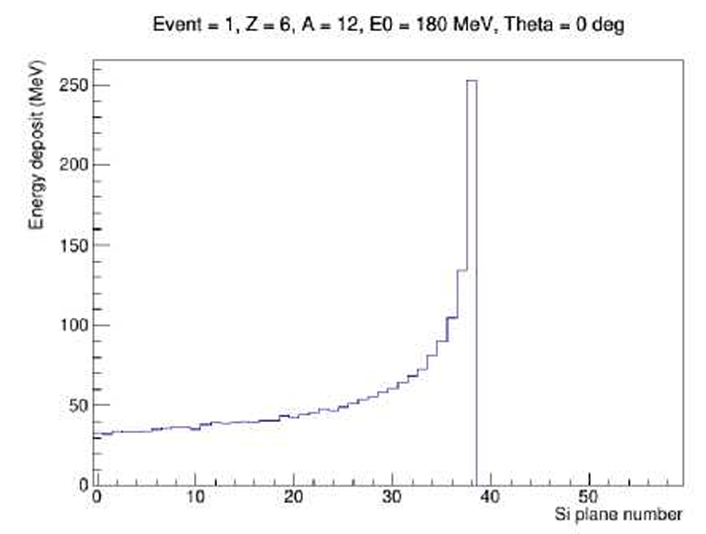
For low energies the NUCLON 2 technique is applied without modifications.
The statistical error of the calculation varies from 0.13% for protons to 0.23% for iron
Элемент | Z | A | E min MeV | Emax MeV
Р | 1 | 1 | 29 | 121
Не | 2 | 4 | 29 | 121
Li | 3 | 7 | 33 | 140
Be | 4 | 9 | 39 | 170
В | 5 | 11 | 45 | 196
С | 6 | 12 | 53 | 231
N | 7 | 14 | 58 | 255
О | 8 | 16 | 63 | 276
F | 9 | 19 | 65 | 286
Ne | 10 | 20 | 70 | 317
Na | 11 | 23 | 73 | 326
Mg | 12 | 24 | 78 | 355
А1 | 13 | 27 | 81 | 364
Si | 14 | 28 | 85 | 391
Р | 15 | 31 | 88 | 400
S | 16 | 32 | 92 | 426
Cl | 17 | 35 | 94 | 435
Ar | 18 | 40 | 93 | 430
К | 19 | 39 | 99 | 467
Ca | 20 | 40 | 104 | 491
Se | 21 | 46 | 103 | 477
Ti | 22 | 49 | 104 | 487
V | 23 | 51 | 106 | 505
Cr | 24 | 52 | 109 | 526
Mn | 25 | 55 | 112 | 532
Fe | 26 | 56 | 115 | 558
Example of a total absorption event. Carbon, 180 MeV/nucleon. Bragg peak

Slide 9
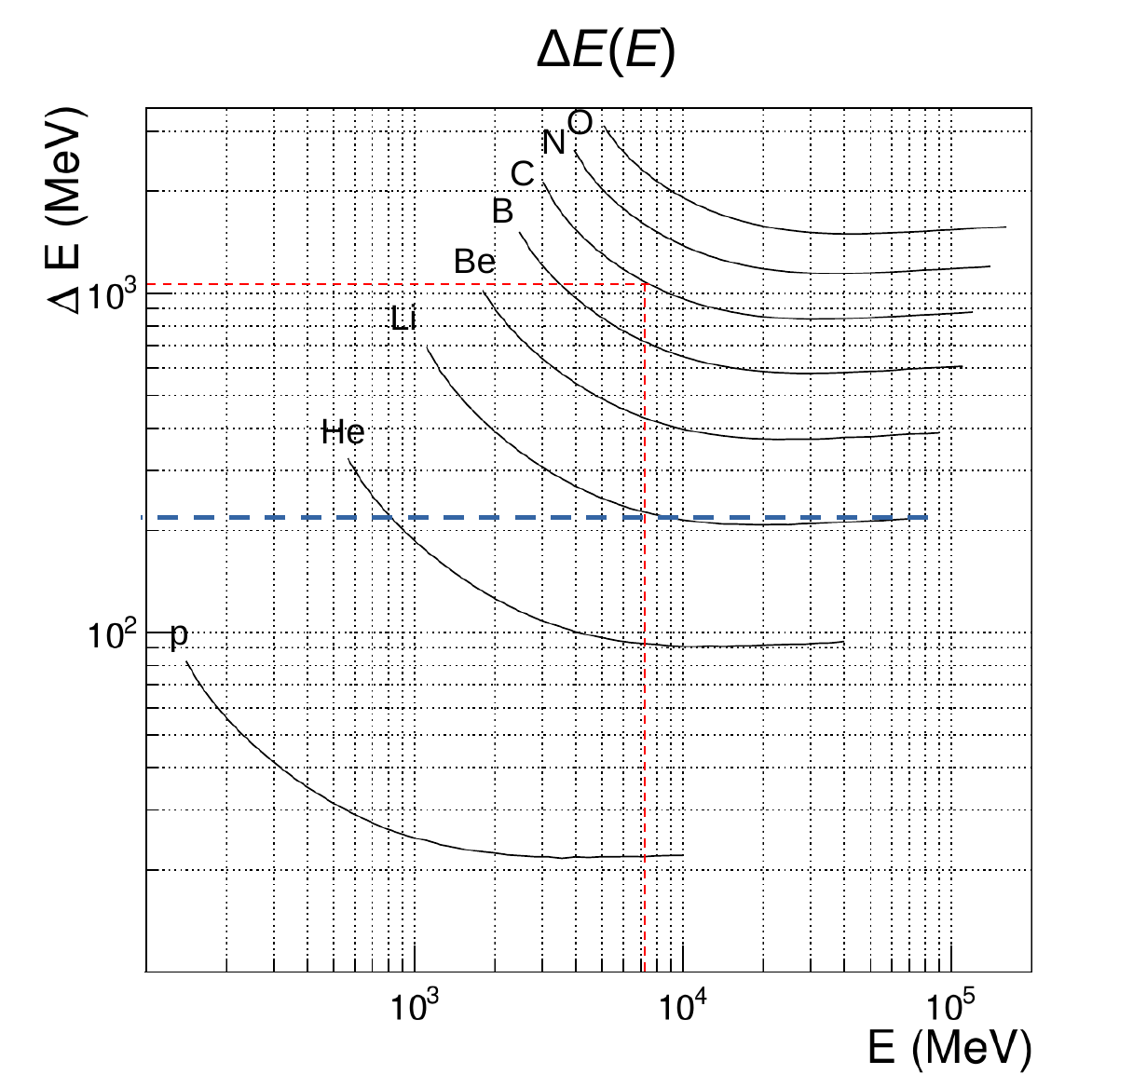
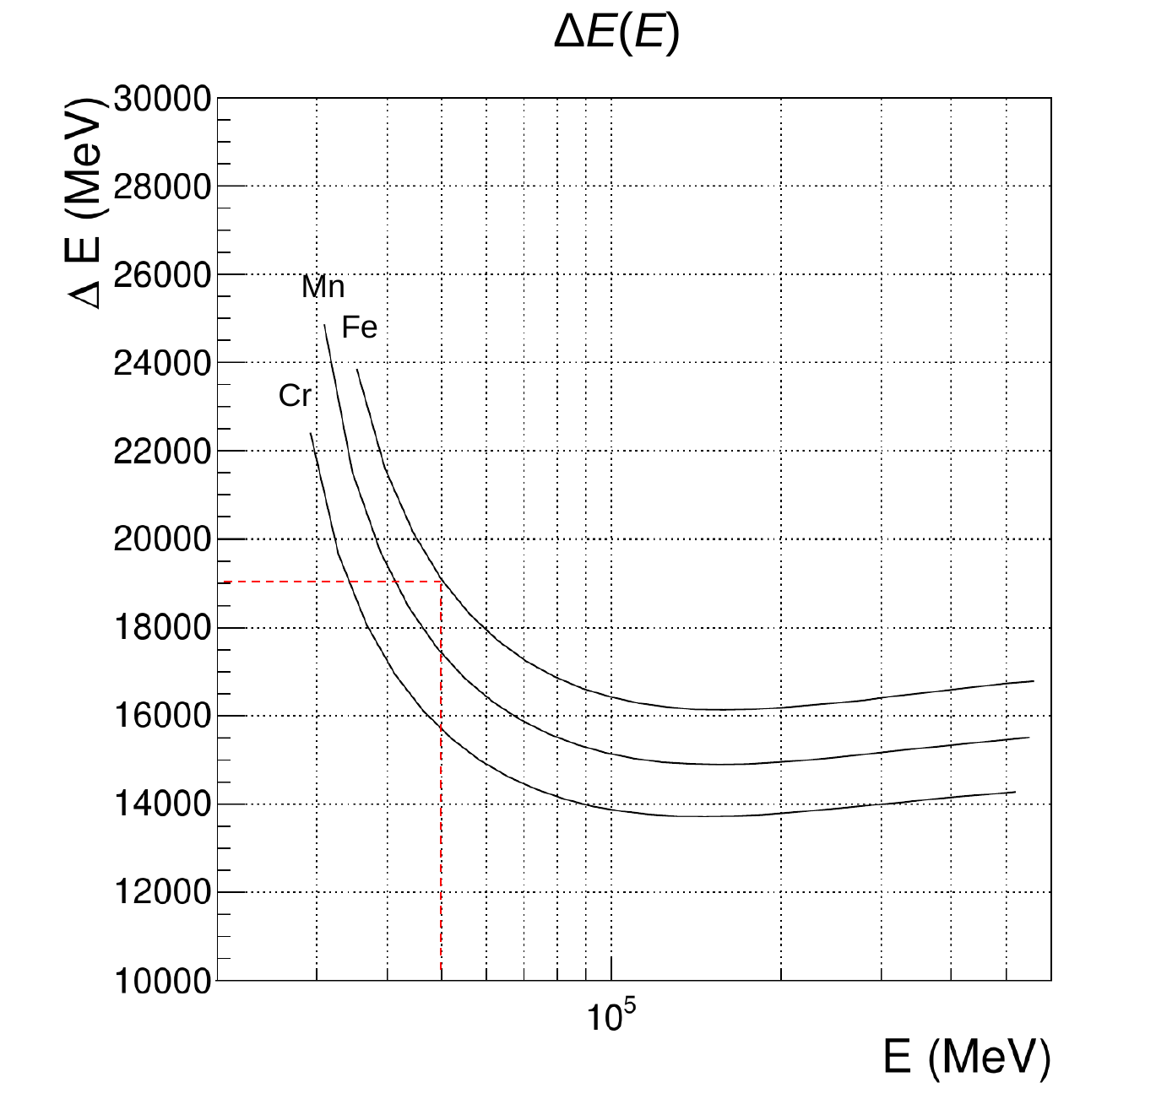
Full energy absorption provides precise measurement of nuclear energy, but not in a sufficient range. The dE/dx methodology fails.
It can be seen from the figures that when only ΔE is measured, the identification of nuclei may be erroneous

Slide 10
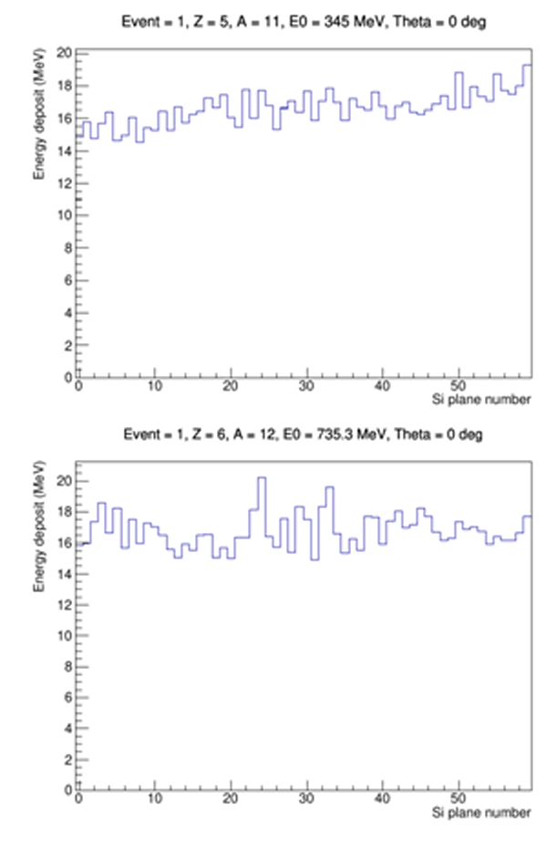
In order to extend the energy range, a new approach for processing the data of the "Modulation" spectrometer is proposed
For example, the figures show the cascade curves of boron and carbon for the same average energy release in the calorimeter ΔE = 1000 MeV. Even by eye one can see the difference in the slopes of the cascade curves.
Therefore, the problem is to determine the type of nucleus only at a given energy ΔE

Slide 11
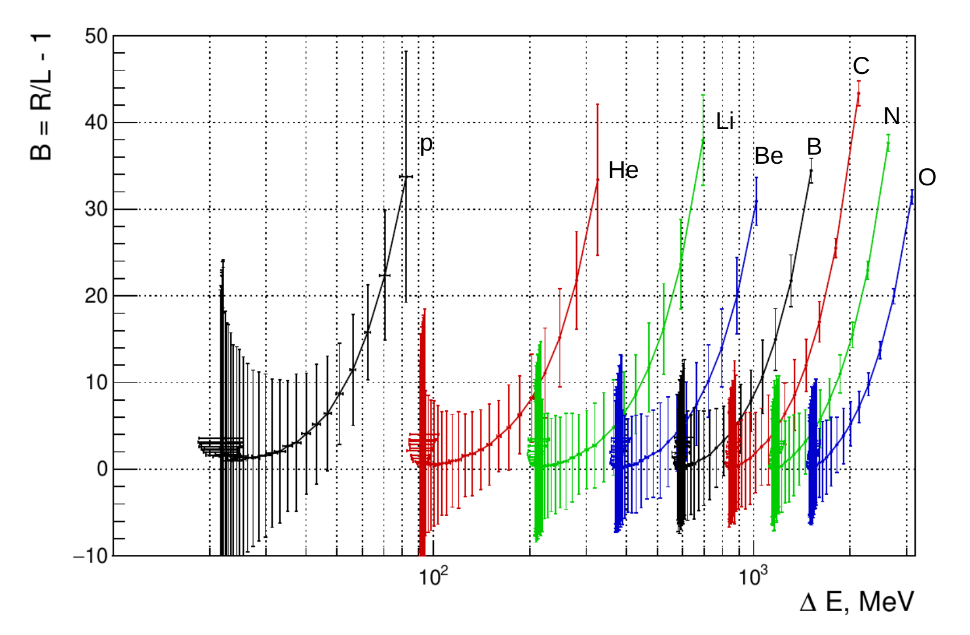
As the simplest example we can introduce the parameter B.
B = (R/L - 1)*100%.
Where R is ΔE in the lower half of the calorimeter and L in the upper half.
The figure shows the dependence of B on ΔE for nuclei from protons to oxygen. You can see that a confident separation of the kernels is underway. The error possibilities are very narrow, for example, to mix up helium and lithium lies in the energy range 270 to 320 MeV/nucleon. For heavier nuclei, there is better separation

Slide 12
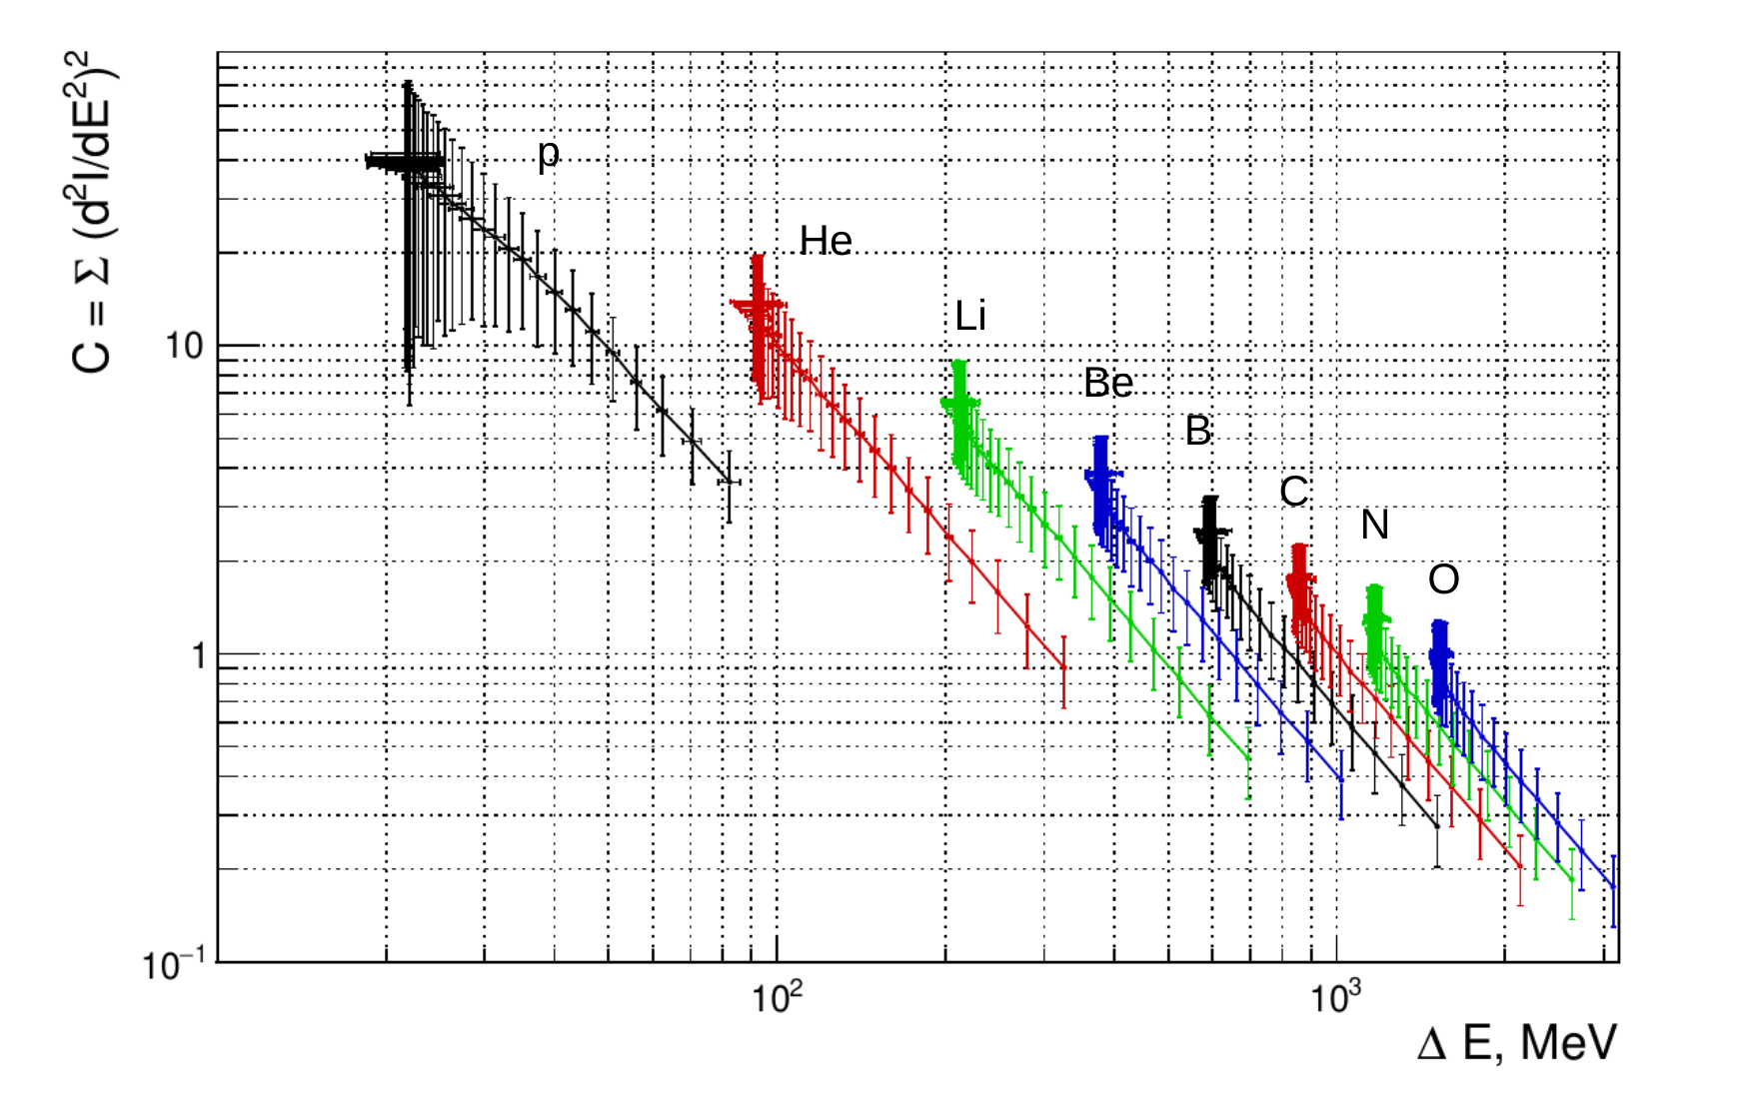
It is possible to improve the parameter under study. For example, introduce a parameter C, which takes into account the degree of fluctuations in each layer of the calorimeter.
C= ∑(d^2/dE^2)
Where d=Si+1-2Si+Si-1, Si is the energy in the i-th layer of the calorimeter.
One can still look for more efficient parameters.
The principle is important!

Slide 13
The table shows the energy resolutions (in percent) for p, He, C, O, Si, and Fe nuclei for several energies. C parameter was used
Энергия, МэВ/нуклон | протоны | He | C | O | Si | Fe
200 400 600 800 1000 1200 1500 2000 | 2.7 7.2 12.0 19.8 30.3 - - - | 1.4 3.7 6.8 11.1 17.3 25.5 - - | 0 1.0 2.0 3.4 5.4 7.8 15.5 - | 0 0.6 1.4 2.4 4.9 5.9 12.1 15.1 | 0 0 0.6 1.2 1.9 3.0 5.8 11.1 | 0 0 0 0.5 0.9 1.4 2.6 7.6
Thus, the energy range of the "Modulation" spectrometer fully satisfies the requirements for all nuclei from protons to iron.

Slide 14
Conclusions
A new approach in the registration of CR nuclei has been proposed.
This approach makes it possible to create equipment with unprecedented characteristics using limited onboard resources.
The "Modulation" project for the Russian Space Station is presented.
The project is now undergoing expert review.

Slide 15
Thank you for your attention

