Slide 1

Evolution of Ionospheric Plasma Density Enhancement on 8 February and 4 November 2018
Kun Wu, Jiyao Xu, Wei Yuan
National Space Science Center, Chinese Academy of Sciences, Beijing, China

Slide 2
Catalog
Introduction
Instrumentation and Data
Observations and Results
Possible Formation Mechanism
Summary

Slide 3
Introduction
Ionospheric plasma irregularities are frequently observed in the equatorial region. These irregularities include EPBs, TIDs, and plasma density enhancements (PDES). They have a great impact on the trans-ionospheric radio wave signals.
Some studies used data from different instruments to characterize PDES and studied their occurrences and evolution. However, very few studies using airglow observations were carried out to show the evolution of PDES .
Although PDES has been reported in some studies, its evolution from occurrence to disappearance has never been studied in detail. Meanwhile, the formation mechanism of PDES remains unclear, which is worthy of further investigation

Slide 4
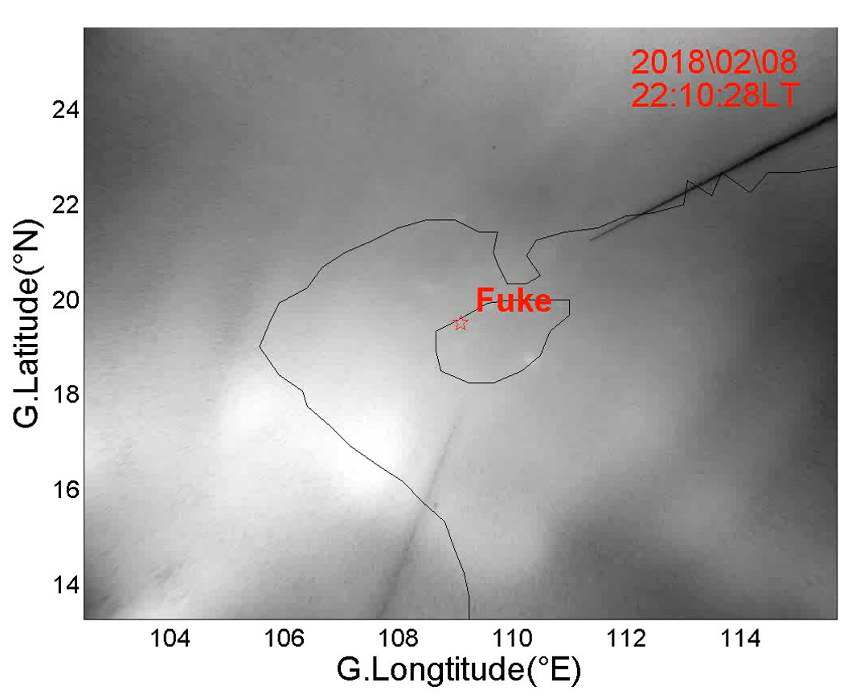
Introduction
Plasma Density Enhancement Structure (PDES)
The equatorial ionosphere is a region where plasma irregularities and disturbances frequently occur. One of the disturbances is the enhancement of the F-region plasma density enhancement structure (PDES), when compared with the background density, which is known as plasma density enhancements or plasma blobs.

Slide 5
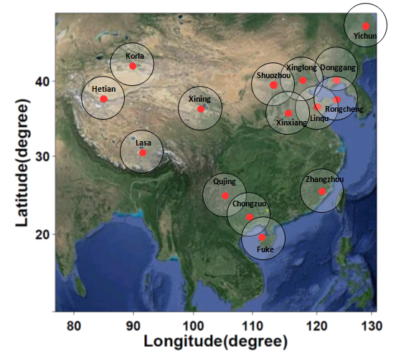
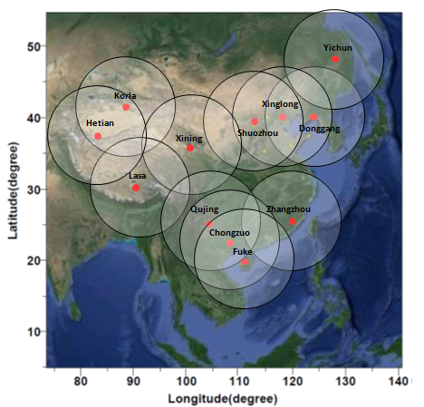
Instrumentation and Dataset
Airglow Observation Network
OH Airglow Observation Network（Altitude : ~ 87km）
630nm Airglow Observation
Network（Altitude: ~ 250km）
Observatory stations of the Chinese Meridian Project

Slide 6
Instrumentation and Dataset
Data Time：February 08 and November 04, 2018
All-sky Imager
Fuke, China (Geographic: 19.5° N, 109.1° E; Geomagnetic: 9.5° N)
(2)Other Instrumentations and Dataset
a.) BDS GEO total electron content (TEC) data from two GNSS receivers : Guangxi, Beihai (GXBH) (109.2° E, 21.5° N; geomagnetic: 11.9° N) and Hainan, Chengmai (HNCM) (110.1° E, 19.8° N; geomagnetic: 10.2° N)
b.) Digisond located at Fuke (Geographic: 19.5° N, 109.1° E; Geomagnetic: 9.5° N)
c.) Simulations of neutral winds from the TIE-GCM
Wu et al., JGR, 2022

Slide 7
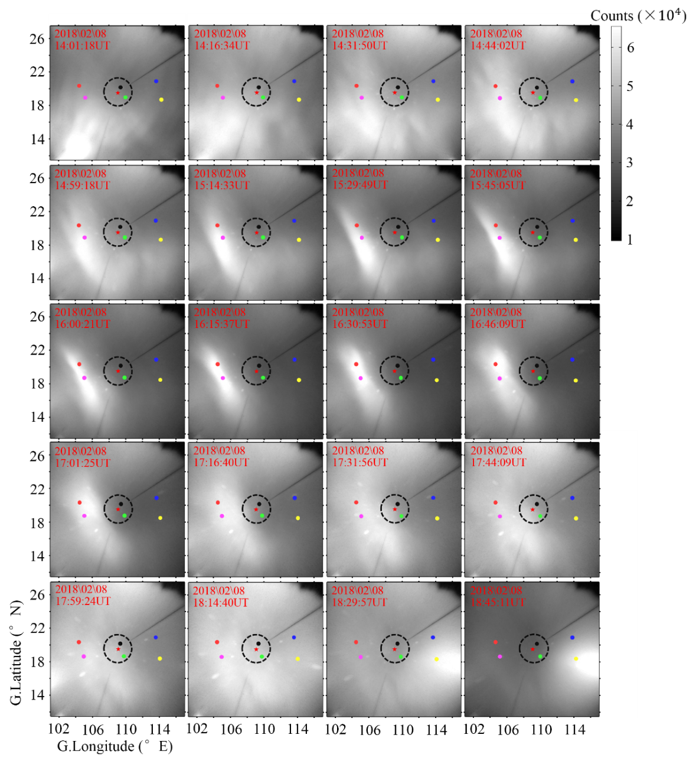
Observations and Results
Airglow Observation Results：
Two PDESs were observed by all-sky imager at Fuke station during nighttime of Feb.8 and Nov.04, 2018
The intensity of the PDES was enhanced by about two times over the background intensity.
These PDESs are elongating from northwest to southeast, which is different from those reported in previous studies.
They occurred before the midnight, elongated into stripe-like PDES, and gradually disappeared after the midnight in the FOVs of the ASI.
Wu et al., JGR, 2022
Notes:
PDES=Plasma Density Enhancement Structure. 气辉图像校正后投影到250km的地理坐标系中，Counts是气辉图像的光子计数。图中黑色虚线圈是富克台站数字测高仪在大约250km高度处的观测视野。红色星是富克台站地理位置。图中彩色点是对应下一页相应北斗TEC的穿刺点位置。

Slide 8
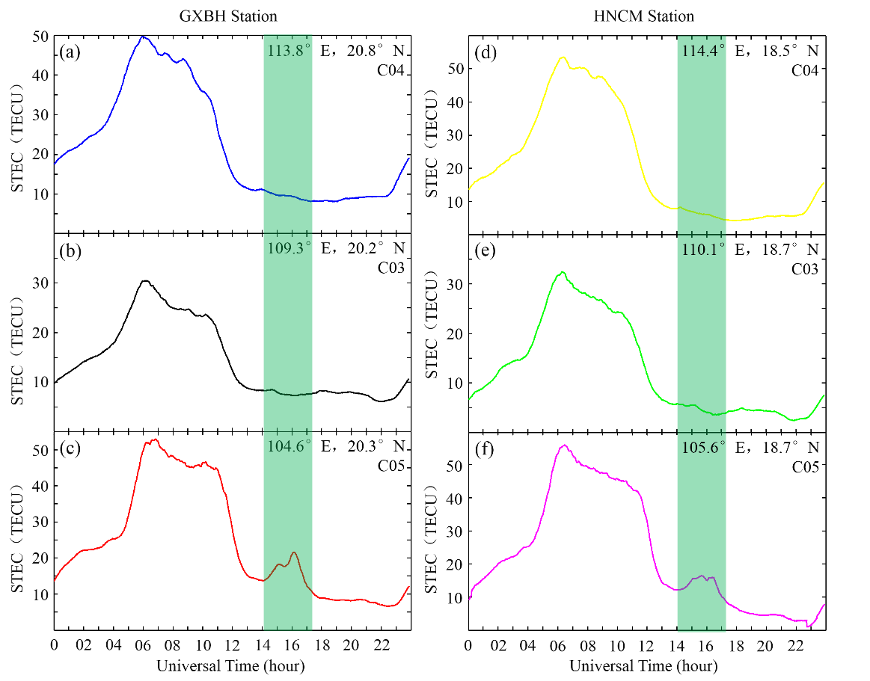
Observations and Results
TEC Observation Results：
Beidou C05 observed TEC enhancement.
The intensity of TEC reached more than twice the background level, confirming the airglow observation results.
Wu et al., JGR, 2022
Notes:
4号结果和8号是一致的，主要挑选8号的进行分析。GXBH=Guangxi, Beihai(109.2° E, 21.5° N; geomagnetic: 11.9° N, 178.2° W)；HNCM=Hainan, Chengmai (110.1° E, 19.8° N; geomagnetic: 10.2° N, 177.4° W). 以02月08的观测为例，气辉图中，PDES最强处光子数达到台站正上空大约2倍以上。两个台站的北斗卫星C05的穿刺点地理位置刚好在PDES上空，而C3和C4均在PDES的东侧，因此C3和C4的观测可作为背景，明显能够看出对应时间段C05的TEC出现明显增强，相较于C3，C4 TEC达到2倍以上，与气辉观测结果一致。

Slide 9
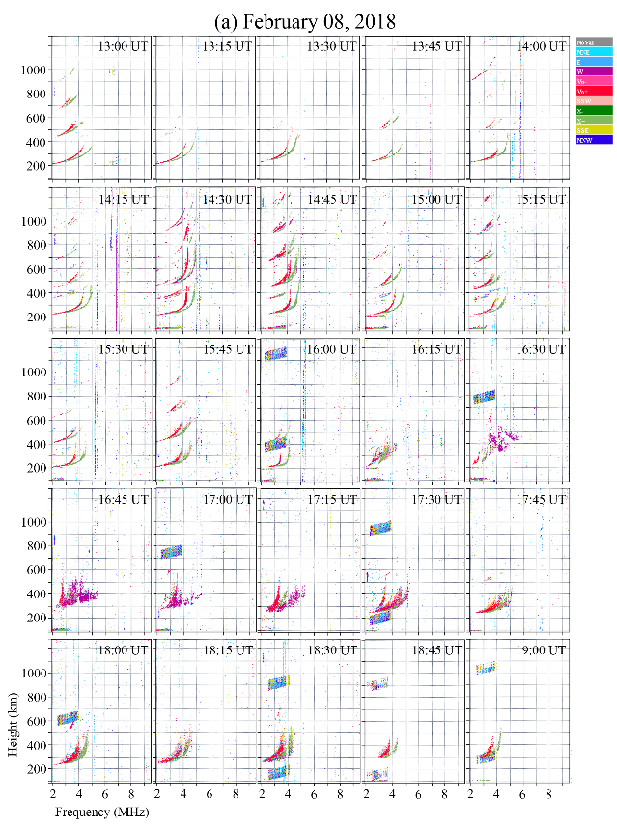
Observations and Results
Digisonde Observation Results：
When the PDES entered the FOV of the digisonde, significant Spread F were appeared.
These PDESs can induce Spread F.
Wu et al., JGR, 2022

Slide 10
Possible Formation Mechanism
TIEGCM simulation results indicate that the occurrence of PDES during the event appear at the border between southward and northward winds.
Southward neutral winds in the northern hemisphere cause the plasma to move upward along the magnetic field lines, whereas northward neutral winds push the plasma downward. Thus, plasma might accumulate at the border between southward and northward winds, forming a PDES.
Wu et al., JGR, 2022
Notes:
机制讨论：两个事件PDES都出现在南北风场的交界面处。在北半球南风主要使plasma沿磁力线抬升，而北风主要使plasma沿磁力线下降，这样在南北风场交界面处就会形成plasma的堆积，形成PDES。

Slide 11
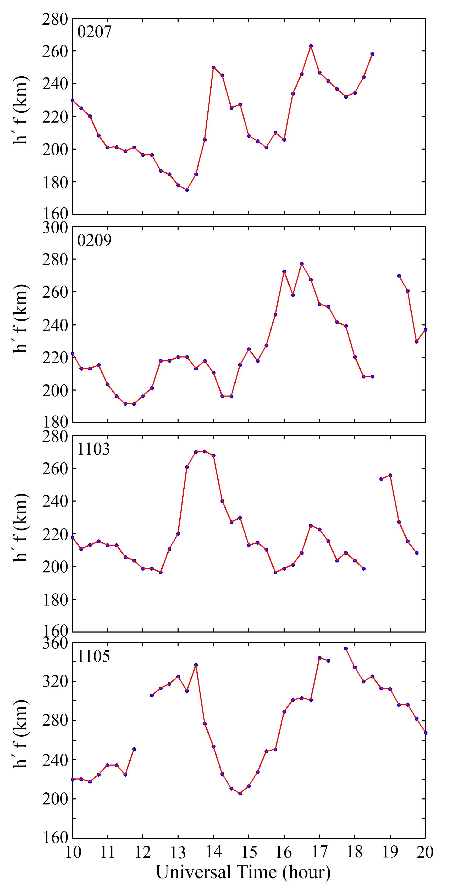
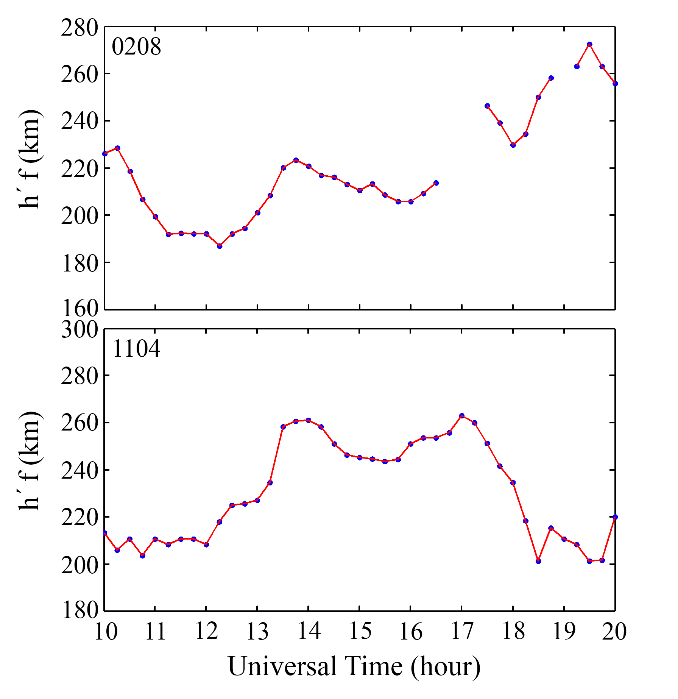
Possible Formation Mechanism
The formation of the PDES we observed here may attribute to the following conditions:
Meridional wind convergence occurs in the equatorial region.
(2) An ionospheric uplift occurs before the time of meridional wind convergence.
(3) The height of the ionosphere is relatively stable during the time of meridional wind convergence.
Wu et al., JGR, 2022
Notes:
风场交界面不是唯一的，也在其它天出现，但不是每天都有PDES出现，因此不是只要有风场交界面就有PDES。用两天的虚高与其它天有风场交界面没有PDES的天进行对比，发现其它天在风场交界面形成期间，电离层高度出现明显的变化，例如较大的抖动。而2月8日和11月4日，在风场交界面存在期间，相对平静，电离层高度几乎不出现明显的变化，所以事件中PDES的形成应该需要同时满足上述三个条件。

Slide 12
Summary
In the study, we showed two unique PDES events that were observed by multiple instruments (an ASI, GPS receivers of the BDS GEO satellite signals, and a digisonde) during the nighttime of Feb. 8 and Nov. 04, 2018.
The PDESs were elongated from northwest and southeast. They occurred before the midnight at low latitudes. Near the midnight, the plasma density enhancement then developed into a stripe-like PDES. After the midnight, the PDES was gradually weakened with time.
The PDESs had east-west and north-south extensions of 200 – 400 km and 800 – 1400 km. They were associated with Spread F in the ionograms.
Based on the simulations from the TIE-GCM and digisonde observations, we proposed a possible formation cause of the PDES in this event. Because of varying neutral winds that can have a convergency in the meridional direction in the equatorial region, plasma accumulation may occur when the ionosphere is relatively stable.
Citation：Wu, K., Xu, J., Wang, W., & Yuan, W. (2022). Morphology and evolution of plasma density enhancement events in the equatorial ionospheric F region on 8 February and 4 November 2018. Journal of Geophysical Research: Space Physics, 127, e2022JA030482. https://doi. org/10.1029/2022JA030482

Slide 13
Summary
Thank you

