Slide 1
Variations in the parameters of the middle atmosphere during geomagnetic disturbance
Mironova I.A. *, Bazilevskaya G.A., Grankin D.V., Mironov A.D., Rozanov E.V.
* St. Petersburg State University, St. Petersburg, Russia
i.a.mironova@spbu.ru
irini.mironova@gmail.com

Slide 2
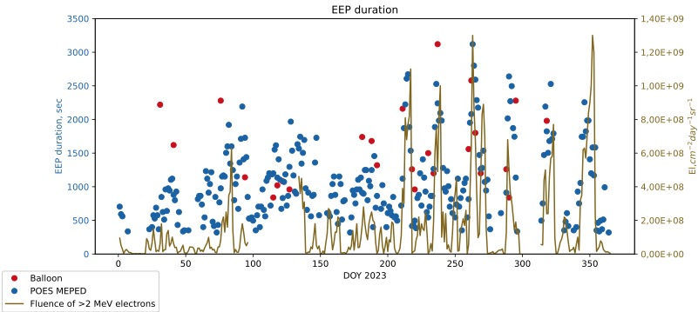
Balloon and NOAA POES observations
The duration of EEP observed with POES and cylinder measurements.
Red - balloon EEP duration, blue - MEPED POES EEP duration.
^{Mironova} ^{et al. (2023)}

Slide 3
Response of the atmosphere to precipitation of energetic particles in 2003
Vertical ionization rate profiles during individual EEP events observed by MEPED POES.
^{Mironova} ^{et al. (2023)}

Slide 4
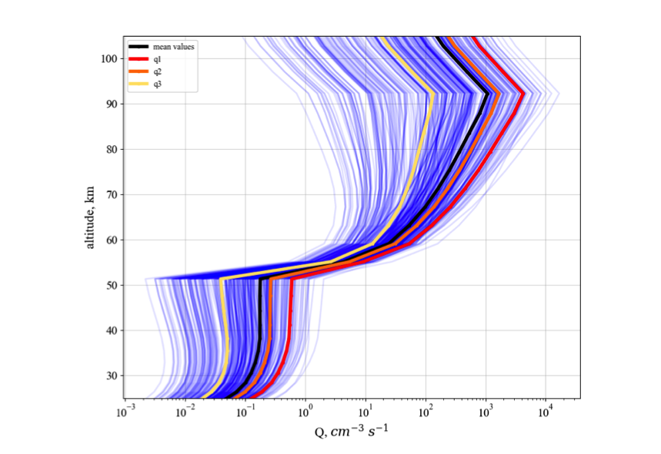
Response of the atmosphere to precipitation of energetic particles in 2003
EEP for the whole year 2003 broken down by geomagnetic activity:
q1. Kp >= 50
Total events 20
q2. Kp in [30, 50]
Total events 189
q3. Kp < 30
Total events 156
^{Mironova} ^{et al. (2023)}

Slide 6
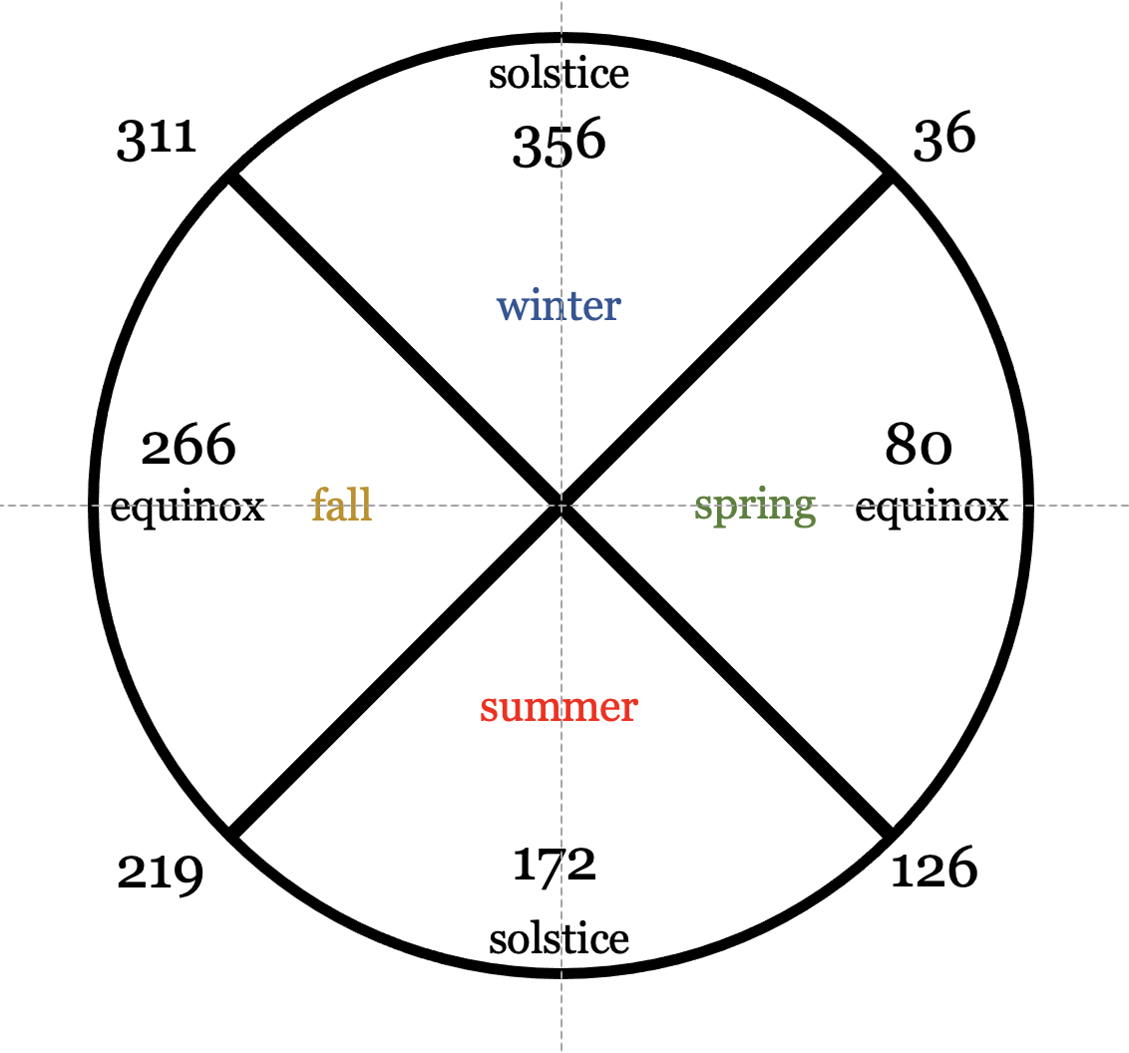
Mesospheric ozone depletion depending on different levels of geomagnetic disturbances and seasons
^{Mironova} ^{et al. (2023)}

Slide 7
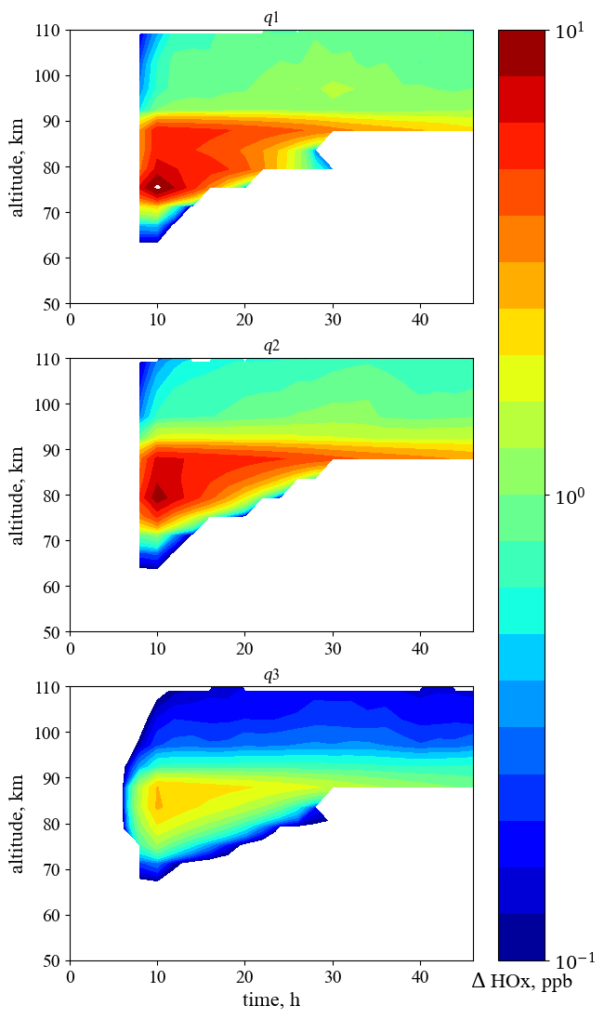
Mesospheric ozone depletion depending on different levels of geomagnetic disturbances and seasons
1D model
with ion chemistry
simulations
EEP for the whole year 2003 broken down by geomagnetic activity:
q1. Kp >= 50
Total events 20
q2. Kp in [30, 50]
Total events 189
q3. Kp < 30
Total events 156
^{Mironova} ^{et al. (2023)}

Slide 8
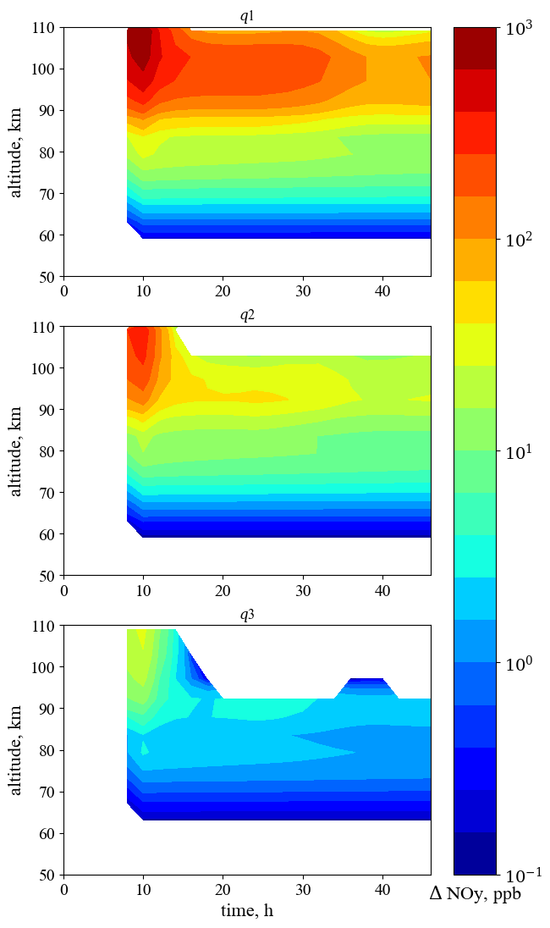
Mesospheric ozone depletion depending on different levels of geomagnetic disturbances and seasons
1D model
with ion chemistry
simulations
EEP for the whole year 2003 broken down by geomagnetic activity:
q1. Kp >= 50
Total events 20
q2. Kp in [30, 50]
Total events 189
q3. Kp < 30
Total events 156
^{Mironova} ^{et al. (submitted 2023)}

Slide 9
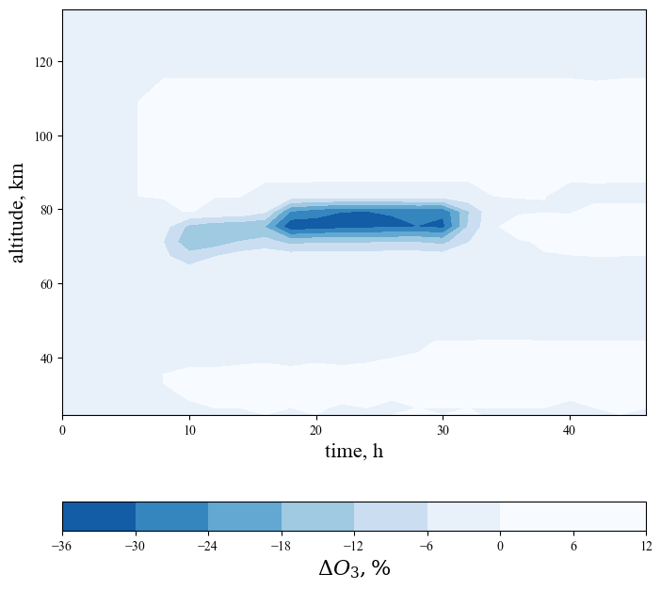
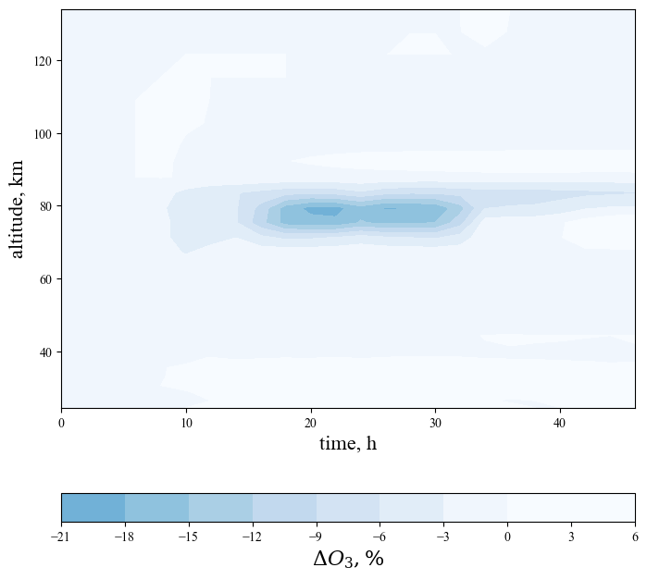
Mesospheric ozone depletion depending on different levels of geomagnetic disturbances and seasons
1D model with ion chemistry simulations
q1. Kp >= 50
Total events 20
q2. Kp in [30, 50]
Total events 189
^{Mironova} ^{et al. (2023)}

Slide 10
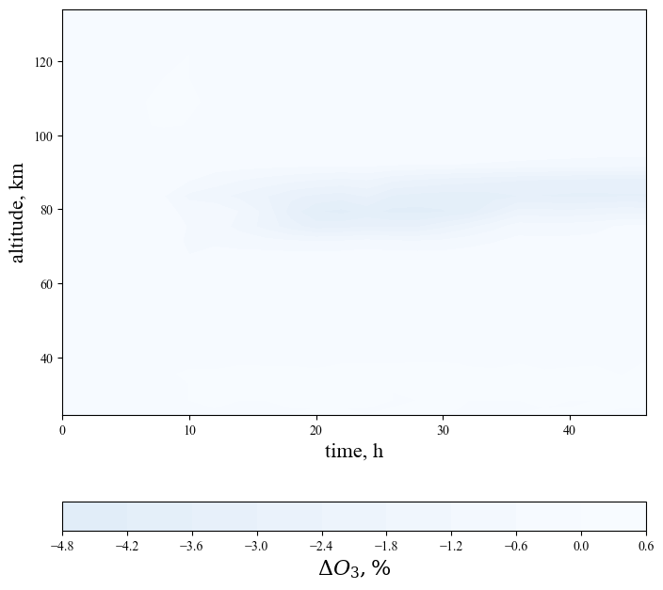
Mesospheric ozone depletion depending on different levels of geomagnetic disturbances and seasons
1D model with ion chemistry simulations
q3. Kp < 30
Total events 156
^{Mironova} ^{et al. (2023)}

Slide 11
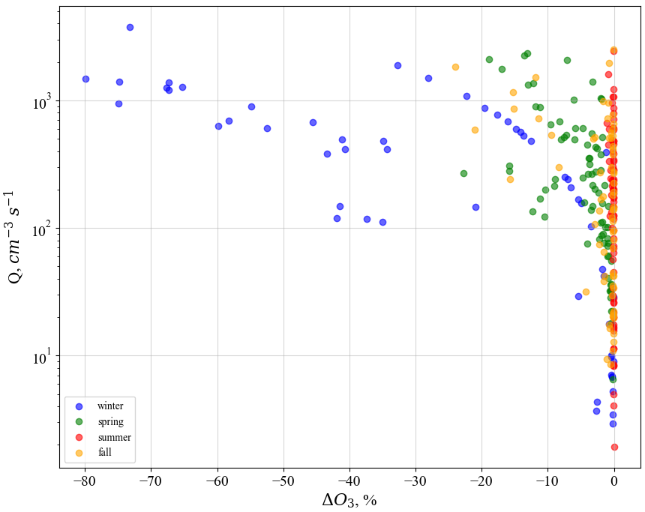
Mesospheric ozone depletion depending on different levels of geomagnetic disturbances and seasons
^{Mironova} ^{et al. (2023)}

Slide 12
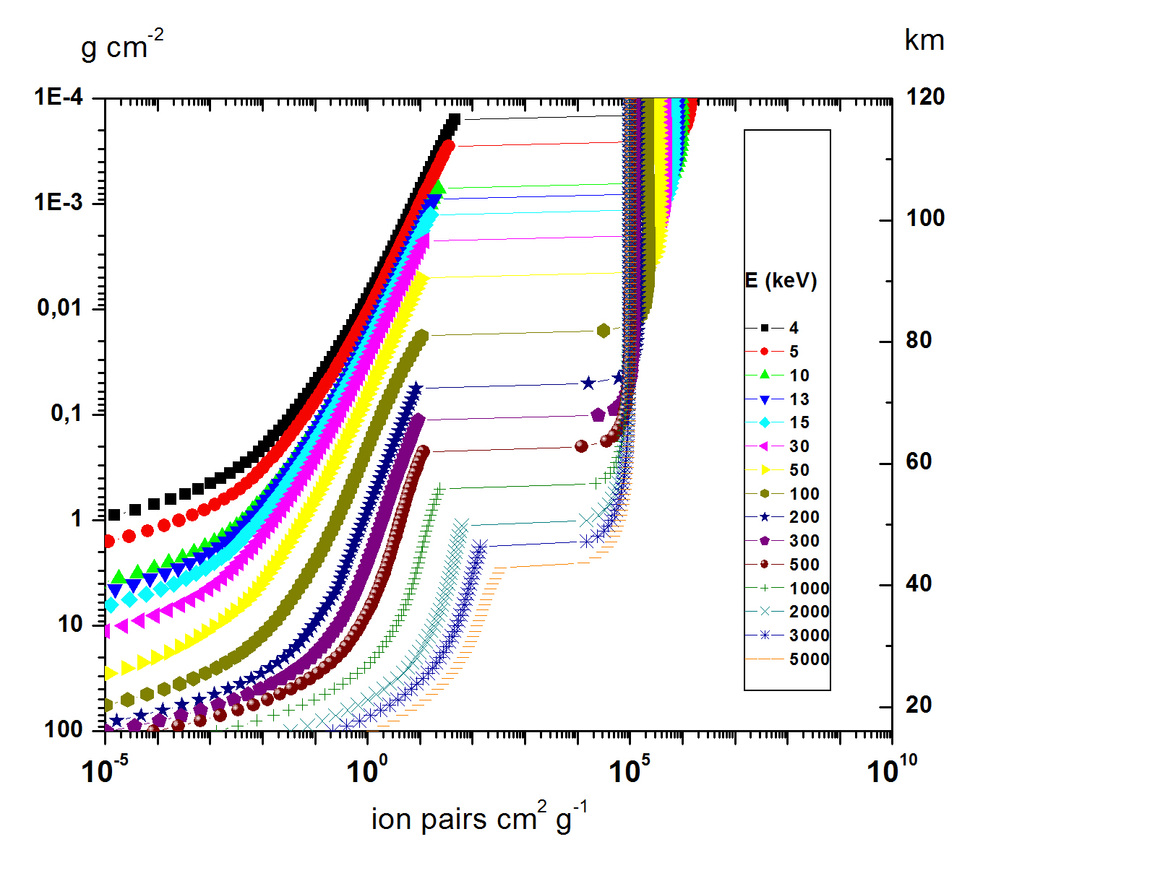
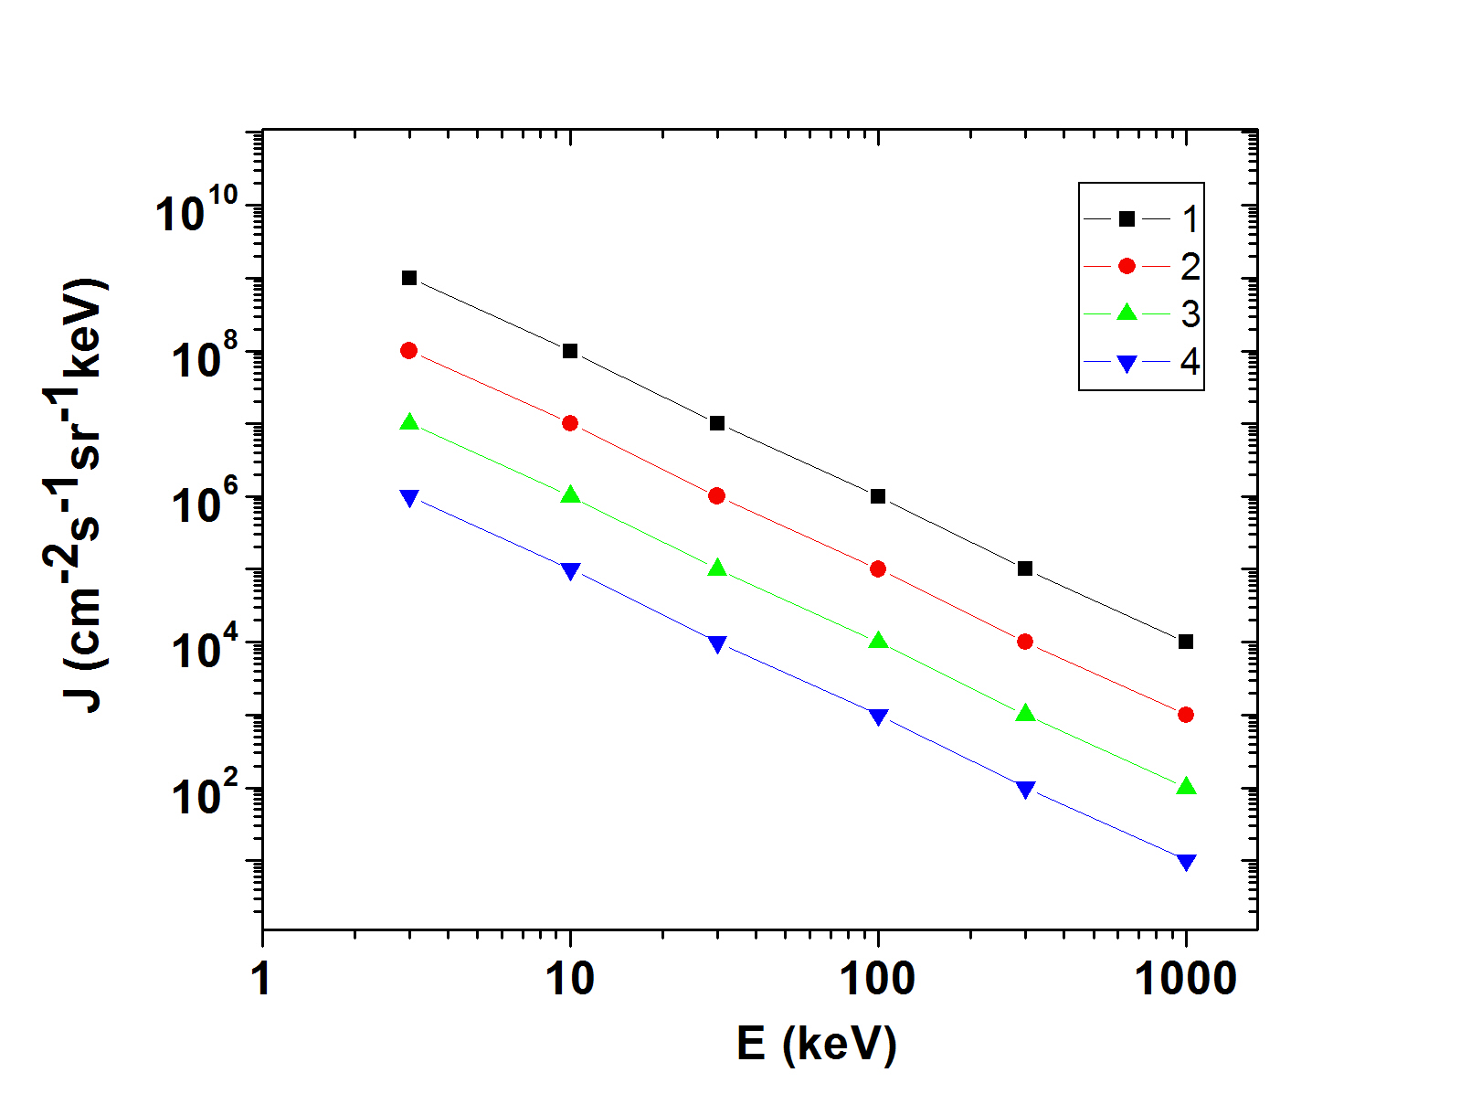
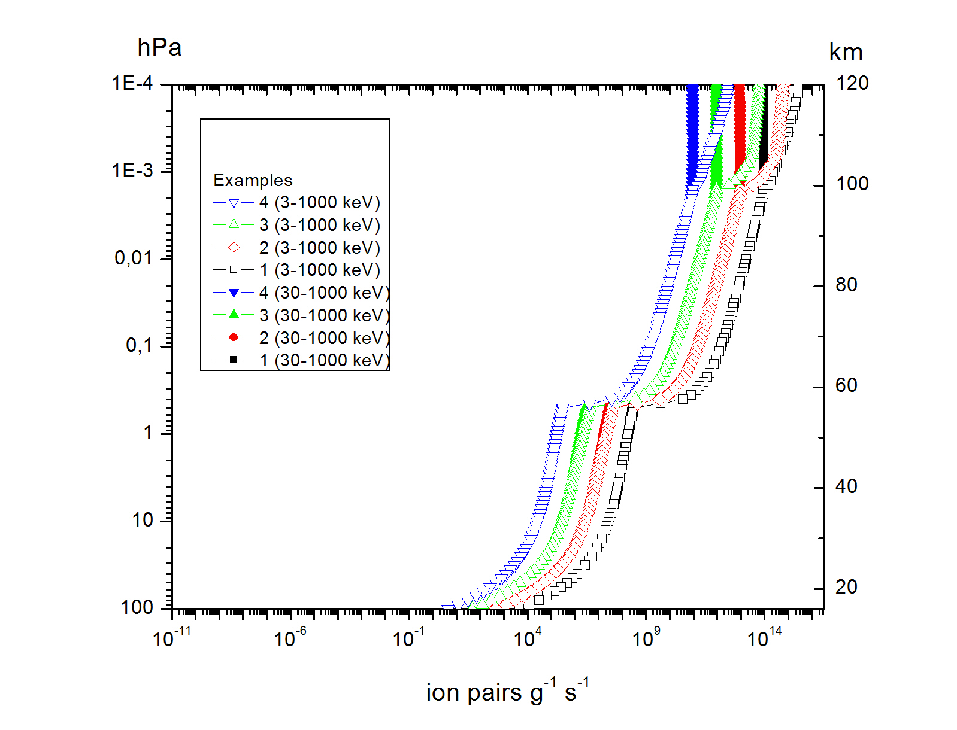
Estimation of characteristics of atmospheric ionization rates taking into account different energies of precipitating electrons
^{Mironova} ^{et al. (submitted 2023)}

Slide 13
Summary
Comparing the results of observations on POES satellites and balloons, we proposed a criterion by which it is possible to control the ionization in the atmosphere at altitudes up to 20-25 km according to measurements on satellites.
We study mesospheric ozone depletion depending on seasons and precipitating energetic electrons with energies from keV up to relativistic energies about 1 MeV, based on the NOAA POES satellites observations in 2003.
EEP induced depletion of the ozone layer at altitude about 80 km reaches 36% for strong geomagnetic disturbances where Kp∗10 > 50 , up to 21% for moderate geomagnetic disturbances with a Kp∗10 index from 40 till 50 and up to about 5% for quiet geomagnetic conditions, where Kp∗10 < 30.
In winter ozone depletion can reach up to 80% in the mesosphere during strong geomagnetic disturbances. In summer, fall and spring, ozone depletion is less intense and can reach about 20% during strong geomagnetic disturbances.
For studying thermospheric and mesospheric effects from energetic electron precipitation it is important to have information about electrons with energies from keV.

Slide 14
More details about the results presented in the report can be found in the articles:
1. Mironova, I.; Bazilevskaya, G.; Makhmutov, V.; Mironov, A.; Bobrov, N. Energetic Electron Precipitation via Satellite and Balloon Observations: Their Role in Atmospheric Ionization. Remote Sens. 2023,15,3291. https://doi.org/ 10.3390/rs15133291
2. Grankin, D.; Mironova, I.; Bazilevskaya, G.; Rozanov, E.; Egorova, T. Atmospheric Response to EEP during Geomagnetic Disturbances. Atmosphere 2023, 14, 273,
https://doi.org/10.3390/atmos14020273

