Slide 1
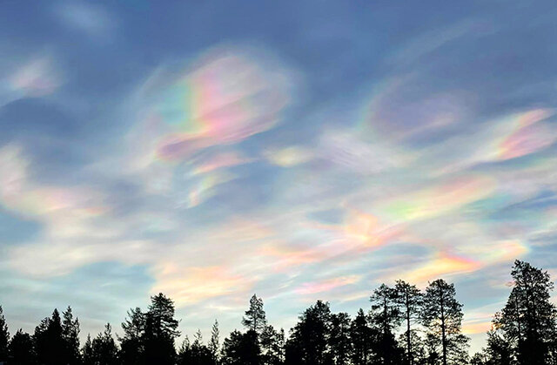
ЛИДАРНЫЕ ИССЛЕДОВАНИЯ ДИНАМИКИ СТРАТОСФЕРНОГО АЭРОЗОЛЯ НАД ТОМСКОМ.
LIDAR INVESTIGATIONS OF THE DYNAMICS OF STRATOSPHERIC AEROSOL OVER TOMSK
V.N.Marichev, D.A.Bochkovsky
Institute of Atmospheric Optics V.E. Zuev, SB RAS, Tomsk
marichev@iao.ru
В.Н.Маричев, Д.А.Бочковский
Институт оптики атмосферы СО РАН, г. Томск
marichev@iao.ru

Slide 2
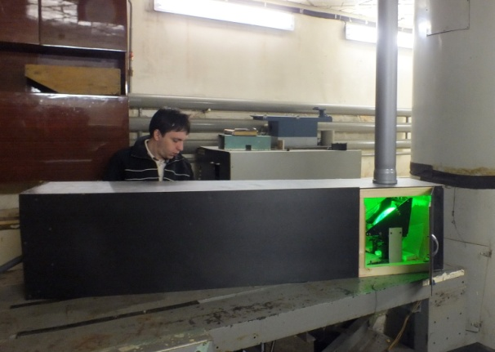
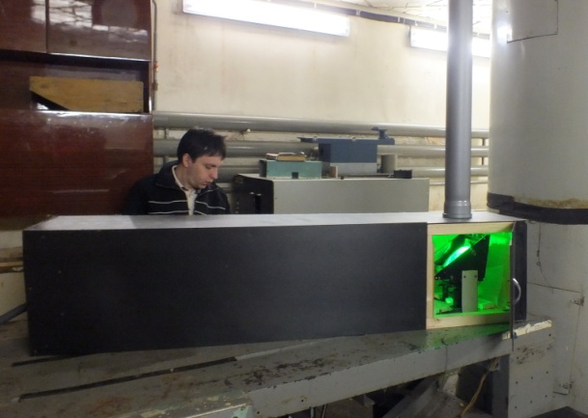
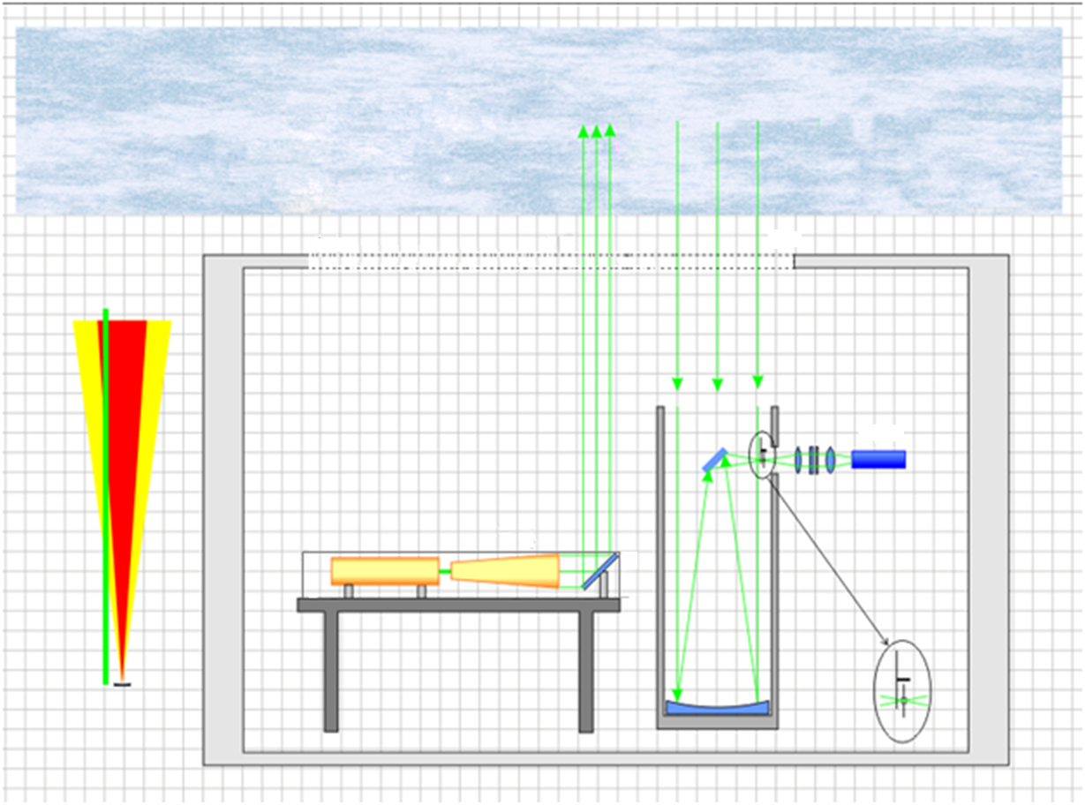
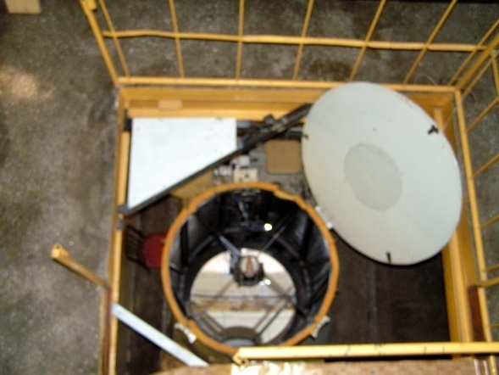
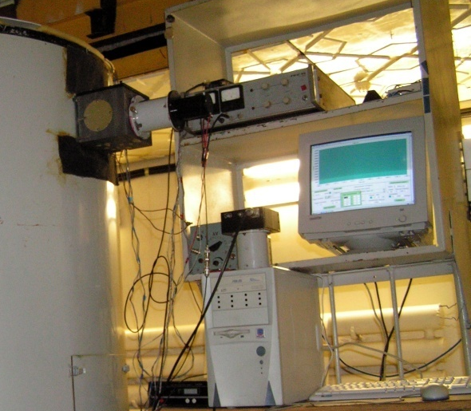
LIDAR complex of the Station of high-altitude sounding of the atmosphere : main components and block diagram
Atmosphere
Hatch
Hatch
PEM
Left: LOTIS LS2147-UV3 laser, telescope with a mirror Ф=1m, receiving photoelectronic channel. Right: lidar layout

Slide 3
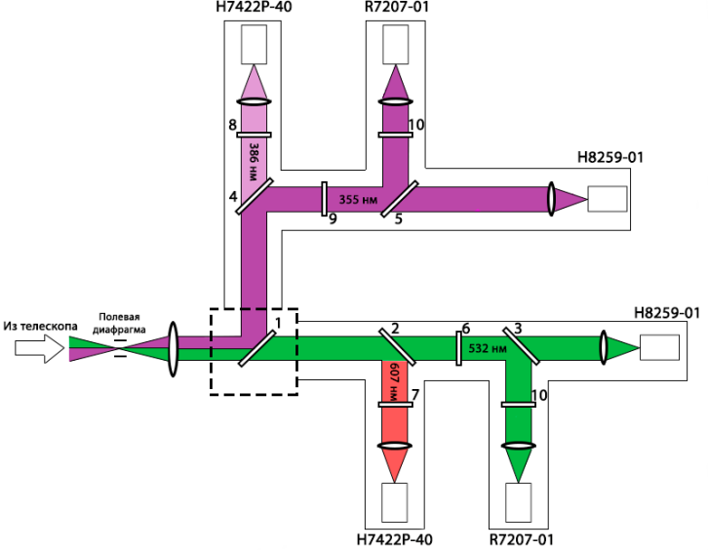
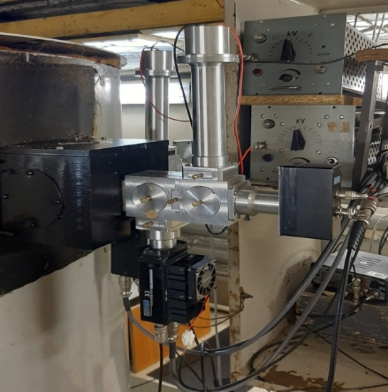
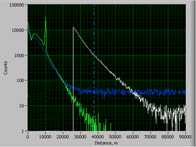
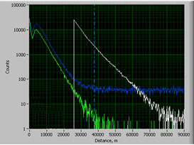
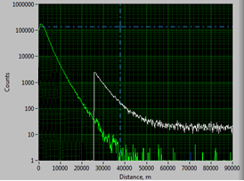
LIDAR complex of the Station of high-altitude sounding of the atmosphere : sounding at wavelengths of 532 and 355 nm; reception of elastic and Raman scattering signals in six channels at wavelengths of 532 and 355 nm, 607 and 384 nm.MSVZA lidar complex: sounding at wavelengths of 532 and 355 nm; reception of elastic and Raman scattering signals in six channels at wavelengths of 532 and 355 nm, 607 and 384 nm.
Scheme of the operating photoreceiving unit (6 receiving channels)
Photoreceiving block of spectral optics (6 receiving channels).
Signals received with a cirus cloud at a height of 10 km (a) and in a cloudless atmosphere (b). Green and white curves are elastic scattering signals from the near and far zones, blue curves are Raman scattering signals at a wavelength of 607 nm (excitation from 532 nm). Signals received during probing at a wavelength of 355 nm (c).

Slide 4
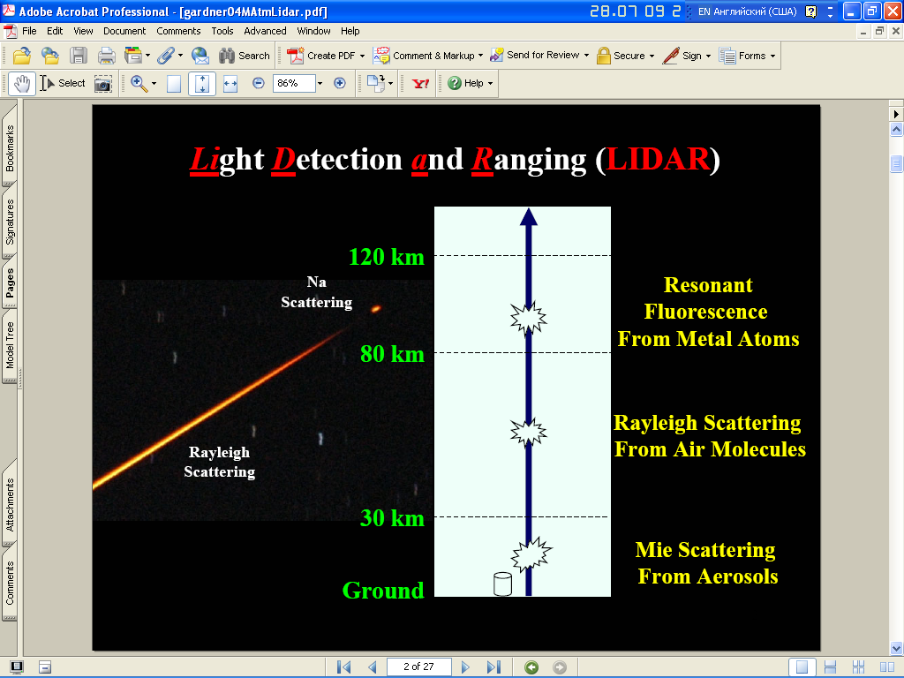


Aerosol Recovery Method stratification and aerosol filling of the stratosphere from single-wave lidar measurements.
N(H)=EAqT2(H)[βa(H)+βm(H)]H-2+Nphn
- Laser sensing equation
- The ratio of aerosol scattering by definition
- Calculation of aerosol scattering ratio through lidar signals
B =
- Integral backscatter coefficient

Slide 5
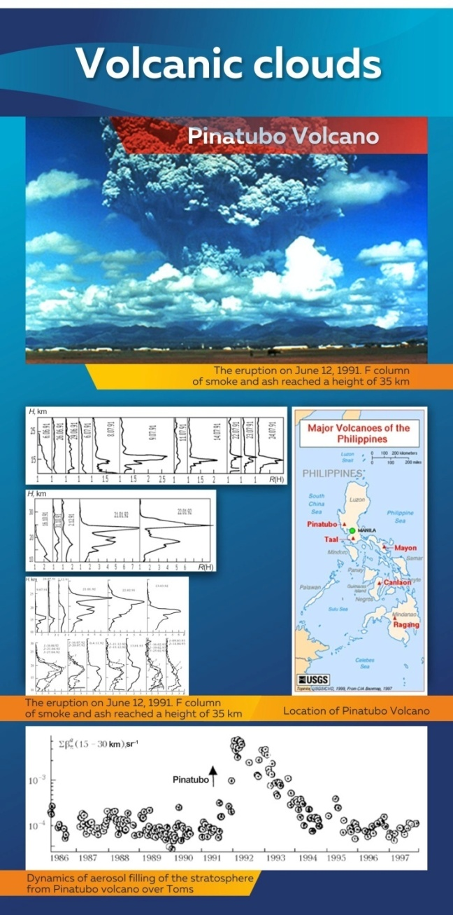
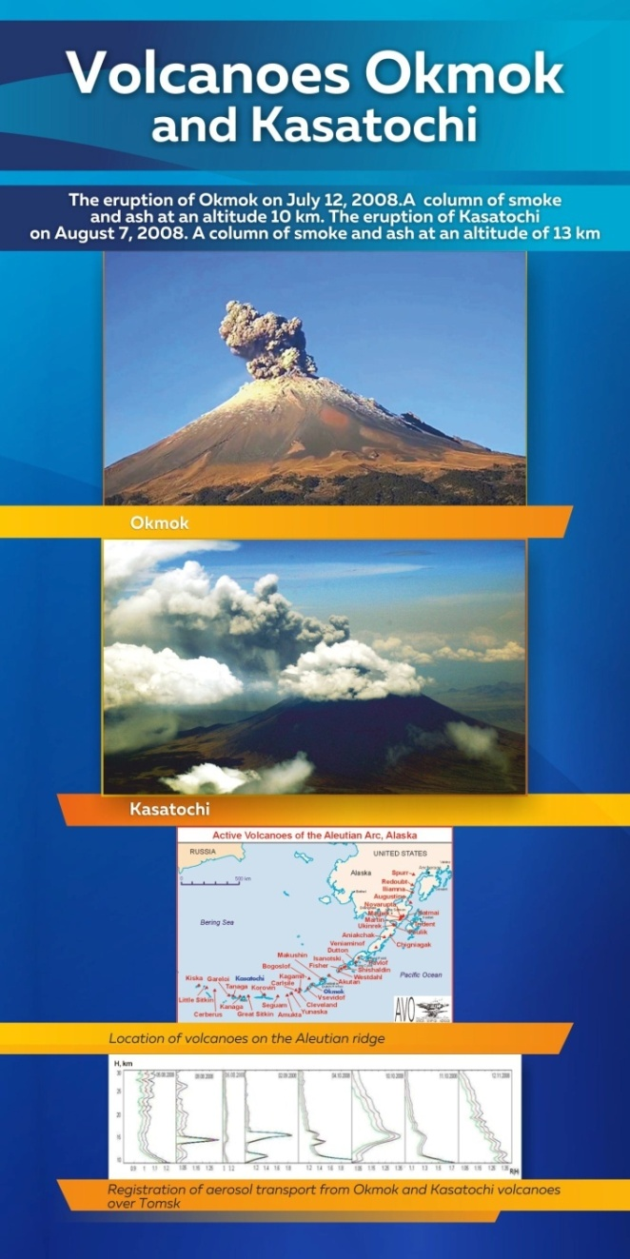
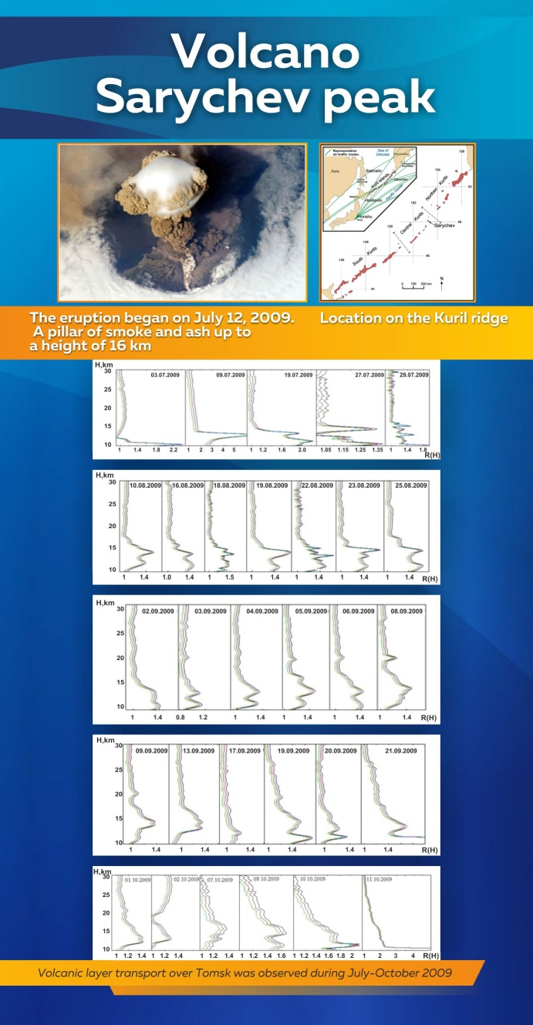
Volcanic aerosol

Slide 6
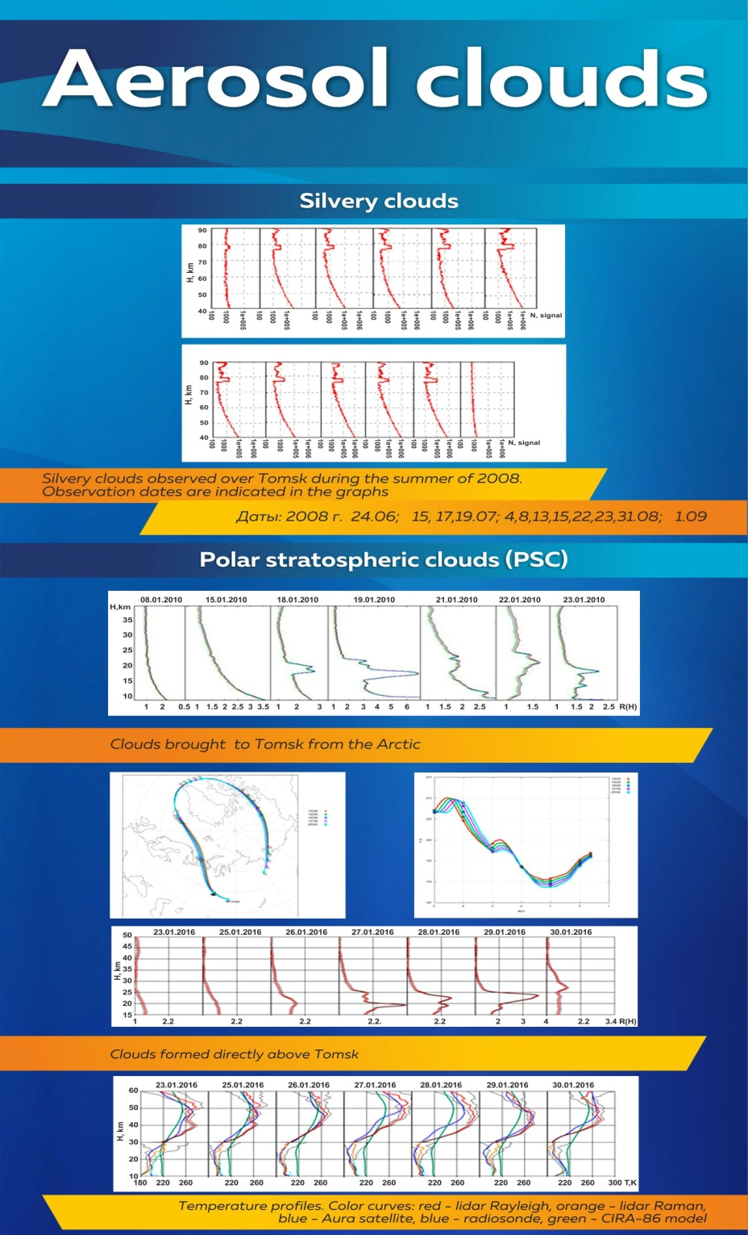
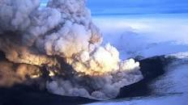
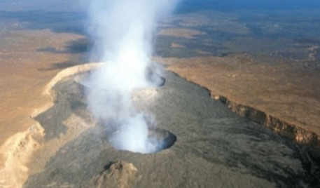
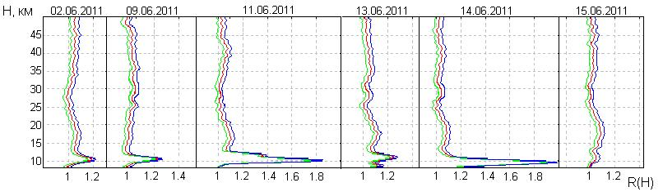
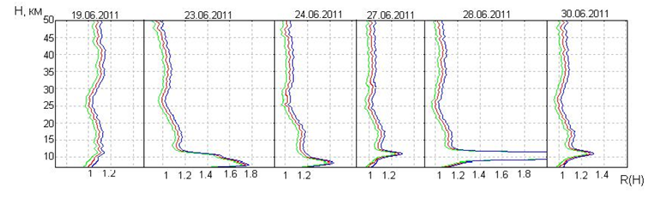
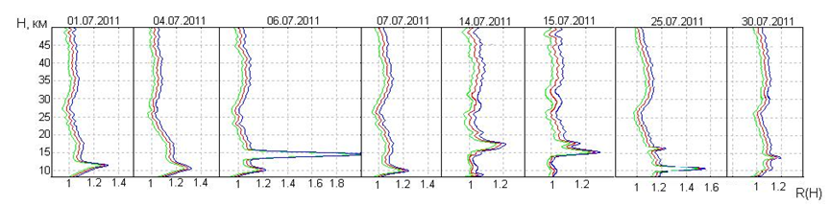
Volcaneos Grimsvotn and Nabro (Iceland, Eritrea)
Aerosol vertical distribution profiles over Tomsk from May to August 2011 after the eruption of the Grimsvotn and Nabro volcanoes

Slide 7
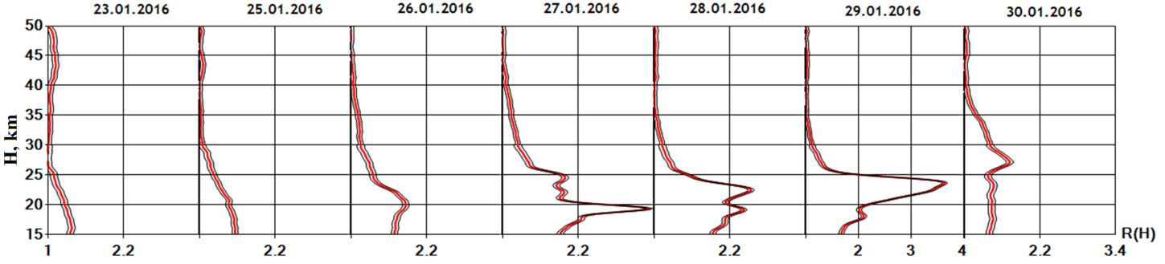
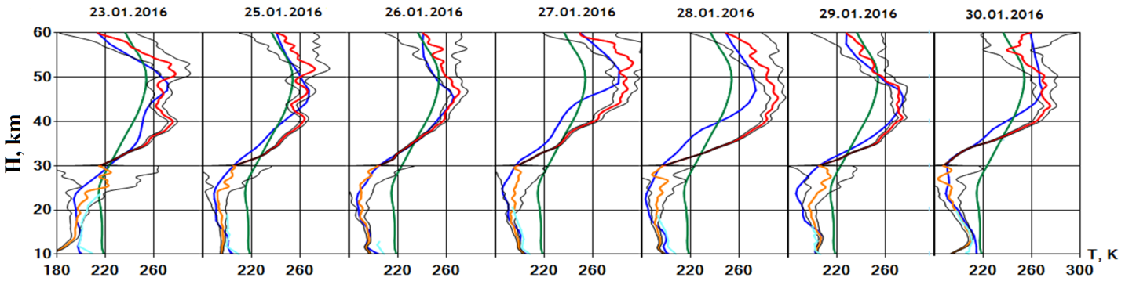
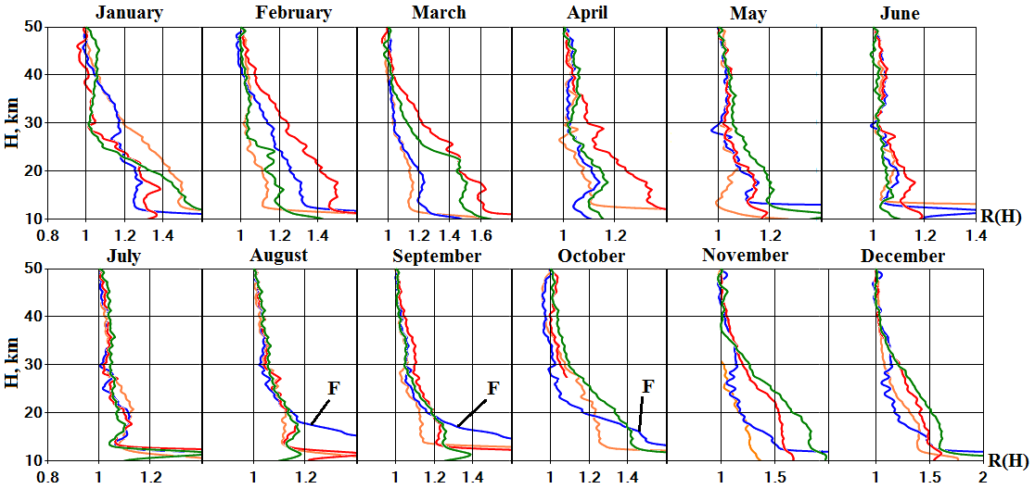
Aerosol of polar stratospheric and pyrocumulative clouds.
Layered aerosol structure of the lower stratosphere observed in the last decade of January 2016 temperature profiles. Color curves: red - Rayleigh lidar, orange - Raman lidar, blue - Aura satellite, blue - radiosonde, green - CIRA-86 model
Average monthly profiles of aerosol vertical stratification for 2018 - 2021, presented through the aerosol scattering ratio parameter. Curves in orange - 2018, blue - 2019, red - 2020 and green - 2021. Arrows F indicate the drift of aerosol from forest fires in Eastern Siberia in 2019.

Slide 8
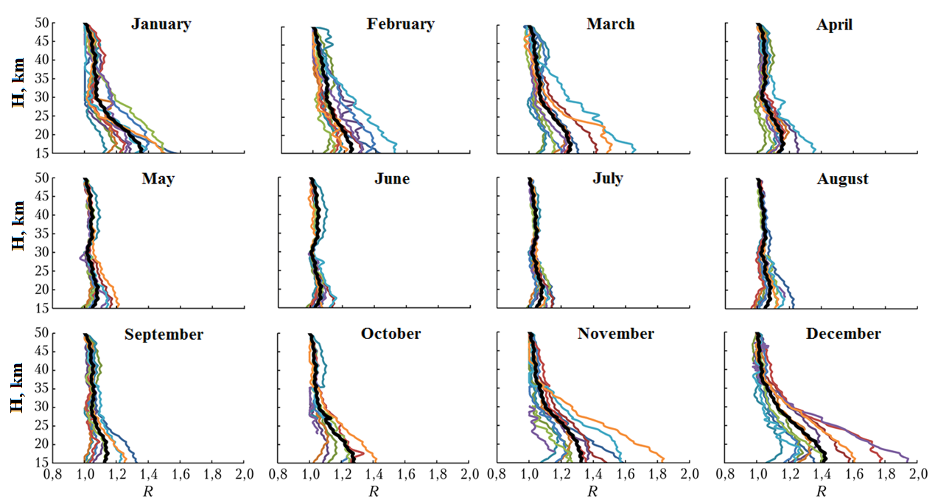
Background aerosol: vertical stratification
Monthly mean scattering ratio profiles for each year for 2010–2021: the black curve is the profile averaged over the entire observation period.
It can be seen from the scatter of the mean monthly scattering ratio profiles that the greatest instability of the aerosol stratification of the stratosphere manifests itself in the period from November to March. Moreover, it is observed in the lower stratosphere in the 15–35 km layer with an increase in the scatter amplitude from top to bottom.
Notes:
По разбросу среднемесячных профилей отно­шения рассеяния видно, что наибольшая нестабиль­ность аэрозольной стратификации стратосферы про­является в период с ноября по март. Причем она наблюдается в нижней стратосфере в слое 15—35 км с возрастанием амплитуды разброса сверху вниз.
Максимальное на­полнение нижней стратосферы (10—30 км) фоновым аэрозолем отмечается зимой, малое содержание (вплоть до пол­ного отсутствия) фонового аэрозоля летом и проме­жуточное значение весной и осенью (с убыванием весной и с ростом осенью). В верхней стратосфере (30—50 км) фоновый аэрозоль летом практически отсутствует. Таким образом, включая подтверждение этого предыдущими многолетними измерениями, выявляется внутригодовая цикличность аэрозольного наполнения стратосферы Западной Сибири.

Slide 9


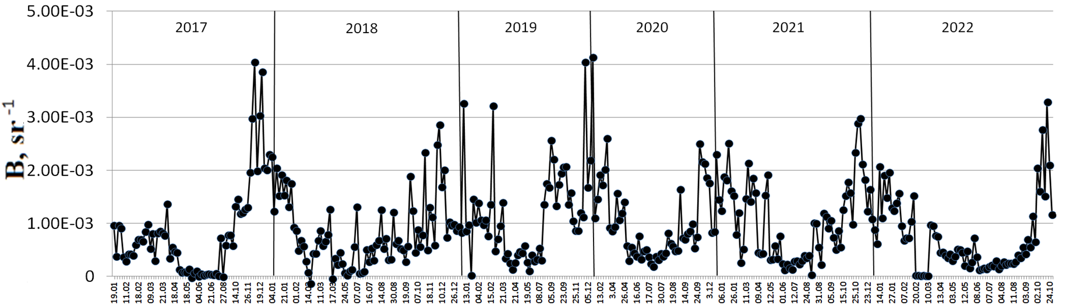
Background aerosol: variability of integral filling in the stratosphere for 2017–2022
where
- aerosol backscatter coefficient
H1 – 10 km, H2 – 30 km
Time series of values of the integral aerosol backscattering coefficient for the period 2017 - 2022.
From long-term observations, it was established that the filling of the lower stratosphere (10–30 km) with background aerosol is noted in winter, a low content (up to complete absence) of background aerosol in summer, and an intermediate value in spring and autumn (with a decrease in spring and with an increase in autumn). In the upper stratosphere (30–50 km), the background aerosol is practically absent in summer. Thus, including the confirmation of this by previous long-term measurements, the intra-annual cyclicity of the aerosol filling of the Western Siberian stratosphere is revealed.

Slide 10
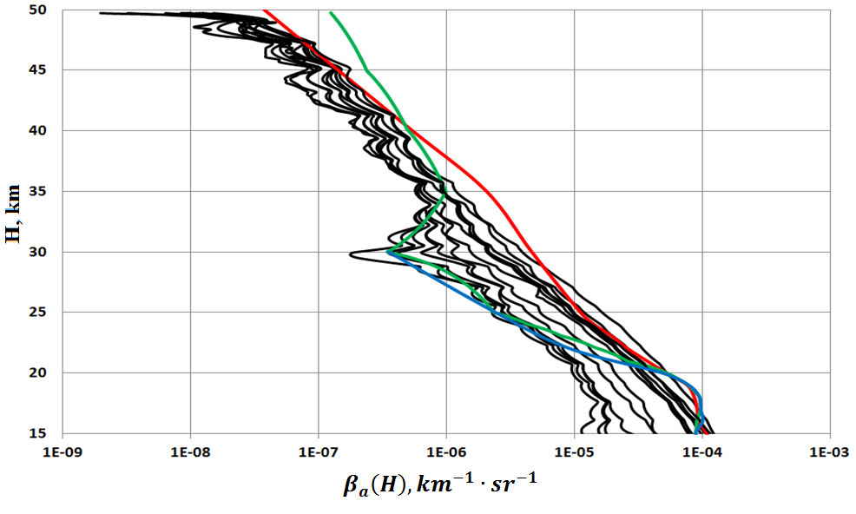
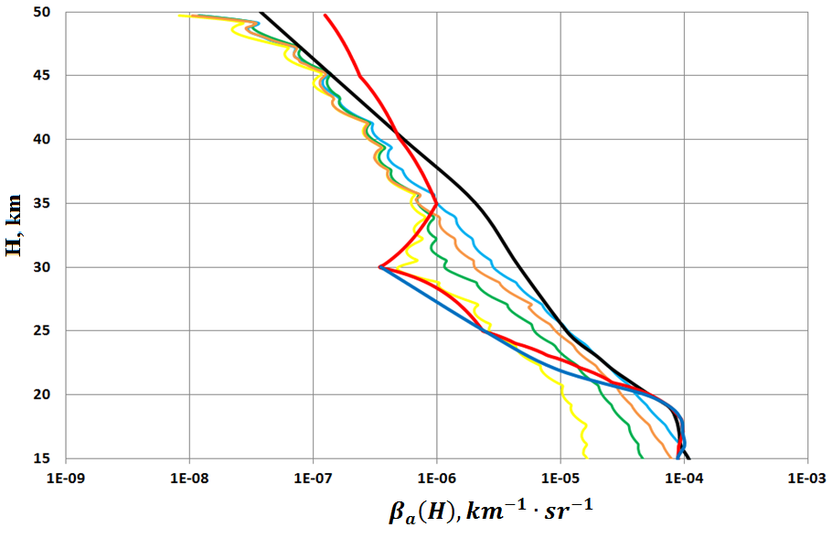
Background aerosol: an optical-location model of the background aerosol of the Western Siberian stratosphere.
Average monthly profiles of the aerosol backscatter coefficient, averaged over the observation period 2010 - 2020 (black curves). Blue, green, and red curves are βа(Н) profiles from the models.
Comparison of the seasonal behavior of the vertical distribution of the aerosol backscatter coefficient (curves in blue, brown, green and yellow - winter, autumn, spring, summer) with models (curves in blue, red and black).

Slide 11
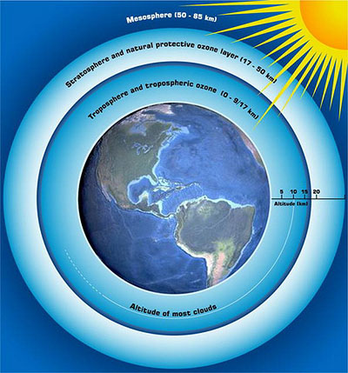
ЛИДАРНЫЕ ИССЛЕДОВАНИЕ ДИНАМИКИ ТЕРМИЧЕСКОГО РЕЖИМА СТРАТОСФЕРЫ НАД ТОМСКОМ
В.Н.Маричев, Д.А. Бочковский
Институт оптики атмосферы СО РАН, г. Томск
marichev@iao.ru

Slide 12
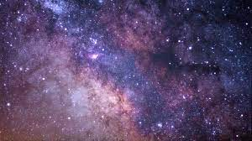
ЛИДАРНЫЕ ИССЛЕДОВАНИЕ ДИНАМИКИ ТЕРМИЧЕСКОГО РЕЖИМА СТРАТОСФЕРЫ
НАД ТОМСКОМ
В.Н.Маричев, Д.А. Бочковский
Институт оптики атмосферы СО РАН, г. Томск
marichev@iao.ru

Slide 13
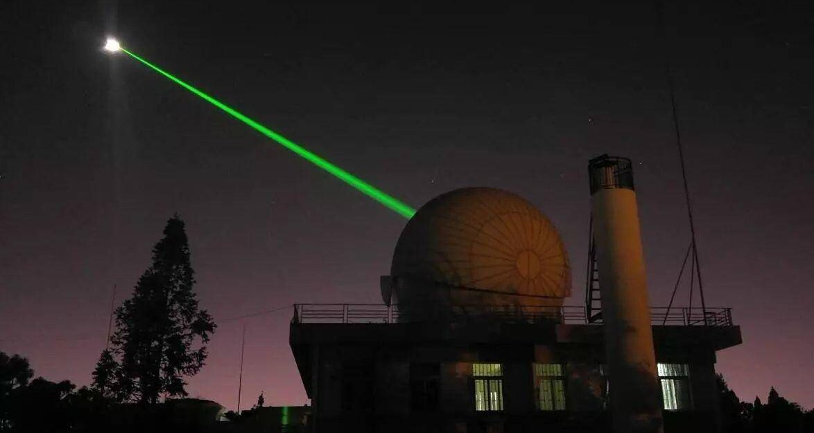
LIDAR INVESTIGATION OF THE DYNAMICS OF THE THERMAL REGIME OF THE STRATOSPHERE OVER TOMSK
V.N.Marichev, D.A.Bochkovsky
Institute of Atmospheric Optics V.E. Zuev, SB RAS, Tomsk
marichev@iao.ru

Slide 14
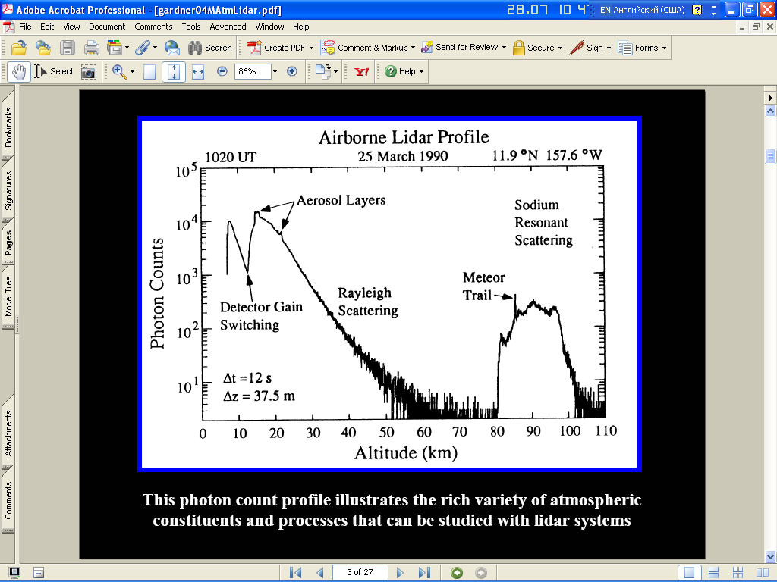
Methods of lidar temperature sensing by molecular (Rayleigh and Raman) light scattering
-Ideal gas equation of state
- Hydrostatic continuity condition
- The formula for calculating the temperature of the lidar signals

Slide 15
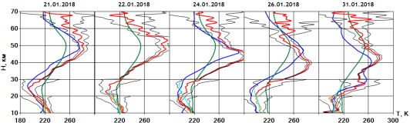
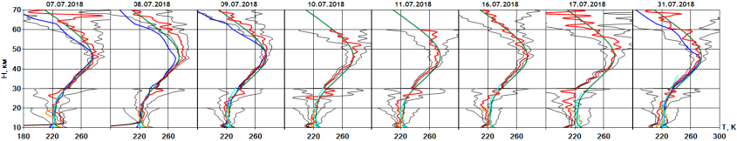
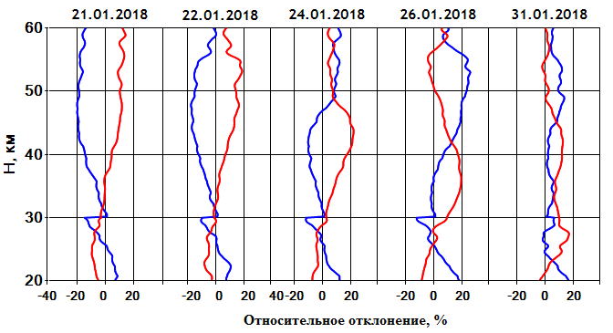
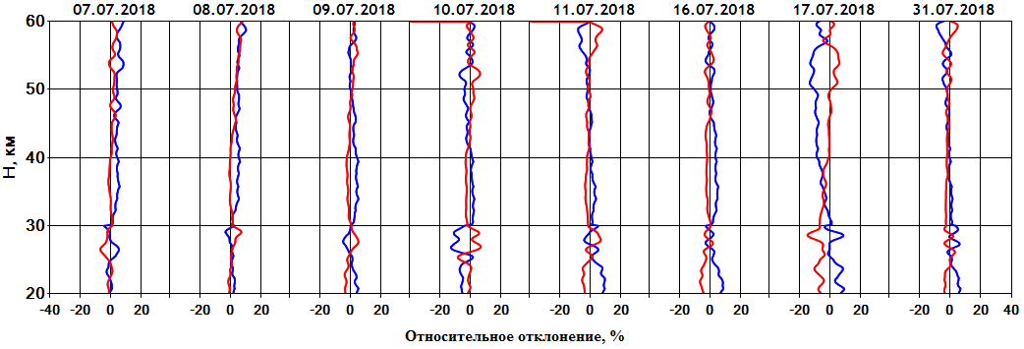
Profile characteristics of temperature and density (warm and cold periods of the year)
H, km
H, km
H, km
H, km
relative deviation,%
relative deviation,%
Vertical profiles of temperature distribution (red curve, green - model CIRA-86, blue - measured from the Aura satellite), aerosol stratification (red curve), and variations in density and temperature in the stratosphere (blue and red curves), observed in January and July 2018

Slide 16
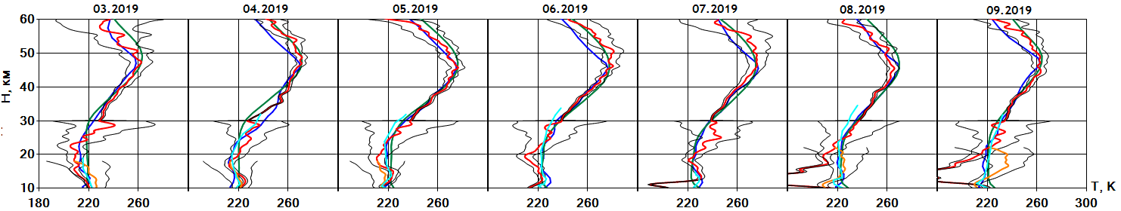
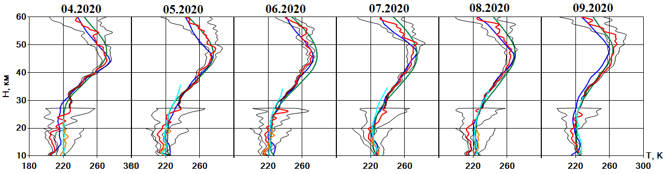
Temperature: background state and explosive changes in the thermal regime of the stratosphere - stratospheric warming
H, km
2019
H, km
2020
Stable vertical temperature distribution, typical for the warm period of the year. Curves in red and black are the average monthly lidar temperature profile with a standard deviation, blue, cyan and green are profiles obtained from measurements from the Aura satellite, the meteorological station of Novosibirsk and given by the CIRA-86 model.
Over the course of long-term observations, it has been shown that for the region of Western Siberia for a long period of the year April - November, the vertical temperature distribution is in good agreement with the model distribution of CIRA-86.

Slide 17
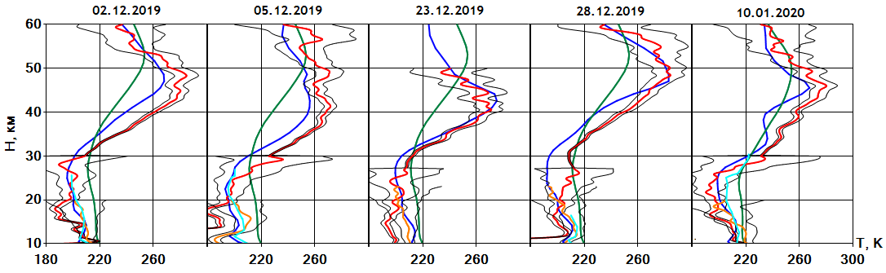
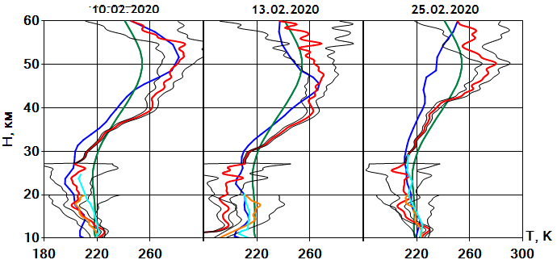
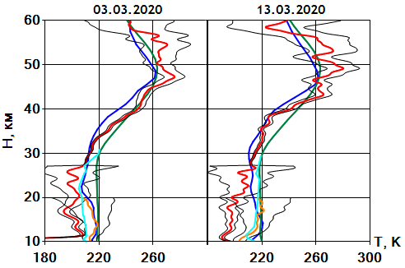
Stratospheric warming 2019/20
H, km
H, km
H, km
Vertical temperature distribution. Curves - red, blue, green, orange and blue - temperature profiles: Rayleigh lidar, Aura satellite, model CIRA-86, Raman lidar, radiosonde.
According to lidar and satellite measurements, on December 2, the beginning of another winter warming was recorded. The warming maximum was below the stratopause at an altitude of about 47 km with a positive deviation of 20K from the model. On subsequent dates of observations, its height fluctuations occurred in the range of 40–50 km. The maximum positive deviation was 40K. As in most cases, the vertical temperature profile was described by a positive half-wave in the upper stratosphere (30-50 km) and a negative half-wave in the lower (10-30 km), which is confirmed by satellite and aerological measurements. The SP continued until January 10, 2020 (lidar observations), and ended on January 15 (satellite measurements). According to the data of the European Center for Medium-Range Weather Forecasts, the SP 2019/20 was of a minor type.

Slide 18
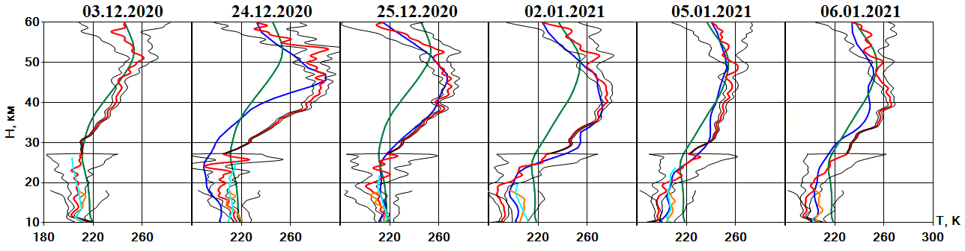
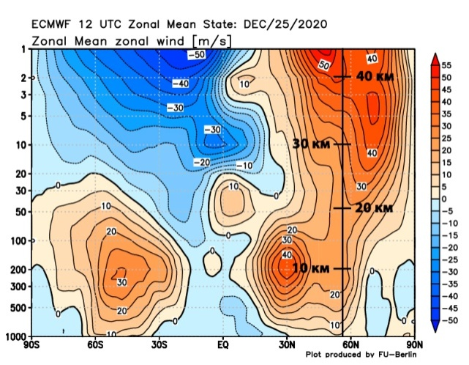
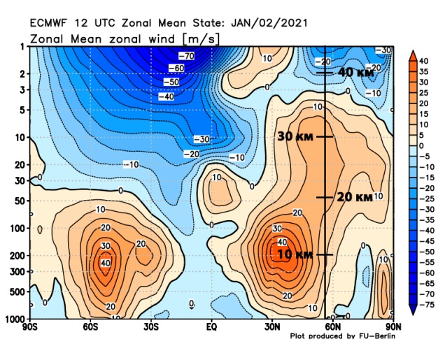
Stratospheric warming 2020/21
H, km
Altitude distribution of the direction and speed of the zonal wind of the Northern Hemisphere, recorded on December 25, 2020 and January 2, 2021. Orange is the west wind, blue is the east. The vertical bold line is the vertical section for the latitude of Tomsk.
The start of warming was registered on December 24 and ended in the first ten days of January 2021. According to lidar data, a day later, according to satellite data, the warming area spread from 25 to 50 km. The maximum positive temperature deviation from the model value was noted at an altitude of about 45 km and reached 40K. According to the European Center for Medium-Range Weather Forecasts. SP 2020-21 was of an intermediate type between minor and major warming. In the altitude range of 10-35 km, the western transfer of air masses remained; at altitudes from 35 km, the transfer changed to the eastern one.

Slide 19
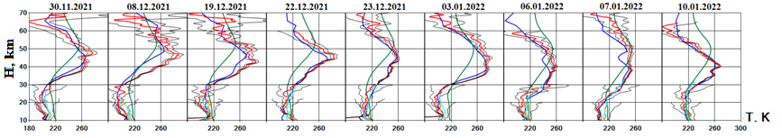
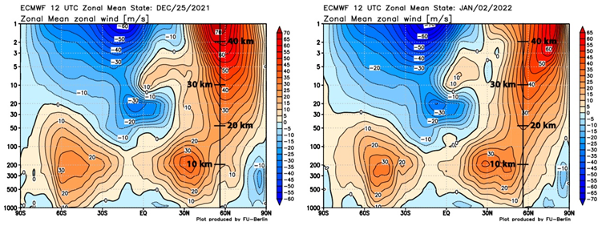
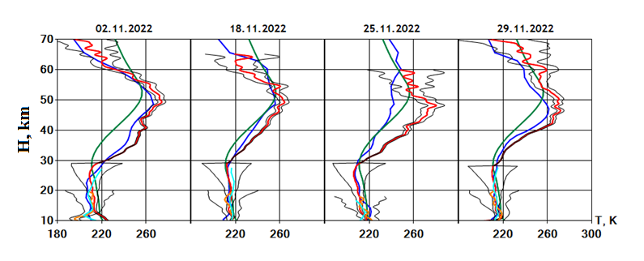
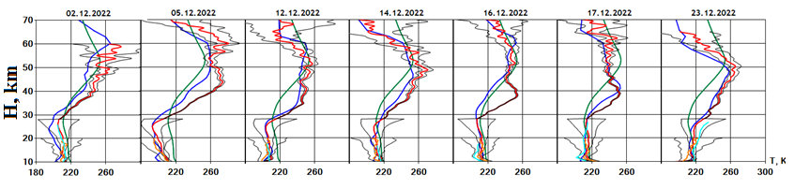
Stratospheric warming in winters 2021/22 and 2022/23
According to lidar and satellite measurements, on November 30, 2021, the beginning of another winter warming was recorded, which continued throughout December 2021. with a decline in the first ten days of January 2022. The warming area, observed both from lidar and satellite data, extended from 30 to 50 km. The maximum positive temperature deviation from the model value was noted at an altitude of about 45 km and reached 40-45K. Observed SP 2021-2022 belonged to the minor type, when the direction of air mass transfer from west to east was preserved in the stratosphere, as indicated by data taken from the website of the European Center for Medium-Range Weather Forecasts. The final stratospheric warming occurred in the third decade of January and in February. The maximum positive temperature shift from the model value had a significant scatter of fluctuations over the dates of observations and altitudes in the range of 5–30 K. Then, in the period March–October, the stratosphere comes to a stable state, as evidenced by the good coincidence of the vertical temperature profiles obtained by the lidar and the Aura satellite with model. In November, another stratospheric warming begins, which continues throughout December. The warming center extends from 30 to 50 km with positive temperature fluctuations up to 30 K.
Рис. 2. Динамика стратосферного потепления зимы 2021/22 гг (вверху), высотное распределение направления и скорости зонального ветра Северного полушария, зарегистрированного 25 декабря 2021г. и 2 января 2022 г. (внизу). Кривые – красный, синий, зеленый, оранжевый и голубой цвет – профили температуры: лидар Рэлей, спутник Аура, модель CIRA-86, лидар Раман, радиозонд.
Рис. 3. Динамика стратосферного потепления зимы 2022/23 гг

Slide 20
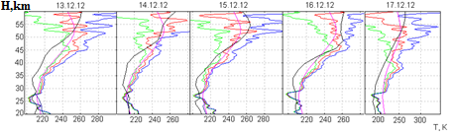
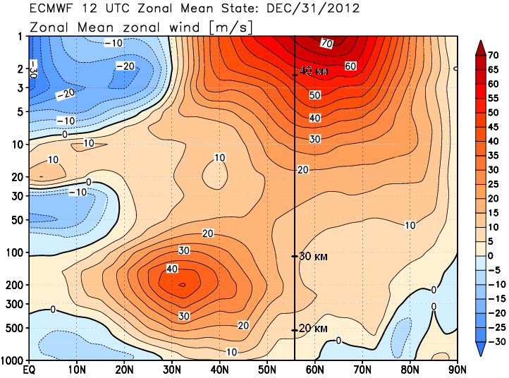



Winter stratospheric warming 2012/13 (for comparison)
40 км
30 км
December 2012
20 км
10 км
January 2013
Lidar observations of stratospheric warming in January 2013 Curves: red - lidar temperature profile, blue and green - its standard deviation, crimson - CIRA-86 model, black - measurements from the Aura satellite.
Dynamics of SP manifestation in winter 2012/13 There was a major SP with the restructuring of the circulation of the upper stratosphere from the western transfer (red) to the east (blue). Altitude sections of the speed and direction of the zonal wind before and after the SP are presented in the figures of the right column. The vertical line is the latitude of Tomsk.

Slide 21





Lidar observations of the SW over Tomsk in the winter of 2014-15. (November-January)
40 km
40 km
30 km
30 km
20 km
20 km
10 km
Temperature profiles: red - lidar, black - sp. Aura, crimson - model CIRA-86.

Slide 22


Lidar observations of the SW over Tomsk in the winter of 2014-15. (February)
H, km
40 км
The maximum phase of the manifestation of SW . is February 3-5 - fig. above. Altitude distribution of the direction and speed of the zonal wind of the Northern Hemisphere, recorded on February 5, 2015. The vertical bold line is the vertical section for the latitude of Tomsk. The type of stratospheric warming is major.
30 км
20 км
10 км

Slide 23




Deviations of air density (1) and temperature (2) from the average monthly value during periods of stratospheric warming in the winters of 2014-16.
H, km
H, km
H, km
H, km
relative deviation,%
relative deviation,%
Vertical profiles of temperature and air density deviations from their average monthly values according to lidar measurements over Tomsk. Curve 1 is density, curve 2 is temperature.

Slide 24
Conclusion
According to the results of lidar sounding of the atmosphere over Tomsk obtained over a 30-year period, a number of features of the intra-annual dynamics of the thermal regime of the stratosphere were established.
* Thus, a steady trend of annual manifestations of stratospheric warming over Tomsk was revealed.
*Warmings are divided into strong (major) and weak (minor). The latter are more common.
*SWs differ both in the duration of manifestation - from several days to a month or more , and in the amplitude of positive deviations from the average monthly values for major SWs with a maximum of up to 60 K and a drop in the stratopause height above the earth's surface to 27 km.
* For the region of Western Siberia for a long period of the year April - November, in the vast majority of cases, the vertical temperature distribution is in good agreement with the CIRA-86 model distribution.

Slide 25

Average monthly temperature profiles for each year of the period 2010 - 2020
The curves of different colors are the average monthly temperature profiles of each year, the black curves are the average monthly for the entire period of 2010-2020.

Slide 26

Average monthly temperature profiles for the entire observation period 2010-2020
Curves in red - lidar temperature profiles, green - model CIRA-86

Slide 27

Long-term temperature variation according to lidar measurements in the stratosphere at different altitudes
Curves in blue - lidar temperature measurements, red - temperature according to the CIRA-86 model.

Slide 28
Спасибо за внимание!

