Slide 1

Near-surface atmospheric electric field changes through magnetic clouds via coronal mass ejections
Li Lei ^{1, 2}, Chen Tao * ¹
¹(State Key Laboratory of Space Weather, National Space Science Center, Chinese Academy of Sciences, Beijing, China)
²(College of Earth and Planetary Sciences, University of Chinese Academy of Sciences, Beijing, China)
Notes:
It's my pleasure to stand here and give a presentation on my recent research. via/vi:er/ coronal/karernl/ academic advisor/ai,dvaizer/

Slide 2
Content
01
Global atmospheric circuit
02
Atmospheric electric field under different meteorological conditions
03
Variation of atmospheric electric field during a CME event
04
Summary of atmospheric electric field changed by CMEs
Notes:
My presentation includes the following 4 main sections. meteorological/mi:tierrer’la:dgikl/

Slide 3
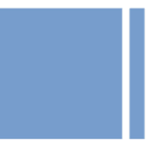
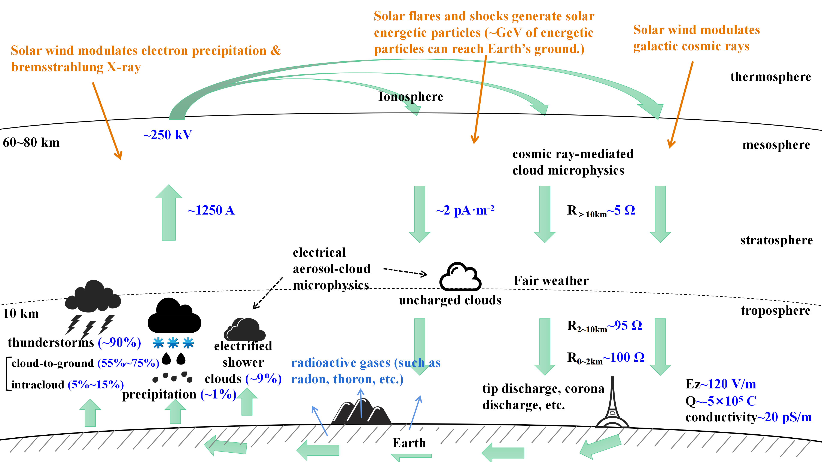
1
Global atmospheric circuit
Vertical atmospheric electric field (E_{z}) is the electric field that exists between bottom of ionosphere and Earth's surface.
Atmosphere: weakly conductive?
(cosmic rays and radioactive decay of the Earth’s surface, attached to aerosols or clouds)
Thunderstorms, charged clouds and precipitation act as batteries for the circuit. Disturbing weather makes ionosphere positively charged (about 250 kV)
Atmospheric currents are vertically downward on fair weather
E_{z} is oriented in a positive direction with the vertical pointing to the ground.
Notes:
exists/Ig’zIsts/; decay/dI’kei/; aerosols/’erer,salz/; circuit/ser’rkIt/; oriented/’o:rientId/

Slide 4
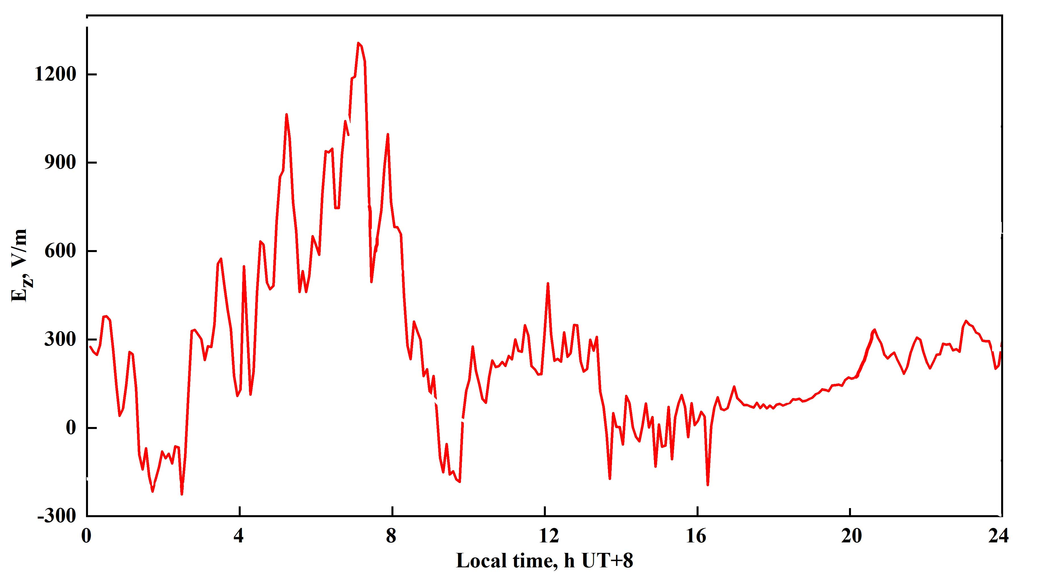
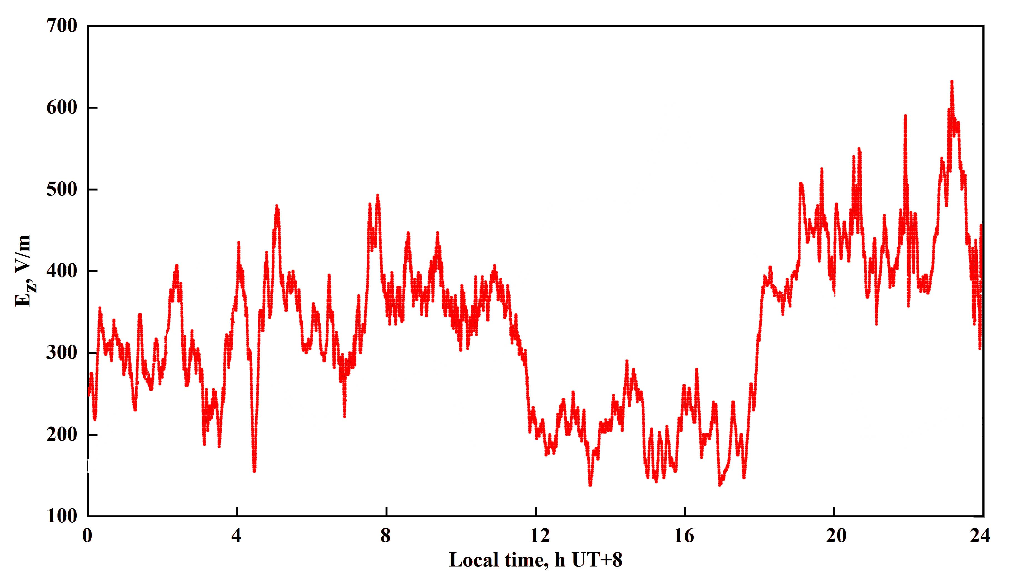
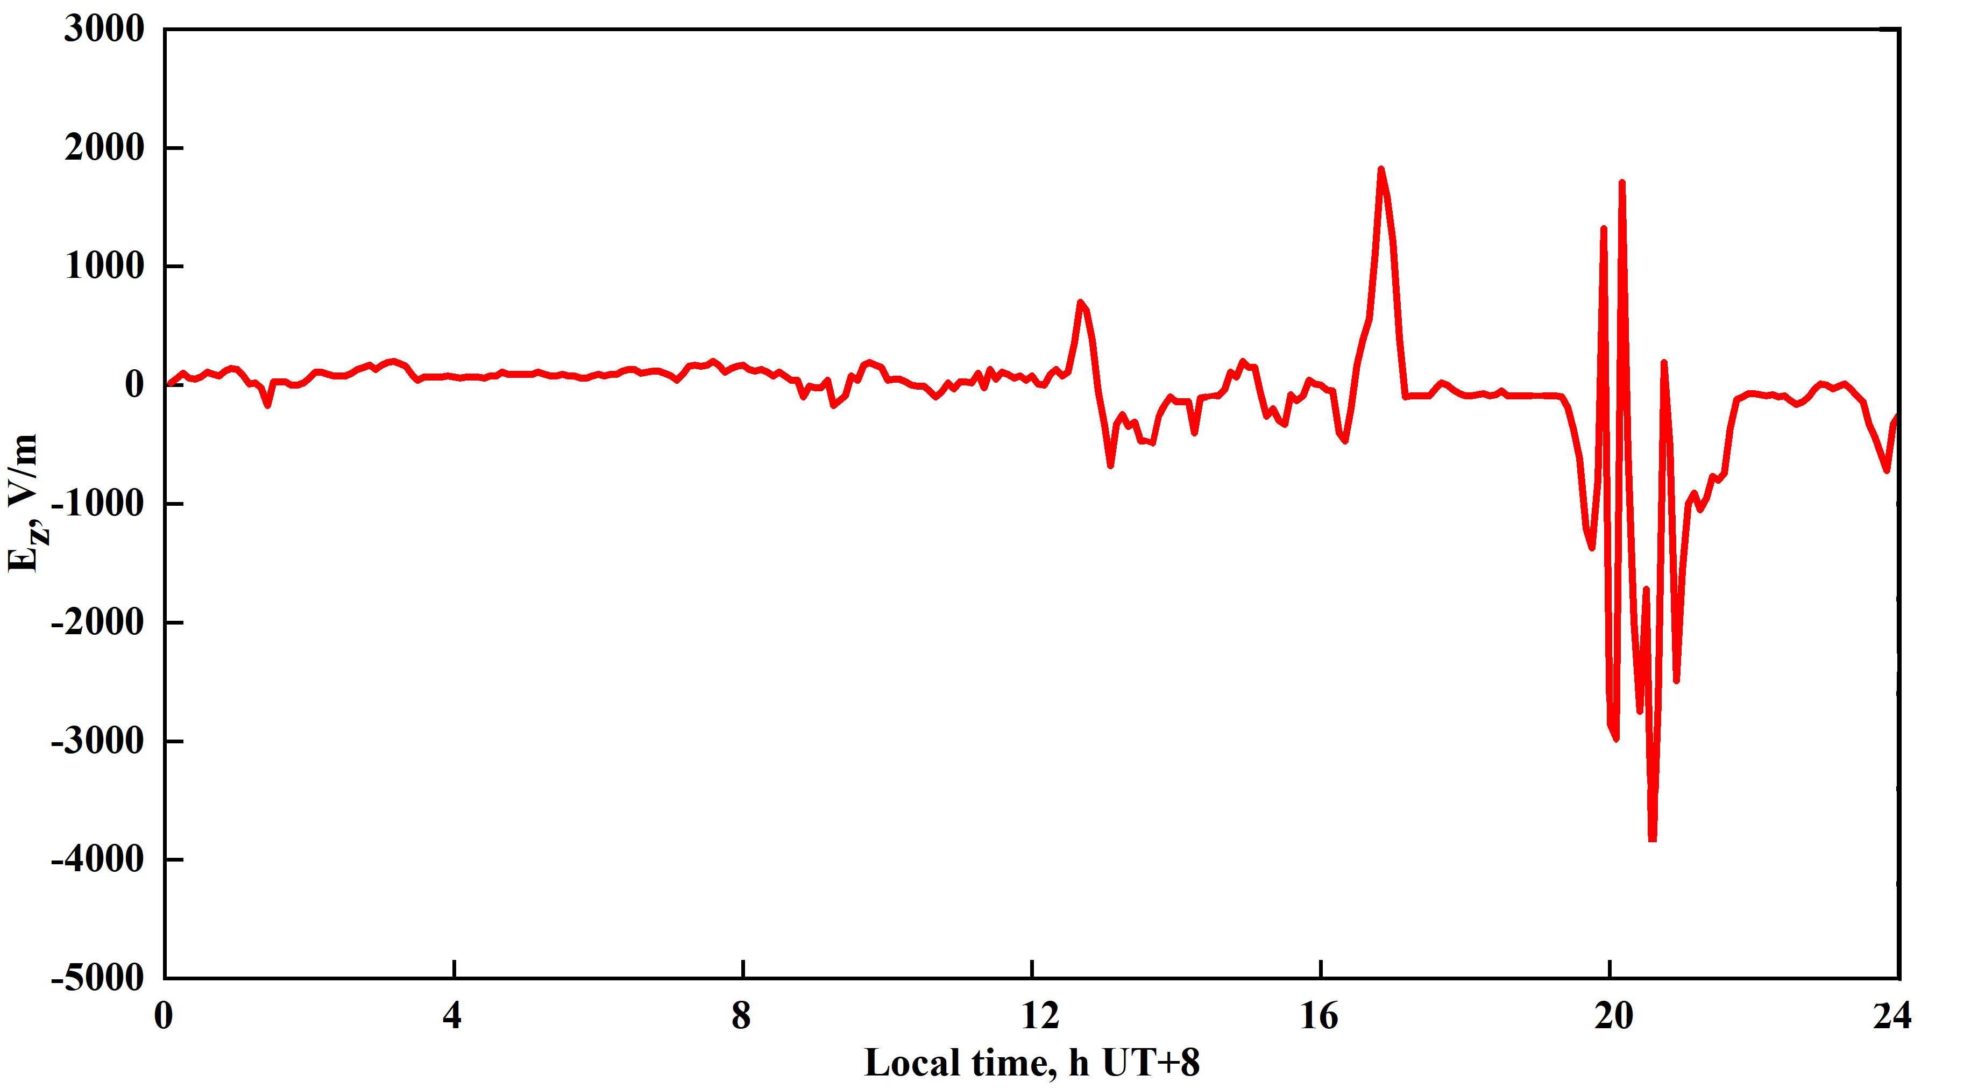
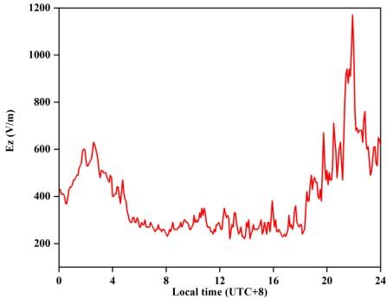
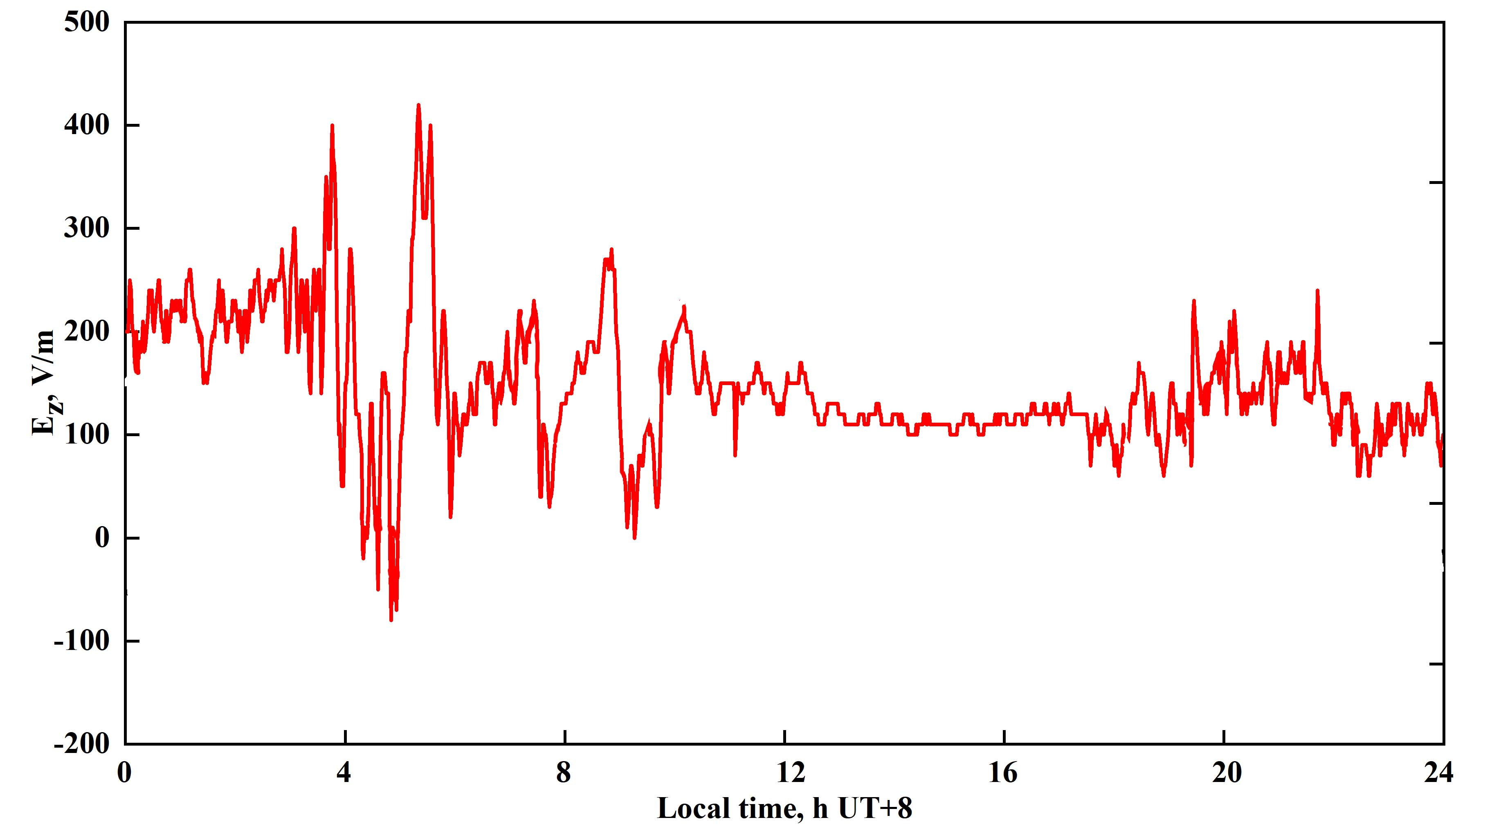
2
Atmospheric electric field under different meteorological conditions
Fog (2020/03/01, Haidian)
Haze (2019/12/24, Haidian)
Lightning (2021/05/19, Inner Mongolia)
increased
increased
fluctuated
The characteristics of the variation of E_{z} under different meteorological conditions are significantly different.
Snow (2020/01/11, Haidian)
Windy (2022/01/31, Haidian)
increased
fluctuated
Notes:
characteristics/kererkter’rIstIks/ Haze/heIz/

Slide 5
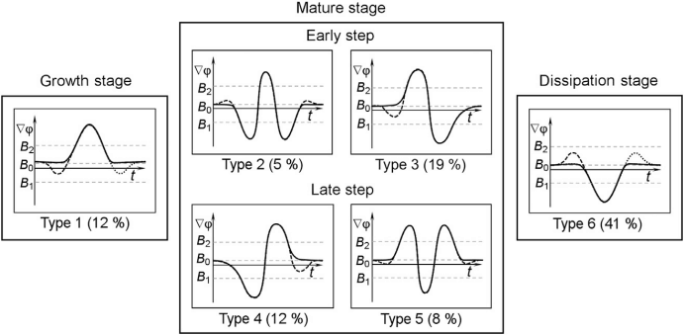
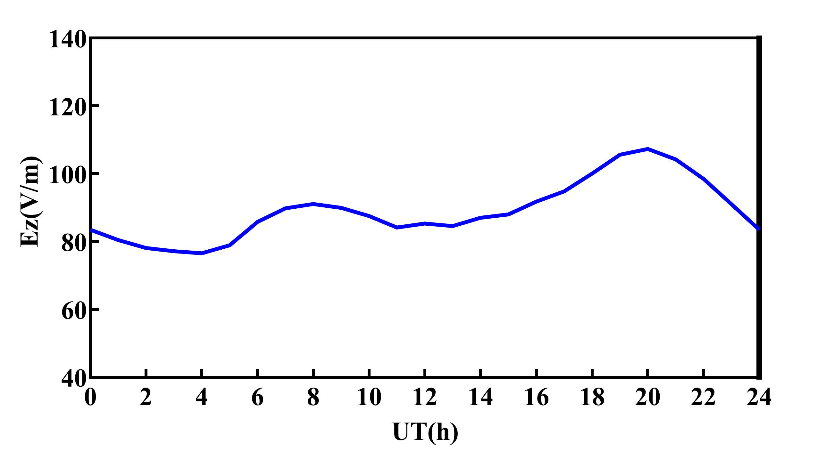
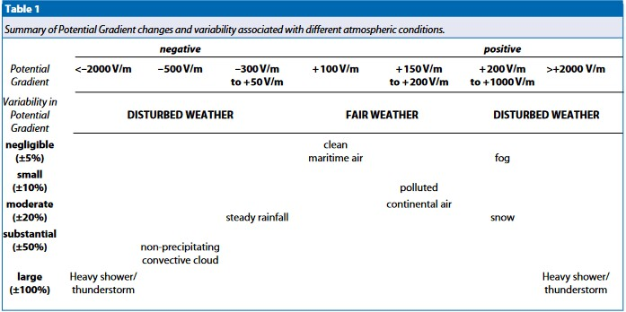
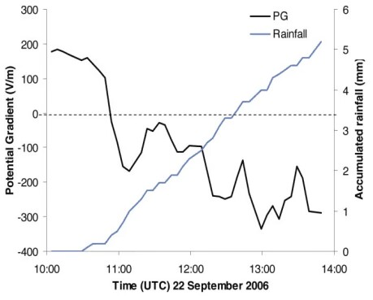
2
Atmospheric electric field under different meteorological conditions
Fair (Ming Tombs)
around +100 V/m
Cloud (Russia, Pustovalov and Nagorskiy, 2018)
increased/fluctuated/decreased
Rainfall (England, Bennett and Harrison, 2007)
decreased
Notes:
Cumulonimbus/,kju:merlou’nImbers/ fluctuated/’flaktueItId/

Slide 6
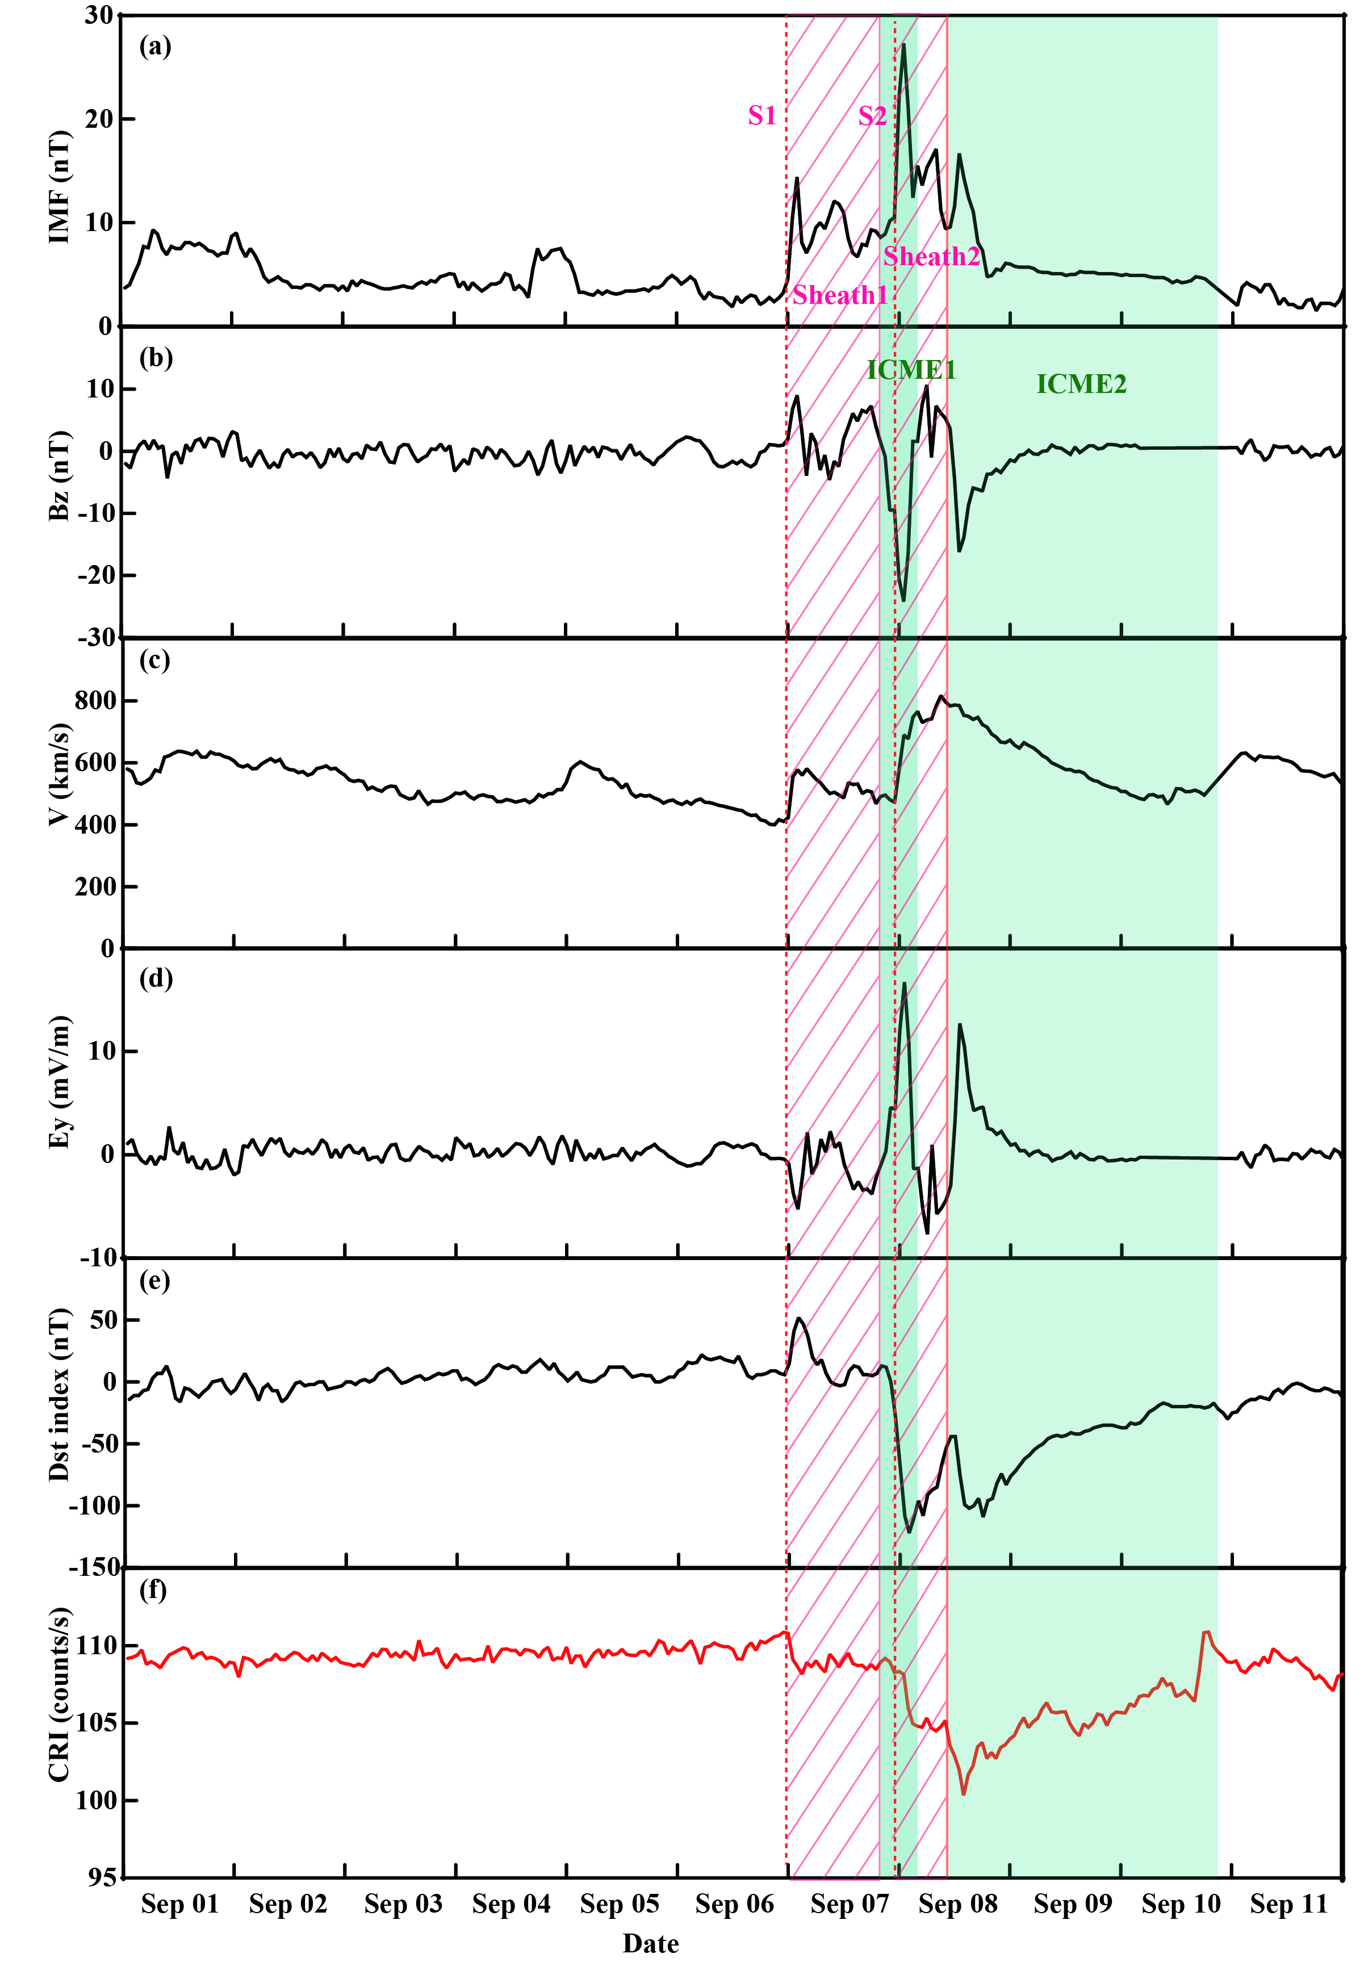
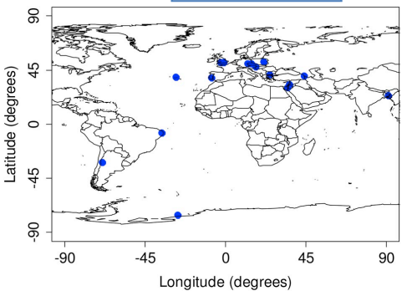
3
Variation of atmospheric electric field during a CME event
Strong Forbush decrease event in September 2017
Both these 2 solar events were due to coronal mass ejections emanating from sunspot group AR2673. The first solar event was associated with the M5.5 flare on September 4th, and the second was associated with the X9.3 flare on September 6th (the most intense flare in solar cycle 24). The southward magnetic field contained in ICME1 was amplified by S2, which enhanced the geomagnetic storm.
Time resolution: 1h
(Nicoll et al., 2019)
Notes:
resolution/,rezer’lu:fn/

Slide 7
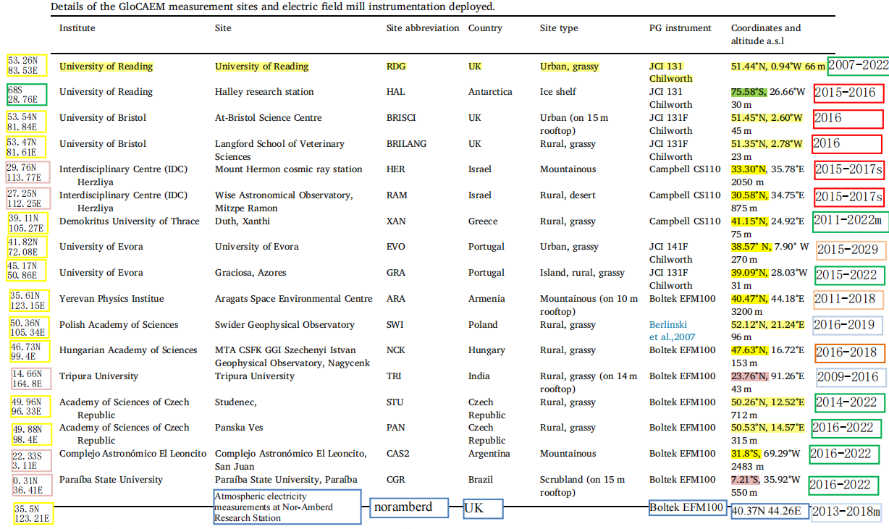
3
Variation of atmospheric electric field during a CME event
syowa station: non-fair
sodankyla station: non-fair
non-fair
Atmospheric electric field variations disturbed by meteorological conditions were excluded.
lost
lost
lost
lost
lost
lost
non-fair
fair
non-fair
non-fair
Azores (AZO) Station and Studenec (STU) Station have been selected.
lost
non-fair
fair
lost
non-fair
non-fair
lost

Slide 8
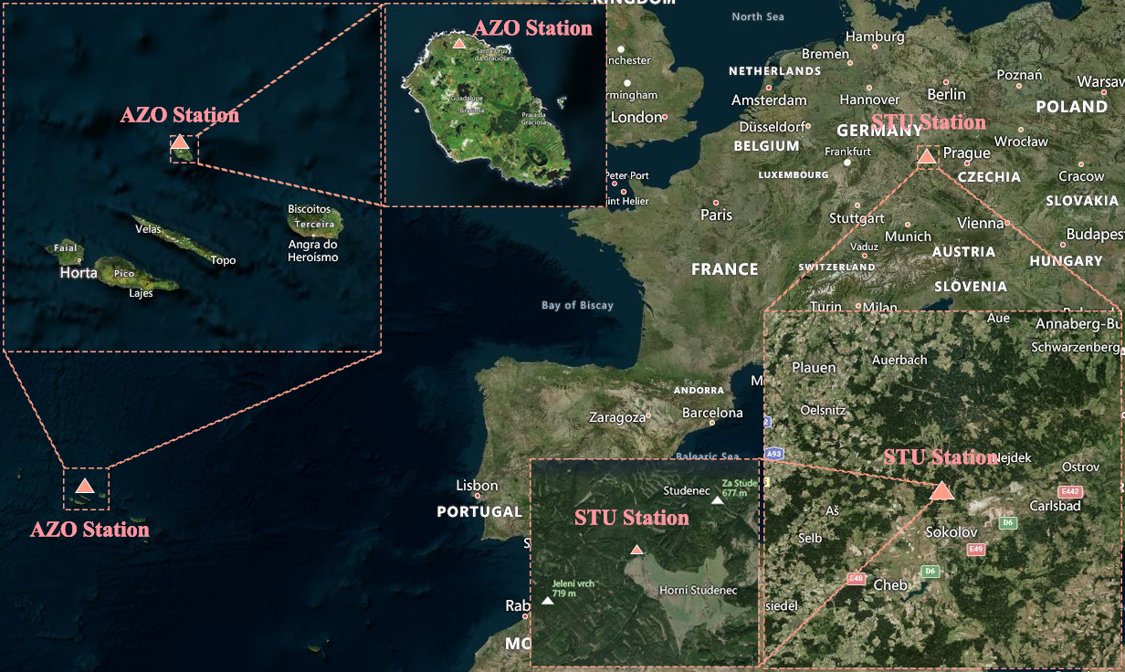
3
Variation of atmospheric electric field during a CME event
Stations | Latitude | Longitude | Altitude | Instrument | Accuracy
Azores Station | 39.09N | 28.03W | 31m | JCI 131F | ±1.5%
Studenec Station | 50.26N | 12.52E | 712m | Boltek EFM 100 | Reading×5% ± 0.05 kV/m
Notes:
Accuracy/aikjerrersi/

Slide 9
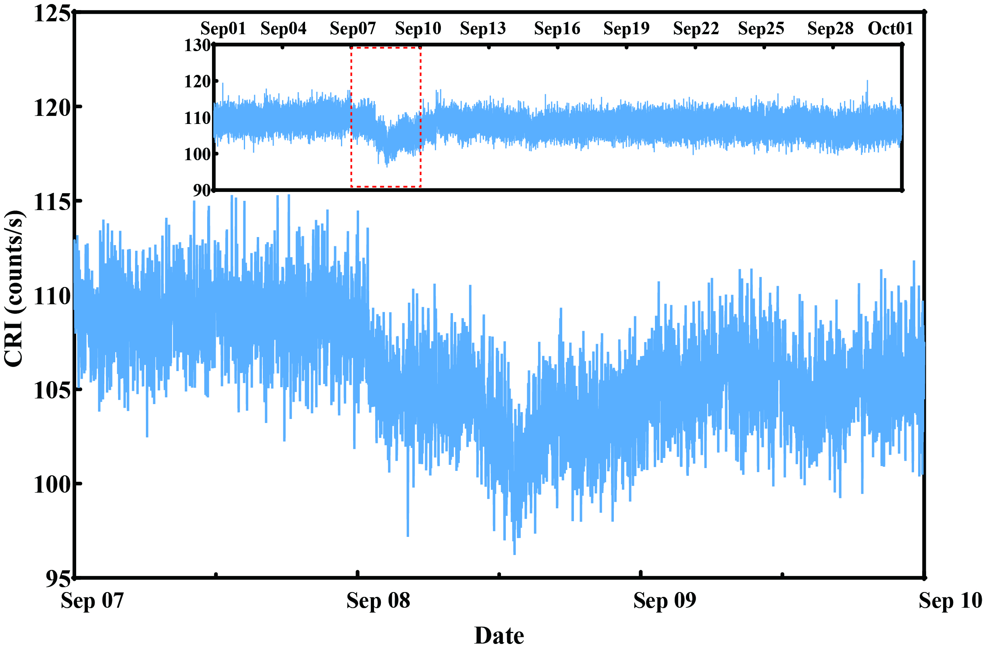
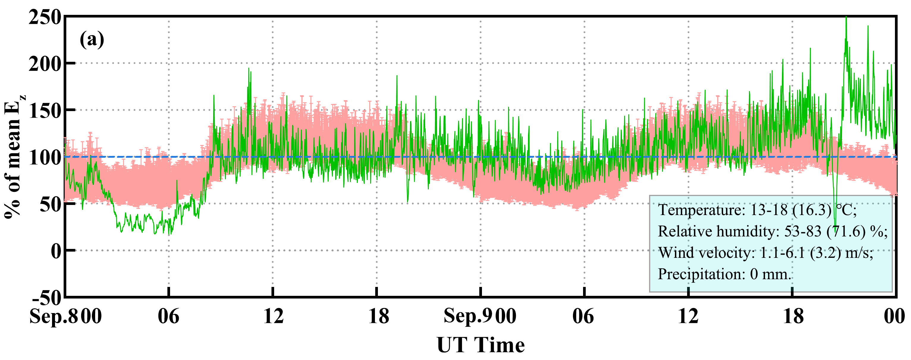
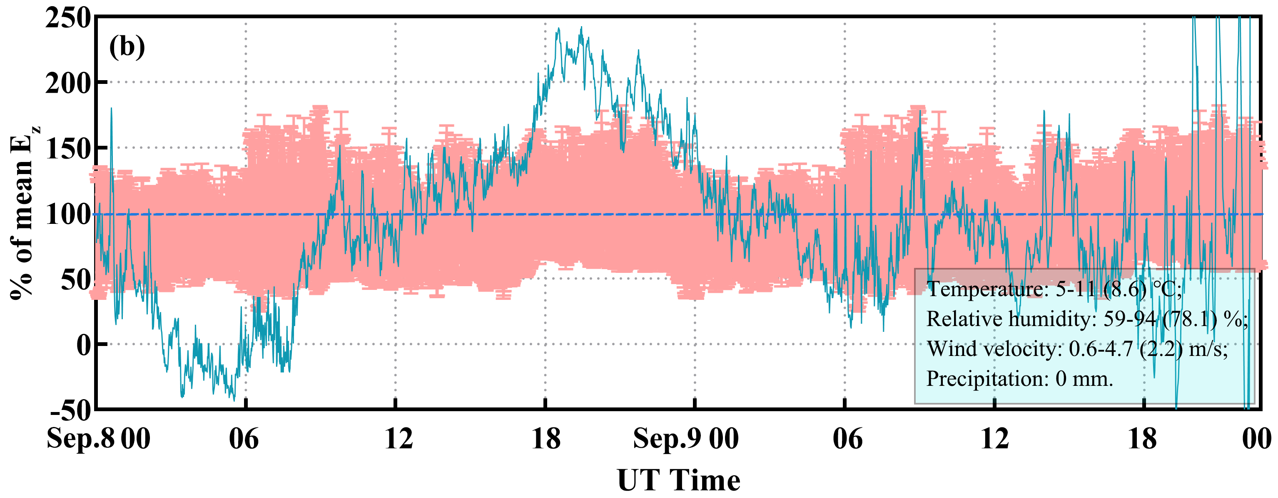
3
Variation of atmospheric electric field during a CME event
Light red background indicates upper and lower quartiles for all fair-weather conditions in September 2017.
Azores Station
80%
Studenec Station
Neutron number variations observed at the OULU station on September 7-10, 2017 (time resolution: 1 min)
120%
Significantly synchronized decrease of the atmospheric electric field during the Forbush decrease on September 8-9th, 2017.
Notes:
Neutron/’nu:tra:n/ synchronized/sIgkrernaizd/

Slide 10
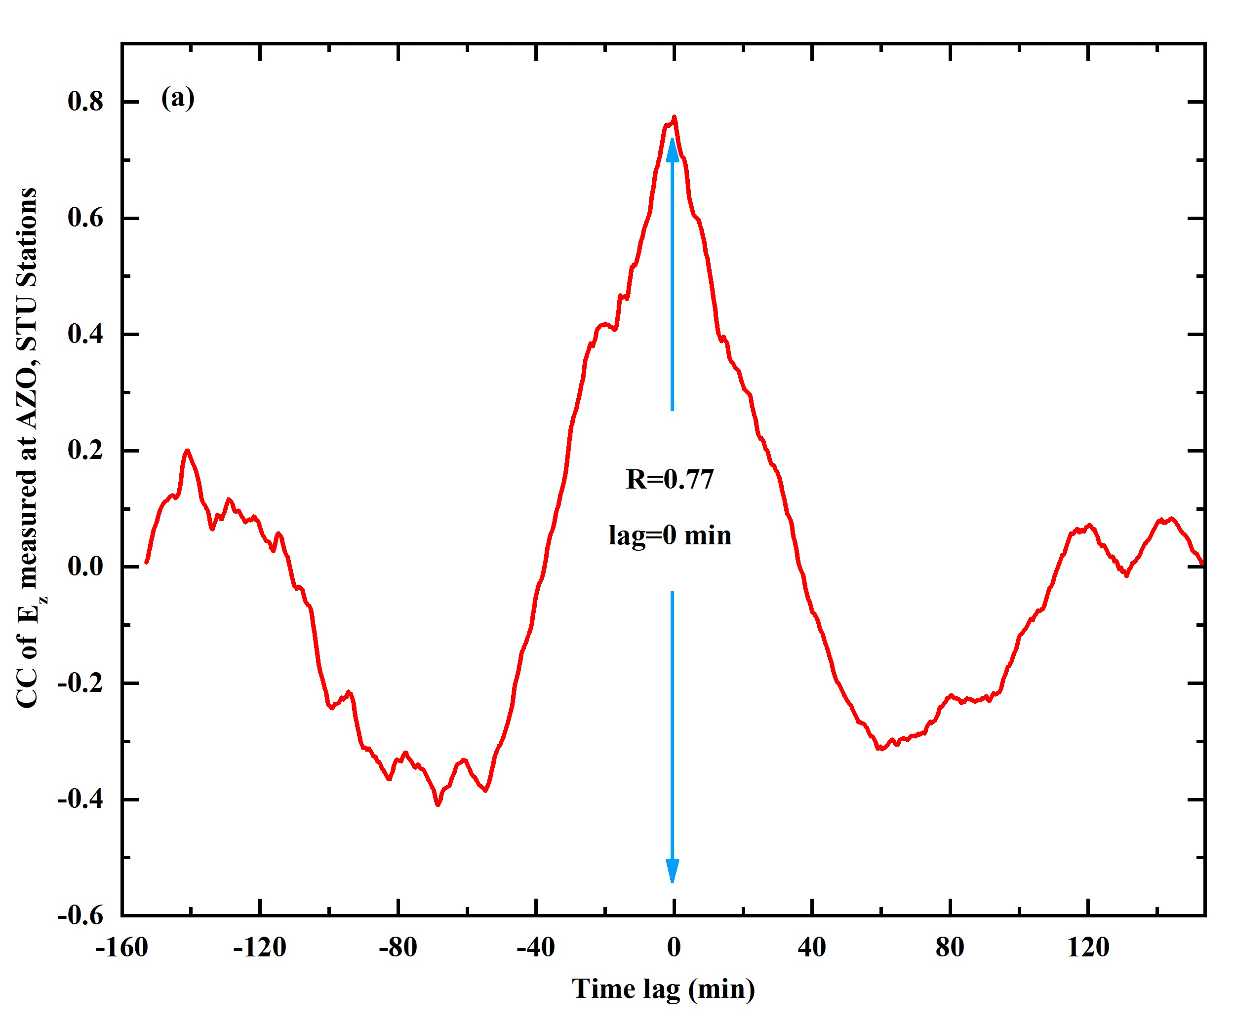
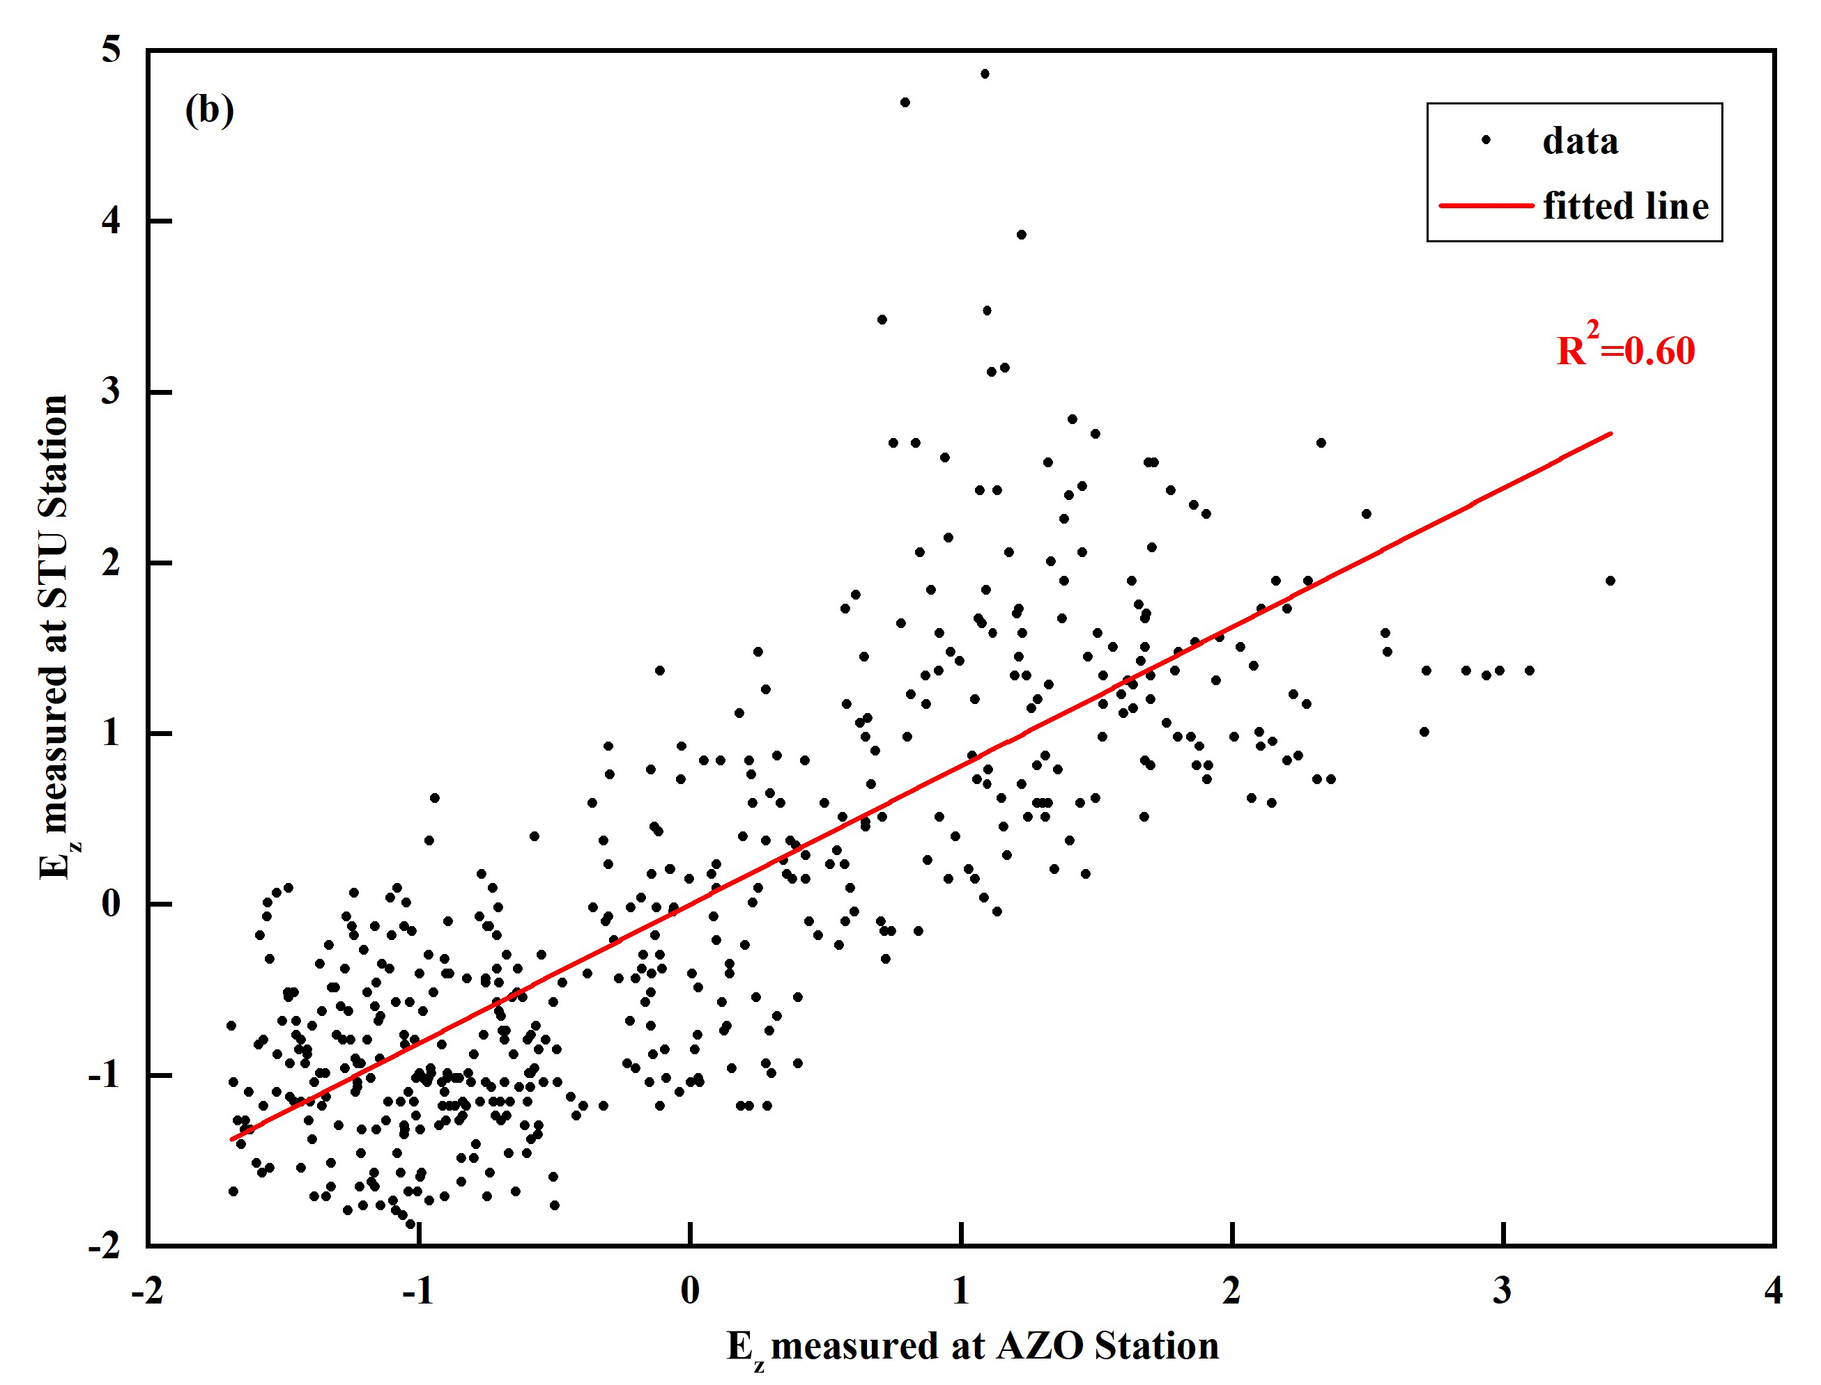
3
Variation of atmospheric electric field during a CME event
Segments of anomalous variations in the electric field at 2 stations were selected for the study (from initial decrease to return back to normal level)
The highest correlation is found at lag=0 min, indicating that the anomalous changes in the electric field at the 2 stations are synchronized without time delay.
A good linear correlation between anomaly segments in atmospheric electric field for these 2 stations.
Notes:
initial /I’nIfl/

Slide 11
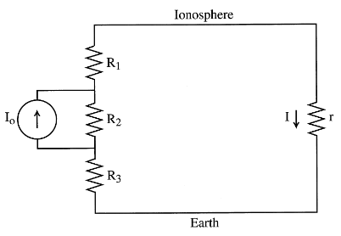


4
Summary of atmospheric electric field changed by CMEs
Which segment has relatively more resistance increase?
i. If atmospheric conductivity decreases uniformly with altitude, then
$$Iair−earth=\frac{I0∗R2}{R1+R2+R3}=constant$$
, for near surface,
$$Iair−earth=conductivity∗atmospheric electirc field$$
Atmospheric electric field increases!
ii. If R₂ increases more, then I_{air-earth} increases, because atmospheric conductivity decreases, so atmospheric electric field increases!
$$Iair−earth=\frac{I0∗R2}{R1+R2+R3+r}≈\frac{I0∗R2}{R1+R2+R3}$$
iii. If R₁ or R₃ increases more, then I_{air-earth} decreases, because atmospheric conductivity decreases, so atmospheric electric field increases or decreases!
Coronal mass ejections generate magnetic clouds, which block the incoming galactic cosmic rays, causing the atmospheric conductivity to decrease and the atmospheric resistance to increase.
It’s consistent with the example we described just now.
Notes:
multiplied by乘以 devided除以

Slide 12
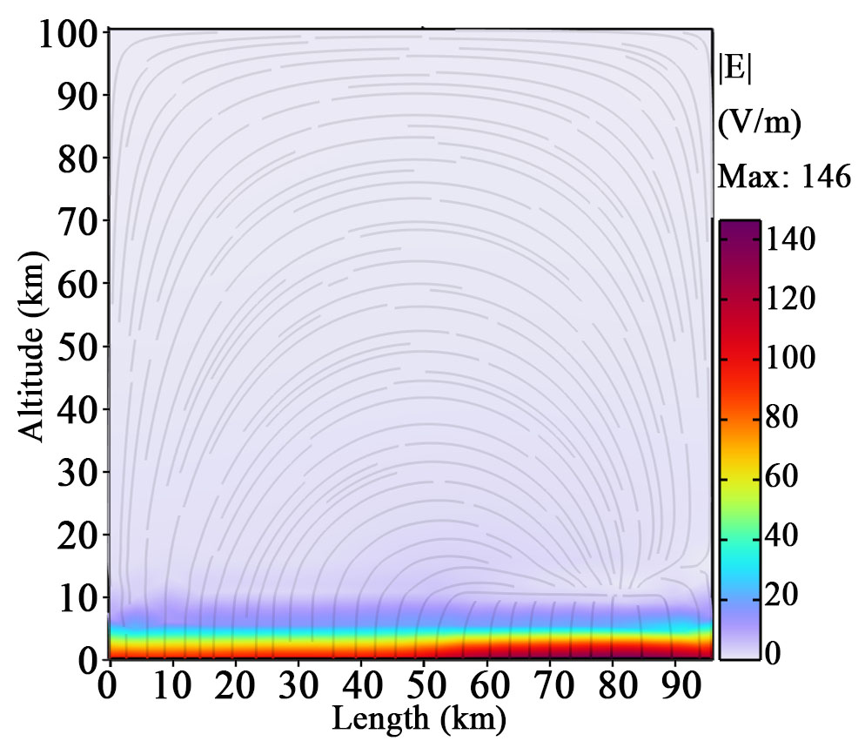
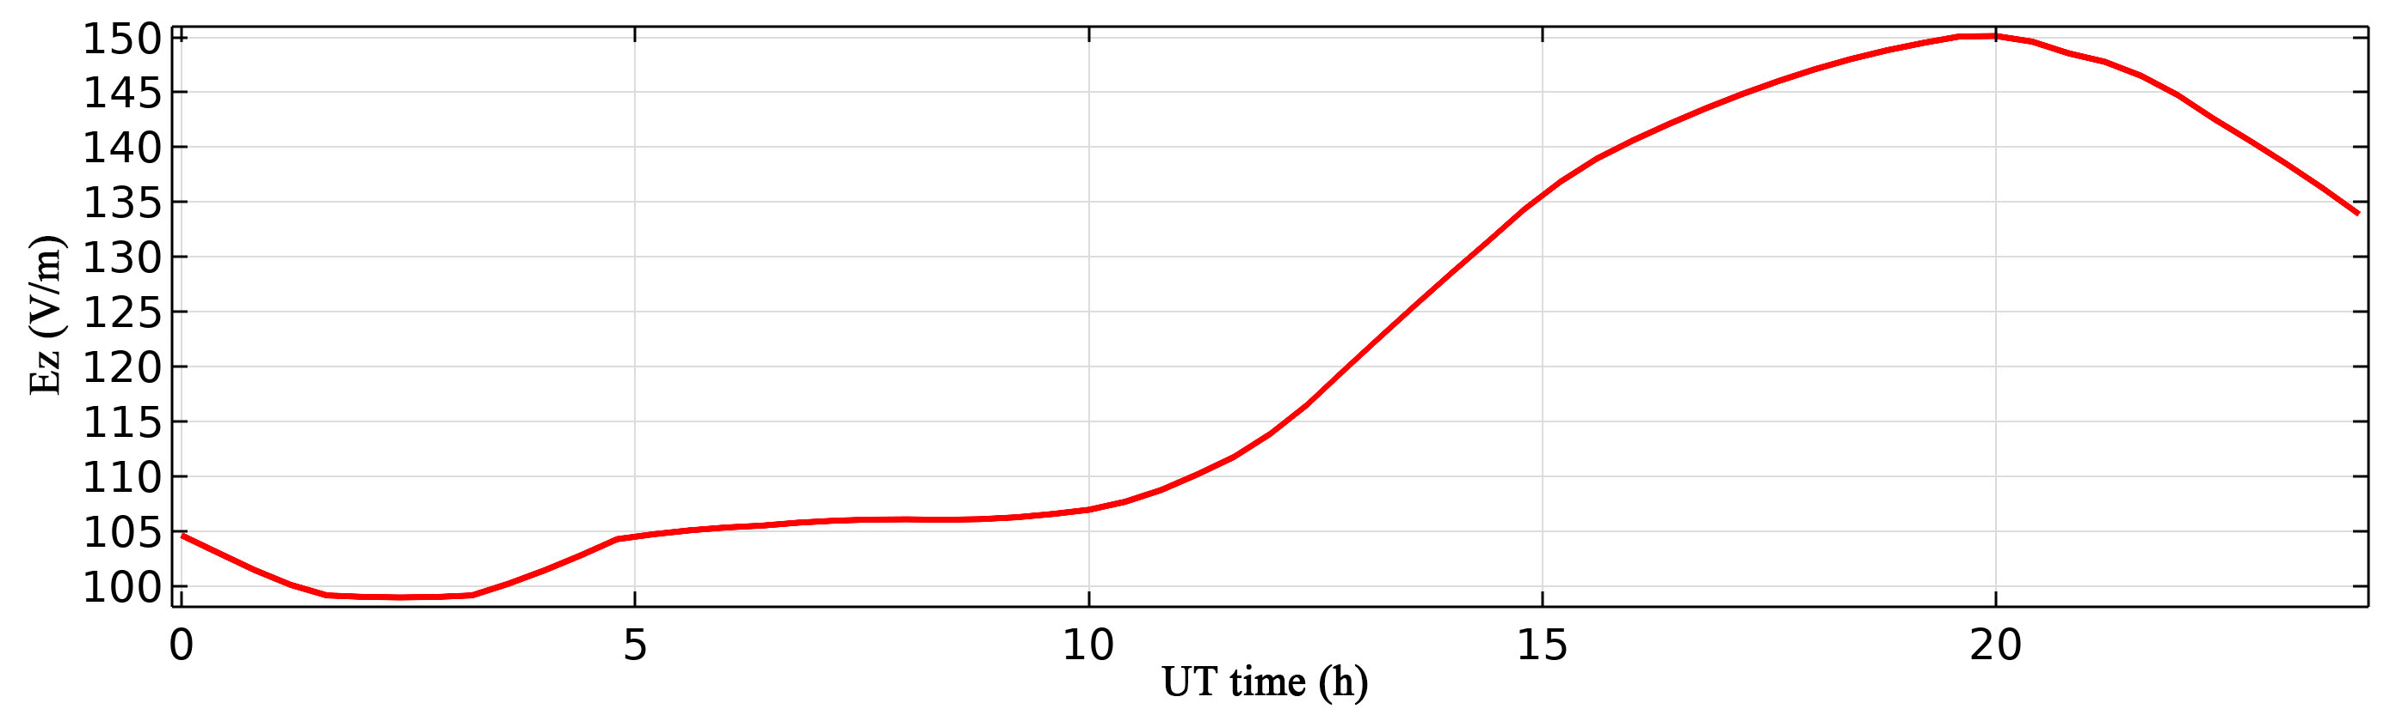
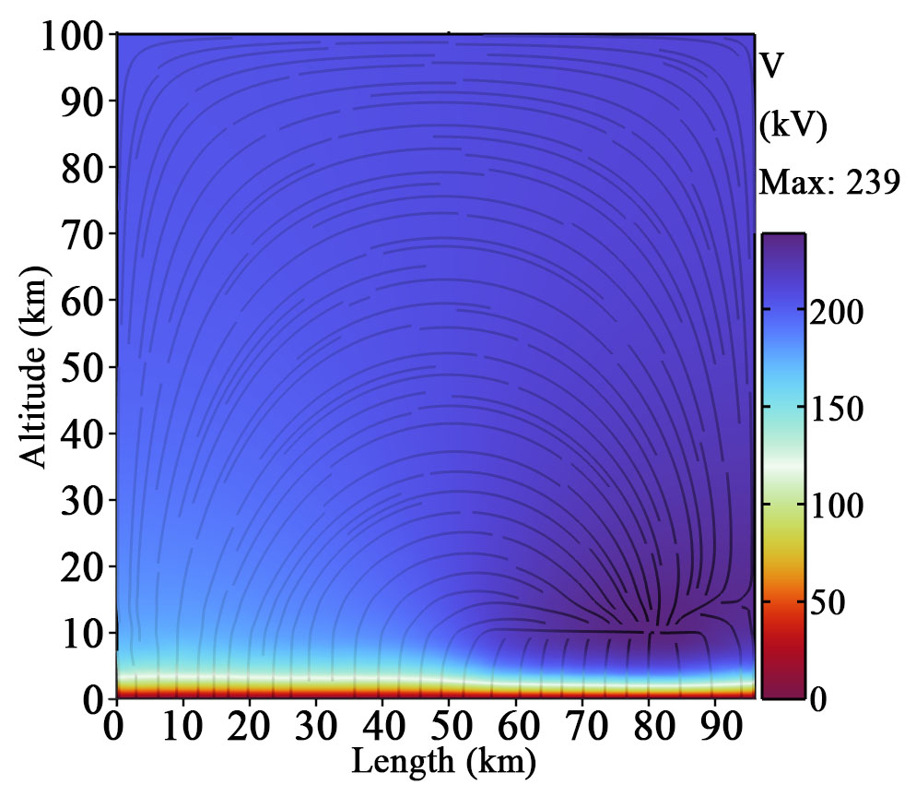
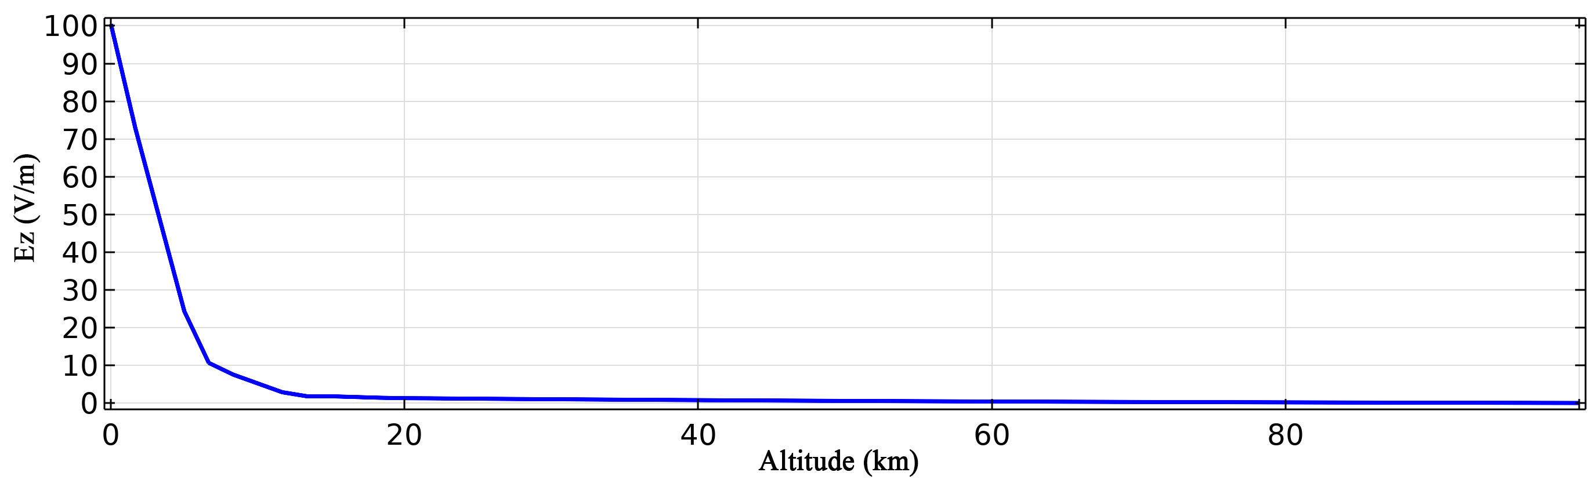
4
Summary of atmospheric electric field changed by CMEs
In order to make these instances more visible, simulations were performed using COMSOL software.
i. Normal fair weather (Set the initial distribution of space charge density and potential.)
Notes:
visible/vIzerbl/

Slide 13
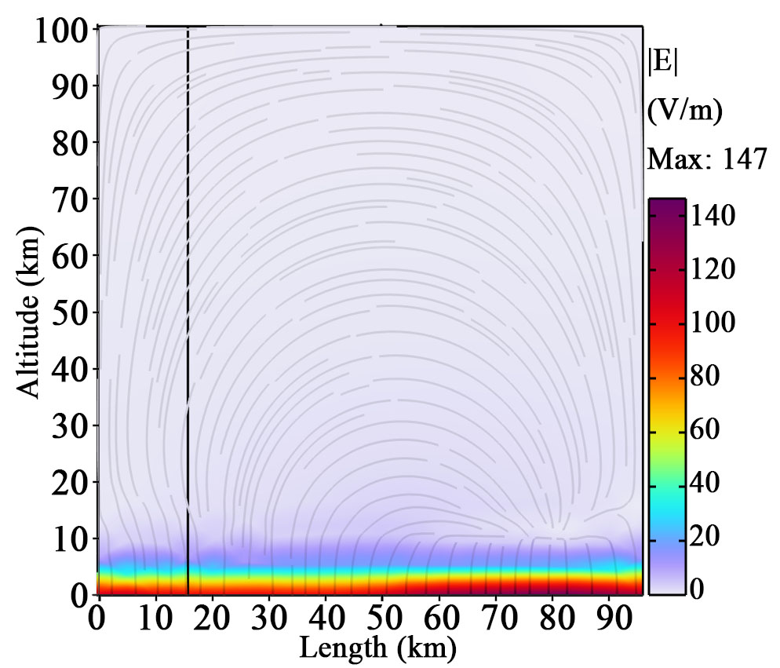
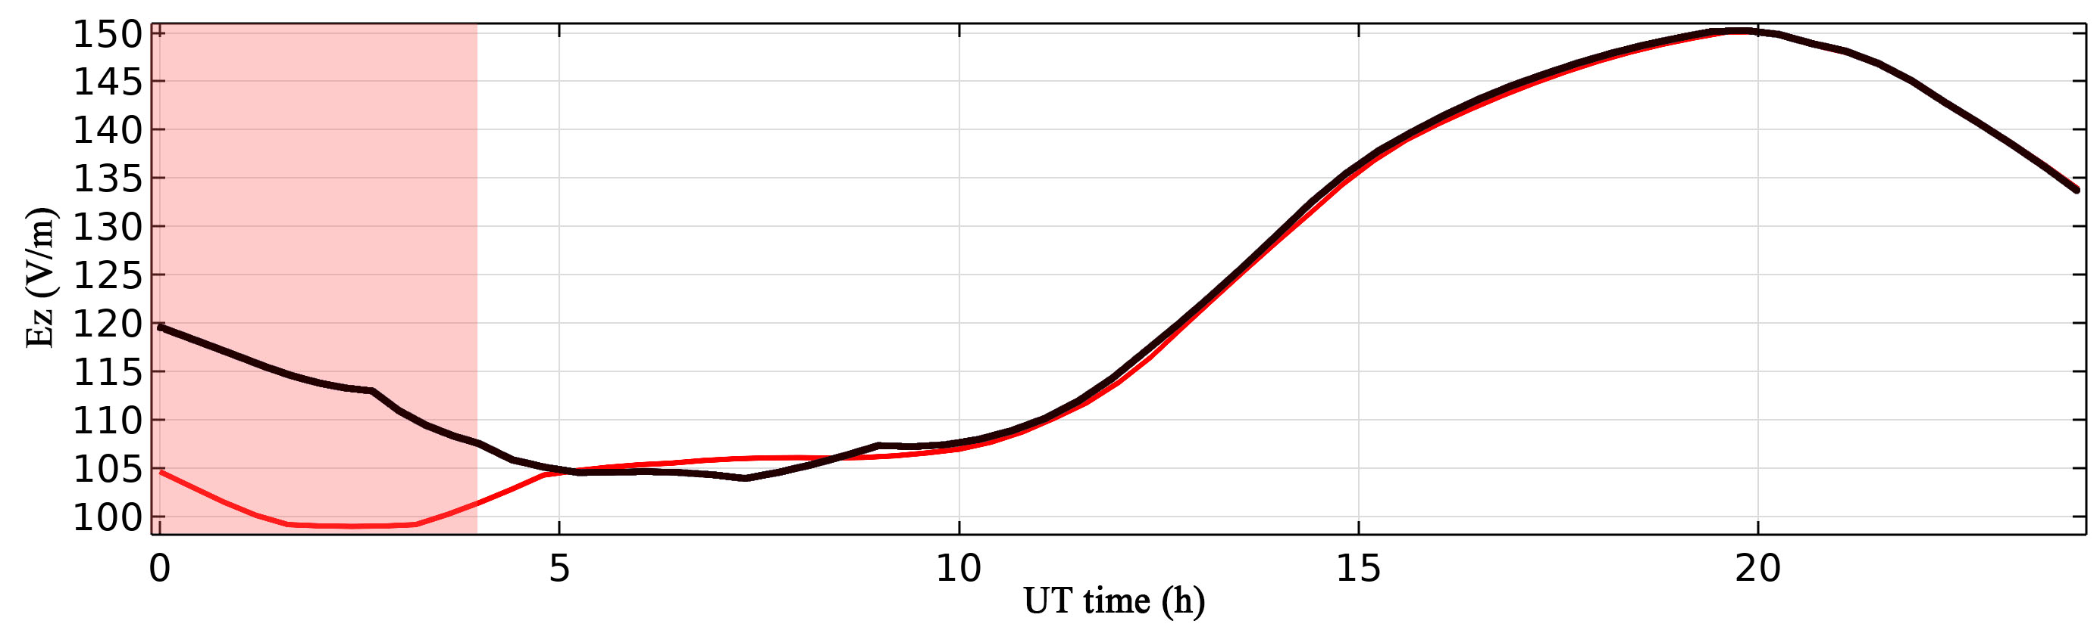
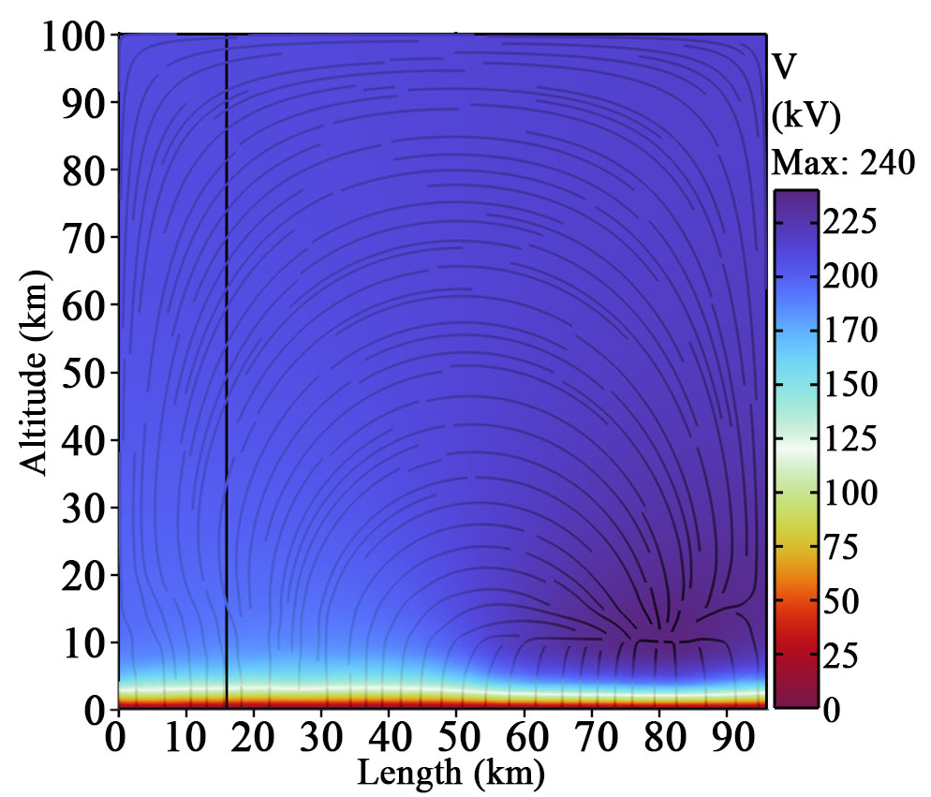
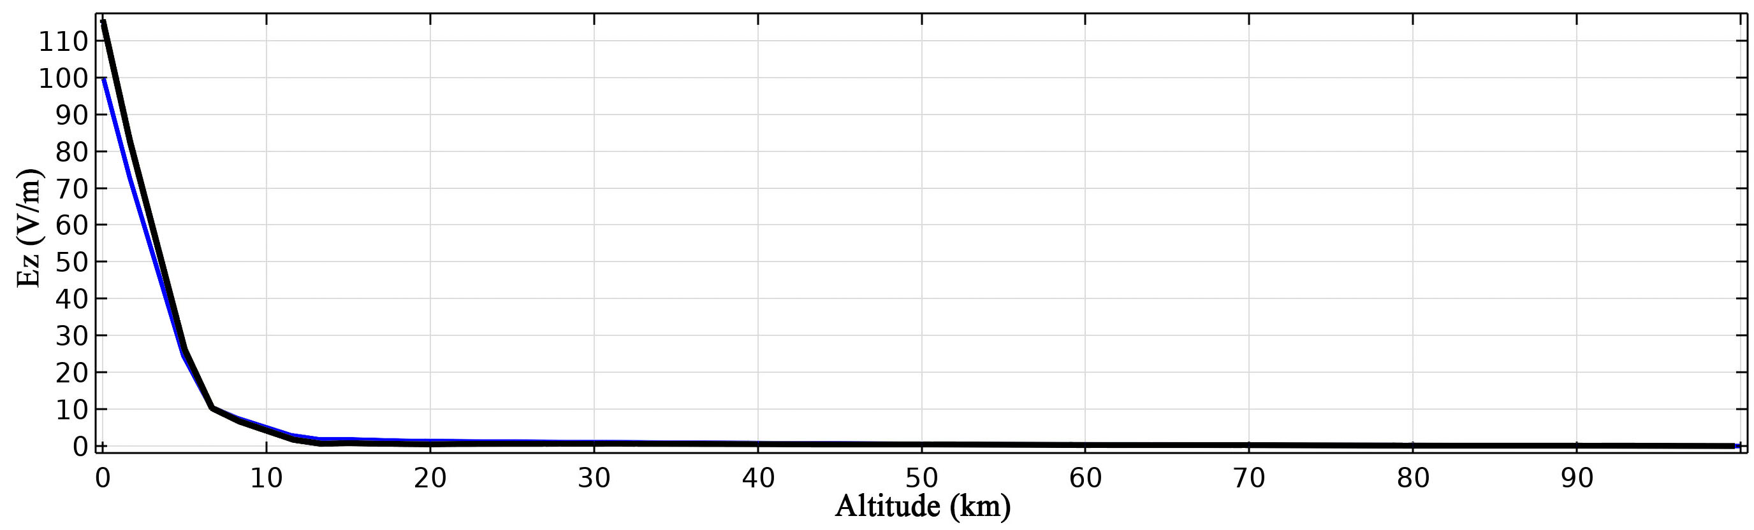
4
Summary of atmospheric electric field changed by CMEs
ii. Atmospheric conductivity decreases uniformly with altitude

Slide 14
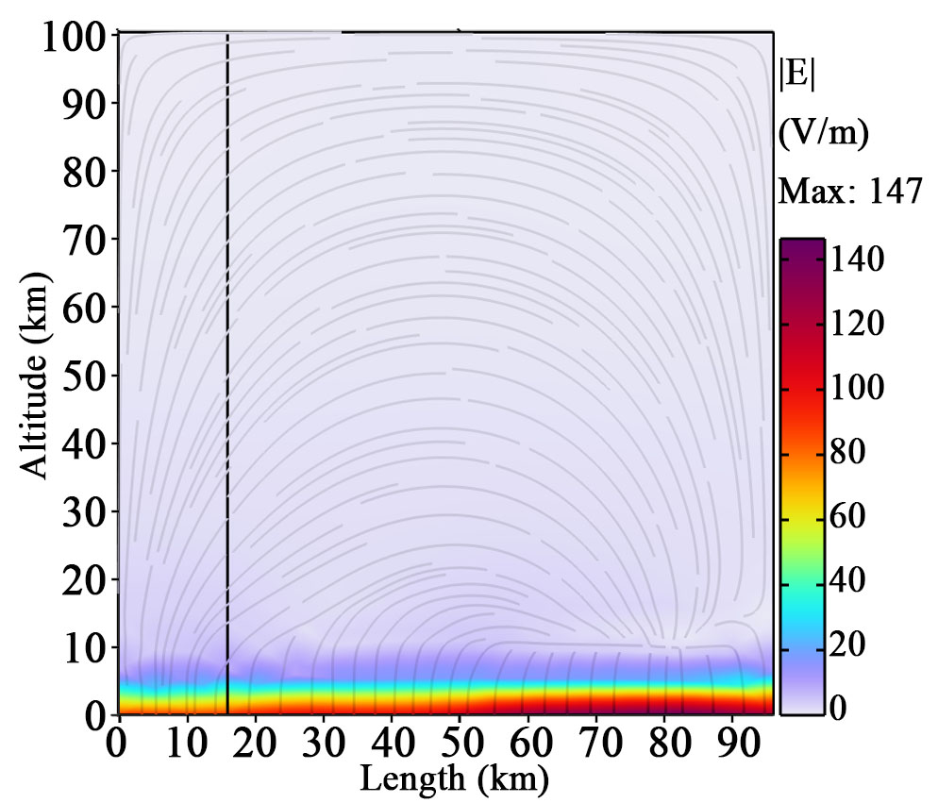
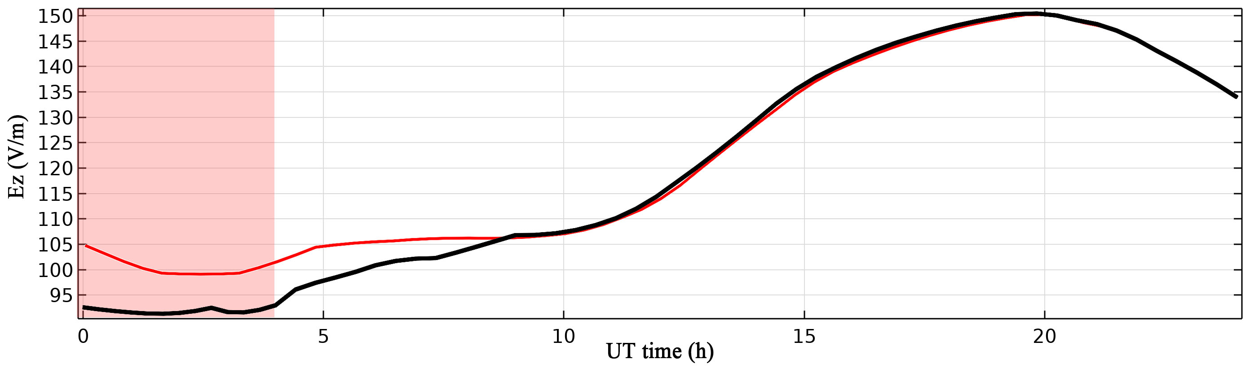
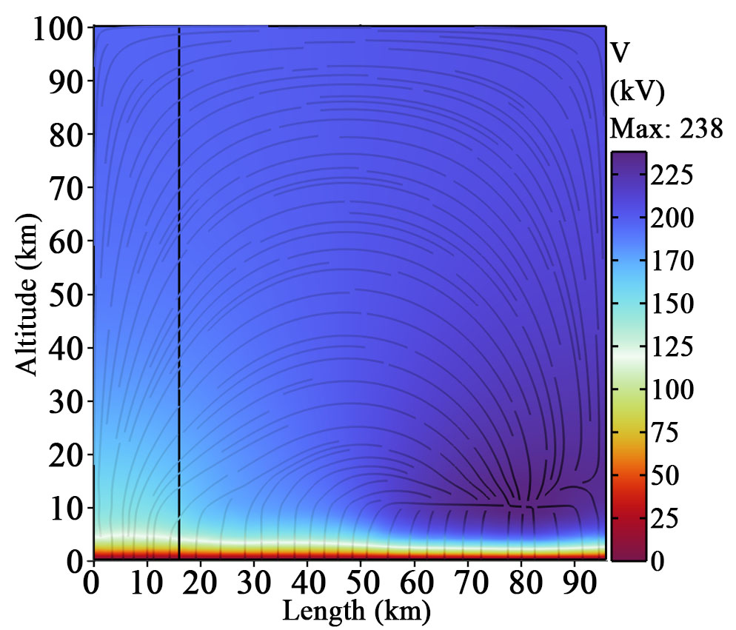
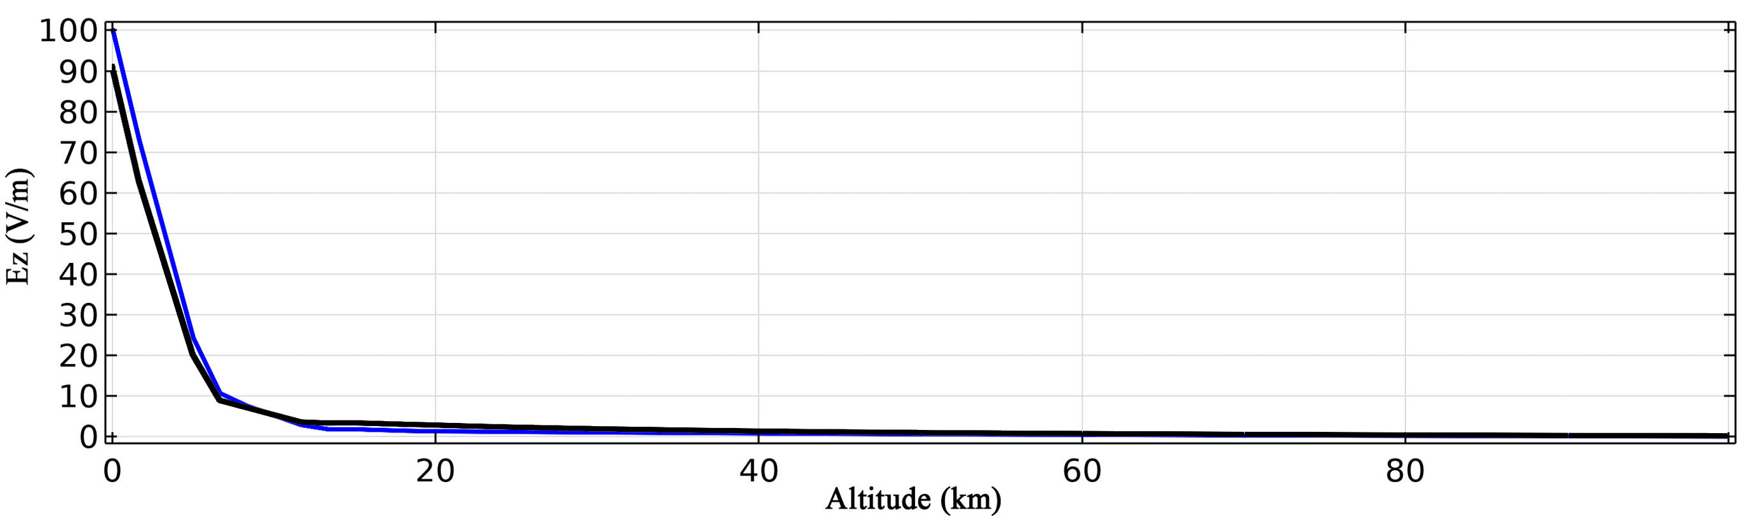
4
Summary of atmospheric electric field changed by CMEs
iii. R₁ or R₃ increases more than R₂
Note: This situation is more complex, depending on how much R₃ and R₁ increase relative to R₂. If the magnitude is not large, the atmospheric electric field may also be increasing.

Slide 15
Do you have any questions?
Thank you！

