Slide 1
Identification of ionospheric earthquake precursors in the Kamchatka region based on correlation analysis
V.V. Bogdanov, A.V. Pavlov
Institute of cosmophysical research and radio wave propagation FEB RAS,
Paratunka, Russia

Slide 2



Seismic activity is one of the sources of ionospheric variability. In this work, on the basis of the method [Pulinets et al, 2004], the change in the concentration of electrons in the ionosphere, preceding the onset of strong earthquakes with M≥6.0 in the Kamchatka region, is investigated.
This method is based on calculating the correlation coefficient between the values of the critical frequency foF2 of two ionospheric stations, one of which is located inside the earthquake preparation zone, and the other is outside it.
If the observation points are located in similar geographic conditions, then they will also observe the same ionospheric variations in both calm and disturbed geomagnetic conditions, except for those points that are located in the seismically active zone. Local anomalies in the F2 layer accompanying the preparation of strong earthquakes should manifest themselves in a decrease in the mutual correlation of the critical frequencies foF2 between stations located inside and outside the seismic zone.
‒ correlation coefficient of critical frequencies
hourly values of both stations.
‒ maximum and minimum difference of critical frequencies
hourly values of both stations.

Slide 3
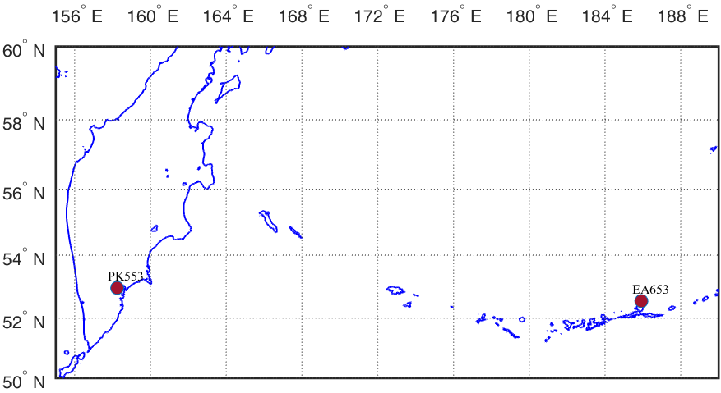
The first station (“receiver-sensor”) PETROPAVLOVSK (PK553) is located on the Kamchatka Peninsula at the point with coordinates (52.97 ° N, 158.24 ° E).
The second station (“control receiver”) - EARECKSON (EA653) is located on the Aleutian Islands in point with coordinates (52.7 ° N, 185.9 E) (http://giro.uml.edu/didbase/scaled.php)
Figure 1. Location of ionospheric stations PK553 and EA653.

Slide 4
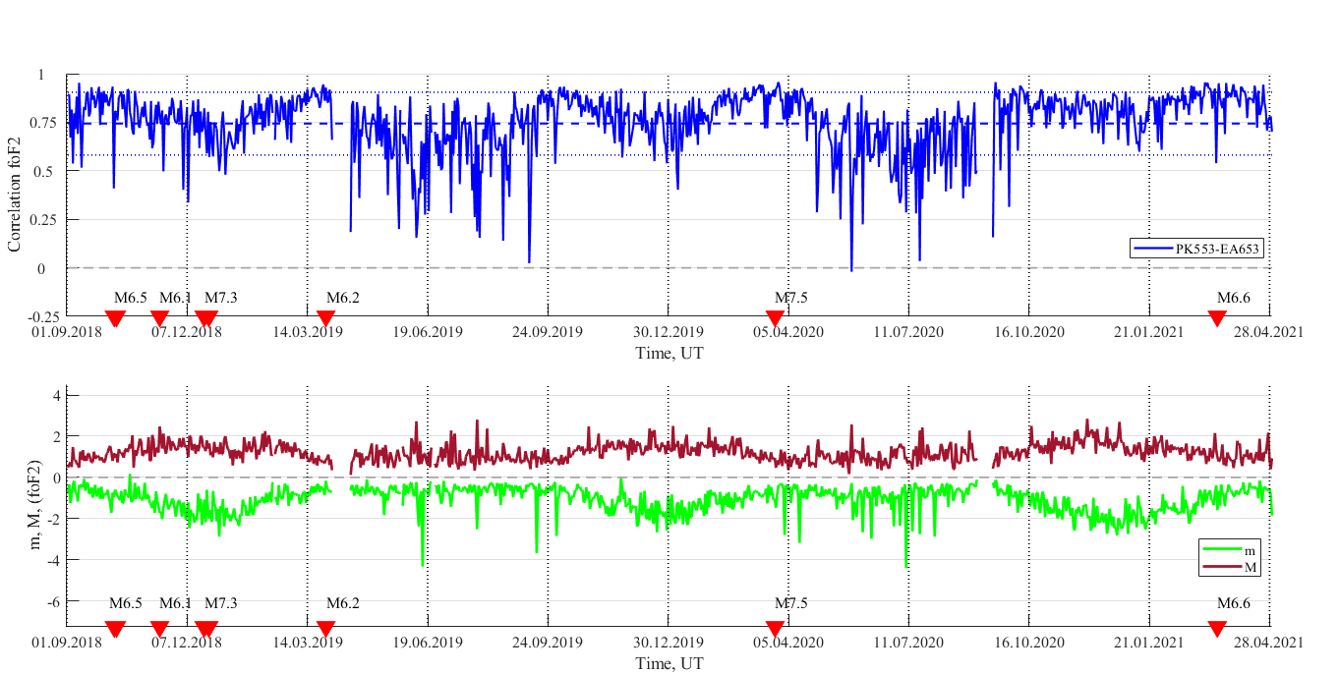
Figure 1. Correlation coefficient for PK553 and EA653 ionospheric stations. Red triangles indicate earthquakes with M≥6.0 that occurred at epicentral distances R≤500 km from the location of the PK553 ionospheric station.
Figure 2. Coefficients m and M for PK553 and EA653 ionospheric stations. Red triangles indicate earthquakes with M≥6.0 that occurred at epicentral distances R≤500 km from the location of the PK553 ionospheric station.

Slide 5
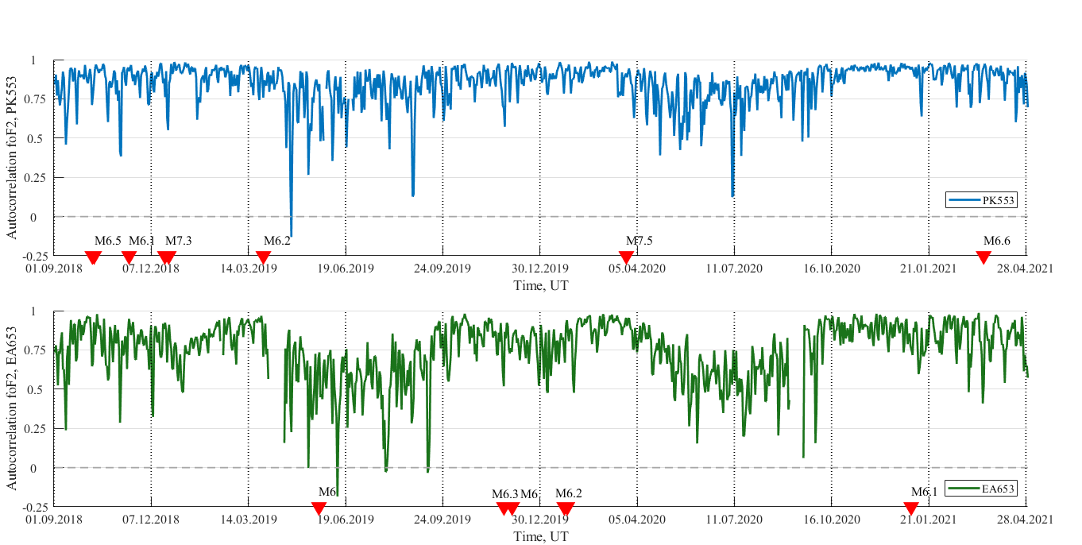
Figure . Autocorrelation coefficient for PK553 ionospheric station. Red triangles indicate earthquakes with M≥6.0 that occurred at epicentral distances R≤500 km from the location of the PK553 ionospheric station.
Figure . Autocorrelation coefficient for EA653 ionospheric station. Red triangles indicate earthquakes with M≥6.0 that occurred at epicentral distances R≤500 km from the location of the EA653.ionospheric station.

Slide 6
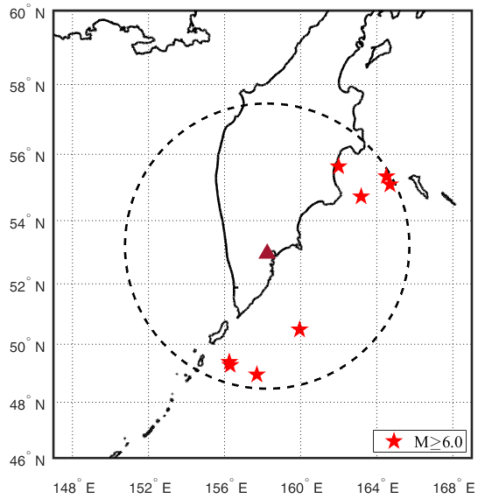
Table 1. List of Kamchatka with magnitude M≥6.0 (USGS)
Date EQ | φ, ° N | λ, ° E | h, km | R, km | M
09.10.2018 07:45:11 | 49.39 | 156.24 | 19 | 421 | 6.1
10.10.2018 23:16:02 | 49.29 | 156.29 | 20 | 431 | 6.5
14.11.2018 21:21:50 | 55.64 | 161.99 | 49 | 384 | 6.1
20.12.2018 17:01:55 | 55.09 | 164.69 | 16.56 | 483 | 7.3
24.12.2018 12:41:19 | 55.34 | 164.50 | 10 | 485 | 6.1
28.03.2019 22:06:49 | 50.49 | 159.94 | 9 | 299 | 6.2
25.03.2020 02:49:21 | 48.96 | 157.69 | 57.8 | 447 | 7.5
16.03.2021 18:38:21 | 54.73 | 163.18 | 13.23 | 378 | 6.6
Figure 3. Epicenters positions of earthquakes with M≥6.0

Slide 7
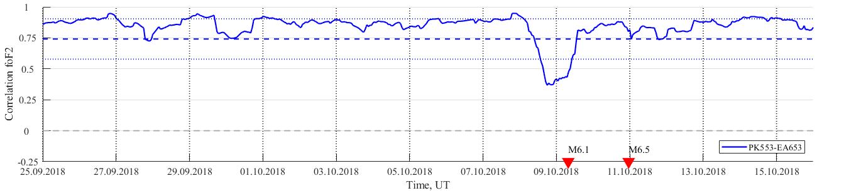
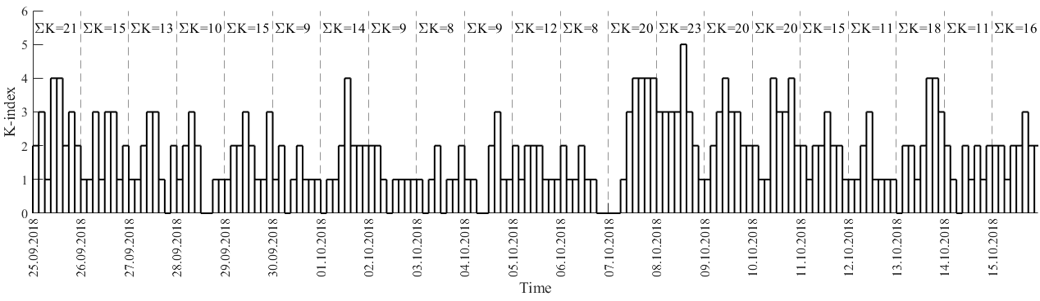
Figure 4. Correlation coefficient C_{foF2} over period 25.09.2018-15.10.2018.
Red triangles indicate earthquakes on the dates: 09.10.2018 (M=6.1, h=19 км, R=421 км); 10.10.2018 (M=6.5, h=20 km, R=431 km).
Figure 5. K-index over period 25.09.2018-15.10.2018.

Slide 8
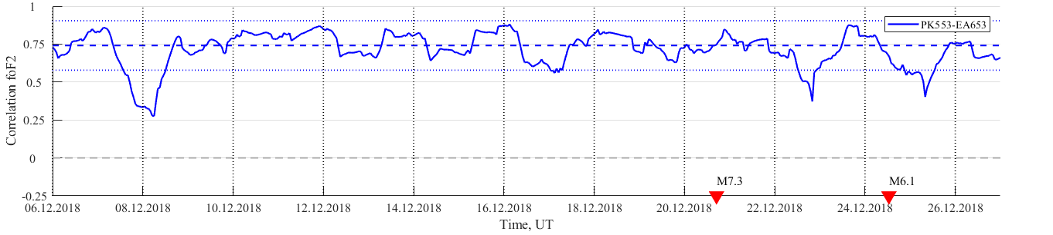
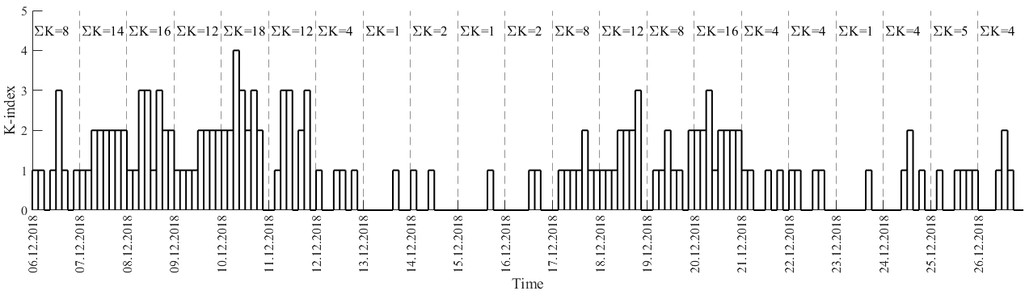
Figure 5. Correlation coefficient C_{foF2} over period 06.12.2018-26.12.2018.
Red triangles indicate earthquakes on the dates : 20.12.2018 (M=7.3, h=16.56 km, R=483 km); 24.12.2018 (M=6.1, h=10 km, R=486 km).
Figure 6. K-index over period 06.12.2018-26.12.2018.

Slide 9
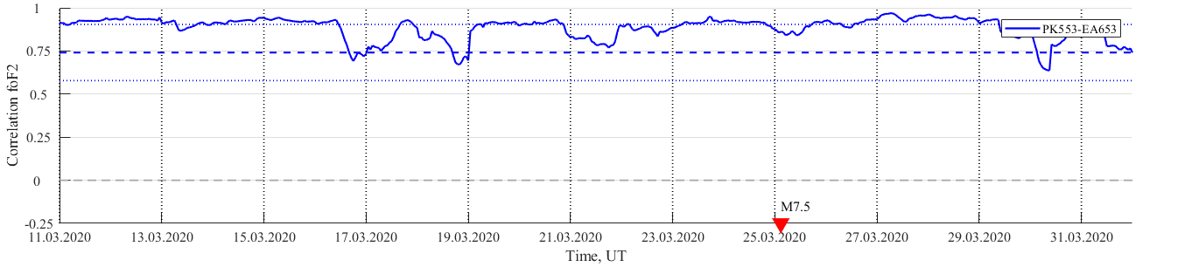
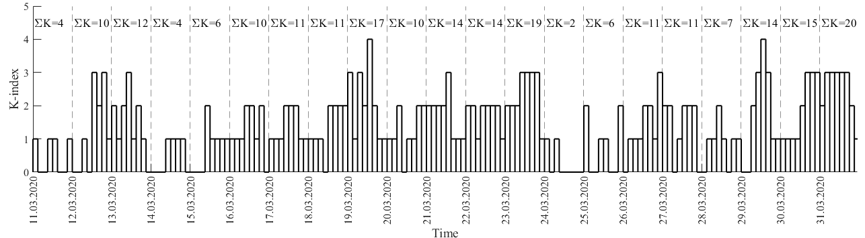
Figure 7. Correlation coefficient C_{foF2} over period 11.03.2020-31.03.2020.
Red triangle indicates earthquake on the date 25.03.2020 (M=7.5, h=57.8 km, R=447 km).
Figure 8. K-index over period 11.03.2020-31.03.2020.

Slide 10
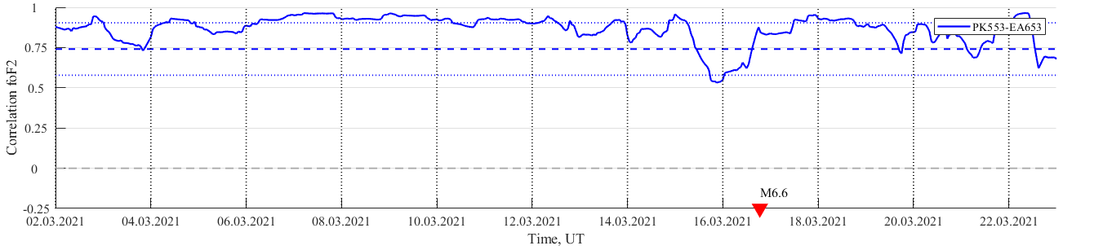
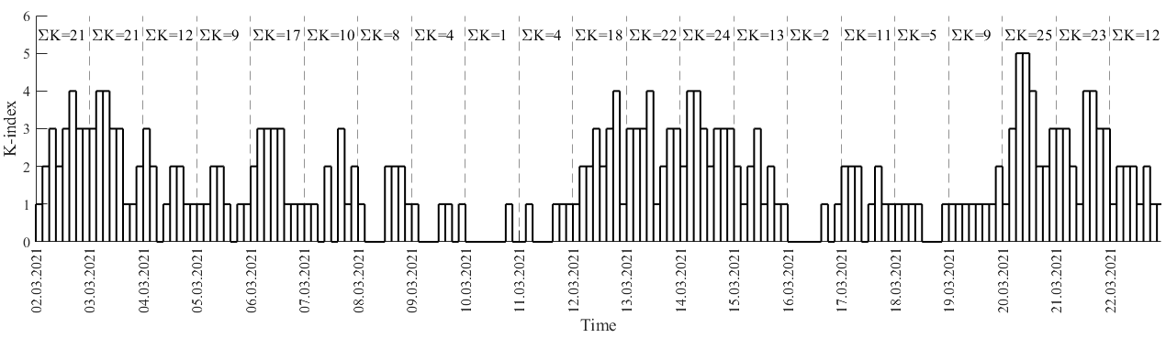
Figure 9. Correlation coefficient C_{foF2} over period 02.03.2021-22.03.2021.
Red triangle indicates earthquake on the date 16.03.2021 (M=6.6, h=13.23 km, R=379 km).
Figure 10. K-index over period 02.03.2021-22.03.2021.

Slide 11
Conclusion
Statistical analysis of the critical frequencies foF2 showed that a noticeable decrease in the correlation coefficient was observed 1-12 days before the earthquakes for 5 out of 8 events with M≥6.0 that occurred at depths of up to 100 km and epicentral distances of up to 500 km from the PK553 location.
The analysis of the correlation coefficients made it possible to reveal changes in the state of the ionosphere that preceded the occurrence of a series of Kamchatka earthquakes with M≥6.0.
This method can be convenient for daily monitoring of the ionospheric state in order to identify earthquake precursors.

Slide 12
THANK YOU FOR THE ATTENTION!

