Slide 1
Estimation earthquake occurrence probability in Kamchatka region based on seismological and complex of ionospheric precursors
V.V. Bogdanov, A.V. Pavlov
Institute of cosmophysical research and radio wave propagation FEB RAS,
Paratunka, Russia

Slide 2
Introduction
In this presentation the authors present the method of estimation of a region, waiting period and probability of strong earthquakes with K_{S}≥13.5 (M≥6.0) in Kamchatka region based on the combination of mid-term and short-term predictive signs accompanying earthquake formation.
The seismological predictive parameter ξ_{P} was taken as a mid-term precursor. It was calculated on the basis of the probabilistic model of seismic regime and determines the statistically significant deviations of current probabilities P_{k}(S_{i}) for seismic events with the energy class K_{S}≥9.0 to fall within the zones S_{i} from long-term (background) probabilities P_{T}(S_{i}). The expectance zone for an earthquake with K_{S} ≥13.5 was determined as a group of zones S_{i}, in which seismic regime anomalies were identified by the parameter ξ_{P}.
A complex of ionospheric parameters was considered as short-term predictive signs with an earthquake waiting period of up to 5 days. It includes the K-layer, the sporadic Es layer of the r type, the critical frequency foF2, and the frequency stratification of the F2 layer. The probabilities of strong earthquakes with K_{S} ≥13.5 (M≥6.0) that occurred over the period 2019-2021 in an expected zone, determined by the parameter ξ_{P}, were estimated on the basis of Bayes method provided that a complex of anomalous parameters of the ionosphere was identified.

Slide 3
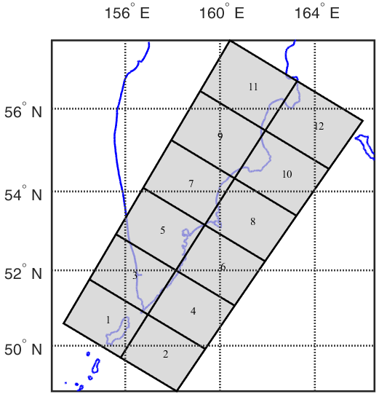





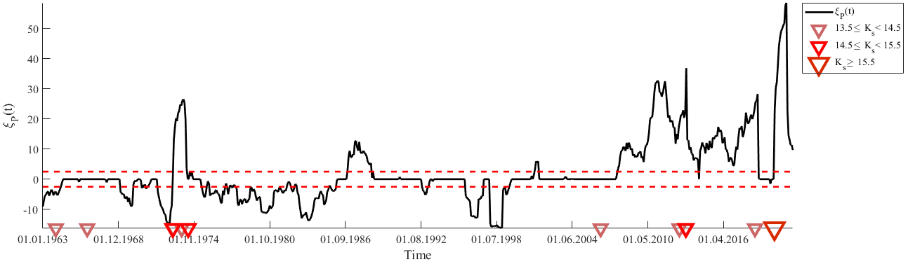
Calculation of seismological parameter ξ_{P}
.
ΔT_{k} =1 year, dt=1 month, T=01.01.1962‒01.06.2021
ξ_{P} ≤ ξ₁ ‒ seismic calm;
ξ_{P} ≥ ξ₂ ‒ seismic activity; ξ₁ < ξ_{P} < ξ₂ ‒ background level.
ξ₁=−2.5; ξ₂=2.5;
Figure 1. Area S=ΣS_{i}, S_{i} = 150×200 km.
Figure 2. Temporary values of the parameter ξ_{P} for region S₂. Red triangles on the time axis indicate earthquakes with K_{S} ≥13.5.

Slide 4
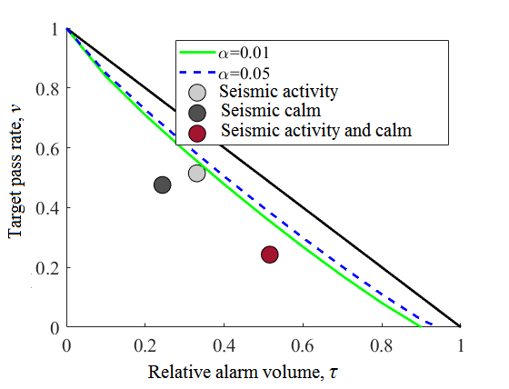
Evaluation of the effectiveness of the prognostic parameter ξ_{P}
Table 1. Predictive efficiency of the parameter ξ_{P}.
Type of seismic anomaly | V | R | J_{G} | J_{M}
Seismic activity (ξ_{P}≥2.5) | 0.57 | 0.49 | 1.47 | 0.15
Seismic calm (ξ_{P}≤2.5) | 0.51 | 0.52 | 2.15 | 0.28
Seismic activity and calm ντ | 0.45 | 0.76 | 1.47 | 0.24
Figure 3. The diagram of errors for the parameter ξ_{P} in predicting earthquakes with K_{S}≥13.5 (M≥6.0).

Slide 5
Method of short-term earthquake prediction based on the complex of
ionospheric precursors
On the basis of the selected most effective ionospheric precursors, an algorithm for short-term earthquake prediction was constructed, in which a joint analysis of the ionospheric
disturbances under consideration is carried out in a sliding time window of width ΔT = 5
days with a step ∆t = 1 day. The condition for announcing the start of the waiting period To
seismic event was the execution in a time interval ∆T for at least three of the four ionospheric
parameters consider the following criteria:
K-layer formation during at least one day of ∆T interval;
Formation of sporadic layer Es type r for at least one day interval ∆T;
Exceeding the critical frequency foF2 layer F2 median values f_{med}, calculated for the previous days, not less than 20% (∆foF2/f_{med}≥0.2) against the background of the development of the magnetospheric storm (total values of the K-index per day K_{Σ}≥20);
Stratification of the F2 layer in frequency (mode "V") for at least one day interval ∆T.
The waiting period is chosen equal to T_{w} = 5 days.

Slide 6
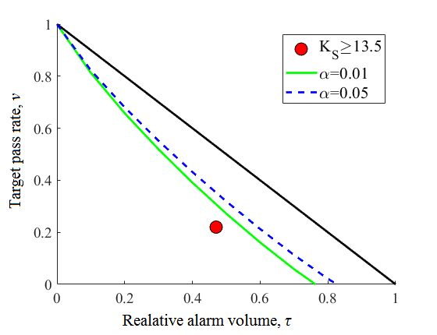
Table 2. The predictive efficiency of the complex ionospheric precursors for the earthquakes with K_{S}≥13.5 (M≥6.0) in time interval 01.01.2013-01.06.2021.
N₊ | N | n(A_{E}) | n(A) | V | R | J_{G} | τ | ν | J_{M}
24 | 30 | 21 | 180 | 0.1 | 0.8 | 1.69 | 0.47 | 0.2 | 0.33
Figure 3. The diagram of errors for the method of the complex ionospheric precursors for K_{S}≥13.5 (M≥6.0). The lower bounds of the confidence interval of the random forecast with the significance level are marked α=0.01 and α=0.05.

Slide 7
Estimation earthquake occurrence probability based on seismological and ionospheric precursors
E ‒ the occurrence of anomalous values of the parameter ξ_{P};
I ‒ the occurrence of complex of the and ionospheric precursors;
D₁ ‒ an earthquake the occurrence predicted energy class K_{S} in the area S_{exp};
D₂ ‒ absence earthquake with energy class K_{S} in the area S_{exp};
P(D₁) ‒ the probability of occurrence of earthquake with predicted energy class K_{S} in the area S_{exp};
P(D₂) ‒ the probability of absence earthquake with predicted energy class K_{S} in the area S_{exp};
P(E|D₁) ‒ the probability of occurrence of earthquake with predicted energy class K_{S} in the area S_{exp} when identifying anomalies of the seismic regime (activation or calm);
P(E|D₂) ‒ the probability of absence earthquake with predicted energy class K_{S} in the area S_{exp} when identifying anomalies of the seismic regime
P(I|D₁) ‒ the probability of occurrence of earthquake with predicted energy class K_{S} in the area S_{exp} when identifying complex of ionospheric precursors;
P(I|D₂) ‒ the probability of occurrence of complex of ionospheric precursors, after which the earthquake with predicted energy class K_{S} in the area S_{exp} did not occur.
P(D₁|EI) ‒ the probability of occurrence of earthquake with predicted energy class K_{S} in the area S_{exp} when identifying anomalies of the seismic regime (event E) and complex of ionospheric precursors (event I ).

Slide 8
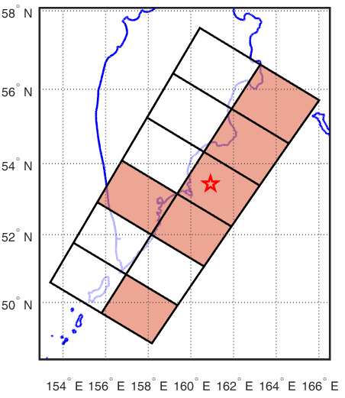
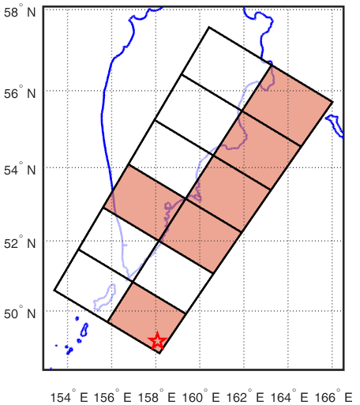
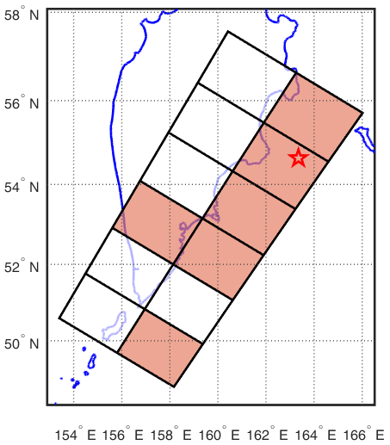
The results of applying the method for predicting earthquakes with K_{S}≥13.5
Table 3. List of predicted earthquakes with energy class K_{S}≥13.5 (M≥6.0) over period 01.01.2019‒01.06.2021.
№ | Date EQ | K_{S} | h, km | P(D₁|EI) | S_{exp} | T_{ож} по комплексу ионосферных параметров
1 | 2019.06.25 09:05:39 | 14.3 | 57 | 0.69 | + | 2019.06.21‒2019.06.26
2 | 2019.06.26 02:18:06 | 14.4 | 53 | 0.69 | + | 2019.06.21‒2019.06.26
3 | 2020.01.22 11:04:11 | 14.3 | 83 | 0.71 | + | 2020.01.21‒2020.02.05
4 | 2020.02.20 18:57:34 | 14.3 | 52 | 0.72 | + | 2020.02.11‒2020.02.29
5 | 2020.03.25 02:49:19 | 16.8 | 48 | 0.73 | + | 2020.03.19‒2020.03.28
6 | 2021.03.16 18:38:21 | 14.6 | 64 | 0.74 | + | 2021.02.14‒2020.03.30
a)
b)
c)
Figure 4. Maps of expectation earthquakes with energy class K_{S}≥13.5: a) 2021.03.20, K_{S}=14.6;
b) 2020.03.25, K_{S}=16.8; c) 2021.03.16, K_{S}=14.6.

Slide 9
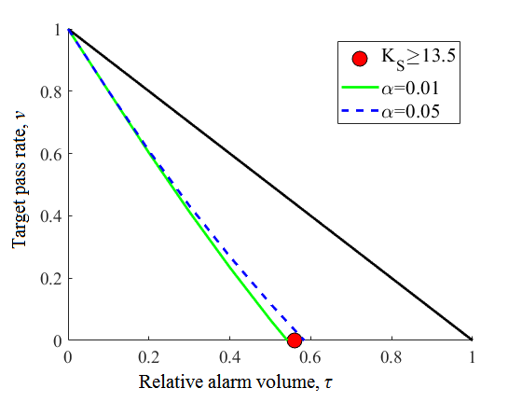
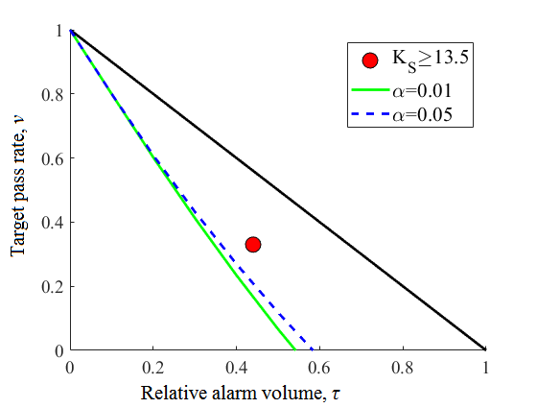
Evaluation of the effectiveness of the method based on seismological and ionospheric precursors
Levels of conditional probability P(D₁|EI) | V | R | J_{G} | J_{M}
0.5 | 0.09 | 1 | 1.8 | 0.44
0.7 | 0.09 | 0.67 | 1.52 | 0.23
a)
b)
Figure 5. The diagram of errors for the method for predicting earthquakes with K_{S}≥13.5 (M≥6.0) based on seismological and complex of ionospheric precursors at a given level of values of the conditional probability of earthquake occurrence P(D₁|EI)=0.5 (a) and P(D₁|EI)=0.7 (b).

Slide 10
Conclusion
An approach is presented that combines seismological and ionospheric prognostic signs in order to assess the probability of occurrence of earthquakes with K_{S} ≥13.5 (M≥6.0) in the Kamchatka region. A retrospective analysis was carried out using this technique for the time period 01.01.2019‒01.06.2021.
The effectiveness of method for determining the area and possible period of the onset of seismic events with K_{S} ≥13.5 in the joint analysis of the seismic parameter ξ_{P} and the complex of ionospheric precursors (at the values of the conditional probability of the onset of earthquakes P(D₁|EI)≥0.5 and P(D₁|EI)≥0.7) shows that the forecast using this method is more than 1.5 times different from a random guess.
The low reliability of the V forecast may be due to the fact that, ionospheric disturbances are formed against the background of solar activity, and it is not yet possible to accurately indicate the lower threshold of the earthquake magnitude, the preparation of which is already beginning to influence the state of the ionosphere. Seismic events with an energy class K_{S} ≥13.5 predicted by ionospheric precursors and taken into account in statistics do not include events with an energy class K_{S}<13.5, although the ionospheric precursor has formed. Consequently, the ionospheric forecast signs that precede seismic events with K_{S}<13.5 are false for events with K_{S} ≥13.5, thereby lowering the forecast reliability.

Slide 11
Thank you for the attention!

