Slide 1
Регистрация синхронных геомагнитных пульсаций и протонных сияний во время суббури 1 марта 2017 г.
Registration of synchronous geomagnetic pulsations and proton aurora during the substorm on March 1, 2017
I.I. Varlamov^{1,2}, S.G. Parnikov², I.B. Ievenko², D.G. Baishev², and Kazuo Shiokawa³
¹M.K. Ammosov North-Eastern Federal University, Yakutsk, Russia
²Yu.G. Shafer Institute of Cosmophysical Research and Aeronomy SB RAS, Yakut Scientific Centre SB RAS, Yakutsk, Russia
³Institute for Space-Earth Environmental Research, Nagoya University, Japan

Slide 2
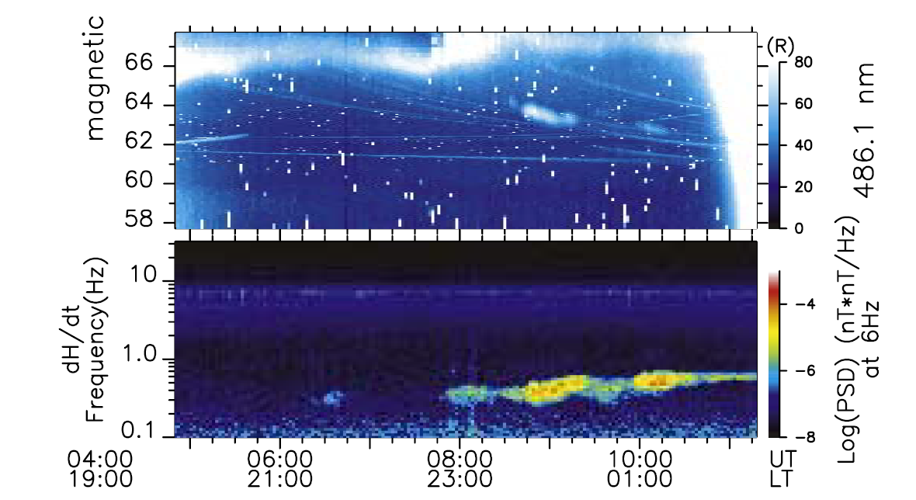
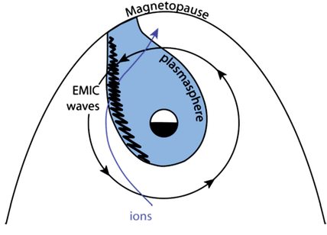
Introduction
(from left to right) Region of generation of EMIC waves in the evening sector at the border of the plasmaspheric plume. Plume is observed during magneto-active periods (magnetic storms, magnetospheric substorms). In the visible part of the spectrum, Hβ lines (486 nm) are emitted, which are used to identify the precipitation of protons from the Earth. EMIC waves manifest themselves in the form of geomagnetic pulsations of the Pc1 range on Earth. As an example, the event of simultaneous registration of a narrow in latitude proton arc and pulsations at the Canadian station Athabasca on September 2 [Sakaguchi et al., 2008] is given. It can be seen that a gradual shift in the position of the proton arc to low latitudes led to a noticeable increase in the frequency of geomagnetic pulsations Pc1.

Slide 3
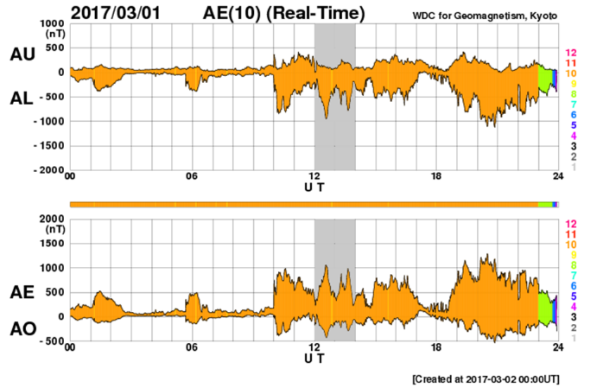
Auroral indices on March 1, 2017 according to the Kyoto World Data Center for Geomagnetism. (the analyzed interval is highlighted in gray)

Slide 4
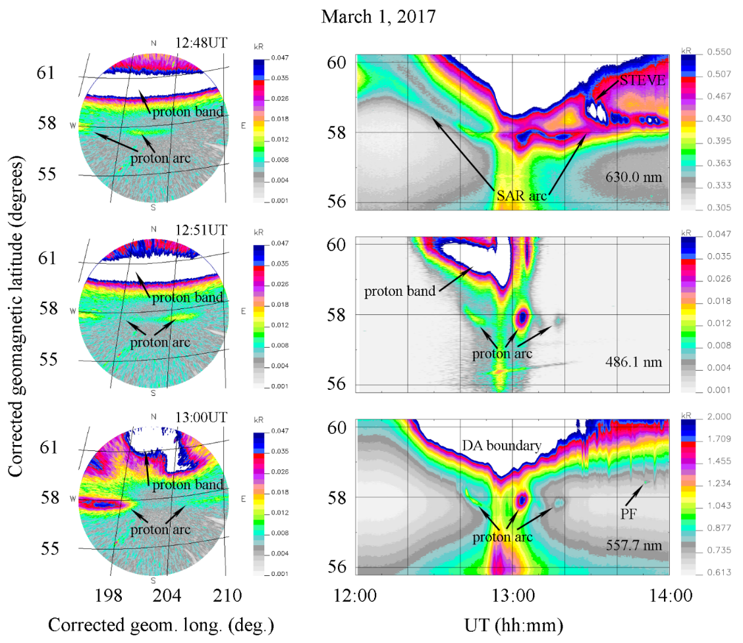
Dynamics of subauroral luminosity at Maimaga station during observations on March 1, 2017. On the left side of the figure are images of all sky in emission of 486.1 nm for three points in time indicated in the images. The right side of the figure shows the latitudinal dynamics of the luminosity in the 630.0, 486.1, and 557.7 nm emissions in the form of keograms. All sky images and keograms projected onto the Earth's surface for luminosity heights of 110 km for emissions of 486.1 and 557.7 nm and 250 km for emissions of 630.0 nm. The signal intensity is given in kilorayleighs.

Slide 5
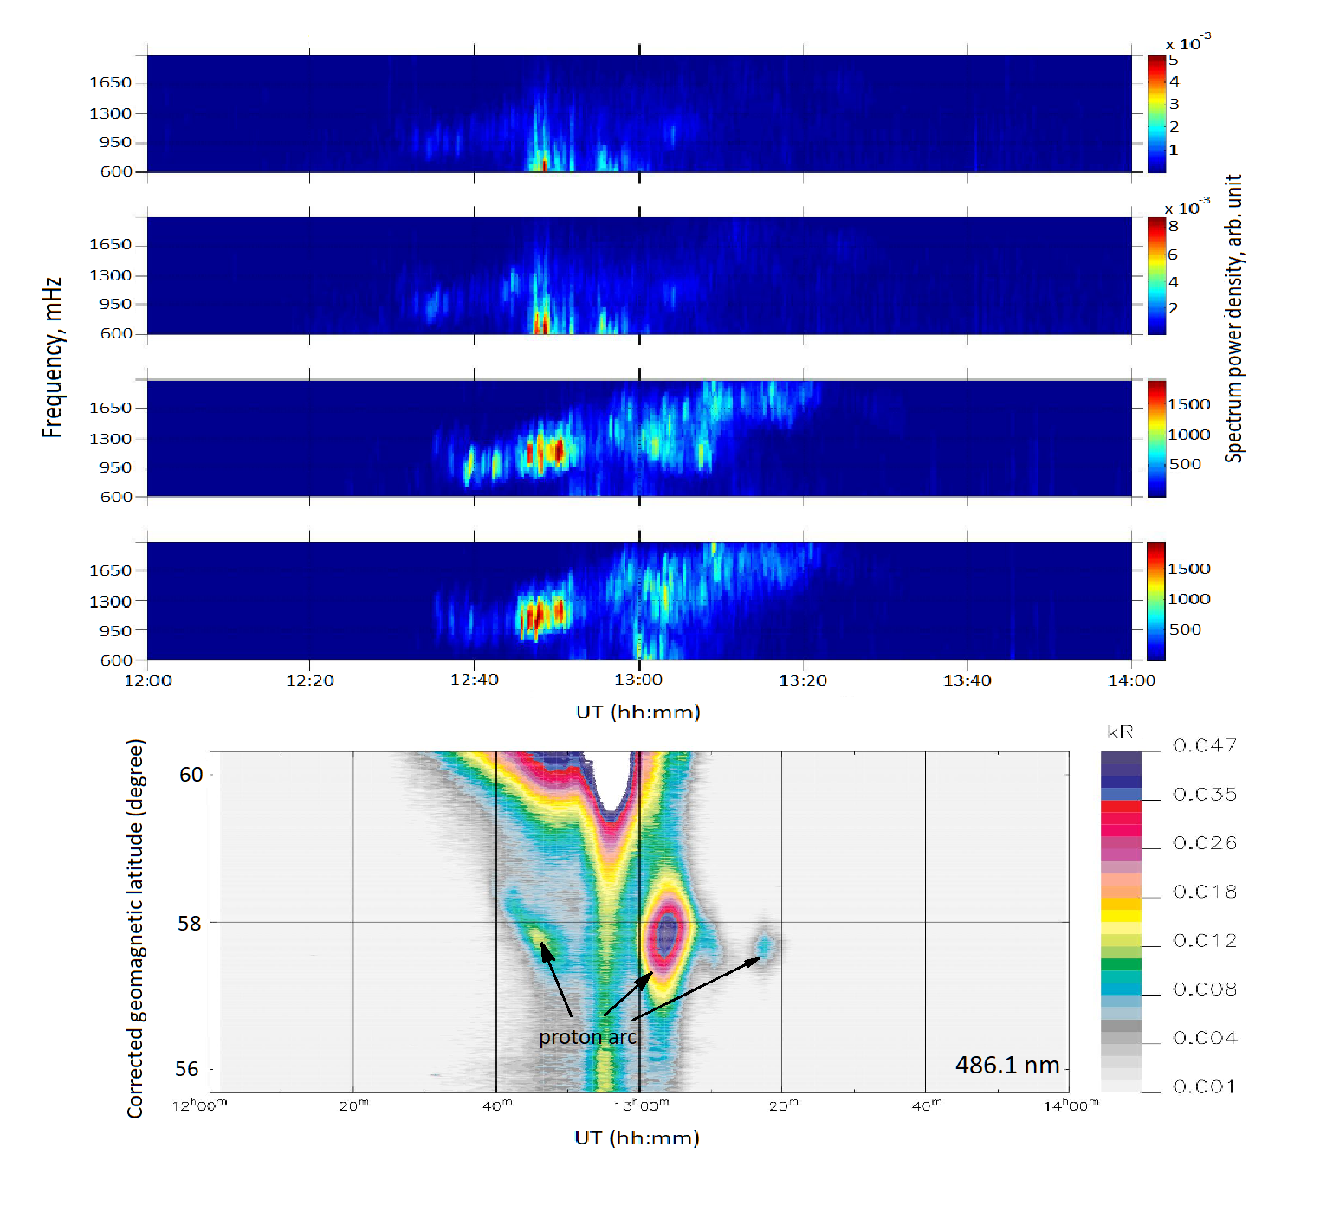
From top to bottom, spectrograms of the H and D components at Zhigansk and Yakutsk stations, and the latitudinal keogram of the luminosity in the 486.1 nm emission at 110 km during observations on March 1, 2017 at 12:00-14:00 UT. The signal intensity is given in kilorayleighs. Figure clearly illustrates that the displacement of narrow proton arcs to low latitudes led to a noticeable increase in both the frequency and intensity of Pc1 pulsations at Yakutsk station, which, however, coincided in time with substorm activation, namely, the excitation of irregular geomagnetic pulsations at station Zhigansk.
A sharp increase in the luminosity over the entire sky at ~ 12:55 UT led to the attenuation of the Pc1 pulsations in the frequency range 0.9-1.3 Hz. Further, in the interval 12:58-13:10 UT at Zhigansk and Yakutsk stations, IPDP was recorded with an increase in frequency from 1 to 2 Hz in 12 minutes, possibly due to substorm activation at ~ 12:45 UT on the Magadan meridian. The IPDP intensity at Yakutsk station is more noticeable than at Zhigansk station, and it is associated with the proton arc recorded at the zenith of Maimaga station in the interval 12:58-13:10 UT, although there was no obvious radial drift in the arc dynamics.
In the interval 13:10-13:22 UT, only at Yakustk station, Pc1 pulsations were recorded in the frequency range 1.6-2 Hz, closely related to the observation of the proton arc at Maimaga station.

Slide 6
Conclusion
Data of synchronous geomagnetic pulsations at Zhigansk (L=4.5) and Yakutsk (L=3.3) and isolated proton arc registrations at Maimaga (L=4) showed one-to-one correspondence between magnetic and optical phenomena. Geomagnetic pulsations at Yakutsk in the interval of 12:35-12:55 UT coincided with isolated proton arc registrations at Maimaga and association of frequency growth of pulsations with equatorward motion of proton arc is clearly seen.
Irregular pulsations of the diminishing periods (IPDPs) in the range of 1-2 Hz in the interval of 12:58-13:10 UT were recorded simultaneously at Zhigansk and Yakutsk accompanying with intense isolated proton arc registrations at Maimaga. As shown by [Baishev et al., 2000] these magnetic and optical phenomena were associated with the injection of energetic protons after second substorm activation with onset at 12:45 UT.
New finding is optical observation of STEVE at Maimaga starting from13:23 UT after the decay of Pc1-associated proton arc registered in the interval 13:10-13:22 UT. Ground-based synchronous optical and geomagnetic observations showed complex physical phenomena in the course of a substorm.
Two-dimensional images of the isolated proton arc showed that its narrow (1 degree) latitudinal widths and limited longitudinal lengths are in agreement with measurements of isolated auroral arcs at Athabasca [Sakaguchi et al., 2008].
Thus it is shown that the proton arc and geomagnetic pulsations are a consequence of ion-cyclotron instability in the area of the outer plasmasphere overlapping by energetic protons.
A sharp increase in the luminosity over the entire sky for all emissions at ~12:55 UT and a short-term attenuation of geomagnetic pulsations Pc1, and STEVE occurrence starting from 13:23 UT require further studies using additional ground-based and satellite measurements.
This work was carried out with the financial support of the RFBR grant No. 21-55-50013.

Slide 7
Thank you for your attention

Slide 8
References
K. Cole, (1965). Stable auroral red arcs, sinks for energy of Dst main phase. J. Geophys. Res. V.70. P.1689-1709.
T. A. Yahnina, A. G. Yahnin, J. Kangas, J. Manninen, D. S. Evans, A. G. Demekhov, V. Y. Trakhtengerts, M. F. Thomsen, G. D. Reeves, and B. B. Gvozdevsky (2003), Energetic particle counterparts for geomagnetic pulsations of Pc1 and IPDP types, Ann. Geophys., V.21, P.2281-2292.
K. Shiokawa, Y. Katoh, Y. Hamaguchi et al, (2017), Ground-based instruments of the PWING project to investigate dynamics of the inner magnetosphere at subauroral latitudes as a part of the ERG-ground coordinated observation network, Earth Planets Space 69, 160, doi:10.1186/s40623-017-0745-9.
S.G. Parnikov, I.B. Ievenko, D.G. Baishev, and I.I. Koltovskoy (2020) Proton aurora observation as a result of ion cyclotron instability, Proc. SPIE 11560, 26th International Symposium on Atmospheric and Ocean Optics: Atmospheric Physics, 1156086 (12 November 2020). doi: 10.1117/12.2575266.
E.A. MacDonald, E. Donovan, Y. Nishimura, et al, (2018), New science in plain sight: Citizen scientists lead to the discovery of optical structure in the upper atmosphere. Sci. Adv. 4, eaaq0030. doi: 10.1126/sciadv. aaq0030.
D.G. Baishev, E.S. Barkova, S.I. Solovyev, K. Yumoto, and A.G. Yahnin (2000) Frequency growth of IPDP pulsations during a substorm as a manifestation of equatorward expansion of particle precipitation and current region, International Journal of Geomagnetism and Aeronomy. V.2. No.2. P.115-127.
K. Sakaguchi, K. Shiokawa, Y. Miyoshi, Y. Otsuka, T. Ogawa, K. Asamura, and M. Connors (2008), Simultaneous appearance of isolated auroral arcs and Pc 1 geomagnetic pulsations at subauroral latitudes, J. Geophys. Res., V.113, A05201, doi:10.1029/2007JA012888.

Slide 9
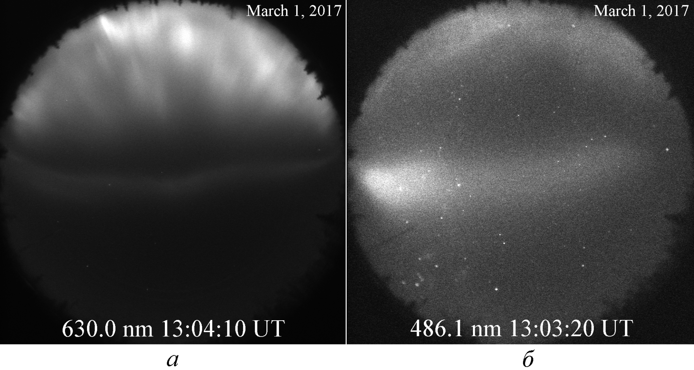
All sky images at Zhigansk 630,0 nm (а) и 486,1 nm (б)

Slide 10
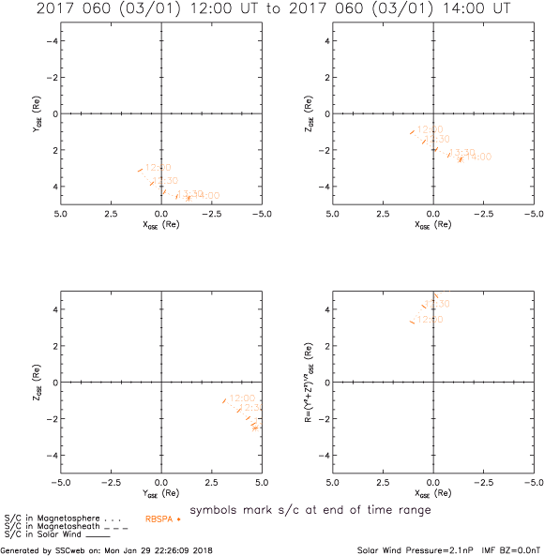
Van Allen A probe orbit at 12-14UT on March 1, 2017г.

Slide 11
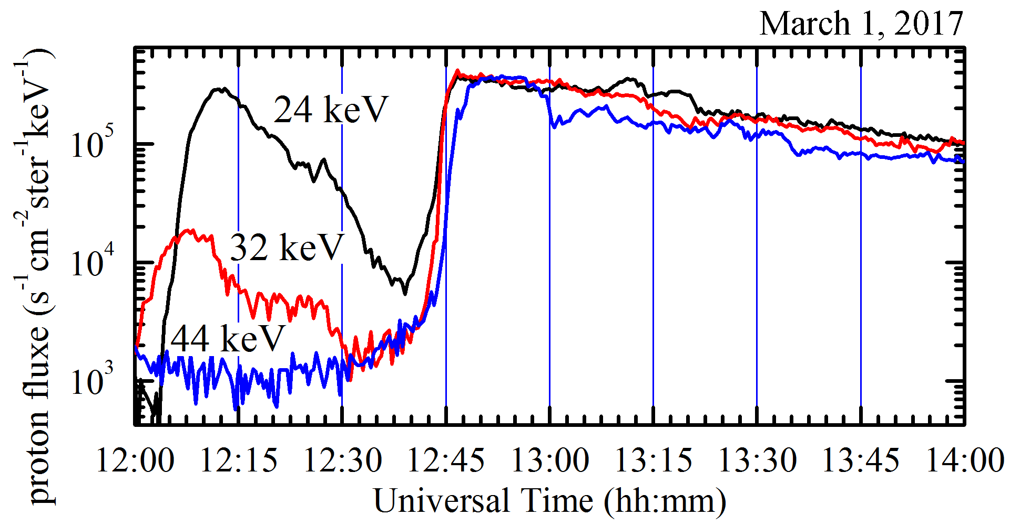
Fluxes of energetic protons at different energies measured on board of the Van Allen Probe A

