Slide 1

Influence of the oxygen ions on the current sheet formation in the Earth's magnetotail
XII INTERNATIONAL CONFERENCE “SOLAR-TERRESTRIAL RELATIONS AND PHYSICS OF EARTHQUAKES PRECURSORS”,
28 September 2021, Paratunka, Kamchatsky kray, Russia
Pavel Setsko, Oleg Mingalev
Polar Geophysical Institute, Apatity, Russia

Slide 2
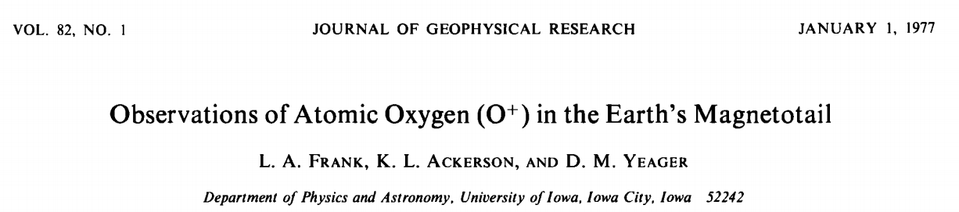
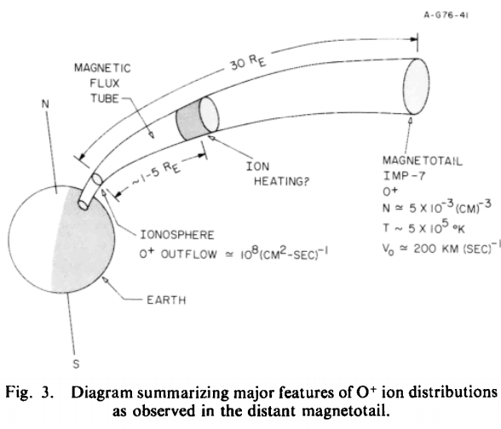
The mechanism of oxygen outflowing is ambipolar electric field. This equation is following from electron force balance:
(b•E ) = -(b•∇ p_{e})/(en_{e})

Slide 3
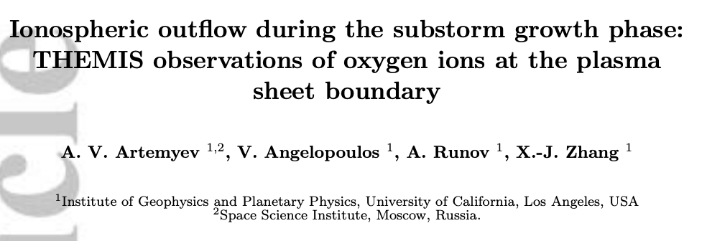
Oxygens ions observed at 20R_{e}<-x<40R_{e}
T_{o} = 0.1-0.4 keV (T_{p} = 4-10 keV)
V_{TO} ~ 25-75 km/s
V_{DO} = 200-250km/s
Can the oxygen ions fluxes with given parameters significantly affect on TCS structure or form TCS?

Slide 4
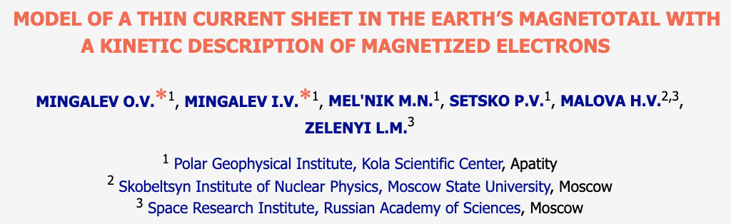
Thin current sheet stationary model key features
1D3V symmetric -> dependence only on z
Vlasov equations for ions
Electrons are magnetized and their contribution is analytical
Method of Characteristics
CUDA Fortran

Slide 5







Three modeling configuration
symmetry condition
nT, nT,
km, km
Only protons with Tp = 4 keV
Only oxygen with To = 0.4 keV
Mixture of oxygen and protons with equal concentration

Slide 6
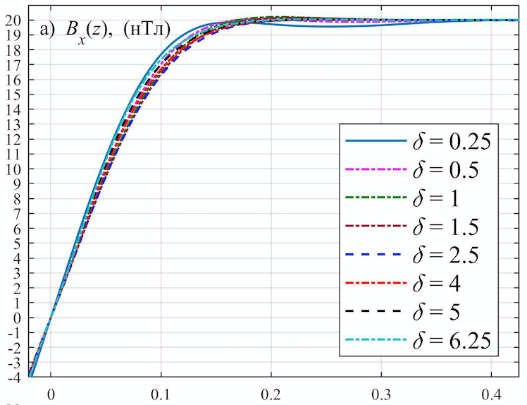
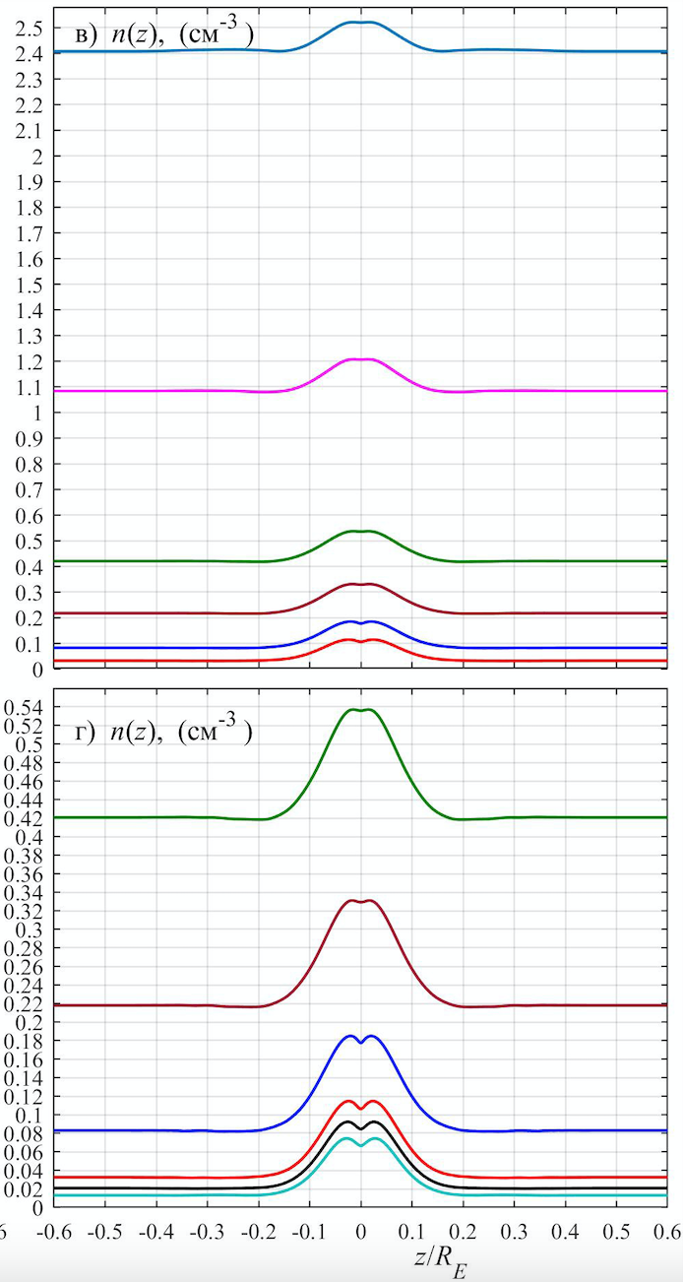
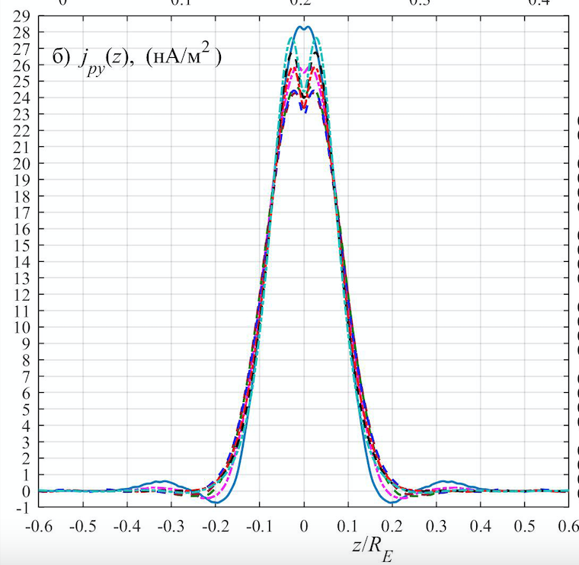
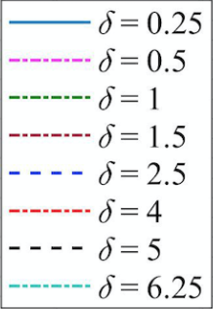
Protons only, T_{p} = 4keV

Slide 7
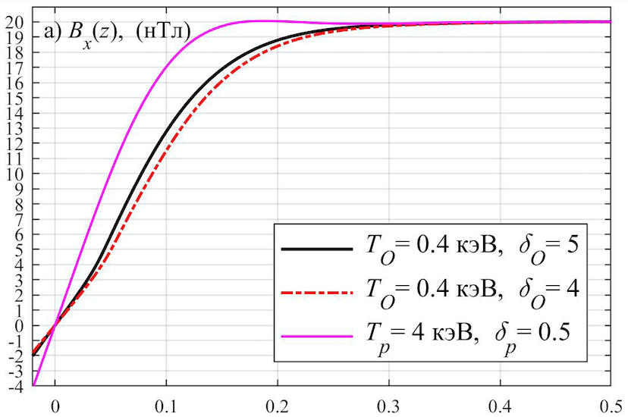
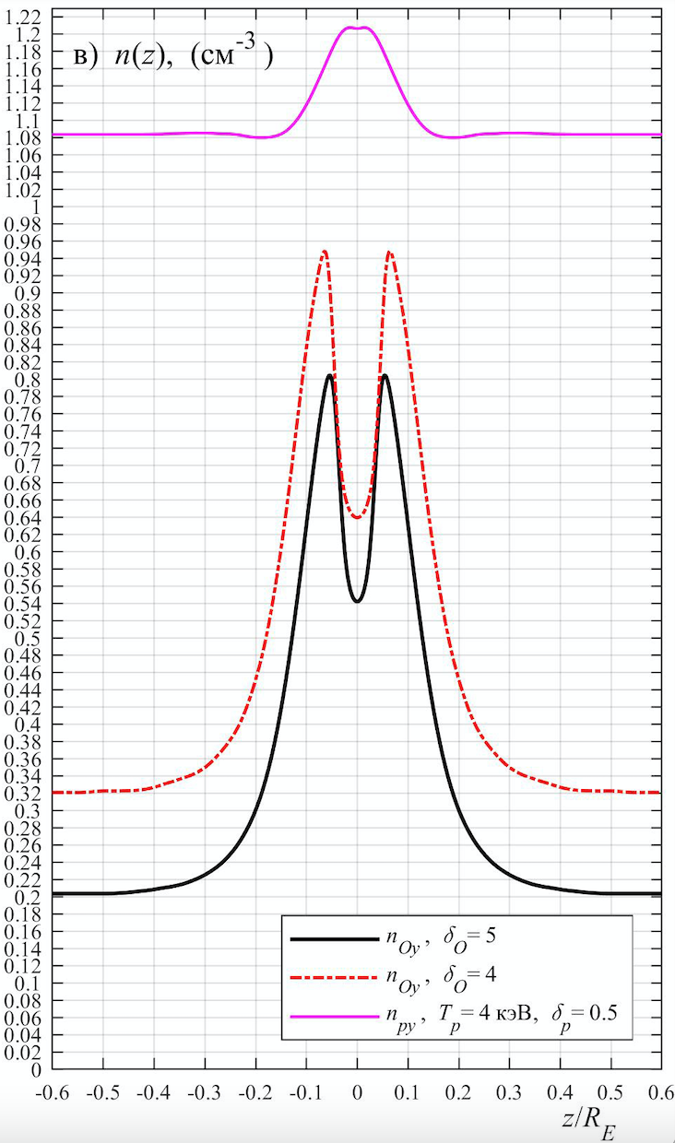
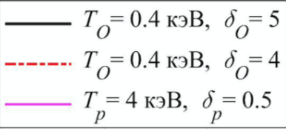
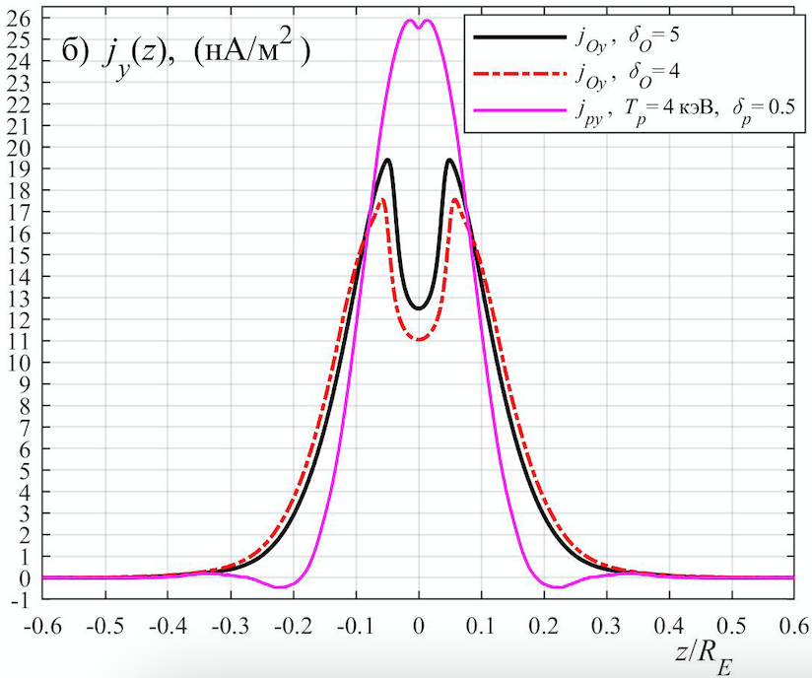
Oxygen only,
T_{o} = 0.4 keV

Slide 8
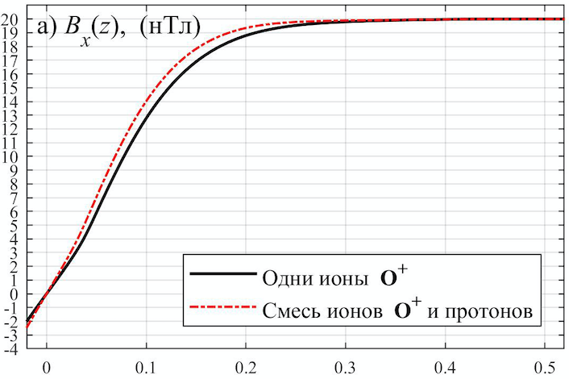
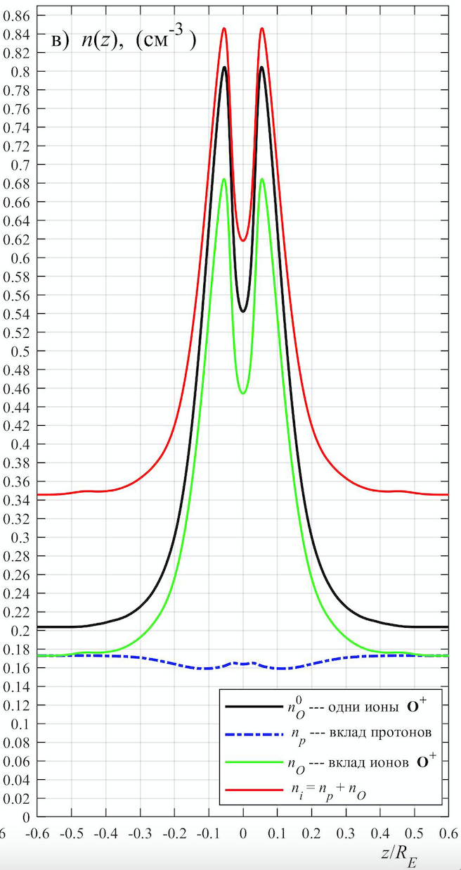
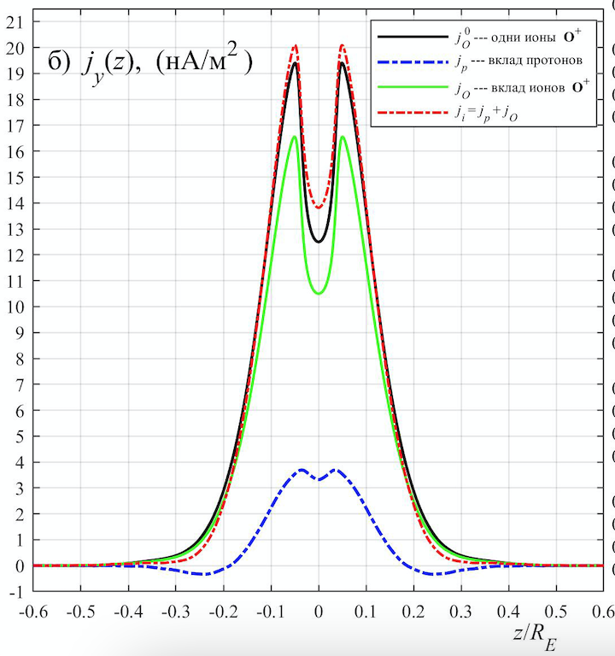
Mixture
T_{p} = 4 keV
T_{o} = 0.4 keV

Slide 9
Conclusion
There is a possibility the current sheet in the near tail of the Earth's magnetosphere under disturbed conditions can be formed only by fluxes of oxygen ions of ionospheric origin, when protons fluxes are either a background or relatively weak
In the case of a mixture, the oxygen ions make the main contribution to the current through the sheet
Low concentration is sufficient to maintain the current sheet when a flux velocity is sufficiently high
more detail in [Mingalev et. al., 2021, Plasma Physics Report]

Slide 10
Thank you for attention
feel free to ask question
and contact me:
Setsko Pavel, PGI, Russia
setsko@pgia.ru

