Slide 1

Is the global MHD modeling of the magnetosphere adequate for the prediction of geomagnetically induced currents?
Olga Kozyreva, Vyacheslav Pilipenko, Yaroslav Sakharov
Institute of Physics of the Earth, Moscow; Polar Geophysical Institute, Apatity

Slide 2
Prediction of space weather hazard to power lines with MHD modeling
The most significant risk of space weather for terrestrial power transmission lines is geomagnetically induced currents (GICs) related to abrupt changes of the geomagnetic field, that is large dB/dt.
The prediction of possible GIC is a challenging problem for the space physics community. Permanent observations of the interplanetary space between the Earth and Sun open a principal possibility to construct a forecast of dB/dt value with a horizon of ~60 min.
Can a global MHD modeling of the space weather solve the problem of GIC prediction?
Space Weather Modeling Framework (SWMF) is a computer system for simulating plasma processes in the near-Earth space.

Slide 3
Available observational facilities
Here we consider the contribution of geomagnetic disturbances to the bursts of GIC in the electric power line of Kola Peninsula and compare observations with results of the global MHD modeling.
Whether can the current MHD models reproduce adequately the magnetic field variability dB/dt, which is the driver of recorded GIC?
The system to monitor the impact of GICs on electric power lines has been deployed at Kola Peninsula by the Polar Geophysical Institute (Apatity) at 330 kV power line “Northern Transit”. Each station records 1-min quasi-DC current in dead-grounded neutral of transformer. The terminal station is Vykhodnoi (VKH) at Φ~65º
Geomagnetic field variations are measured by 10-sec magnetometers from the IMAGE array.

Slide 4
Analysis of magnetic and GIC data during storm on May 27, 2017
This storm started from arrival of interplanetary shock: the jump of the solar wind plasma density is ~30 cm⁻³, and then Np gradually increases till~50 cm⁻³.
The solar wind velocity V increases from ~300 km/s till ~360 km/s.
Growth of the magnetic storm is caused by re-orientation of IMF Bz up to -20 nT.
At maximum of the growth phase is |SYM-H|~140 nT.
The auroral SML index irregularly decreases till ~1700 nT.

Slide 5
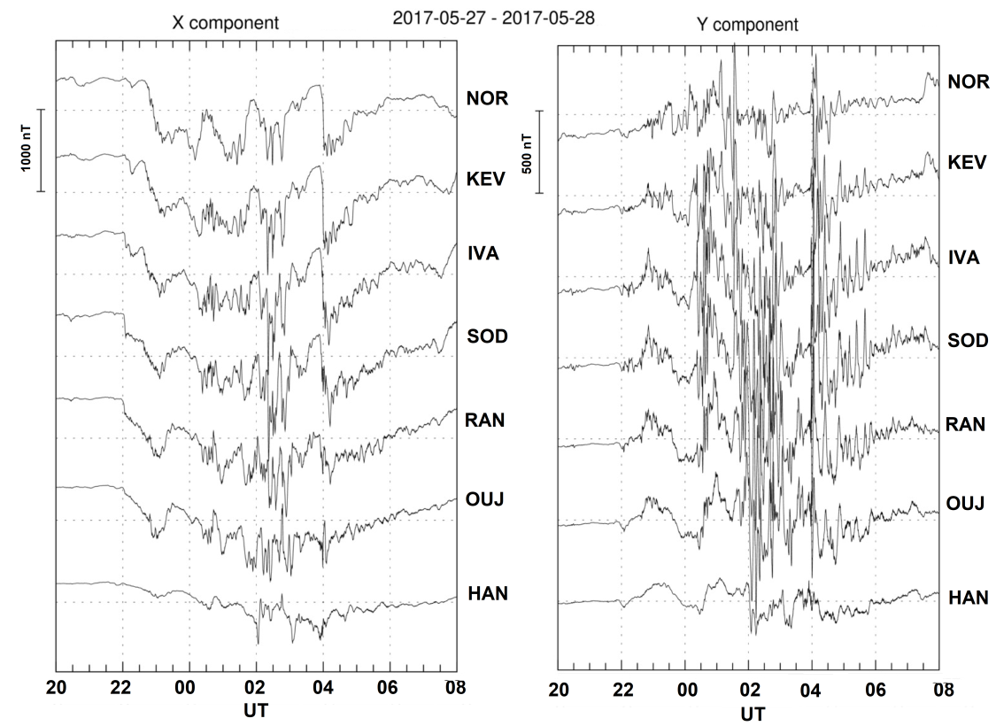
Pi3 pulsations during storm maim phase
Magnetic disturbance gradually increased and then decayed. During the maximal disturbance the magnetic field variations became more chaotic, and intense Pi3 pulsations were superposed on the magnetic bay.
Pi3 pulsations are not quasi-sinusoidal waves like typical Pc5 pulsations; but they are rather quasi-periodic sequence of magnetic impulses with time scale 1-20 min.

Slide 6
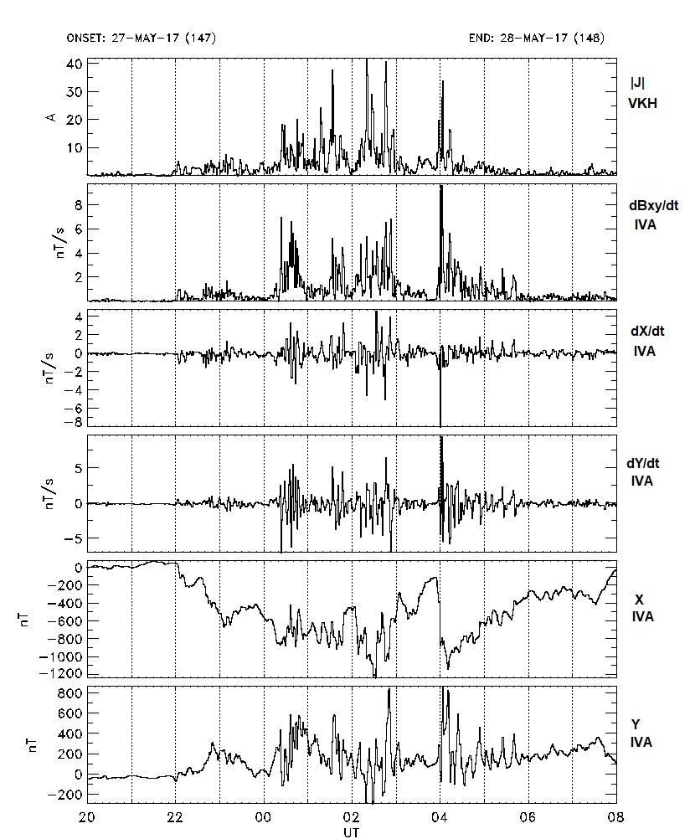
Comparison of magnetic disturbances X and Y with time derivatives |dX/dt|, |dY/dt| at IVA station
Though the magnetic disturbance is much larger in X-component than in Y-component, |X|>>|Y|, the time derivative dY/dt and dX/dt are nearly the same. Therefore, variations of both horizontal components provide a similar contribution to the |dB/dt| and are probably caused by localized current structures.
During this storm extremely high values of GIC were recorded (up to ~50 A) at the terminal station VKH.
Bursts of magnetic field variability dB/dt reached ~8-10 nT/s. Each burst was accompanied by burst of GIC!

Slide 7
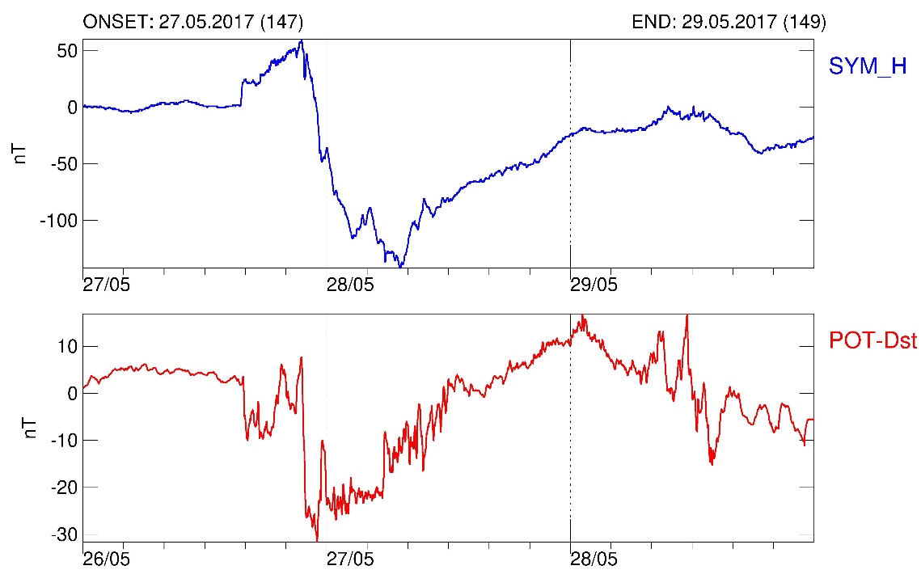
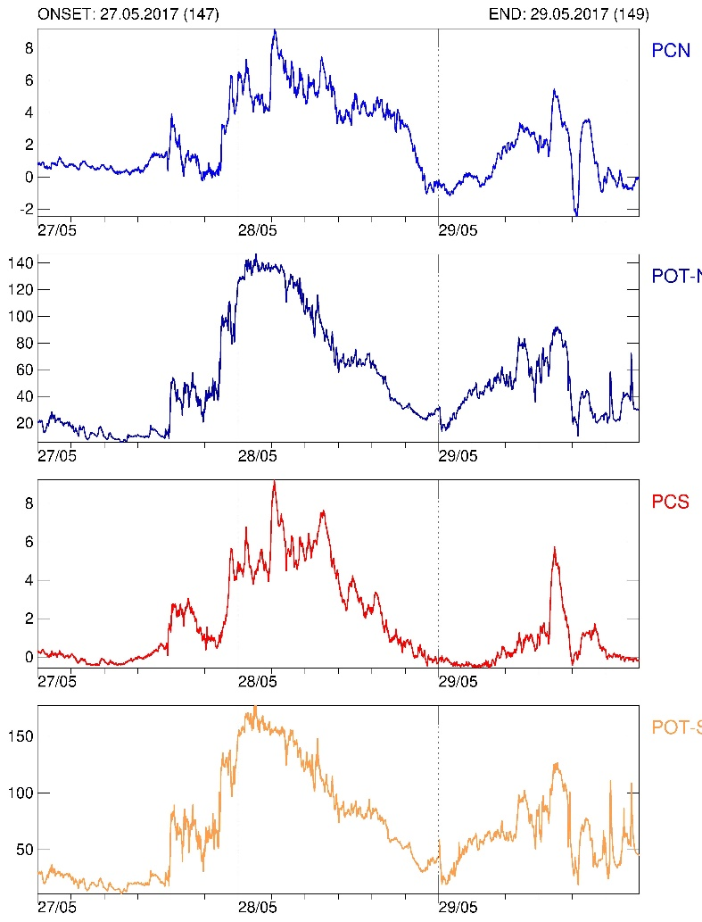
Comparison of global magnetospheric parameters reproduced by the MHD modeling with observations
Basic features of the index SYM-H agree with the MHD modeling predictions.
The SWMF model enables one to reproduce the cross-polar potential. As a measure of the trans-polar current, PC index can be used. The comparison shows a similarity in variations of modeled cross-polar potential and PC index.

Slide 8
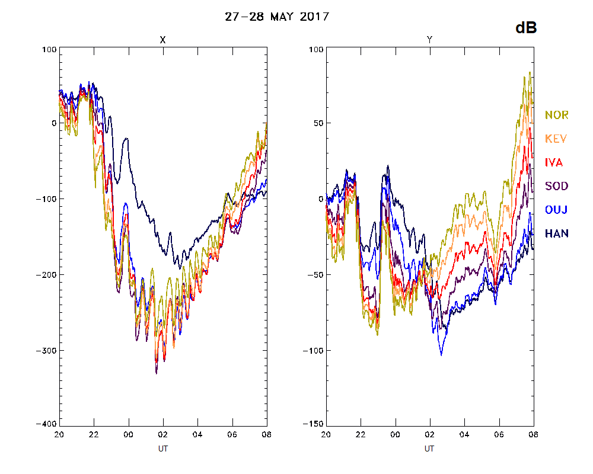
Virtual ground magnetograms for Scandinavian stations
SWMF simulations of virtual magnetograms along the latitudinal profile NOR-HAN from the IMAGE array.

Slide 9
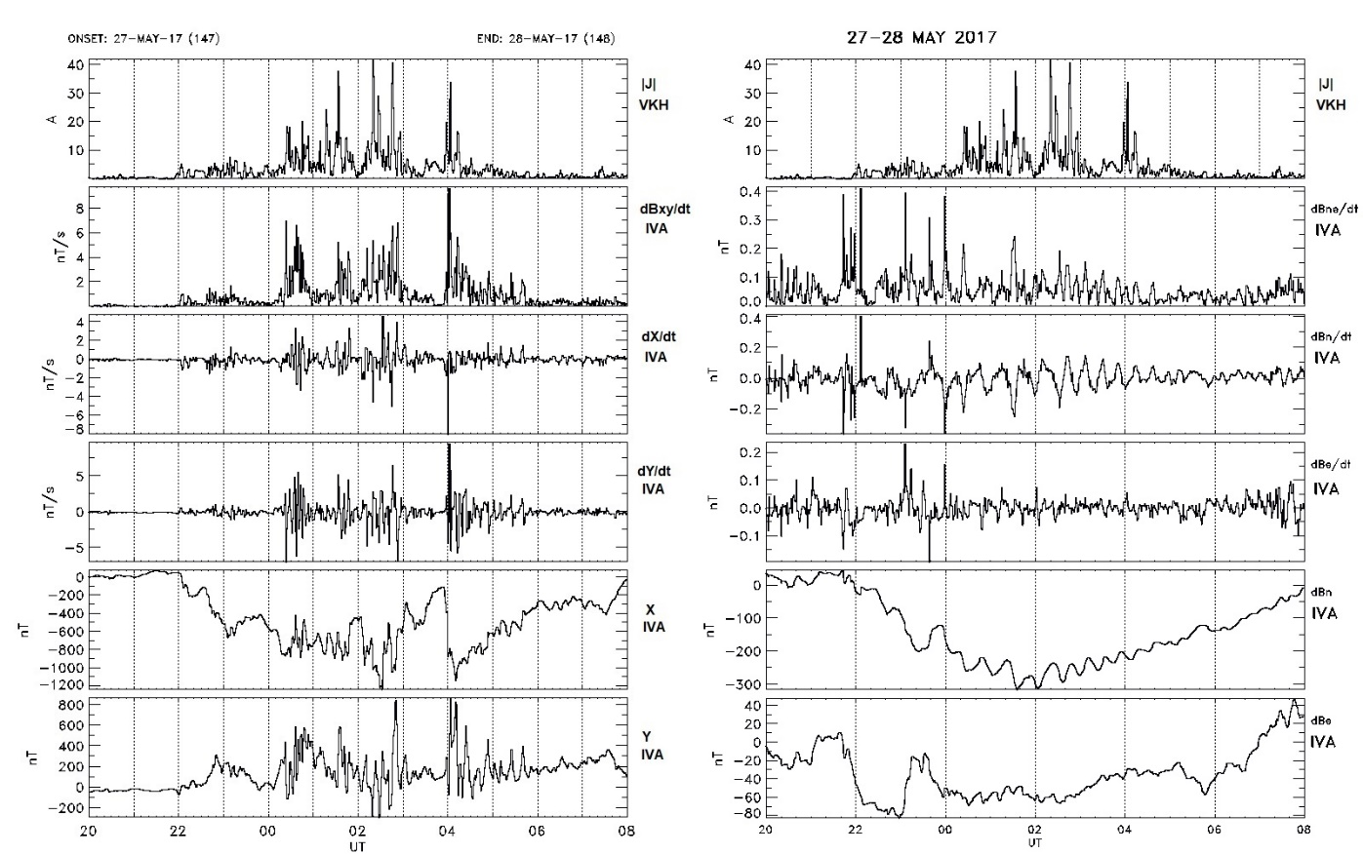
Comparison of the magnetic field variability from actual data and modeled data for key station IVA
Variability predicted by MHD model reaches up to ~20 nT/min, i.e. ~30 times less than actual observations!

Slide 10
Validation of the MHD model feasibility to predict GIC in power transmission line
We considered the contribution of geomagnetic disturbances to the growth of GIC during the 27 May 2017 strong geomagnetic storm. We have examined a feasibility of the SWMF code to predict the occurrence of irregular Pi3 pulsations, which are drivers of GIC.
Why Pi3 pulsations are of key importance for GIC problem? Amplitudes of geomagnetic variations decay with frequency, whereas the induced electric field E is expected to grow with frequency. Therefore, the GIC response, which is a convolution of both factors, must have maximum at some frequencies! This characteristic time scale, ~2-10 min, falls into the ULF band!
Global magnetospheric response to IMF/solar wind variations is reasonably well reproduced by global MHD modeling.
In smaller regional scales, weaker but rapidly varying, localized current systems are superposed on the electrojet, and are responsible for intense GIC. However, MHD modeling fails to reproduce the small-scale features of storm/substorm – Pi3 pulsations.
Variability of geomagnetic field predicted by MHD modeling turns out to be more than order of magnitude less than observed one. Thus, SWMF model is inadequate for the GIC prediction!

