Slide 1
Relaxation and nonlinear oscillations of a magnetic dynamo: beats in solar activity
B.M. Shevtsov
IKIR FEB RAS

Slide 2
History of the issue
The theory of relaxation generators was created in the twenties of the last century (B. van der Pol, 1926).
The theory of quantum generators was created in the sixties.
In the same years, work was underway on the creation of the theory of the magnetic dynamo, which largely borrowed the successes of electronics, but was limited to this, since the correct representation of a dynamo was never obtained.

Slide 3
Magnetic dynamo and solar activity
E. C. Bullard (1955), T. Rikitake (1958)
E.N. Parker (1955)
Babcock-Leighton mechanism (1961/1969)
Max Steenbeck, et al. (1966)
Kliorin N.I., Ruzmaikin A.A. // Magn. hydrodyn.1982 Т.18 с.116.
Van der Pol equation for solar activity
Zeldovich Ya. B., Ruzmaikin A.A. // Astrophys. and Space Phys. Rev. 1983. V.2. P. 333.
Lorenz equations for solar activity

Slide 4
Dynamo problem now
Until now, there is no predictive model of the magnetic dynamo.
The wide variety of existing dynamo models indicates the incompleteness of these studies.
The search for methods to adequately represent the dynamo continues.
At our last conference, a new dynamo paradigm was proposed to your attention.
Now we will consider its rationale for the example of solar activity.

Slide 5
The magnetic dynamo is represented by a Lienard generator with cubic nonlinearity of the restoring force, which corresponds to the generalized Higgs potential (Mexican hat or the bottom of a champagne bottle).
Using solar activity as an example, it is shown how the relaxation model of a magnetic dynamo works.
The regime of the solar dynamo is determined as quasi-harmonic.
Explained specific nonlinear fluctuations in solar activity cycle.
Analogies are drawn with various relaxation-type generators.
Various applications and development of the new paradigm of the magnetic dynamo are discussed.

Slide 6
Representation of a magnetic dynamo by a Lienard relaxation generator
∂_{t}B = Y, (1)
∂_{t}Y = rot(∂_{t}v × B + v × Y) + ν_{m}∆Y,
where Y = rot(v × B) + ν_{m}∆B.
∂_{t}v = Dˆ v + f, (2)
Dˆ v = −ρ⁻¹∇P − 2Ωe_{z} × v − (v, ∇v) + ν∆v – the generalized diffusion operator,
f = gβTe_{r} − (ρµµ₀)⁻¹ (B × rot B) – balance of forces of Archimedes and Lorentz.

Slide 7
v(r, t) = Gˆf(r, t) – generalized Stokes law, (3)
∂_{t}v = (DˆGˆ + 1ˆ)f. (4)
Lienard equation for magnetic field
∂_{t}B = Y, (5)
∂_{t}Y = rot[Gˆf × Y + (DˆGˆ + 1ˆ)f × B] + ν_{m}∆Y,
f = gβTe_{r} − (ρµµ₀)⁻¹ (B × rotB).
Heat transfer equation
∂_{t}T + (Gˆf, ∇)(T + T₀) = k∆(T + T₀) (6)

Slide 8
Magnetic fields
The condition f = 0 allows us to determine the configuration of the magnetic field, the Lorentz force of which is in balance with the Archimedes force.
The condition f = 0 gives B± = ± (ρµµ₀gβT L/2π)^{1/2}, where L is the wave motion scale.
For β = 1/T₀ (as for ideal gas), we obtain the upper estimate for the Archimedes force gβT = g and the magnetic field B± = ± (µµ₀ρgL/2π)^{1/2}, where ρgL is moment of gravitational forces.
For the Sun parameters, we obtain B± = ±10Gs.

Slide 9
Oscillations
There are three types of oscillations with the periods: T_{A}, T_{DG} and T_{g}.
T_{A}= D_{S} /v = 11 years, v = D_{S} /T_{A} = 4m/s
Taking into account the local, linear and isotropic approximation for (3) v = Gˆf → v = G₀f and the upper estimate f = f _{|B=0} = gβT = g (βT = 1 see above), we find the mobility G₀ = v/g = 10⁻² s.
T_{DG} =T_{g} /(2ΩG₀ )^{1/2} = 2/3 year, T_{A} /T_{DG}= 16
T_{g} = (2πD_{S}/g)^{1/2} = 2 hours,
Ω = 2π/T_{R} , T_{R} is the sun rotation period, about one month.

Slide 10
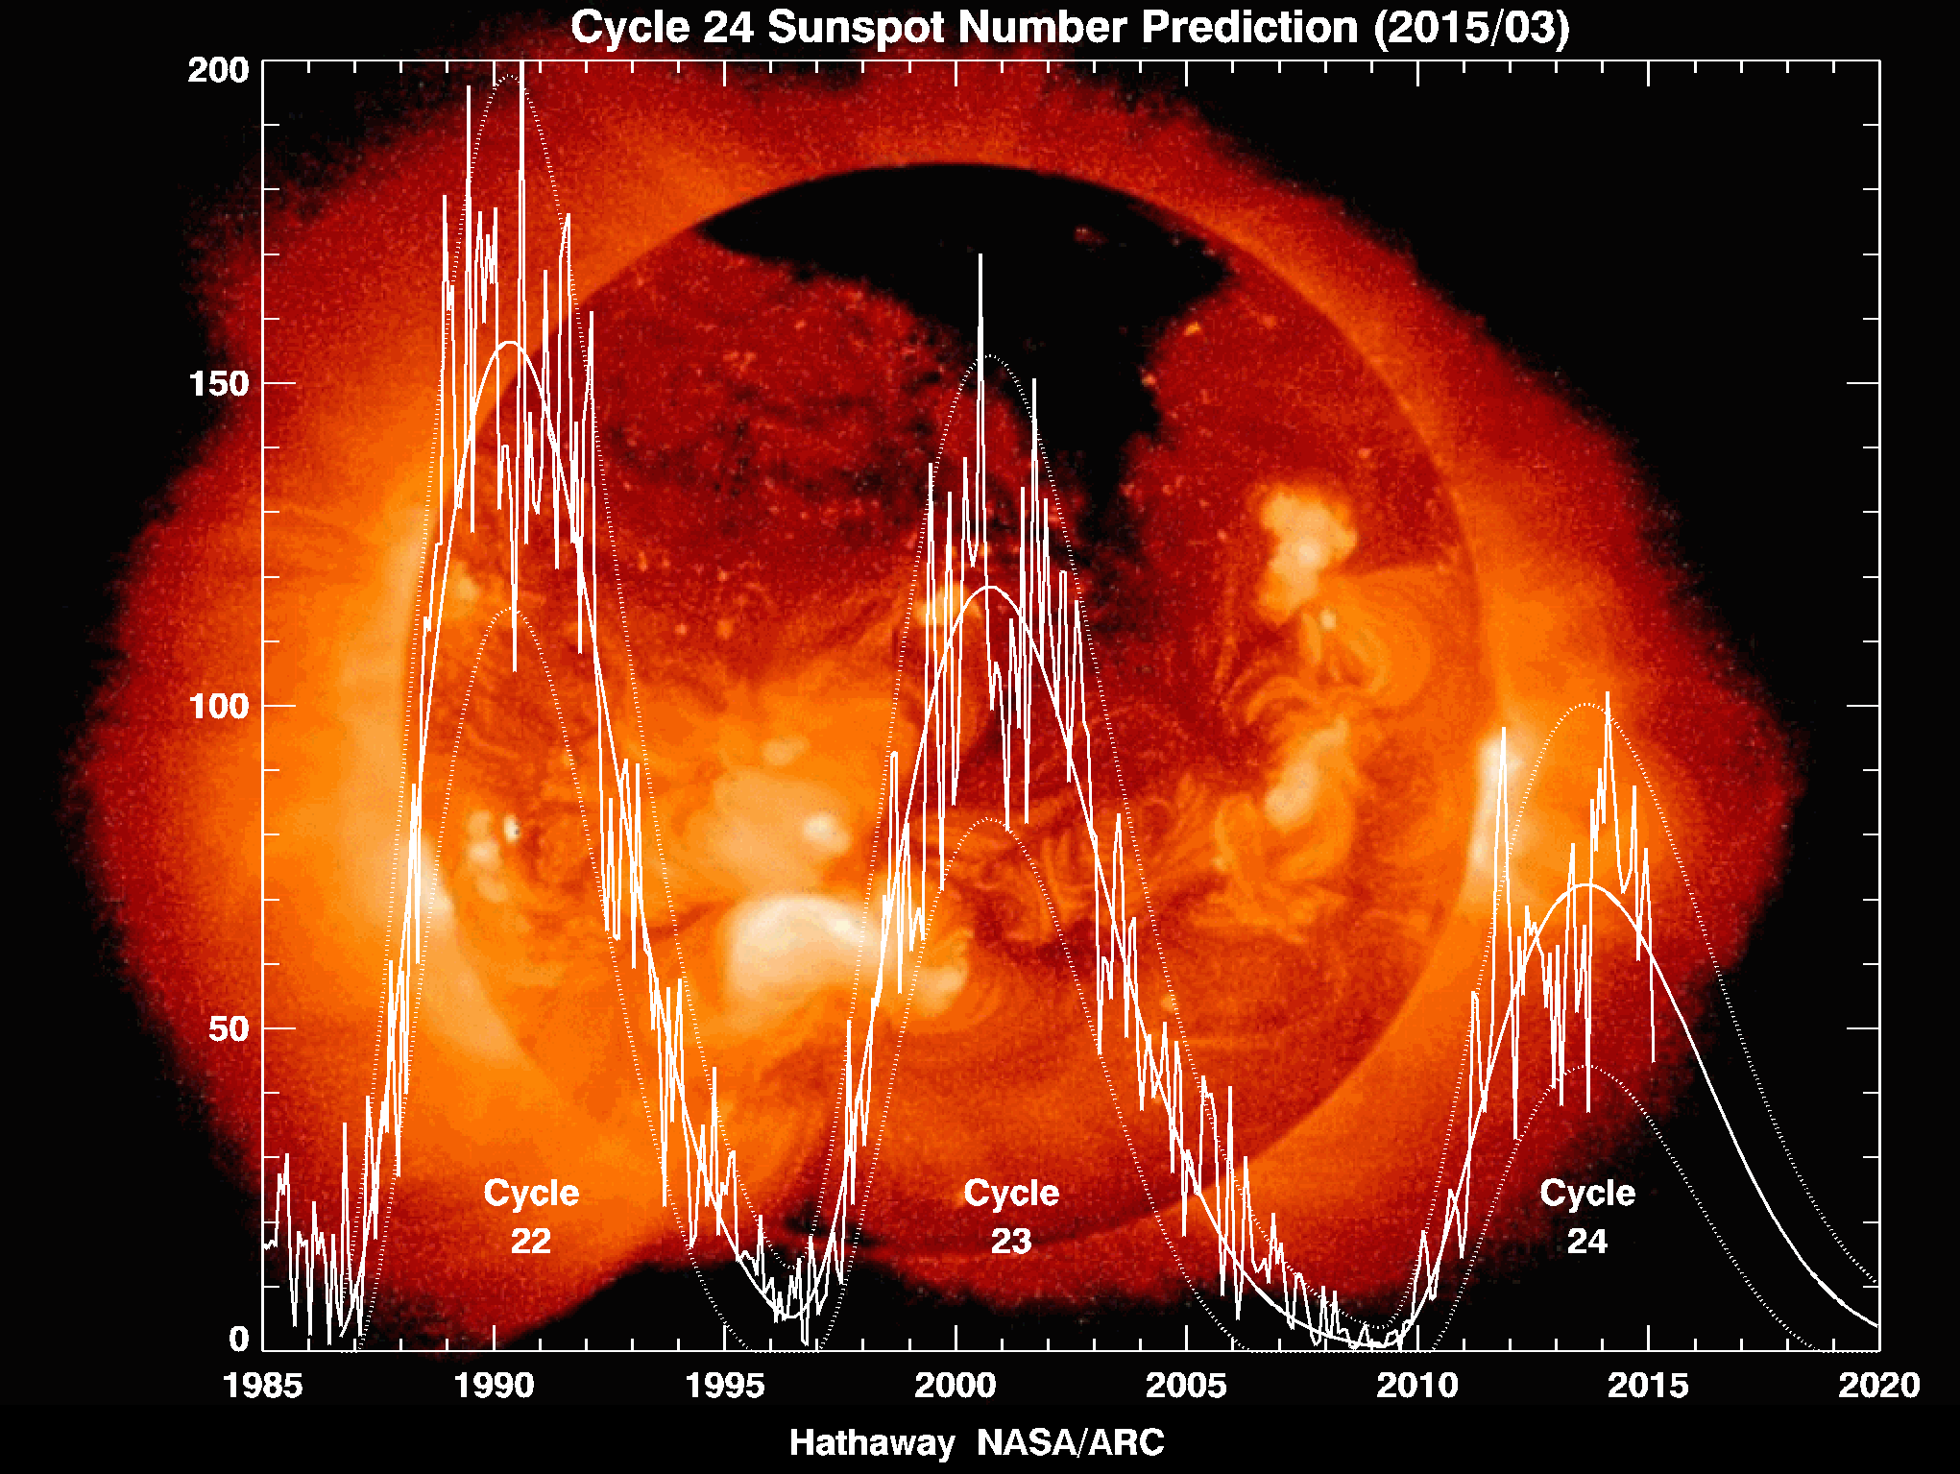
Oscillations in the solar cycle with a period of about 2/3 years in the Wolf numbers

Slide 11
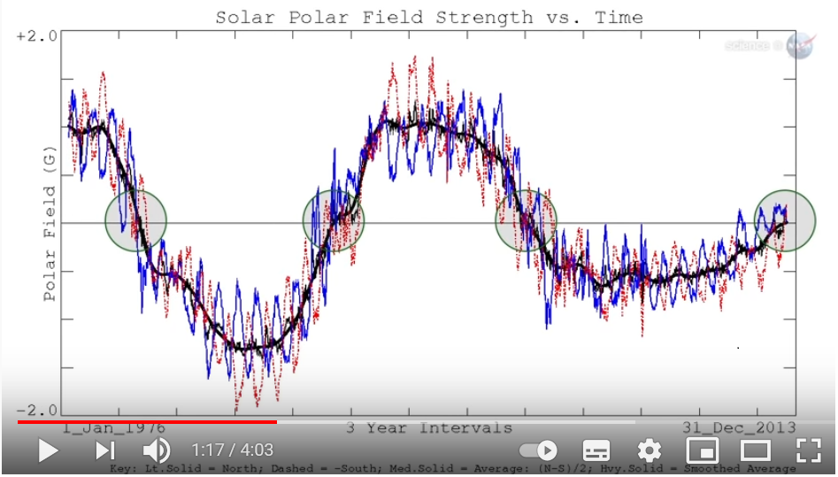
Oscillations in the solar cycle with a period of about 2/3 years in the magnetic field

Slide 12
Nonlinearity parameter
µ = T_{DG}/T_{A} = (πG₀g/ΩL )^{1/2} = (πv/ΩL )^{1/2}
We have to note that µ = (Ro/2)^{1/2}, were Ro is Rossby number.
For the dipole scale L = D_{S} , µ = 0.06,
quasi-harmonic oscillations.
For the sunspots scale 10⁻²D_{S} , µ = 0.6.
For the critical scale 10⁻³D_{S} , µ = 2.
L < 10⁻³D_{S} , turbulent friction prevails over Coriolis one, µ > 1, oscillations are nonlinear.

Slide 13
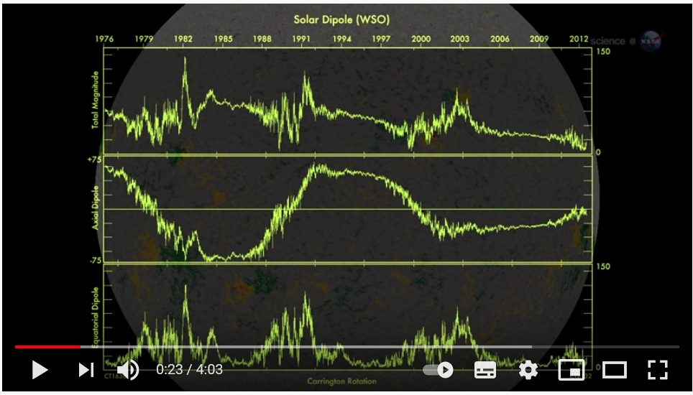
Three regimes of convection and oscillations
µ² = πυ/ΩD_{S} > 1, nonlinear mode
µ²= πυ/ΩD_{S} < 1, quasi-harmonic mode
µ² = πυ/ΩD_{S} << 1, provided that the generation threshold is exceeded, this is a planetary dynamo with rare reverses
The dipole components of the magnetic field during reverses.

Slide 14

Аналогии: скрипка
Струна, смычек, канифоль и усилие.
Магнитное поле, движение среды, турбулентность и сила Архимеда (гравитация).

Slide 15
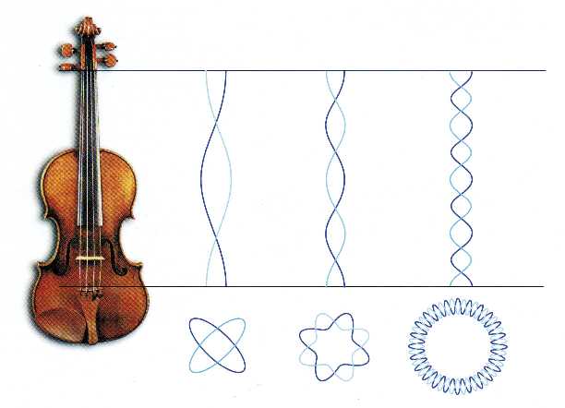
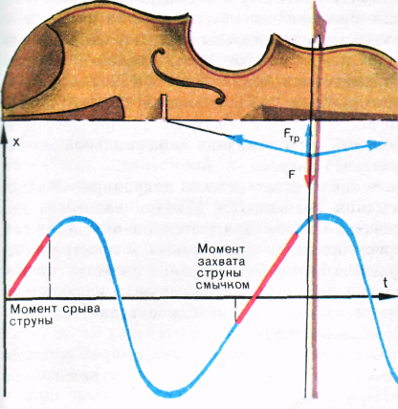
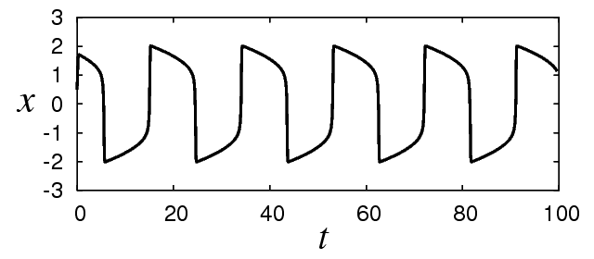
B. van der Pol equation, 1927
three modes of oscillations

Slide 16
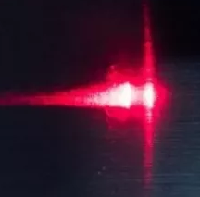
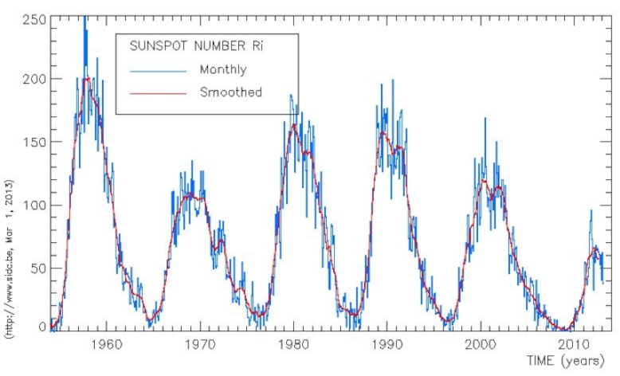
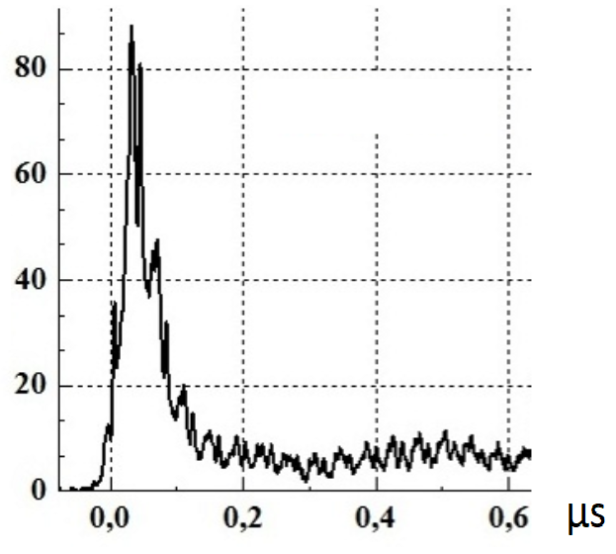
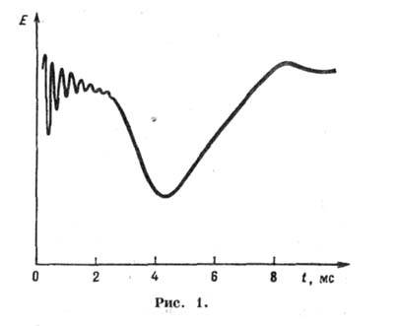
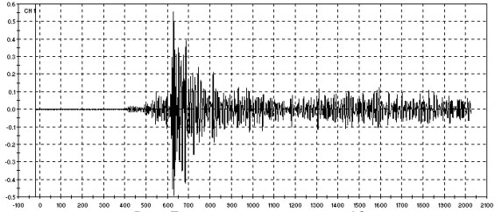
Berlage pulse Examples of relaxation oscillations
solar activity
laser pulse
atmospheric
acoustic emission

Slide 17
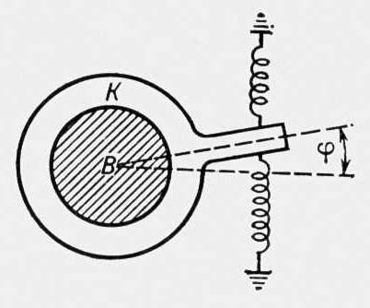
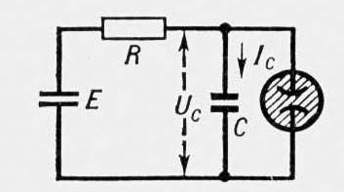
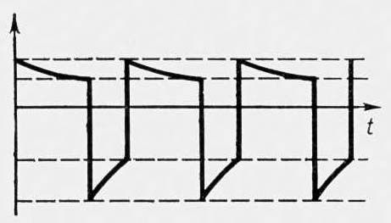
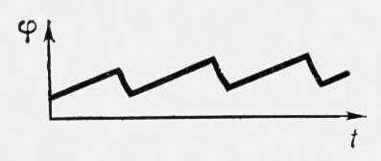
Examples of oscillation systems (three modes of oscillations)

Slide 18
Conclusion
A representation of the magnetic dynamo in the form of a generalized Lienard generator is obtained.
On the example of solar activity, the features of nonlinear oscillations of the dynamo are investigated.
The analogies of the magnetic dynamo with other relaxation-type generators are considered.
The possibility of using the new dynamo paradigm in the field theory is shown.

Slide 19
New problems
Lightning and seismic generators.
The theory of earthquake precursors from the point of view of dynamo theory.
Dynamo paradigm in field theory.

