Slide 1
The impact of developed Alfven turbulence of the solar wind magnetic field on processes in the Earth’s inner magnetosphere
Khalipov V.L.
IKI RAN, Moskow, Russia, khalipov@iki.rssi.ru
Leonovich A.S.
ISTP RAN, Irkutsk, Russia :leon@iszf.irk.ru
Sibeck D.G.
NASA, USA, david.g.sibeck@nasa.gov

Slide 2
During IGY 1957-1959 Daniel Barbier obtained a large data set from observations of red-arcs with intensities of 50-100 kR. Such intensities cannot be associated with the ring current energy dissipation. However we can appeal to another powerful energy source: MHD-turbulence in the solar wind which causes field line resonance (FLR) in the magnetosphere. This mechanism assumes the presence of fast magnetosonic (FMS) waves penetrating from the magnetopause into the magnetosphere. The source of the FMS waves themselves can be, for example, the Kelvin-Helmholtz instability which develops at the magnetopause. Monochromatic FMS waves penetrating into the magnetosphere drive standing Alfven waves at the resonance magnetic shells, where their frequency coincides with the local Alfven wave frequency . If the FMS wave source is broadband, then Alfven waves can be excited in a wide range of magnetic shells including the plasmapause, where the resonant shells concentration is maximum and the kinetic Alven waves with an electric field component directed along the magnetic field are excited. Such waves were observed experimentally. This physical process was considered in detail theoretically by Japanese scientists Hasegawa and Mima as well as by V. Mazur and A. Leonovich from the ISTP in Irkutsk. It was found that the waves were locked at the plasmapause and became standing. The phase velocity of the waves is close to the thermal velocity of background electrons, and as a result of the Cherenkov resonance, the electrons are selectively accelerated to an energy of several eV, creating a red arc of luminescence in the atmosphere.

Slide 3
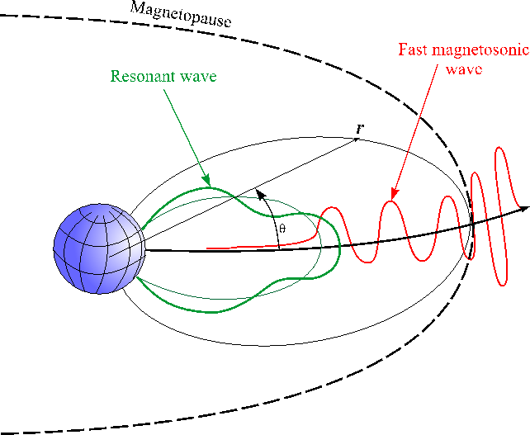
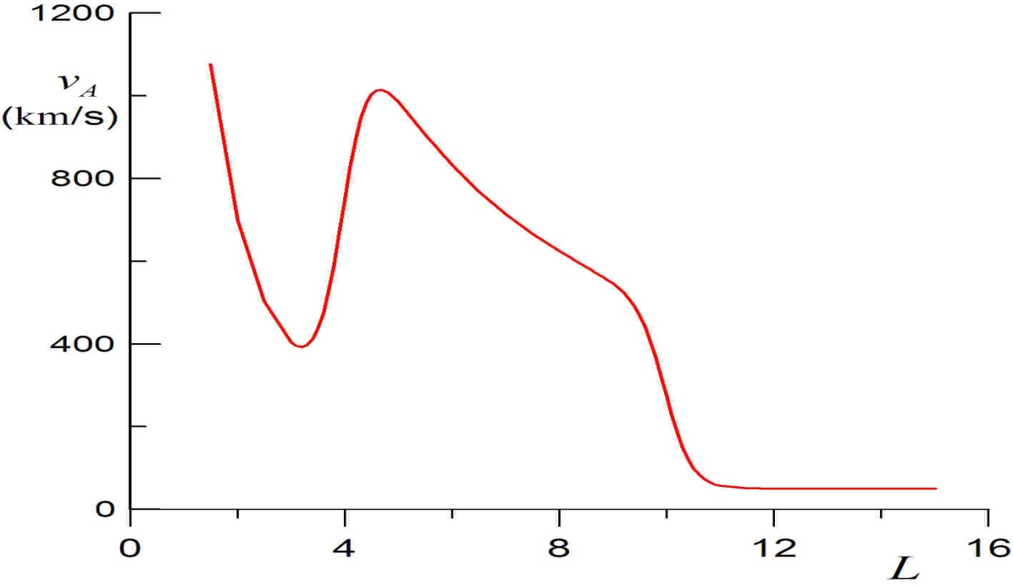
Field line resonance in a dipole-like magnetosphere
Chen, L., and Hasegawa, A., A theory of long period magnetic pulsation. 1. Steady state excitation of field line resonances, J. Geophys. Res., 79, 1024–1032, 1974
Radoski, H. R., A theory of latitude dependent geomagnetic micropulsations: The asymptotic fields, J. Geophys. Res., 79, 595–604, 1974.
Southwood, D. J., Some features of field line resonances in the magnetosphere, Planet. Space Sci., 22, 483–492, 1974.
Tamao, T., Transmission and coupling resonance of hydromagnetic disturbances in the non-uniform Earth’s magnetosphere, Sci.
Rep. Tohoku Univ., 5, 17, 43–54, 1965.
Distribution (in the Equatorial Plane)
Of Alfven speed v_{A}(L), where L=a/R_{E} is
the Mcilwain parameter, a is the equatorial
Radius of a dipole magnetic shell,
R_{E} is the Earth’s radius.

Slide 4
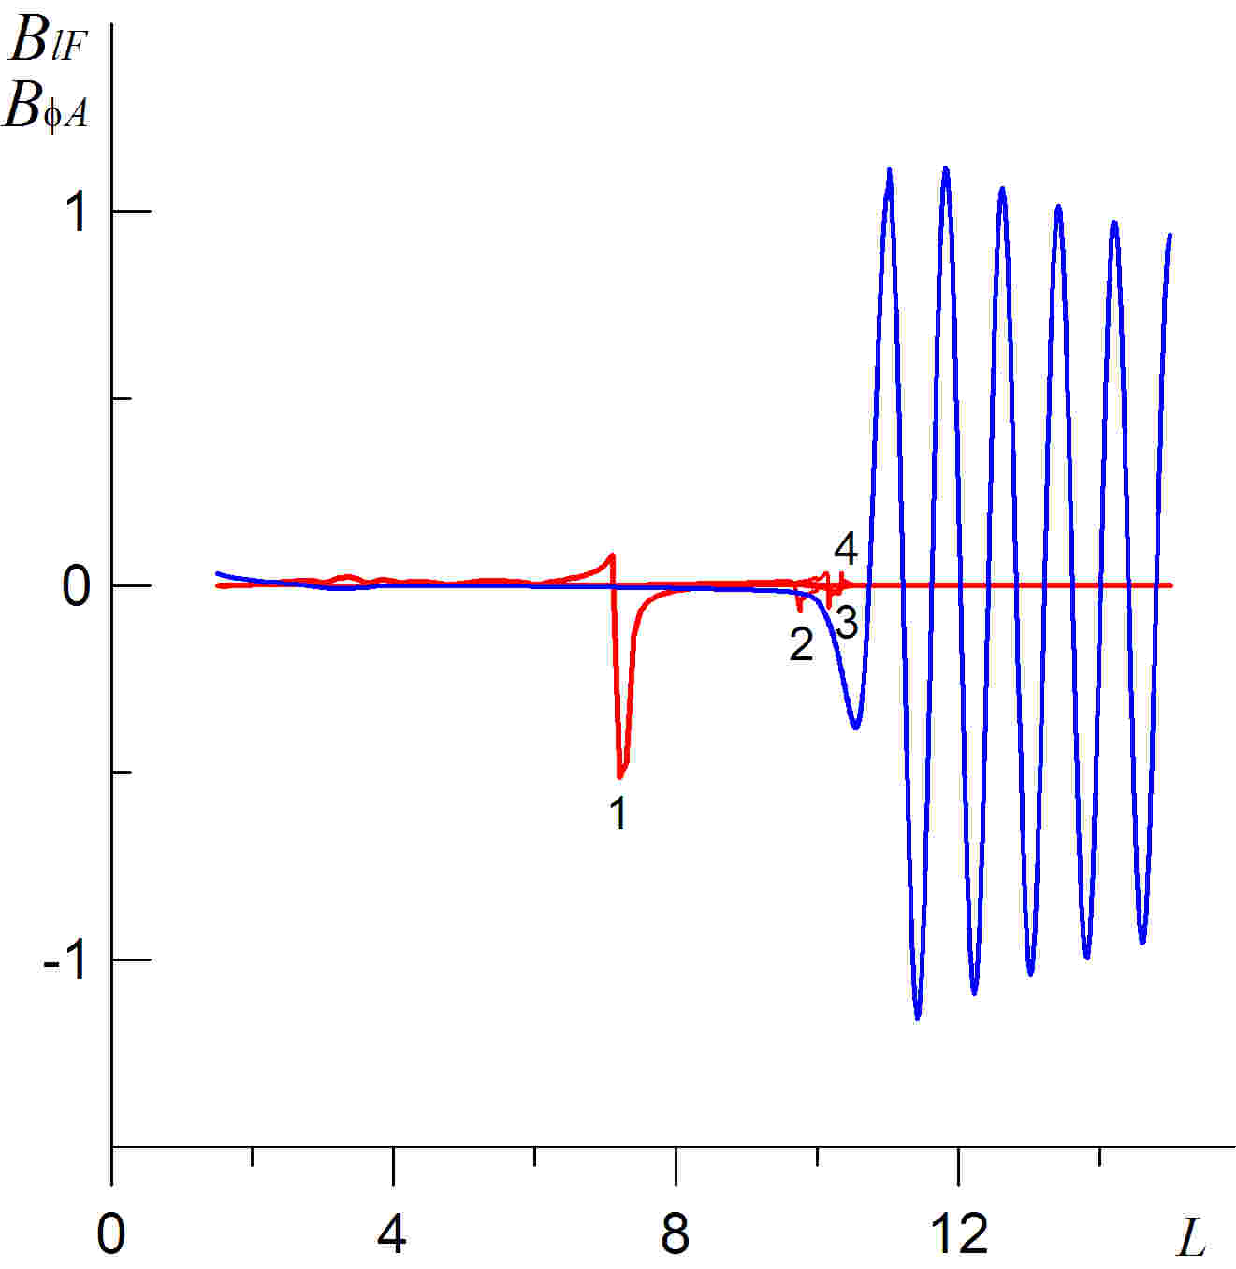
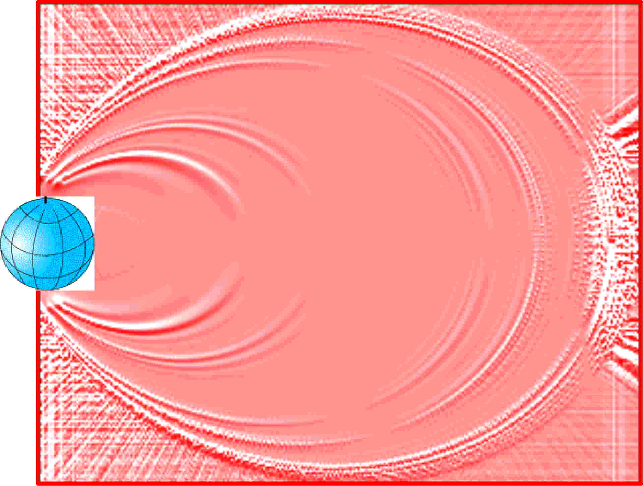
Field line resonances driven by a monochromatic fast magnetosonic (FMS) -wave
Distribution along the equatorial
surfaces of FMS wave field (____)
and resonant standing Alfven
waves harmonics (1,2,3,4) (___) excited by it
Distribution (in the meridional plane)
of the field amplitude of various harmonics of
resonant standing Alfven waves

Slide 5
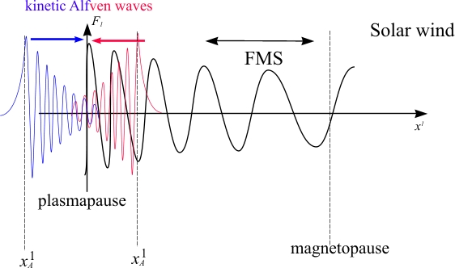
Kinetic Alfvén waves at the plasmapause

Slide 6
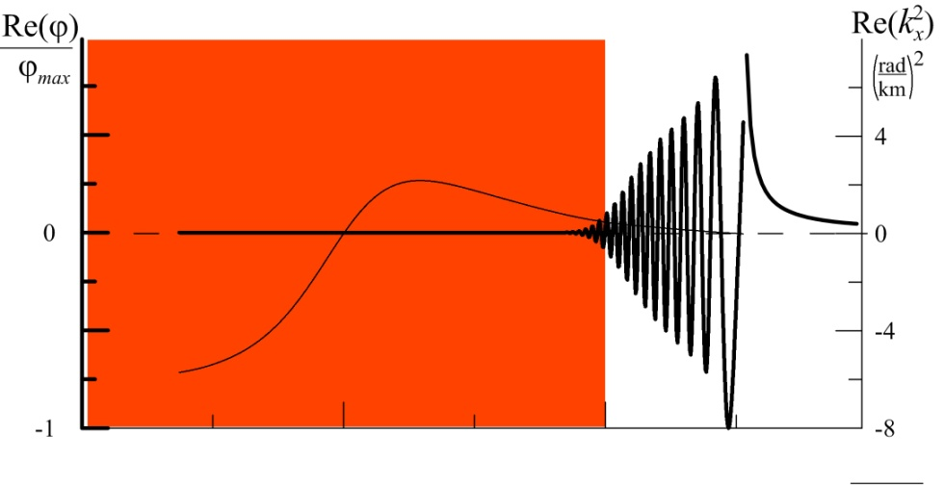
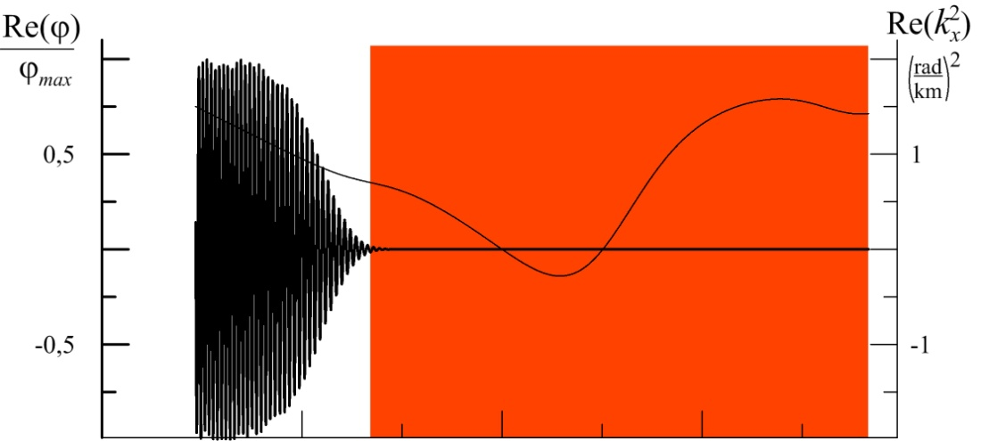
Dissipation of kinetic Alfven waves at the plasmapause dissipative layer
At the plasmapause:
that corresponds to
energy of resonant electrons to be in the range:
Here φ is scalar potential of transverse electric field of a kinetic Alfven wave, is a square of its transverse wave number.
dissipative layer
dissipative layer

Slide 7
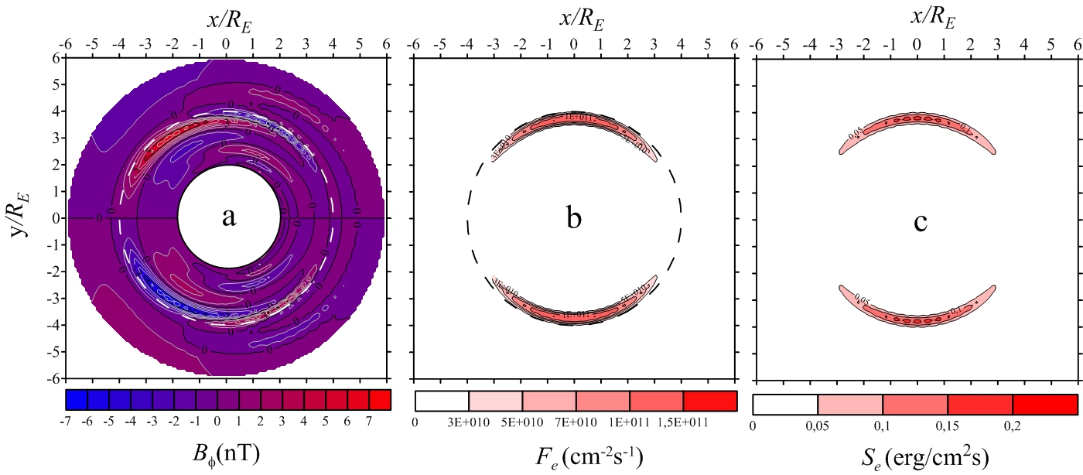
Resonant Alfven waves field excited by a shock wave (with amplitude 50nT )
passing through the magnetosphere and the density fluxes (F_{e}) , (S_{e} ) :
of the suprathermal (with energy ≥ 2eV) electrons precipitating into the ionosphere
and the energy transported by them
Main component
of the resonant
Alfven waves field
Flux density (F_{e}) of the resonant electrons precipitating into the ionosphere
Energy flux density (S_{e} ) transported by the suprathermal electrons precipitating into the ionosphere

Slide 8
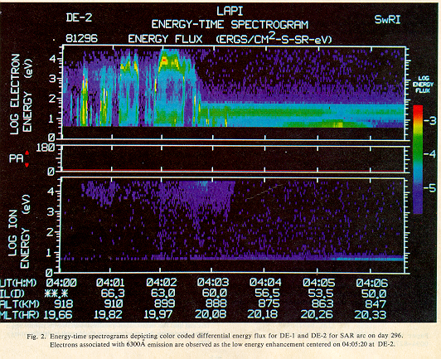

Slide 9
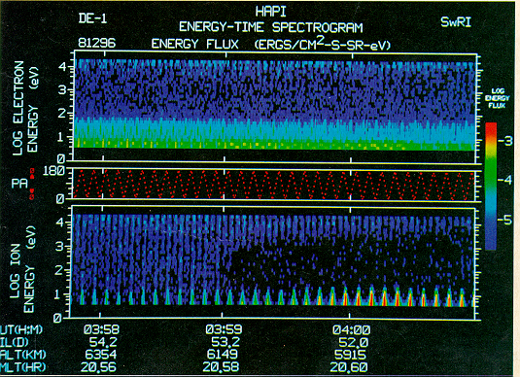

Slide 10
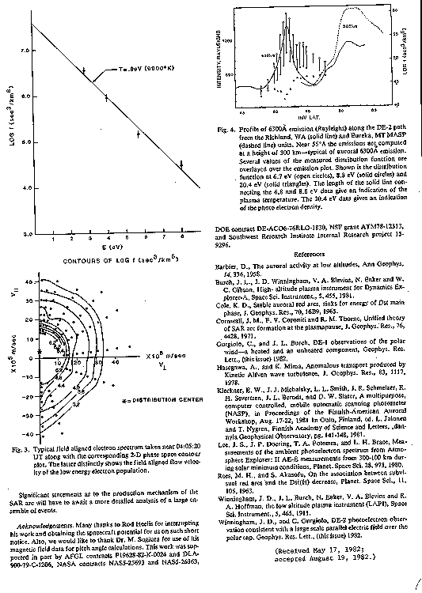

Slide 11
Summary
Based on the theoretical analysis, a method for calculating the effects created by kinetic Alfven waves in the inner magnetosphere has been developed. It is established that the phase velocity of the kinetic Alfven wave lies in the range of thermal velocities of the background plasma. In this case, the Cherenkov resonance condition is fulfilled and the electrons are bunched and selectively accelerated in the lowest part of the energy range.
The energy fluxes generated by the interaction of waves with electrons are calculated. The calculations show that the kinetic Alfven wave is able to cause the radiance of the atomic oxygen line of 630.0 nm with an intensity of 2-4 kr.
The data from the satellites DE 1 and 2 were considered for October 21, 1981. The DE 1 satellite spectrometer did not detect energetic hydrogen and oxygen ions above SAR-arc at an altitude of 1Re. The DE 2 lower conjugate satellite detected a downward directed electron flux at ionospheric heights. A short segment of 1-minute solar wind data (OMNI database) indicates a high turbulence of the solar wind magnetic field. All measurements suggest generating SAR-arc by Alfven wave.
We have a significant number of events of high electron temperature observations in the F layer of the ionosphere by the IK-24, IK-25, AUREOLE 3 satellites, during strong solar wind turbulence according to OMNI data.

