Slide 1
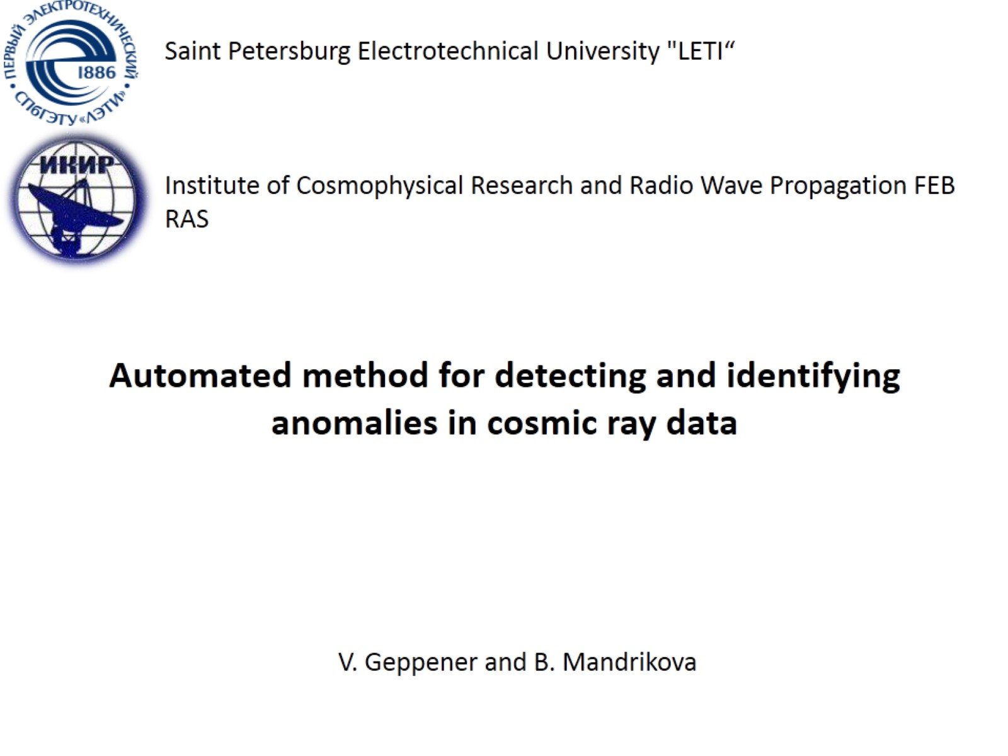
Automated method for detecting and identifying anomalies in cosmic ray data

Slide 2
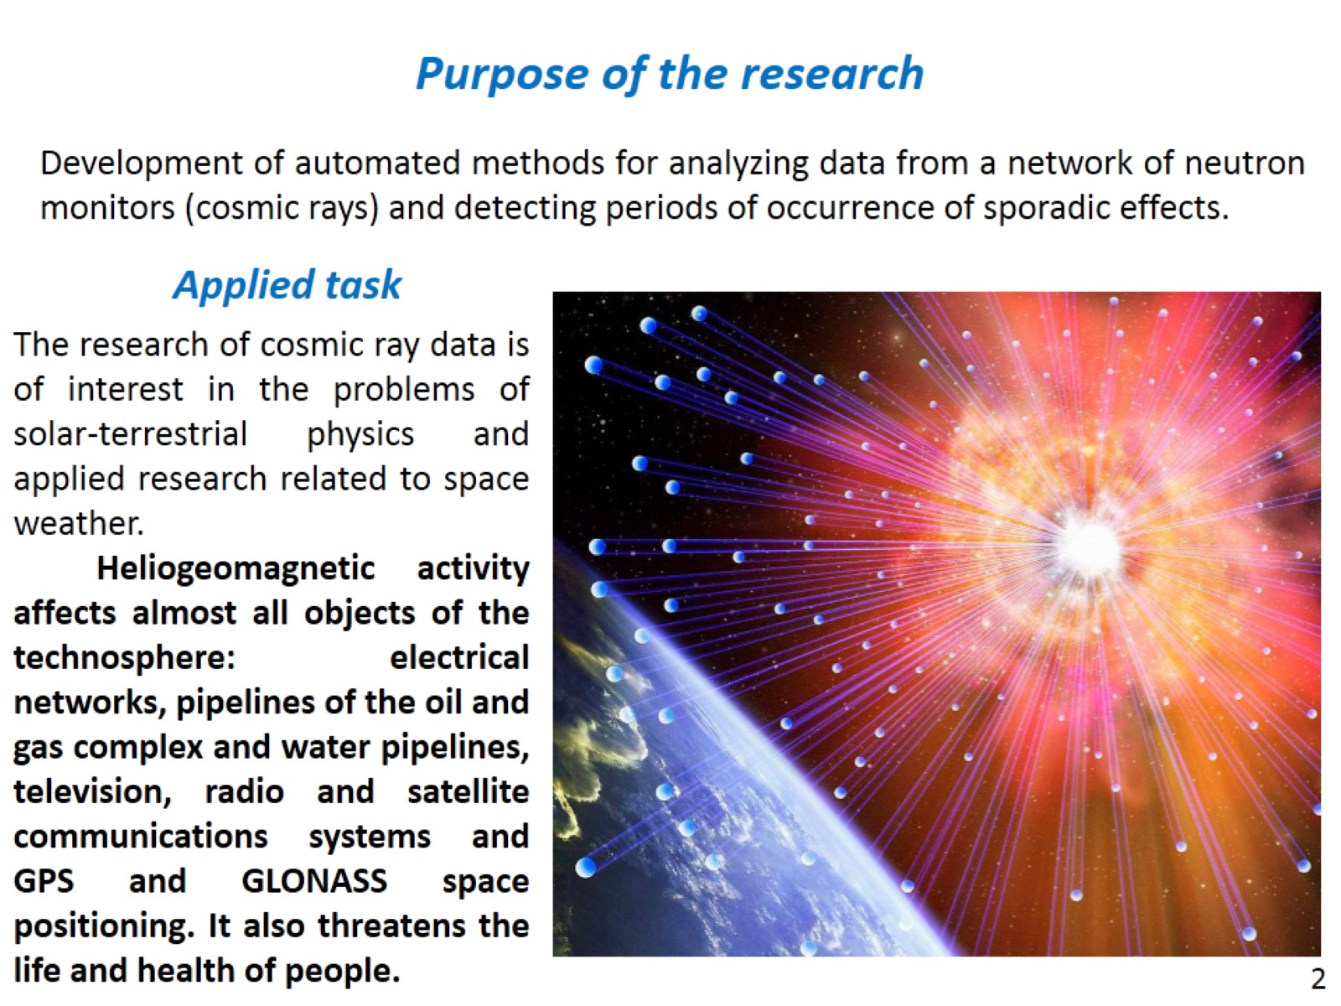

Slide 3
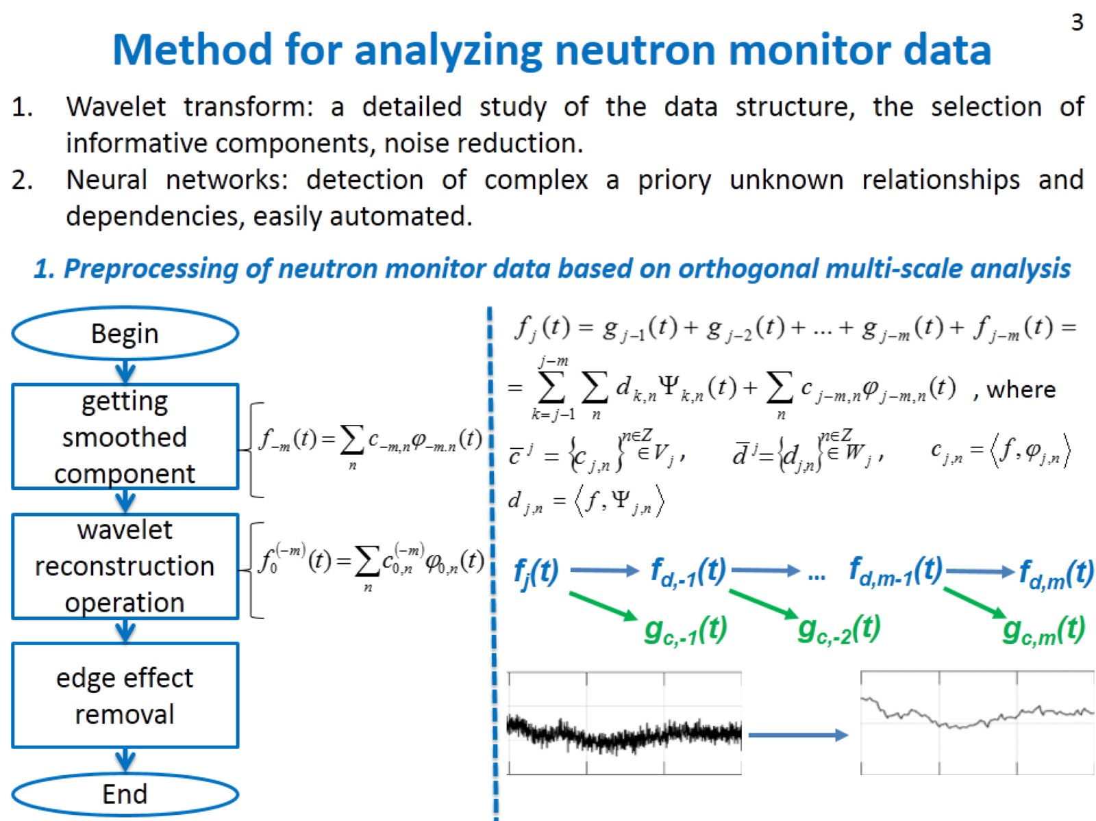
Method for analyzing neutron monitor data

Slide 4
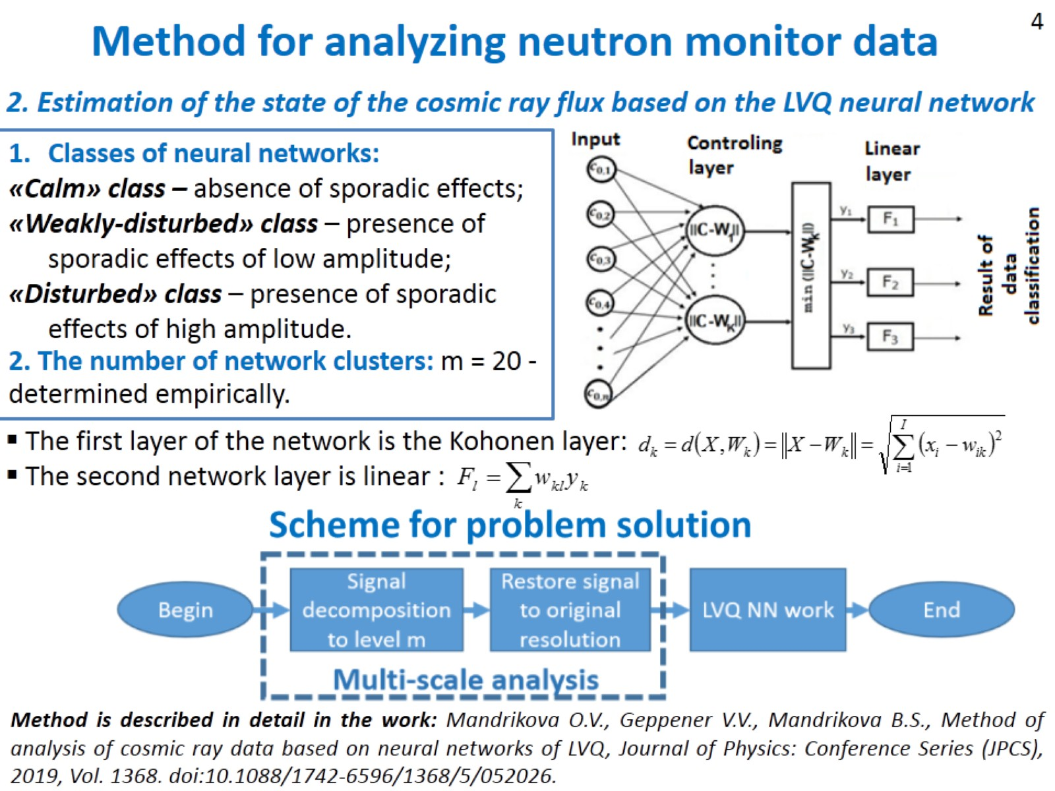

Slide 5
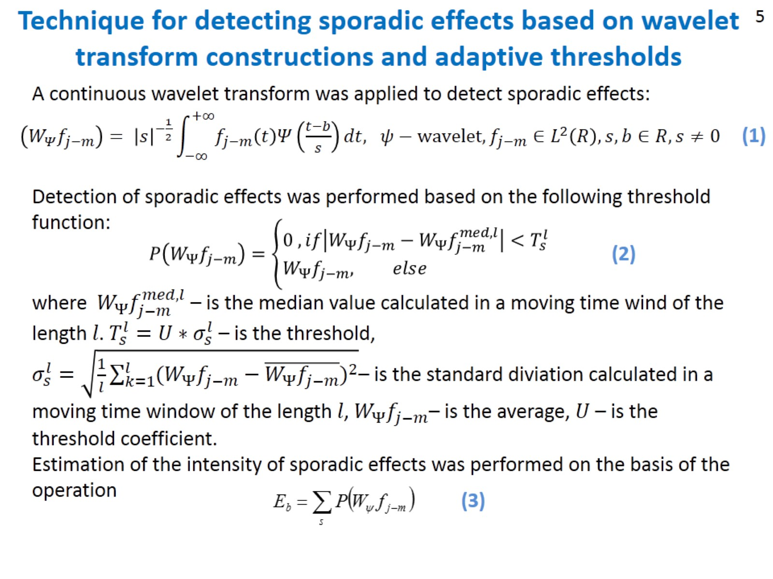

Slide 6
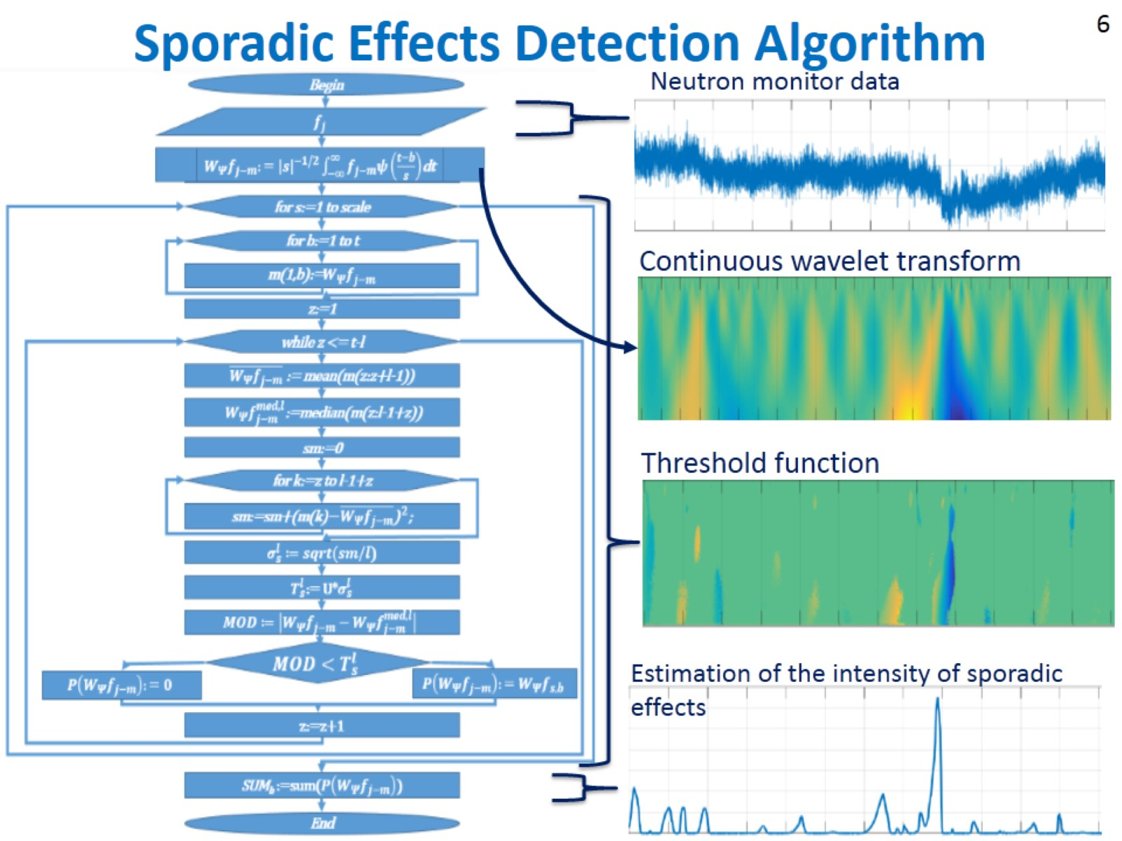
Sporadic Effects Detection Algorithm

Slide 7
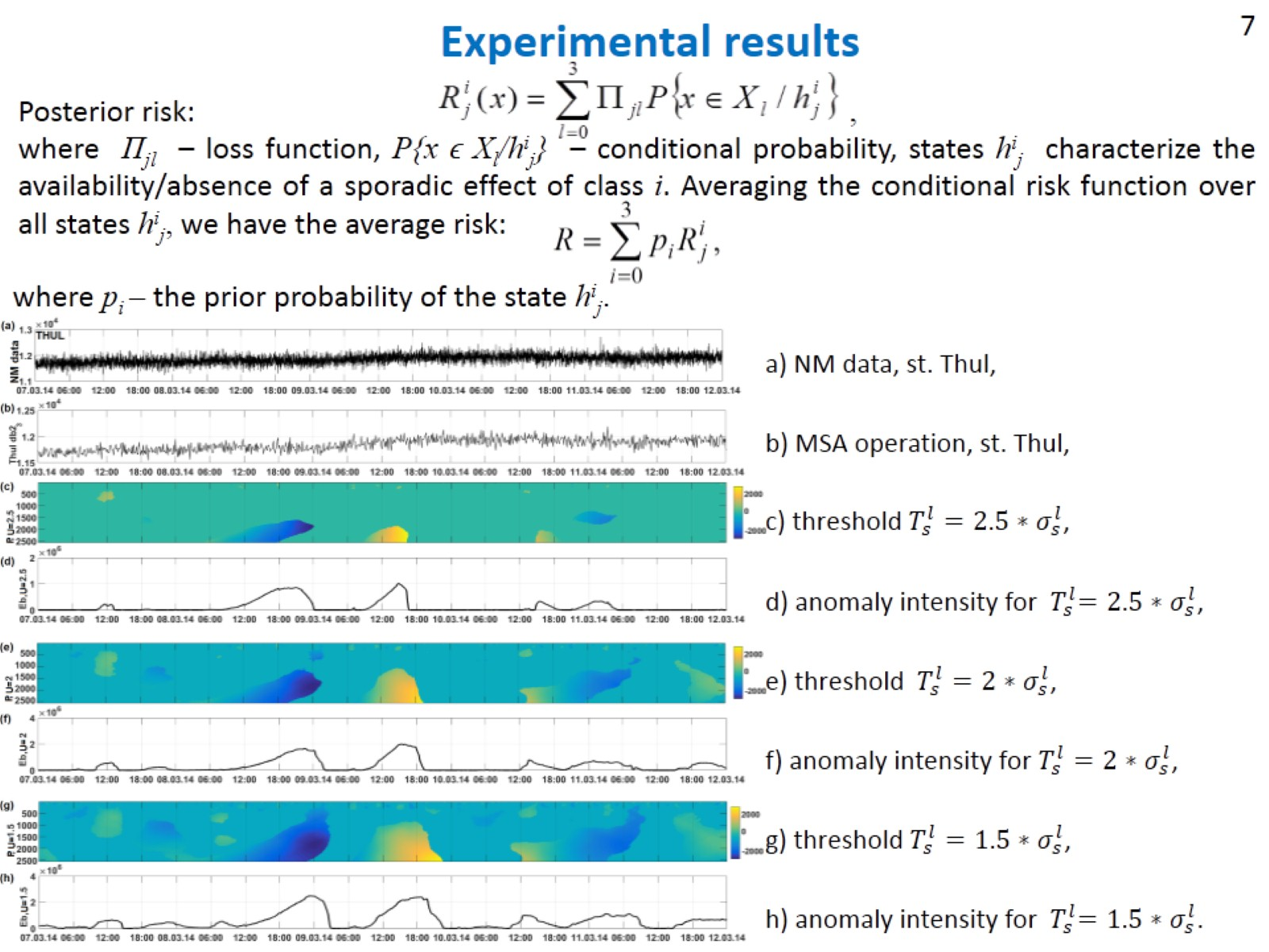
Experimental results

Slide 8
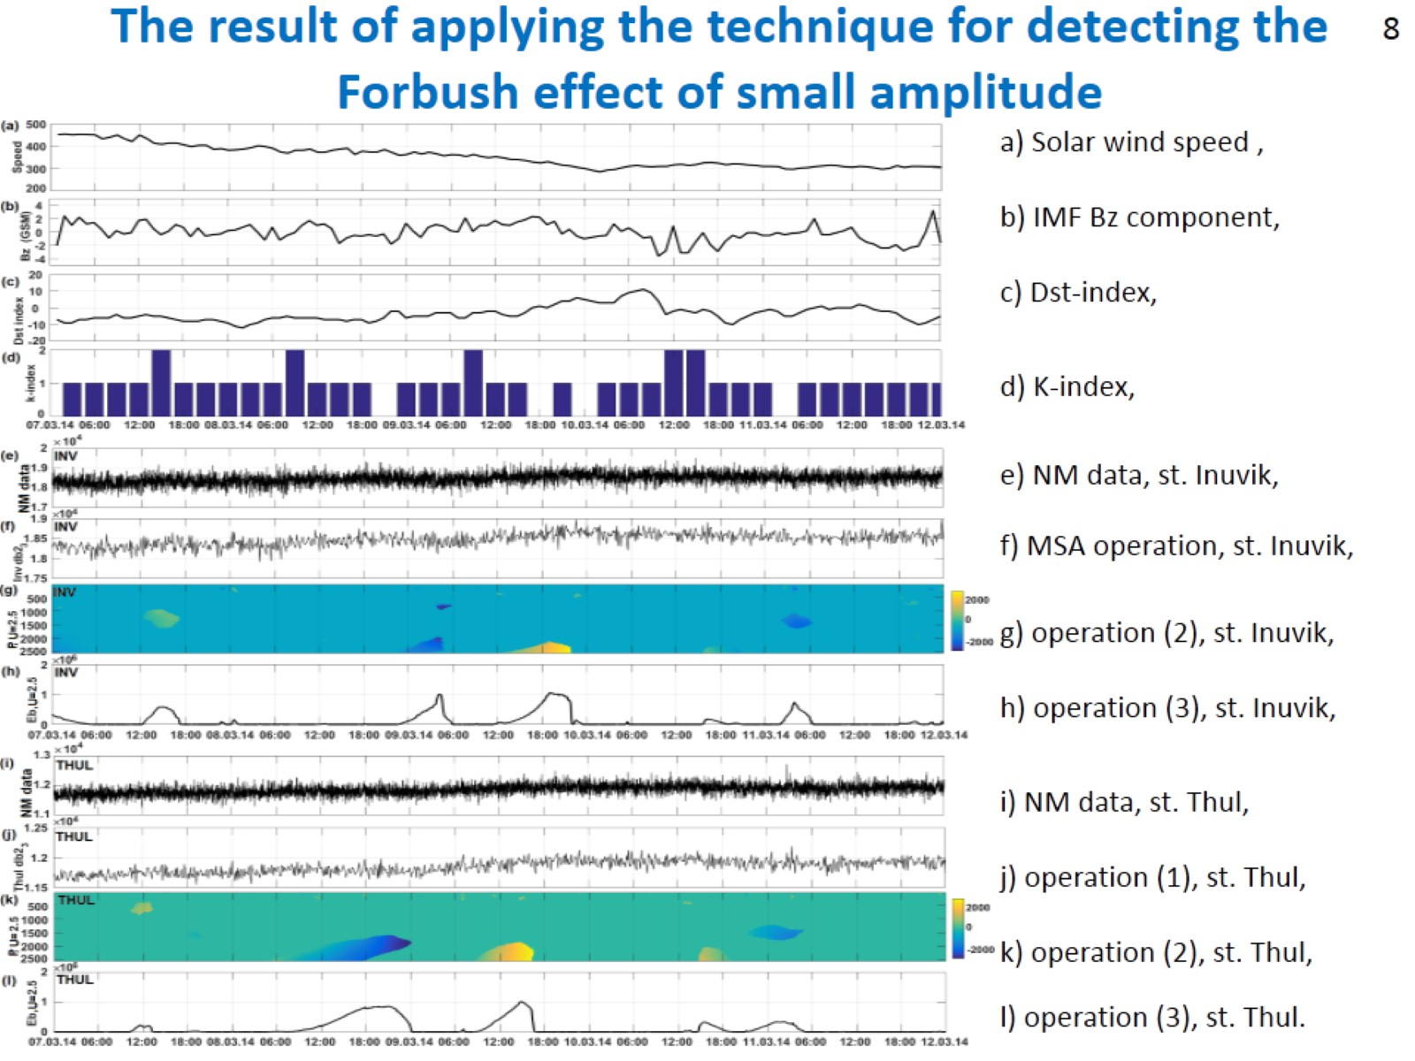
The result of applying the technique for detecting the Forbush effect of small amplitude

Slide 9
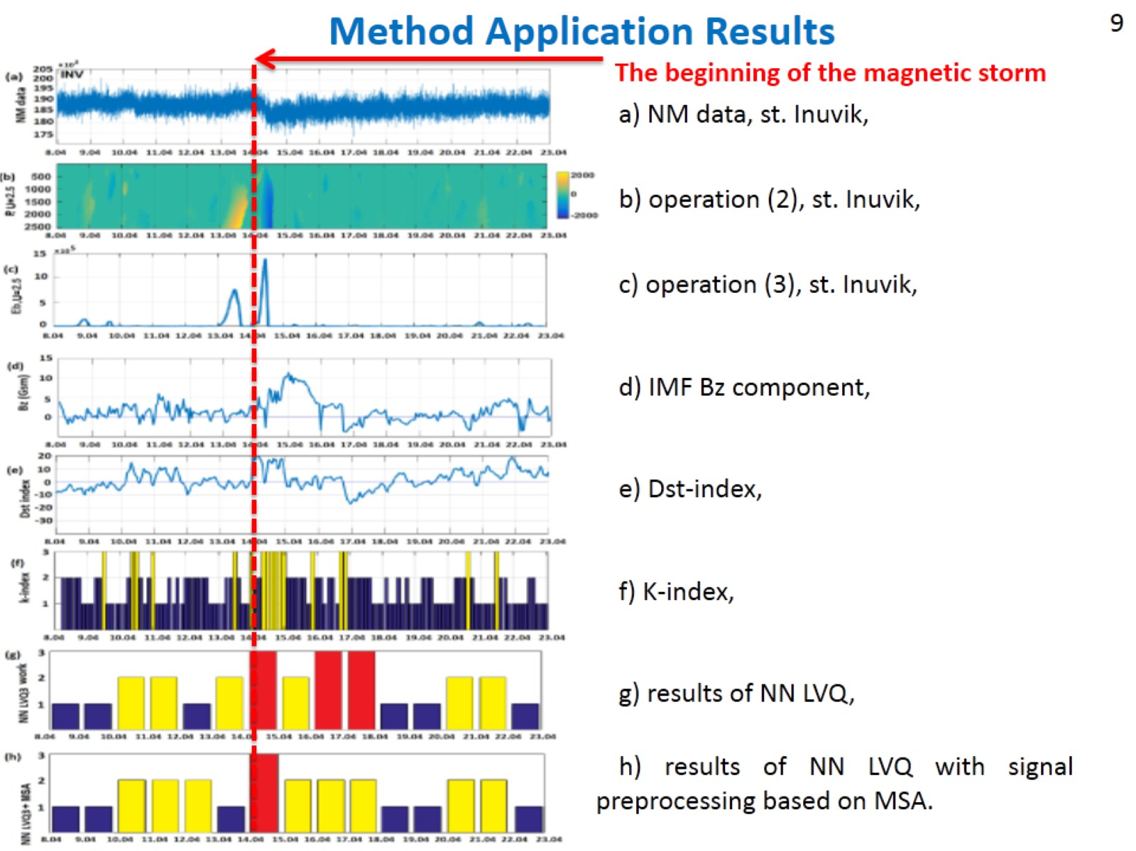
Method Application Results

Slide 10
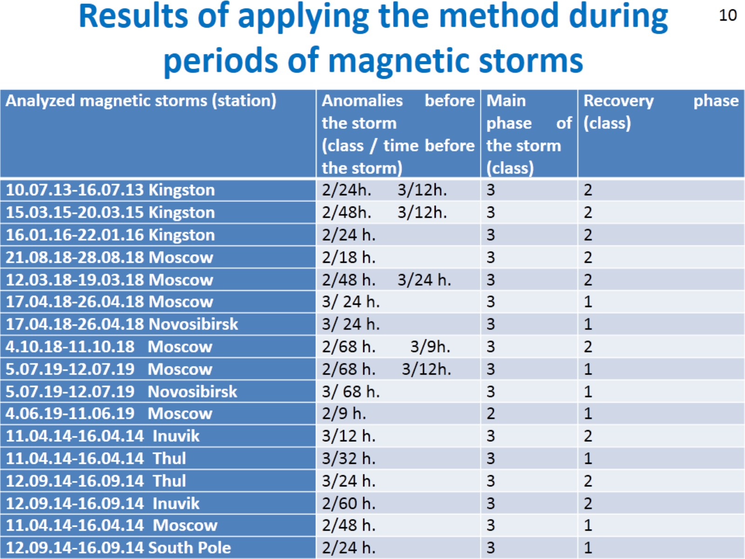
Results of applying the method during periods of magnetic storms

Slide 11
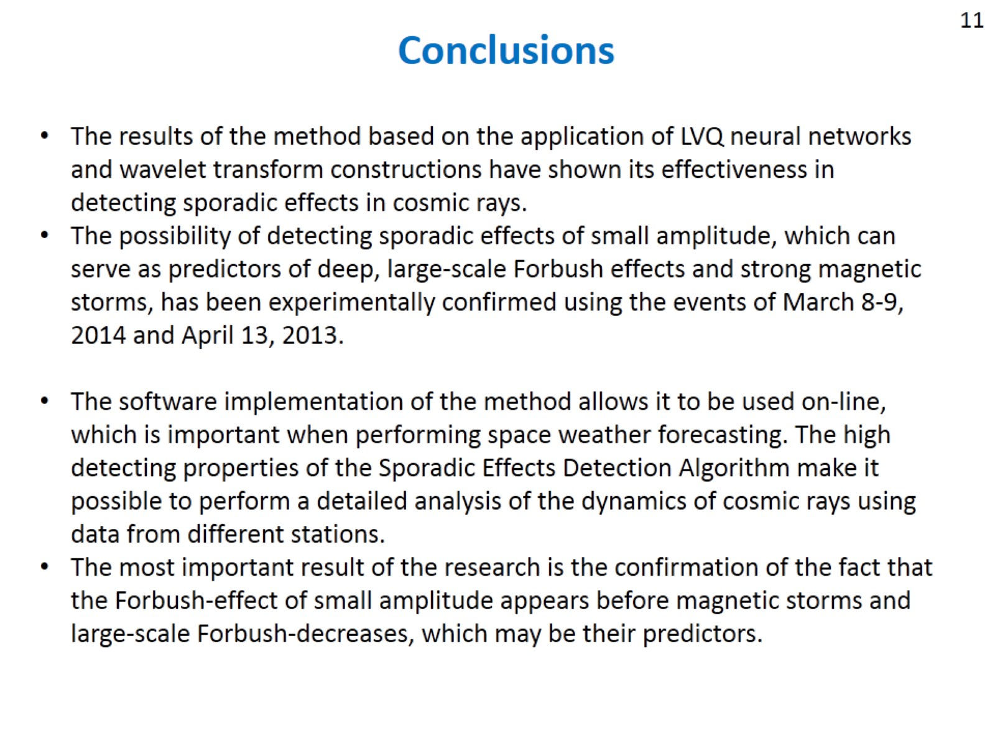
Conclusions

Slide 12
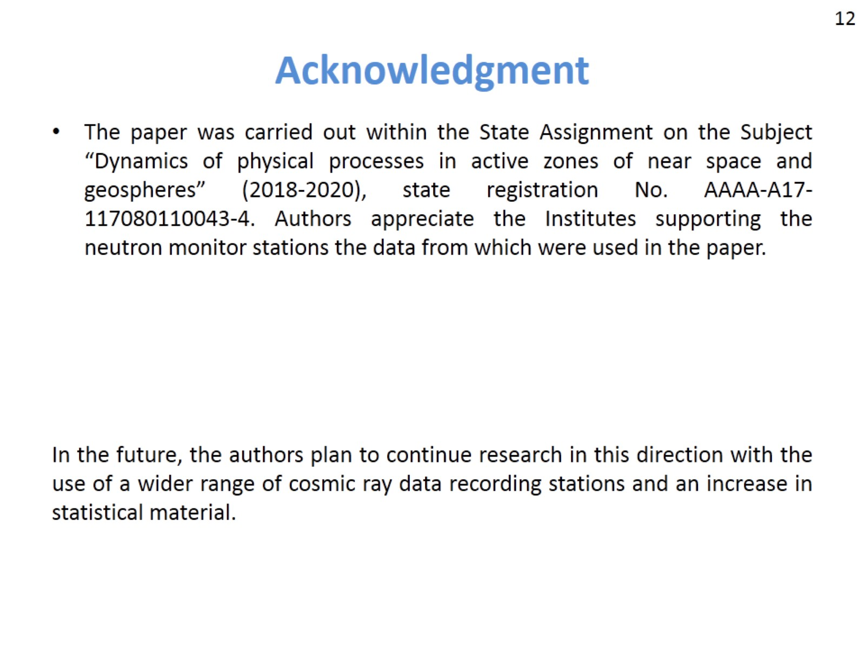
Acknowledgment

Slide 13
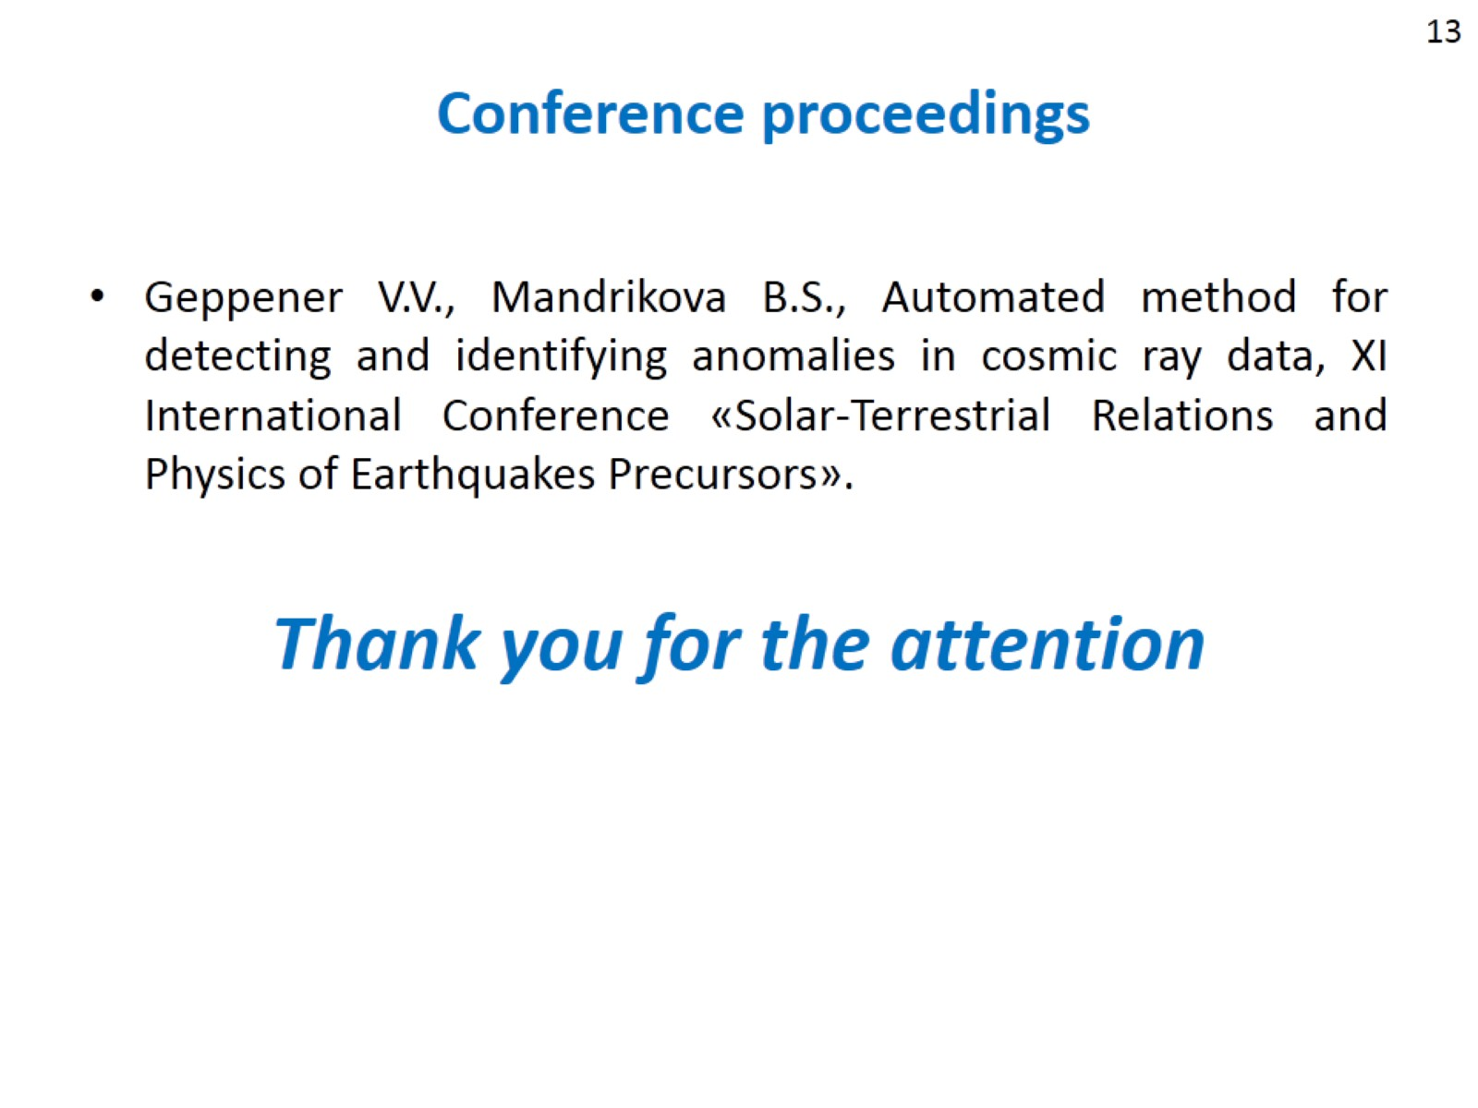
Conference proceedings

