Slide 1
Kendirbaeva Dzumagul
IDENTIFICATION OF HYDROGEOCHEMICAL AND HYDRODYNAMIC EFFECTS WITH MANIFESTATIONS OF SEISMICITY IN THE TERRITORY OF KYRGYZSTAN

Slide 6
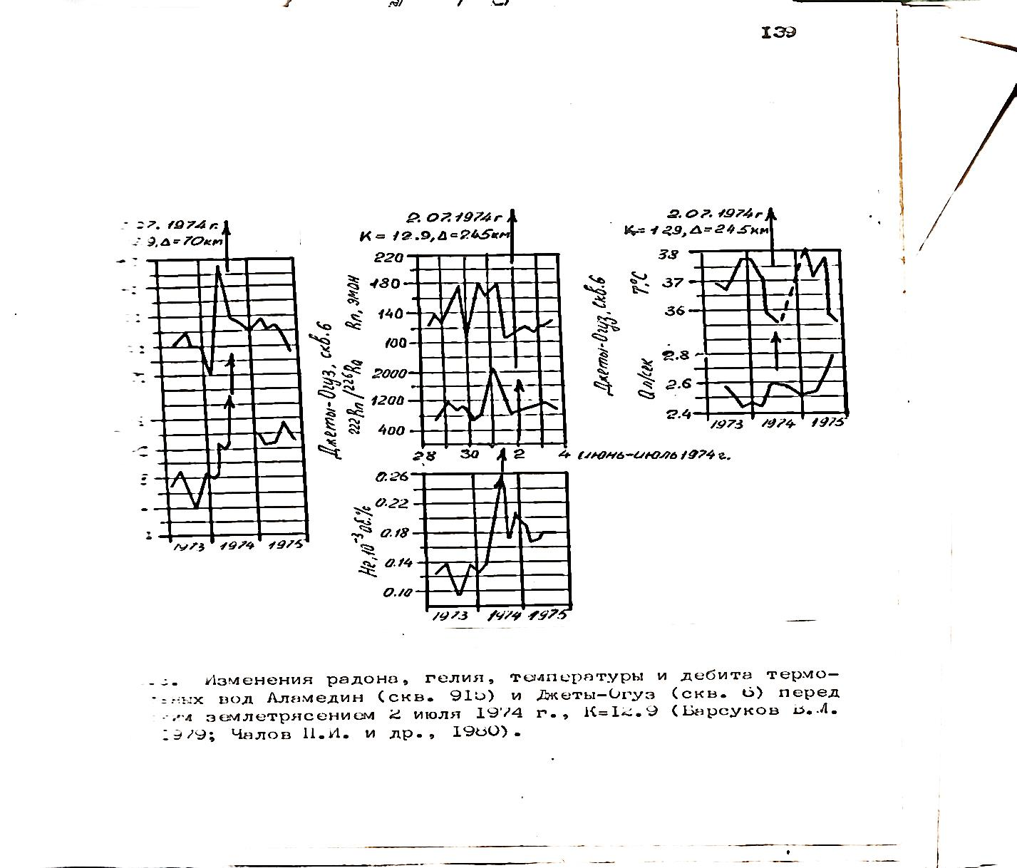
"Alamedin"（sle. 915）"jeti-Oguz"(sle. 6）02.07.1974 Kochkor

Slide 8
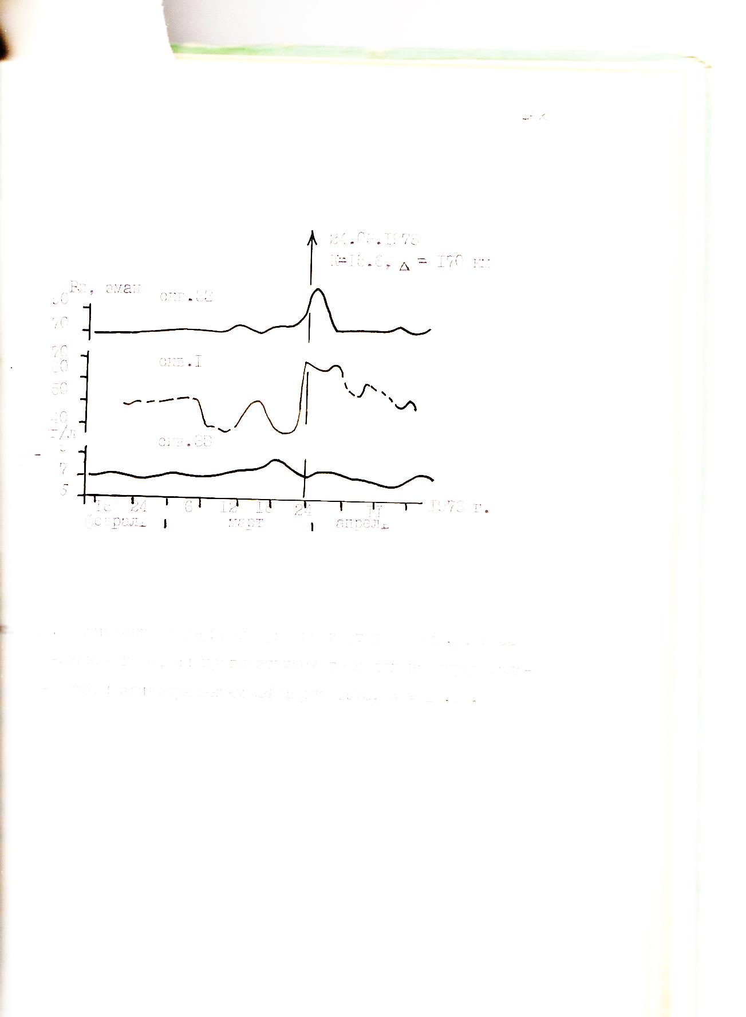
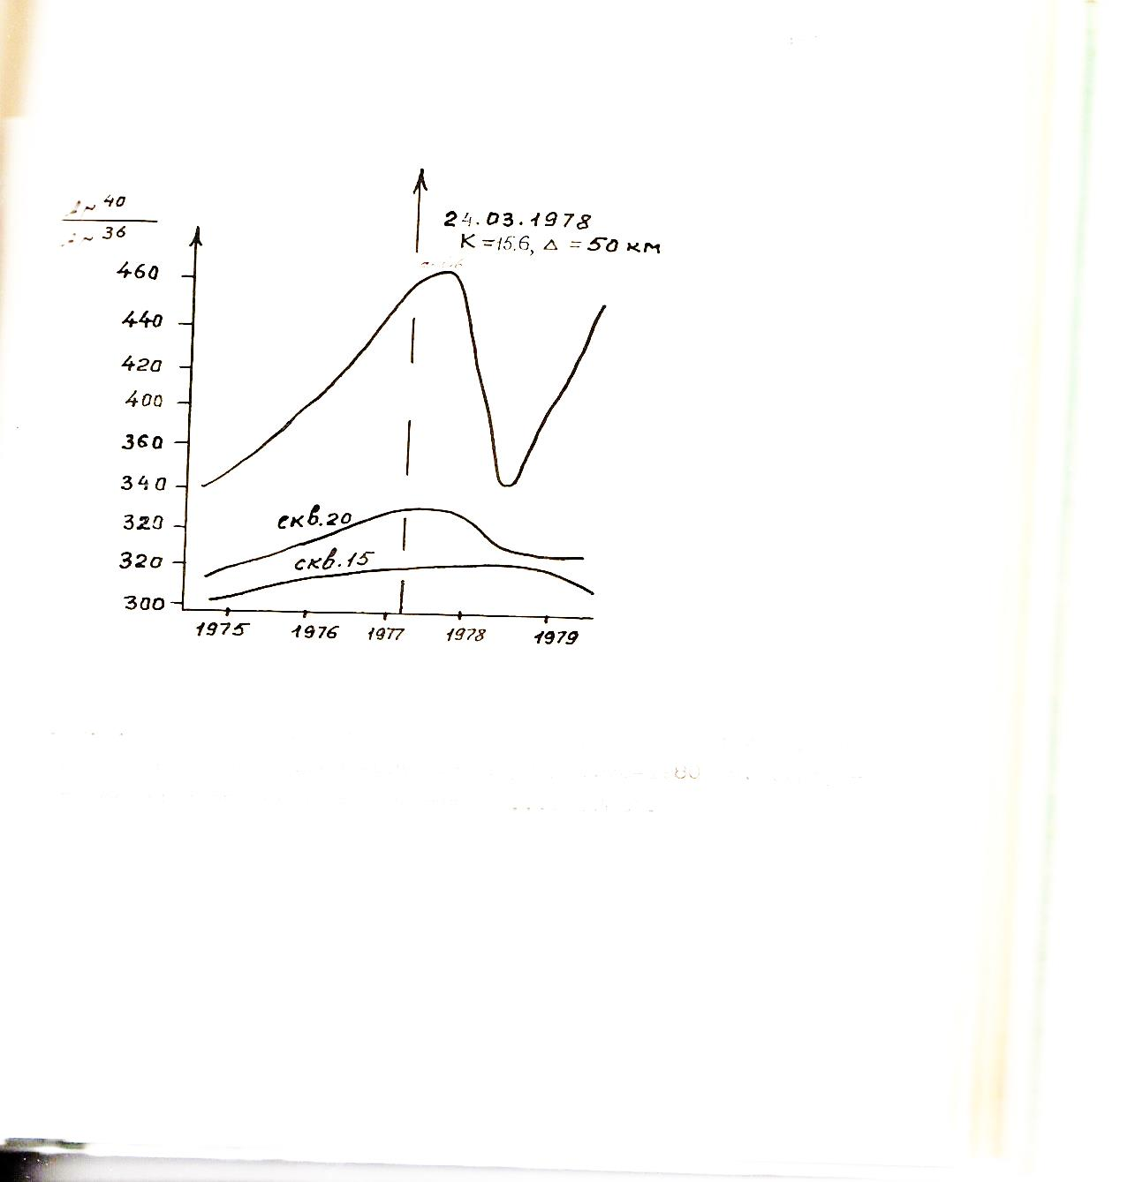
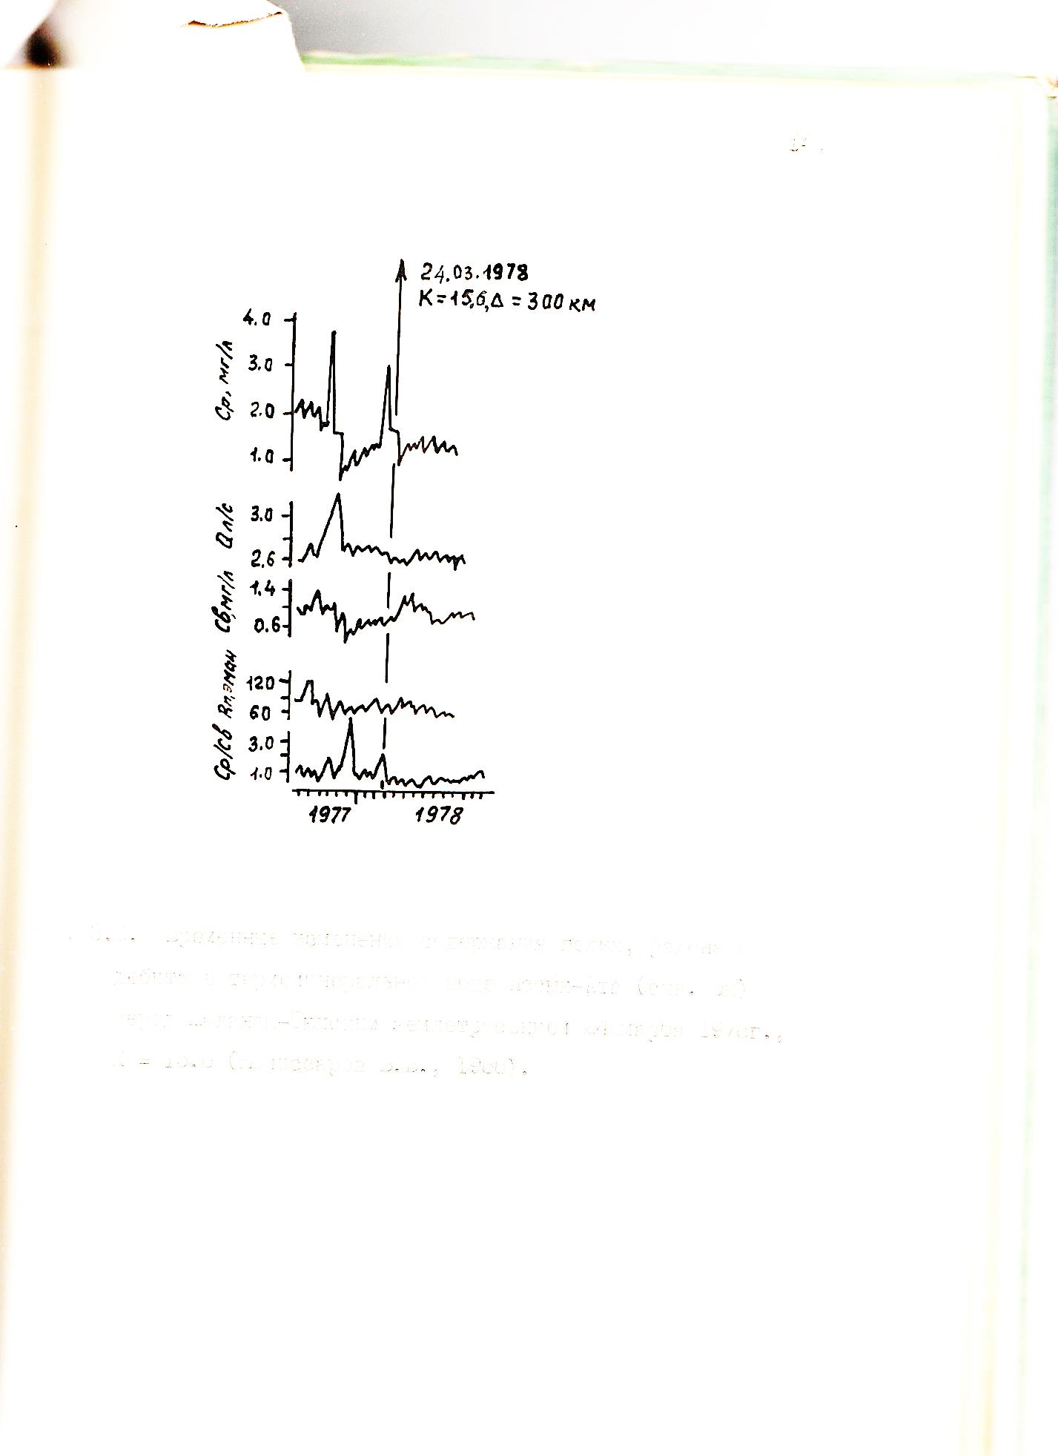
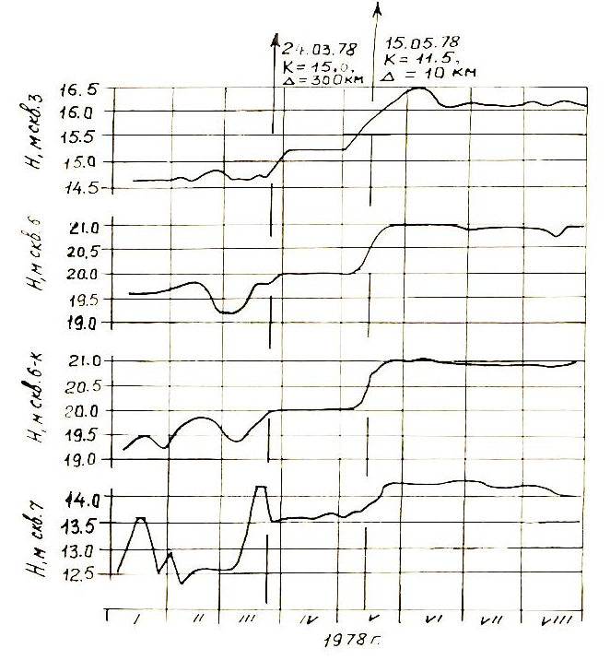
"Gorelnik""Kamenka"（a）arg（Ar40/Ar36）"Jety-Oguz"（б）"Issyk-Aта"（c，d）Zhalanash-Tyup rad 24.03.1978

Slide 9
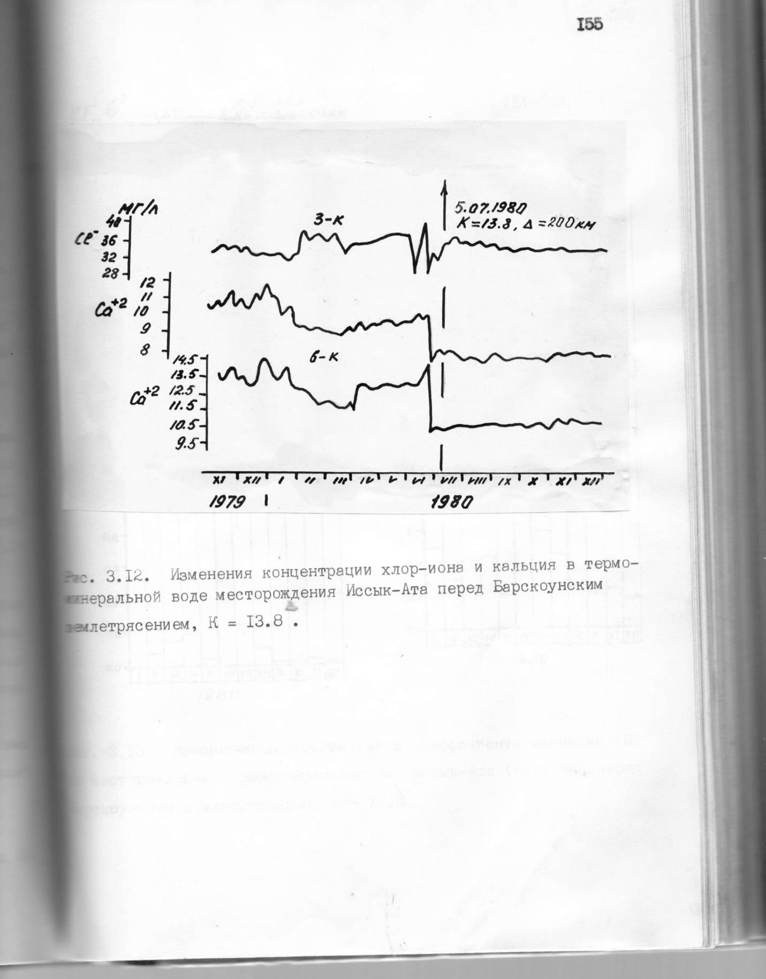
05.07.1980 Barskaun for «Issyk-Ata»
«Аlma-Arasan»

Slide 14
СПАСИБО ЗА ВНИМАНИЕ!

