Slide 1
The influence of geomagnetic activity on hemodynamics in young men - Yakuts
Kozlov V.I.¹, Stepanova G.K.², Ustinova M.V.² 1 Yu.G. Shafer Institute of Cosmophysical Research and Aeronomyof Siberian Branch of the Russian Academy of Sciences 2 Institute of Medicine of the North-Eastern Federal University

Slide 2

In the northern latitudes, adverse natural factors are combined with changes due to new technologies and increase the number of people with disharmonious physical development and functional deviations in the Russian North [Maximov, A. L., Sukhanova, I. V., Vdovenko, S. I. "Functional profiles observed in young males-residents of Magadan depending on their constitution tipes," Human Ecology 12, 25-30 (2012)] and among the Inuit of Alaska, Canada and Greenland [Andersen, S., Rex, K. F., Noahsen, P., Sørensen H. C. F., Mulvad G., Raised P. L., "BMI cut-off for overweight in Greenland Inuit," International Journal of Circumpolar Health 72(1), 21086 (2013). https://doi.org/10.3402/ijch.v72i0.21086. Hackett F.J. Paul, Abonyi S., Dyck R. F., "Anthropometric indices of First Nations children and youth on first entry to Manitoba/Saskatchewan residential schools - 1919 to 1953," International Journal of Circumpolar Health 75(1), 30734 (2016). http://dx.doi.org/10.3402/ijch.v75.30734]. In the North, from November to February, there is a low standing of the sun and a short duration of its radiance, because of which the amount of ultraviolet radiation is sharply reduced and the "biological polar night" practically comes. The Earth’s magnetic field serves as protection against the solar wind, but part of the charged particles and the associated magnetic disturbances are able to penetrate the Earth’s magnetosphere. The penetration of charged particles of the solar wind occurs mainly in high latitudes. In [Zenchenko, T. A., Poskotinova, L. V., Medvedeva, A. A., and Khorseva, N. I., “The correlation of heart rate variability dynamics and electrocardiogram dispersion mapping in humans by long-term monitoring in resting state,” Ekologiya cheloveka (Human Ecology) 10, 16-27 (2012).], it is noted that indicators of the human cardiovascular system change under the influence of factors of terrestrial and space weather. This necessitates further research. Note that the development of normative indicators for the temporal characteristics of hemodynamic fluctuations of indigenous people of the Far North who have been living for more than one generation under these conditions is one of the important directions for studying heart rate variations (HRV).

Slide 3
METHODS AND DATA
A long series of studies of hemodynamic parameters covered the period from 1983 to 2019. In the period from 1983 to 2019, studies were conducted in practically healthy youths - Yakuts of 18-25 years old, mainly students of the NEFU medical institute, as well as residents of three villages of Yakutia. All examined persons did not complain at the time of the examination and did not have a history of diseases of the cardiovascular system. According to questionnaire data, the examined were born and permanently resided in Yakutia.
Hemodynamics were evaluated in different four seasons of the year.

Slide 4
To analyze the functional state of the circulatory system, the heart rate (HR, beats per min.) Was determined from records in different years of peripheral and central sphygmograms, tetrapolar thoracic rheograms and electrocardiograms and blood pressure (BP).
In general, 1983-1998 in different seasons of the year, 860 fragments of hemodynamic indexes were analyzed. Measurement of systolic pressure (SBP, mm Hg) and diastolic (DBP, mm r.s.) was carried out according to the method of A.S. In one of the examined groups of students (n = 9), registration and analysis of hemodynamic parameters at the same time of the year were carried out for four years.
In 2005-2007, 95-150 measurements per year were performed for 20 young men. In 2013 and 2019, measurements were performed for 74 and 63 young men, respectively.

Slide 5
High geomagnetic activity
Measurements of hemodynamic parameters were carried out during high geomagnetic activity (K index Yakutsk http://www.wdcb.ru/stp/data/K_indices/)
02.03.83 (K=7); 03.02.89 (K=6); 13.03.89 (K=7); 19.11.91 (K=7); 11.05.92 (K=6); 5.05.94 (K=5); 13.09.94 (K=7); 20.03.96 (K=5)
and (Kp) 07-09.09.1994 (Kp = 5-6), 20-21.03.1996 (Kp = 5-6), 18-19.03. 2006 (Kp = 5-6) and 06-07.12.2006 (Kp = 5-6).
During these 12 medium magnetic storms, the reaction of HR and BP did not go beyond fluctuations Q50%.
HR~70 bpm; SBP~120 mm Hg ; DBP~75 mm Hg .

Slide 6
Very strong magnetic storm
For a very strong storm December 15, 2006 (Kp = 8), an increase in HR values was observed on December 17-18, 2006 (19 young men) to 78-79 bpm (Q25 = 73; Q75 = 84 bpm), that is, on the second and third days after the storm, relative to the values on calm days, 65 bpm (Q25 = 64; Q75 = 69 bpm.
An extremely strong magnetic storm (Kp = 8) began on September 11, 2005 and consisted of a series of magnetic disturbances of the level Kp = 7–8, lasting four days until September 15. In 20 young men, measurements were taken during the period of high and low geomagnetic activity on September 11-07, 2005. In a 24-day cycle of continuous observations, three consecutive time periods are distinguished. The geomagnetic situation was mostly weakly disturbed 16.09-07.10. There were sharp changes in intraday and day-today air temperature on 23-28.09. In the quiet period (29.09–07.10), there were no significant disturbances in the geomagnetic and meteorological parameters. An increase in HR was revealed during an extremely strong magnetic storm (Me = 74; Q25 = 73; Q75 = 76 bpm) relative to a quiet period (Me = 67; Q25 = 66; Q75 = 69 bpm). The threshold of the air temperature difference (ΔT = 5-8 ° C), the excess of which causes a significant increase in HR relative to a quiet period, is revealed.
At ΔT = 2 ° С HR = 67 bpm, and at ΔT = 18 ° С HR = 74 bpm.
A comparative analysis of blood pressure values revealed an increase in SBP = 115 ± 2 mm Hg during a magnetic storm during a relatively quiet period SBP = 110 ± 2 mm Hg (P <0.1). The reaction of DBP to temperature disturbances did not go beyond fluctuations.

Slide 7
Seasons of the year
In 1997-99. a study of the parameters of central hemodynamics (systolic, minute volume of blood circulation, total peripheral vascular resistance, HR) in Yakut students (winter 68, spring 50, summer 40 examinations) at rest and under load (bicycle ergometry test) in contrasting seasons of the year (winter -year) using the method of thoracic tetrapolar rheography. A more economical mode of activity of this system at rest, a high reactivity to physical activity and a higher rate of restoration of blood circulation in the summer period were revealed, which indicates high reserve possibilities of regulating the circulatory system in the warm season [Stepanova G. K., Ustinova M. V., “The duration of exercise tolerance in terms of circulatory indices in the inhabitants of the Sakha republic (Yakutia) within a ten-year period,” Human Physiology 28(4), 483-488 (2002). https://link.springer.com/content/pdf/10.1023/A:1016546302385.pdf].

Slide 8
In autumn 2005 and spring 2006, 59 surveys per season were conducted. The optimal heart rate regulation parameters are observed in the fall of HR = 70 ± 5 bpm, and the worst - in the winter of HR = 74.8 ± 5 bpm, which indicates high reserve possibilities of regulating the circulatory system in the warm season. Note that the relationship of HRV parameters with the seasons of the year is individual in individual subjects [Stepanova, G. K., and Kozlov, V. I., “Variability of heart rhythm in young men in Yakutia depending on seasonal changes of atmospheric parameters,” Pros. SPIE 10833, 108337 (2018) DOI: 10.1117/12.2504342].
Index | Autumn 2005 | Spring 2006 | Winter 2006 | Spring 2007 | The significance of differences seasonal
RR, ms | 830(770-920) | 840(780-900) | 795(740-900) | 835(780-898) | Р₃₋₄=0,009
HR, bpm | 70±5,1 | 71±6,9 | 74,8±6,0 | 72,6±6,8 | Р₃₋₄=0,009

Slide 9
Interannual variations in hemodynamic parameters (HR and BP) with an interval of 16 and 20 years
Table. Hemodynamics (M ± m) in students in 1983, 1999 and 2019.
From 1983 to 1999, an increase in HR was observed, accompanied by a decrease in SBP and an increase in DBP. From 1999 to 2019, hemodynamic parameters changed to a much lesser extent.
Year | n | HR, bpm | SBP, mm Hg | DBP, mm Hg
1983 | 58 | 60±2.8 | 120±2.8 | 80±2.5
1999 | 54 | 74.5±1.52 | 114.7±1.12 | 75.0±0.92
2019 | 63 | 76.3±1.18 | 122.5±1.46 | 72.2±1.04

Slide 10
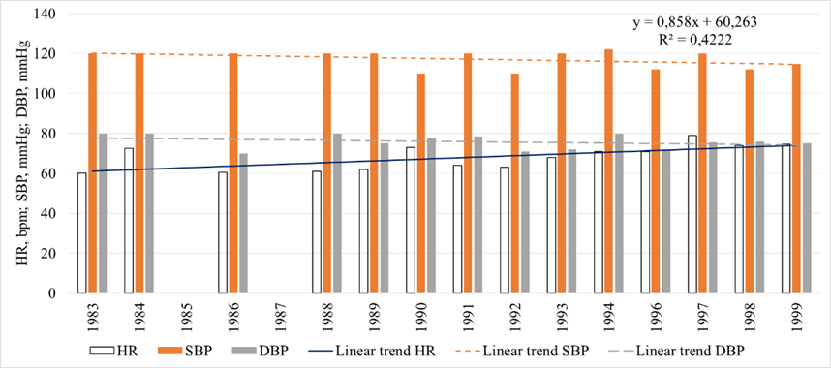
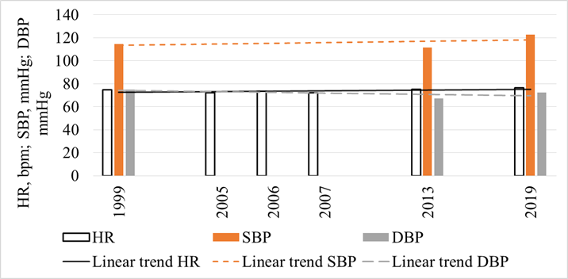
Fig.1 Variations HR, SBP and DBP for 17 years from 1983 to 1999
Fig.2. Variations HR, SPB and DBP for 17 years from 1999 to 2019

Slide 11
Analysis of the dynamics of the physical development of Yakut students over 10 years (from 1988-1989 to 1998-1999) showed a significant increase in body length, while body weight (BM) did not change. In 1988-1989, height = 169.1 ± 1.1 cm, body mass = 62.6 ± 1.4 kg. In 1998-1999, height = 172.2 ± 0.9 cm, body mass = 62.3 ± 1.8 kg. A comparative analysis of anthropometric indicators between students in 2019 and their peers in 1998-1999 revealed a significant increase in growth. A number of authors indicate an increase in youth growth in modern society [Sukhanova, I. V., Maksimov, A. L. “Modern trends in the physical development and the state of the cardiovascular system in yong men of the city of Magadan,” Gigiena i Sanitariya 94(3), 83-86 (2015). (in Russion). https://europepmc.org/article/med/26302568.]. However, significant changes have taken place over the past 20 years, compared with the decade 1988-1999: at the same time as the increase in growth, the average BMI values increased significantly (by 14%). The incidence of young men with exceeding the optimal BM values in 2019 was 2.3 times higher than that of their peers in 1998-99. A significantly higher BM value was revealed among students in 2019, as well as an increase of 29.1% in the prevalence of individuals with a high value of this index. Over the past 20 years, the distribution of students by body type has changed: the incidence of hypersthenic type has increased due to a decrease in the proportion of people with an asthenic constitution.

Slide 12
There are works indicating a tendency to asthenization in modern students and in other regions of Russia, the city of Magadan and among the Inuit of Alaska, Canada and Greenland [Andersen, S., Rex, K. F., Noahsen, P., Sørensen H. C. F., Mulvad G., Raised P. L., "BMI cut-off for overweight in Greenland Inuit," International Journal of Circumpolar Health 72(1), 21086 (2013). https://doi.org/10.3402/ijch.v72i0.21086. Hackett F.J. Paul, Abonyi S., Dyck R. F., "Anthropometric indices of First Nations children and youth on first entry to Manitoba/Saskatchewan residential schools - 1919 to 1953," International Journal of Circumpolar Health 75(1), 30734 (2016). http://dx.doi.org/10.3402/ijch.v75.30734]. The study of the functional state of the cardiovascular system in young Yakuts, depending on their physique, revealed elevated SBP and DBP in hypersthenics relative to normosthenics and asthenics, which indicates the functional tension of the system. The literature indicates the reduced functionality of the circulatory system in young hypersthenics of the city of Magadan [Maximov, A. L., Sukhanova, I. V., Vdovenko, S. I. "Functional profiles observed in young males-residents of Magadan depending on their constitution tipes," Human Ecology 12, 25-30 (2012).]. In modern youths - Yakuts (2019), we noted the lowest SBP values among asthenics, which suggests that the most economical mode of functioning of their circulatory system is.

Slide 13
CONCLUSION
The moderately disturbed state of the magnetic field (moderate and severe storms) did not significantly affect the functional state of the body of practically healthy young northerners. For very strong storms, September 11-15, 2005 and December 15, 2006, a significant increase in heart rate and blood pressure was observed.
In most of the examined men in the Asian North of Russia, heart rate variability indicators are within the mid-latitude standard. The revealed shifts of anthropometric indicators in modern Yakut students, compared with the young men of 1998-99, indicate an increase in the prevalence of overweight and the development of a constitution according to the hypersthenic type. Against the background of body hypersthenization, the adaptive capabilities of the circulatory system decrease.

