Slide 1
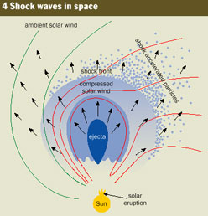
Forbush-storm classification of the events as a device for the solar wind diagnostics
Shadrina L.P.
Academy of sciences
of Sakha (Yakutia) Republic,
33 Lenin ave., 677007
Yakutsk, Russia
lushadr@mail.ru

Slide 2
This paper describes one of the possible methods for diagnosing the interaction of solar wind disturbed structures and the Earth's magnetosphere on the basis of ground-based observations of the geomagnetic field and galactic cosmic rays (GCR).
Forbush storm classification of events was proposed and substantiated in papers
L.P. Shadrina, V.P. Mamrukova, I.Ya. Plotnikov, Geomagnetism and Aeronomy, 1996;
L.P. Shadrina, S.A. Starodubtsev, I.Ya. Plotnikov, Int. Geomagnetism and Aeronomy, 2001.
The catalog is a result of geomagnetic storms and Forbush effects studies carried out since the 1980s.
It includes 22 sheets from 1996 to 2017, each containing the information on the geomagnetic storms and GCR intensity decreases. In total, the catalog includes data on 1193 storms and 1551 Forbush effects.

Slide 3
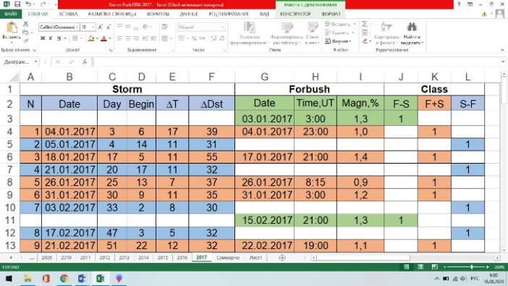
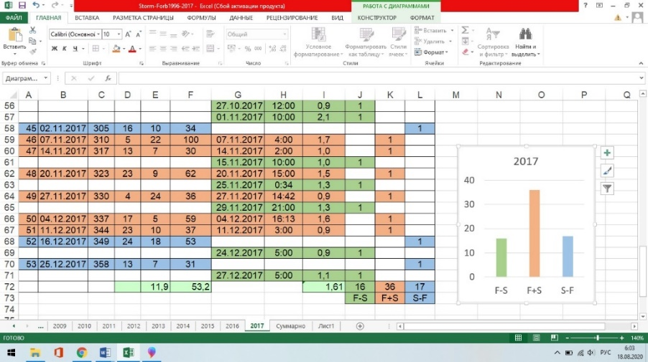
Figure 1. Example of a sheet from the catalog –Forbush-Storm classes (FBC) events in 2017 - the beginning of the table (Fig. 1a, above) and the end (Fig. 1b, below).

Slide 4
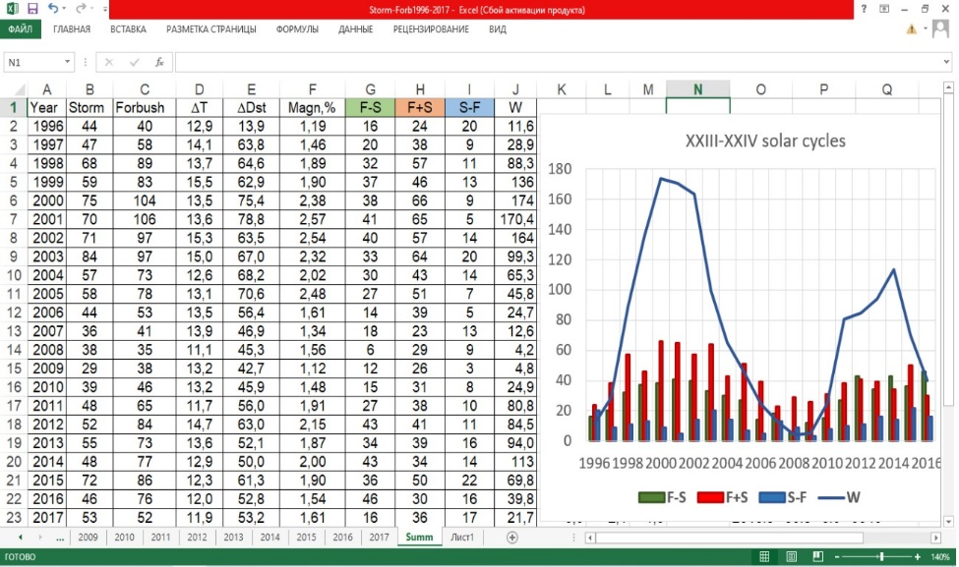
Figure 2. A sheet of summary indicators of Forbush-Storm events – the number
of geomagnetic storms (Storm) and Forbush decreases (Forbush) for each year,
average values of the storm main phase duration ΔT, the intensity of storms
ΔDst and Forbush decreases ΔΙ, the number of the events for every three
classes of the events (F - S, F + S, S - F) and average annual solar activity
(W - Wolf number, sunspot number) for XXIII and XXIV solar cycles.

Slide 5
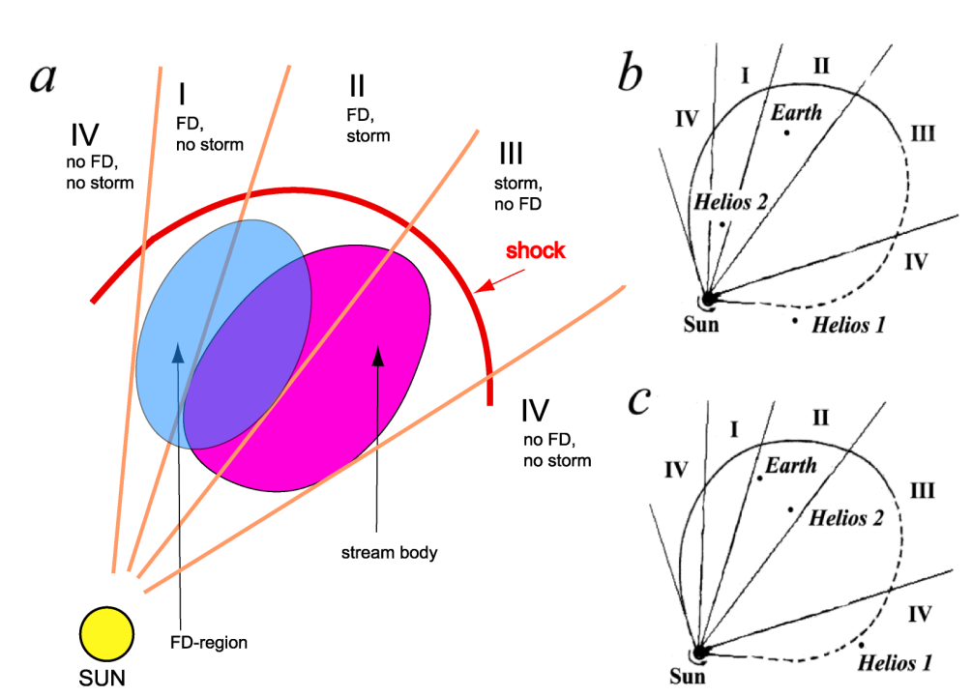
A figure from paper L.P. Shadrina, S.A. Starodubtsev, I.Ya. Plotnikov, Int. Geomagnetism and Aeronomy, 2001 for demonstration 3 classes of Forbush-Storm classification of the events:
Forbush decreases of cosmic ray intencities (FD) without geomagnetic storms – left flank crossing;
FD with storms – central crossing;
storms without FD – right flank crossing.
There is also a 4th way to cross a disturbed solar structure (IV) – distant left or right flanks are observed on the Earth only in geomagnetic field as SCs.

Slide 6
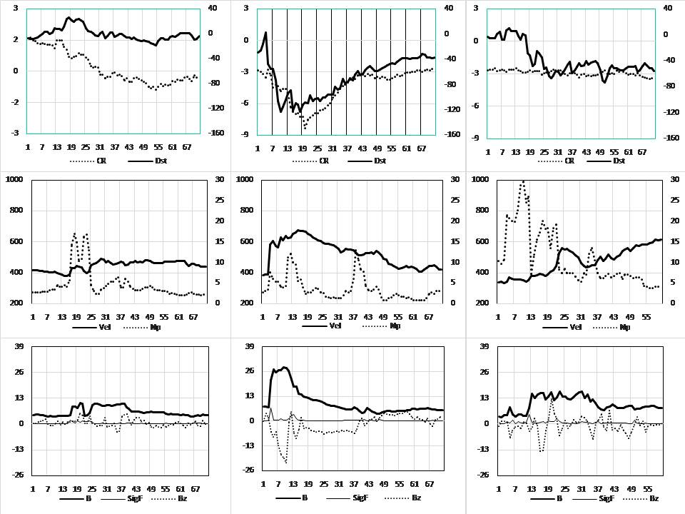
June, 26-28, I class F-S February, 18-20, II class F+S November, 6-8, III class S-F

Slide 7
Figure 3. An example of interplanetary parameters behavior
in three classes of Forbush-Storm classification for events in 1999.
Class 1 – June, 26-29 – CR decrease without
a geomagnetic storm,
Class 2 – February, 18-20 – Forbush decrease CR
with a geomagnetic storm,
Class 3 – November, 6-8 - geomagnetic storm
without CR decreasing.
Upper row – geomagnetic Dst index and CR intensity;
middle row – velocity (Vel) and density (Np) of the solar wind;
bottom row – IMF parameters: value (B), variability (sig B)
and Bz-component.

Slide 8
Conclusions
1. The catalog of Forbush-Storm events is a set of data on geomagnetic storms (1193 events) and decreases in CR intensity (1551 events) during
two cycles, XXIII and XXIV, of solar activity.
2. The catalog shows that together with the generally accepted registration of a simultaneous decreases of the geomagnetic field and CR intensity - a geomagnetic storm accompanied by Forbush decreases, quite often there are events when these two consequences of the impact of a disturbed solar wind flux on the Earth are observed separately.
3. The ratio of these 3 classes of events varies from year to year.
4. The behavior of the interplanetary medium parameters in each of the classes of the events is different and, evidently, is a consequence of 3 possible intersections of the disturbed solar wind structures by the Earth – in the western flank, in the center, or in the eastern flank.
5. Therefore, the use of the Forbush-Storm classification catalog of the events can be considered as a device for diagnostic of the Earth interaction with disturbed structures of the solar wind.

Slide 9
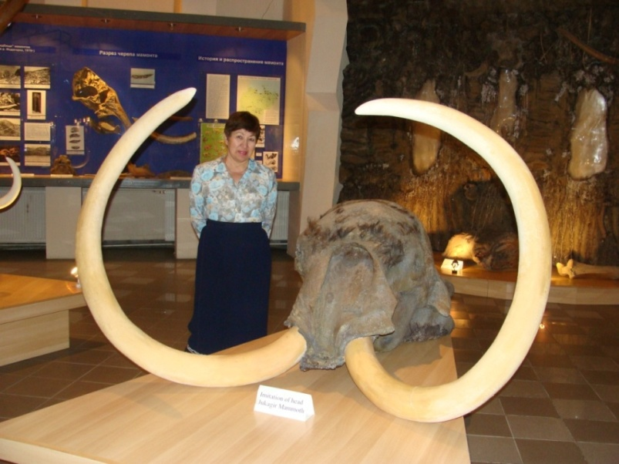
Congratulations to everyone who had the patience to listen the talk, from the title (α) to the end (ω).
lushadr@mail.ru

